Slide 1
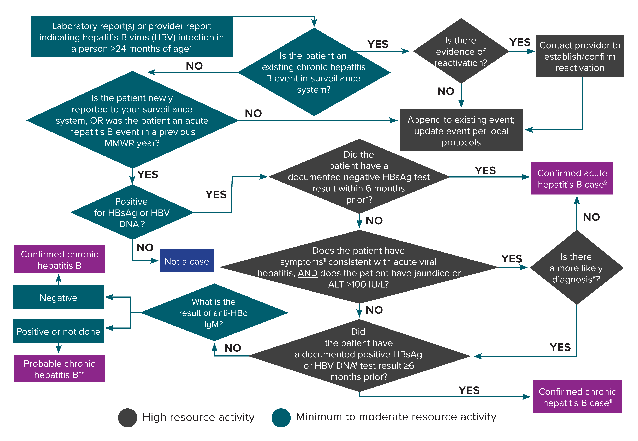
Figure 3-3. Process for acute and chronic hepatitis B case ascertainment and classification
*A person <24 months of age whose mode of exposure is not perinatal (e.g., health care-acquired) should be classified under the 2012 acute or chronic hepatitis B case definitions. A person <24 months of age whose mode of exposure is perinatal should be classified under the 2017 perinatal hepatitis B case definition. Surveillance programs should provide prevention programs with information on people who have positive test outcomes for post-test counseling and referral to treatment and care, as appropriate.
†Nucleic acid testing for HBV DNA, including qualitative, quantitative, and genotype testing. An isolated positive hepatitis B ‘e’ antigen (HBeAg) test result should prompt further investigation into the hepatitis B surface antigen (HBsAg) and/or HBV DNA results.
‡A documented negative HBsAg within 6 months prior to a positive test (either HBsAg, HBeAg, or HBV DNA) does not require acute clinical presentation to meet the acute hepatitis B case definition.
§A new acute hepatitis B case is an incident case that has not been previously notified as an acute or chronic hepatitis B case.
¶Acute hepatitis B clinical symptoms include fever, headache, malaise, anorexia, nausea, vomiting, diarrhea, and abdominal pain.
#May include evidence of acute liver injury from infectious, autoimmune, metabolic, drug or toxin exposure, neoplastic, circulatory or thromboembolic, or idiopathic causes.
**May re-classify as confirmed if additional information is later received before the Nationally Notifiable Diseases Surveillance System (NNDSS) close-out date for national notification purposes. Jurisdictions with a longitudinal system can update probable cases to confirmed within their system at any time regardless of the NNDSS close-out date.
Notes:
Figure 3-3 illustrates an approach for acute and chronic hepatitis B case ascertainment and classification.

