Slide 1
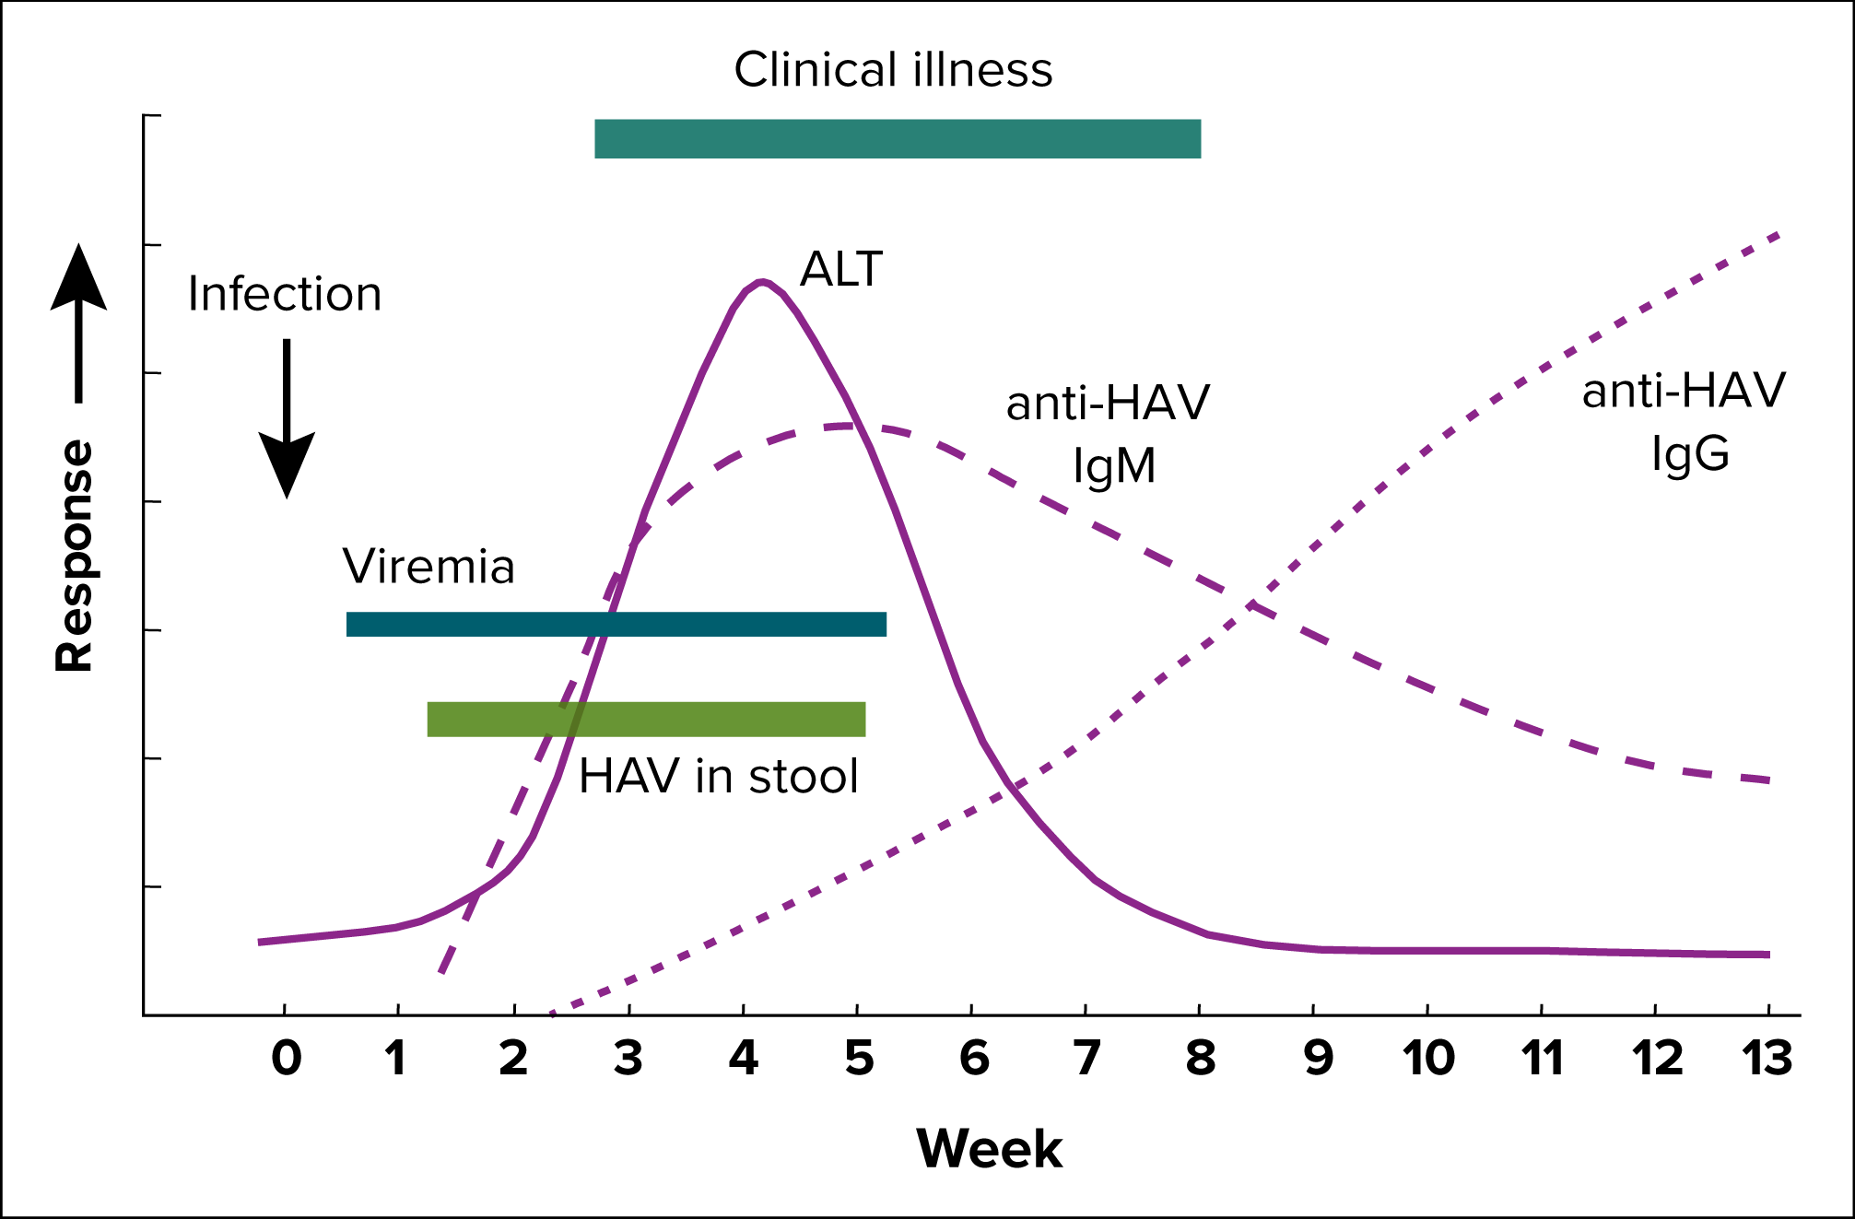
Figure 2-1. Typical serologic course of hepatitis A virus infection and recovery
Figure obtained from https://www.cdc.gov/mmwr/pdf/rr/rr5304.pdf.
Notes:
Figure 2-1 illustrates the typical serologic course of hepatitis A virus infection and recovery. Anti-HAV IgM, the marker for recent HAV exposure, is detectable in blood by 4 weeks after exposure. Anti-HAV IgG, the marker of previous HAV infection or immunity, appears a few weeks after anti-HAV IgM.

