Slide 1
Table 1-1. National notification and print criteria for hepatitis A, hepatitis B, and hepatitis C
Condition | National Notification Criteria* | Print Criteria†
Hepatitis A | Confirmed | Confirmed
Acute hepatitis B | Confirmed | Confirmed
Chronic hepatitis B | Confirmed and probable | Confirmed
Perinatal hepatitis B | Confirmed | Confirmed
Acute hepatitis C | Confirmed and probable | Confirmed and probable
Chronic hepatitis C | Confirmed and probable | Confirmed and probable
Perinatal hepatitis C | Confirmed | Confirmed
*The transmission of conditions from health departments to the Centers for Disease Control and Prevention (CDC)’s National Notifiable Diseases Surveillance System (NNDSS).
†The standards upon which CDC can publish cases, as determined by the Council of State and Territorial Epidemiologists (CSTE) and CDC and listed in CSTE Position Statements.

Slide 2
Table 1-2. Viral hepatitis conditions with corresponding National Notifiable Diseases Surveillance System (NNDSS) event codes and national notification criteria
Condition | NNDSS Event Code | National Notification Criteria
Hepatitis A, acute | 10110 | Yes
Hepatitis B, acute | 10100 | Yes
Hepatitis B, perinatal | 10104 | Yes
Hepatitis B, chronic | 10105 | Yes
Hepatitis C, acute | 10101 | Yes
Hepatitis C, perinatal | 50248 | Yes
Hepatitis C, chronic | 10106 | Yes
Hepatitis D, acute* | 10102 | No
Hepatitis E, acute | 10103 | No
*Hepatitis D is considered a coinfection or superinfection that can only occur in the presence of hepatitis B virus infection.

Slide 3
Table 1-3. Epidemiologic risk behaviors, risk exposures, and groups at risk for hepatitis A, hepatitis B, and hepatitis C
Hepatitis A | Hepatitis B | Hepatitis C
Injection drug use Non-injection drug use Incarceration Experience of homelessness/unstable housing Household contact (non- sexual) Sexual contact with a person with confirmed or suspected hepatitis A Sexual or other practices that lead to fecal-oral contact Men who have sex with men* Exposure to contaminated food or water Close contacts of adopted children newly arriving from countries with high or intermediate hepatitis A endemicity International travel to high or intermediate endemic countries | Injection drug use Non-injection drug use Incarceration Experience of homelessness/unstable housing Surgery, dialysis, or other medical procedures IV infusions or injections as part of health care (inpatient or outpatient) Accidental stick/puncture with a needle or other sharp object contaminated with blood Receipt of a blood transfusion, tissue product, or organ transplant Sexual or household contact with a person with confirmed or suspected hepatitis B History of sexually transmitted infections Men who have sex with men* Birth to an infected gestational parent† Non-commercial tattoo or body piercing Dental work or oral surgery Other exposure to blood or bodily fluids (not including risk behaviors or exposures listed above) | Injection drug use Non-injection drug use Incarceration Experience of homelessness/unstable housing Surgery, dialysis, or other medical procedures IV infusions or injections as part of health care (inpatient or outpatient) Accidental stick/puncture with a needle or other sharp object contaminated with blood Receipt of a blood transfusion, tissue product, or organ transplant HIV infection‡ Sexual practices that result in exposure to blood Birth to an infected gestational parent† Non-commercial tattoo or body piercing Dental work or oral surgery Other exposure to blood (not including risk behaviors or exposures listed above)
*Men who have sex with men are recommended by the Advisory Committee on Immunization Practices to receive hepatitis A and hepatitis B vaccination.
†Gestational parent is defined in this context as the parent who gave birth.
‡HIV infection is not a risk factor for hepatitis C. People with hepatitis C and HIV share risk behaviors or exposures; therefore, co-infection is common.

Slide 4
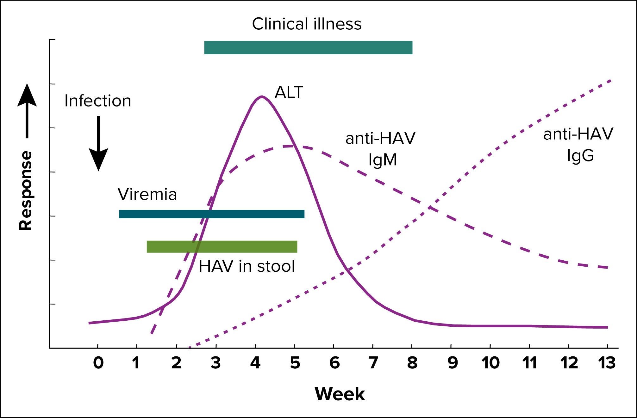
Figure 2-1. Typical serologic course of hepatitis A virus infection and recovery
Figure obtained from https://www.cdc.gov/mmwr/pdf/rr/rr5304.pdf.
Notes:
Figure 2-1 illustrates the typical serologic course of hepatitis A virus infection and recovery. Anti-HAV IgM, the marker for recent HAV exposure, is detectable in blood by 4 weeks after exposure. Anti-HAV IgG, the marker of previous HAV infection or immunity, appears a few weeks after anti-HAV IgM.

Slide 5
Table 2-1. Interpretation of hepatitis a laboratory results
Total anti-HAV | Anti-HAV IgM | Interpretation*
Positive | Positive | Current infection, recent infection, or recent vaccination
Positive | Not done | Previous infection or current infection; cannot differentiate recent from remote infection or prior vaccination
Positive | Negative | Previous infection or vaccination
Negative | Negative | Not infected (i.e. susceptible)
Not done or negative | Positive | Current infection or false-positivity/cross-reactivity
*Ingestion of high levels of biotin can significantly interfere with certain commonly used biotinylated immunoassays, such as those used to detect anti-HAV, and cause false-positive or false-negative laboratory test results. Currently, the US Food and Drug Administration (FDA) is investigating thresholds associated with false-positive and false-negative tests. This section will be updated as more information becomes available. Source: https://www.fda.gov/medical-devices/safety-communications/update-fda-warns-biotin-may-interfere-lab-tests-fda-safety-communication.

Slide 6
Table 2-2. US Centers for Disease Control and Prevention (CDC) and Council of State and Territorial Epidemiologists (CSTE) case definition for hepatitis A, 2019
Criteria Type | Criteria
Clinical | An acute illness with a discrete onset of any sign or symptom consistent with acute viral hepatitis (e.g., fever, headache, malaise, anorexia, nausea, vomiting, diarrhea, abdominal pain, or dark urine) AND Jaundice OR peak elevated total bilirubin levels >3.0 mg/dL OR peak elevated serum alanine aminotransferase (ALT)>200 IU/L, AND The absence of a more likely diagnosis.
Laboratory* | Positive IgM hepatitis A virus antibody (anti-HAV IgM) OR Positive nucleic acid amplification test (NAAT), such as polymerase chain reaction (PCR) or genotyping for HAV
Epidemiologic Linkage | Contact (e.g., household or sexual) with a laboratory-confirmed case of hepatitis A 15-50 days prior to the onset of symptoms
Case Status | Classification
Confirmed* | Meets the clinical criteria and is positive for anti/HAV IgM† OR Is positive for HAV RNA OR Meets the clinical criteria and had contact (e.g., household or sexual) with a laboratory-confirmed case of hepatitis A 15-50 days prior to onset of symptoms
*Surveillance programs should provide prevention programs with information on people who have positive test outcomes for post-test counseling, as appropriate.
†And not otherwise ruled out by anti-HAV IgM or NAAT for HAV RNA testing performed in a public health laboratory.

Slide 7
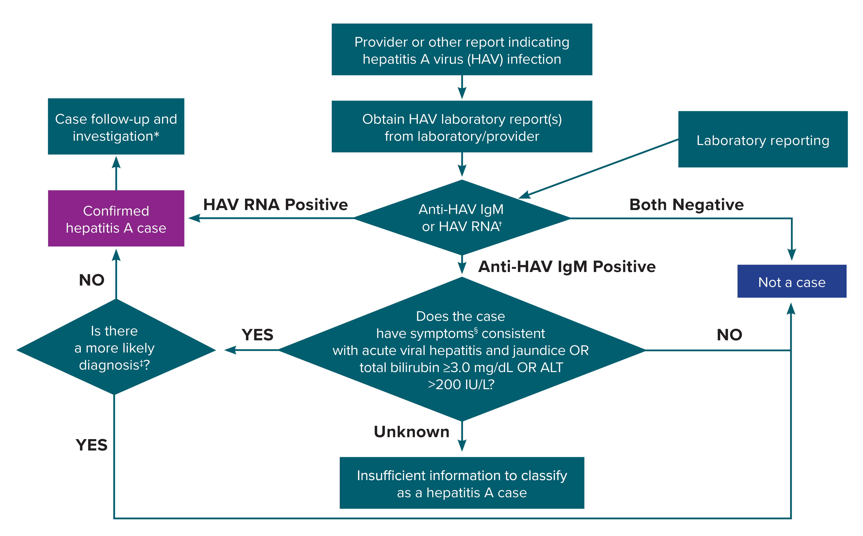
Figure 2-2. Process for hepatitis A case ascertainment and classification
*A person who had contact with a laboratory-confirmed hepatitis A case 15–50 days prior to onset of symptoms AND meets the clinical criteria should be classified as a confirmed hepatitis A case.
†Surveillance programs should provide prevention programs with information on people who have positive test outcomes for post-test counseling, as appropriate.
‡May include evidence of acute liver injury from infectious, autoimmune, metabolic, drug or toxin exposure, neoplastic, circulatory or thromboembolic, or idiopathic causes.
§Clinical symptoms include fever, headache, malaise, anorexia, nausea, vomiting, diarrhea, abdominal pain, or dark urine.
Notes:
Figure 2-2 illustrates a process for hepatitis A case ascertainment and classification in accordance with the 2019 CDC/CSTE case definition for hepatitis A.

Slide 8
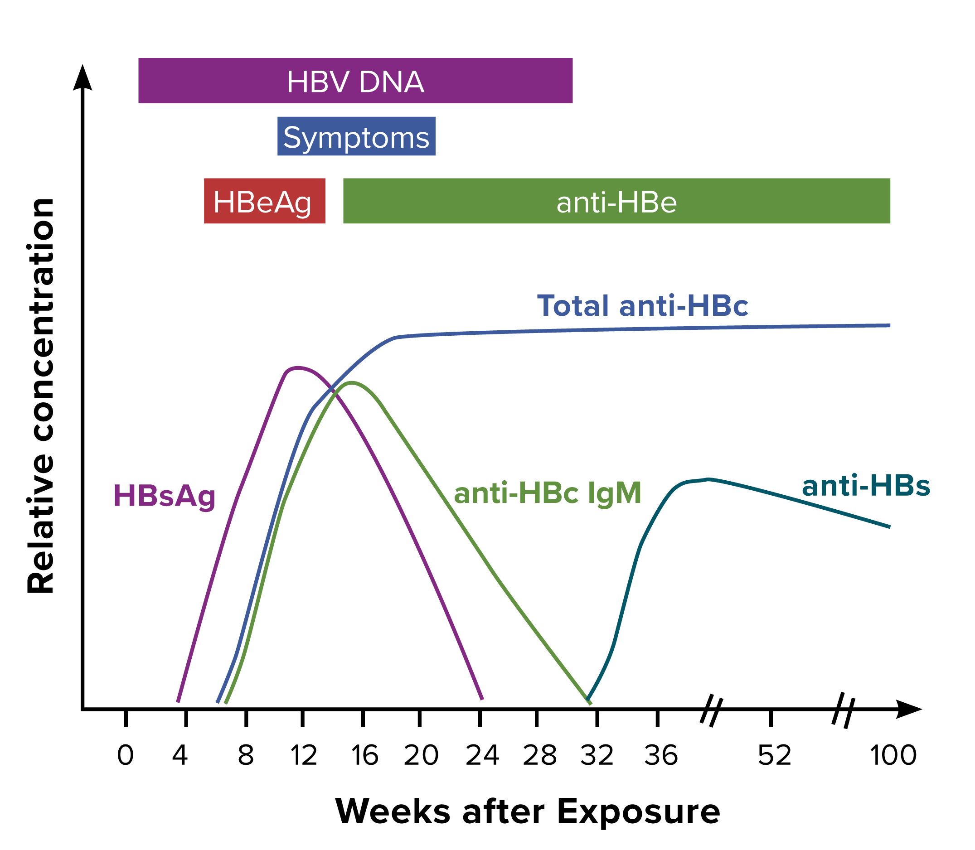
Figure 3-1. Typical serologic course of acute hepatitis B to recovery
Figure obtained from https://www.cdc.gov/mmwr/preview/mmwrhtml/rr5708a1.htm.
Notes:
Figure 3-1 illustrates the typical biomarker changes of acute hepatitis B to recovery.

Slide 9
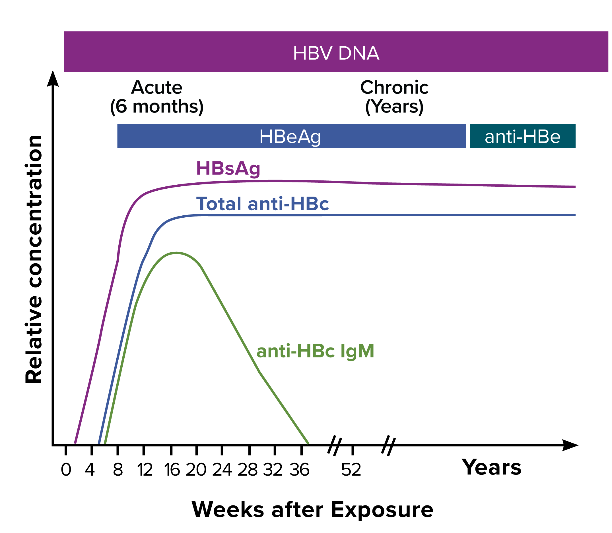
Figure 3-2. Typical serologic course of the progression to chronic hepatitis B
Figure obtained from https://www.cdc.gov/mmwr/preview/mmwrhtml/rr5708a1.htm.
Notes:
Figure 3-2 illustrates the typical biomarker changes of the progression to chronic hepatitis B.

Slide 10
Table 3-1. Interpretation of hepatitis B laboratory results
HBsAG | Total anti-HBc | Anti-HBc IgM | Anti-HBs | HBV DNA | Possible Interpretation*
– | – | – | – | – | Never infected: susceptible if never vaccinated or vaccine failure
+ | – | – | – | + or – | Early acute infection (if HBV DNA is positive); transiently positive for HBsAg after vaccination (if HBV DNA is negative)†
+ | + | + | – | + | Acute infection
– | + | + | + or – | + or – | Acute resolving infection; “window period” if anti-HBs is negative
– | + | – | + | – | Recovered from past infection and immune
+ | + | – | – | + | Chronic HBV infection
– | – | – | + | – | Immune from vaccination; passive anti-HBs transfer after hepatitis B immune globulin administration
– | + | – | – | + or – | Isolated total anti-HBc positive‡
– | + or – | – | + or – | + | Occult HBV infection§
+ or – | + | + or – | + or – | + | Possible HBsAg mutant infection
Table modified from https://www.cdc.gov/mmwr/volumes/67/rr/pdfs/rr6701-H.PDF. Abbreviations: – = negative; + = positive; anti-HBc = antibody to hepatitis B core antigen; anti-HBs = antibody to hepatitis B surface antigen; HBsAg = hepatitis B surface antigen; HBV DNA = hepatitis B virus deoxyribonucleic acid; IgM = immunoglobulin class M.
*Ingestion of high levels of biotin can significantly interfere with certain commonly used biotinylated immunoassays and cause false-positive or false-negative laboratory test results. The US Food and Drug Administration (FDA) is investigating thresholds associated with false-positive and false-negative tests. This section will be updated as more information becomes available. Reference: https://www.fda.gov/medical-devices/safety-communications/update-fda-warns-biotin-may-interfere-lab-tests-fda-safety-communication.
†People who receive hepatitis B vaccine might be transiently positive for HBsAg, with reports of transient positivity 18 days post-vaccination⁽⁵⁶⁾. Retesting of patients who are positive for HBsAg shortly after hepatitis B vaccination at a later time is needed to determine the true HBV infection status.
‡Could result from:
Loss of anti-HBs after past resolved infection. HBV DNA is negative.
False-positive total anti-HBc, i.e., susceptible. HBV DNA is negative. To resolve the ambiguity of a false-positive total anti-HBc result, test a follow-up sample 4–8 weeks later. If found positive, interpret as a resolved infection. If negative, interpret as false-positive.
Passive maternal transfer of total anti-HBc to infant born to a HBsAg-positive gestational parent for up to 24 months. HBV DNA is negative.
Occult HBV infection. HBV DNA is positive, typically at low levels. Anti-HBs might or might not be positive.
HBsAg mutant infection. HBV DNA is positive, typically at high levels. Anti-HBs might or might not be positive.
§HBsAg mutants will not be detectable if testing was performed using an older assay that cannot detect HBsAg mutants. HBsAg mutant strains can be detected by some HBsAg assays that first became available in the United States in 2015, including Abbot ARCHITECT instrument, ETI-MAK-2 PLUS, and Siemens Advia Centaur XP or XPT instrument. Though specimens should be tested using an assay that can detect HBsAg mutants, older HBsAg assays that cannot detect HBsAg mutants remain available. Reference: Apata I W, Nguyen D B, Khudyakov Y, et al. Hepatitis B virus mutant infections in hemodialysis patients: A case series. Kidney Medicine 2019; 1(6): 347-353. DOI: https://doi.org/10.1016/j.xkme.2019.07.011.

Slide 11
Table 3-2. US Centers for Disease Control and Prevention (CDC) and Council of State and Territorial Epidemiologists (CSTE) case definition for acute hepatitis B, 2012
Criteria Type | Criteria
Age | >24 months of age, OR <24 months of age and the mode of exposure was not perinatal
Clinical | An acute illness with a discrete onset of any sign or symptom consistent with acute viral hepatitis (e.g., fever, headache, malaise, anorexia, nausea, vomiting, diarrhea, and abdominal pain), AND Jaundice OR serum alanine aminotransferase (ALT) >100 IU/L
Laboratory* | Positive hepatitis B surface antigen (HBsAg), AND Positive immunoglobulin M (IgM) antibody to hepatitis B core antigen (anti-HBc IgM) (if done)
HBsAg Test Conversion* | Documented negative HBsAg test within 6 months prior to a positive test of either HBsAg, hepatitis B e antigen, or nucleic acid test (NAT) for HBV DNA (including qualitative, quantitative, or genotype)
Case Status | Classification
Confirmed Status* | >24 months of age OR <24 months of age and the mode of exposure was not perinatal, AND Not known to have a history of acute or chronic hepatitis B, AND Meets the clinical and laboratory criteria OR meets the HBsAg test conversion criterion
*Surveillance programs should provide prevention programs with information on people who have positive test outcomes for post-test counseling and referral to treatment and care, as appropriate.

Slide 12
Table 3-3. US Centers for Disease Control and Prevention (CDC) and Council of State and Territorial Epidemiologists (CSTE) case definition for chronic hepatitis B, 2012
Criteria Type | Criteria
Age | >24 months of age, OR <24 months of age and the mode of exposure was not perinatal
Clinical | No symptoms are required. People with chronic hepatitis B might have no evidence of liver disease or might have a spectrum of diseases ranging from chronic hepatitis to cirrhosis or liver cancer.
Diagnostic Laboratory* | Negative Immunoglobulin M (IgM) antibody to hepatitis B core antigen (anti-HBc IgM) AND a positive result on one of the following tests: HBsAg, nucleic acid test (NAT) for HBV DNA (including qualitative, quantitative, or genotype), or hepatitis B e antigen (HBeAg), OR Positive for any combination of the following tests two times at least 6 months apart: Hepatitis B surface antigen (HBsAg) NAT for HBV DNA (including qualitative, quantitative, or genotype testing) HBeAg
Presumptive Laboratory* | Does not meet the case definition for acute hepatitis B AND Has one positive HBsAg, NAT for HBV DNA (including qualitative, quantitative, or genotype testing), or HBeAg laboratory result
Case Status | Classification
Confirmed Chronic* | >24 months of age OR <24 months of age and the mode of exposure was not perinatal, AND Has diagnostic laboratory evidence
Probable Chronic* | >24 months of age OR <24 months of age and the mode of exposure was not perinatal, AND Has presumptive laboratory evidence, AND Does not meet the clinical criteria of the acute hepatitis B case definition
Comments | Multiple laboratory results indicative of chronic hepatitis B might be performed simultaneously on the same patient specimen as part of a “hepatitis panel.” Testing performed in this manner can lead to seemingly discordant results, e.g., HBsAg-negative AND HBV DNA-positive. For the purpose of this case definition, any positive result among the three laboratory tests mentioned above is acceptable, regardless of other testing results. Negative HBeAg results and HBV DNA levels below positive cutoff level do not confirm the absence of HBV infection.
*Surveillance programs should provide prevention programs with information on people who have positive test outcomes for post-test counseling and referral to treatment and care, as appropriate.

Slide 13
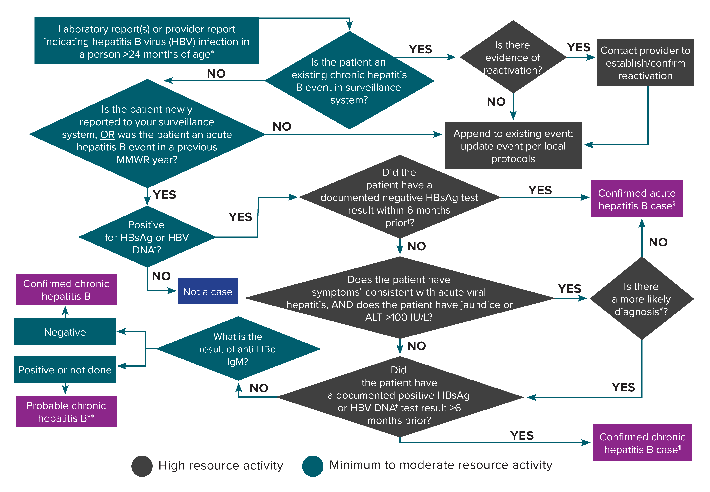
Figure 3-3. Process for acute and chronic hepatitis B case ascertainment and classification
*A person <24 months of age whose mode of exposure is not perinatal (e.g., health care-acquired) should be classified under the 2012 acute or chronic hepatitis B case definitions. A person <24 months of age whose mode of exposure is perinatal should be classified under the 2017 perinatal hepatitis B case definition. Surveillance programs should provide prevention programs with information on people who have positive test outcomes for post-test counseling and referral to treatment and care, as appropriate.
†Nucleic acid testing for HBV DNA, including qualitative, quantitative, and genotype testing. An isolated positive hepatitis B ‘e’ antigen (HBeAg) test result should prompt further investigation into the hepatitis B surface antigen (HBsAg) and/or HBV DNA results.
‡A documented negative HBsAg within 6 months prior to a positive test (either HBsAg, HBeAg, or HBV DNA) does not require acute clinical presentation to meet the acute hepatitis B case definition.
§A new acute hepatitis B case is an incident case that has not been previously notified as an acute or chronic hepatitis B case.
¶Acute hepatitis B clinical symptoms include fever, headache, malaise, anorexia, nausea, vomiting, diarrhea, and abdominal pain.
#May include evidence of acute liver injury from infectious, autoimmune, metabolic, drug or toxin exposure, neoplastic, circulatory or thromboembolic, or idiopathic causes.
**May re-classify as confirmed if additional information is later received before the Nationally Notifiable Diseases Surveillance System (NNDSS) close-out date for national notification purposes. Jurisdictions with a longitudinal system can update probable cases to confirmed within their system at any time regardless of the NNDSS close-out date.
Notes:
Figure 3-3 illustrates an approach for acute and chronic hepatitis B case ascertainment and classification.

Slide 14
Table 3-4. Considerations for hepatitis B cases who received a solid organ from a donor*
Organ Recipient Pre-Transplant Laboratory Results† | Organ Recipient Post-Transplant Laboratory Results† | Case Classification
Positive hepatitis B surface antigen (HBsAg) or HBV DNA | Positive HBsAg or HBV DNA | Should not be considered a new case due to organ transplant, but rather an infection documented prior to transplant. To determine whether this case should be considered newly reported, follow Figure 3-3.
Evidence of resolved prior infection: Positive total hepatitis B core antibody Negative HBsAg Hepatitis B surface antibody (could be detectable, undetectable, or not done) | Evidence of reactivation: Detectable HBV DNA, OR Positive HBsAg | Should not be considered a new case, but reactivation of prior infection. Reactivation information should be appended to the case record of the existing case in the jurisdiction’s surveillance system.
Negative HBsAg Negative total anti-HBc | Positive HBsAg or HBV DNA | Three major potential possibilities should be considered” Donor-derived infection, Transmission related to recipient risk behaviors or household exposures, and Health care-associated infection Centers for Disease Control and Prevention (CDC)’s Division of Viral Hepatitis (DVH) might already have been notified and is available for consultation and coordination of investigation.
No prior HBV laboratory results‡ |  | Three major
*All donors should be tested for total anti-HBc, HBsAg and HBV DNA prior to organ procurement⁽⁶⁷⁾. This table applies to recipients of organs from donors who tested negative for all these markers.
†Because of the large number of tests performed on transplant recipients, irreproducible positive results are rarely reported. Investigators should evaluate all available results in context. CDC DVH is available for consultation.
‡Pre-transplant hepatitis B screening (total anti-HBc, HBsAg and anti-HBs) is recommended for all transplant recipient candidates in accordance with guidelines published by the US Public Health Service. If a transplant recipient does not have hepatitis B laboratory results prior to transplantation of an organ, consider following-up with the transplant facility to discuss appropriate pre-transplant hepatitis B screening protocols.

Slide 15
Table 3-5. US Centers for Disease Control and Prevention (CDC) and Council of State and Territorial Epidemiologists (CSTE) case definition for perinatal hepatitis B, 2017
Criteria Type | Criteria
Demographic | Diagnosis of hepatitis B in a child 1-24 months of age who was born in the United States
Clinical | Can range from asymptomatic to fulminant hepatitis
Laboratory* | Child <24 months of age with evidence of hepatitis B as shown by the following laboratory results: Positive HBsAg† from 1-24 months of age only if at least 4 weeks after last dose of Hep B vaccine OR Positive HBeAg from 9-24 months of age OR Positive nucleic acid test (NAT) for HBV DNA (including qualitative, quantitative, or genotype testing) from 9-24 months of age
Epidemiological Linkage | Born to an HBV-infected mother
Case Status | Classification
Confirmed Perinatal* | Child <24 months of age AND Born in the United States AND Meets laboratory criteria AND Born to an HBV-infected mother
Probable Perinatal* | Child <24 months of age AND Born in the United States AND Meets laboratory criteria AND HBV infection status of mother is unknown (i.e.; no epidemiologic linkage)
*Surveillance programs should provide prevention programs with information on people who have positive test outcomes for post-test counseling and referral to care, as appropriate.
†Positive HBsAg results obtained from infants ≤9 months of age who received hepatitis B vaccine should not be interpreted as positive due to the potential for transient HBsAg positivity.

Slide 16
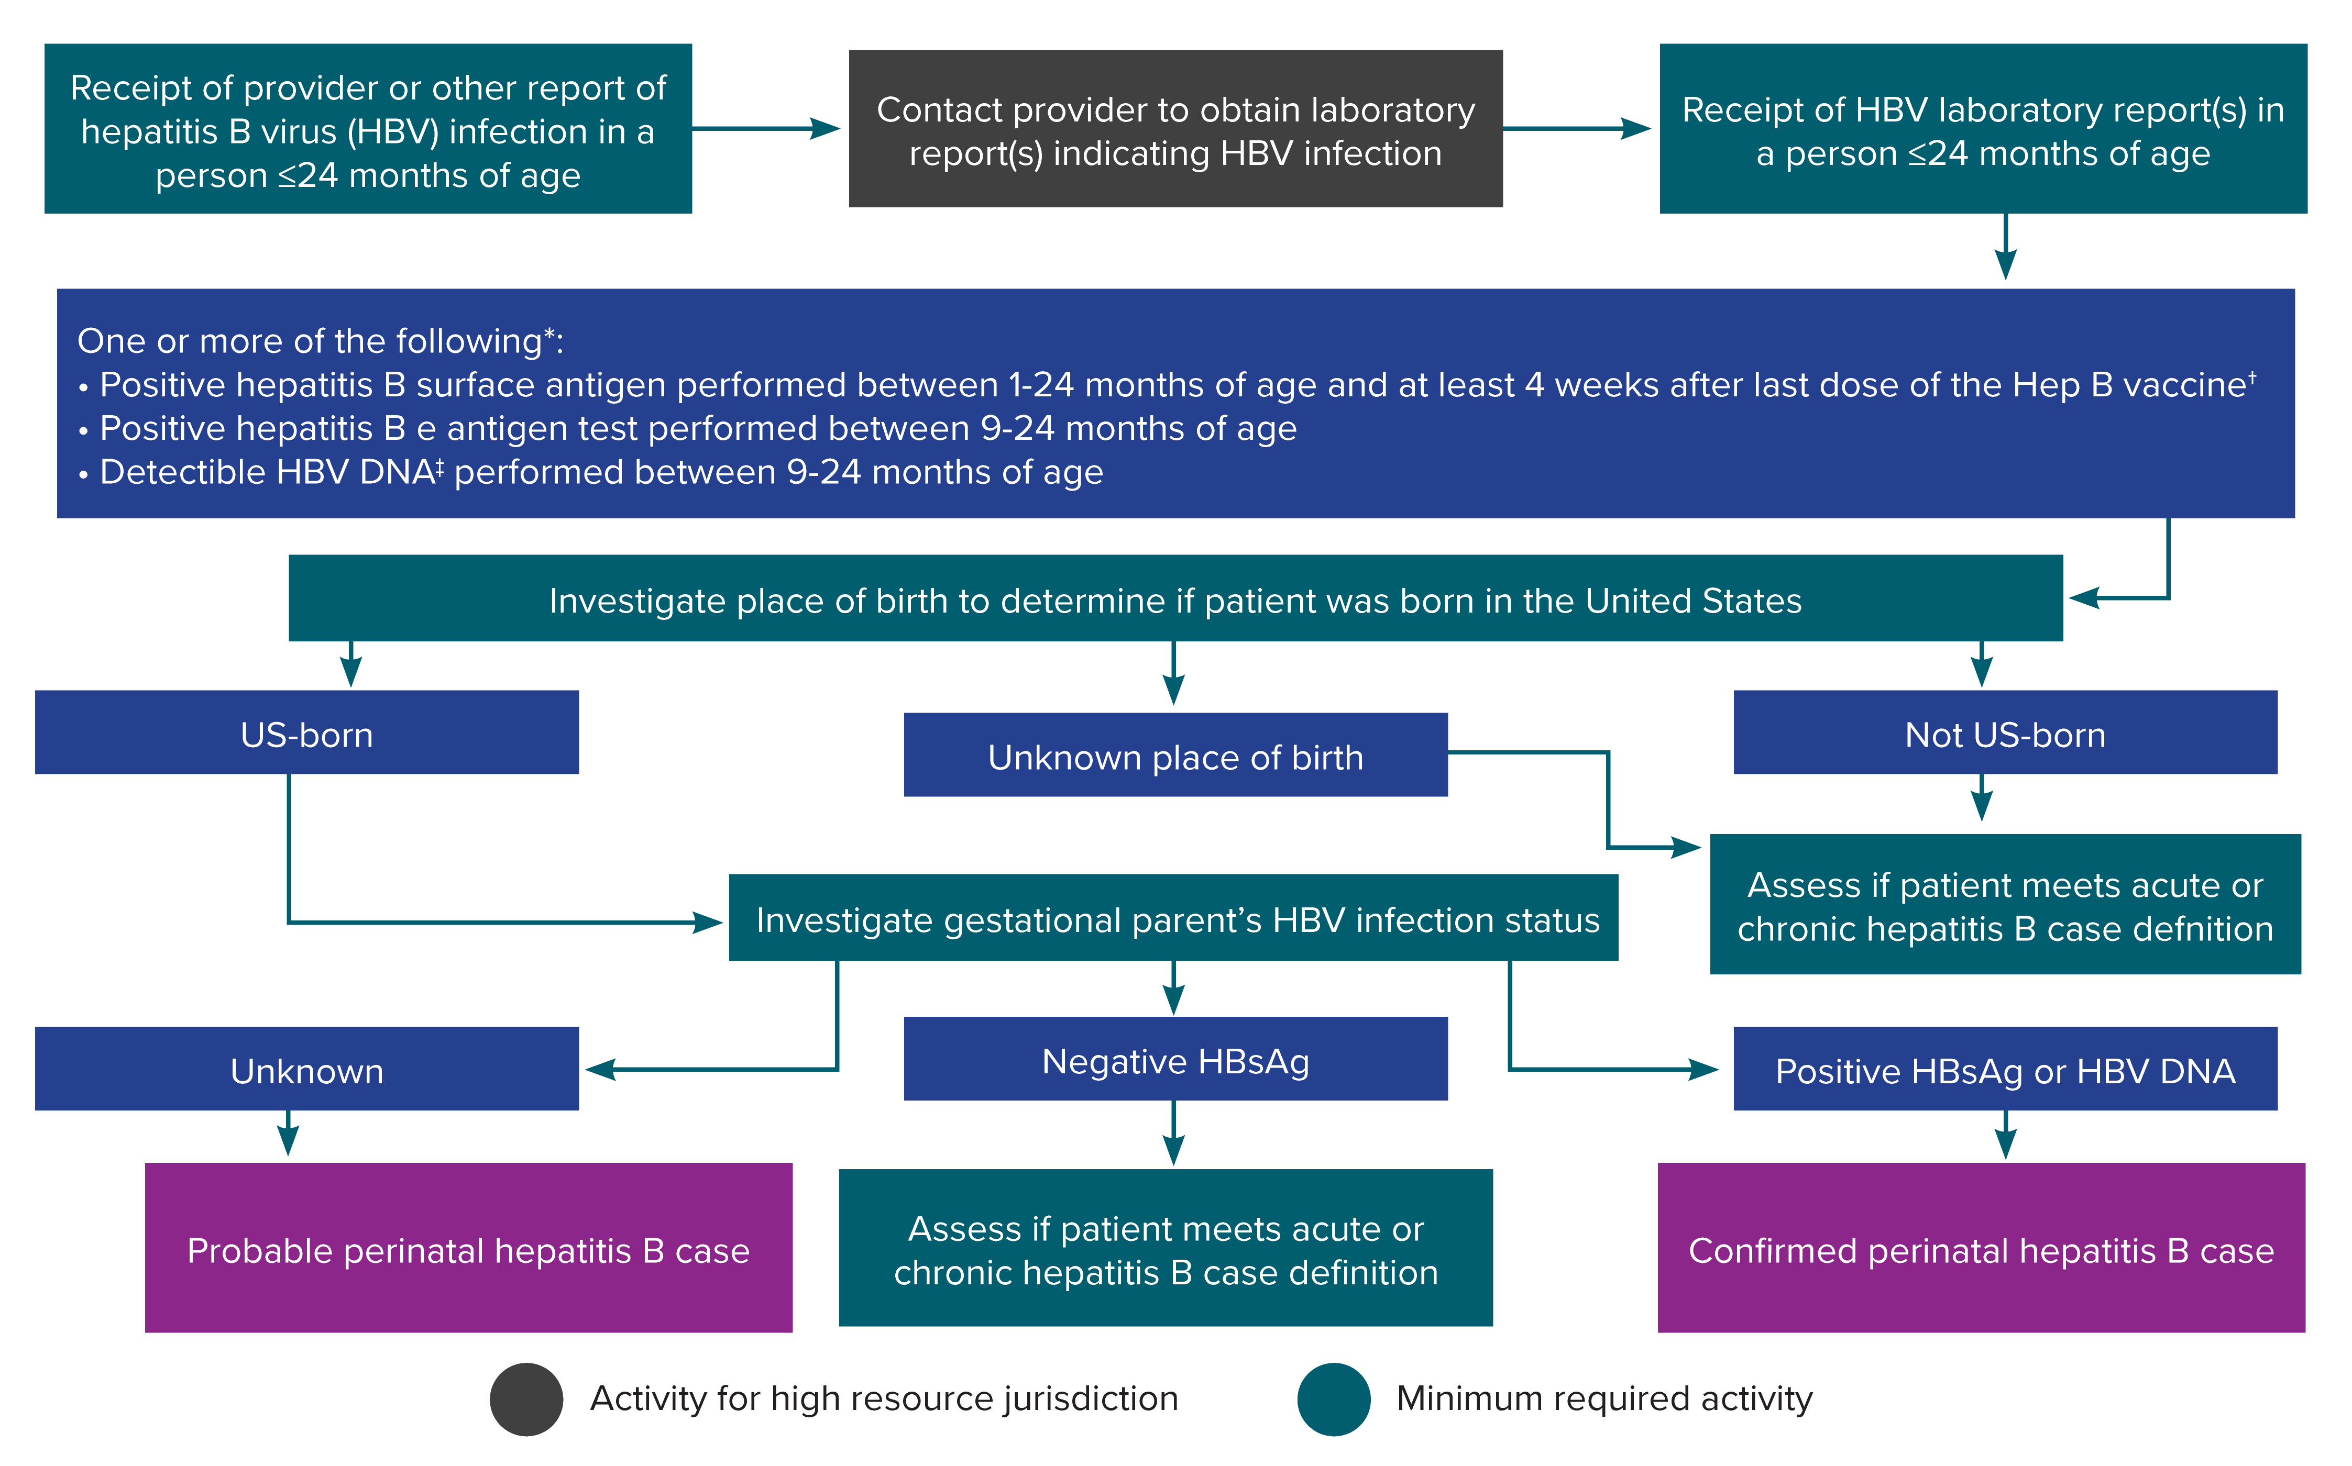
Figure 3-4. Process for perinatal hepatitis B case ascertainment and classification
*Surveillance programs should provide prevention programs with information on people who have positive test outcomes for post-test counseling and referral to care, as appropriate. HBsAg test results obtained from infants ≤1 month of age and hepatitis B e antigen and HBV DNA results obtained from those ≤9 months of age should not be used for classification. Cases among children <24 months of age who are known to have been exposed to HBV through health care (not perinatally) should be reported according to the 2012 acute and chronic hepatitis B case definitions.
†Positive HBsAg results obtained from infants ≤9 months of age who received hepatitis B vaccine should not be interpreted as positive due to the potential for transient HBsAg positivity.
‡Nucleic acid testing for HBV DNA, including qualitative, quantitative, and genotype testing.
Notes:
Figure 3-4 illustrates an approach for perinatal hepatitis B case ascertainment and classification. Recommended follow-up activities are color-coded based on if they are minimally required or are high resource.

Slide 17
Table 3-6. Common laboratory codes for hepatitis B post-vaccination serologic testing
Laboratory | Hepatitis B Surface Antigen | Antibody to hepatitis Surface Antigen
Affiliated Medical Services | 5196-1 | 10900-9
LabCorp | 006510 | 006530
Mayo Medical Labs | 9013 | 8254
Quest Diagnostics | 498 | 8475

Slide 18
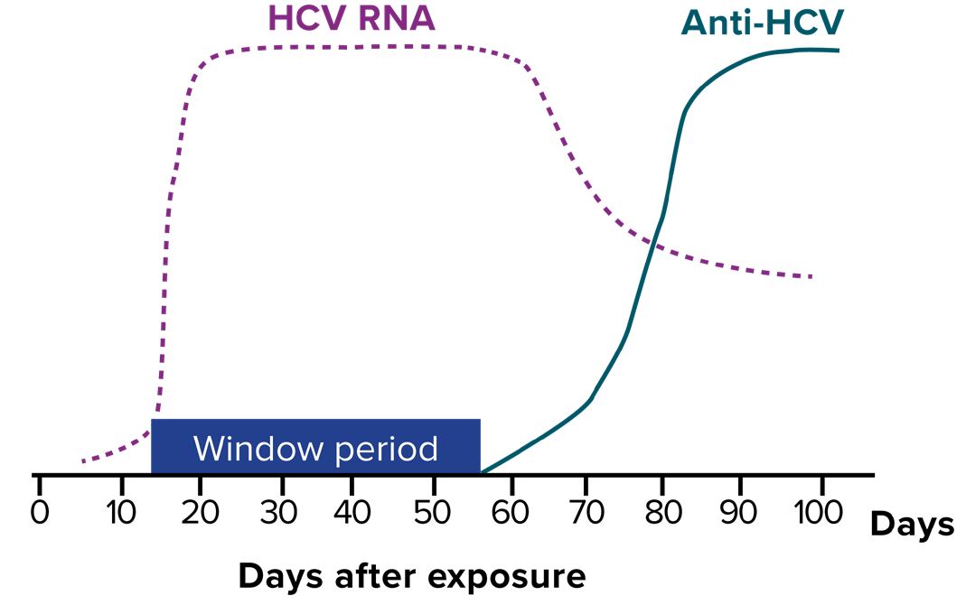
Figure 4-1. Typical serologic course of hepatitis C virus infection
Figure obtained from https://www.aphl.org/aboutAPHL/publications/Documents/ ID-2019Jan-HCV-Test-Result-Interpretation-Guide.pdf.
Notes:
Figure 4.1 illustrates the typical serologic course of hepatitis C virus infection. There is an 8–11 week window period between exposure to hepatitis C virus and the ability to detect hepatitis C virus antibodies. Hepatitis C virus RNA may be detectable approximately 1–2 weeks after exposure.

Slide 19
Table 4-1. Interpretation of hepatitis C laboratory results
Test Outcome* | Interpretation† | Further Actions
Nonreactive hepatitis C virus (HCV) antibody | No HCV antibody detected | No further action required in most cases. Though this would not be considered a case, some jurisdictions do require reporting (especially among children <36 months of age). There might be some instances where further testing is recommended.‡
Reactive HCV antibody§ | Presumptive hepatitis C | A reactive result is consistent with current HCV infection, past HCV infection that has resolved, or biologic false positivity for HCV antibody. Recommend testing for HCV RNA to identify current infection.
Reactive HCV antibody AND Positive nucleic acid test (NAT) for HCV RNA (including qualitative, quantitative, or genotype testing) OR Positive HCV antigen* | Current hepatitis C | Provide patient with appropriate counseling and linkage to care.
Reactive HCV antibody AND Negative NAT for HCV RNA (including qualitative, quantitative, or genotype testing) OR/AND Negative HCV antigen | Cleared hepatitis C | Result might be consistent with natural clearance or successful treatment or with a false-positive HCV antibody result. No further action required in most cases. Further testing may be recommended in some instances.¶
Table modified from https://www.cdc.gov/mmwr/pdf/wk/mm62e0507a2.pdf.
*Surveillance programs should provide prevention programs with information on people who have positive test outcomes for post-test counseling and referral to treatment and care, as appropriate. No HCV antigen tests have been approved by the US Food and Drug Administration (FDA). When an FDA-approved test becomes available, it will be acceptable laboratory criteria, equivalent to HCV RNA testing. For surveillance purposes, the reporting of positive genotype test results should be considered equivalent to HCV RNA detection, as RNA is required for this test. However, a genotype test in which the genotype cannot be determined is not the same as a “not detected” HCV RNA result.
†Ingestion of high levels of biotin can significantly interfere with certain commonly used biotinylated immunoassays and cause false-positive or false-negative laboratory test results. Currently, the FDA is investigating thresholds associated with false-positive and false-negative tests. Reference: https://www.fda.gov/medical-devices/safety- communications/update-fda-warns-biotin-may-interfere-lab-tests-fda-safety-communication.
‡Further testing might be recommended if a recent HCV exposure is suspected in the past 6 months (or longer in people who are immunocompromised) or if there is concern regarding the handling or storage of the specimen. If recent exposure is suspected, test for the presence of virus using either a NAT for HCV RNA or a test for HCV antigen (if available). If HCV RNA testing is not feasible, conduct follow-up testing for HCV antibody to demonstrate test conversion.
§If the HCV RNA result is indeterminate, consider provider follow-up to discuss interpretation of result and re-testing strategy.
¶Further testing might be recommended if a recent HCV exposure is suspected in the past 6 months, or if there is concern regarding the handling or storage of the specimen. If distinction between true positivity and biologic false positivity for HCV antibody is desired and the sample is repeatedly reactive, testing with an alternative HCV antibody assay may be useful. In certain situations (e.g., suspected HCV infection within the past 6 months, clinical evidence of HCV infection, and questionable specimen integrity), follow up with another HCV RNA test and appropriate counseling.

Slide 20
Table 4-2. US Centers for Disease Control and Prevention (CDC) and Council of State and Territorial Epidemiologists (CSTE) case definitions for acute and chronic hepatitis C, 2020
Criteria Type | Criteria
Age | >36 months of age, OR <36 months of age and the mode of exposure was not perinatal
Clinical | Jaundice, OR Peak elevated total bilirubin levels >3.0 mg/dL, OR Peak elevated serum alanine aminotransferase (ALT) >200 IU/L, AND The absence of a more likely diagnosis (which may include evidence of acute liver disease due to other causes or advanced liver disease due to pre-existing chronic hepatitis C or other causes, such as alcohol exposure, other viral hepatitis, hemochromatosis, etc.)
Confirmatory Laboratory | HCV detection test Positive nucleic acid test (NAT) for HCV RNA (including qualitative, quantitative, or genotype testing), OR Positive test indicating presence of HCV antigen*
Presumptive Laboratory | Positive HCV antibody (anti-HCV) test†
Anti-HCV Test Conversion | Documented negative anti-HCV test followed within 12 months by a positive anti-HCV test
HCV Detection Test Conversion Criteria‡ | Documented negative anti-HCV test followed within 12 months by a positive HCV detection test OR Documented negative HCV detection test in someone without a prior diagnosis of hepatitis C followed within 12 months by a positive HCV detection test OR At least 2 sequential documented negative HCV detection tests at least 12 weeks apart in someone with a prior diagnosis of hepatitis C followed by a positive HCV detection test§

Slide 21
Table 4-2. US Centers for Disease Control and Prevention (CDC) and Council of State and Territorial Epidemiologists (CSTE) case definitions for acute and chronic hepatitis C, 2020 (continued)
Case Status | Classification
Confirmed Acute‡ | >36 months of age OR <36 months of age and the mode of exposure was not perinatal, AND Meets the clinical criteria and has confirmatory laboratory evidence OR has documentation of an anti-HCV test conversion OR has documentation of an HCV detection test conversion
Probable Acute‡ | >36 months of age OR <36 months of age and the mode of exposure was not perinatal, AND Meets the clinical criteria, AND Has presumptive laboratory evidence, AND Has no or unknown HCV detection test result, AND Has no documentation of an anti-HCV or HCV detection test conversion, AND Has not been previously reported as a confirmed acute or chronic HCV case
Confirmed Chronic‡ | >36 months of age OR <36 months of age and the mode of exposure was not perinatal, AND Does not meet or is not known to meet the clinical criteria, AND Has confirmatory laboratory evidence, AND Has no documentation of an anti-HCV or HCV detection test conversion
Probable Chronic‡ | >36 months of age OR <36 months of age and the mode of exposure was not perinatal, AND Does not meet or is not known to meet the clinical criteria AND Has presumptive laboratory evidence, AND Has no documentation of an anti-HCV or HCV detection test conversion, AND Has no or unknown HCV detection test result, AND Has not been previously reported as a confirmed acute or chronic hepatitis C case
*At present, no HCV antigen tests are approved by the US Food and Drug Administration (FDA). These tests will be acceptable laboratory criteria, equivalent to HCV RNA testing, when an FDA-approved test becomes available.
†The presence of a negative HCV detection test result, in the absence of criteria that would allow for confirmation, indicates that the case should not be classified as probable and should not be reported to CDC.
‡Surveillance programs should provide prevention programs with information on people who have positive test outcomes for post-test counseling and referral to treatment and care, as appropriate.
§Timing of these tests may change as standard of care for HCV treatment evolves. Some jurisdictions are creating a local condition specific for reinfection as opposed to creating a new acute condition to maintain deduplication.

Slide 22
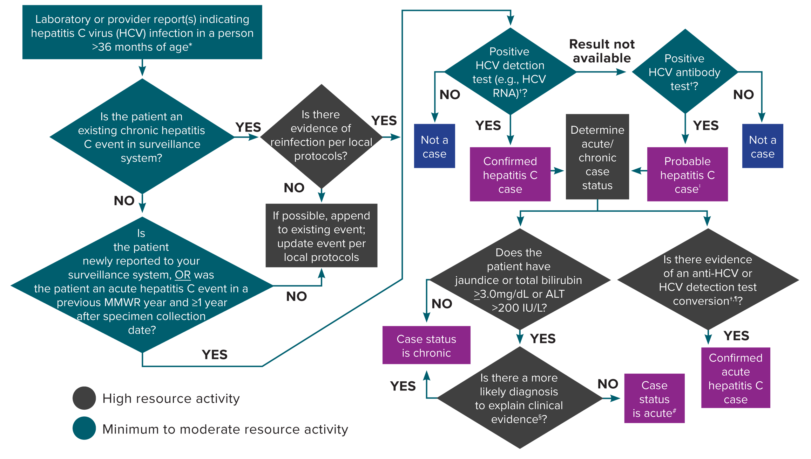
Figure 4-2. Process for acute and chronic hepatitis C case ascertainment and classification
*A child <36 months of age whose mode of exposure is not perinatal (e.g., health care-acquired) should be classified under the 2020 acute or chronic hepatitis C case definition. A child 2–36 months of age whose mode of exposure is perinatal should be classified under the 2018 perinatal hepatitis C case definition.
†Surveillance programs should provide prevention programs with information on people who have positive test outcomes for post-test counseling and referral to treatment and care, as appropriate. HCV detection testing includes nucleic acid testing for HCV RNA (including qualitative, quantitative, or genotype testing) or a test indicating the presence of HCV antigen. At present, no HCV antigen tests are approved by the US Food and Drug Administration (FDA). These tests will be acceptable laboratory criteria, equivalent to HCV RNA testing, when an FDA-approved test becomes available.
‡May re-classify as confirmed if a positive HCV detection test is later received before the National Notifiable Diseases Surveillance System (NNDSS) close-out date for national notification purposes. Jurisdictions with a longitudinal system can update probable cases to confirmed within their system at any time regardless of the NNDSS close-out date.
§May include evidence of acute liver injury from infectious, autoimmune, metabolic, drug or toxin exposure, neoplastic, circulatory or thromboembolic, or idiopathic causes.
¶A documented negative HCV antibody followed within 12 months by a positive HCV antibody test (anti-HCV test conversion) OR a documented negative HCV antibody OR negative HCV detection test (in someone without a prior diagnosis of HCV infection) followed within 12 months by a positive HCV detection test (HCV detection test conversion).
#A new, acute hepatitis C case is either an incident case that has not been previously reported or a case among someone previously reported as having hepatitis C who has laboratory evidence of reinfection⁽¹⁴⁾. Some jurisdictions are creating a local condition specific for reinfection as opposed to creating a new acute condition to maintain a deduplicated registry.
Reference:
14. Council of State and Territorial Epidemiologists. Position statement 19-ID-06: revision of the case definition for hepatitis C. Available at: https://cdn.ymaws.com/www. cste.org/resource/resmgr/2019ps/final/19-ID-06_HepatitisC_final_7..pdf. Accessed on January 16, 2020.
Notes:
Figure 4-2 illustrates an approach for acute and chronic hepatitis C case ascertainment and classification. The flow chart begins with receipt of a provider report, laboratory report, or other report indicating hepatitis C virus infection and walks through follow-up and case classification decisions based on available information. Recommended follow-up activities are color-coded based on if they are minimum-to-moderate resource or high resource activities.

Slide 23
Table 4-3. Considerations for hepatitis C cases who were organ (or tissue) transplant recipients*
Organ Recipient Pre-Transplant Laboratory Result† | Organ Recipient Post-transplant Laboratory Result† | Case Classification
Positive HCV antibody (anti-HCV) AND positive HCV detection test‡ | Positive anti-HCV AND positive HCV detection test‡ | Should not be considered a new case due to organ transplant, but rather an infection documented prior to transplant§. To determine whether this case should be considered newly reported, follow Figure 4-2.
Positive anti-HCV with evidence of cure according to AASLD/IDSA hepatitis C treatment guidelines⁽⁹²⁾ | Positive anti-HCV AND positive HCV detection test‡ | Should be classified as an acute infection due to reinfection according to the CDC/CSTE case definition⁽¹⁴⁾ and investigated with three major hypotheses in mind: donor-derived transmission transmission related to recipient risk behaviors or exposures health care-associated transmission CDC’s Division of Viral Hepatitis might already have been notified about the investigation and is available for consultation.
Negative anti-HCV AND negative HCV detection test‡ | Positive anti-HCV AND positive HCV detection test‡ | Should be classified as an acute infection according to the CDC/CSTE case definition⁽¹⁴⁾ and investigated to identify the source of transmission with 3 major hypotheses in mind: donor-derived transmission transmission related to recipient risk behaviors or exposures health care-associated transmission CDC’s Division of Viral Hepatitis might already have been notified about the investigation and is available for consultation.
No prior HCV laboratory results¶
*It is recommended that donors undergo anti-HCV and HCV RNA testing prior to organ procurement. If donors are negative for HCV RNA, transmission is considered “unexpected.” Transmission has occurred from donors who were infected/re-infected shortly before death; in this scenario, transmission to the recipient occurs during the “window period”.
†Because of the large number of tests performed on recipients, irreproducible positive results are sometimes reported. Investigators should review all results in context. CDC’s Division of Viral Hepatitis is available for consultation.
‡The 2020 Public Health Service (PHS) guidelines recommend testing all organ recipients for anti-HCV and HCV RNA pre-transplant and for HCV RNA at 4–5 weeks post- transplant⁽⁶⁷⁾.
§If the pre-transplant genotype differs from that observed post-transplant, consider investigating as if the infection is newly acquired.
¶All recipients should be tested pre-transplant for anti-HCV and HCV RNA. If the recipient has not been tested appropriately pre-transplant, consider contacting the transplant center to promote awareness of the 2020 PHS guidelines.
References:
14. Council of State and Territorial Epidemiologists. Position statement 19-ID-06: Revision of the case definition for hepatitis C. Available at: https://cdn.ymaws.com/www. cste.org/resource/resmgr/2019ps/final/19-ID-06_HepatitisC_final_7..pdf. Accessed on January 16, 2020.
92. American Association for the Study of Liver Diseases/Infectious Diseases Society of America

Slide 24
Table 4-4. US Centers for Disease Control and Prevention (CDC) and Council of State and Territorial Epidemiologists (CSTE) case definition for perinatal hepatitis C, 2018
Criteria Type | Criteria
Demographic | Diagnosis of hepatitis C in an infant 2–36 months of age
Clinical | Ranges from asymptomatic to fulminant hepatitis
Laboratory* | Child <36 months of age with evidence of hepatitis C as shown by the following laboratory results: Diagnostic Laboratory Evidence: HCV detection test: » Positive nucleic acid test (NAT) for HCV RNA (including qualitative, quantitative, or genotype testing) during 2–36 months of age OR » Positive test indicating presence of HCV antigen during 2–36 months of age
Epidemiologic Linkage | Maternal infection with hepatitis C of any duration, if known AND Not known to have been exposed to hepatitis C via a mechanism other than perinatally (e.g., not acquired via health care)
Case Status | Classification
Confirmed Perinatal* | Has a positive HCV detection test performed during 2–36 months of age AND Is not known to have been exposed to hepatitis C via a mechanism other than perinatally.
*Surveillance programs should provide prevention programs with information on people who have positive test outcomes for post-test counseling and referral
to treatment and care, as appropriate. At present no HCV antigen tests are approved by the US Food and Drug Administration (FDA). These tests will be acceptable laboratory criteria, equivalent to HCV RNA testing, when an FDA- approved test becomes available.

Slide 25
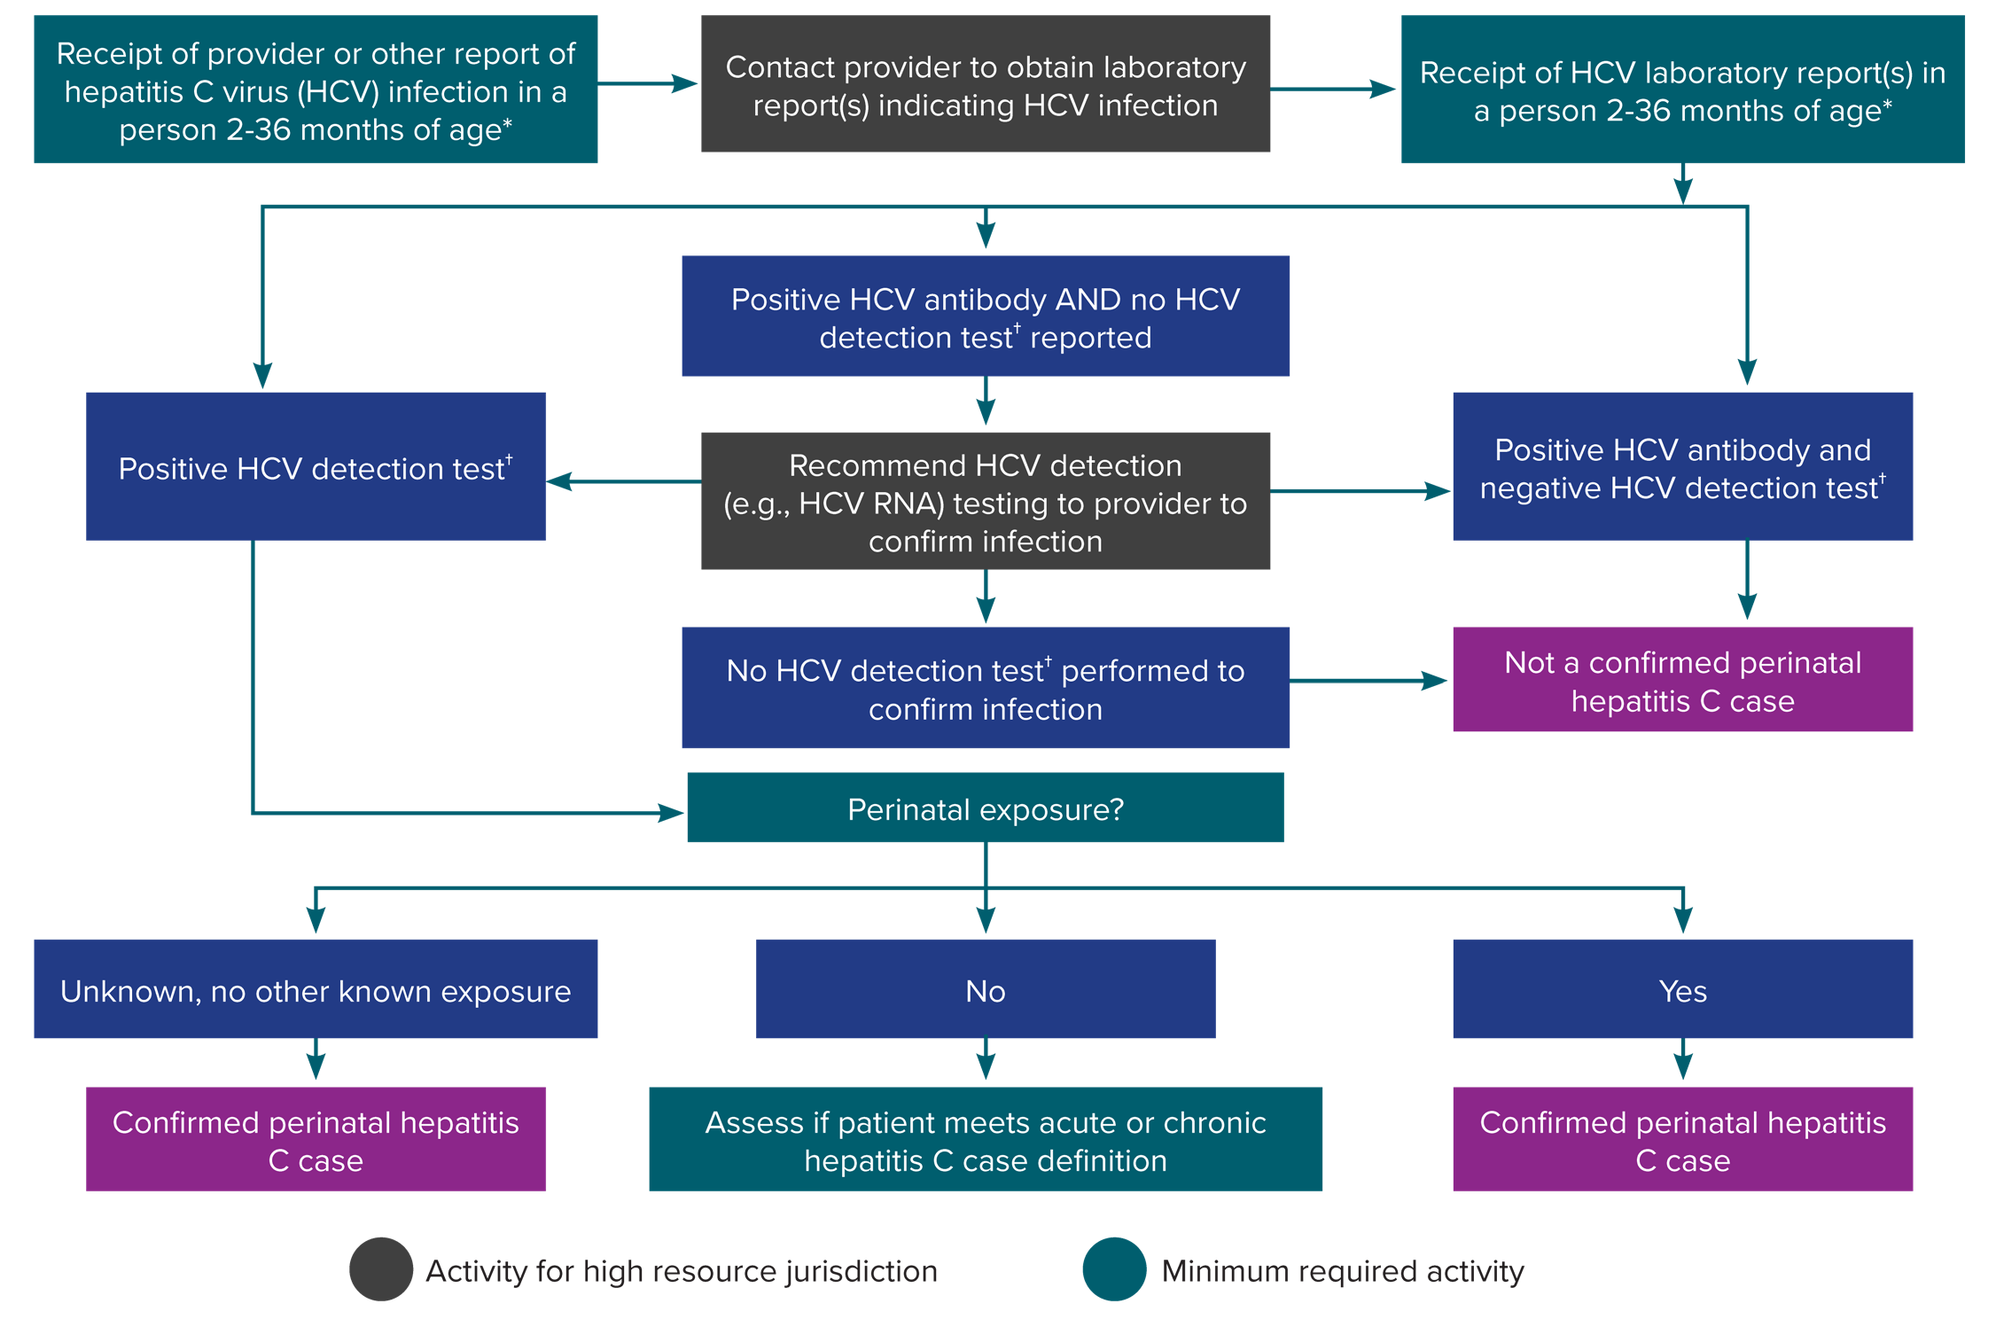
Figure 4-3. Process for perinatal hepatitis C case ascertainment and classification
*Test results among infants <2 months of age should not be used for classification. Cases among children <36 months of age who are known to have been exposed to HCV through health care or otherwise, and not perinatally, should be reported under the 2020 acute and chronic hepatitis C case definitions.
†HCV detection testing includes nucleic acid testing (NAT) for HCV RNA (including qualitative, quantitative, and genotype testing) or testing indicating the presence of HCV antigen. At present, no HCV antigen tests are approved by the US Food and Drug Administration (FDA). These tests will be acceptable laboratory criteria, equivalent to HCV RNA testing, when an FDA-approved test becomes available.
Notes:
Figure 4-3 illustrates an approach for perinatal hepatitis C case ascertainment and classification. The flow chart begins with receipt of a provider report, laboratory report, or other report indicating hepatitis C virus infection in an infant or child 36 months of age or younger and walks through follow-up and case classification decisions based on available information. Recommended follow-up activities are color-coded based on if they are minimumly required or are high resource.

Slide 26
Table 5-1. Classification of hepatitis C cases diagnosed concurrently with hepatitis A
Scenario Confirmed hepatitis A* AND… | Classification | Rationale
Hepatitis C virus (HCV) test conversion* documented | Confirmed acute hepatitis C | Documented HCV test conversion.† Clinical criteria not required to be met for acute hepatitis C case classification. However, because the patient has confirmed hepatitis A, clinical criteria are present.*
Negative anti-HCV Positive HCV detection test HCV test conversion† not documented | Confirmed acute hepatitis C | For the first 8 weeks following exposure to HCV, anti-HCV tests might not detect HCV antibodies.‡,§ HCV RNA is likely detectable ~1–2 weeks after HCV exposure.‡ If HCV RNA is detectable and anti-HCV is not detectable in the same specimen, this could indicate early acute HCV infection.‡ This scenario might be more common in settings where HCV testing is regularly performed (e.g., syringe services providers and blood donation centers).
Positive anti-HCV (by history or documented) Positive HCV detection test HCV test conversion* not documented Documentation of recent initiation of injection drug use within 12 months of first report to public health | Confirmed acute hepatitis C | The risk of HCV infection associated with injection drug use is strong following onset of injection. However, in the absence of information about recent initiation of injection drug use, this case would be classified as confirmed chronic hepatitis C. See below scenario.
Positive anti-HCV (by history or documented) Positive HCV detection test HCV test conversion† not documented | Confirmed chronic hepatitis C | The 2020 acute hepatitis C case definition, under clinical criteria, states that a more likely diagnosis, such as another viral hepatitis infection (e.g., hepatitis A), should be considered as a possible explanation for the presence of clinical criteria before considering that the clinical criteria for acute hepatitis C is met.
Positive anti-HCV No HCV detection test reported HCV test conversion† not documented | Probable chronic hepatitis C | The 2020 acute hepatitis C case definition, under clinical criteria, states that a more likely diagnosis, such as another viral hepatitis infection (e.g., hepatitis A), should be considered as a possible explanation for the presence of clinical criteria before considering that the clinical criteria for acute hepatitis C is met.
*A case of confirmed hepatitis A, in this context, has evidence of
acute hepatitis symptoms (i.e., the abrupt onset of symptoms consistent with acute viral hepatitis [e.g., fever, headache, malaise, anorexia, nausea, vomiting, diarrhea, abdominal pain, or dark urine]), AND
acute hepatitis signs or laboratory abnormalities (defined as a report of jaundice or peak elevated total bilirubin levels ≥3.0 mg/dL or peak ALT levels >200 IU/L), AND
anti-HAV IgM positive and/or HAV RNA positive. †Anti-HCV test conversion: 1) documented negative HCV antibody (anti-HCV) test followed by a positive HCV antibody test within 12 months or 2) documented negative HCV detection test followed by a positive anti-HCV test within 12 months.
HCV detection test conversion: 1) documented negative anti-HCV test followed by a positive HCV detection test within 12 months or 2) documented negative HCV detection test in someone without a prior diagnosis of hepatitis C followed by a positive HCV detection test within 12 months.
‡Source of information: https://www.aphl.org/aboutAPHL/publications/Documents/ID-2019Jan-HCV-Test-Result-Interpretation-Guide.pdf
§In people who are immunocompromised, development of HCV antibodies might not occur or be delayed. In people who have risks for HCV infection, HCV detection testing, regardless of HCV antibody status, should always be performed to determine presence or absence of infection.

Slide 27
Table 5-2. Person and case identification variables in the National Electronic Disease Surveillance System Base System (NBS)
CDC Variable ID | CDC Variable Name | CDC Variable Type | CDC Question/Variable Description
DEM197 | Person_local_id | Alphanumeric (<200 characters) | The local ID of the subject/entity of the case. This is the ID that the state NBS application assigned to the subject when it was entered into NBS.
INV168 | Case_local_id | Alphanumeric (<200 characters) | State-assigned expanded case ID/local record ID in source NBS Master Message.
NOT109/nbsState Code | NND_Reporting_State_Cd | Alphanumeric (<20 characters) | NBS reporting state code.

Slide 28
Table 5-3. Person and case identification variables via Health Level Seven (HL7) case notification
PHIN Variable | Variable Type | Data Element | Data Element Description
DEM197 | Text | Local subject ID | The person local ID associated with the case.
INV168 | Text (Alphanumeric <200 characters) | Local record ID | Sending system- assigned local ID of the case with which the subject is associated.
NOT116 | Coded value (Alphanumeric <20 characters) | 77968-6 National Reporting Jurisdiction | National jurisdiction reporting the notification to CDC.

Slide 29
Table 5-4. Variables indicating outbreak source for hepatitis A cases notified to the National Notifiable Diseases Surveillance System (NNDSS) via the National Electronic Telecommunications System for Surveillance
CDC Variable Name | Position (Column/Length) | Description | Coding for Transmission to NNDSS
Outbreak (Core Data) | 55/1 | Outbreak-associated | Indicates whether the case-report was associated with an outbreak. 1 = Case is outbreak-associated 2 = Case is not outbreak-associated 9 = Unknown
Outbreak (Hepatitis-Specific Data) | 82/1 | Common-source outbreak | Was the patient suspected as being part of a common-source outbreak? 1 = Yes 2 = No 9 = Unknown

Slide 30
Table 5-5. Variables indicating outbreak source for hepatitis A cases notified to the National Notifiable Diseases Surveillance System (NNDSS) via the National Electronic Disease Surveillance System Base System (NBS)
NBS ID | NBS Label | Description | Coding for Transmission to NNDSS
INV150 | OUTBREAK | Outbreak-associated | Indicates whether the case-report was associated with an outbreak. 1 = Case is outbreak-associated 2 = Case is not outbreak-associated 9 = Unknown
HEP143 | AOUTBREAK | Common-source outbreak | Was the patient suspected as being part of a common-source foodborne or water borne outbreak? 1 = Yes 2 = No

Slide 31
Table 5-6. Variables indicating outbreak source for hepatitis A cases notified to the National Notifiable Diseases Surveillance System via Health Level Seven case notification
PHIN Variable | OBX 3.1 Identifier | Data Element Name | Data Element Description
INV150 | 77980-1 | Case outbreak indicator | Indicates whether the case report was associated with an outbreak.
INV618 | INV618 | Common-source outbreak | Is the subject suspected as being part of a common-source outbreak?
INV609 | INV609 | Foodborne outbreak; infected food handler | If yes, was the outbreak associated with an infected food handler?
INV610 | INV610 | Foodborne outbreak; not an infected food handler | If yes, was the outbreak not associated with an infected food handler?
INV612 | INV612 | Waterborne outbreak | If yes, was the outbreak waterborne?

Slide 32
Table 5-7. Selections for variables indicating outbreak source for hepatitis A cases notified to the National Notifiable Diseases Surveillance System via Health Level Seven case notification
Hepatitis A Outbreak Scenario | Variable Selections
 | 77980-1 | INV618 | INV609 | INV610 | INV612
Person-to-person outbreak | Yes | No | No | No | No
Foodborne outbreak, infected food handler | Yes | Yes | Yes | No | No
Foodborne outbreak, not infected food handler | Yes | Yes | No | Yes | No
Waterborne outbreak | Yes | Yes | No | No | Yes

Slide 33
Table 5-8. Supplementary data sources
Data Source | Representativeness | May Be Able to Link to Surveillance Data? | Additional Information
Registry/Surveillance System Data
Accurint/LexisNexis | Jurisdiction-specific | No | https://www.accurint.com
Birth Certificates | National-level and jurisdiction-specific | Yes | https://www.cdc.gov/nchs/nvss/births.htm
Birth Defects Registry | Jurisdiction-specific | Yes | https://www.cdc.gov/ncbddd/birthdefects/data.html
Cancer Registry | National-level and jurisdiction-specific | Yes | https://www.cdc.gov/cancer/npcr/index.htm
Commercial Laboratory | US population-based | No (standalone system) | https://www.ncbi.nlm.nih.gov/pmc/articles/PMC6606113/
Death Certificates | National-level and jurisdiction-specific | Yes | https://www.cdc.gov/nchs/nvss/deaths.htm
Enhanced HIV/AIDS Reporting System (eHARS) | National-level and jurisdiction-specific | Yes | https://www.cdc.gov/hiv/library/reports/hiv-surveillance.html
Immunization Registry | Jurisdiction-specific | Yes | https://www.cdc.gov/vaccines/programs/iis/index.html
National Death Index (NDI) | National-level and jurisdiction-specific | Yes | https://www.cdc.gov/nchs/ndi/index.htm
Ryan White Eligibility System (RWES) | National-level and jurisdiction-specific | Yes | https://hab.hrsa.gov/data/data-reports
Jurisdiction-specific Infectious Disease Surveillance Databases (e.g., HIV, STI, Tuberculosis Case Surveillance) | Jurisdiction-specific | Yes
Jurisdiction-specific Non-infectious Disease Surveillance Databases (e.g., Cancer Registry and Injury Prevention) | Jurisdiction-specific | Yes
Social Security Death Master File (SSDMF) | National-level and jurisdiction-specific | Yes | https://dmf.ntis.gov
Jurisdictional Corrections Information Systems | Jurisdiction-specific | Yes

Slide 34
Table 5-8. Supplementary data sources (continued 1)
Data Source | Representativeness | May Be Able to Link to Surveillance Data? | Additional Information
Health Care Systems Data
AIDS Drug Assistance Programs (ADAP) | Jurisdiction-specific | Yes | https://adap.directory
All-payers/Insurance Claims | Jurisdiction-specific | Yes | https://www.ahrq.gov/data/apcd/index.html https://www.cms.gov/OpenPayments/Explore-the-Data/ Data-Overview
Electronic Medical Records (EMR) or Electronic Health Records (EHR) | Jurisdiction-specific | Yes | https://www.cancer.gov/publications/dictionaries/cancer- terms/def/electronic-medical-record
Electronic Case Reporting (eCR) | Jurisdiction-specific pilot study | Yes | https://www.cdc.gov/ecr/index.html
Hospital Discharge Databases | Jurisdiction-specific | Yes | https://www.cdc.gov/nchs/nhds/index.htm
Healthcare Cost and Utilization Project (HCUP) | National-level | No (standalone system) | https://www.hcup-us.ahrq.gov/overview.jsp
Pharmacy Claims | US-population-based | Yes | https://www.ajmc.com/journals/supplement/2019/burden- chronic-hepatitis-c/assessing-burden-illness-chronic- hepatitis-impact-antiviral-healthcare-costs-medicaid
Syndromic Surveillance for Injection Drug-Related Complaints, Non-Fatal Drug Overdoses | Jurisdiction-specific | Dependent on capabilities of surveillance system | https://www.cdc.gov/nssp/overview.html

Slide 35
Table 5-8. Supplementary data sources (continued 2)
Data Source | Representativeness | May Be Able to Link to Surveillance Data? | Additional Information
Survey Data
Behavioral Risk Factor Surveillance System (BRFSS) | Jurisdiction-specific | No (standalone system) | https://www.cdc.gov/brfss/index.html
Medical Monitoring Project (MMP) (e.g., HCV in medical chart review portion) | Jurisdiction-specific | Yes | https://www.cdc.gov/hiv/statistics/systems/mmp/index.html
National Health and Nutrition Examination Survey (NHANES) | National-level | No (standalone system) | https://www.cdc.gov/nchs/nhanes/index.htm
National HIV Behavioral Surveillance (HCV testing during IDU cycle) | Jurisdiction-specific | No (standalone system) | https://www.cdc.gov/hiv/statistics/systems/nhbs/index.html
National Health Interview Survey | National-level | No (standalone system) | https://www.cdc.gov/nchs/nhis/index.htm

Slide 36
Table 5-9. Use of supplementary data sources for case ascertainment, investigation, characterization, and for monitoring of infection trends and disease-related outcomes
Data Source | Usefulness
Birth Certificates | Birth certificate data can be matched with surveillance data to identify infants born to gestational parents who are positive for hepatitis B and hepatitis C. Some jurisdictions’ birth certificates also have indicators of a history of maternal hepatitis B and hepatitis C, which can help identify unreported cases, although the quality of these variables should be validated prior to use for case ascertainment. For hepatitis B, matching birth certificates to gestational parent-infant pairs in the Perinatal Hepatitis B Prevention Program and/or hepatitis B registry or database may be used to assess appropriate hepatitis B testing, and the administration of hepatitis B immunoglobulin and hepatitis B vaccine.
Death Certificates | Death certificate data can be used to identify people reported with viral hepatitis as the underlying or contributing cause of death. This information is stored in both text form and in ICD-10 codes. Though viral hepatitis infections are often underreported on death certificates, crossmatches between viral hepatitis surveillance data and death certificates can identify deaths among people known to have viral hepatitis and can characterize trends in mortality among affected populations.
All-payers/Insurance Claims | These databases have information regarding specific medical claims and reimbursements (e.g., Medicaid data). When identifiable, viral hepatitis surveillance staff can match viral hepatitis surveillance data to these data sources to identify unreported cases and learn about case-specific viral hepatitis-related health care visits or costs and prescribed medications. If the database cannot be matched to viral hepatitis surveillance data, it can be used as a standalone system to a) provide estimates of viral hepatitis-related health care visits, prescriptions, and costs and b) assist in constructing the care and cure continuum in the jurisdiction.
Hospital Discharge Databases | Hospital discharge databases are maintained by many jurisdictions and contain data about hospital admissions. The databases generally contain inpatient records; other types of records (e.g., emergency department visits) are available in some jurisdictions. Some conditions, like endocarditis, are suggestive of risk behaviors (e.g., injection drug use) for viral hepatitis. Identifying the distribution of such conditions, such as data regarding the prevalence of injection drug use, can be used to inform hospitals of the need to test for viral hepatitis. Matching viral hepatitis surveillance data with hospital discharge databases can also help monitor disease severity, specifics of treatment, and cost of hospitalizations among specific populations.
Electronic Medical and Health Records (EHRs) | EHRs can be used to obtain additional patient data for case ascertainment, investigation, and classification (e.g., review negative laboratory results to clarify infection status, test results for other types of viral and non-viral hepatitis, and collect risk history). These data can also be used for identifying unreported cases in facilities that have data mining capabilities. EHRs can also potentially be used to identify missing data elements from known cases (e.g., race/ethnicity) through electronic case reporting, although EHR data quality and completeness varies depending on how data are stored.
Supplementary Laboratory Data | In addition to the positive viral hepatitis laboratory results that are routinely received by jurisdictions, some jurisdictions also receive non-positive laboratory results (e.g., undetectable HBV DNA and undetectable HCV RNA results). If available, viral hepatitis surveillance staff can use these data to identify acute cases by test conversion, differentiate between acute hepatitis B and hepatitis B reactivation, identify hepatitis C reinfection, determine if a laboratory result is likely false-positive, estimate hepatitis B and hepatitis C treatment coverage in their jurisdiction, and detect the prevalence of viral suppression in certain communities. Staff can use these data to clarify whether a positive HBV DNA or HCV RNA is in a chronic case, a reinfection (hepatitis C), a reactivation (hepatitis B), or possibly represents treatment failure. In addition, pregnancy status can be added to laboratory reports to encourage timely reporting of hepatitis B and hepatitis C in pregnancy.
Jurisdiction-specific Infectious Disease Surveillance Databases | Viral hepatitis surveillance data can be matched to other infectious disease surveillance databases (e.g., HIV, sexually transmitted infections, and tuberculosis) to obtain additional patient data for case investigation and classification. Matching viral hepatitis surveillance data with those for other infectious diseases can also be used to monitor rates of coinfection and inform data-to-care interventions.
Jurisdiction-specific Non-infectious Disease Surveillance Databases | Non-infectious disease surveillance data for related conditions can also be matched to viral hepatitis databases. For example, matching hepatitis B and hepatitis C databases to cancer registries or other chronic disease surveillance databases can be used to identify the prevalence of these outcomes among patients with chronic hepatitis B and hepatitis C. Data from injury prevention records can also be used to better characterize the intersecting epidemics of infectious diseases, opioid, methamphetamine, and other drug use disorder, and to inform the development of integrated public health interventions for people who use drugs.

Slide 37
Table 5-10. International Statistical Classification of Diseases and Related Health Problems, Tenth Revision (ICD- 10) codes for hepatitis A, hepatitis B, and hepatitis C for clinical diagnosis and cause of death coding
Condition | ICD-10 Codes
Hepatitis A | B15
Hepatitis B | B16, B17.0, B18.0, and B18.1
Hepatitis C | B17.1 and B18.2
Source: World Health Organization. ICD-10 Version: 2019. Available at: https://icd.who.int/browse10/2019/en#/. Accessed on May 20, 2021.

Slide 38
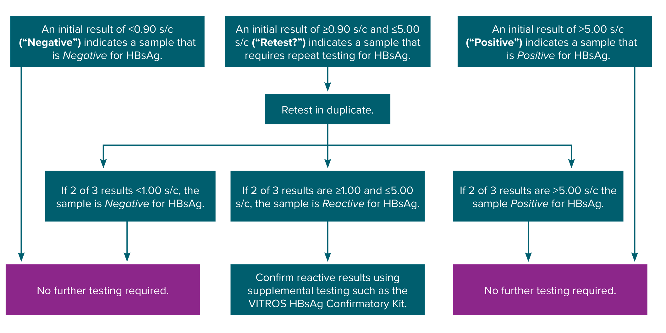
Figure 6-1. Testing algorithm for the Ortho VITROS hepatitis B surface antigen initial assay
Obtained from https://www.utmb.edu/policies_and_procedures/IHOP/Supporting_Documents/IHOP%20-%2009.13.15%20-%20Serological%20Testing%20for%20 Syphilis,%20Hepatitis%20B,%20and%20HIV%20during%20Pregnancy%20and%20Delivery%20(HBsAg_Screening).pdf.
Notes:
Figure 6-1 depicts the hepatitis B surface antigen testing algorithm for the Ortho VITROS hepatitis B surface antigen initial assay based on signal-to-cutoff value and indicates when retesting and supplemental confirmatory, or neutralization, testing should be performed.

