Slide 1

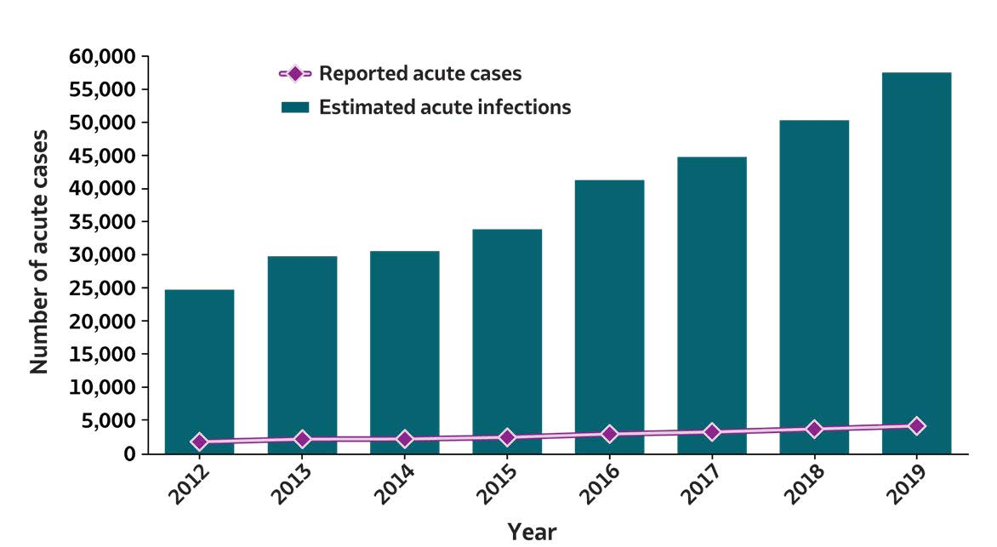
2019 VIRAL HEPATITIS
SURVEILLANCE REPORT
Figure 3.1. Number of reported acute hepatitis C virus infection cases and estimated infections* — United States, 2012–2019
Acute Hepatitis C | 2012 | 2013 | 2014 | 2015 | 2016 | 2017 | 2018 | 2019
Reported acute cases | 1,778 | 2,138 | 2,194 | 2,436 | 2,967 | 3,216 | 3,621 | 4,136
Estimated acute infections | 24,700 | 29,700 | 30,500 | 33,900 | 41,200 | 44,700 | 50,300 | 57,500
Source: CDC, National Notifiable Diseases Surveillance System.
*The number of estimated viral hepatitis infections was determined by multiplying the number of reported cases that met the classification criteria for a confirmed case by a factor that adjusted for underascertainment and underreporting. The 95% bootstrap confidence intervals for the estimated number of infections are displayed in the Appendix.

