Slide 1

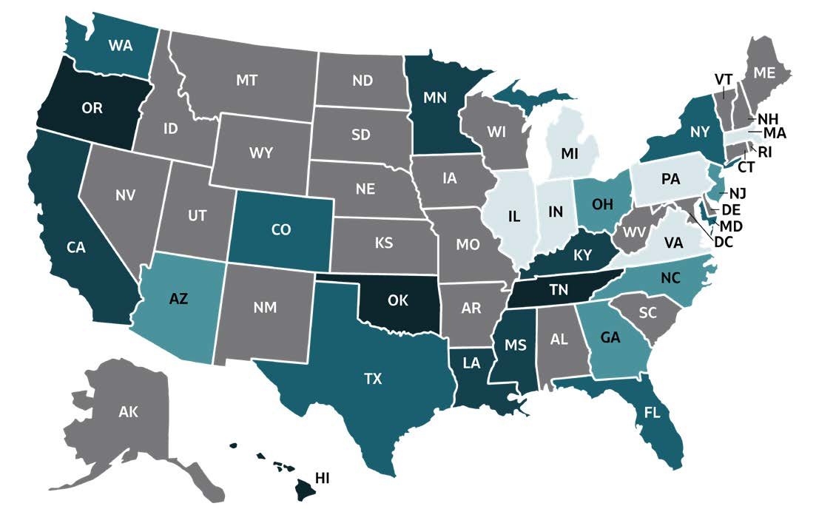
2019 VIRAL HEPATITIS
SURVEILLANCE REPORT
Figure 2.8. Rates* of deaths with hepatitis B virus infection listed as a cause of death† among residents, by jurisdiction — United States, 2019
Color Key | Deaths/100,000 Population | State or Jurisdiction
 | 0.00-0.29 | IL, IN, MA, MI, PA, VA
 | 0.30-0.40 | AZ, GA, NC, NJ, OH
 | 0.41-0.54 | CO, FL, MD, NY, TX, WA
 | 0.55-0.77 | CA, KY, LA, MN, MS
 | 0.78-1.17 | HI, OK, OR, TN
 | UR | AK, AL, AR, CT, DC, DE, IA, ID, KS, ME, MO, MT, ND, NE, NH, NM, NV, RI, SC, SD, UT, VT, WI, WV, WY
Source: CDC, National Center for Health Statistics, Multiple Cause of Death 1999–2019 on CDC WONDER Online Database. Data are from the 2015–2019 Multiple Cause of Death files and are based on information from all death certificates filed in the vital records offices of the fifty states and the District of Columbia through the Vital Statistics Cooperative Program. Deaths of nonresidents (e.g., nonresident aliens, nationals living abroad, residents of Puerto Rico, Guam, the Virgin Islands, and other U.S. territories) and fetal deaths are excluded. Numbers are slightly lower than previously reported for 2015–2016 due to NCHS standards which restrict displayed data to
U.S. residents. Accessed at http://wonder.cdc.gov/mcd-icd10.html on January 11, 2021. CDC WONDER dataset documentation and technical methods can be accessed at https://wonder.cdc.gov/wonder/help/mcd.html.
* Rates are age-adjusted per 100,000 US standard population in 2000 using the following age group distribution (in years): <1, 1–4, 5–14, 15–24, 25–34, 35–44, 45–54, 55–64, 65–74, 75–84, and ≥85. For age-adjusted death rates, the age-specific death rate is rounded to one decimal place before proceeding to the next step in the calculation of age-adjusted death rates for NCHS Multiple Cause of Death on CDC WONDER. This rounding step may affect the precision of rates calculated for small numbers of deaths. Missing data are not included.
† Cause of death is defined as one of the multiple causes of death and is based on the International Classification of Diseases, 10th Revision (ICD-10) codes B16, B17.0, B18.0, B18.1 (hepatitis B).
UR: Unreliable rates. Death counts that were less than 20 were not displayed due to the instability associated with those rates.

