Slide 1
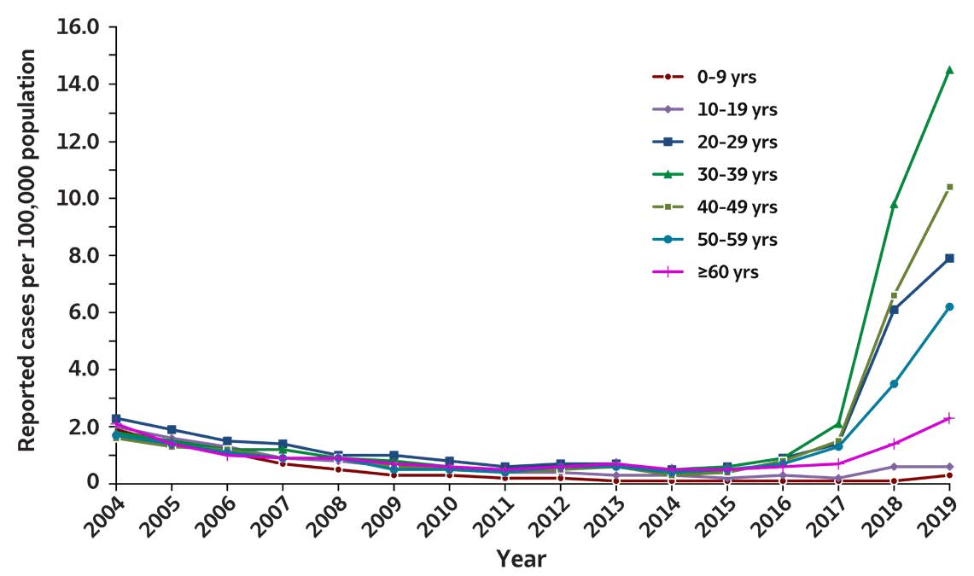
2019 VIRAL HEPATITIS
SURVEILLANCE REPORT
Figure 1.4. Rates of reported hepatitis A virus infection, by age group — United States, 2004–2019
Age (years) | 2004 | 2005 | 2006 | 2007 | 2008 | 2009 | 2010 | 2011 | 2012 | 2013 | 2014 | 2015 | 2016 | 2017 | 2018 | 2019
0-9 | 1.9 | 1.4 | 1.1 | 0.7 | 0.5 | 0.3 | 0.3 | 0.2 | 0.2 | 0.1 | 0.1 | 0.1 | 0.1 | 0.1 | 0.1 | 0.3
10-19 | 2.0 | 1.6 | 1.3 | 0.9 | 0.8 | 0.6 | 0.5 | 0.4 | 0.4 | 0.3 | 0.3 | 0.2 | 0.3 | 0.2 | 0.6 | 0.6
20-29 | 2.3 | 1.9 | 1.5 | 1.4 | 1.0 | 1.0 | 0.8 | 0.6 | 0.7 | 0.7 | 0.5 | 0.6 | 0.9 | 1.4 | 6.1 | 7.9
30-39 | 1.8 | 1.5 | 1.2 | 1.2 | 0.9 | 0.8 | 0.6 | 0.5 | 0.5 | 0.7 | 0.5 | 0.6 | 0.9 | 2.1 | 9.8 | 14.5
40-49 | 1.6 | 1.3 | 1.2 | 0.9 | 0.9 | 0.6 | 0.5 | 0.4 | 0.5 | 0.6 | 0.3 | 0.4 | 0.8 | 1.5 | 6.6 | 10.4
50-59 | 1.7 | 1.4 | 1.1 | 0.9 | 0.9 | 0.5 | 0.5 | 0.4 | 0.6 | 0.6 | 0.4 | 0.5 | 0.7 | 1.3 | 3.5 | 6.2
≥60 | 2.1 | 1.4 | 1 | 0.9 | 0.9 | 0.7 | 0.6 | 0.5 | 0.6 | 0.7 | 0.5 | 0.5 | 0.6 | 0.7 | 1.4 | 2.3
Source: CDC, National Notifiable Diseases Surveillance System.

