Slide 1

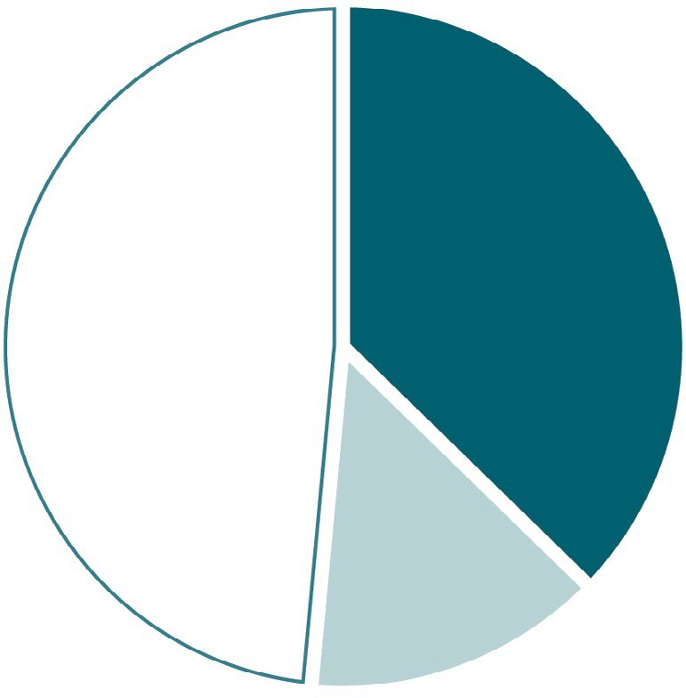
VIRAL HEPATITIS
SURVEILLANCE
Figure 3.7. Availability of information on risk behaviors/exposures* associated with reported cases of acute hepatitis C — United States, 2018
1,350
(37%)
1,757
(49%)
Risk identified*
No risk identified Risk data missing
514
(14%)
Source: CDC, Nationally Notifiable Diseases Surveillance System.
* Case reports with at least one of the following risk behaviors/ exposures reported 6 weeks to 6 months prior to symptom onset: 1) injection drug use; 2) sex contact with suspected/confirmed hepatitis C patient; 3) men who have sex with men; 4) multiple sex partners; 5) occupational exposure to blood; 6) dialysis patient; 7) receive blood transfusion; 8) underwent surgery.

