Slide 1

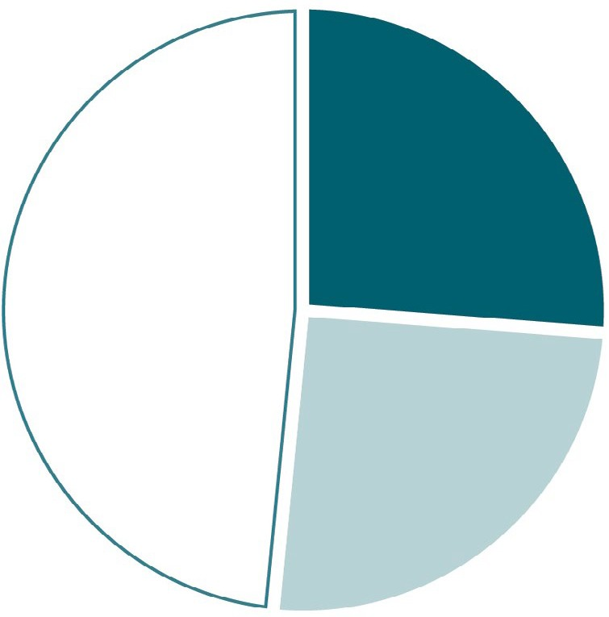
VIRAL HEPATITIS
SURVEILLANCE
Figure 2.7. Availability of information on risk behaviors/exposures* associated with reported cases of acute hepatitis B — United States, 2018
870
(26%)
1,609
(48%)
Risk identified*
No risk identified Risk data missing
843
(25%)
Source: CDC, Nationally Notifiable Diseases Surveillance System.
* Case reports with at least one of the following risk behaviors/ exposures reported 6 weeks to 6 months prior to symptom onset: 1) injection drug use; 2) multiple sex partners; 3) underwent surgery; 4) men who have sex with men; 5) sexual contact with suspected/confirmed hepatitis B case; 6) sustained a percutaneous injury; 7) household contact with suspected/confirmed hepatitis B case; 8) occupational exposure to blood; 9) dialysis; and 10) transfusion.

