Slide 1

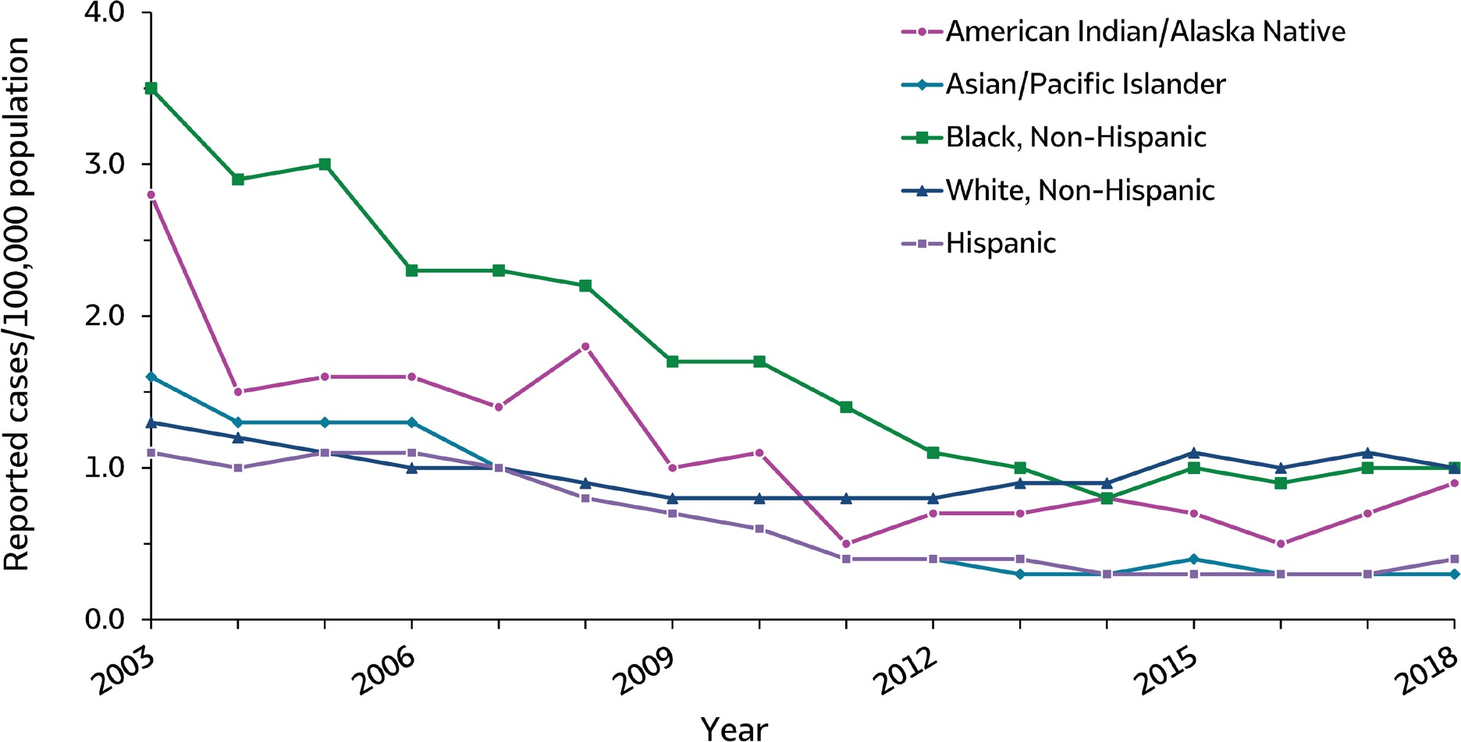
VIRAL HEPATITIS
SURVEILLANCE
Figure 2.6. Rates of reported acute hepatitis B, by race/ethnicity — United States, 2003–2018
Source: CDC, National Notifiable Diseases Surveillance System.

Slide 2
VIRAL HEPATITIS
SURVEILLANCE
Figure 2.6. Rates of reported acute hepatitis B, by race/ethnicity — United States, 2003–2018
Race/ Ethnicity | 2003 | 2004 | 2005 | 2006 | 2007 | 2008 | 2009 | 2010 | 2011 | 2012 | 2013 | 2014 | 2015 | 2016 | 2017 | 2018
American Indian/ Alaska Native | 2.8 | 1.5 | 1.6 | 1.6 | 1.4 | 1.8 | 1.0 | 1.1 | 0.5 | 0.7 | 0.7 | 0.8 | 0.7 | 0.5 | 0.7 | 0.9
Asian/Pacific Islander | 1.6 | 1.3 | 1.3 | 1.3 | 1.0 | 0.8 | 0.7 | 0.6 | 0.4 | 0.4 | 0.3 | 0.3 | 0.4 | 0.3 | 0.3 | 0.3
Black, Non-Hispanic | 3.5 | 2.9 | 3.0 | 2.3 | 2.3 | 2.2 | 1.7 | 1.7 | 1.4 | 1.1 | 1.0 | 0.8 | 1.0 | 0.9 | 1.0 | 1.0
White, Non-Hispanic | 1.3 | 1.2 | 1.1 | 1.0 | 1.0 | 0.9 | 0.8 | 0.8 | 0.8 | 0.8 | 0.9 | 0.9 | 1.1 | 1.0 | 1.1 | 1.0
Hispanic | 1.1 | 1.0 | 1.1 | 1.1 | 1.0 | 0.8 | 0.7 | 0.6 | 0.4 | 0.4 | 0.4 | 0.3 | 0.3 | 0.3 | 0.3 | 0.4
Source: CDC, National Notifiable Diseases Surveillance System.

