Slide 1

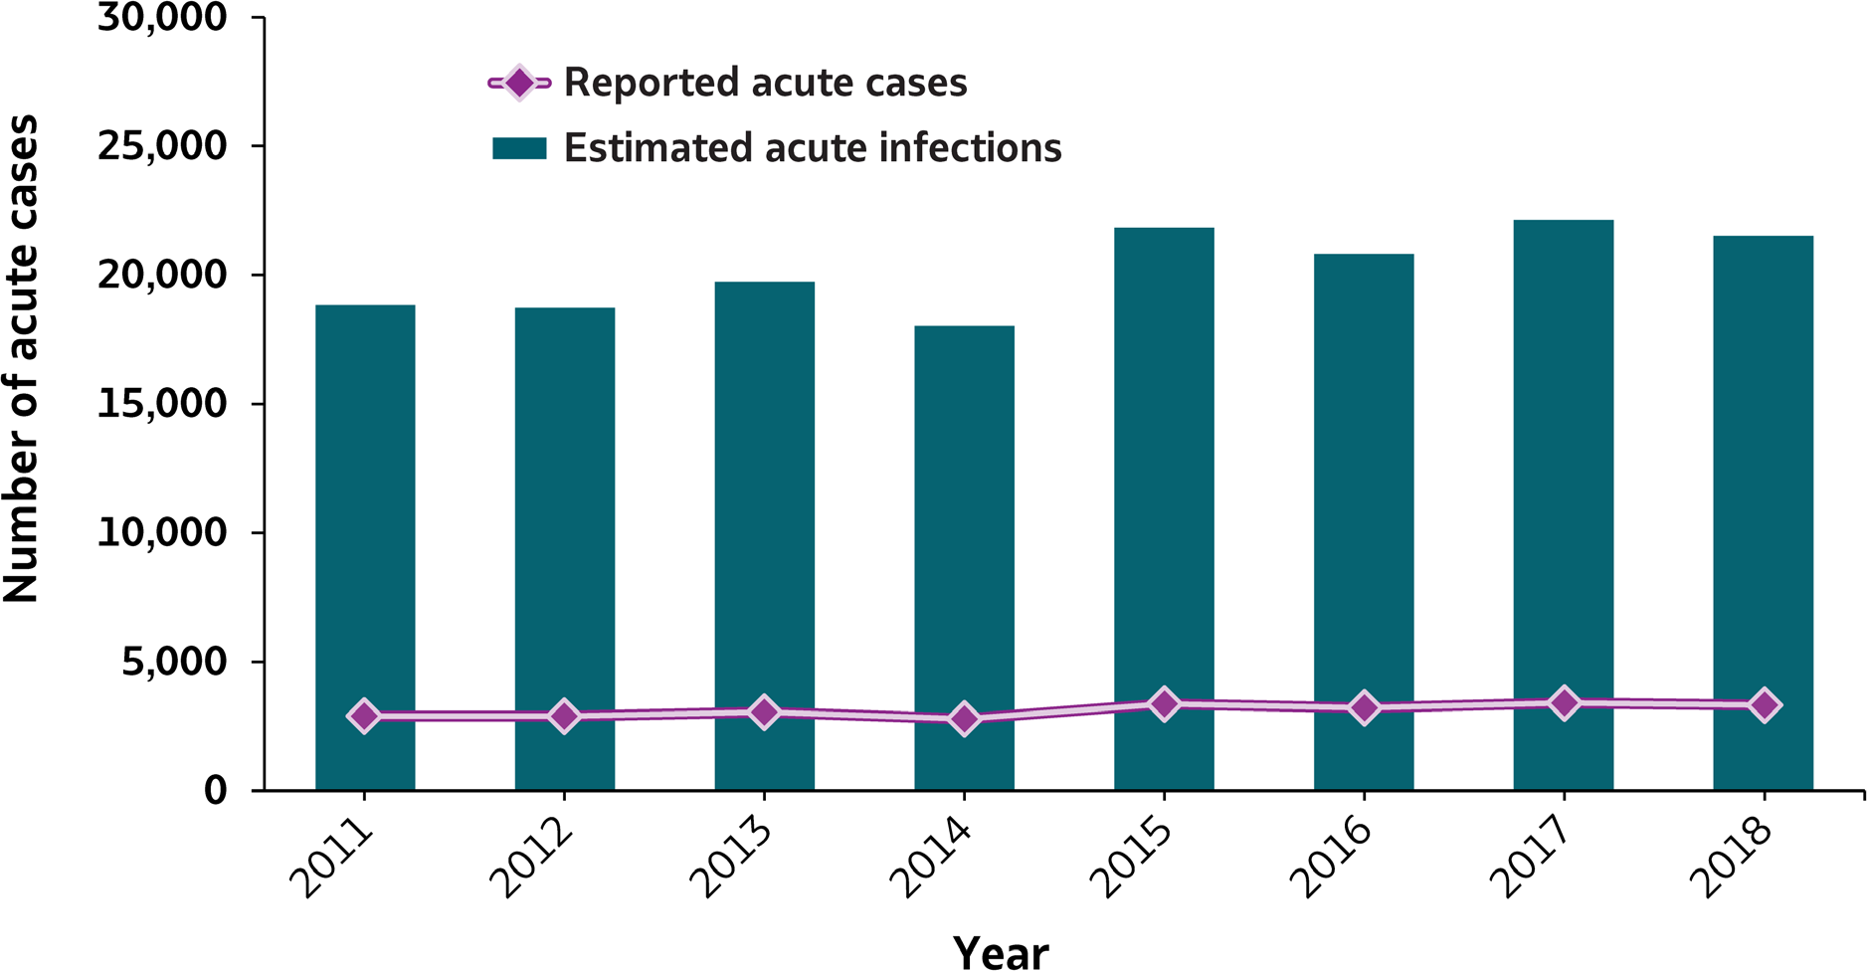
VIRAL HEPATITIS
SURVEILLANCE
Figure 2.1. Number of reported acute hepatitis B cases and estimated infections* — United States, 2011–2018
Source: CDC, National Notifiable Diseases Surveillance System
* The number of estimated viral hepatitis infections was determined by multiplying the number of reported cases by a factor that adjusted for under-ascertainment and under-reporting⁽⁷⁾. The 95% bootstrap confidence intervals for the estimated number of infections are shown in the Appendix.

Slide 2
VIRAL HEPATITIS
SURVEILLANCE
Figure 2.1. Number of reported acute hepatitis B cases and estimated infections* — United States, 2011–2018
Hepatitis B | 2011 | 2012 | 2013 | 2014 | 2015 | 2016 | 2017 | 2018
Reported cases | 2,903 | 2,895 | 3,050 | 2,791 | 3,370 | 3,218 | 3,409 | 3,322
Estimated cases | 18,900 | 18,800 | 19,800 | 18,100 | 21,900 | 20,900 | 22,200 | 21,600
Source: CDC, National Notifiable Diseases Surveillance System
* The number of estimated viral hepatitis infections was determined by multiplying the number of reported cases by a factor that adjusted for under-ascertainment and under-reporting⁽¹⁰⁾. The 95% bootstrap confidence intervals for the estimated number of infections are shown in the Appendix.

