Slide 1

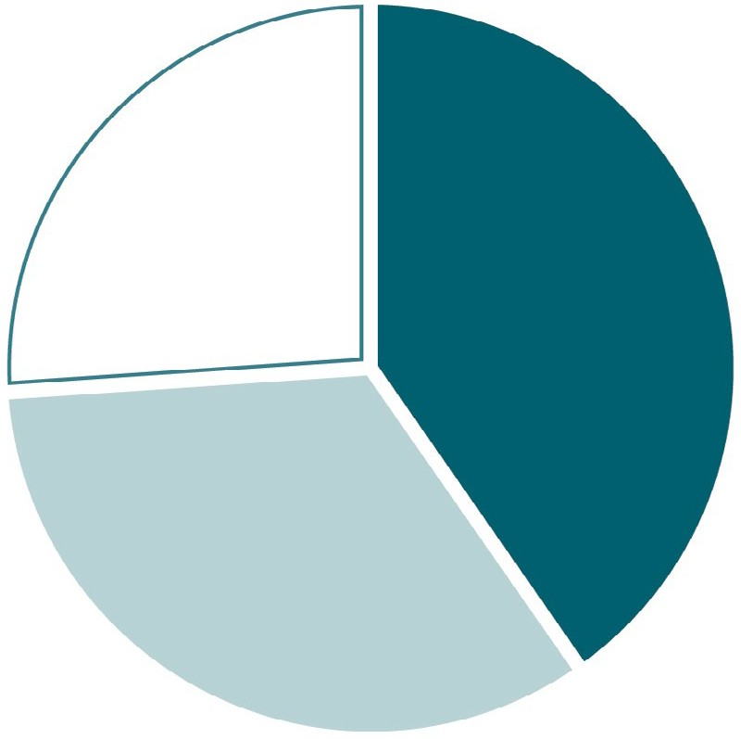
VIRAL HEPATITIS
SURVEILLANCE
Figure 1.7. Availability of information on risk behaviors/exposures* associated with reported cases of hepatitis A — United States, 2018
3,251
(26%)
5,026
(40%)
Risk identified*
No risk identified Risk data missing
4,197
(34%)

