Slide 1

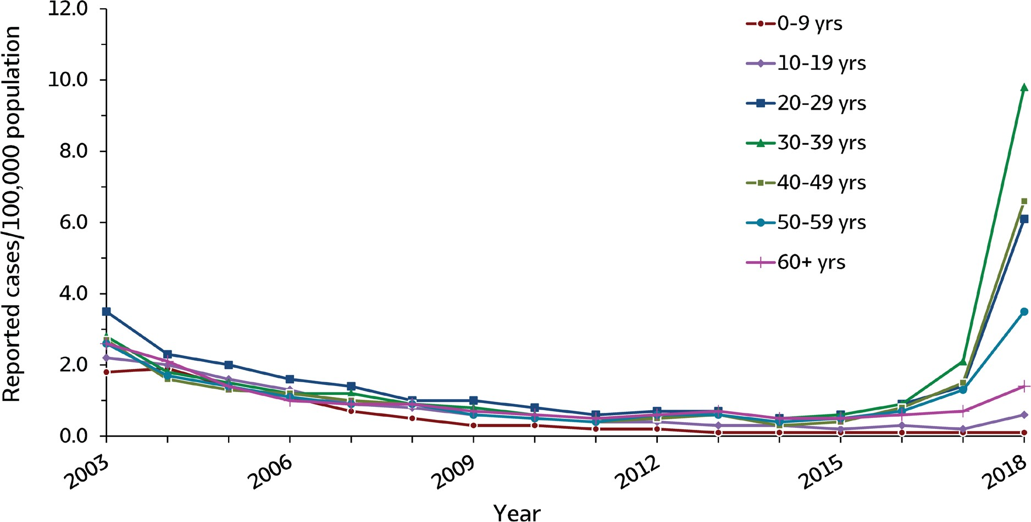
VIRAL HEPATITIS
SURVEILLANCE
Figure 1.4. Rates of reported hepatitis A, by age group — United States, 2003–2018
Source: CDC, National Notifiable Diseases Surveillance System.

Slide 2
VIRAL HEPATITIS
SURVEILLANCE
Figure 1.4. Rates of reported hepatitis A, by age group — United States, 2003–2018
Age (years) | 2003 | 2004 | 2005 | 2006 | 2007 | 2008 | 2009 | 2010 | 2011 | 2012 | 2013 | 2014 | 2015 | 2016 | 2017 | 2018
0-9 | 1.8 | 1.9 | 1.4 | 1.1 | 0.7 | 0.5 | 0.3 | 0.3 | 0.2 | 0.2 | 0.1 | 0.1 | 0.1 | 0.1 | 0.1 | 0.1
10-19 | 2.2 | 2.0 | 1.6 | 1.3 | 0.9 | 0.8 | 0.6 | 0.5 | 0.4 | 0.4 | 0.3 | 0.3 | 0.2 | 0.3 | 0.2 | 0.6
20-29 | 3.5 | 2.3 | 2.0 | 1.6 | 1.4 | 1.0 | 1.0 | 0.8 | 0.6 | 0.7 | 0.7 | 0.5 | 0.6 | 0.9 | 1.4 | 6.1
30-39 | 2.8 | 1.8 | 1.5 | 1.2 | 1.2 | 0.9 | 0.8 | 0.6 | 0.5 | 0.5 | 0.7 | 0.5 | 0.6 | 0.9 | 2.1 | 9.8
40-49 | 2.7 | 1.6 | 1.3 | 1.2 | 1.0 | 0.9 | 0.6 | 0.5 | 0.4 | 0.5 | 0.6 | 0.3 | 0.4 | 0.8 | 1.5 | 6.6
50-59 | 2.6 | 1.7 | 1.4 | 1.1 | 0.9 | 0.9 | 0.6 | 0.5 | 0.4 | 0.6 | 0.6 | 0.4 | 0.5 | 0.7 | 1.3 | 3.5
60+ | 2.6 | 2.1 | 1.4 | 1.0 | 0.9 | 0.9 | 0.7 | 0.6 | 0.5 | 0.6 | 0.7 | 0.5 | 0.5 | 0.6 | 0.7 | 1.4
Source: CDC, National Notifiable Diseases Surveillance System.

