Slide 1
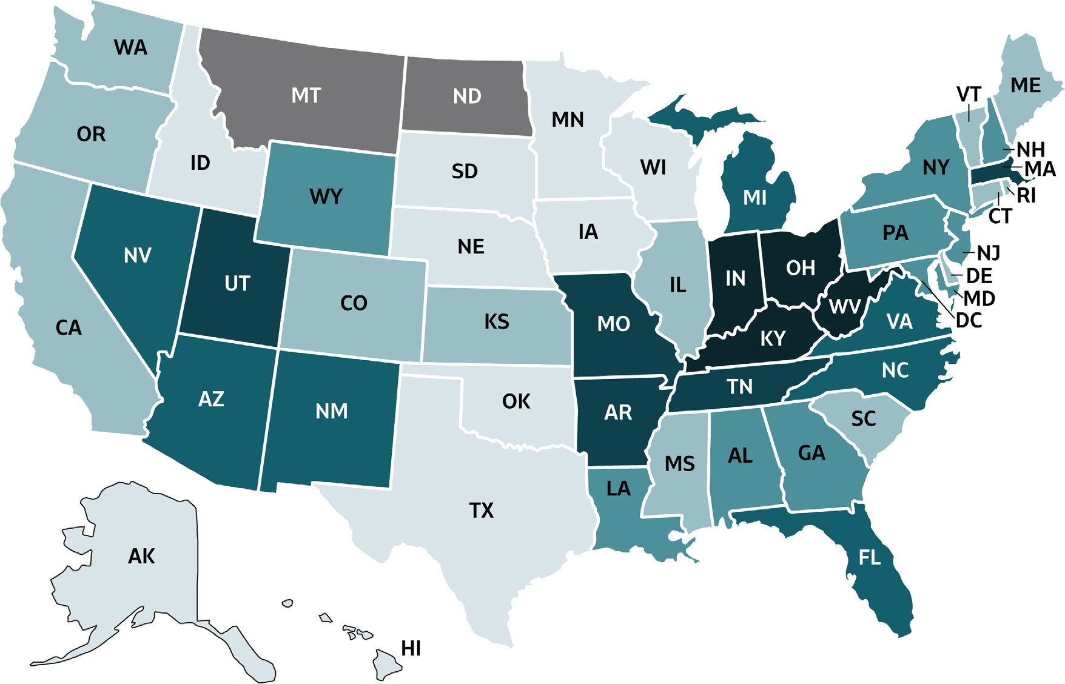
VIRAL HEPATITIS
SURVEILLANCE
Figure 1.3. Rates of reported hepatitis A, by state or jurisdiction — United States, 2018
https://wwwdev.cdc.gov/hepatitis/statistics/2018surveillance/index.htm

Slide 2
VIRAL HEPATITIS
SURVEILLANCE
Figure 1.3. Rates of reported hepatitis A, by state or jurisdiction — United States, 2018
Color Key | Cases/100,000 Population | States
 | 0-0.3 | AK, HI, ID, IA, MN, NE, OK, SD, TX, WI
 | >0.3-0.7 | CA, CO, CT, DE, IL, KS, ME, MS, OR, RI, SC, VT, WA
 | >0.7-0.9 | AL, GA, LA, MD, NH, NJ, NY, PA, WY
 | >0.9-3.9 | AZ, DC, FL, MI, NV, NM, NC, VA
 | >3.9-9.7 | AR, MA, MO, TN, UT
 | >9.7-124.4 | IN, KY, OH, WV
 | No reported cases | MT, ND
Source: CDC, National Notifiable Diseases Surveillance System.

