Slide 1

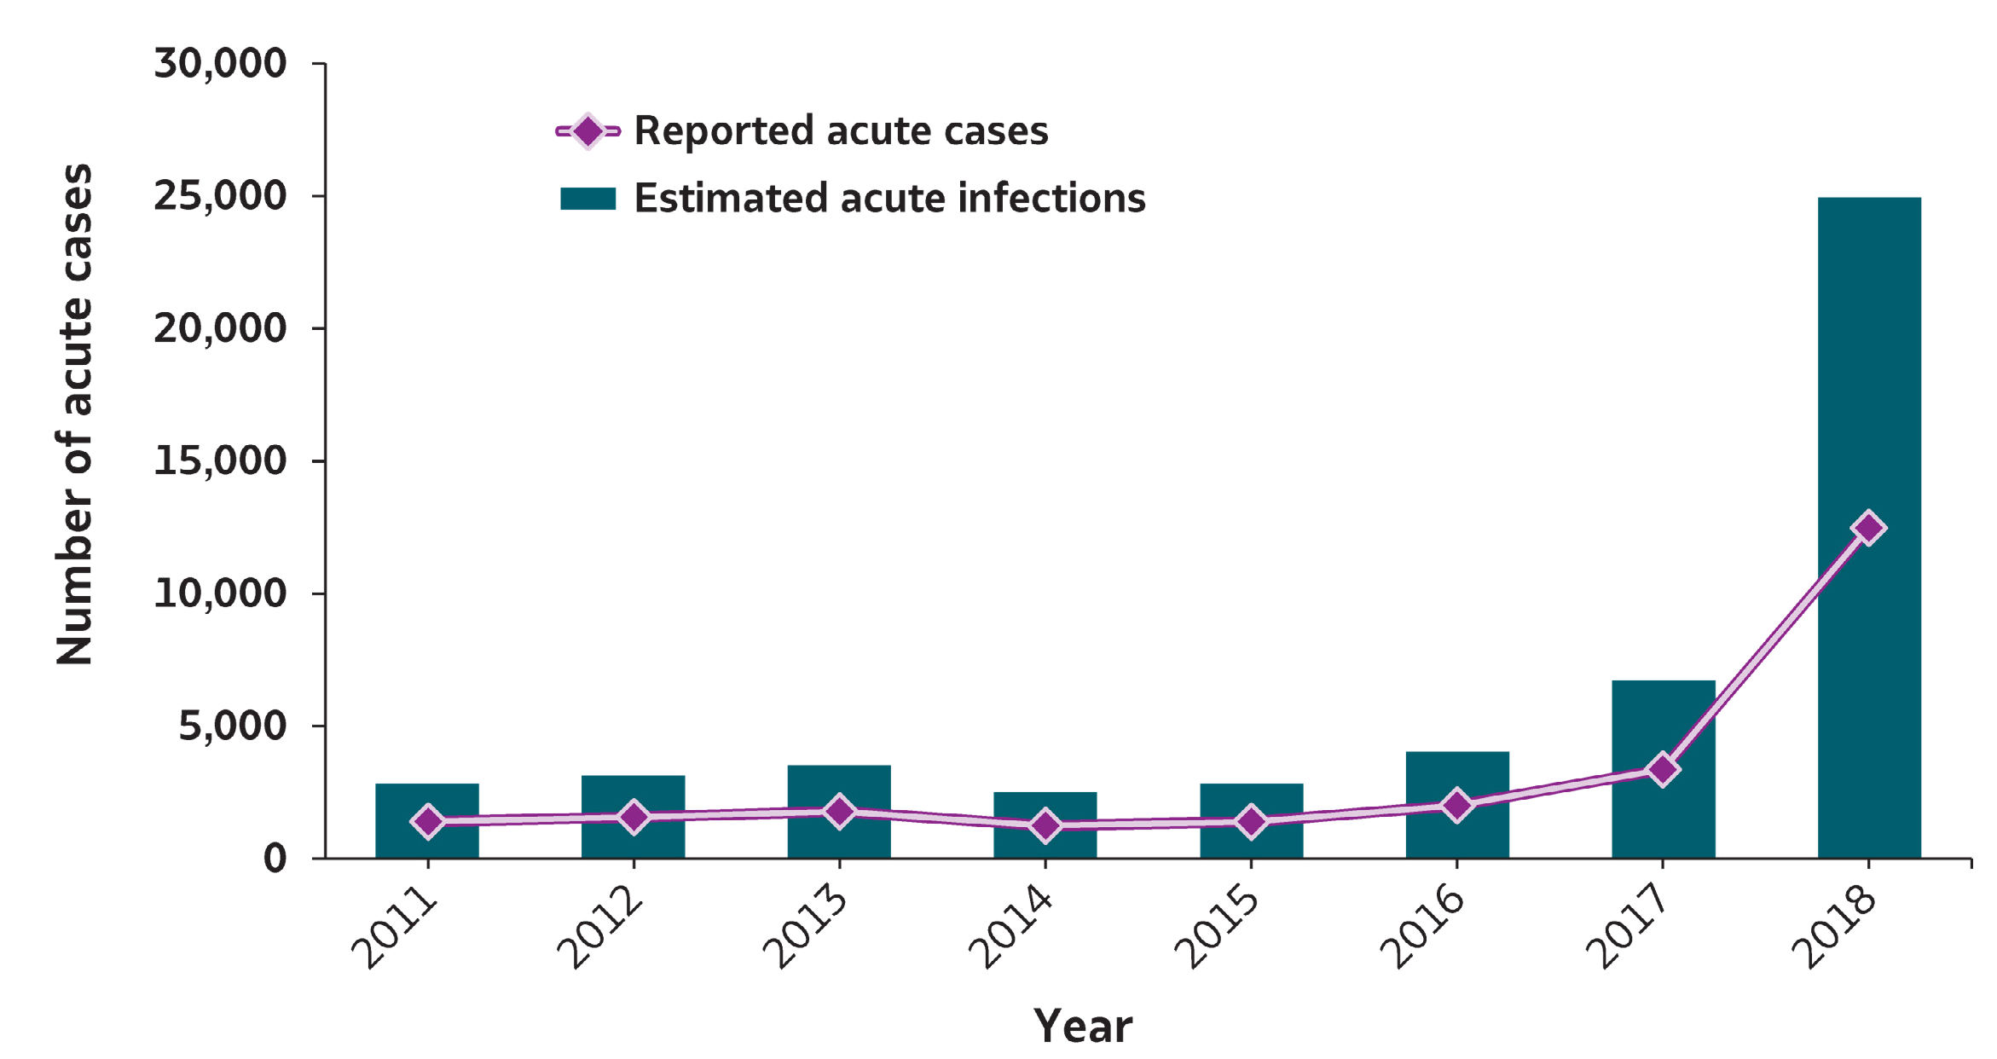
VIRAL HEPATITIS
SURVEILLANCE
Figure 1.1. Number of reported hepatitis A cases and estimated infections* — United States, 2011–2018
Source: CDC, National Notifiable Diseases Surveillance System
* The number of estimated viral hepatitis infections was determined by multiplying the number of reported cases by a factor that adjusted for under-ascertainment and under-reporting⁽¹⁰⁾. The 95% bootstrap confidence intervals for the estimated number of infections are shown in the Appendix.

Slide 2
VIRAL HEPATITIS
SURVEILLANCE
Figure 1.1. Number of reported hepatitis A cases and estimated infections* — United States, 2011–2018
Hepatitis A | 2011 | 2012 | 2013 | 2014 | 2015 | 2016 | 2017 | 2018
Reported cases | 1,398 | 1,562 | 1,781 | 1,239 | 1,390 | 2,007 | 3,366 | 12,474
Estimated cases | 2,800 | 3,100 | 3,500 | 2,500 | 2,800 | 4,000 | 6,700 | 24,900
Source: CDC, National Notifiable Diseases Surveillance System
* The number of estimated viral hepatitis infections was determined by multiplying the number of reported cases by a factor that adjusted for under-ascertainment and under-reporting⁽¹⁰⁾. The 95% bootstrap confidence intervals for the estimated number of infections are shown in the Appendix.

