Slide 1
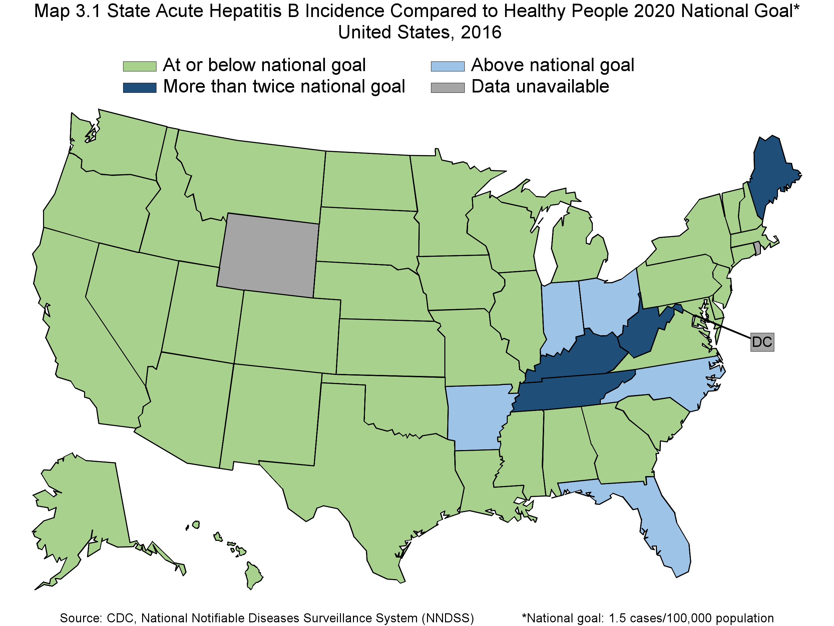
Notes:
Map 3.1 State Acute Hepatitis B Incidence Compared to Healthy People 2020 National Goal of 1.5 cases/100,000 population / United States, 2016.
Four categories: 1. At or below national goal. 2. Above national goal. 3. More than twice national goal. 4. Data Unavailable. Source: CDC, National Notifiable Diseases Surveillance System (NNDSS)

