Slide 1
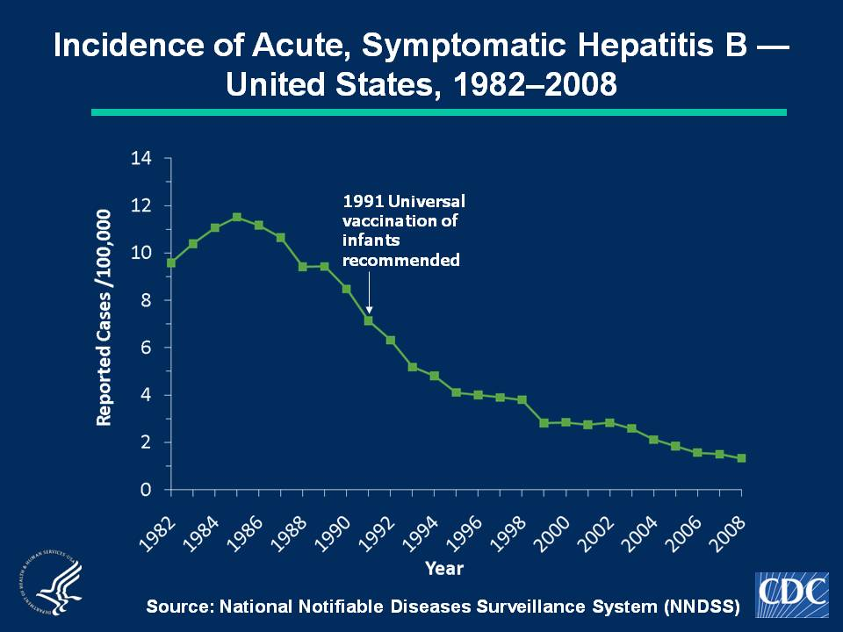
Notes:
Slide 1b - Incidence of Acute, Symptomatic Hepatitis B — United States, 1982–2008
Hepatitis B vaccine was licensed in 1981 and in 1991 a comprehensive strategy by the Advisory Committee on Immunization Practices (ACIP) was recommended for the elimination of hepatitis B virus transmission in the United States. In 2008, a total of 4,033 acute, symptomatic cases of hepatitis B were reported nationwide. The 2008 national incidence rate of 1.3 cases per 100,000 population was the lowest ever recorded.

Slide 2
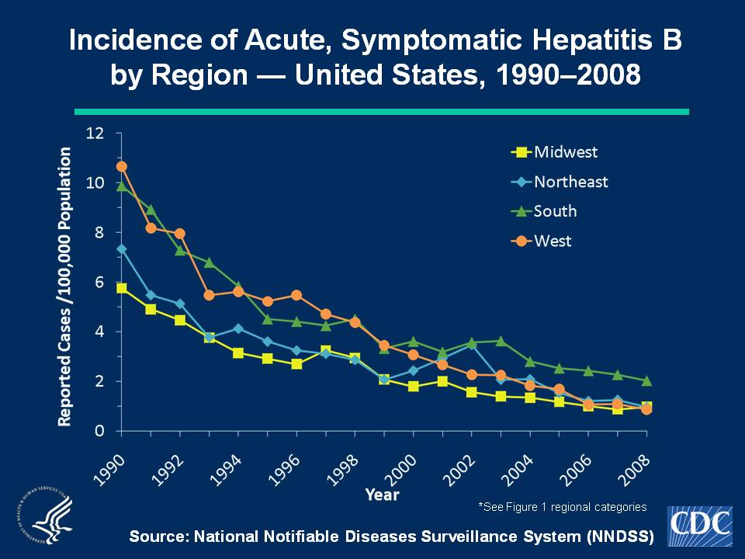
Notes:
Slide 2b - Incidence of Acute, Symptomatic Hepatitis B by Region — United States, 1990–2008
Hepatitis B rates have varied geographically. Higher rates were reported in the western and southern regions of the United States. During 2000-2008, rates in the South have been higher than in other regions of the United States.
The Midwest is comprised of the following states: Illinois, Indiana, Iowa, Kansas, Michigan, Minnesota, Missouri, Nebraska, North Dakota, Ohio, South Dakota, and Wisconsin. The Northeast is comprised of the following states: Connecticut, Maine, Massachusetts, New Hampshire, New Jersey, New York, Pennsylvania, Rhode Island, and Vermont. The South is comprised of the following states: Alabama, Arkansas, Delaware, District of Columbia, Florida, Georgia, Kentucky, Louisiana, Maryland, Mississippi, North Carolina, Oklahoma, South Carolina, Tennessee, Texas, Virginia, and West Virginia. The West is comprised of the following states: Alaska, Arizona, California, Colorado, Hawaii, Idaho, Montana, Nevada, New Mexico, Oregon, Utah, Washington, and Wyoming.

Slide 3
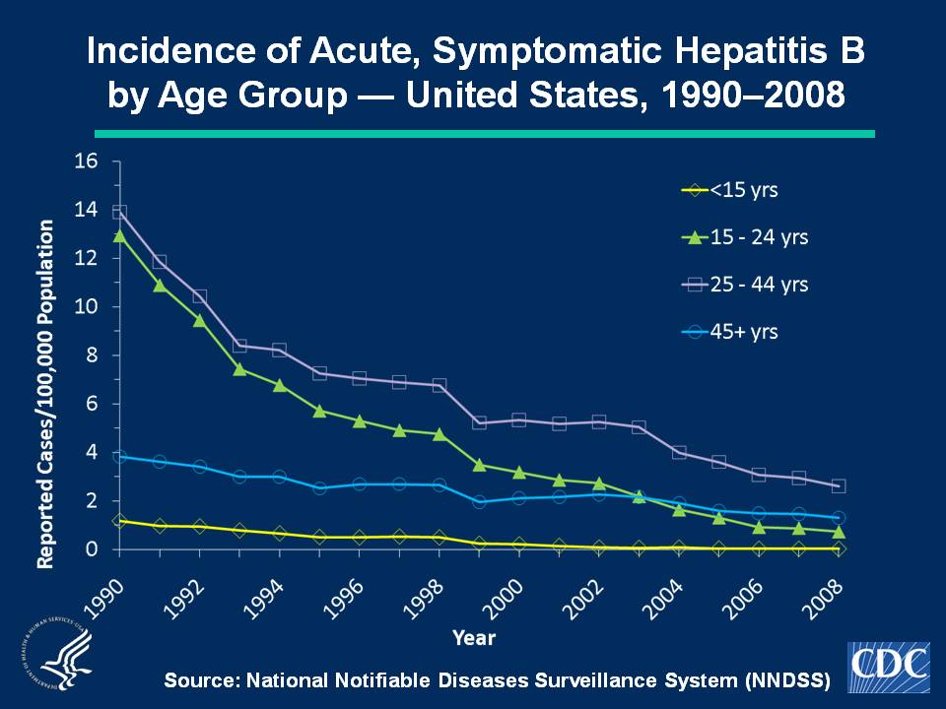
Notes:
Slide 3b - Incidence of Acute, Symptomatic Hepatitis B by Age Group — United States, 1990–2008
These data indicate acute, symptomatic hepatitis B rates have differed by age; the highest rates were observed among persons aged 15-44 years; the lowest rates were among persons aged < 15 years. In 2008, rates were highest for persons aged 25-44 years (2.6 cases per 100,000 population); the lowest rates were among children < 15 years (0.02 cases per 100,000 population).

Slide 4
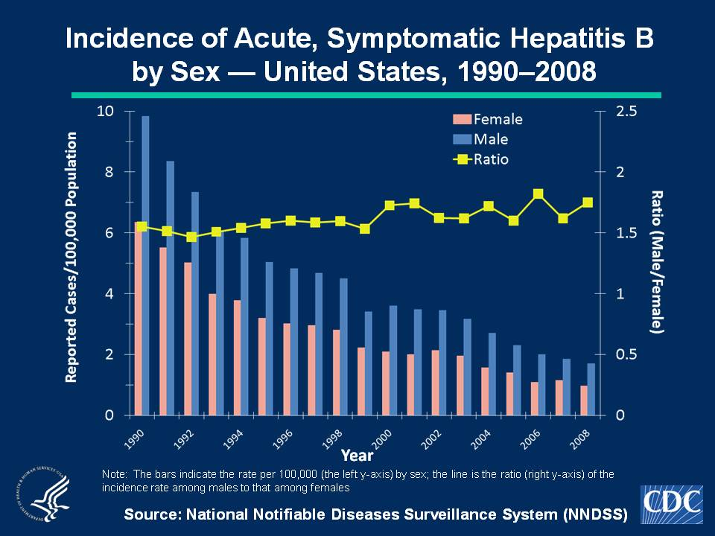
Notes:
Slide 4b - Hepatitis B by Sex — United States, 1990–2008
Over time, rates of acute, symptomatic hepatitis B have been higher among males than females. During 1990-2008, the male-to-female ratio of rates remained stable (1.5-1.8). In 2008, the rate for males was approximately 1.8 times higher than for females. In 2008, incidence among males was 1.7cases per 100,000 population, compared with 1.0 cases per 100,000 population among females.

Slide 5
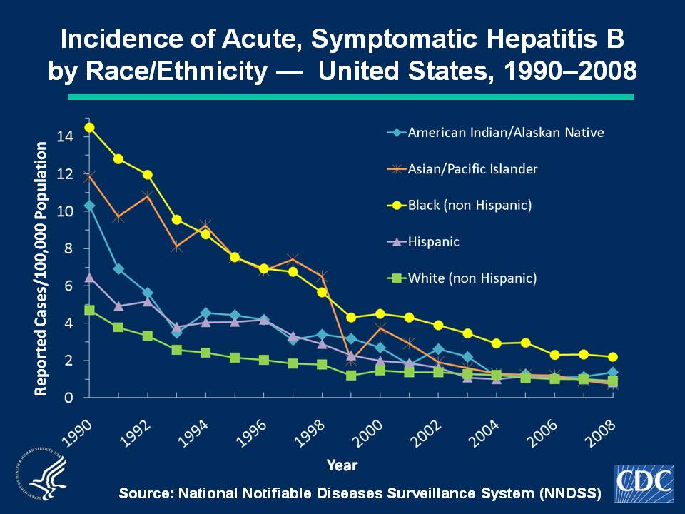
Notes:
Slide 5b - Incidence of Acute, Symptomatic Hepatitis B by Race/Ethnicity — United States, 1990–2008
Historically, acute, symptomatic hepatitis B rates have differed by race; the highest rates occurred among non-Hispanic blacks and Asian/Pacific Islanders (APIs). In 2008, the rate of acute, symptomatic hepatitis B was highest for non-Hispanic blacks (2.2 cases per 100,000 population). The downward trend among APIs continued, and the rate for this population in 2008 (0.7 cases per 100,000 population) was similar to that for Hispanics (0.8 cases per 100,000 population) and non-Hispanic whites (0.9 cases per 100,000 population).

