Slide 1
Healthy Kids. Successful Students.
Stronger Communities.
Improving Academic Achievement through
Healthy Eating and Physical Activity

Slide 2
Objectives
Describe the evidence supporting the link between healthy eating, physical activity, and improved academic achievement.
Identify key messages and benefits of addressing healthy eating and physical activity in schools to improve academic achievement and motivate stakeholders to take action.
Identify at least three actions that can be implemented by states, school districts, schools, parents, and/or students to support healthy eating and physical activity in schools and improve academic achievement.
Identify at least two resources that can be used to explain the relationship between healthy eating, physical activity, and academic achievement.
Notes:
NARRATIVE
The purpose of this presentation is to explain the evidence linking healthy eating, physical activity, and improved academic achievement. The purpose also is to explain how to use the evidence to engage stakeholders and get them to take action in supporting healthy eating and physical activity in schools.
Following the presentation, participants from state, territory, regional, or local education and health agencies or other stakeholders will be able to:
Describe the evidence supports the link between healthy eating, physical activity, and improved academic achievement.
Identify key messages and benefits of addressing healthy eating and physical activity in schools to improve academic achievement and motivate stakeholders to take action.
Identify at least three actions that can be implemented by states, school districts, schools, parents, and/or students to support healthy eating and physical activity in schools and improve academic achievement.
Identify at least two resources that can be used to explain the relationship between healthy eating, physical activity, and academic achievement.
Before we talk about the evidence, we will provide a rationale for health and education working together to ensure that students are healthy and ready to learn.

Slide 3

Health is Academic Because . . .
Helping young people stay healthy is a fundamental part of the mission of our schools
Health behaviors are associated with academic achievement
School health programs can help improve students’ academic achievement
Notes:
NARRATIVE
Schools are an ideal setting for students to learn about health and healthy behaviors. More than 95% of young people in the United States are in school for 13 critical years of their development.¹
Health is academic because…
Helping young people stay healthy is a fundamental part of the mission of our schools.
Health behaviors are associated with academic achievement.
School health programs can help improve students’ academic achievement.
Health behaviors clearly influence the quality of life for youth and their ability to contribute to and live productively in society.

Slide 4

“No matter how well teachers are prepared to teach, no matter what accountability measures are put in place, no matter what governing structures are established for schools, educational progress will be profoundly limited if students are not motivated and able to learn. Health related problems play a major role in limiting the motivation and ability to learn…”
~Charles Basch
http://www.equitycampaign.org/i/a/document/12557_equitymattersvol6_web03082010.pdf
Notes:
NARRATIVE
In the 2010 report, Healthier Students Are Better Learners: A Missing Link in School Reforms to Close the Achievement Gap.² This report articulates that educationally relevant health disparities, such as participation in and access to physical activity and eating breakfast, affect the educational opportunities and outcomes of students.
In the report, Charles Basch clearly states that “No matter how well teachers are prepared to teach, no matter what accountability measures are put in place, no matter what governing structures are established for schools, educational progress will be profoundly limited if students are not motivated and able to learn. Health related problems play a major role in limiting the motivation and ability to learn…”
While schools cannot address all of the conditions that cause educational or health disparities, there are evidence-based and promising approaches that can be applied to address the health issues of students and ensure they are able to learn and be successful.

Slide 5
Healthy Eating and Academic Achievement
Dietary Behavior/Issue | Related Academic Achievement Outcomes
Participation in the School Breakfast Program (SBP) | Increased academic grades and standardized test scores Reduced absenteeism Improved cognitive performance
Skipping breakfast | Decreased cognitive performance
Lack of adequate consumption of specific foods | Lower grades
Deficits in specific nutrients | Lower grades Higher rates of absenteeism and tardiness
Insufficient food intake | Lower grades Higher rates of absenteeism Repeating a grade Inability to focus
Notes:
NARRATIVE
Evidence has shown that specific dietary practices and issues are related to different aspects of academic achievement. Specifically:
Student participation in the USDA School Breakfast Program (SBP) is associated with increased academic grades and standardized test scores, reduced absenteeism, and improved cognitive function (e.g., memory).⁷⁻¹⁴
Skipping breakfast is associated with decreased cognitive performance (e.g., alertness, attention, memory, processing of complex visual display, and problem solving) among students.^{10,11,13,15-20}
Lack of adequate consumption of specific foods, such as fruits, vegetables, or dairy products, is associated with lower grades among students.²¹⁻²³
Deficits of specific nutrients (i.e., vitamins A, B6, B12, C, folate, iron, zinc, and calcium) are associated with lower grades and higher rates of absenteeism and tardiness among students.^{3,7,12}
Hunger due to insufficient food intake is associated with lower grades, higher rates of absenteeism, repeating a grade, and an inability to focus among students.^{7,12,22-26}
CDC and many national organizations recommend establishing a healthy school nutrition environment to support both student health and learning. A healthy school nutrition environment includes:
access to healthy and appealing foods and beverages available to students in school meals, vending machines, school stores, à la carte lines in the cafeteria, fundraisers, and classroom parties;
consistent messages about food and healthy eating across the school environment and school curricula; and
opportunities for students to learn about healthy eating through health education.²⁷

Slide 6

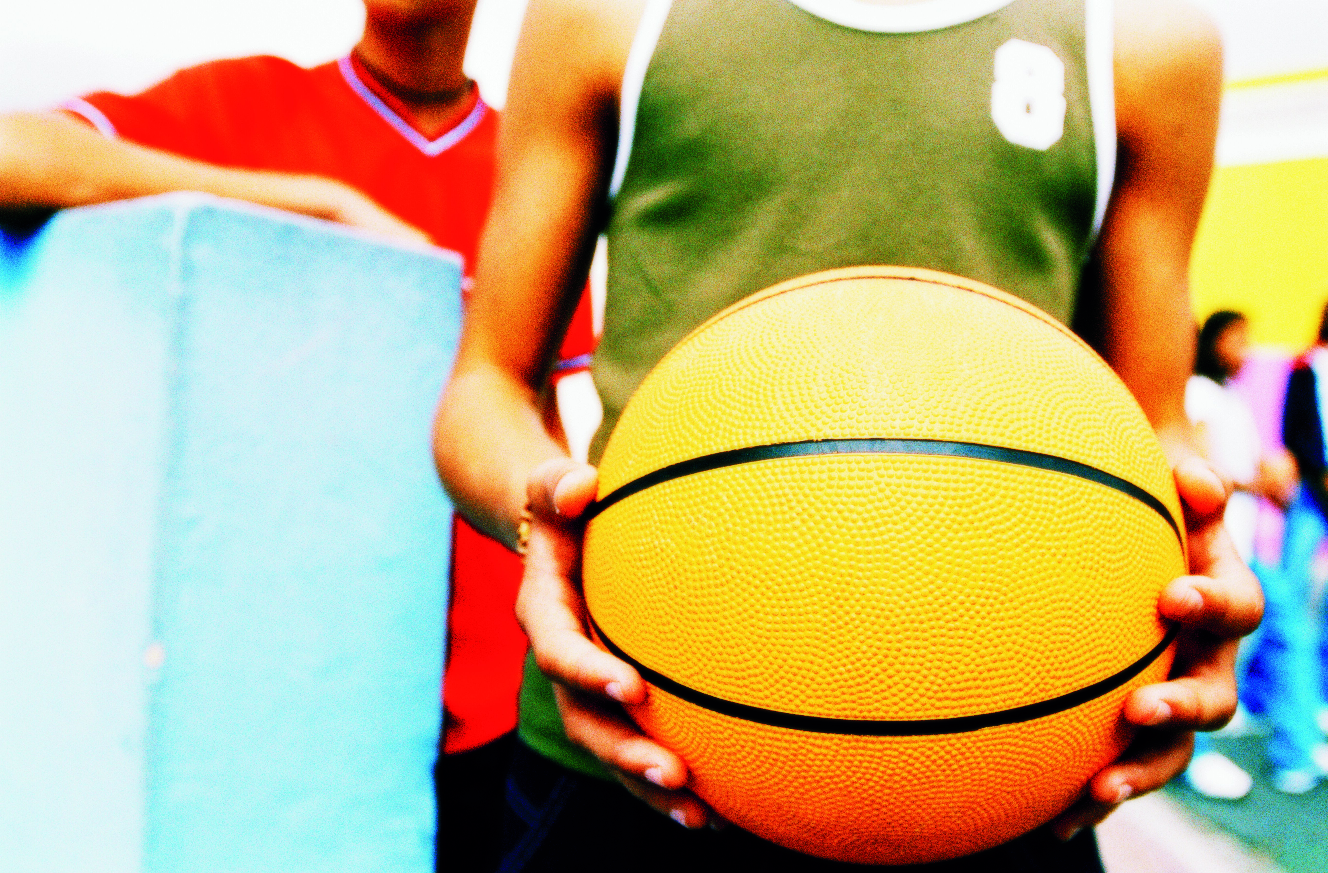
Success in School is
More Than Just Academics
Schools must also consider other factors that affect
academic achievement:
  Healthy Food
  Options
  Opportunities To Be
  Physically Active
  Healthy Food
  Options
Notes:
NARRATIVE
It boils down to the fact that students’ success in schools is more than just academics. Evidence indicates that education and health for students must go hand-in-hand in order for students to succeed.^{2,3} In addition to making sure students are learning, there are school health policies and practices that affect academic achievement that need to be in place such as offering healthy food options and providing opportunities for students to be physically active.

Slide 7
EVIDENCE |  | MESSAGE |  | ACTION
 |  | Know the Core Messages AND The Audience-Specific Messages |  | Be Ready to Share with Key Stakeholders How They Can Take Action
Healthy Eating
Academic Achievement
Physical Activity
Notes:
NARRATIVE
Based on available evidence and purpose of this presentation, the remaining slides will focus on healthy eating and physical activity as they relate to academic achievement. Specifically, we will discuss:
The evidence you should know about the link between healthy eating, physical activity, and improved academic achievement. While we are focusing on this direct link between healthy eating and academic achievement and physical activity and academic achievement, there could be other factors (e.g., positive peer relationships and support) that could affect these relationships,^{4,5} although these will not be discussed in this presentation.
Then we will discuss what core and audience-specific messages should be shared with key stakeholders about the importance of addressing student health to improve academic achievement.
And hopefully, knowing the evidence and sharing these messages will motivate key stakeholders to take action. We will identify actions that each key stakeholder could implement to support healthy eating and physical activity in schools to promote positive academic achievement.

Slide 8
KNOW THE EVIDENCE
Notes:
NARRATIVE
The first step in making the case for addressing healthy eating and physical activity in schools is to know the evidence that supports the link between these behaviors and academic achievement.

Slide 9

Academic Achievement
Academic performance
  Class grades
  Standardized tests
  Graduation rates
Education behavior
  Attendance
  Drop out rates
  Behavioral problems at school
Students’ cognitive skills and attitudes
  Concentration
  Memory
  Mood
Notes:
NARRATIVE
Let’s first define academic achievement. There are three aspects of academic achievement — academic performance, education behavior, and students’ cognitive skills and attitudes.⁶
As shown on the slide,
academic performance includes class grades, standardized tests, and graduation rates;
education behavior includes attendance, dropout rates, and behavioral problems at schools;
and finally, students’ cognitive skills and attitudes include concentration, memory, and mood.

Slide 10
Percentage of High School Students Who Drank a Can, Bottle, or Glass of Soda or Pop at Least One Time Per Day,* by Type of
Grades Earned (Mostly A’s, B’s, C’s or D’s/F’s), 2009**
*Drank a can, bottle, or glass of soda or pop (not including diet soda or diet pop) at least one time per day during the 7 days before the survey.
**p<.0001 after controlling for sex, race/ethnicity, and grade level.
United States, Youth Risk Behavior Survey, 2009, http://www.cdc.gov/healthyyouth/health_and_academics/data.htm
Notes:
NARRATIVE
Data from the 2009 Youth Risk Behavior Survey indicate that 22% of high school students with mostly A’s drank a can, bottle, or glass of soda or pop (not including diet soda or diet pop) at least one time per day, and 47% of high school students with mostly D’s/F’s drank a can, bottle, or glass of soda or pop (not including diet soda or diet pop) at least one time per day during the 7 days before the survey.²⁸ In other words, of the students who drank soda pop at least once a day, more earned D’s/F’s than A’s. In other words, of the students who drank soda pop at least once a day, more earned D’s/F’s than A’s.
These kinds of associations do not prove causation. Further research is needed to determine whether low grades lead to health-risk behaviors, health-risk behaviors lead to low grades, or some other factors lead to both of these problems.
Notes to Facilitator:
Participants might question why the percentages for each of the health risk behaviors do not add up to 100%. This is because each bar shows the percentage of students getting that academic grade who engage in that behavior. For example, 22% of students getting mostly A’s drank a can, bottle, or glass of soda or pop (not including diet soda or diet pop) — 78% of students getting mostly A’s did not. Among students getting mostly D’s or F’s, 47% drank a can, bottle, or glass of soda or pop (not including diet soda or diet pop) — and 53% did not.
A total of 16,410 students responded to the 2009 national YRBS with valid data; of those, 14,362 (88%) responded to the academic performance question. The proportion of students responding to each category of academic performance was: 32.1% (29.6-34.7) received mostly A’s, 41.7% (39.7-43.7) received mostly B’s, 20.1% (18.1-22.2) received mostly C’s, and 6.2% (5.2-7.2) received mostly D’s & F’s.
The survey question about students’ academic grades is included periodically in the National YRBS and was asked most recently in 2009. Therefore, these analyses represent the most current data available.

Slide 11
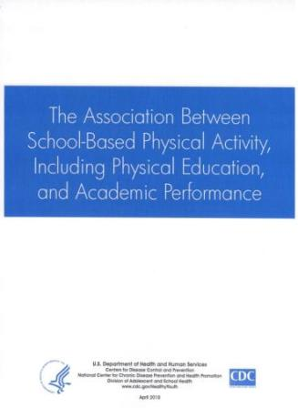
Physical Activity
Physical education
Recess
Classroom-based
Extracurricular
Results
School-based physical activity can:
Help improve academic performance.
Have a positive impact on education behaviors and cognitive skills.
www.cdc.gov/HealthyYouth/health_ and_academics/pdf/pa-pe_paper.pdf
Notes:
NARRATIVE
In 2010, CDC released a report on The Association Between School-Based Physical Activity, Including Physical Education and Academic Performance.⁶ This report examined how different physical activity contexts in schools, including physical education, recess, classroom-based activity, and extracurricular activities are associated with a variety of academic outcomes.
First, an important result from this report is that increasing or maintaining time for PE does not appear to adversely impact academic achievement (e.g., grades, test scores).
There also was substantial evidence that school-based physical activity can:
Help improve academic performance (including grades and standardized test scores); and
Have a positive impact on education behaviors and cognitive skills.

Slide 12
Physical Activity and
Academic Achievement
Physical Activity Practice | Related Academic Achievement Outcomes
Students who are physically active | Have better grades, better school attendance, and better classroom behaviors
Increased physical activity and physical fitness levels | Improved cognitive performance
Increased participation in physical education class | Better grades, standardized test scores, and classroom behavior
Time spent in recess | Improved cognitive performance and classroom behaviors
Participation in brief classroom physical activity breaks | Improved cognitive performance, classroom behaviors, and education outcomes
Participation in extracurricular physical activities | Higher GPAs, lower drop-out rates, and fewer disciplinary problems
Notes:
NARRATIVE
Taking a closer look at the evidence, specific physical activity practices are linked to different aspects of academic achievement.
Students who are physically active tend to have better grades, school attendance, cognitive performance (e.g., memory), and classroom behaviors (e.g., on-task behavior).²⁸⁻³⁴
Higher physical activity and physical fitness levels are associated with improved cognitive performance (e.g., concentration and memory) among students.³⁴⁻³⁹
More participation in physical education class has been associated with better grades, standardized test scores, and classroom behavior (e.g., on-task behavior) among students.⁴⁰⁻⁴³
Time spent in recess has been shown to positively affect students’ cognitive performance (e.g., attention, concentration) and classroom behaviors (e.g., not misbehaving).⁴⁴⁻⁴⁸
Brief classroom physical activity breaks (i.e., 5-10 minutes) are associated with improved cognitive performance (e.g., attention and concentration), classroom behavior (e.g., on-task behavior), and educational outcomes (e.g., standardized test scores, reading literacy scores, math fluency scores) among students.^{32,49-54}
Participation in extracurricular physical activities such as interscholastic sports has been associated with higher GPAs, lower drop-out rates, and fewer disciplinary problems among students.⁵⁵⁻⁶⁷
CDC and many national organizations recommend a comprehensive, school-wide approach to physical activity that provides opportunities for students to be physically active throughout the school day and after school.⁶⁸ This comprehensive approach provides a variety of physical activities to help all students attain at least 60 minutes of physical activity each day.⁶⁸
Note to Facilitator:
For this presentation, the term physical activity includes physical education. Physical activity is any bodily movement that is produced by skeletal muscle and that substantially increase energy expenditure; whereas physical education provides students with the knowledge and skills necessary to perform a variety of physical activities, maintain physical fitness, and to value and enjoy physical activity as part of a healthy lifestyle. Physical education includes curriculum, instruction, and assessment that is sequential from pre-kindergarten through high school.

Slide 13
Percentage of High School Students Who Did Not Play on at
Least One Sports Team,* by Type of Grades Earned
(Mostly A’s, B’s, C’s or D’s/F’s), 2009**
*Run by their school or community groups during the 12 months before the survey.
**p<.0001 after controlling for sex, race/ethnicity, and grade level.
United States, Youth Risk Behavior Survey, 2009, http://www.cdc.gov/healthyyouth/health_and_academics/data.htm
Notes:
NARRATIVE
Data from the 2009 Youth Risk Behavior Survey indicate that 33% of high school students with mostly A’s did not play on at least one sports team run by their school or community groups, and 60% of high school students with mostly D’s/F’s did not play on at least one sports team run by their school or community groups during the 12 months before the survey.²⁸
This supports other evidence showing that student involvement in extracurricular activities such as playing on a sports team is linked to better grades.
These kinds of associations do not prove causation. Further research is needed to determine whether low grades lead to health-risk behaviors, health-risk behaviors lead to low grades, or some other factors lead to both of these problems.
Notes to Facilitator:
Participants might question why the percentages for each of the health risk behaviors do not add up to 100%. This is because each bar shows the percentage of students getting that academic grade who engage in that behavior. For example, 33% of students getting mostly A’s did not play on at least one sports team — 67% of students getting mostly A’s did play on at least one sports team. Among students getting mostly D’s or F’s, 60% did not play on at least one sports team — and 40% did.
A total of 16,410 students responded to the 2009 national YRBS with valid data; of those, 14,362 (88%) responded to the academic performance question. The proportion of students responding to each category of academic performance was: 32.1% (29.6-34.7) received mostly A’s, 41.7% (39.7-43.7) received mostly B’s, 20.1% (18.1-22.2) received mostly C’s, and 6.2% (5.2-7.2) received mostly D’s & F’s.
The survey question about students’ academic grades is included periodically in the National YRBS and was asked most recently in 2009. Therefore, these analyses represent the most current data available.

Slide 14
SHARE THE MESSAGE
Notes:
NARRATIVE
Now that you know the evidence, the next step is to use it to support messages you share with your audience—this could be someone from the state, school district, or school as well as parents and students. You also want to share with these different audiences how it benefits them to address healthy eating and physical activity in schools.

Slide 15

Core Messages
Healthy students are better learners
Schools can influence eating and physical
activity behaviors
Healthy, successful students help build
strong communities.
All students deserve the opportunity to be healthy and successful
Notes:
NARRATIVE
First, we will review core messages. These are broad messages that state the importance of healthy students and link to academic achievement. They connect to common values in our communities.
These core messages can be incorporated in all communication (e.g., conversations, PowerPoints, webinars, meetings, presentations, web content, emails, newsletters, print documents) to support state, school district, and/or school strategies for healthy eating and physical activity.
Here are four core messages that should be consistently shared:
Healthy students are better learners
Healthy students are better on all levels of academic achievement: academic performance, education behavior, and cognitive skills and attitudes.
Schools can influence eating and physical activity behaviors
Students spend much of their time at school, and may eat as many as 2 out of 3 meals per day and may get much of their physical activity at school.
Healthy, successful students help build strong communities.
Investing in the health of students contributes to healthy communities in the future.
All students deserve the opportunity to be healthy and successful
Providing access to healthy foods and physical activity plays an important role in the academic achievement of students.

Slide 16
Audience-specific Messages
Audience | Benefits to the Audience
States | Help reduce barriers to learning More likely to have higher levels of education Contributes to a better prepared workforce
School Districts | Increased attendance rates Increased graduation rates Higher district-wide test scores and grades
Schools | Meet educational goals Decreased rates of student absenteeism Fewer behavioral problems Higher school-wide test scores and grades
Parents | Opportunities for your child to practice healthy behaviors Help your child become better learners
Students | Feel better Increase their concentration Have better grades and test scores
Notes:
NARRATIVE
In addition to the core messages, it is important to have and disseminate audience-specific messages that explain how they can benefit if they support healthy eating and physical activity in schools. This table identifies the specific benefits for each audience. For example, schools that are addressing healthy eating and physical activity should have decreased rates of student absenteeism, fewer behavioral problems, and higher school-wide test scores and grades. This is important to both schools and school districts.
The audience-specific message should also resonate with the audience’s core values. For example, when talking with schools, you might want to mention that promoting the healthy eating and physical activity of staff and students helps schools to meet their educational goals and enables students to become better learners. When talking with school districts, you might want to say that schools are an important part of the community and the place where all students can have a healthy start.
These audience-specific messages should be added to the core messages when communicating to specific stakeholder audiences (e.g., conversation, PowerPoints, webinars, meetings, presentations, web content, emails, newsletters, and print documents) to support state, school district, and/or school strategies for healthy eating and physical activity. For example, if you were talking with someone in a school, you might say to them providing students with healthy foods and opportunities to be physically active throughout the school day help them to be healthier and better learners. This could also help decrease your schools’ rates of student absenteeism and help increase school-wide test scores and grades.
Note to Facilitator:
You can go through the benefits for each audience or highlight a few of them as mentioned in the narrative.
You might want to note that schools and school districts have diverse staff including administrators (district directors, program coordinators, administrators, and school principals), instructional staff (teachers, paraeducators, physical education specialists, and special education staff), and other personnel (coaches, school nurses, health assistants, counselors, before- and after-school staff, and school resource officers) all of whom can share the message.

Slide 17
Share the Message
Consistently share the evidence, key messages, and benefits with key stakeholders
Include this topic in professional development for district and school staff
Ask parents to support and promote the healthy eating and physical activity as a way to improve academic achievement
Use meaningful success stories that support healthy eating and physical activity as a way to improve academic achievement
Notes:
NARRATIVE
Addressing healthy eating and physical activity in schools matters. The goal is for stakeholders to take action, but to get them to this point, we need to make a strong case for why they need to be involved. This is done by getting them to understand the link between health and academics and sharing the core and audience-specific messages that are relevant to them.
Here are some ways to share the message:
Consistently share the evidence, key messages, and benefits with key stakeholders — this can be done in conversation, PowerPoints, webinars, meetings, presentations, web content, emails, newsletters, and print documents. This also can be shared at any meeting that addresses the academic success of students.
Include this topic in professional development — many school administrators and classroom teachers have not learned about the evidence or benefits of addressing healthy eating and physical activity in schools. This would be opportunity to not only share with the evidence and messages but also to ask them to take action.
Ask parents to support and promote the healthy eating and physical activity as a way to improve academic achievement — parents are great advocates and could create awareness among other parents of the importance of healthy school nutrition environments and opportunities for physical activity as a way to improve academic achievement.
Use meaningful stories that support this link — many schools have implemented healthy eating and physical activity policies and practices that have made a difference in their students’ academic achievement outcomes. Identifying and sharing these stories should garner support in the school community to address these health behaviors and issues in school.

Slide 18
Remember . . .
It is our responsibility to share the evidence and important link between healthy eating, physical activity, and improved academic achievement with state and local policy makers, state and local school boards, key community organizations, parents, and anyone else interested in equipping children to be healthy and successful in school.

Slide 19
TAKE ACTION
Notes:
NARRATIVE
The goal of knowing the evidence and sharing the core and audience-specific messages is to get folks to take action. The next few slides highlight key actions that states, school districts, schools, parents, and students can take to support strategies for addressing healthy eating and physical activity in schools.

Slide 20

Who Can Take Action?
States
Schools Districts
Schools
Parents
Students
Notes:
NARRATIVE
Who can take action? States, school districts, schools, parents, and students can all play a role in making sure that health is addressed in schools.
Note to Facilitator:
You might want to note that schools and school districts have diverse staff including administrators (district directors, program coordinators, administrators, and school principals), instructional staff (teachers, paraeducators, physical education specialists, and special education staff), and other personnel (coaches, school nurses, health assistants, counselors, before- and after-school staff, and school resource officers) all of whom can be involved and take action.

Slide 21
Take Action
Establish an agenda to support health in schools
Develop and implement key policies
Provide appropriate guidance, technical assistance, and professional development
Implement effective, high-quality programs
and practices
Ensure accountability
Notes:
NARRATIVE
The purpose of making the link between healthy eating, physical activity, and improved academic achievement is to implement sustainable changes to policies, practices, and programs. That is, use the message that healthy students do better in school as a strategy to gain support for addressing healthy eating and physical activity in schools.
There are several types of actions that can be implemented or supported. These actions include:
Establishing an agenda to support health in schools.
Developing and implementing key policies for school health, particularly related to healthy eating and physical activity.
Providing appropriate guidance, technical assistance, and professional development for health-related topics such as healthy eating and physical activity.
Implementing effective, high-quality programs and practices.
Ensuring accountability supported by data and software systems.
Currently, CDC funds all 50 states through the State Public Health Actions program to provide support for policy development, technical assistance, professional development, and programs and practices related to healthy eating and physical activity.

Slide 22
Examples of Actions
State
  Create a partnership between departments of health and education to support the connection between health and academic achievement
  Provide professional development and technical assistance to school districts and schools on healthy school nutrition environments and a comprehensive approach to physical activity in schools
School Districts
  Establish, implement, and monitor local school wellness policies
  Collect data on health and educational behaviors and outcomes to assess the benefits of school health policies and practices
Notes:
NARRATIVE
Here are some examples of actions that can be taken by states:
Create a partnership between departments of health and education as well as with other key stakeholders to support the connection between health and academic achievement at a national level.
Provide professional development and technical assistance to school districts and schools on healthy school nutrition environments and a comprehensive approach to physical activity in schools, which includes quality physical education programs, physical activity before and after school (e.g., walking and biking to school program); physical activity during school (e.g., recess, physical activity breaks in and outside the classroom); school employee wellness programs; and parent and community engagement. This will ensure that school districts and schools are using evidence-based practices.
Here are some examples of actions that can be taken by school districts:
Establish, implement, and monitor local school wellness policies that support healthy school nutrition environments and a comprehensive approach to physical activity in schools.
Collect data on health and educational behaviors and outcomes to assess the benefits of school health (e.g., nutrition, physical activity, and chronic disease management) policies and practices. This will help school districts identify what is being done well and areas for improvement.
Notes to Facilitator:
Depending on who the audience is, you might want to tailor the actions to that specific group(s). You can also get more examples of actions for each group in the overview document.

Slide 23
Examples of Actions
Schools
  Establish a school health advisory council or wellness committee
  Provide healthy food
  Provide physical education programs
Parents
  Be involved in school health activities at your child’s school
  Ask the school to provide educational opportunities for you to help increase access to healthy eating and physical activity in your child’s school
Students
  Participate on state, district, and/or school health advisory councils or other health-related committees
  Lead activities in your school that promote eating healthy and being physically active
Notes:
NARRATIVE
Here are some examples of actions that can be taken by schools:
Establish a school health advisory council or wellness committee that includes school staff, parents, students, and other community members and that meets regularly to develop and implement a school-wide plan for addressing healthy eating and physical activity in schools.
Provide healthy food options for breakfast and lunch, in other school venues (e.g., school store, vending machines), and at school-sponsored events. This will improve the school nutrition environment and help kids make the healthy choice.
Provide physical education programs, recess for elementary students, classroom-based physical activity, extracurricular physical activities (e.g., sports programs or physical activity club). This will help students achieve the nationally recommended guidance of 60 minutes each day of physical activity.
Parents can also take action.
They can be involved in school health activities at their child’s school — this can be done by attending classes on health topics supported by the school, communicating with the school about health issues, volunteering to support health activities, making decisions related to school health policies and practices, reinforcing health messages taught in school at home, and taking advantage of health services provided by the school.
They can ask the school to provide educational opportunities for them to learn about the connection between health and academic achievement and the importance of a healthy school nutrition environment and physical activity and physical education.
Students can help lead change in their school.
Students can participate on state, district, and/or school health advisory councils or other health-related committees. This will give them the opportunity to be part of the discussion and help make health-related decisions for the school. They can be a voice for the student body.They can also lead activities in the school that promote eating healthy and being physically active. Students are creative and know know what will engage their classmates in these health-related activities.
Notes to Facilitator:
Depending on who the audience is, you might want to tailor the actions to that specific group(s). You can also get more examples of actions for each group in the overview document.

Slide 24
USE THE RESOURCES
Notes:
There are resources available for you to use to make the case for healthy eating and physical activity improving academic achievement.

Slide 25
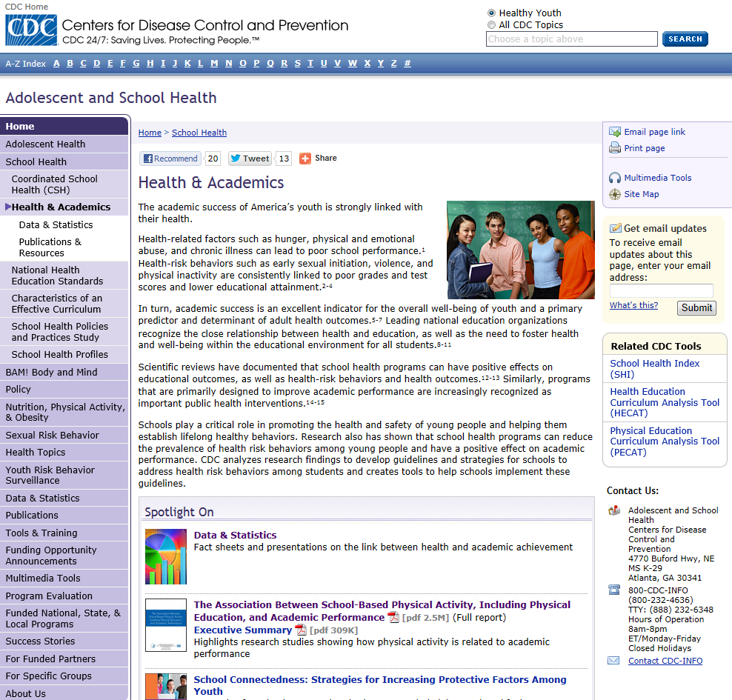
http://www.cdc.gov/HealthyYouth/health_and_academics/
Notes:
NARRATIVE
The Centers for Disease Control and Prevention (CDC) has a web page on health and academics. On this page, you can find fact sheets and presentations on the link between health behaviors and academic grades, as well as evidence reports.

Slide 26
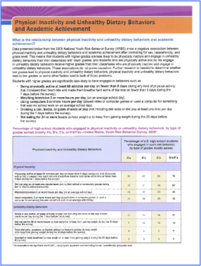
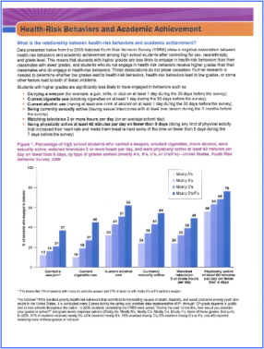
Health-Risk Behaviors and
Academic Grades Fact Sheets
http://www.cdc.gov/healthyyouth/health_and_academics/data.htm
Notes:
NARRATIVE
These are the CDC fact sheets. There are a total of six fact sheets — there is one overview fact sheet, and others address specific health-risk behaviors including alcohol and other drug use behaviors, physical inactivity and unhealthy dietary behaviors, sexual-risk behaviors, tobacco use behaviors, and unintentional injury and violence-related behaviors. You can get to these fact sheets from the main health and academics web page, or directly from the link provided on this slide.

Slide 27

New CDC Health and
Academic Resources
Health and Academic Achievement overview document
Presentation slides with notes
Podcast for health
and academics
  Nutrition
  Physical activity
  Chronic conditions
Notes:
NARRATIVE
CDC has released three new resources for health and academics. These include:
A Health and Academic Achievement overview document. The purpose of this document is to 1) become familiar with the evidence linking health and academic achievement; 2) incorporate key, evidence-driven messages when communicating with states, school districts, schools, parents, and students about the benefits of better health and better grades; 3) convey specific, feasible, and effective actions that each group can take to support health in schools; and 4) access key resources to learn more.
This PowerPoint presentation, which is a short, but comprehensive presentation on making the case for health (specifically, healthy eating and physical activity) and academic achievement.
Two podcasts on health (specifically, healthy eating and physical activity) and academic achievement, which are approximately 60 seconds in length.

Slide 28
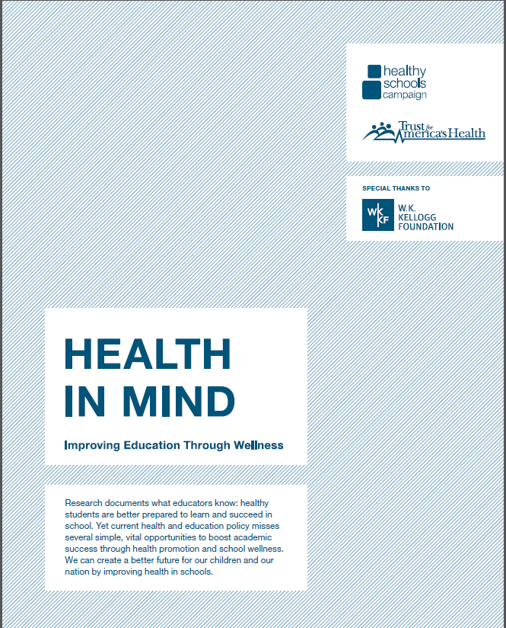
Health in Mind
Focuses on several initiatives
and policies that can benefit
the health and well-being
of students
Provides strategies that federal agencies can support to create the conditions for health and learning in our nation’s schools
Provides recommendations that can be addressed at the state, district, and school levels
http://www.nasmhpd.org/docs/PreventionResources/Health_in_Mind_Report.pdf
Notes:
NARRATIVE
Health in Mind is a new report from Healthy Schools Campaign (HSC) and Trust for America’s Health (TFAH). The report details immediate solutions that can help close the achievement gap and create a healthy future for all children. Health in Mind focuses on several federal initiatives and policies that can broadly benefit the health, well-being and education of the nation’s students.
This document provides recommendations that can be addressed at the state, district, and school levels. Some of the recommendations include:
Prepare principals and teachers to promote student health and wellness through professional development programs and in-service training that equips them to identify and address student health issues while creating classroom and school environments that support all students’ wellness.
Provide schools with strategies to partner with parents as agents of change for integrating health and wellness into education.
Incorporate health and wellness into school metrics and accountability systems to allow schools to make data-driven decisions about how health and wellness impact student learning.
Re-think the role schools can play in our nation’s prevention efforts and the ways that the Department of Health and Human Services can support schools in creating the conditions for health.

Slide 29

The Learning Connection
Demonstrates that physical activity supports academic achievement, well-nourished kids learn better and that healthier practices in schools can increase school revenue
Provides a roadmap for parents, educators, school administrators and school volunteers to create healthier school environments
http://www.actionforhealthykids.org/storage/documents/pdfs/afhk_
thelearningconnection_digitaledition.pdf.
Notes:
NARRATIVE
The Learning Connection: What You Need to Know to Ensure Your Kids Are Healthy and Ready to Learn is a report developed by Action for Healthy Kids. This report demonstrates that physical activity supports academic achievement, well-nourished kids learn better, and that healthier practices in schools can increase school revenue.
The report is a roadmap for parents, educators, school administrators and school volunteers to create healthier school environments so the kids in their lives are better positioned to learn. It is a follow-up to Action for Healthy Kids' landmark 2004 report The Learning Connection: The Value of Improving Nutrition and Physical Activity in Our Schools.

Slide 30

The Wellness Impact
Highlights that improved nutrition and physical activity can help lead to better academic performance
Serves as a launch pad to ignite the conversation about how all sectors of society can work together to create an environment for children to reach their full potential.
http://www.nationaldairycouncil.org/ChildNutrition/Pages/The-Wellness-Impact-Healthy-Eating-and-
Physical-Activity-Helps-Improve-Academic-Performance.aspx
Notes:
NARRATIVE
The report, produced by National Dairy Council, in partnership with GENYOUth Foundation, American College of Sports Medicine, and American School Health Association, highlights that improved nutrition and physical activity can help lead to better academic performance.
This report serves as a launch pad to ignite the conversation about how all sectors of society can work together to create a​n atmosphere where children have the knowledge, options, and opportunities to help them reach their full potential.
There is an available corresponding executive summary. There also are fact sheets customized for key audiences including parents, students, and school administrators. Resources are available at: http://www.nationaldairycouncil.org/ChildNutrition/Pages/The-Wellness-Impact-Healthy-Eating-and-Physical-Activity-Helps-Improve-Academic-Performance.aspx

Slide 31
THANK YOU!
Notes:
NARRATIVE
Thank you for your participation!

Slide 32
Healthy Kids.
Successful Students.
Better Communities.
Improving Academic Achievement through
Healthy Eating and Physical Activity
WEB INFORMATION
www.cdc.gov/healthyyouth
www.cdc.gov/BAM

