Slide 1
School Health Profiles
2018
State Results
Division of Adolescent and School Health
Notes:
This slide set contains information about and data from the School Health Profiles or Profiles. It includes state data from 2018.

Slide 2
What is the School Health Profiles (Profiles)?
Profiles is a system of surveys assessing school health policies and practices in states, territories, and large urban school districts
Profiles surveys are conducted biennially (during even-numbered years) by state, territorial, and local education and health agencies with technical assistance from CDC
Profiles questionnaires are administered to middle and high school principals and lead health education teachers
Notes:
What is the School Health Profiles?
Profiles is a system of surveys assessing school health policies and practices in states, territories, and large urban school districts
Profiles surveys are conducted biennially (during even-numbered years) by state, territorial, and local education and health agencies with technical assistance from CDC
Profiles questionnaires are administered to middle and high school principals and lead health education teachers

Slide 3
Topics Monitored by Profiles
School health education requirements and content
Physical education and physical activity
Practices related to bullying and sexual harassment
School health policies related to tobacco-use prevention and nutrition
School-based health services
Family engagement and community involvement
School health coordination
Notes:
Topics Monitored by Profiles
School health education requirements and content
Physical education and physical activity
Practices related to bullying and sexual harassment
School health policies related to tobacco-use prevention and nutrition
School-based health services
Family engagement and community involvement
School health coordination

Slide 4
Profiles Participation, 1998-2018
 | 1998 | 2000 | 2002 | 2004 | 2006 | 2008 | 2010 | 2012 | 2014 | 2016 | 2018
# of states | 38 | 38 | 43 | 41 | 44 | 50 | 50 | 49 | 50 | 50 | 48
# of large urban school districts | 10 | 13 | 14 | 13 | 16 | 21 | 20 | 19 | 21 | 21 | 21
# of territories | -- | -- | -- | -- | -- | 5 | 6 | 5 | 3 | 4 | 2
# of tribal governments | -- | -- | -- | -- | -- | 2 | 2 | 2 | -- | -- | --
Total # of sites | 48 | 51 | 57 | 54 | 60 | 78 | 78 | 75 | 74 | 75 | 71
Total % of sites with weighted data | 77% | 75% | 77% | 70% | 82% | 94% | 99% | 92% | 96% | 97% | 93%
Notes:
This slide contains state, large urban school district, territory, and tribal government Profiles participation data from 1998 through 2018.
In 1998, 38 states and 10 cities (including Washington, D.C.) participated in Profiles, for a total number of 48 states and cities. The percent of sites with weighted data in 1998 was 77%.
In 2000, 38 states and 13 cities (including Washington, D.C.) participated in Profiles, for a total number of 51 states and cities. The percent of sites with weighted data in 2000 was 75%.
In 2002, 43 states and 14 cities (including Washington, D.C.) participated in Profiles, for a total number of 57 states and cities. The percent of sites with weighted data in 2002 was 77%.
In 2004, 41 states and 13 cities (including Washington, D.C.) participated in Profiles, for a total number of 54 states and cities. The percent of sites with weighted data in 2004 was 70%.
In 2006, 44 states and 16 cities (including Washington, D.C.) participated in Profiles, for a total number of 60 states and cities. The percent of sites with weighted data in 2006 was 82%.
In 2008, 50 states, 21 cities (including Washington, D.C.), 5 territories, and 2 tribes participated in Profiles, for a total number of 78 sites. The percent of sites with weighted data in 2008 was 94%.
In 2010, 50 states, 20 cities (including Washington, D.C.), 6 territories, and 2 tribes participated in Profiles, for a total number of 78 sites. The percent of sites with weighted data in 2010 was 99%.
In 2012, 49 states, 19 cities (including Washington, D.C.), 5 territories, and 2 tribes participated in Profiles, for a total number of 75 sites. The percent of sites with weighted data in 2012 was 92%.
In 2014, 50 states, 21 cities (including Washington, D.C.), and 3 territories participated in Profiles, for a total number of 74 sites. The percent of sites with weighted data in 2014 was 96%.
In 2016, 50 states, 21 cities (including Washington, D.C.), and 4 territories participated in Profiles, for a total number of 75 sites. The percent of sites with weighted data in 2016 was 97%.
In 2018, 48 states, 21 cities (including Washington, D.C., and 4 territories participated in Profiles, for a total number of 71 sites. The percent of sites with weighted data in 2018 was 93%.

Slide 5
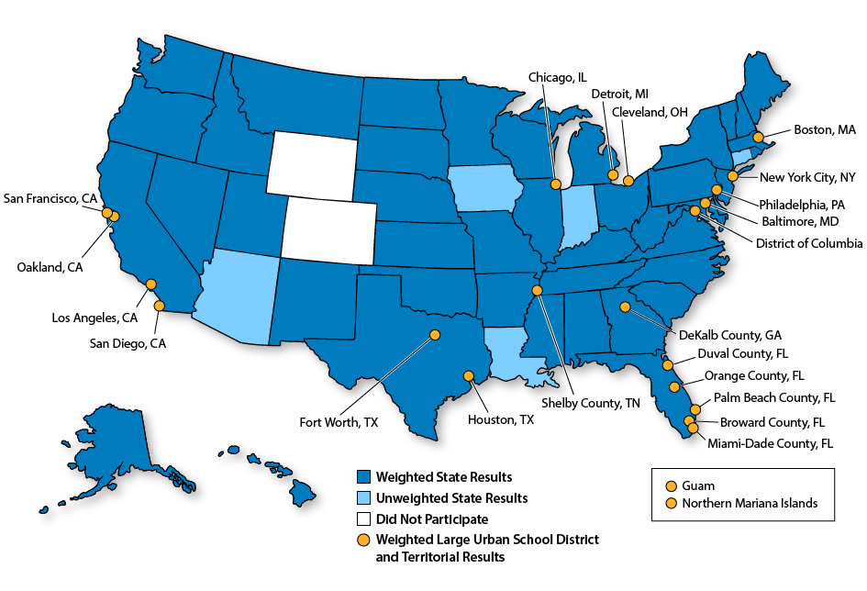
State, Territorial, and District Participation—Profiles 2018
Notes:
This map illustrates states and large urban school districts that participated in the School Health Profiles in 2018. States and large urban school districts with weighted and unweighted results are shown.
States with weighted results are: Alabama, Alaska, Arkansas, California, Delaware, Florida, Georgia, Hawaii, Idaho, Illinois, Kansas, Kentucky, Maine, Maryland, Massachusetts, Michigan, Minnesota, Mississippi, Missouri, Montana, Nebraska, Nevada, New Hampshire, New Jersey, New Mexico, New York, North Carolina, North Dakota, Ohio, Oklahoma, Oregon, Pennsylvania, Rhode Island, South Carolina, South Dakota, Tennessee, Texas, Utah, Vermont, Virginia, Washington, West Virginia, and Wisconsin.
States with unweighted results are: Arizona, Connecticut, Indiana, Iowa, and Louisiana.
Surveyed large urban school districts with weighted results are: Baltimore, MD; Boston, MA; Broward County, FL; Chicago, IL; Cleveland, OH; DeKalb County, GA; Detroit, MI; District of Columbia; Duval County, FL; Fort Worth, TX; Houston, TX; Los Angeles, CA; Miami-Dade County, FL; New York City, NY; Oakland, CA; Orange County, FL; Palm Beach County, FL; Philadelphia, PA ; San Diego, CA; San Francisco, CA ; Shelby County, TN.
Surveyed territories with weighted results are: Guam and Northern Mariana Islands.
Weighted data means that at least 70% of the principals or lead health education teachers in the sample completed the survey. Weighted data represent the state, large urban school district, territory, or tribal government. With weighted data, it is possible to say, for example, "X% of schools in our state offer students intramural activities or physical activity clubs."
Unweighted data represent only the schools that completed the questionnaire.

Slide 6
Uses of Profiles Data
Education and health officials use Profiles data to
Describe school health policies and practices and compare them across jurisdictions
Identify professional development needs
Plan and monitor programs
Support health-related policies and legislation
Seek funding
Garner support for future surveys
Notes:
Uses of Profiles Data
Education and health officials use Profiles data to
Describe school health policies and practices and compare them across jurisdictions
Identify professional development needs
Plan and monitor programs
Support health-related policies and legislation
Seek funding
Garner support for future surveys

Slide 7
Examples of Uses of Profiles Data
Maine Department of Education
  Used School Health Profiles results to inform the revision of their health education and physical education standards.
Boston Public Schools
  Has used Profiles results to track implementation of the District Wellness Policy, including health education curriculum delivery, training of teachers, and implementation of their Safe and Supportive Schools Policy.
New York City Office of School Wellness Programs
  Use Profiles data to inform the design of professional learning opportunities for health and physical education teachers and principals.
Notes:
Examples of Uses of Profiles Data
Maine Department of Education
Used School Health Profiles results to inform the revision of their health education and physical education standards.
Boston Public Schools
Has used Profiles results to track implementation of the District Wellness Policy, including health education curriculum delivery, training of teachers, and implementation of their Safe and Supportive Schools Policy.
New York City Office of School Wellness Programs
Use Profiles data to inform the design of professional learning opportunities for health and physical education teachers and principals.

Slide 8
Profiles Information
http://www.cdc.gov/schoolhealthprofiles
Overview of the School Health Profiles
Questionnaires
Comprehensive results
Fact sheet
Publications and journal articles
Participation history
Frequently asked questions about requesting data files
Data file request form
Notes:
For more information about Profiles go to http://www.cdc.gov/schoolhealthprofiles.
This web site contains
Overview of the School Health Profiles
Questionnaires and item rationales
Comprehensive results
Fact sheet
Publications and journal articles
Participation history
Frequently asked questions about requesting data files
Data file request form

