Slide 2
Overview
Epidemiology
“The Dale City Dilemma” Activity
Diarrheal Illnesses and Prevention

Slide 3
What is epidemiology?
The basic science of public health
The study of the distribution and causes of health problems in communities
The use of the scientific method to solve problems using research and statistics to find the source of the outbreak

Slide 4
So what does that mean?
Epidemiologists are “disease detectives” and look for clues
They gather information about a population:
- Who is sick? - What are the symptoms?
- When did they get sick? - Where was exposure?
- What common things did these people do?
They draw conclusions based on the information gathered
They come up with ways to contain the outbreak and educate the public to prevent future outbreaks

Slide 5
What is a disease outbreak?
It is the occurrence of more cases of an illness than would normally be expected in a community.

Slide 6
Why is epidemiology important?
To track and contain illnesses and outbreaks
To help prevent future epidemics, as well as educate the public about diseases

Slide 7
Washington State example
In 1993, more than 200 people developed severe stomach cramps and diarrhea
Investigators were able to trace the illness to undercooked hamburgers
Use the knowledge to inform and help prevent future outbreaks

Slide 8
Steps of an outbreak investigation
Prepare for the investigation
Decide if it is really an outbreak
Specify the nature of the disease
Define and identify ill people
Describe, locate, and track the data by time, place, and person
Identify the source of the outbreak
Start programs to control and prevent the spread of disease
Educate the public

Slide 9
Steps of an Outbreak investigation
Step 1: Prepare for the investigation
Step 2: Decide if this is really an outbreak
Step 3: Specify the nature of the disease
Step 4: Define and identify cases
These steps have already been completed for you in the upcoming exercise.
Notes:
Is the italicized text centered? The second line especially looks off-center, but I’m not sure how to fix it.

Slide 10
Steps of an Outbreak Investigation
Step 5: Describe, locate, and track the data by time, place, and person
Step 6: Develop ideas for the source of the outbreak

Slide 11
Describe, locate, and track the data: Example of an epi curve

Slide 12
Steps of an Outbreak Investigation
Step 7: Start programs to control and prevent the spread of disease
Step 8: Educate the public

Slide 13
GROUP ACTIVITY
The Dale City Dilemma
Notes:
Would it be possible to remove the black background on the photo?

Slide 14
Dateline: Dale City, June 10
Physicians in Dale City report an outbreak of cryptosporidiosis within the 1,500-resident population.
Initial patients attended Sunshine Daycare. Other ill residents had no connection to the daycare center.
Epidemiologists have been sent in to investigate the source of the illness.
No one is sure of the disease’s exact source.

Slide 15
Review the four completed steps of the investigation
Step 1: The epidemiologists prepared by researching cryptosporidiosis and familiarizing themselves with Dale City.
Step 2: An outbreak of cryptosporidiosis is confirmed because the number reporting illness is higher than expected.
Step 3: Lab results have confirmed the presence of crypto in the stool of several patients.
Step 4: Cases will be considered a part of the outbreak if they have lab confirmed crypto or watery diarrhea plus one other symptom and became ill between May 4 and May 20 in Dale City.

Slide 16
What is cryptosporidiosis?
Symptoms include diarrhea, watery stool, stomach cramps, upset stomach, slight fever
Symptoms appear 7 days (with a range from 2-10 days) after infection
Caused by swallowing a microscopic parasite
Fecal material ingestion:
Poor hygiene
Eating contaminated food
Drinking contaminated water
Notes:
I think the order somehow changed here and this should come after the next slide with steps 1-4, right?

Slide 17
GROUP ACTIVITY
The Dale City Dilemma
Test your knowledge of epidemiology to discover the source of the disease! Be sure your group has:
Instruction sheet
Dale City spot map
Victim Cards

Slide 18
Clue #1
Dana Dewey is a model child in the Sunshine Daycare Center. However, her teachers are working on her hygiene–she usually forgets to wash her hands after going to the bathroom. Her parents, Phil and Jill, have noticed that she does not wash her hands at home either.
Notes:
I LOVE these!

Slide 19
Clue #2
When she cleans, Ella Bloom usually uses gloves to protect her hands from germs. However, because she was in such a hurry on May 8, she did not take the time to put on gloves before cleaning.

Slide 20
Clue #3
Marge’s new low-impact exercise is water aerobics that she does at the only pool in town. It gets her joints moving without hurting herself and she loves being outside to enjoy the pleasant Dale City weather.

Slide 21
Clue #4
Sunshine Daycare sponsors a monthly trip for its students. On May 6, they went to the Dale City Pool and Park.

Slide 22
Clue #5
Ben finds a chair at the pool and lies down to relax, but gets a stomach cramp that means that disaster is soon to follow. He hurries to the bathroom. He cannot find soap near the sink, and decides to just wipe his hands on his swimming trunks instead.

Slide 23
GROUP ACTIVITY
The Dale City Dilemma
Based on the information that you have gathered, where was the outbreak primarily spread?
When did people get ill and when were they exposed to Crypto?
Briefly describe how you know.
What clues made you certain?

Slide 24
The Dale City Dilemma Epi curve
Sunshine Daycare Trip
Dana’s Parents
Dana Dewey

Slide 25
The Dale City Dilemma
Now that we have found the culprit and the source of the disease, what did we learn about Crypto?
Crypto is a parasite that can be spread by swallowing water that has been contaminated with feces
Because Crypto can be spread through pool water, it is considered a Recreational Water Illness or RWI

Slide 26
What now?
Steps 7 and 8:
EDUCATE! Tell the public what the disease detectives have found. Start programs that will help control and prevent the spread of disease.

Slide 27
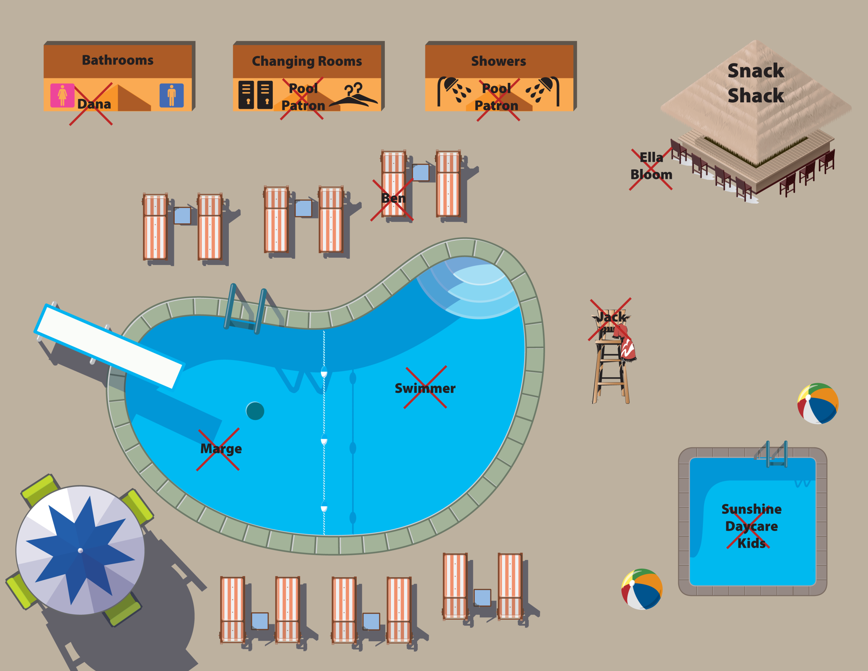
Practice good hygiene!
Don’t change diapers at poolside
Shower before swimming
Wash hands with soap and water
Wash hands with soap and water
Don’t swallow the pool water
Don’t swim with diarrhea
Notes:
I’ve attached the PDF of the basic map; you may want to get the files directly from the designer (Kate Mollenkamp). Note that the pink boxes in the PPT version I sent you are things that were added on top of the map, so if you could add some boxes with those messages, that would be great! Let me know if you have questions.

Slide 28
What Are Recreational Water Illnesses?
Illnesses that are spread by swallowing, breathing, or having contact with contaminated water from recreational water venues (swimming pools, lakes, rivers, oceans)
RWIs can cause a variety of symptoms, including skin, ear, respiratory, eye, neurological, and wound infections
Most common: diarrhea
Notes:
Use standard bullets here for consistency.

Slide 29
Other RWI germs that cause diarrheal illness
General symptoms:
Diarrhea
Loose, watery stool
Stomach cramps
Slight fever
No symptoms
Most common:
Crypto
Giardia
Shigella
E.coli O157:H7

Slide 30
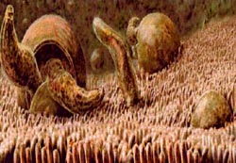
Cryptosporidium
Parasite with outer shell
Location: intestine
Chlorine resistant
Onset of illness:
Average 7 days after infection (range of 2- 10 days)
Lasts 2-4 weeks

Slide 31
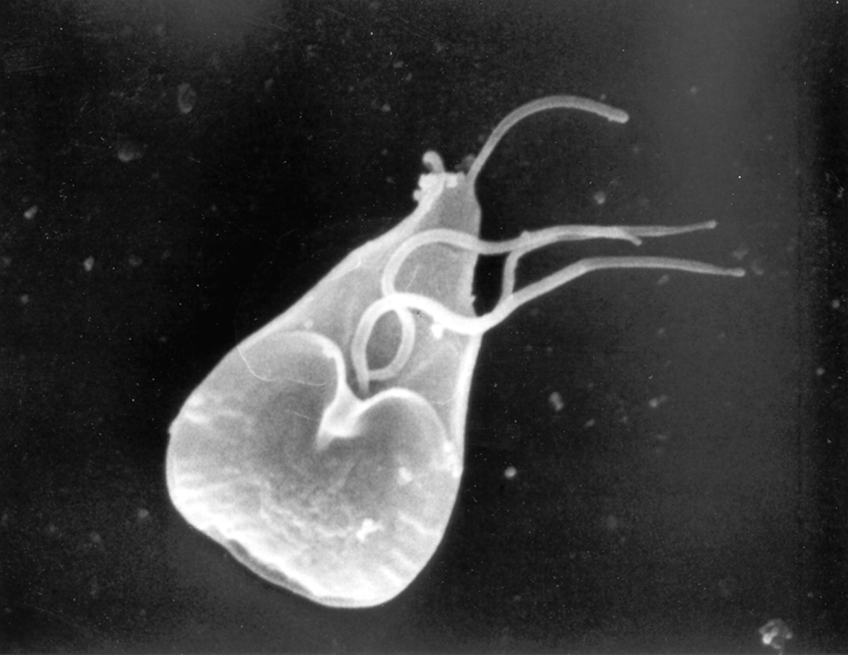
Giardia intestinalis
One-celled parasite
Location: intestine
Onset of illness:
Average 7 days after infection (range of 2- 10 days)
Lasts 2-6 weeks or longer

Slide 32
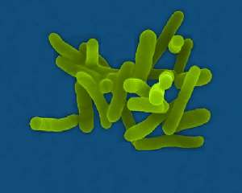
Shigella
Bacteria
Onset of illness:
1-2 days after infection
Lasts 5-7 days
Most at risk:
Children
Elderly

Slide 33
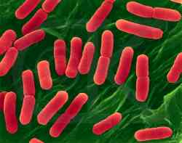
E. coli O157:H7 “Hamburger Disease”
Location: intestine (toxic)
Bacteria
Onset of illness:
A few days after infection
Lasts 5 to 10 days
Most at risk:
Not washing hands
Diaper-aged and <5 children
Families and friends of young children
Elderly
Hemolytic Uremic Syndrome—can cause severe disease and/or death

Slide 34
How are diarrheal RWIs spread?
By swallowing recreational water contaminated with waterborne bacteria, viruses, or parasites

Slide 35
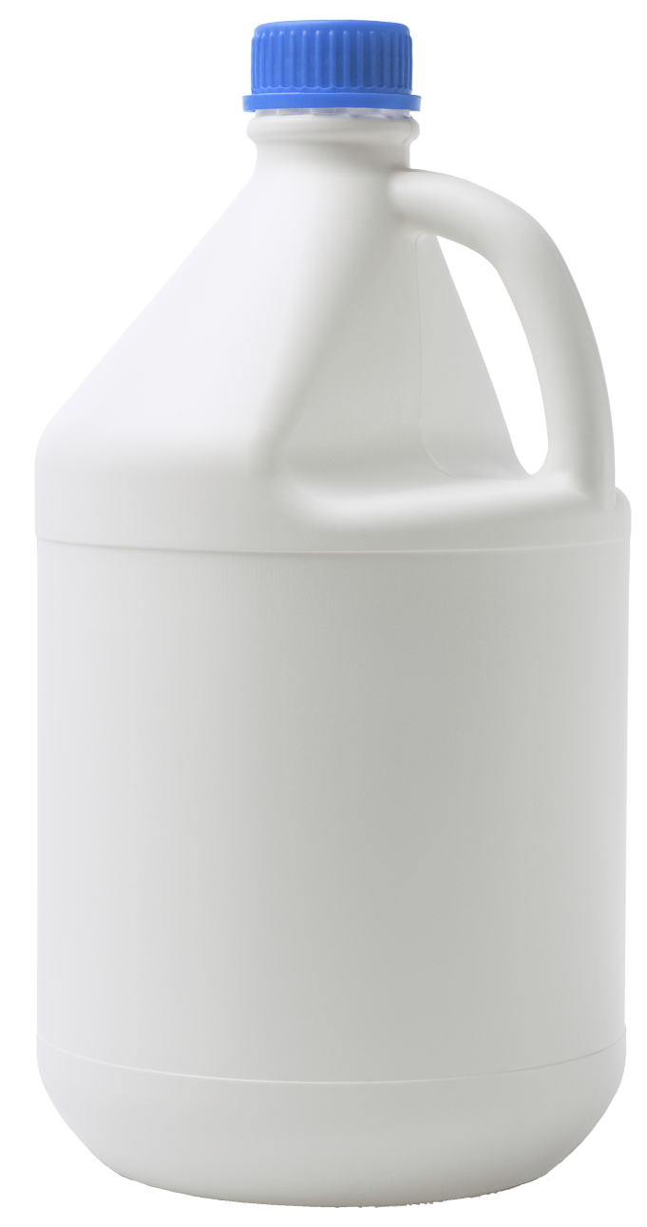
Does Chlorine Kill ALL Germs?
Notes:
Thanks! Looks like there is still a bit of white near the bottom right corner of the jug (on the blue background).

Slide 36
Disinfection time for microbes in chlorinated water
Agent | Disinfection time (1 ppm)
E. coli O157:H7 Bacteria | < 1 minute
Giardia Parasite | approximately 45 minutes
Cryptosporidium Parasite | approximately 9600 minutes (6.7 days)
Notes:
Is there another color that we could try here? I’m not sure I like the green against the background—it looks so dark!

Slide 37
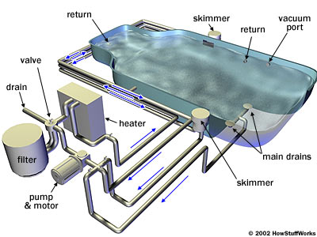
How do swimming pools work?
Filtration and chemical treatment
Flow of water
(kid pool → adult pool)

Slide 38
STOP the spread!
Practice Healthy Swimming to prevent RWIs:
Keep the poop, germs, and pee out of the water.
Don't swim when you have diarrhea.
Shower with soap before you start swimming.
Take a rinse shower before you get back into the water.
Take bathroom breaks every 60 minutes.
Wash your hands after using the toilet or changing diapers.
Notes:
“Keep the poop, germs…” should be the main bullet here, and the others are sub-bullets of it (with “Take a rinse shower…” as a further sub-bullet as shown above).

Slide 39
STOP the spread!
Check the free chlorine level and pH before getting into the water.
Pools: Proper free chlorine level (1–3 mg/L or parts per million [ppm]) and pH (7.2–7.8) maximize germ-killing power.
Hot tubs/spas: Proper disinfectant level (chlorine [2–4 parts per million or ppm] or bromine [4–6 ppm] and pH [7.2–7.8]) maximize germ-killing power.
Most superstores, hardware stores, and pool-supply stores sell pool test strips.
Don't swallow the water you swim in.
Notes:
“Most superstores…” text looks different/bigger than bullets above?

Slide 40
STOP the spread!
Parents of young children should take a few extra steps:
Take children on bathroom breaks every 60 minutes or check diapers every 30–60 minutes.
Change diapers in the bathroom or diaper-changing area and not at poolside where germs can rinse into the water.

Slide 41
Get more information on RWIs
www.cdc.gov/healthyswimming
Notes:
Let’s update this photo. I can send you some.

Slide 42
Any questions?
Thank you!

