Slide 1
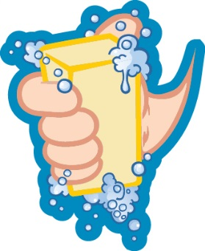
Global Handwashing Day – October 15
Handwashing
Around the World

Slide 2
There are 13,947,476,866 hands in the world.
Many don’t get washed, which can make people sick.

Slide 3
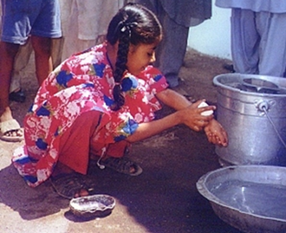
More than 1 in 3 people in the world live in a place where their bathroom waste isn't flushed away safely in a toilet.
(This is called sanitation.)
Instead, waste can spread germs onto the ground, water, and food.

Slide 4
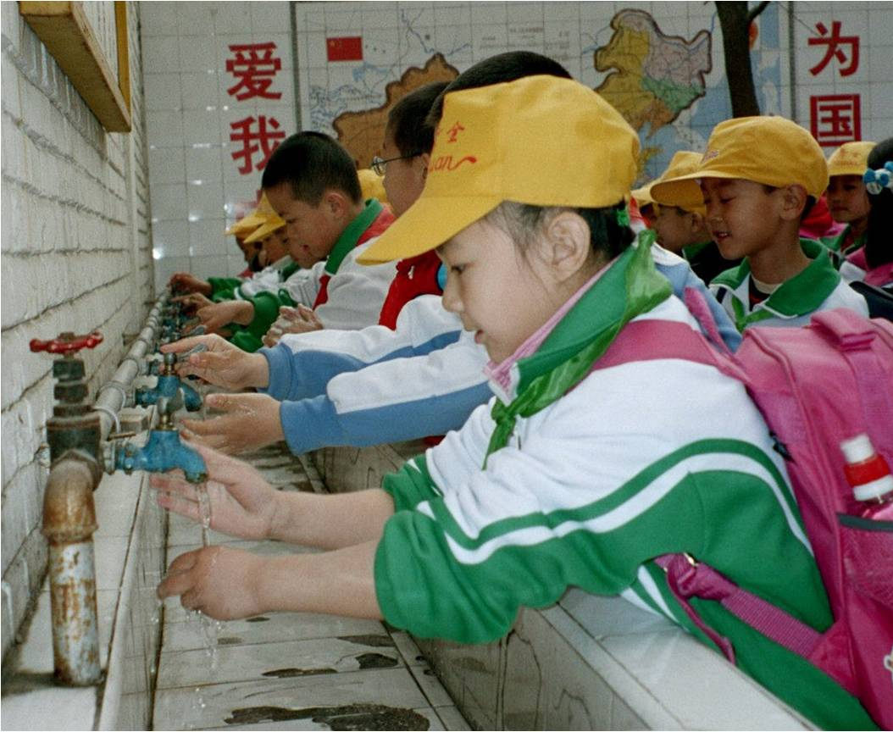
More than 800,000 kids around the world die each year because of diarrhea they get from water that’s not safe to drink, not washing their hands, or having bad sanitation.

Slide 5
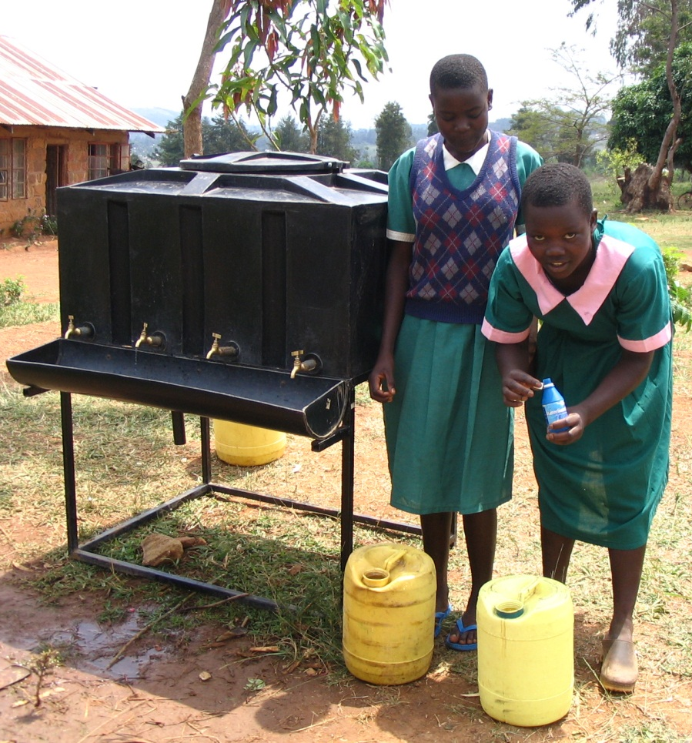
Handwashing and good hygiene can help kids
Stay healthy
Not have diarrhea or colds
Not get family members sick
Not miss school
In some places, even learn better & grow taller!

Slide 6
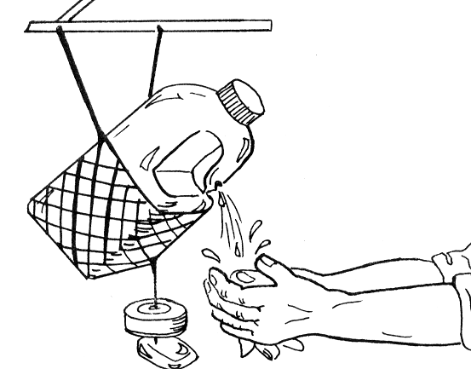
Some kids get their water from a tippy tap.
People make their own handwashing stations out of plastic jugs or water bottles in many places where they don’t have sinks.

Slide 7
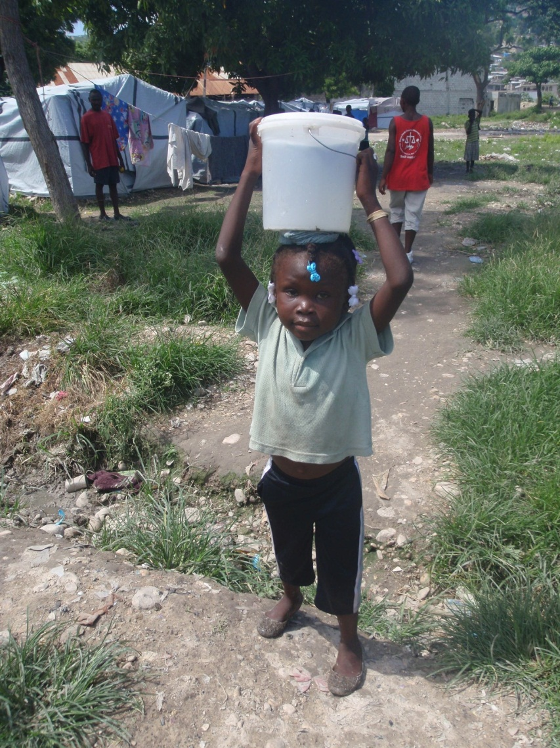
We could prevent almost 1 in 10 sicknesses around the world with more handwashing, safer drinking water, and better sanitation.

Slide 8
It starts with you!
[Video below and at http://www.cdc.gov/CDCTV/WashYourHands]

