Slide 1
Managing Food Allergies in Schools the Role of TRANSPORATION STAFF
Voluntary Guidelines for Managing Food Allergies in Schools and Early Care and Education Programs
Notes:
Notes to Facilitator: Introduce yourself. Take the opportunity to get to know your audience. If the group is small, perhaps each participant can introduce themselves and describe their role in schools. Larger groups might be prompted by a show of hands to identify their roles, or take a moment to introduce themselves to the participants around them. Another idea is to have participants write down one question they have about food allergies on a piece of paper. At the end of the presentation, you can ask for participants to share questions that were not answered during the presentation.

Slide 2
Objectives
Describe the symptoms of food allergies and life-threatening reactions.
Identify three ways to prepare for and respond to food allergy emergencies on the school bus.
Identify three ways to support safe school buses for students with food allergies.
Notes:
NARRATIVE
The purpose of this presentation is to explain the role of school transportation staff in helping students with food allergies stay safe while riding school buses. The purpose also is to share with you the CDC resource of the Voluntary Guidelines for Managing Food Allergies in Schools and Early Care and Education Programs.
Following this presentation, you will be able to do the following:
Describe the symptoms of food allergies and life-threatening reactions.
Identify three ways to prepare for and respond to food allergy emergencies on the school bus.
Identify three ways to support safe school buses for students with food allergies.
Before we review action steps, I will share some information about the guidelines and the nature of food allergies in lives of the students we serve.

Slide 3
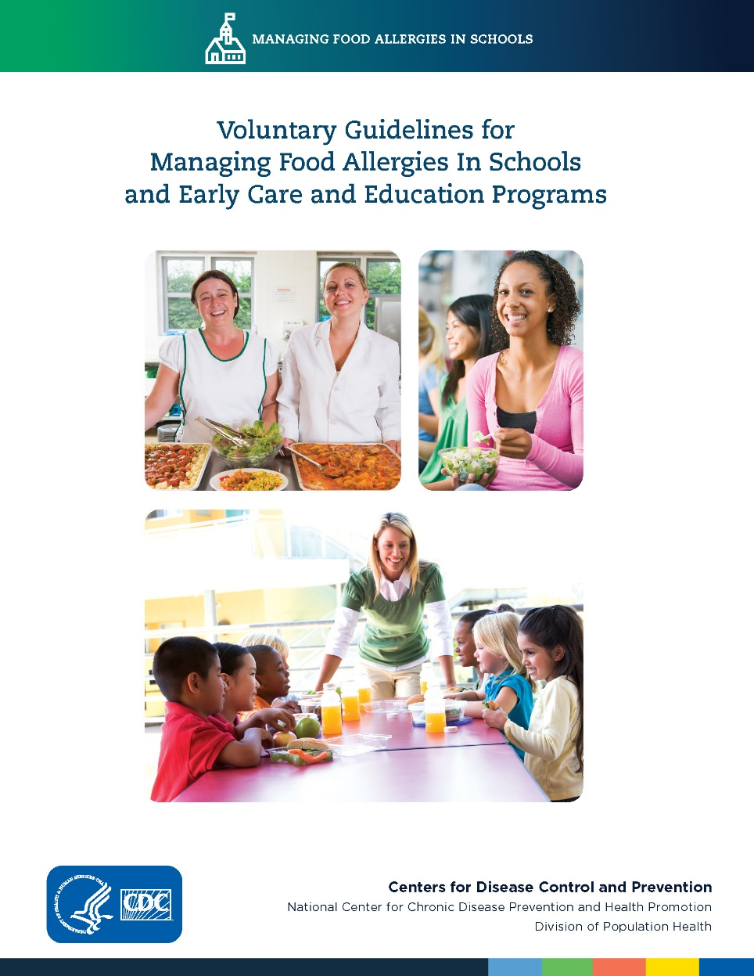
Overview
The guidelines can help schools manage the risk of food allergies and severe allergic reactions in students.
School bus drivers and transportation staff can help keep students with food allergies safe during school bus transport.
Notes:
NARRATIVE
CDC published the Voluntary Guidelines for Managing Food Allergies in Schools and Early Care and Education Programs, to help schools manage the risk of food allergies and severe allergic reactions in students. As a school bus driver or transportation attendant, you need to know how to help students with food allergies be safe during transportation on school buses. This presentation will give you the information you need for managing food allergies and responding to food allergy emergencies during school transportation.

Slide 4
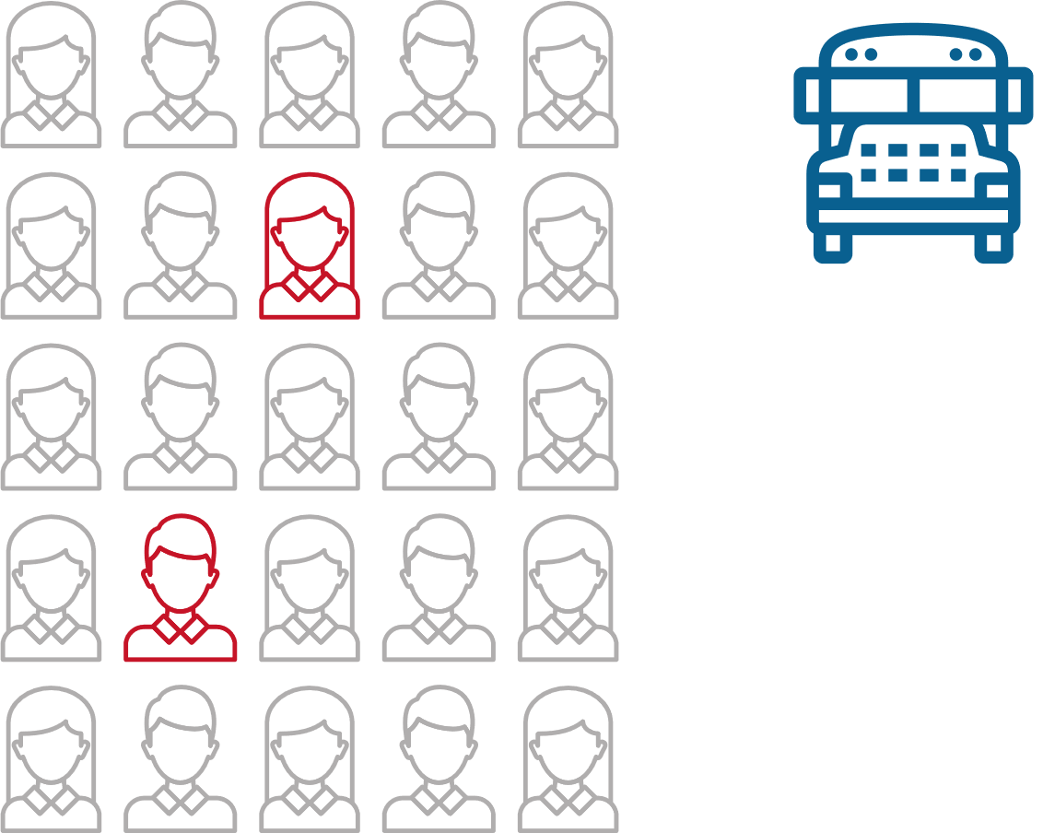
Did you know?
A food allergy is an adverse reaction that occurs soon after exposure to a certain food.
In a typical bus of 25 students, at least two students are likely to have food allergies.
Food allergy reactions can be very serious and even cause death.
Notes:
NARRATIVE
A food allergy is an adverse reaction that occurs soon after exposure to a certain food.
Food allergies are a growing concern for health care providers and school officials alike. In a typical school busload of 25 students, at least 2 students likely to have food allergies.
For reasons that are not completely understood, the number of children with food allergies is also increasing.^{1,2}
Another alarming fact is that food allergy reactions can be very serious and even cause death.
Notes to Facilitator: This may be a good time to have participants who have ever worked with a student with food allergies or have had a family member with life threatening allergies stand up. This could help emphasize the importance of learning more about managing food allergies during school transportation.
So, what do you need to know about food allergies and what you can do to help keep your students healthy and safe?

Slide 5
What can you do?
Get trained!
Participate in food allergy training.
Ask the school nurse or administrator for information about school food allergy policies.
Know which students on your bus have food allergies and review their emergency care plans.
Share emergency plans with substitute bus drivers and attendants.
Notes:
NARRATIVE
Notes to Facilitator: This may be a good time to ask participants if they are aware of a food allergy emergency plan in your school or school division and if they know where to locate this plan. Depending on their responses, you could let them know where to locate the food allergy emergency plan and charge them with becoming familiar with the contents.
The first action step you can take is to get trained. Plan to participate in training to learn about food allergies and learn how to respond to an allergic reaction if it occurs on your bus.
Ask the school nurse or school administrator for information about school food allergy policies.
It is also very important to know which students on your bus have food allergies and to be able to review their emergency plans.
Share emergency plans and responsibilities with substitute bus drivers and other adult attendants who assist students on the school bus.
Let’s take a moment to learn more about food allergies, their symptoms and how to respond to a food allergy emergency.

Slide 6
What can you do?
Learn about food allergies!
A food allergy is an adverse reaction that occurs soon after exposure to a certain food.
Any food can cause a food allergy, but most are caused by milk, eggs, fish, shellfish, wheat, soy, peanuts, and tree nuts.
A severe life-threatening allergic reaction is called anaphylaxis.
Notes:
NARRATIVE
Our second action step is to learn about food allergies. Understanding the nature of food allergies is important so that you know how to help students with food allergies.
A severe life-threatening allergic reaction is called anaphylaxis. This kind of reaction usually happens quickly and may cause death.
Not all allergic reactions will develop into anaphylaxis; however, early signs of anaphylaxis can resemble a mild allergic reaction. It is not easy to predict whether these initial, mild symptoms will become an anaphylactic reaction that can result in death.¹ Therefore, all children with known or suspected ingestion of a food allergen and the appearance of symptoms of an allergic reaction must be closely watched and possibly treated for early signs of anaphylaxis.
I now want to share with you more about the symptoms of food allergy reactions.

Slide 7
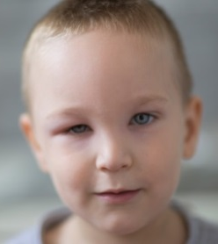
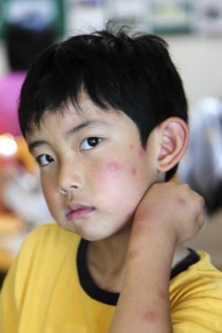
What can you do?
Recognize food allergy symptoms!
Food allergy symptoms can include the following:
Swollen lips, tongue or eyes.
Itchiness, rash or hives.
Nausea, vomiting, or diarrhea.
Congestion, hoarse voice, trouble swallowing.
Wheezing or difficulty breathing.
Dizziness, fainting or loss of consciousness.
Mood change or confusion.
Notes:
NARRATIVE
You can learn to recognize food allergy symptoms. The symptoms of food allergy reactions vary for different people and can even change over time. Signs and symptoms of an allergic reaction can develop in a few minutes or up to 1-2 hours after exposure to an allergen, or rarely, even several hours later. Food allergy symptoms can include swollen lips, tongue or eyes; itchiness, rash, or hives; nausea, vomiting, diarrhea; congestion, hoarse voice, trouble swallowing; wheezing or difficulty breathing; dizziness or fainting, or loss of consciousness; and mood change or confusion.
In children, food allergy reactions can be difficult to see. Some children may not be able to clearly communicate their symptoms due to their development or age. Children with food allergies might communicate their symptoms in the following ways:
It feels like something is poking my tongue.
My tongue (or mouth) is tingling (or burning).
My tongue (or mouth) itches.
My tongue feels like there is hair on it.
My mouth feels funny.
There’s a frog in my throat; there’s something stuck in my throat.
My tongue feels full (or heavy).
My lips feel tight.
It feels like there are bugs in there (to describe itchy ears).
It (my throat) feels thick.
It feels like a bump is on the back of my tongue or throat.⁸
Source: The Food Allergy & Anaphylaxis Network. Food Allergy News. 2003; 13(2).

Slide 8
WHAT CAN YOU DO?
What can you do?
Know how to respond to food allergy emergencies!
The recommended first-line treatment for anaphylaxis is the prompt use of an injectable medication called epinephrine.
Notes:
NARRATIVE
Knowing how to respond to food allergy emergencies is an important action step for school transportation staff. There is no treatment to prevent food allergy reactions. Strict avoidance of the food allergen is the only way to prevent a reaction. Since avoidance is not always possible, school transportation staff must be prepared to deal with allergic reactions, including anaphylaxis. The recommended first-line treatment for anaphylaxis is the prompt use of an injectable medication called epinephrine.

Slide 9
WHAT CAN YOU DO?
What can you do?
If you suspect a severe food allergy reaction, or anaphylaxis, take immediate action:
Know the location of emergency medication and be ready to administer an epinephrine auto-injector if you are a delegated and trained staff member and epinephrine is available.
Call 911 or the emergency medical system (EMS) to ask for emergency transportation of any student showing signs of anaphylaxis.
Let the school administrator know your actions and the need for someone to contact the student’s parents.
Notes:
NARRATIVE
If you suspect a severe food allergy reaction, or anaphylaxis, take immediate action:
Know the location of emergency medication and be ready to administer an epinephrine auto-injector if you are a delegated and trained staff member.³⁻⁴
Call 911 or the emergency medical system (EMS) to ask for emergency transportation of any student showing signs of anaphylaxis. It is important to make sure that your emergency communication device (phone, walkie talkie, etc.) is charged and functional at all times.
Let the school administrator know your actions and the need for someone to contact the student’s parents.
As with any bus emergency, attending to the needs of the student should take priority. Pulling over to the side of the road to attend to the emergency and wait for emergency medical services is an appropriate action.

Slide 10
WHAT CAN YOU DO?
What can you do?
Help prevent food allergy emergencies!
Enforce rules that prohibit eating and drinking on the school bus.
Do not give food or candy to students.
Follow your school district’s cleaning procedures for bus surfaces, such as seats and handrails.
Notes:
NARRATIVE
The goal of transporting students is to get them to their homes and schools safely. There are several important actions that bus drivers and attendants can do to help prevent food allergy emergencies on school buses.
First, always enforce district food policies for all students riding a school bus. Rules that prohibit eating and drinking on school buses help to protect students from food allergy reactions while riding the bus. Exceptions may need to be made for individual students who need to eat due to medical conditions, such as diabetes.
Also, never give food or candy to students riding your bus, even if they are to consume it after riding the bus. Many allergens are hidden in candy and could pose a danger to students with food allergies. Consider rewarding children with praise or small nonfood items. A kind word of praise will linger with a child much longer than a piece of candy.
Finally, follow your school district cleaning procedures for bus surfaces, such as seats and handrails. This will help decrease the possibility of cross contact with allergens.

Slide 11
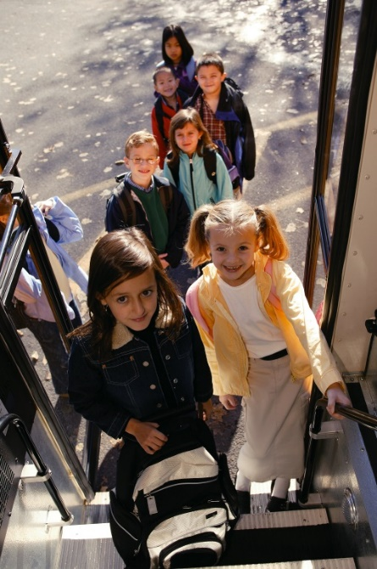
WHAT CAN YOU DO?
What can you do?
Support a healthy and safe transportation
Make sure your radios or phones are working properly.
Enforce no eating rules on buses.
Do not give food or candy to students.
Encourage students to treat each other with kindness and respect.
Report all cases of bullying to the school administrator.
Notes:
NARRATIVE
Finally, another important consideration for bus drivers is to support health and safe transportation. Several actions are critical.
Ensure that two-way communication systems between schools and school buses are working properly.
Enforce district food policies for all students riding a school bus. Rules that prohibit eating and drinking on school buses help to protect students from food allergy reactions while riding the bus.
Although you may want to reward students for good behavior or just celebrate a special day with them, it is very important that you do not give food or candy to students.
Follow district cleaning procedures for bus surfaces, such as seats and handrails.
Encourage students to treat each other with kindness and respect.
Report all cases of bullying to parents and the school administrator.

Slide 12
Where can you find more information?
Centers for Disease Control and Prevention. Voluntary Guidelines for Managing Food Allergies in Schools and Early Care and Education Programs. Available at: https://www.cdc.gov/healthyschools/foodallergies
2015 Revisions to National School Transportation Specifications and Procedures (NSTSP). Available at: http://ncstonline.org
Notes:
NARRATIVE
The Voluntary Guidelines for Managing Food Allergies in Schools and Early Care and Education Programs along with a tool kit of resources for schools at the link on your screen. This resource can provide school administrators with information needed to be effective school leaders in the important job of managing food allergies in schools.
Additionally, the National School Transportation Specifications & Procedures document includes resources for school transportation directors which you may find helpful.

Slide 13
Questions ?
Notes:
NARRATIVE
Managing food allergies can be accomplished through a partnership between families, health care providers, and schools. Educators need to know how to help students with food allergies be safe and supported at school. This presentation presented an overview of the CDC Voluntary Guidelines for Managing Food Allergies in Schools and Early Care and Education Programs. Thank you for being part of this critical team effort to support students with food allergies so that they can be healthy and safe at school.

Slide 14
THANK YOU!

Slide 15
References
Gupta RS, Warren CM, Smith BM, Blumenstock JA, Jiang J, Davis MM, Nadeau KC. The public health impact of parent-reported childhood food allergies in the united states. Pediatrics. 2018;142(6):e20181235
Nowak-Wegrzyn A, Conover-Walker MK, Wood RA. Food-allergic reactions in schools and preschools. Arch Pediatr Adolesc Med. 2001;155(7):790-795
McIntyre CL, Sheetz AH, Carroll CR, Young MC. Administration of epinephrine for life-threatening allergic reactions in school settings. Pediatrics. 2005;116(5):1134-1140

