Slide 1
Evidence-Based Practices for Hereditary Breast and Ovarian Cancer Syndrome and Lynch Syndrome
{Template Slide Set}

Slide 2
Overview
What are Hereditary Breast and Ovarian Cancer syndrome (HBOC) and Lynch syndrome (LS)?
How common are LS and HBOC?
How do LS and HBOC affect individuals and families?
How do I identify individuals at risk and their families?
What should I do after I identify a patient at risk?
What should I do after a patient is diagnosed?

Slide 3
Hereditary Breast and Ovarian Cancer Syndrome (HBOC): An Overview
Individuals with HBOC have a significantly increased risk for breast, ovarian, and other cancers.
Identifying individuals with HBOC is important because steps can be taken to reduce future cancer risks for patients and their relatives.

Slide 4


BRCA-Associated Hereditary Breast and Ovarian Cancer Syndrome
Caused by inherited changes in BRCA1 and BRCA2 genes
Increased risk for breast, ovarian, and other types of cancer (high grade prostate, male breast, pancreatic)
Certain ethnic groups are at increased risk for BRCA mutations
  1 in 40 Ashkenazi Jews
Interventions can significantly reduce risk of cancers

Slide 5
BRCA1 and BRCA2 Mutations:
Cancer Risks by Age 70
 | General population | BRCA1 | BRCA2
Breast Cancer¹ | 12.3% | 45-65%
Ovarian Cancer¹ | 1.4% | 39% | 10-17%
Prostate Cancer² | 15-18% | <30% | <39%
Pancreatic Cancer² | 0.5% | 1-3% | 2-7%
Male Breast Cancer² | 0.1% | 1-2% | 5-10%
U.S. Preventive Services Task Force. Risk Assessment, Genetic Counseling, and Genetic Testing for BRCA-Related Cancer in Women: U.S. Preventive Services Task Force Recommendation Statement. Ann Intern Med. 2014;160:271-281.
Petrucelli, N., Daly, M.B., and Feldman, G.L. (2013). BRCA1 and BRCA2 Hereditary Breast and Ovarian Cancer. GeneReviews. Retrieved from: http://www.ncbi.nlm.nih.gov/books/NBK1247/

Slide 6
Lynch Syndrome: An Overview
Individuals with Lynch syndrome have a significantly increased risk for colorectal (colon), endometrial, and other cancers.
Identifying individuals with Lynch syndrome is important because steps can be taken to reduce cancer risks in the future for patients and their relatives.

Slide 7
Lynch Syndrome
Increased risk for certain cancers:
  Colorectal
  Endometrial (Uterine)
  Ovarian
  Bladder
  Stomach
Caused by inherited mutations in the mismatch repair genes, MLH1, MSH2, MSH6, and PMS2, and the EPCAM gene
Interventions can significantly reduce risk of cancers
1 in 30 patients with colorectal cancer has
Lynch Syndrome

Slide 8
Lynch Syndrome: Cancer Risks by Age 70
Cancer | General Population Risk | Risk with LS | Mean Age of Onset with LS
Colorectal Cancer | 4.5% | ≤ 82% | 44-66 years
Endometrium | 2.7% | ≤ 60% | 48-62 years
Stomach | <1% | ≤ 13% | 56-78 years
Ovary | 1.6% | ≤ 24% | 42-46 years
Hepatobiliary tract | <1% | ≤ 4% | 50-57 years
Urinary tract | <1% | ≤ 7% | 54-65 years
Small bowel | <1% | ≤ 6% | 47-59 years
Brain/ central nervous system | <1% | ≤ 3% | 45-50 years
Source: NCCN http://www.nccn.org/professionals/physician_gls/pdf/genetics_colon.pdf
Notes:
Note that according to EGAPP, colorectal cancer risk is 45% by age 70

Slide 9
Identifying Patients at Risk for Hereditary Breast and Ovarian Cancer Syndrome and Lynch Syndrome

Slide 10
How Do I Identify Patients At Risk for Hereditary Cancer Syndromes?
National Evidence-Based Guidelines:
Hereditary Breast and Ovarian Cancer
  U.S. Preventive Services Task Force (USPSTF)
  Risk Assessment, Genetic Counseling, and Genetic Testing for BRCA-Related Cancer in Women (2013)
Lynch Syndrome
Evaluation of Genomic Applications in Practice and Prevention (EGAPP) Working Group
Genetic Testing Strategies in Newly Diagnosed Individuals with Colorectal Cancer Aimed at Reducing Morbidity and Mortality from Lynch Syndrome (2009)

Slide 11
Hereditary Breast and Ovarian Cancer:
U.S. Preventive Services Task Force
“The USPSTF recommends that primary care providers screen women who have family members with breast, ovarian, tubal, or peritoneal cancer with one of several screening tools designed to identify a family history that may be associated with an increased risk for potentially harmful mutations in breast cancer susceptibility genes (BRCA1 or BRCA2)”
“Women with positive screening results should receive genetic counseling and, if indicated after counseling, BRCA testing.”
U.S. Preventive Services Task Force. Risk Assessment, Genetic Counseling, and Genetic Testing for BRCA-Related Cancer in Women: U.S. Preventive Services Task Force Recommendation Statement. Ann Intern Med. 2014;160:271-281.

Slide 12
Hereditary Breast and Ovarian Cancer:
Family Health History Risk Assessment
≥1 family member with breast, ovarian, or other BRCA-related cancer
Family health history risk stratification tools to determine the need for genetic counseling
Tools included in USPSTF recommendation:
  Ontario Family History Assessment Tool
  Manchester Scoring System
  Referral Screening Tool
  Pedigree Assessment Tool
  Family History Screen 7 (FHS-7)
U.S. Preventive Services Task Force. Risk Assessment, Genetic Counseling, and Genetic Testing for BRCA-Related Cancer in Women: U.S. Preventive Services Task Force Recommendation Statement. Ann Intern Med. 2014;160:271-281.
Notes:
Family history assessment tools can be found in the USPSTF recommendation

Slide 13
Example: Referral Screening Tool
Risk Factor | Breast Cancer At Age ≤ 50y | Ovarian Cancer at Any Age
Yourself
Mother
Sister
Daughter
Mother’s side
Grandmother
Aunt
Father’s side
Grandmother
Aunt
≥ 2 cases of breast cancer after age 50y on the same side of the family
Male breast cancer at any age in any relative
Eastern European or Ashkenazi Jewish ancestry
Bellcross CA, Lemke AA, Pape LS, Tess AL, Meisner LT. Evaluation of a breast/ovarian cancer genetics referral screening tool in a mammography population. Genet Med. 2009;11:783-9.
Notes:
Patient completes the checklist if she has a family history of breast or ovarian cancer and receives a referral if she checks 2 or more items.

Slide 14
Example: Pedigree Assessment Tool
Risk Factor | Score
Breast cancer at age ≥ 50y | 3
Breast cancer at age < 50y | 4
Ovarian cancer at any age | 5
Male breast cancer at any age | 8
Ashkenazi Jewish heritage | 4
Hoskins KF, Zwaagstra A, Ranz M. Validation of a tool for identifying women at high risk for hereditary breast cancer in population-based screening. Cancer. 2006;107:1769-76.
Notes:
Score points for each family member with a breast or ovarian cancer diagnosis, including second- or third-degree relatives
A score ≥ 8 is the optimum referral threshold

Slide 15
Other Clinical Guidelines for Identifying Patients At Risk for HBOC
USPSTF: individuals without a personal history of breast or ovarian cancer
Individuals with a personal history of breast, ovarian, and other cancers
  National Comprehensive Cancer Network (NCCN), 2017
  American College of Medical Genetics and Genomics (ACMG)/ National Society of Genetic Counselors (NSGC), 2014
Notes:
USPSTF recommendation only addresses risk assessment in individuals without a personal history of breast or ovarian cancer. Other guidelines are available that address HBOC risk assessment in individuals with a personal history or breast, ovarian, or other cancers (as well as addressing risk assessment based on family history in individuals without a personal history).

Slide 16
National Comprehensive Cancer Network (NCCN) Guidelines (2017)
Further genetic evaluation if personal history of
Ovarian carcinoma
Male breast cancer
Pancreatic cancer or high grade prostate cancer at any age, 1 or more of the following:
  ≥ 1 close blood relatives with:
    Ovarian carcinoma at any age
    Breast cancer ≤50 years
  ≥ 2 close blood relatives with:
    Breast cancer at any age
    Pancreatic cancer at any age
    High grade prostate cancer at any age
Pancreatic cancer and Ashkenazi Jewish or Eastern European ancestry
BRCA1 or BRCA2 mutation detected by tumor profiling in the absence of germline mutation analysis
Source: National Comprehensive Cancer Network. NCCN Guidelines Version 2.2017 Genetics/Familial High-Risk Assessment: Breast and Ovarian.

Slide 17
National Comprehensive Cancer Network (NCCN) Guidelines (2017)
Further genetic evaluation if personal history of breast cancer and one or more of the following
Diagnosed ≤ age 45
Diagnosed ≤ age 50 with:
  Another primary cancer
  ≥ 1 close blood relative with breast cancer, pancreatic cancer, or high grade prostate cancer at any age
  An unknown or limited family history
Diagnosed ≤ age 60 with triple negative breast cancer
Source: National Comprehensive Cancer Network. NCCN Guidelines Version 2.2017 Genetics/Familial High-Risk Assessment: Breast and Ovarian.

Slide 18
National Comprehensive Cancer Network (NCCN) Guidelines (2017)
Further genetic evaluation if personal history of breast cancer and one or more of the following
Diagnosed at any age with:
  ≥ 1 close blood relative with breast cancer diagnosed ≤ age 50
  ≥ 2 close blood relatives with breast cancer at any age
  ≥ 1 close blood relative with ovarian carcinoma
  ≥ 2 close blood relatives with pancreatic cancer and/or high grade prostate cancer at any age
  A close male blood relative with breast cancer
  Ashkenazi Jewish or Eastern European ancestry
Source: National Comprehensive Cancer Network. NCCN Guidelines Version 2.2017 Genetics/Familial High-Risk Assessment: Breast and Ovarian.

Slide 19
ACMG/NSGC Referral Indications for Cancer Predisposition Assessment (2014)
Further genetic evaluation if personal history of
Breast cancer diagnosed ≤ age 50
Triple-negative breast cancer diagnosed ≤ age 60
Two or more primary breast cancers
Ovarian, fallopian tube, or primary peritoneal cancer
Male breast cancer
Ashkenazi Jewish or Eastern European ancestry and breast or pancreatic cancer at any age
Breast, ovarian, or pancreatic cancer and two or more cases of breast, ovarian, pancreatic, or aggressive prostate cancer in close blood relatives
Aggressive prostate cancer and two or more cases of breast, ovarian, or pancreatic cancer in close blood relatives
Source: A practice guideline from the American College of Medical Genetics and Genomics and the National Society of Genetic Counselors: referral indications for cancer predisposition assessment. Genetics in Medicine. 2014 .

Slide 20

Is Your Patient At Risk For HBOC?
[sample HBOC risk assessment pedigree]
There is a free CME Course Hereditary Breast and Ovarian Cancer, Available at: https://learn.education.jax.org/browse/hpe/cme/courses/hboc Developed by the National Coalition for Health Professional Education in Genetics (NCHPEG), now The Jackson Laboratory Clinical and Continuing Education Program

Slide 21

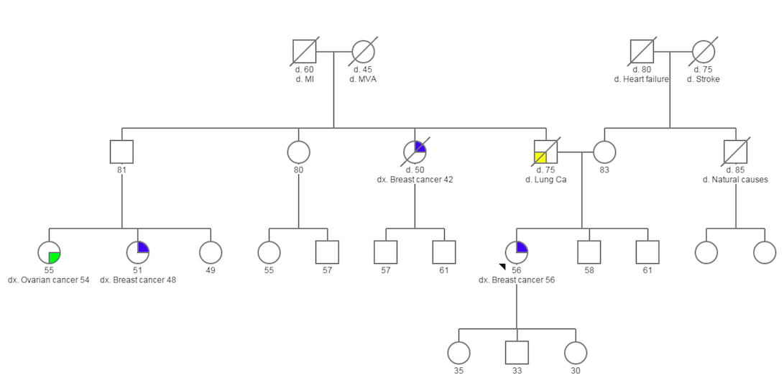
HBOC Risk Assessment Pedigree
SAMPLE
Notes:
This is a fictional family history. Any similarities it has to a real patient family history is purely coincidental.

Slide 22
Lynch Syndrome: Evaluation of Genomic Applications in Practice and Prevention Recommendation (2009)
The Evaluation of Genomic Applications in Practice and Prevention (EGAPP) Working Group found sufficient evidence to recommend offering [screening and] genetic testing for Lynch syndrome to individuals with newly diagnosed colorectal cancer to reduce morbidity and mortality in relatives.
Evaluation of Genomic Applications in Practice and Prevention (EGAPP) Working Group. Recommendations from the EGAPP Working Group: Genetic testing strategies in newly diagnosed individuals with colorectal cancer aimed at reducing morbidity and mortality from Lynch syndrome in relatives. Genetics in Medicine 2009; 11:35-41.

Slide 23
Other Clinical Guidelines For Identifying Patients At Risk for Lynch Syndrome
EGAPP: individuals with a personal history of colorectal cancer
Individuals without a personal history of colorectal cancer
      National Comprehensive Cancer Network (NCCN), 2016
      American College of Medical Genetics (ACMG) and the National Society of Genetic Counselors (NSGC), 2014
Notes:
EGAPP only addresses Lynch syndrome screening in individuals with a personal history of colorectal cancer. Other guidelines address Lynch syndrome screening in individuals without a personal history of breast or ovarian cancer

Slide 24
National Comprehensive Cancer Network (NCCN) Guidelines (2017): Family History
Further genetic evaluation for
  Women with endometrial cancer diagnosed before age 50
  Individuals in families with known Lynch syndrome
  Individuals with a family history of one or more of the following
    First-degree relative with colorectal or endometrial cancer diagnosed before age 50
    First-degree relative with colorectal or endometrial cancer and another synchronous or metachronous Lynch-syndrome related cancer**
    Two or more first- or second-degree relatives with Lynch-Syndrome-related cancers**, at least one of whom was diagnosed before age 50
    Three or more first- or second-degree relatives with Lynch-Syndrome-related cancers**, regardless if age
** Lynch syndrome associated cancers include colorectal cancer, endometrial (uterine) cancer, gastric cancer, ovarian cancer, pancreatic cancer, ureter and renal pelvis cancers, biliary tract cancer, brain cancer (usually glioblastoma), small intestinal cancer, sebaceous gland adenocarcinoma, and keratoacanthoma
Source: National Comprehensive Cancer Network. NCCN Guidelines Version 1.2017 Genetics/Familial High-Risk Assessment: Colon.
Notes:
** Lynch syndrome associated cancers include colorectal cancer, endometrial (uterine) cancer, gastric cancer, ovarian cancer, pancreatic cancer, ureter and renal pelvis cancers, biliary tract cancer, brain cancer (usually glioblastoma), small intestinal cancer, sebaceous gland adenocarcinoma, and keratoacanthoma

Slide 25
ACMG/NSGC (2014) Guidelines: Endometrial Cancer
Further genetic evaluation if
Endometrial cancer < age 50
Endometrial cancer ≥ age 50 and a first-degree relative with colorectal or endometrial cancer at any age
Synchronous or metachronous colorectal or endometrial cancers in the same person
Endometrial cancer showing mismatch repair deficiency on tumor screening
Endometrial cancer and two additional cases of any LS-associated cancer in the same person or in close relatives
  All affected relatives must be on the same side of the family
Source: A practice guideline from the American College of Medical Genetics and Genomics and the National Society of Genetic Counselors: referral indications for cancer predisposition assessment. Genetics in Medicine. 2014

Slide 26
Screening Tumor Tissue for Lynch Syndrome
For individuals newly diagnosed with colorectal cancer, tumor screening is often done before genetic testing
Less complicated
Less expensive
Identify patients for genetic testing
Guide which genes to include in genetic testing

Slide 27
Screening Tumor Tissue for Lynch Syndrome
Immunohistochemistry (IHC) or Microsatellite Instability (MSI) screening
  Screening tests, not diagnostic tests
    Identify those more likely to have Lynch syndrome but further testing needed for diagnosis of Lynch syndrome
  Can be done individually or in combination
  Some institutions may decide to perform IHC and/or MSI testing on newly diagnosed endometrial cancers
Source: National Comprehensive Cancer Network. NCCN Guidelines Version 1.2017 Genetics/Familial High-Risk Assessment: Colon.

Slide 28
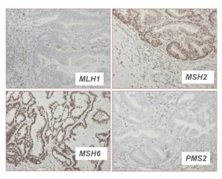
Immunohistochemical (IHC) Screening
Mutations in mismatch repair genes result in loss of expression of 1-2 of the mismatch repair proteins in tumor tissue
IHC involves staining tumor tissue for protein expression of the Lynch syndrome-related mismatch repair genes: MLH1, MSH2, MSH6, and PMS2
Absence of staining in tumor tissue = loss of protein expression
If screen positive, referral for genetic counseling and diagnostic germline mutation analysis
  About 20% CRC tumors have abnormal IHC, not all Lynch
  5-15% false-negative rate
Not useful screen for other hereditary colon cancer syndromes
http://www.lynchscreening.net/implementation/immunohistochemistry-ihc-only-2
This tumor sample has absent staining of MLH1 and PMS2 proteins
Source: National Comprehensive Cancer Network. NCCN Guidelines Version 1.2017 Genetics/Familial High-Risk Assessment: Colon. and
American Medical Association and National Coalition for Health Professional Education in Genetics. Colorectal Cancer Fact Sheets: Testing for Lynch syndrome. 2012 Feb.

Slide 29
Screening Tumor Tissue for Lynch Syndrome:
BRAF Testing
BRAF mutations present in 15% of colorectal cancers
  BRAF mutations can inhibit MLH-1 expression so absent MLH-1 and PMS2 expression in IHC screening could be due to BRAF mutations
  BRAF mutations are not associated with Lynch syndrome and are consistent with sporadic, not inherited, colorectal cancer
  Molecular genetic testing for somatic BRAF mutations can help rule out Lynch syndrome in individuals with absent expression of MLH1 and PMS2 in IHC screening
For Endometrial Cancers: BRAF testing is not helpful in distinguishing sporadic vs. Lynch syndrome-related cancers
Kohlmann W, Gruber SB. Lynch Syndrome. 2004 Feb 5 [Updated 2014 May 22]. In: Pagon RA, Adam MP, Ardinger HH, et al., editors. GeneReviews® [Internet]. Seattle (WA): University of Washington, Seattle; 1993-2014. Available from: http://www.ncbi.nlm.nih.gov/books/NBK1211/

Slide 30
IHC Testing Algorithm
Immunohistochemistry (IHC) Screening of
Tumor Cells for Lynch Syndrome
Abnormal: Absent MLH1 and PMS2 protein expression
BRAF Positive
BRAF Negative
Abnormal: Absent MSH2 and MSH6, MSH6, or PMS2 protein expression
Likely Lynch syndrome
Follow-up with DNA testing to confirm
Normal
(all 4 proteins expressed)
Likely not Lynch Syndrome
Not Lynch Syndrome
Possibly Lynch Syndrome
Follow-up with MLH1 Hypermethylation Testing and/or MLH1 DNA Testing
BRAF Mutation Testing (performed on tumor block)

Slide 31
Microsatellite Instability (MSI) Testing
Compares areas of repeated DNA, called microsatellites, in the tumor tissue to normal tissue to determine if the mismatch repair genes associated with Lynch syndrome are working properly
5-15% false-negative rate
Possible results
  MSI-High (MSI-H): microsatellite unstable, patient may have Lynch syndrome
    Additional testing to determine if result is due to Lynch syndrome (IHC, MLH1 hypermethylation testing, or DNA testing)
  MSS (MSI-Low): microsatellite stable, patient likely does not have Lynch syndrome
Source: National Comprehensive Cancer Network. NCCN Guidelines Version 1.2017 Genetics/Familial High-Risk Assessment: Colon. and
American Medical Association and National Coalition for Health Professional Education in Genetics. Colorectal Cancer Fact Sheets: Testing for Lynch syndrome. 2012 Feb.

Slide 32
Screening Tumor Tissue for Lynch Syndrome
> 90% of colorectal cancer tumors due to Lynch syndrome screen positive
  MSI-High
  Abnormal IHC results (lack protein expression for one or more of the mismatch repair genes)
About 1 in 5 patients who screen positive has Lynch syndrome
  Genetic testing to identify mutation

Slide 33
Is Your Patient At Risk for LS?
[sample LS risk assessment pedigree]
Insert Video Clip Here
There is a free CME Course Colorectal Cancer: Is Your Patient at High Risk?
Available at https://www.jax.org/education-and-learning/clinical-and-continuing-education/cancer-resources/colorectal-cancer-is-your-patient-at-high-risk Developed by the American Medical Association and the National Coalition for Health Professional Education in Genetics (NCHPEG), now The Jackson Laboratory Clinical and Continuing Education Program

Slide 34

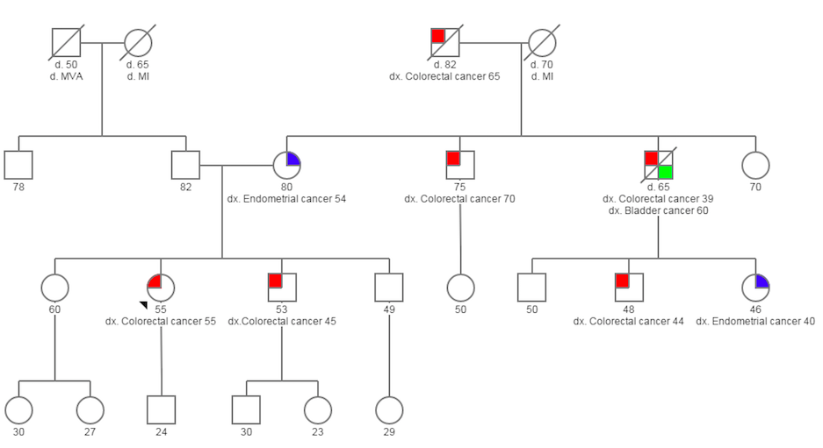
Lynch Syndrome Risk Assessment Pedigree
SAMPLE
Notes:
This is a fictional family history. Any similarities it has to a real patient family history are purely coincidental.

Slide 35
Family Health History Screening and Risk Assessment

Slide 36
Family Health History Screening and
Risk Assessment
Health care providers should ask the following questions when taking a family health history:
Do you have any relatives who have been diagnosed with cancer?
  Be sure to ask about parents, brothers, sisters, children, grandparents, aunts, uncles, nieces, and nephews
For each relative with a diagnosis of cancer
  What type(s) of cancer did the relative have (note multiple primaries)?
  What was the specific pathology of the cancer (if known)? Is the tumor available for testing (if colorectal or endometrial cancer)?
  At what age was the relative diagnosed with cancer?
Family ethnicity/country of origin

Slide 37
Possible Indicators for BRCA1/BRCA2 Mutations
Personal or family health history of
Known BRCA1 or BRCA2 mutation in the family
Breast cancer diagnosed ≤ age 45 in women
Breast cancer diagnosed ≤ age 50 in women with at least one close blood relative with breast, pancreatic, or high grade prostate cancer at any age or limited family history
Triple negative breast cancer diagnosed ≤ age 60 in women
Two diagnoses of breast cancer or two types of BRCA-related cancer in the same person
Breast cancer at any age in men
Source: National Comprehensive Cancer Network. NCCN Guidelines Version 2.2017 Genetics/Familial High-Risk Assessment: Breast and Ovarian.

Slide 38
Possible Indicators for BRCA1/BRCA2 Mutations
Personal or family health history of
Breast cancer at any age and any of the following
  Two or more close blood relative with breast cancer at any age
  One or more close blood relative with breast cancer diagnosed ≤ age 50
  Two or more close blood relatives with pancreatic cancer or high grade prostate cancer
  Close male blood relative with breast cancer
  Close blood relative with ovarian carcinoma
  Ashkenazi Jewish or Eastern European ancestry
Source: National Comprehensive Cancer Network. NCCN Guidelines Version 2.2017 Genetics/Familial High-Risk Assessment: Breast and Ovarian.

Slide 39
Possible Indicators for BRCA1/BRCA2 Mutations
Personal or family health history of
Ovarian carcinoma
Pancreatic cancer and at least 2 close blood relatives with breast, ovarian, pancreatic cancer, or high grade prostate cancer at any age
Aggressive prostate cancer and 2 close blood relatives with breast, ovarian, or pancreatic cancer at any age
Pancreatic cancer and Ashkenazi Jewish or Eastern European ancestry
Third-degree blood relative with breast cancer or ovarian carcinoma who has 2 or more close blood relatives with breast cancer (at least one diagnosed < age 50) or ovarian carcinoma
Source: National Comprehensive Cancer Network. NCCN Guidelines Version 2.2017 Genetics/Familial High-Risk Assessment: Breast and Ovarian. and A practice guideline from the American College of Medical Genetics and Genomics and the National Society of Genetic Counselors: referral indications for cancer predisposition assessment. Genetics in Medicine. 2014

Slide 40
Other Causes of Breast and Ovarian Cancer in a Family
Familial cancers
  Mutations in genes other than BRCA1 or BRCA2
  Shared environment
  Chance clustering of sporadic cancer cases
  Combinations of these factors
Other genes associated with inherited susceptibility to breast and/or ovarian cancer
  PTEN, TP53, CDH1, ATM, CHEK2, PALB2, STK11 and others
  Genetic testing using multi-gene panels is available that include these and other genes
Source: National Comprehensive Cancer Network. NCCN Guidelines Version 2.2017 Genetics/Familial High-Risk Assessment: Breast and Ovarian.

Slide 41
Possible Indicators for Lynch Syndrome
EGAPP recommends genetic screening of all newly diagnosed patients with colorectal cancer
Indicators cited by other guidelines
Endometrial (uterine) cancer < age 50
Three or more family members with a Lynch-associated cancer
History of a known Lynch syndrome mutation in a family
Sebaceous adenomas or carcinomas
Abnormal IHC/MSI
Source: National Comprehensive Cancer Network. NCCN Guidelines Version 1.2017 Genetics/Familial High-Risk Assessment: Colon. And A practice guideline from the American College of Medical Genetics and Genomics and the National Society of Genetic Counselors: referral indications for cancer predisposition assessment. Genetics in Medicine. 2014

Slide 42
Other Causes of Colorectal Cancer
Often sporadic
Other familial cancer syndromes
  APC-associated familial adenomatous polyposis (FAP, also known as classic FAP)
  Attenuated FAP (AFAP)
  MUTYH-associated polyposis (MAP)
  Familial colorectal cancer type X
  Peutz-Jeghers syndrome
  Cowden syndrome
  Juvenile polyposis
American Society of Clinical Oncology (ASCO) and National Comprehensive Cancer Network (NCCN) have separate management guidelines for these syndromes
American Society of Clinical Oncology Clinical Practice Guideline Endorsement of the Familial Risk- Colorectal Cancer: European Society for Medical Oncology Clinical Practice Guidelines. Journal of Clinical Oncology. 2014. 58. 1322.
National Comprehensive Cancer Network. NCCN Guidelines Version 1.2017 Genetics/Familial High-Risk Assessment: Colon.

Slide 43
Genetic Counseling for Hereditary Breast and Ovarian Cancer Syndrome and
Lynch Syndrome

Slide 44
What Do I Do After I Identify a Patient as At-Risk?
Refer for genetic counseling
Provide education regarding the genetics of cancer and the likelihood of developing cancer
Discuss risks, benefits, and limitations of genetic testing
Review appropriate cancer screening and prevention strategies
NSGC Practice Guideline: Risk Assessment and Genetic Counseling for Hereditary Breast and Ovarian Cancer: J Genet Counsel (2013) 22:155-163.

Slide 45
Who Can Provide Genetic Counseling?
Several professional organizations describe skills and training needed for comprehensive genetic counseling
National Society of Genetic Counselors
American College of Surgeons Commission on Cancer

Slide 46
Who Can Provide Genetic Counseling?
National Society of Genetic Counselors
Certified Genetic Counselors
  Have Master’s-level education through accredited program
  Passed certification exam
  Meet other requirements of American Board of Genetic Counseling
    Certification and licensure requirements differ by state
  Search for a genetic counselor by specialty and location at http://www.nsgc.org/

Slide 47
Who Can Provide Genetic Counseling?
American College of Surgeons Commission on Cancer
Standard 2.3. Risk Assessment and Genetic Counseling
Genetics professionals include
  American Board of Genetic Counseling or American Board of Medical Genetics board-certified or licensed genetic counselor
  American College of Medical Genetics physician board-certified in medical genetics
  Genetics Clinical Nurse or an Advanced Practice Nurse in Genetics credentialed through Genetics Nursing Credentialing Commission
  Board-certified physician with experience in cancer genetics (defined as providing cancer risk assessment on a regular basis)
  Advanced practice oncology nurse with specialized graduate education in cancer genetics and hereditary cancer predisposition syndromes; certification by the Oncology Nursing Certification Corporation preferred
    Educational seminars offered by commercial laboratories about how to perform genetic testing not considered adequate training for cancer risk assessment and genetic counseling

Slide 48
Why is Genetic Counseling Essential?
Ensure full informed consent
Address patient’s and families’ concerns
Review differential diagnosis
Assess best strategy to test the family
Obtain records (on other family members), pathology, detailed family health history
Interpret results accurately
  Positive, negative, variant of unknown significance
Increase the likelihood that correct surveillance is recommended
Coordinate testing for family members

Slide 49
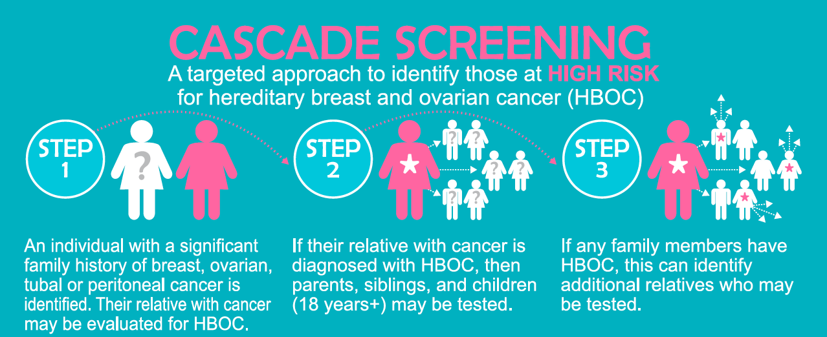
Cascade Screening
An active process to find relatives of person affected with certain genetic conditions at a pre-symptomatic stage because interventions exist that can save lives
An example of cascade screening for HBOC:

Slide 50
Risks to Family Members
BRCA- and Lynch syndrome-associated genetic changes are almost always inherited from a parent
First degree relatives (parents, siblings, children) of an individual diagnosed with a BRCA or Lynch syndrome-associated genetic change have a 50% risk of having the same genetic change
  Second, third, and more distant relatives are also at risk to have the same genetic change
Relatives who do not have the genetic change identified in the family cannot pass it on to their children

Slide 51
Genetic Testing in Relatives
First person tested in family should have had breast or ovarian cancer (for BRCA testing) or colorectal or other Lynch syndrome-related cancer (for Lynch syndrome testing) whenever possible
  Full gene sequencing of one or more indicated genes
  Testing for founder mutations if Ashkenazi Jewish or Eastern European ancestry
  Identify specific genetic change in the family
Relatives should have genetic testing for the specific genetic change identified
  Single Site testing or Site-specific testing
  Significantly less expensive

Slide 52
Continuity of Care
Continuity of care is essential and includes
Continuing contact with patients, inquiring about changes in family history
Asking carriers about other family members considering genetic counseling
Discuss new testing techniques, changes in variants of uncertain significance

Slide 53
When Can Genetic Evaluation Be Done?
After identification of risk (significant family health history)
After cancer diagnosis
Concomitant with diagnosis and treatment discussions
During treatment, including chemotherapy
After treatment
  Months, years later, when other family members become concerned

Slide 54
Affordable Care Act
Affordable Care Act (ACA) requires many health plans to provide in-network coverage without cost-sharing for preventive services with a USPSTF rating of “A” or “B”
  B rating for BRCA screening recommendation
  Genetic counseling, if appropriate, is covered in-network without cost sharing when used in accordance with the USPSTF recommendation
  Department of Health and Human Service clarified in 2013 that the BRCA test itself, if appropriate, is within the scope of the USPSTF recommendation and should be covered in-network without cost sharing
  Applies to non-grandfathered health plans and health insurance coverage offered in the individual or group market
*Billing practices for genetic counseling vary by institution and may affect coverage
http://www.cms.gov/CCIIO/Resources/Fact-Sheets-and-FAQs/aca_implementation_faqs12.html
https://www.healthcare.gov/preventive-care-benefits/women/

Slide 55
Management Options for Hereditary Breast and Ovarian Cancer Syndrome and
Lynch Syndrome

Slide 56
Interventions for Women with BRCA1 and BRCA2 Mutations
Several management options exist but the strength of evidence varies across types of interventions
USPSTF recommends:
Risk-reducing bilateral mastectomy
  85-100% reduction in breast cancer risk
Risk-reducing oophorectomy or bilateral salpingo-oophorectomy (BSO)
  69-100% reduction in ovarian cancer risk
  37-100% reduction in breast cancer risk
Chemoprevention
  Tamoxifen or raloxifene
U.S. Preventive Services Task Force. Risk Assessment, Genetic Counseling, and Genetic Testing for BRCA-Related Cancer in Women: U.S. Preventive Services Task Force Recommendation Statement. Ann Intern Med. 2014;160:271-281.

Slide 57
Interventions for Women with
BRCA1 and BRCA2 Mutations
Other recommendations include increased surveillance:
Breast
  Breast awareness starting at age 18
  Clinical breast exam 2X per year beginning at age 25
  Yearly MRI or mammogram (Age 25-29 years)
  Yearly MRI and mammogram (Age 30-75 years)
Ovarian
  Data do not support routine ovarian screening
  Not shown to be sufficiently sensitive or specific but may be considered:
    Trans-vaginal ultrasound starting at age 30-35
    Serum CA-125
Source: National Comprehensive Cancer Network. NCCN Guidelines Version 2.2017 Genetics/Familial High-Risk Assessment: Breast and Ovarian. BRCA-A.

Slide 58
Interventions for Individuals with Lynch Syndrome
EGAPP recommends:
Contacting blood relatives to offer counseling and targeted testing for Lynch syndrome
For relatives with Lynch syndrome, having colonoscopies more frequently and beginning at an earlier age
For all women with Lynch syndrome (both index case and relatives), considering additional surveillance for endometrial cancer
Not address colorectal cancer treatment in index case
Evaluation of Genomic Applications in Practice and Prevention (EGAPP) Working Group. Recommendations from the EGAPP Working Group: Genetic testing strategies in newly diagnosed individuals with colorectal cancer aimed at reducing morbidity and mortality from Lynch syndrome in relatives. Genetics in Medicine 2009; 11:35-41.

Slide 59
Interventions for Individuals with Lynch Syndrome
NCCN recommends:
Colon and Rectum
  Colonoscopy every 1-2 years starting at age 20-25 (or 2-5 years prior to age of earliest CRC diagnosis in family if relative diagnosed < age 25)
Endometrium and Ovary
  Patient education that dysfunctional uterine bleeding warrants evaluation
  Risk-reducing total abdominal hysterectomy-bilateral salpingo-oophorectomy
  Annual endometrial sampling (not clear evidence to support this screening)
  Limited screening for ovarian cancer at provider’s discretion (not clear evidence to support this screening)
Gastric and Small Bowel
  Extended duodenoscopy and polypectomy at 3-5 yr. intervals beginning age 30-35
Urinary Tract
  Annual urine analysis starting at age 30-35
Central Nervous System Cancer
  Annual physical/neurological exam starting at age 25-30
National Comprehensive Cancer Network. NCCN Guidelines Version 2.2017 Genetics/Familial High-Risk Assessment: Breast and Ovarian. BRCA-A.

Slide 60
Interventions for Individuals with Lynch Syndrome
European Society for Medical Oncology/American Society of Clinical Oncology recommends:
Colon and Rectum
  Colonoscopy every 1-2 years starting at age 20-25 or 5 years before the youngest case in the family
Endometrium and ovary-
  Gynecological examination, pelvic ultrasound, CA-125 analysis, and aspiration biopsy every year, starting at ages 30-35
  Risk-reducing total abdominal hysterectomy-bilateral salpingo-oophorectomy
Gastric cancer-
  Search for presence of Helicobacter pylori and subsequent eradication
Upper gastrointestinal endoscopy every 1-3 years for high incidence populations
Familial risk-colorectal cancer: ESMO Clinical Practice Guidelines. American Society of Clinical Oncology Clinical Practice Guideline Endorsement of the Familial Risk- Colorectal Cancer: European Society for Medical Oncology Clinical Practice Guidelines. Journal of Clinical Oncology. 2014. 58. 1322.

Slide 61
Bidirectional Cancer Registry Reporting for the Identification of Individuals at Risk for Hereditary Breast and Ovarian Cancer Syndrome and Lynch Syndrome
Notes:
Please note that bidirectional cancer registry reporting for the identification of individuals at risk for Hereditary Breast and Ovarian Cancer syndrome and Lynch syndrome is one approach that some state health departments have used. However, the evidence on the effectiveness of this approach has not been evaluated in a systematic manner.

Slide 62
Cancer Registries
All states maintain central cancer registries in accordance with state laws
All cancers diagnosed in a state are reported to that state’s central cancer registry
Cancer registrars at each institution collect information required by the state to submit to the state registry, including:
  Demographics
  Information about cancer diagnosis
  Treatment information

Slide 63
Cancer Registries
State central cancer registry data are used for
  Identifying trends
  Public health purposes
  Approved research
Patient information is kept confidential
  Only reported in aggregate, without patient identifiers
  IRB approval required for research using cancer registry data

Slide 64
Bidirectional Cancer Registry Reporting
Insert Video Clip Here
Notes:
Please note that bidirectional cancer registry reporting for the identification of individuals at risk for Hereditary Breast and Ovarian Cancer syndrome and Lynch syndrome is one approach that some state health departments have used. However, the evidence on the effectiveness of this approach has not been evaluated in a systematic manner.

Slide 65
Bidirectional Cancer Registry Reporting
A two-way exchange of information between the state cancer registry and reporting institutions
  Cancer cases reported to state registry by institution
  State cancer registry uses national guidelines to identify cases with increased risk for HBOC or LS
  State compiles these cases and associated informational materials for providers and patients
  State sends this information back to institution
Notes:
Please note that bidirectional cancer registry reporting for the identification of individuals at risk for Hereditary Breast and Ovarian Cancer syndrome and Lynch syndrome is one approach that some state health departments have used. However, the evidence on the effectiveness of this approach has not been evaluated in a systematic manner.

Slide 66
Information Provided Through
Bidirectional Cancer Registry Reporting
Number of patients identified as being potential candidates for genetic evaluation for HBOC or LS
Information for providers about HBOC and LS
Summary of patient management recommendations
List of cancer genetic counseling services in the state
Patient educational materials about HBOC and LS
Information to assist patients with sharing information about their HBOC or LS diagnosis with family members
Notes:
Please note that bidirectional cancer registry reporting for the identification of individuals at risk for Hereditary Breast and Ovarian Cancer syndrome and Lynch syndrome is one approach that some state health departments have used. However, the evidence on the effectiveness of this approach has not been evaluated in a systematic manner.

Slide 67
State Tumor Registry Data for xxxx-xxxx
Potential HBOC-Associated Cancers*
Number of cancers diagnosed during [Timeframe] in [Location] patients who could have Hereditary Breast and Ovarian Cancer syndrome (HBOC)
Cancer Site | Sample (Facility specific) | Entire State
Female Breast (≤ Age 45)* | # of cases | # of cases
Female Breast (≤ Age 50)* | # of cases | # of cases
Triple Negative Female Breast (≤ Age 60) | # of cases | # of cases
Ovary, Fallopian Tube, or Peritoneum (All Ages) | # of cases | # of cases
Male Breast (All Ages) | # of cases | # of cases
Multiple Primary Breast Cancers | # of cases | # of cases
*These are cancers in individuals who should be evaluated for referral to genetic counseling but are not confirmed HBOC-associated.
Notes:
This is an example template of what would be sent to providers or institutions as part of bidirectional registry reporting.
Please note that bidirectional cancer registry reporting for the identification of individuals at risk for Hereditary Breast and Ovarian Cancer syndrome and Lynch syndrome is one approach that some state health departments have used. However, the evidence on the effectiveness of this approach has not been evaluated in a systematic manner.

Slide 68
State Tumor Registry Data xxxx-xxxx
Potential Lynch Syndrome Associated Cancers*
Number of cancers diagnosed during [Timeframe] in [Location] patients who could have Lynch syndrome (also called Hereditary Nonpolyposis Colorectal Cancer)
Cancer Site | Your institution | Entire State
Colon or Rectum (All Ages) | # of cases | # of cases
Endometrium (< Age 50) | # of cases | # of cases
*These are cancers in individuals who should be evaluated for referral to genetic counseling but are not confirmed HBOC-associated.
Notes:
This is an example template of what would be sent to providers or institutions as part of bidirectional registry reporting.
Available at:
Please note that bidirectional cancer registry reporting for the identification of individuals at risk for Hereditary Breast and Ovarian Cancer syndrome and Lynch syndrome is one approach that some state health departments have used. However, the evidence on the effectiveness of this approach has not been evaluated in a systematic manner.

Slide 69
How Bidirectional Cancer Registry Reporting
Can Improve Patient Health
Identifies patients who are potential candidates for genetic counseling and testing for HBOC and LS
Allows for identification of at-risk relatives of individuals with HBOC or LS through cascade screening
Provides patients and their family members with information for primary and secondary prevention of cancer in the future, if patients are contacted as part of bidirectional reporting program
Aids providers in personalizing screening and prevention plans for patients and their family members, if providers receive information on individual patients
Increases awareness of national guidelines for HBOC and LS
Notes:
Please note that bidirectional cancer registry reporting for the identification of individuals at risk for Hereditary Breast and Ovarian Cancer syndrome and Lynch syndrome is one approach that some state health departments have used. However, the evidence on the effectiveness of this approach has not been evaluated in a systematic manner.

Slide 70
[State’s] Bidirectional Cancer Registry Reporting Program
[Use this slide to describe the program being implemented in your state. For example, who will be receiving information from the cancer registry and in what format? What patients will be identified? Will providers have access to specific patient names? Etc.]
Notes:
Please note that bidirectional cancer registry reporting for the identification of individuals at risk for Hereditary Breast and Ovarian Cancer syndrome and Lynch syndrome is one approach that some state health departments have used. However, the evidence on the effectiveness of this approach has not been evaluated in a systematic manner.

Slide 71
Bidirectional Cancer Registry Reporting: Limitations
Bidirectional reporting will not identify all patients who meet national guidelines
  Most state cancer registries do not collect family history information, so patients with a significant family history of cancer may not be identified.
  Providers must continue to be vigilant in identifying these patients through careful family health history collection.
Lag in registry data (2+ years) so most individuals will be finished with treatment at the time they are identified.
Reporting physician information is not always reliable, and provider may no longer provide care for patient.
Reporting institution might be where patient got diagnosed and not where they received care or routinely see doctors.
Reports sent to institutions may not be seen by providers.
Notes:
Please note that bidirectional cancer registry reporting for the identification of individuals at risk for Hereditary Breast and Ovarian Cancer syndrome and Lynch syndrome is one approach that some state health departments have used. However, the evidence on the effectiveness of this approach has not been evaluated in a systematic manner.

Slide 72
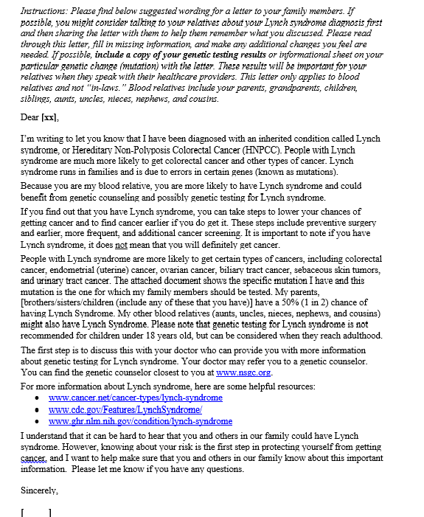
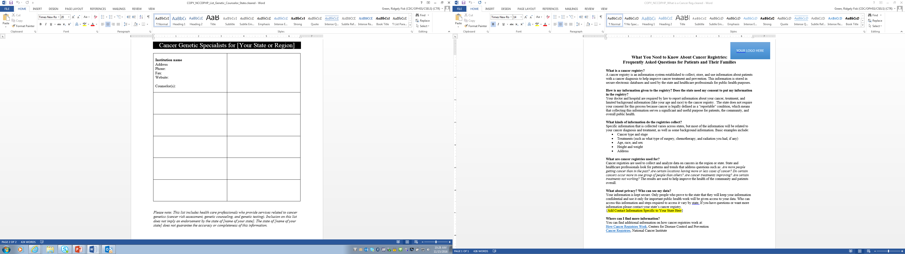

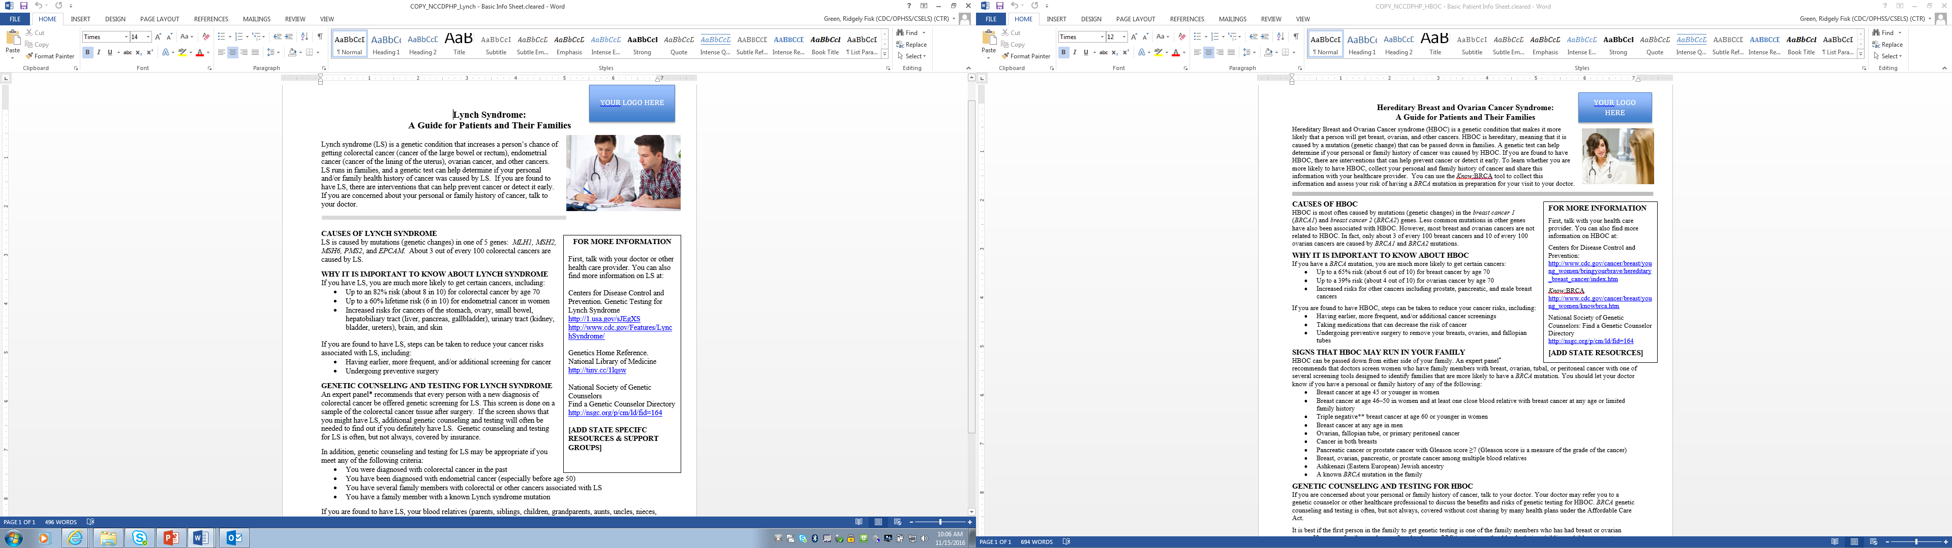
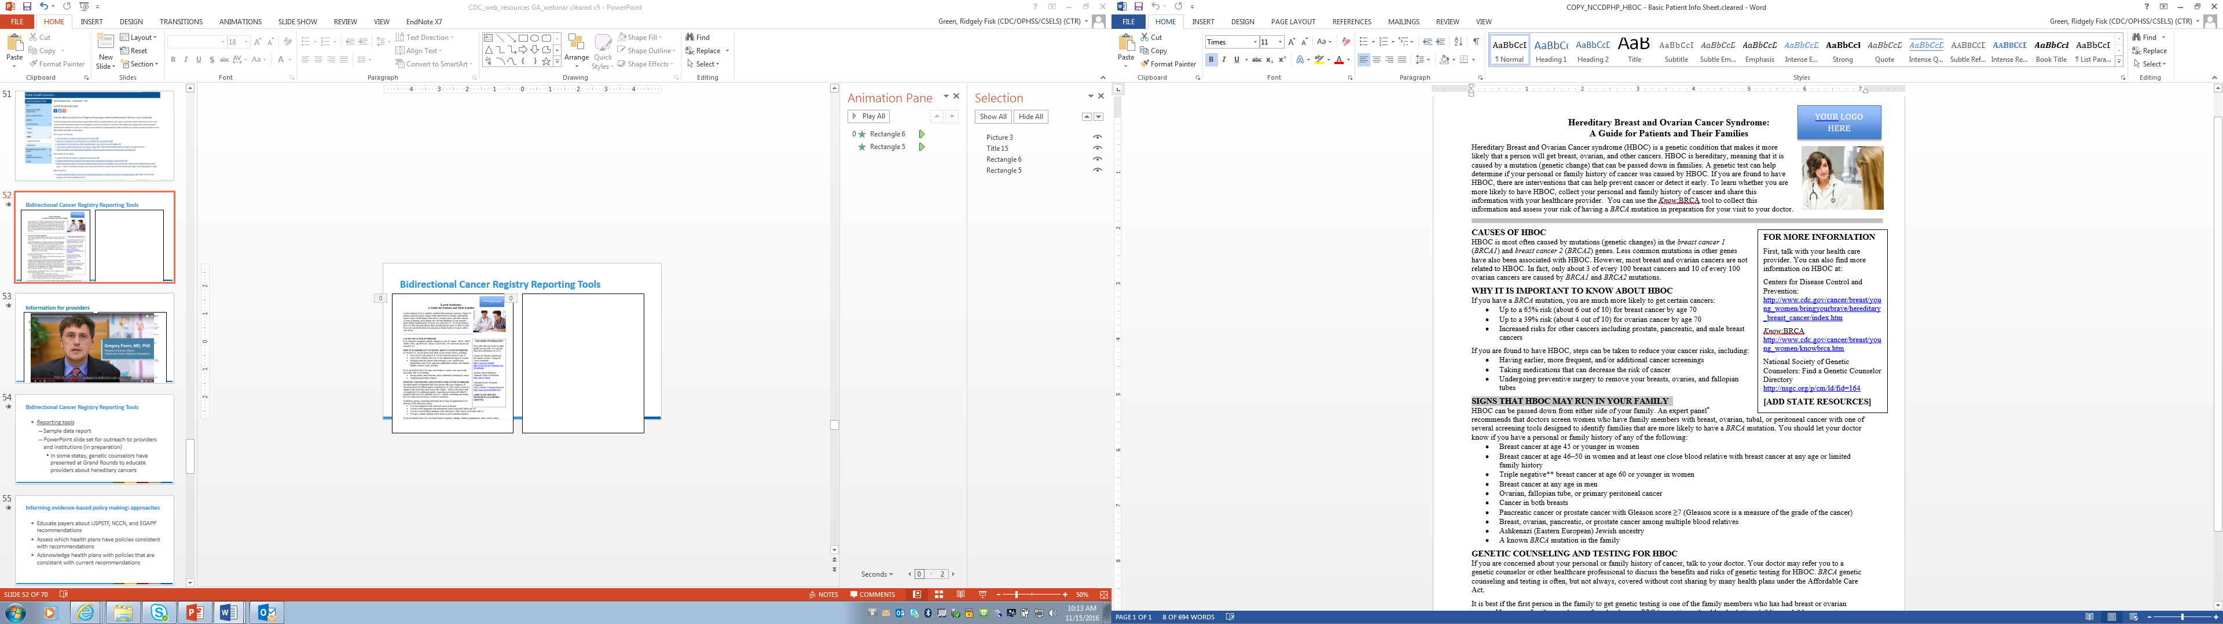
Information for Patients and Families
Notes:
Please note that these materials are available on the CDC website and can be used for patient and provider education on HBOC and Lynch syndrome.
Lynch syndrome: https://www.cdc.gov/genomics/implementation/toolkit/lynch_4.htm
HBOC: https://www.cdc.gov/genomics/implementation/toolkit/hboc_4.htm
Patient materials include:
Lynch Syndrome: A Guide for Patients and Their Families(https://www.cdc.gov/genomics/implementation/toolkit/file/lynch_basic_info.docx)
Brochure on Talking to Your Family About Your Diagnosis of Lynch Syndrome(https://www.cdc.gov/genomics/implementation/toolkit/file/lynch_talk_to_family.pptx)
Sample Letter for Informing Your Family Members about Your Lynch Syndrome Mutation(https://www.cdc.gov/genomics/implementation/toolkit/file/lynch_letter_patients.docx)
List of Cancer Genetic Specialists for Your State or Region(https://www.cdc.gov/genomics/implementation/toolkit/file/list_genetic_counselor_state.docx) (Please note that state programs will need to complete this form.)
What You Need to Know About Cancer Registries: Frequently Asked Questions for Patients and Their Families(https://www.cdc.gov/genomics/implementation/toolkit/file/what_is_a_cancer_reg.docx)

Slide 73


Brochure
Why Talk to My Family?
Your family members can benefit from knowing about your diagnosis of Lynch syndrome. Talk to your family members about Lynch syndrome, so that they will know that:
Lynch syndrome is passed through families.
A person with Lynch syndrome is more likely to get colorectal, endometrial (uterine), ovarian, and other cancers.
Genetic counseling and testing for Lynch syndrome can provide information about their risk.
If they choose to be tested, they should be tested for the same mutation that you have.
Steps can be taken to prevent colorectal and other cancers or find them earlier.
IT’S NOT EASY...
...but talking about Lynch syndrome is one of the most important things you can do to protect your family.
Judi’s Story
When you share information with people, sometimes they feel helpless and don’t want to address it. I used to have that mentality, too. After my genetic testing, the genetic counselor asked if I wanted to come in to talk about my test results or if I would rather have them over the phone. I wanted it quick like a band-aid. At that moment, my life changed: I was positive for Lynch syndrome. I could not ignore it anymore. Now there’s always the question, where do you go from here? Because it’s not something you get better from. That is the most difficult part of explaining to people what Lynch syndrome is and what it means for the future.
Talking to Your Family About Your Diagnosis of Lynch Syndrome
Insert Your Logo/Organization Info Here
Notes:
Please note that these materials are available on the CDC website and can be used for patient and provider education on HBOC and Lynch syndrome.
Lynch syndrome: https://www.cdc.gov/genomics/implementation/toolkit/lynch_4.htm
HBOC: https://www.cdc.gov/genomics/implementation/toolkit/hboc_4.htm
Patient materials include:
Lynch Syndrome: A Guide for Patients and Their Families(https://www.cdc.gov/genomics/implementation/toolkit/file/lynch_basic_info.docx)
Brochure on Talking to Your Family About Your Diagnosis of Lynch Syndrome(https://www.cdc.gov/genomics/implementation/toolkit/file/lynch_talk_to_family.pptx)
Sample Letter for Informing Your Family Members about Your Lynch Syndrome Mutation(https://www.cdc.gov/genomics/implementation/toolkit/file/lynch_letter_patients.docx)
List of Cancer Genetic Specialists for Your State or Region(https://www.cdc.gov/genomics/implementation/toolkit/file/list_genetic_counselor_state.docx) (Please note that state programs will need to complete this form.)
What You Need to Know About Cancer Registries: Frequently Asked Questions for Patients and Their Families(https://www.cdc.gov/genomics/implementation/toolkit/file/what_is_a_cancer_reg.docx)

Slide 74

Brochure 2
How Do I Talk to My Family About My Lynch Syndrome Diagnosis?
WHO: Your parents, siblings, and children are the family members who are most likely to have Lynch syndrome. Other blood relatives, such as aunts, uncles, nieces, nephews and cousins, are also more likely to have Lynch syndrome. Your healthcare provider or genetic counselor can help you figure out who in your family might have Lynch syndrome and thus would benefit from knowing about your diagnosis.
WHAT: You can share test results, letters from your doctor or genetic counselor, or other information you received about your diagnosis with your family. Giving family members information about your specific genetic mutation helps their healthcare providers know exactly which test to use and might possibly save your family money.
HOW: If you need extra support talking to your family, bring a friend. You can also ask a family member to attend your next medical appointment with you. The website http://kintalk.org can help you let your relatives know about your diagnosis and provides resources to help them learn more about Lynch syndrome. A sample letter that you can fill out and send to your family is available at www.cdc.gov/genomics/restoflink
What if My Family Does Not Want to Talk?
Talking to some family members about Lynch syndrome might not be easy. Some might not understand why they need to know this information. Others might be nervous about receiving a diagnosis of Lynch syndrome. Remember that family members need to make their own choices about getting tested, whether or not you agree with their decisions. If family members don’t want to talk about Lynch syndrome, respect their wishes. Let them know you are available to talk if they have questions, and give them places to find information.
When family members do not want to talk about Lynch syndrome, you might feel upset or alone. Seek support from friends, healthcare providers, other family members, or people you know with Lynch syndrome.
Where Can I Find More Information?
You can find more information on Lynch syndrome at:
www.ghr.nlm.nih.gov/condition/lynch-syndrome
You can find information on support groups for Lynch syndrome at:
http://www.diseaseinfosearch.org/Lynch+syndrome/3371
How Do I Talk to My Children?
If you have Lynch syndrome, each of your children has a 50% (1 in 2) chance of having Lynch syndrome. Genetic testing for Lynch syndrome is typically not recommended for children younger than 18, but can be considered when your children reach adulthood.
Younger children might not be able to understand what your diagnosis means for you or for them. Children differ in the age at which they are ready to learn about this information. Answer the questions they ask. They will ask more complex questions as they grow and are ready to learn more.
Know that your children may have fears about the risk both to themselves and to you. Just as you need time and support to cope with the information and accept it, so will your children.
Notes:
Please note that these materials are available on the CDC website and can be used for patient and provider education on HBOC and Lynch syndrome.
Lynch syndrome: https://www.cdc.gov/genomics/implementation/toolkit/lynch_4.htm
HBOC: https://www.cdc.gov/genomics/implementation/toolkit/hboc_4.htm
Patient materials include:
Lynch Syndrome: A Guide for Patients and Their Families(https://www.cdc.gov/genomics/implementation/toolkit/file/lynch_basic_info.docx)
Brochure on Talking to Your Family About Your Diagnosis of Lynch Syndrome(https://www.cdc.gov/genomics/implementation/toolkit/file/lynch_talk_to_family.pptx)
Sample Letter for Informing Your Family Members about Your Lynch Syndrome Mutation(https://www.cdc.gov/genomics/implementation/toolkit/file/lynch_letter_patients.docx)
List of Cancer Genetic Specialists for Your State or Region(https://www.cdc.gov/genomics/implementation/toolkit/file/list_genetic_counselor_state.docx) (Please note that state programs will need to complete this form.)
What You Need to Know About Cancer Registries: Frequently Asked Questions for Patients and Their Families(https://www.cdc.gov/genomics/implementation/toolkit/file/what_is_a_cancer_reg.docx)

Slide 75
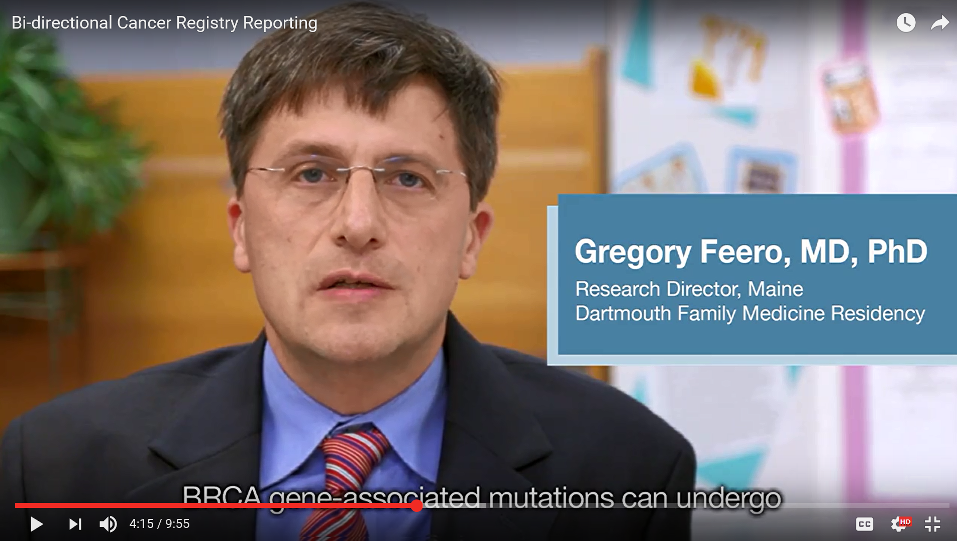
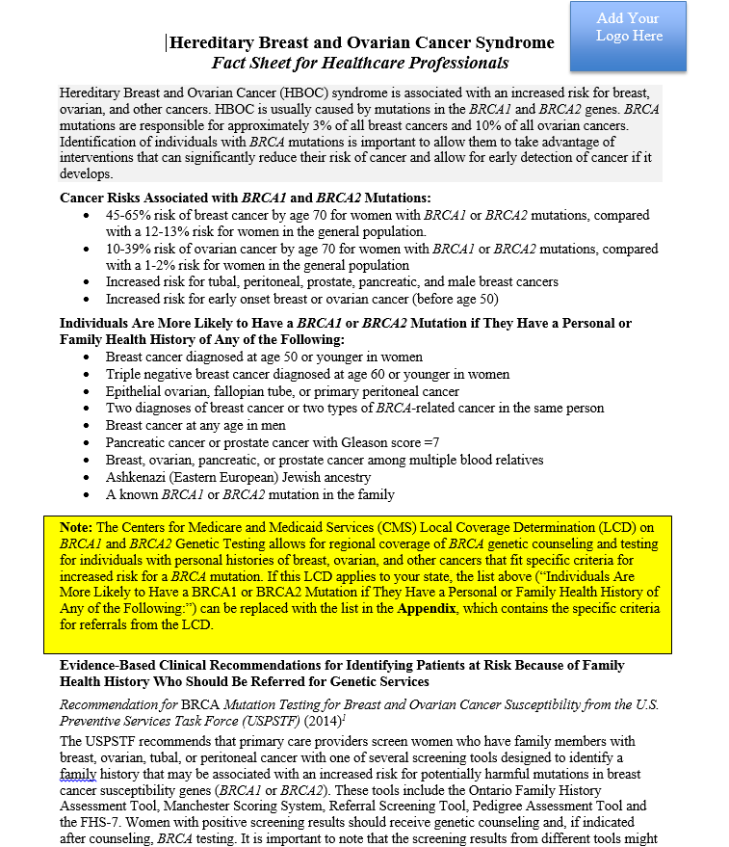
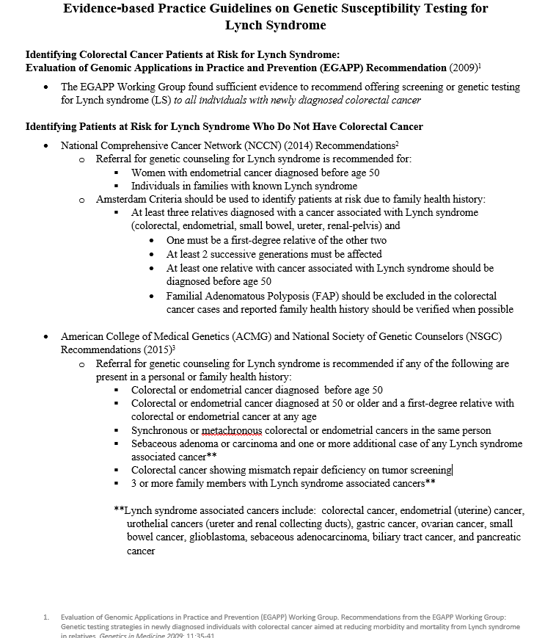
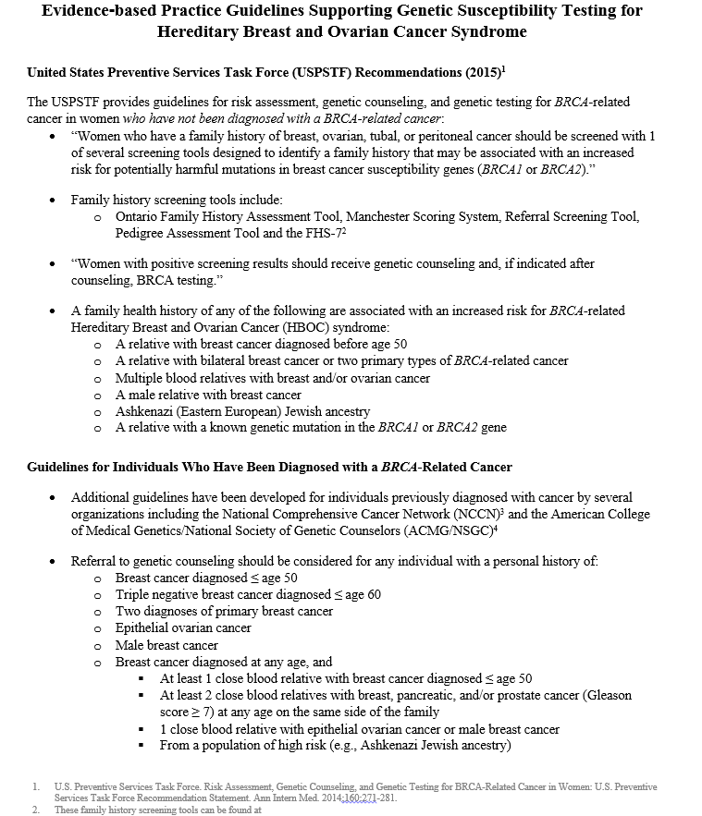
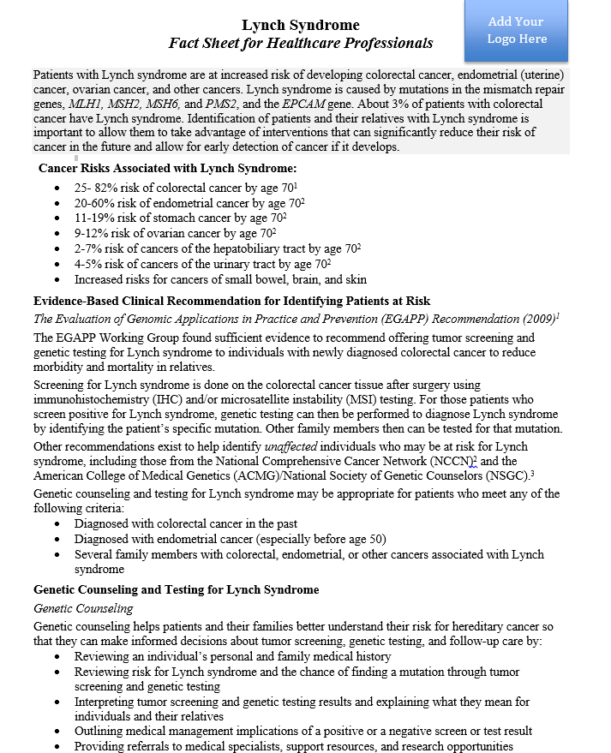
Information for Providers
Notes:
Please note that these materials are available on the CDC website and can be used for patient and provider education on HBOC and Lynch syndrome.
Lynch syndrome: https://www.cdc.gov/genomics/implementation/toolkit/lynch_4.htm
HBOC: https://www.cdc.gov/genomics/implementation/toolkit/hboc_4.htm
Information for Providers
Lynch Syndrome: Fact Sheet for Healthcare Professionals(https://www.cdc.gov/genomics/implementation/toolkit/file/lynch_healthcare_professionals_fact_sheet.docx)
Evidence-based Practice Guidelines Supporting Genetic Susceptibility Testing for Lynch Syndrome(https://www.cdc.gov/genomics/implementation/toolkit/file/lynch_guidelines.docx)
Bidirectional cancer registry reporting to identify patients at high risk for hereditary cancer syndromes: what providers and institutions need to know. Video for educational outreach to providers and institutions in states that have bidirectional cancer registry reporting programs in place.

Slide 76
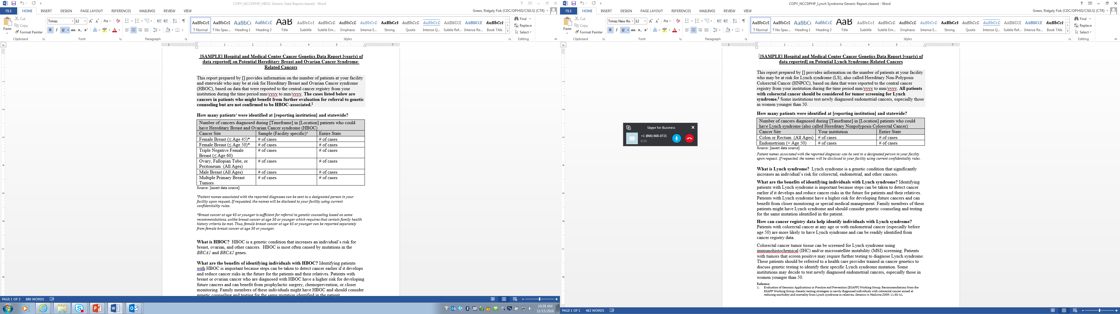
Reporting Tools
Reporting tools
  Sample data report
  PowerPoint slide set for outreach to providers and institutions (in preparation)
    In some states, genetic counselors have presented at Grand Rounds to educate providers about hereditary cancers
Notes:
The following materials were developed to support state programs using bidirectional cancer registry reporting to identify individuals at risk for Lynch syndrome and HBOC. State health departments are encouraged to customize the materials to meet their needs.
Please note that these materials are available on the CDC website:
Lynch syndrome: https://www.cdc.gov/genomics/implementation/toolkit/lynch_4.htm
HBOC: https://www.cdc.gov/genomics/implementation/toolkit/hboc_4.htm
Reporting Tools
Sample Hospital and Medical Center Cancer Genetics Data Report on Potential Lynch Syndrome-Related Cancers(https://www.cdc.gov/genomics/implementation/toolkit/file/lynch_generic_report.docx) (Please note that state programs will need to complete this form.)

Slide 77
Quiz time!

Slide 78
HBOC Scenarios
Scenario 1: All adult women diagnosed with breast cancer should be referred for further genetic evaluation
True
False

Slide 79
HBOC Scenarios
Scenario 1: All adult women diagnosed with breast cancer should be referred for further genetic evaluation
True
False
Notes:
Only those who meet certain criteria (related to age of diagnosis, type of cancer, presence of certain other cancers or cancer in both breasts, ancestry, and family health history) should be referred.

Slide 80
USPSTF Scenarios
Scenario 2: All adult women with a family history of breast cancer should be referred for further genetic evaluation.
True
False

Slide 81
HBOC Scenarios
Scenario 2: All adult women with a family history of breast cancer should be referred for further genetic evaluation.
True
False
Notes:
Only those who meet certain criteria (related to the number of relatives affected and relatives’ age of diagnosis, type of cancer, presence of certain other cancers or cancer in both breasts, ancestry, and degree of closeness) should be referred.

Slide 82
HBOC Scenarios
Scenario 3: Any adult woman with multiple primary breast cancers should be referred for further genetic evaluation.
True
False

Slide 83
HBOC Scenarios
Scenario 3: Any adult woman with multiple primary breast cancers should be referred for further genetic evaluation.
True
False
Notes:
Multiple primary breast cancers, in the same breast or bilaterally, are an indication for referral.

Slide 84
HBOC Scenarios
Scenario 4: Your patient, Karen, was recently diagnosed with breast cancer. Her mother died of breast cancer that was diagnosed at age 65 and her mother’s sister was diagnosed with breast cancer at age 58 and is still living. Because so many people in her family have been affected by breast cancer, she is concerned about the risks for her younger sisters and asks if there is anything she can do to help them. Karen should be referred for further genetic evaluation.
True
False

Slide 85
HBOC Scenarios
Scenario 4: Your patient, Karen, was recently diagnosed with breast cancer. Her mother died of breast cancer that was diagnosed at age 65 and her mother’s sister was diagnosed with breast cancer at age 58 and is still living. Because so many people in her family have been affected by breast cancer, she is concerned about the risks for her younger sisters and asks if there is anything she can do to help them. Karen should be referred for further genetic evaluation.
True
False
Notes:
A woman with a personal history of breast cancer and any of the following should be referred:
≥ 1 close blood relative with breast cancer diagnosed ≤ age 50
≥ 2 close blood relatives with breast cancer at any age
≥ 1 close blood relative with ovarian carcinoma
≥ 2 close blood relatives with pancreatic cancer and/or high grade prostate cancer at any age
A close male blood relative with breast cancer
Ashkenazi Jewish or Eastern European ancestry
Both Karen and her aunt meet criteria for further genetic evaluation.

Slide 86
HBOC Scenarios
Scenario 5: Your patient, Kristen, has no personal history of cancer. However, her paternal first cousin, Tara, was recently diagnosed with breast cancer and underwent genetic testing. Tara was found to be a carrier of a BRCA2 mutation. Kristen’s father and Tara’s parents have passed away, so they are not available for genetic testing. Kristen should be referred for further genetic evaluation.
True
False

Slide 87
HBOC Scenarios
Scenario 5: Your patient, Kristen, has no personal history of cancer. However, her paternal first cousin, Tara, was recently diagnosed with breast cancer and underwent genetic testing. Tara was found to be a carrier of a BRCA2 mutation. Kristen’s father and Tara’s parents have passed away, so they are not available for genetic testing. Kristen should be referred for further genetic evaluation.
True
False
Notes:
All close blood relatives of an individual with a BRCA mutation should be referred for further genetic evaluation. BRCA mutations can increase risk for prostate, pancreatic, and male breast cancer in men, so male relatives should also be considered for referral. First degree relatives have a 50% chance of having HBOC.

Slide 88
HBOC Scenarios
Scenario 6: Your patient, Alice, has never had cancer, but her sister, Nina, got breast cancer at age 40. Nina is not interested in getting genetic testing, so Alice decided to get BRCA testing herself, and her test results were negative. This means that Alice is not at an increased risk for breast cancer.
a. True
b. False

Slide 89
HBOC Scenarios
Scenario 6: Your patient, Alice, has never had cancer, but her sister, Nina, got breast cancer at age 40. Nina is not interested in getting genetic testing, so Alice decided to get BRCA testing herself, and her test results were negative. This means that Alice is not at an increased risk for breast cancer.
a. True
b. False
Notes:
Because Nina has not had genetic testing, we do not know if her early-onset breast cancer was caused by a BRCA mutation. Nina is the most informative person in the family to test. If Nina’s BRCA testing result were negative, Alice would still be at a heightened risk for breast cancer due to her family history.

Slide 90
HBOC Scenarios
Scenario 7: Your patient, Megan, has been diagnosed with triple negative breast cancer at age 65. No one else in her family has ever been diagnosed with breast or ovarian cancer, but Megan has four daughters and is worried about their risk for breast cancer. Despite her concerns, Megan should not be referred for further genetic evaluation.
True
False

Slide 91
HBOC Scenarios
Scenario 7: Your patient, Megan, has been diagnosed with triple negative breast cancer at age 65. No one else in her family has ever been diagnosed with breast or ovarian cancer, but Megan has four daughters and is worried about their risk for breast cancer. Despite her concerns, Megan does not meet the criteria for further genetic evaluation.
True
False
Notes:
Because her triple negative breast cancer was not diagnosed before age 60, Megan does not meet criteria for further genetic evaluation.

Slide 92
Lynch Syndrome Scenarios
Scenario 1: All colorectal cancers should be screened for Lynch syndrome.
True
False

Slide 93
Lynch Syndrome Scenarios
Scenario 1: All colorectal cancers should be screened for Lynch syndrome.
True
False
Notes:
According to EGAPP recommendations, all individuals with newly diagnosed colorectal cancer should be screened for Lynch syndrome.

Slide 94
Lynch Syndrome Scenarios
Scenario 2: Any adult woman diagnosed with endometrial cancer prior to age 50 should be referred for genetic evaluation.
True
False

Slide 95
Lynch Syndrome Scenarios
Scenario 2: Any adult woman diagnosed with endometrial cancer prior to age 50 should be referred for genetic evaluation.
True
False
Notes:
Women with endometrial cancer prior to age 50 are more likely to have Lynch syndrome.

Slide 96
Lynch Syndrome Scenarios
Scenario 3: An adult male with colorectal cancer and normal IHC screening results should be referred for genetic evaluation.
True
False

Slide 97
Lynch Syndrome Scenarios
Scenario 3: An adult male with colorectal cancer and normal IHC screening results should be referred for genetic evaluation.
True
False: unless there is a significant family history or other reasons to remain concerned about a hereditary colorectal cancer syndrome (remember 5-10% of IHC screening results are false negatives)

Slide 98
Lynch Syndrome Scenarios
Scenario 4: Your patient, Alan, has never had cancer, but has a family history of endometrial and colon cancer. Alan’s maternal grandmother was diagnosed with endometrial cancer at age 66 and his paternal uncle was diagnosed with colon cancer at age 61. Based on his family history, Alan should be referred for further genetic evaluation.
True
False

Slide 99
Lynch Syndrome Scenarios
Scenario 4: Your patient, Alan, has never had cancer, but has a family history of endometrial and colon cancer. Alan’s maternal grandmother was diagnosed with endometrial cancer at age 66 and his paternal uncle was diagnosed with colon cancer at age 61. Based on his family history, Alan should be referred for further genetic evaluation.
True
False
Notes:
This family history does not meet criteria for further genetic evaluation. Alan’s affected second-degree relatives are on opposing sides of the family, and neither instance of cancer occurred before age 50.

Slide 100
Lynch Syndrome Scenarios
Scenario 5: Your patient, Joe, has never had cancer, but is concerned about his risk for developing cancer due to his family history. His maternal uncle was diagnosed with colon cancer, and his maternal aunt was diagnosed with endometrial cancer. Additionally, his maternal grandmother was diagnosed with ovarian cancer. Joe has heard a lot about inherited cancer on the news and is interested in learning more about it. Based on his family history, Joe should be referred for further genetic evaluation.
True
False

Slide 101
Lynch Syndrome Scenarios
Scenario 5: Your patient, Joe, has never had cancer, but is concerned about his risk for developing cancer due to his family history. His maternal uncle was diagnosed with colon cancer, and his maternal aunt was diagnosed with endometrial cancer. Additionally, his maternal grandmother was diagnosed with ovarian cancer. Joe has heard a lot about inherited cancer on the news and is interested in learning more about it. Based on his family history, Joe should be referred for further genetic evaluation.
True
False
Notes:
3 or more family members with a Lynch-associated cancer is an indication for referral.

Slide 102
Summary
Use the evidence-based recommendations for cancer risk assessment and genetic testing for hereditary cancer syndromes to help ensure that your patients receive the life-saving interventions that they need.

Slide 103
Contact Information
Presenter contact info
State public health department contact info

