Slide 1

How to Use this Resource
How to Use this Resource
These slides:
provide a snapshot of CDC fellowships
are intended to be a resource for alumni, internal and external partners, etc.
can be used to pull slides from and incorporate into other slide presentations
include a webpage link for up-to-date information on application dates, how to apply, etc.
Thank you for using the relevant content in your presentation materials. Building the next generation of the public health workforce is our first line of defense to protect against existing and emerging health threats.
For questions about this slide deck, please contact fellowships@cdc.gov

Slide 2
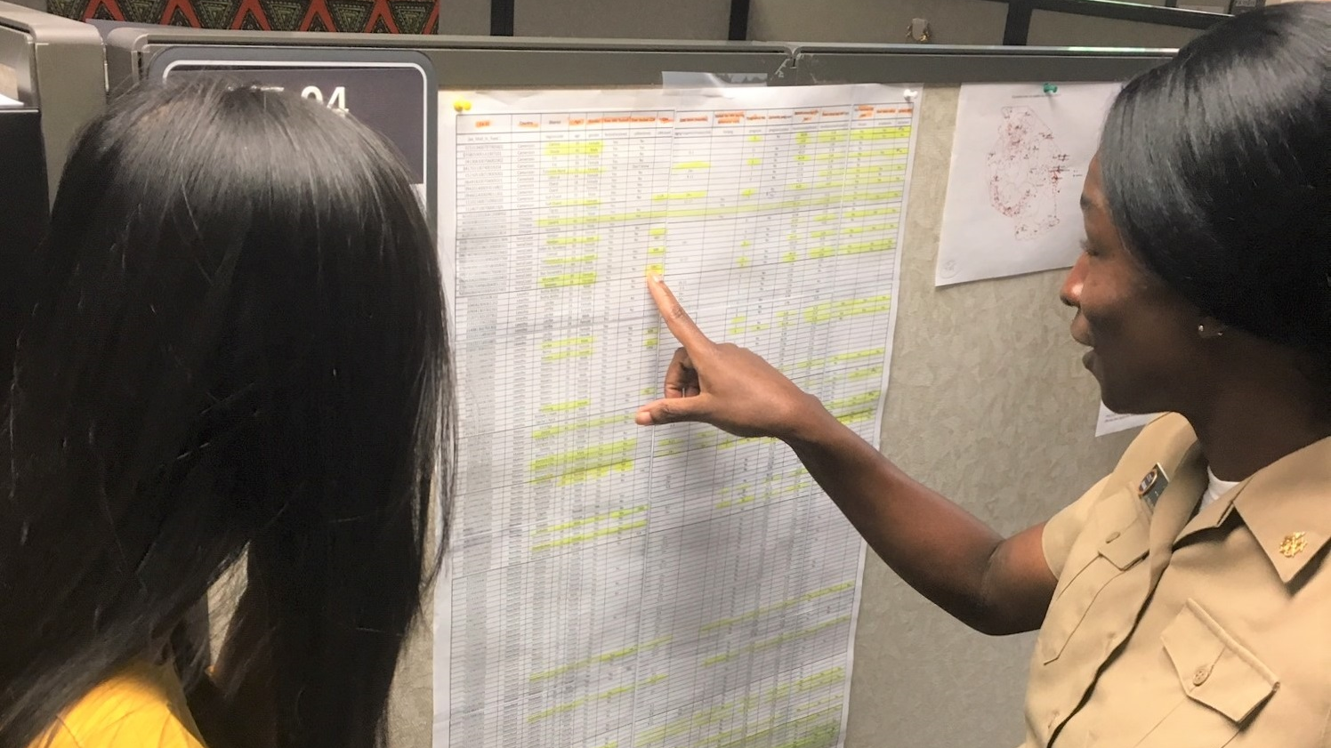
Table of Contents
Slides 3-6 General/Overview Slides
Slides 7-20 CDC Fellowship and Internship Programs
(see slides 3-4 for specific eligible audiences)
Slides 21-27 Additional Optional Slide Design Ideas

Slide 3
CDC Fellowship/Internship Programs by Eligible Audience
Slide #’s | Program | Eligible Audience
7-8 | Epidemic Intelligence Service (EIS) | Physicians, veterinarians , nurses, allied healthcare professions (PA, PharmD), doctoral-level scientists . See details at https://www.cdc.gov/eis/application/eligibility.html
9-10 | Epidemiology Elective Program (EEP) | Medical or veterinary students See details at https://www.cdc.gov/epielective/application/eligibility.html
11-12 | Laboratory Leadership Service (LLS) | Doctoral-level scientists in a laboratory related discipline See details at https://www.cdc.gov/lls/application/eligibility.html
13-14 | Preventive Medicine Residency and Fellowship (PMR/F) | Physicians, veterinarians, nurses, or other health professional See details at https://www.cdc.gov/prevmed/application/eligibility.html
15-16 | Public Health Informatics Fellowship Program (PHIFP) | Doctoral or masters -level scientists (public health, medicine, health care, health services research, computer science, information science, information systems, statistics, epidemiology, public health informatics or related discipline See details at https://www.cdc.gov/phifp/application/eligibility.html
17-18 | Steven M. Teutsch Prevention Effectiveness (PE) Fellowship | Doctoral-level decision scientists (economics or applied economics, health services research or related health sciences, industrial engineering, operations research, public policy or policy analysis) See details at https://www.cdc.gov/pef/application/eligibility.html

Slide 4
CDC Fellowship/Internship Programs by Eligible Audience
Slide #’s | Program | Eligible Audience
19-20 | E-learning Institute (ELI) Fellowship Program | Public health professionals who are tasked with developing training for their public health organization. See details at www.cdc.gov/elearninginstitute

Slide 5






Featured CDC Fellowship Programs
Featured CDC Fellowship Programs
Public Health Informatics Fellowship Program (PHIFP)
Epidemic Intelligence Service (EIS)
Steven M. Teutsch Prevention Effectiveness (PE) Fellowship
Epidemiology Elective Program (EEP)
E-learning Institute (ELI) Fellowship Program
Laboratory Leadership Service (LLS)
Preventive Medicine Residency and Fellowship (PMR/F)
cdc.gov/fellowships

Slide 6
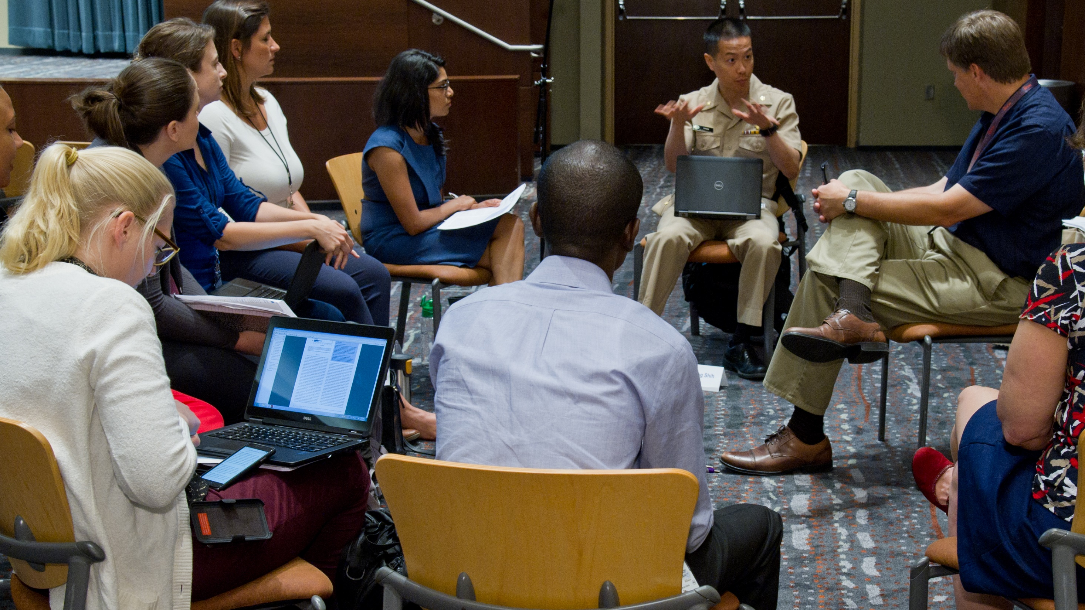
Fellowships at CDC
Fellowships at CDC

Slide 7
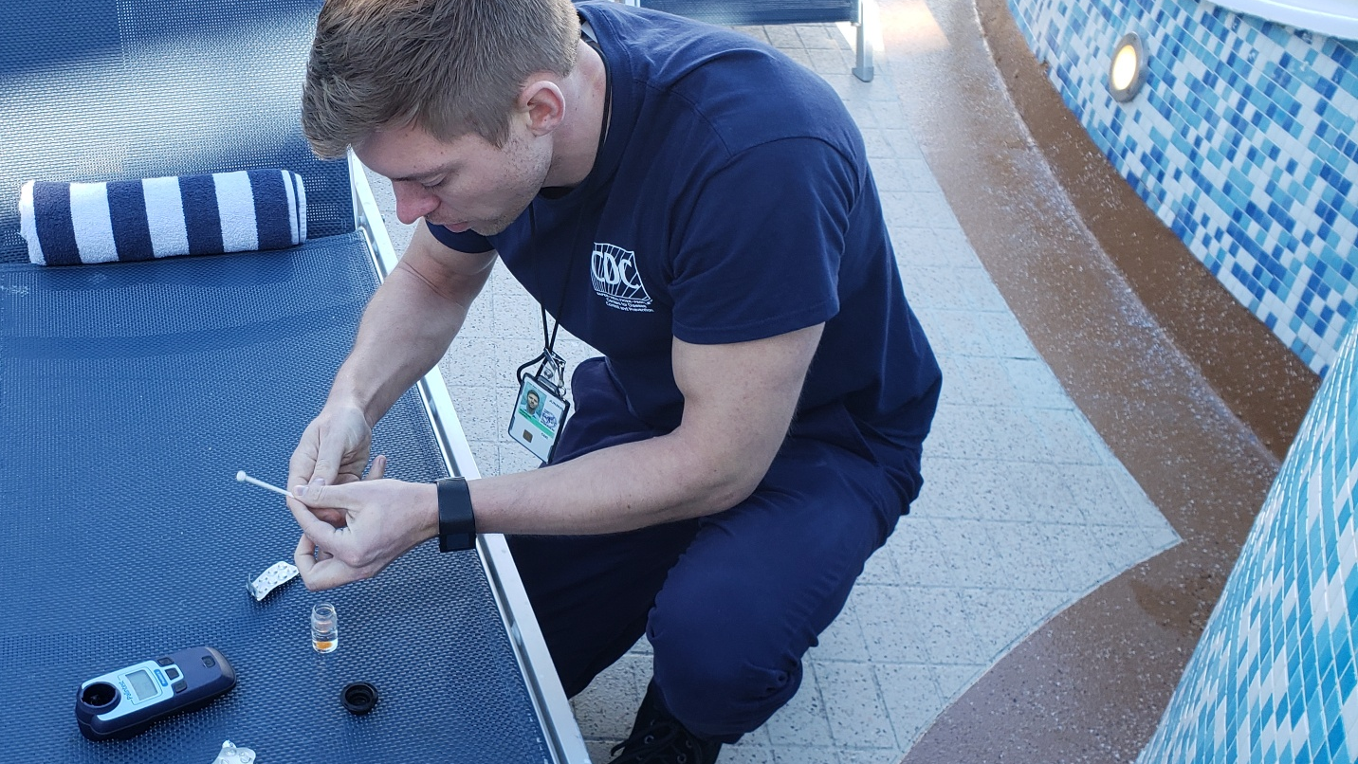
Epidemic Intelligence Service (EIS)
Epidemic Intelligence Service (EIS)

Slide 8
EIS trains the next generation of disease detectives.
EIS trains the next generation of disease detectives.
Hands-on training
in applied epidemiology
Responding
to outbreaks
around the world
Protecting America
and the world
from health threats
www.cdc.gov/EIS

Slide 9
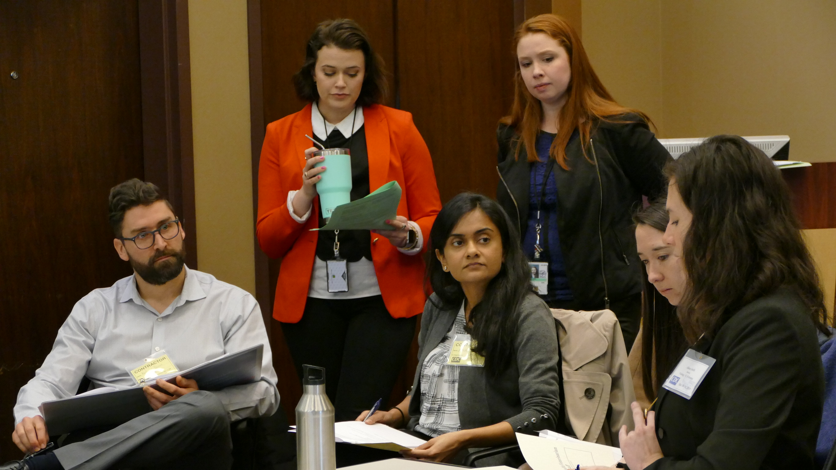
Epidemiology Elective Program (EEP)
Epidemiology Elective Program (EEP)

Slide 10
Through short-term student rotations, EEP prepares the next generation of public health clinicians.
Through short-term student rotations,
EEP prepares the next generation of public health clinicians.
Applied epidemiology training
on-the-ground at CDC
Mentorship by CDC
subject matter experts
Develop leadership skills through experiential service learning
www.cdc.gov/EEP

Slide 11
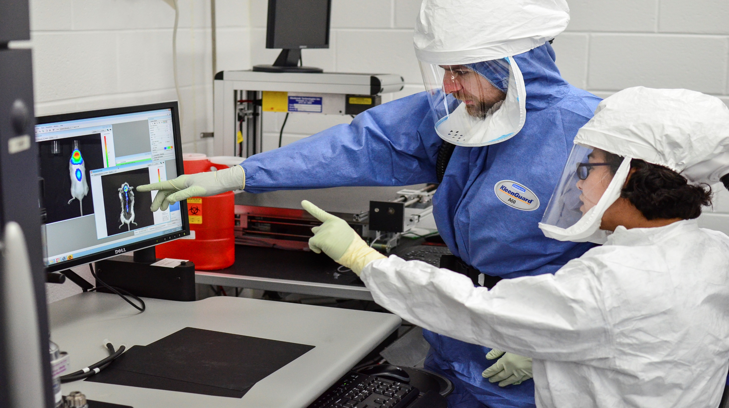
Laboratory Leadership Service (LLS)

Slide 12

LLS trains the next generation of laboratory leaders.
LLS trains the next generation of laboratory leaders.
Experiential training
on-the-ground at CDC,
state labs and/or
in the field
Bolster knowledge of laboratory quality
management
Develop leadership skills in scientific research and biosafety
www.cdc.gov/LLS

Slide 13
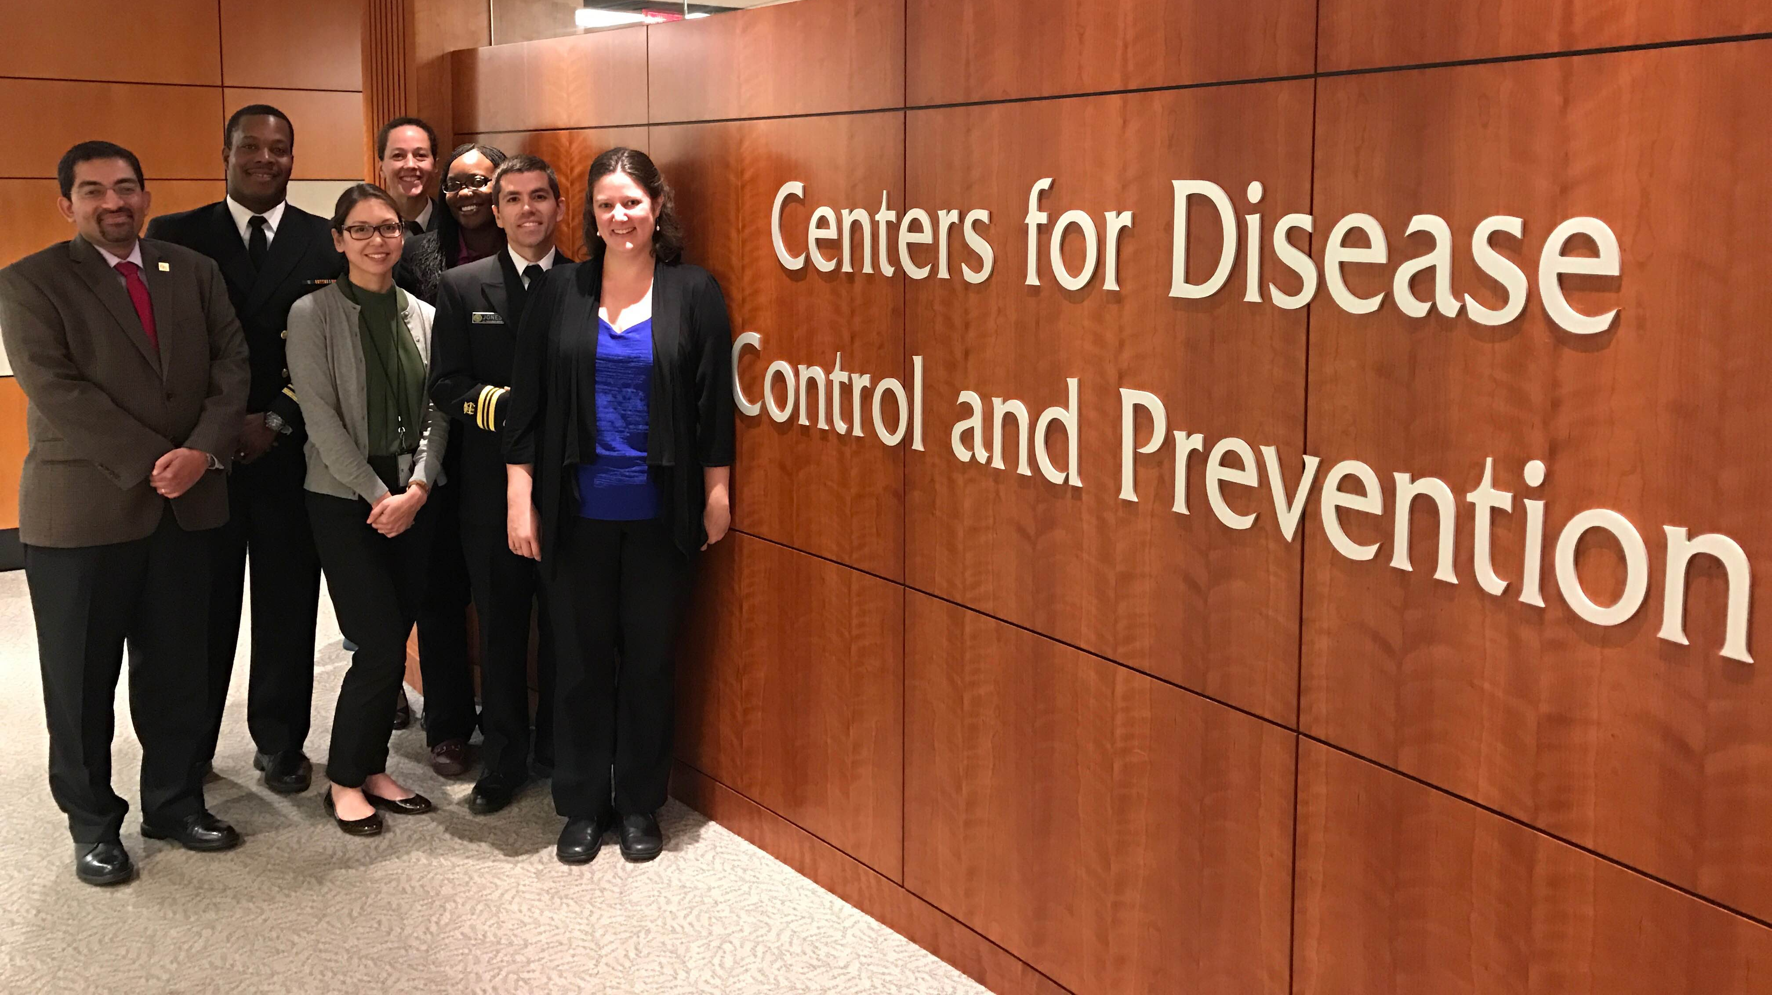
Preventive Medicine Residency and Fellowship (PMR/F)

Slide 14
PMR/F trains the next generation of preventive medicine leaders.
  PMR/F trains the next generation of preventive medicine leaders.
Develop leadership and management skills in disease prevention and health promotion
Bridge medicine and public health to comprehensively address population health
Work at CDC or local health departments to address priority public health projects and initiatives
www.cdc.gov/prevmed

Slide 15
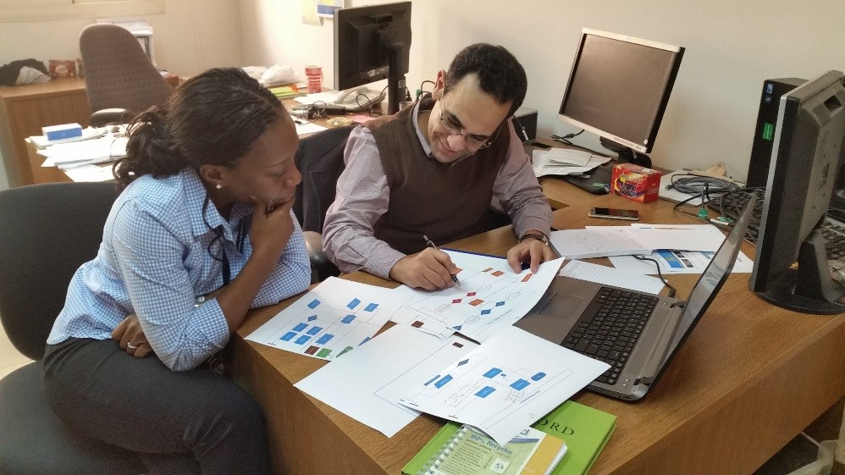
Public Health Informatics Fellowship Program (PHIFP)

Slide 16
PHIFP trains the next generation of public health informatics leaders.
  PHIFP trains the next generation of public health informatics leaders.
Enhance CDC’s public health informatics capacity
Design and evaluate public health information systems
Prepare to help solve complex public health informatics challenges
www.cdc.gov/PHIFP

Slide 17
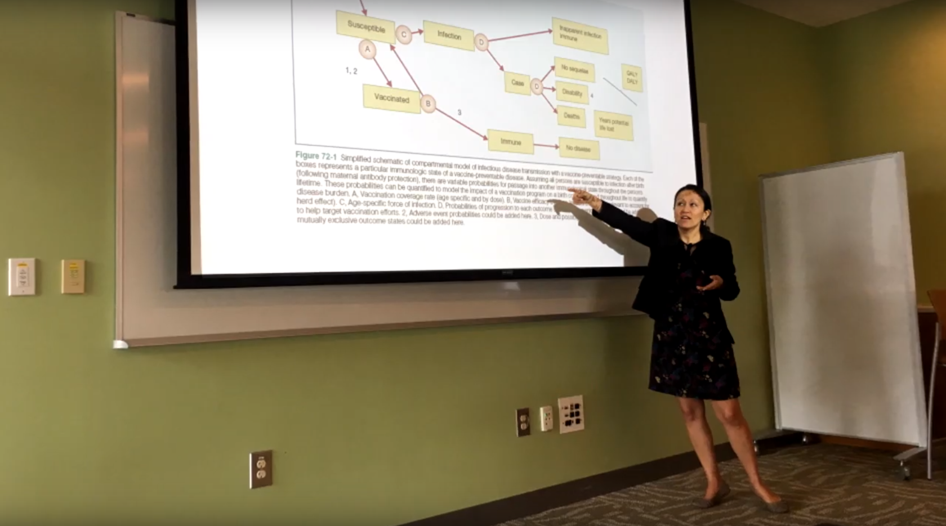
CDC Steven M. Teutsch Prevention Effectiveness (PEF) Fellowship
Notes:
Audience: Economics or applied economics, Health services research or related health sciences, Industrial engineering, Operations research, Public policy or policy analysis, Related quantitatively-oriented fields

Slide 18
PEF trains the next generation of health economics leaders.
  PEF trains the next generation of health economics leaders.
Apply quantitative methods to evaluate public health policy
Identifying vital information to maximize the impact of public health programs
Participate in studies to assess the effectiveness of prevention strategies
www.cdc.gov/PEF

Slide 19
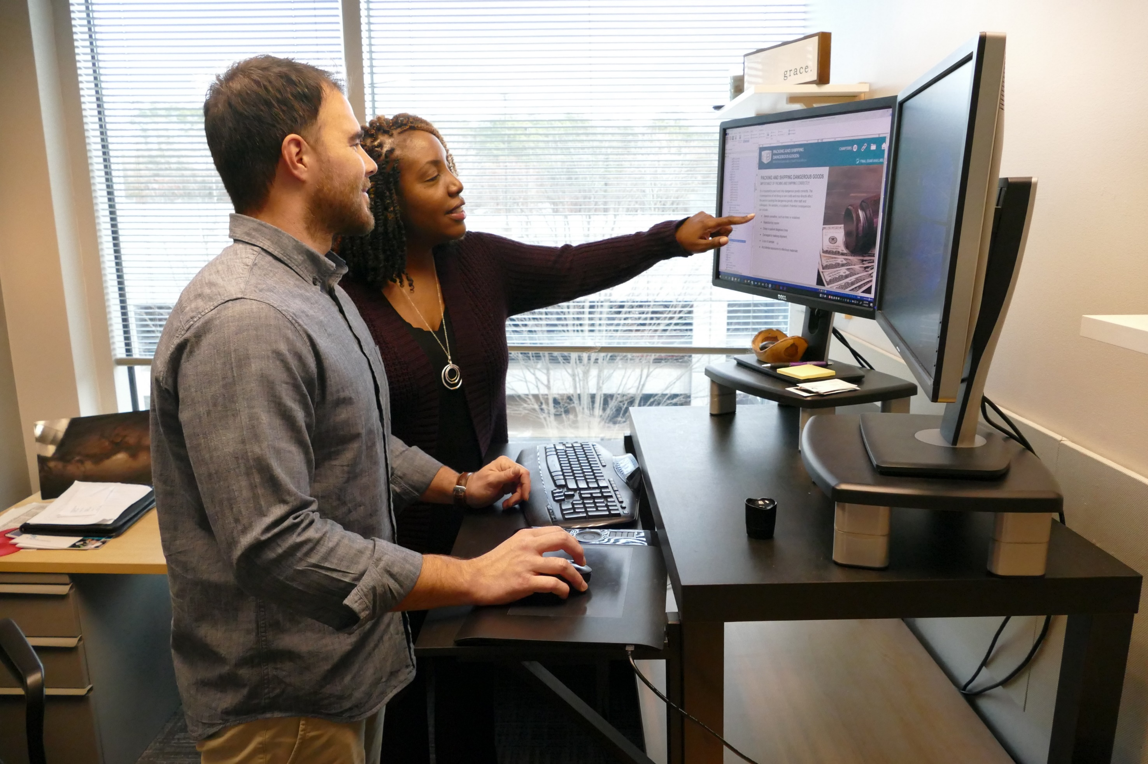
Epidemic Intelligence Service (EIS)
E-learning Institute (ELI)

Slide 20


EIS trains the next generation of disease detectives.
ELI provides hands-on experience to improve public health training.
Learn from expert education specialists
Build e-learning development skills
Create a quality online training product
www.cdc.gov/elearninginstitute

Slide 21
Additional Optional Slide Designs
Additional Optional Slide Designs

Slide 22
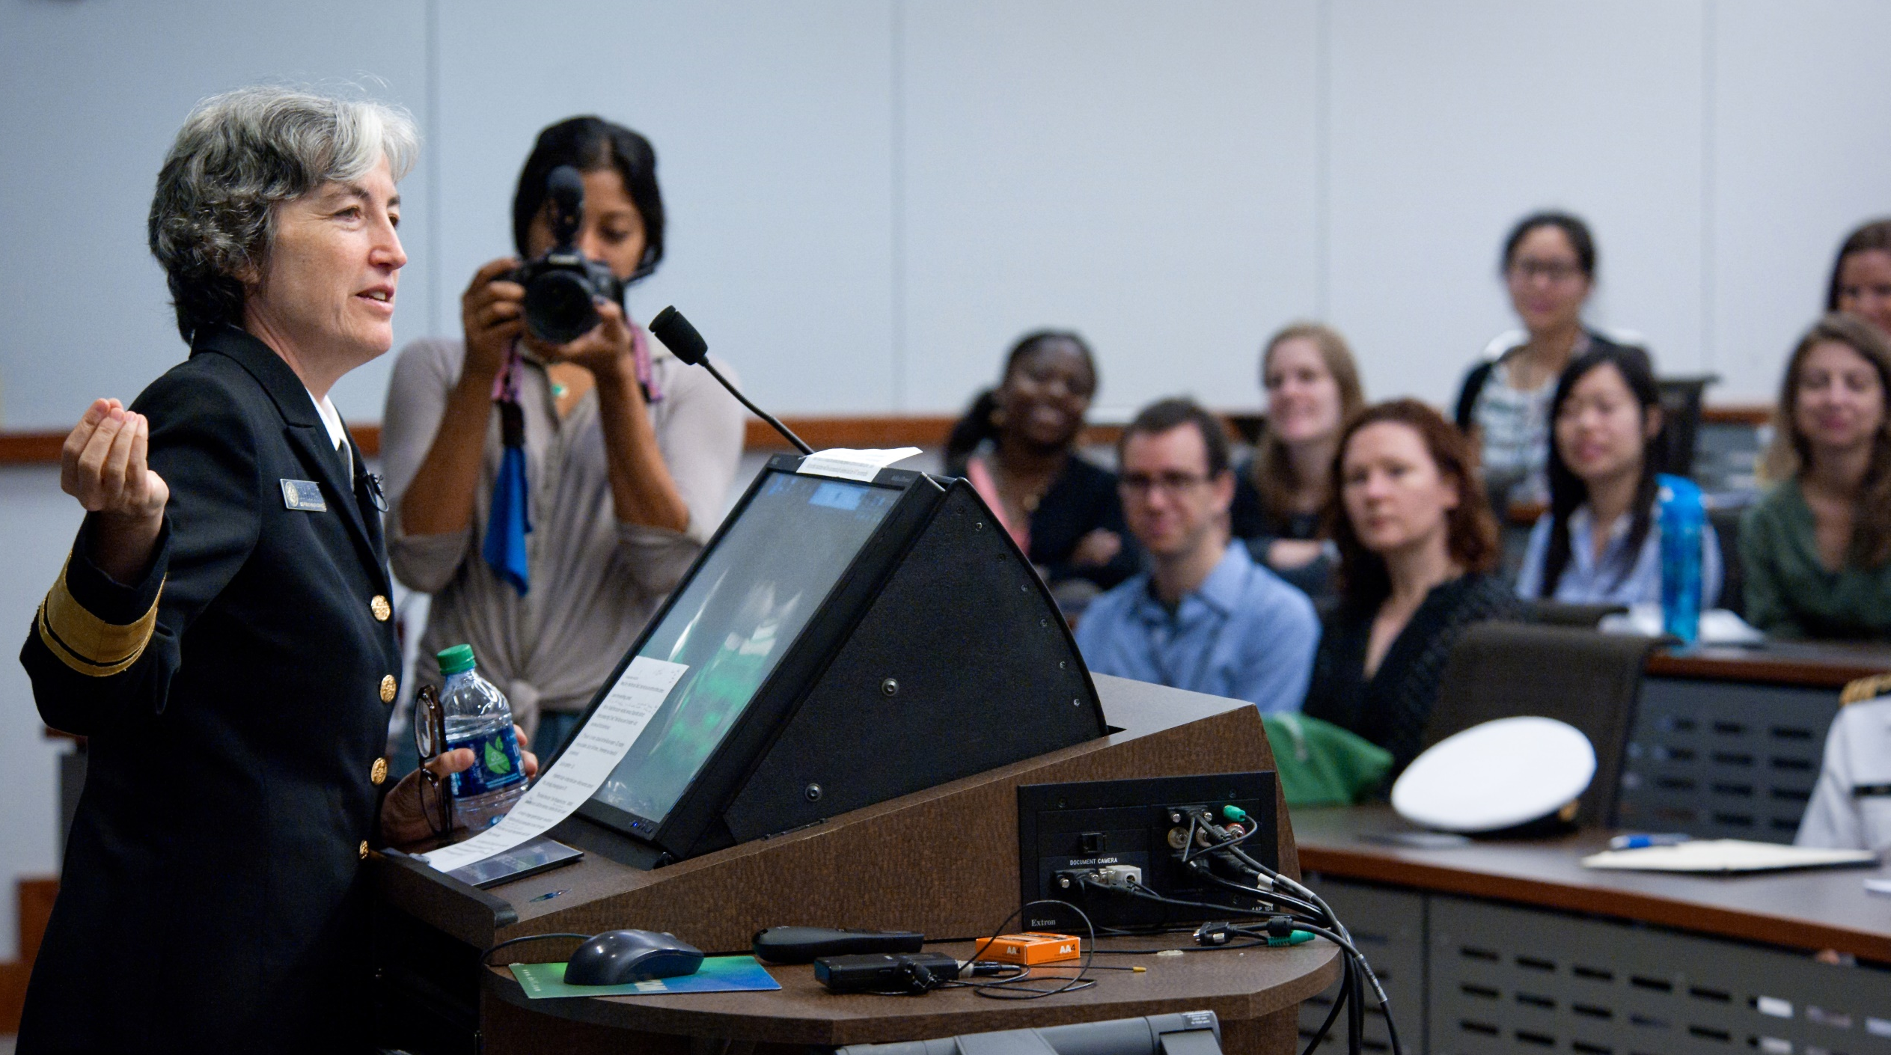
Learn More About Opportunities for Student and Professionals
To learn more about opportunities
for students and professionals,
visit cdc.gov/fellowships
Notes:
Audience: Public health, medicine, health care, health services research, Computer science, information science, information systems, Statistics, Epidemiology, Public health informatics or related discipline

Slide 23
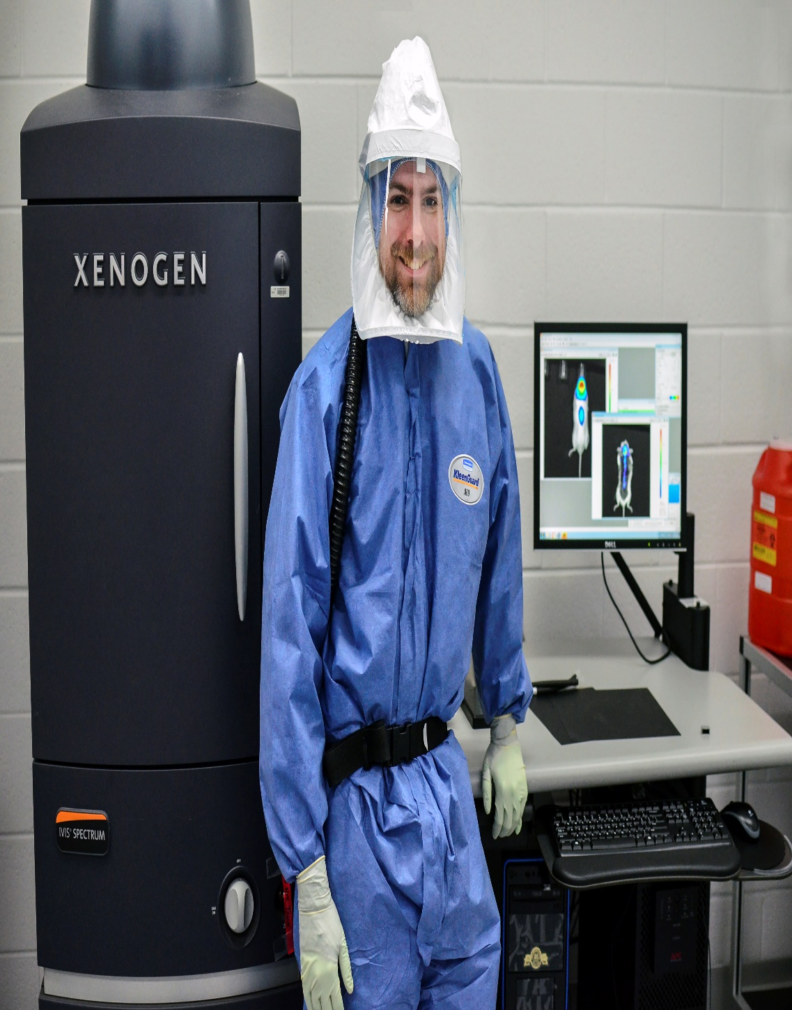
Learn More About Opportunities for Student and Professionals
To learn more about opportunities
for students and professionals,
visit cdc.gov/fellowships

Slide 24
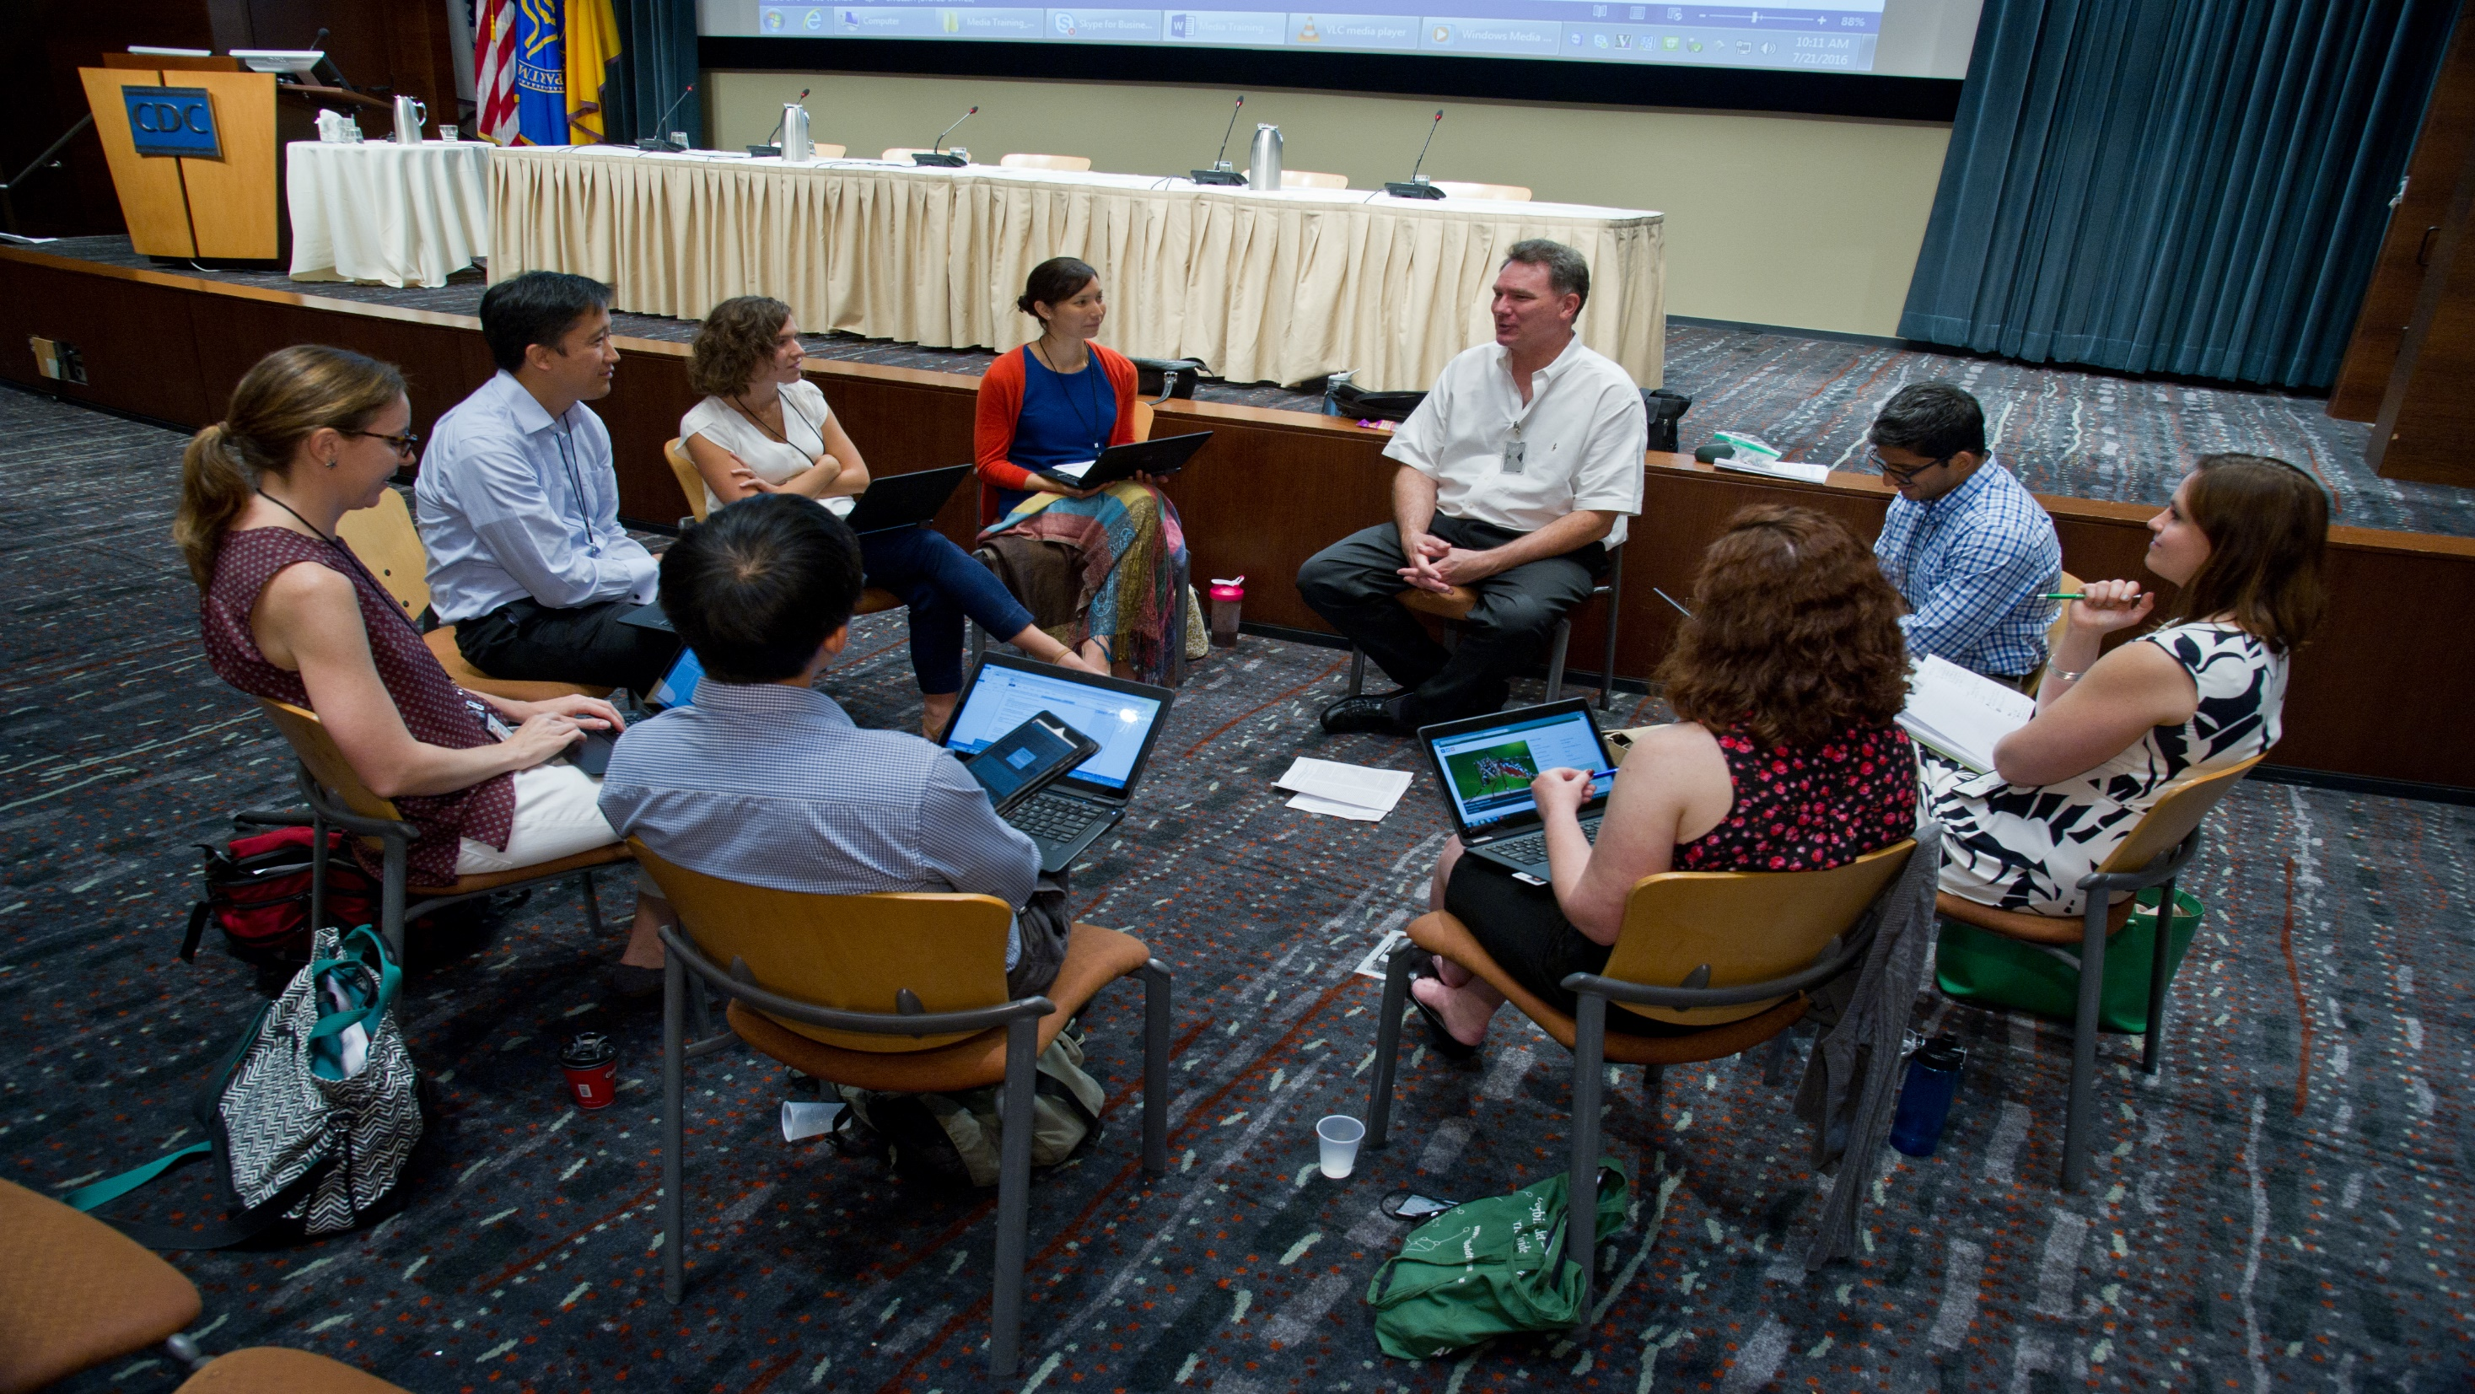
Learn More About Opportunities for Student and Professionals
To learn more about opportunities
for students and professionals,
visit cdc.gov/fellowships

Slide 25
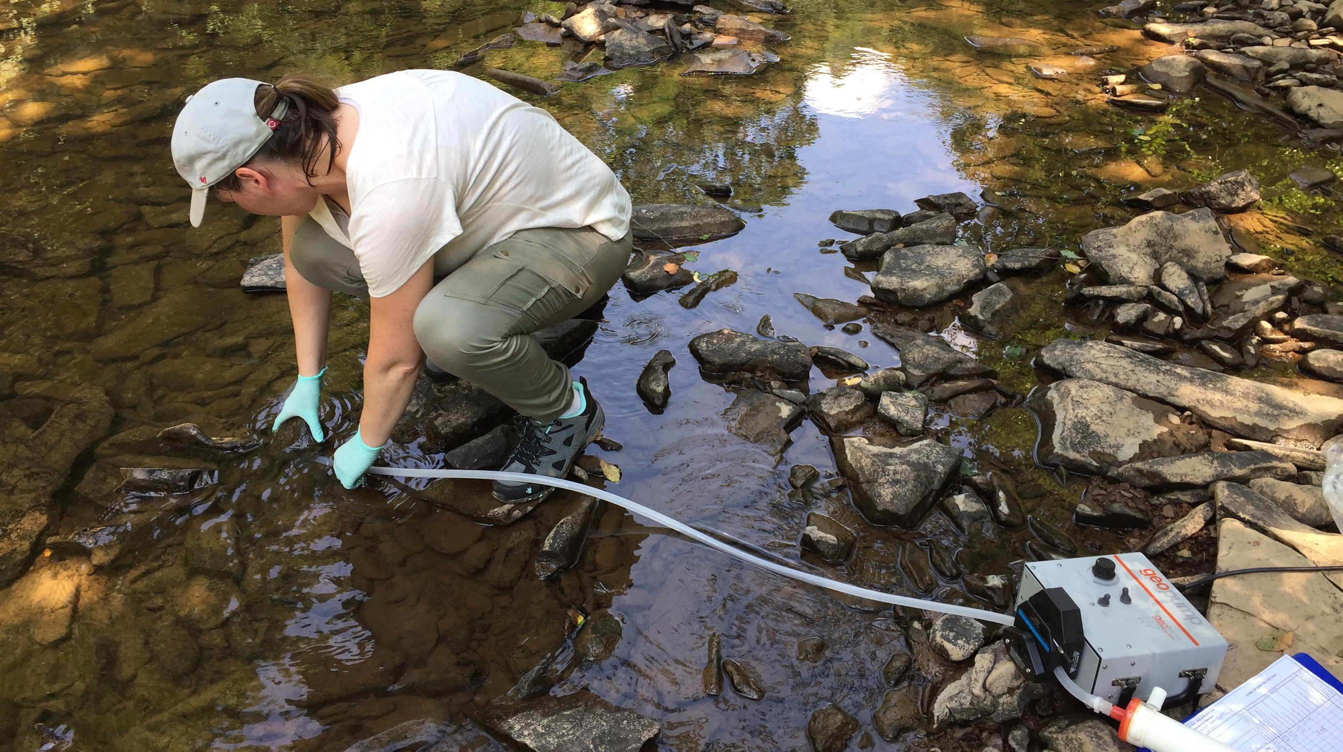
Learn More About Opportunities for Student and Professionals
To learn more about opportunities
for students and professionals,
visit cdc.gov/fellowships

Slide 26
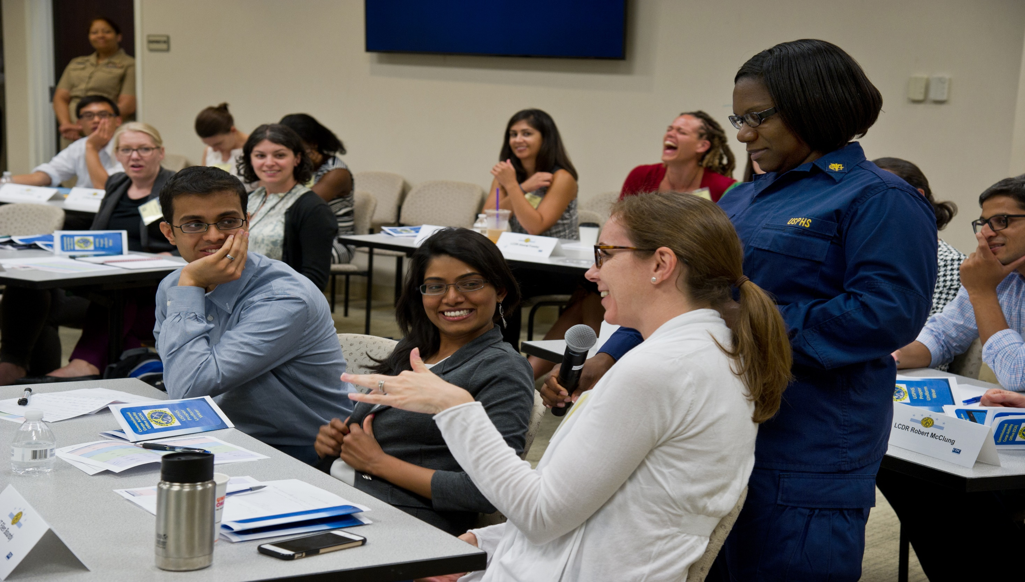
Learn More About Opportunities for Student and Professionals
To learn more about opportunities
for students and professionals,
visit cdc.gov/fellowships

Slide 27
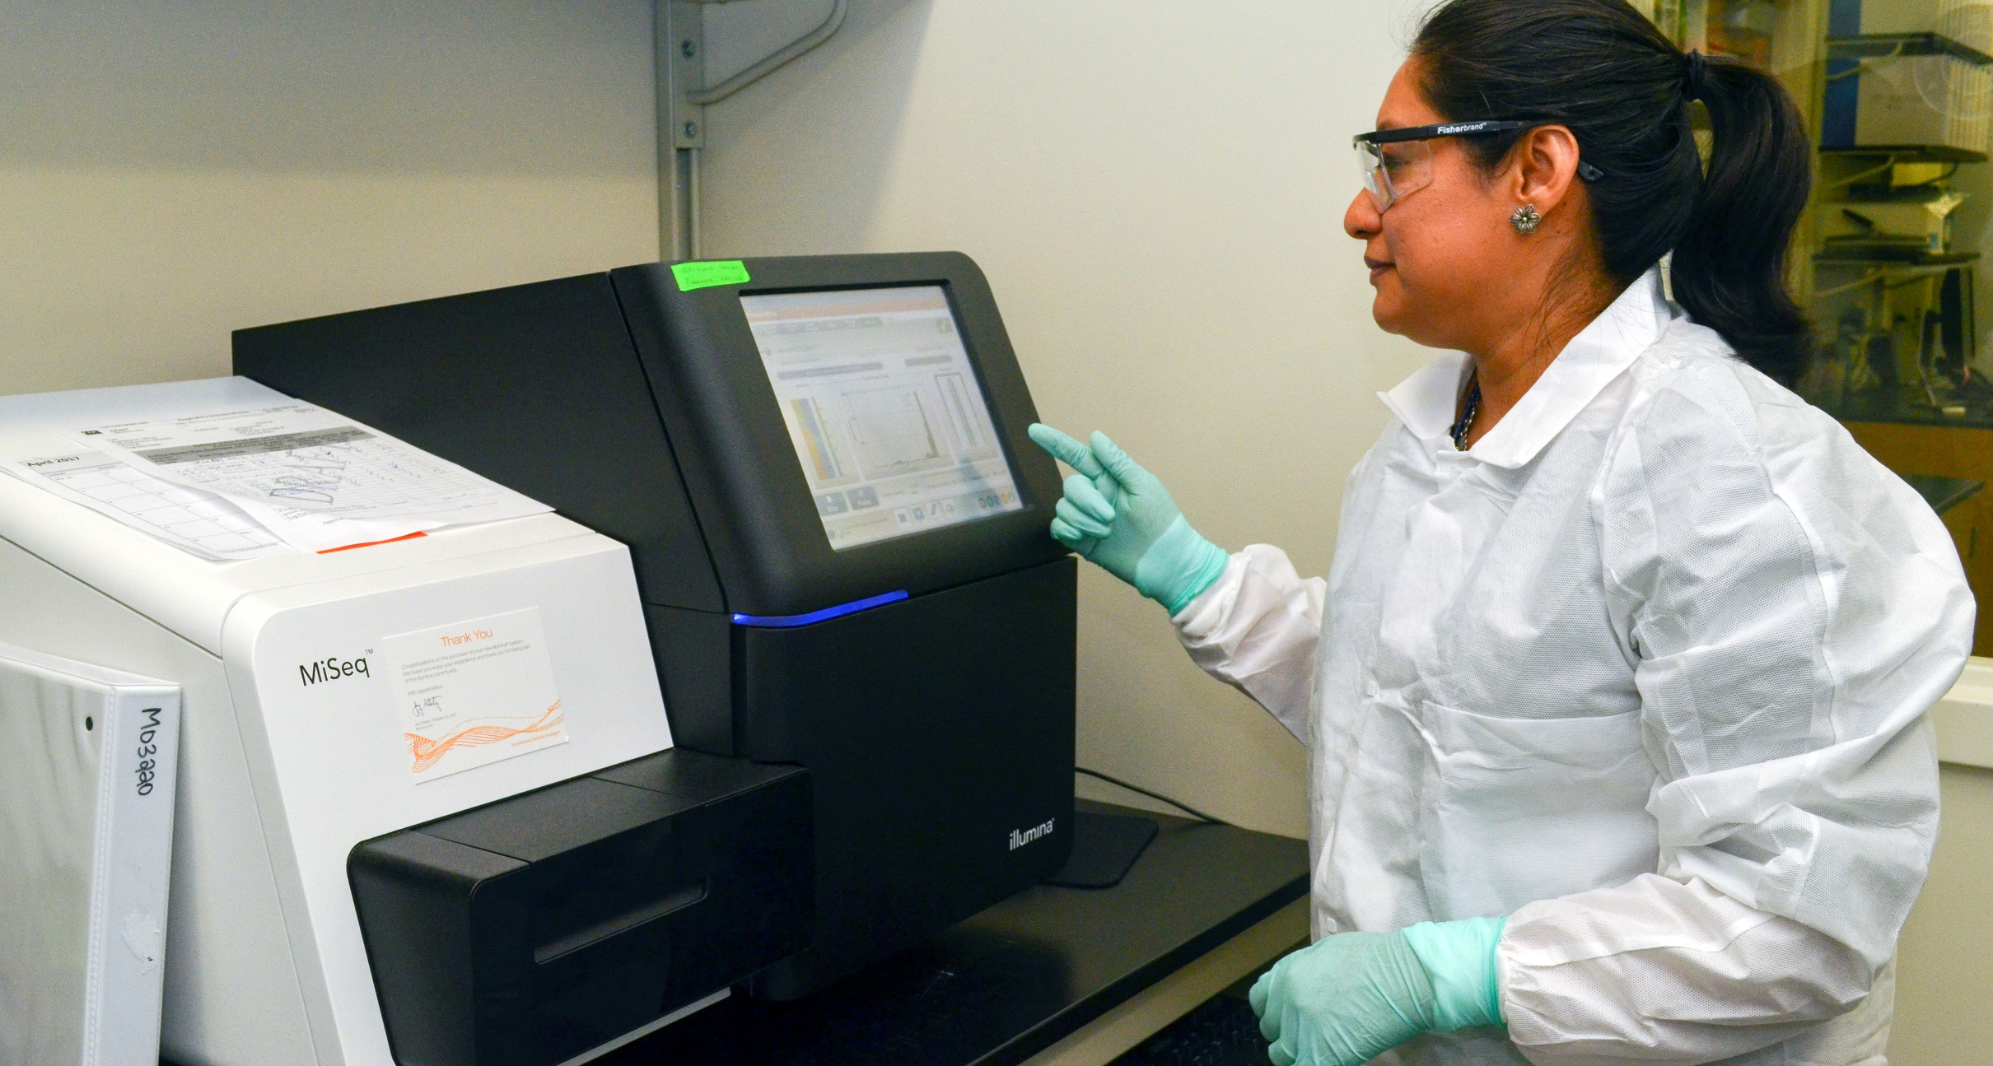
Learn More About Opportunities for Student and Professionals
To learn more about opportunities
for students and professionals,
visit cdc.gov/fellowships

