Slide 1
CDC’s Epidemic Intelligence Service
Center for Surveillance, Epidemiology, and Laboratory Services
Division of Scientific Education and Professional Development

Slide 2
CDC: The Nation’s Health Protection Agency
CDC: The Nation’s Health Protection Agency
Founded in 1946
Part of the US. Department of Health and Human Services
Headquartered in Atlanta, GA
14,000+ employees
70% of funding helps state and local public health departments and others
Notes:
Founded in 1946
Part of the US. Department of Health and Human Services
Headquartered in Atlanta, GA
14,000+ employees
70% of funding helps state and local public health departments and others

Slide 3
All Heroes Don’t Wear Capes
All Heroes Don’t Wear Capes
EIS Officers Are Public Health Heroes
When disease outbreaks or natural disasters strike at home or abroad, EIS officers ─ CDC’s “boots-on-the-ground” disease detectives ─ are there.
Notes:
The EIS logo, with the hole in the sole of shoe, depicts “shoe leather“ epidemiology e.g., means being a detective, walking the streets or remote paths and wearing out shoes, trying to solve a mystery.

Slide 4
EIS is the world’s best introduction to interventional epidemiology
“EIS is the world’s best introduction to interventional epidemiology:
finding problems fast, and stopping them.”
Tom Frieden, MD, MPH
Former Director, CDC

Slide 5
EIS Helps Turn Science into Real World Solutions
EIS Helps Turn Science into Real World Solutions
65+ Years of Success ─ Protecting People and Saving Lives
Polio Measles HIV / AIDS Smallpox
SARS TB
Ebola MERS
E.coli 157 Zika
Notes:
65+ Years of Success ─ Protecting People and Saving Lives
EIS officers have applied their epidemiologic skills, investigating infection outbreaks wherever needed in the U.S. and around the world. They have contributed to many landmark public health achievements, including: Polio, Measles, HIV / AIDS, Smallpox, SARS, TB, Ebola, E.coli 157, MERS, Zika

Slide 6
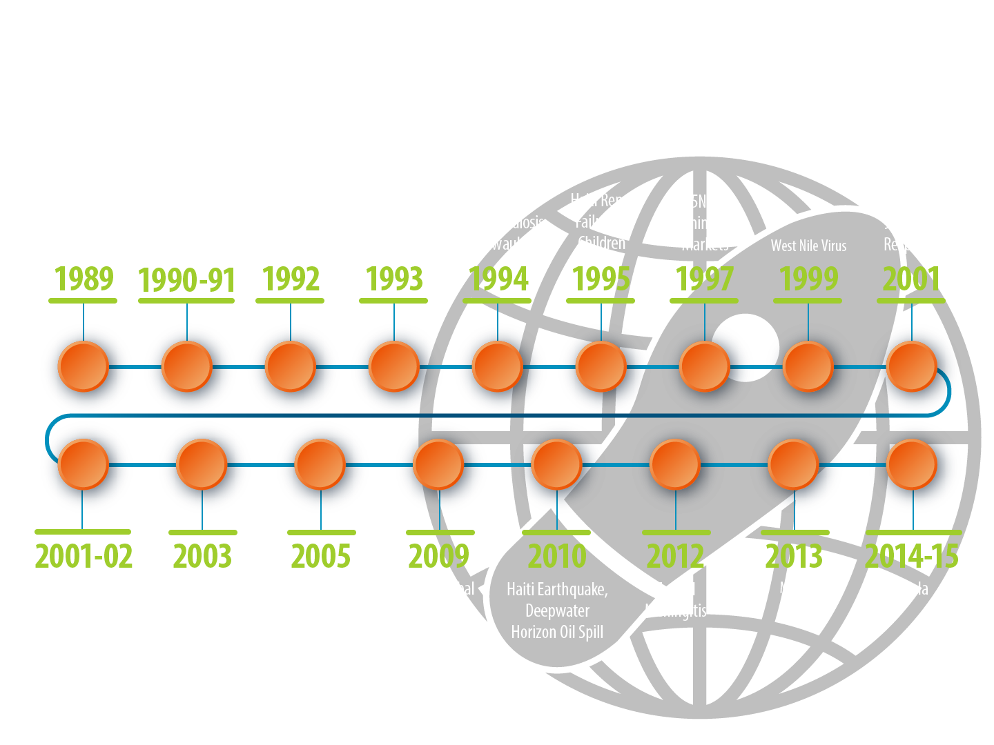
Times Change ─ But the Need for EIS Never Does
Notes:
EIS officers are CDC’s first responders to mysterious outbreaks and public health emergencies. This 25+ year timeline reflects selected infectious disease outbreaks, natural disasters, and terrorist events that EIS officers have responded to at a moments notice. Times change – but the need for EIS never does.

Slide 7
What is the Epidemic Intelligence Service?
What is the
Epidemic Intelligence Service?
2-year postgraduate fellowship in applied epidemiology for health professionals interested in public health
Trains through hands-on assignments and mentoring
Provides opportunity to gain applied, front-line public health experience
Modeled on traditional medical residency program
Notes:
Photo descriptor: EIS officers often are first on the scene when a public health emergency occurs as shown by this EIS officer obtaining a specimen during CDC’s emergency response to the 2010 Tennessee flood.
EIS is a 2-year postgraduate fellowship that provides training in applied epidemiology for health professionals interested in public health.
EIS trains through hands-on assignments and mentoring.
It provides opportunity to gain applied, front-line public health experience
EIS is modeled on traditional medical residency program.

Slide 8
EIS: Who is Eligible?
EIS: Who is Eligible?
Physicians
Veterinarians
Nurses
Allied healthcare professionals
Doctoral-level scientists
Refer to cdc.gov/eis for eligibility requirements for each profession, or email eis@cdc.gov.
Notes:
Photo descriptor: Regardless of background and training, EIS officers gain a variety of frontline experience, as shown by this photo of an EIS officer performing a tick check during an outbreak investigation. EIS officers are selected among hundreds of applicants who are physicians, doctoral-level scientists, veterinarians, nurses, and allied healthcare professionals with MPH or equivalent degree. The 2017 class consists of 71 new officers: 34 physicians, 28 doctoral-level scientists, 7 veterinarians, and 2 nurses.

Slide 9
EIS Mission: Domestic and International Service
EIS Mission:
Domestic and International Service
Provide epidemiologic assistance
Prevent and control disease and injury
Promote health
Build capacity
Notes:
Photo descriptor:
Domestic and International Service is a hallmark of the EIS mission. This EIS officer prepares for deployment to assist in the 2014-15 Ebola response in West Africa. Accomplishing the mission of domestic and international service, EIS officers…..

Slide 10
EIS Mission: Training
EIS Mission: Training
Skill development work includes
Applied epidemiology
Quantitative methods
Research design
Epidemiologic judgment
Health communication
Notes:
Photo descriptor: Training is an integral part of the EIS mission. This EIS officer assigned to the NYC Department of Health and Mental Hygiene took part in a NYC health department vaccination program against rabies — participating in the activity to trap, vaccinate, tag, and release raccoons in remote parts of Central Park, helping to keep human rabies a rare occurrence. As a part of their training, EIS officers learn to apply the science of epidemiology to solve public health problems. About 90% of learning is experiential, on-the-job service, gaining epidemiologic skills. Skill development, as a part of EIS training, includes…….

Slide 11
EIS Officer Assignments
EIS Officer Assignments
State or local health departments
Broad front-line public health experience
Surveillance, investigation, and intervention
Notes:
Photo descriptor:
EIS officers provide service and participate in investigations during their assignments at public health departments in the United States and its territories. Approximately 25% of EIS officers are assigned to public health departments in the U.S. its territories, or to other federal agencies or partner organizations. During their assignments to state or local health departments, they gain broad public health experience and perform surveillance, investigation, and intervention.

Slide 12
EIS Officer Assignments
EIS Officer Assignments
CDC headquarters and campuses
Specialized disease or problem-specific experience (e.g. vaccine-preventable diseases, STDs, injury, ectopic pregnancy)
Surveillance, investigation, and policy development
Notes:
Photo descriptor: During a public health emergency, CDC may activate the Emergency Operations Center to manage the response. EIS officers are deployed to the Emergency Operations Center at CDC headquarters in Atlanta to provide epidemiologic support.
Approximately 75% of EIS officers are assigned to CDC headquarters in Atlanta or campuses across the United States. These include, Anchorage, Alaska; Fort Collins, Colorado; Hyattsville, Maryland, San Juan, Puerto Rico, and other locations. EIS officers assigned to CDC gain experience in specific diseases or conditions. Additionally, they gain experience in surveillance, investigation, and policy development.

Slide 13
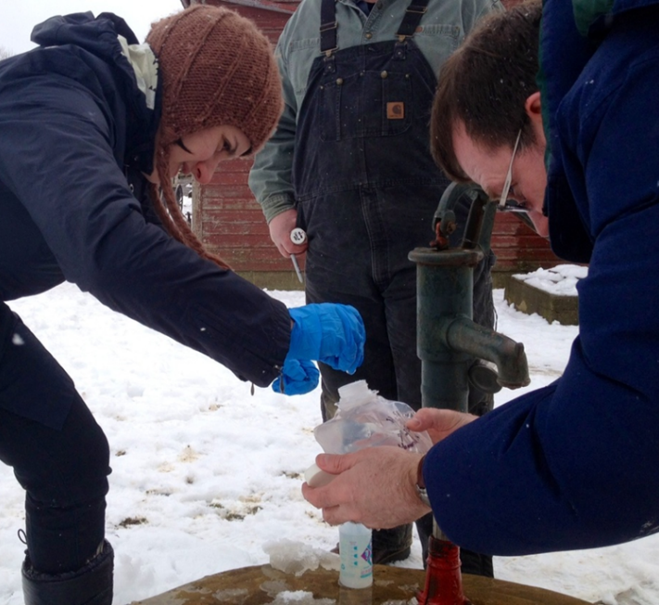
EIS: Limitless Possibilities
EIS: Limitless Possibilities
From assessment of farm wells in the Midwest
To responding to the Ebola outbreak in West Africa
EIS offers the unique potential to make a difference in people’s lives anywhere, at any time…

Slide 14
EIS Officers Across the Country
Notes:
Map descriptor:
The 2015 and 2016 EIS classes include 158 officers, with
33 officers assigned to state and territorial health departments
10 officers assigned to city, county, tribal, and federal partners
115 officers assigned to CDC headquarters and campuses

Slide 15
EIS: Outbreak Investigations
EIS: Outbreak Investigations
EIS officers in the 2015 and 2016 classes reported 281 deployments to conduct field investigations addressing urgent public health needs in the United States and worldwide
Notes:
Photo descriptor: Following the earthquake that hit Haiti in January 2010, epidemic cholera emerged in October. EIS officers were deployed to participate in the emergency response to reduce the spread of epidemic cholera. During the response, EIS officers conducted field investigations and performed waterborne disease surveillance.
Whether EIS officers are deployed to investigate disease outbreaks or respond to natural disasters or other events, or are assigned to a state or local health department, outbreak investigation is an integral part of the EIS experience.

Slide 16
Examples of CDC Emergency Operations Center Deployments of EIS Officers
Examples of CDC Emergency Operations Center Deployments of EIS Officers
West Nile virus (2002)
SARS (2003)
Monkey pox (2003)
Avian influenza (2004)
Hurricane Katrina (2005)
Rift Valley fever in Kenya (2007)
Acanthamoeba keratitis (2007)
H1N1 (2009)
Haiti earthquake (2010)
Polio eradication (2012)
Ebola (2007 and 2014)
Zika (2015 and 2016)
Notes:
Photo descriptor: In the immediate aftermath of the 2010 Haiti earthquake, CDC’s Emergency Operations Center or EOC, was activated and deployed EIS officers. EIS officers were among the first on the scene to support this response, saving lives and reducing suffering. In this photo, during their response to the Haiti earthquake, EIS officers are shown using geographic information system, known as GIS, a technology designed to capture, store, display, and analyze geographical data.
In addition to the emergency response to the Haiti earthquake in 2010, during the first decade of the 21st century, CDC activated the Emergency Operations Center and deployed EIS officers to provide epidemiologic support for multiple events, including those listed on the slide.

Slide 17
EIS Training Model: Service While Learning
EIS Training Model:
Service While Learning
10% classroom instruction, case studies, exercises, and e-learning
90% experiential learning on the job
Notes:
EIS officers learn to apply the science of epidemiology to solve public health problems. Service and learning are hallmarks of the EIS training model. EIS officers learn through classroom instruction and case studies and on-the-job experiential learning — 90% is through on-the-job experience.

Slide 18
EIS Training Model: Service While Learning
EIS Training Model:
Service While Learning
90% experiental learning on the job
Provide service to CDC and partners (especially state and local health departments)
Investigate outbreaks
Conduct epidemiologic investigations
Conduct public health research
Conduct and evaluate public health surveillance
Study infectious or chronic diseases, environmental or occupational health, injuries, or birth defects and developmental disabilities
Notes:
Photo descriptor:
An example of experiential, on-the-job learning is shown in this photo. During a 2014 investigation of tuberculosis, this EIS officer views a slide with acid-fast stain, a valuable laboratory aid in the diagnosis of tuberculosis.

Slide 19
EIS Prepares You for Anything Become a World Class Problem-solver
EIS Prepares You for Anything
Become a World Class Problem-solver
Professional skills and abilities are acquired and refined through EIS
Investigation of acute outbreaks and hazards
Analysis of large datasets
Evaluation of surveillance systems
Publication and presentation of scientific manuscripts
Oral presentation at national conferences
Response to public inquiries
Notes:
Photo descriptor:
Whether using paper and pen or sophisticated technologic tools to chart the outbreak, EIS officers learn investigative techniques and hone their epidemiologic skills.
EIS prepares EIS officers to become world class problem-solvers; they gain and refine professional skills and abilities.

Slide 20
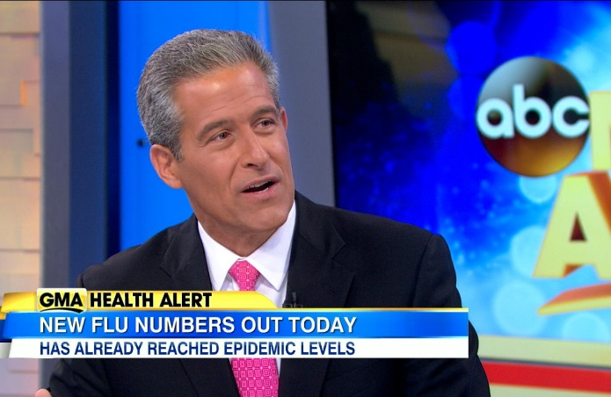
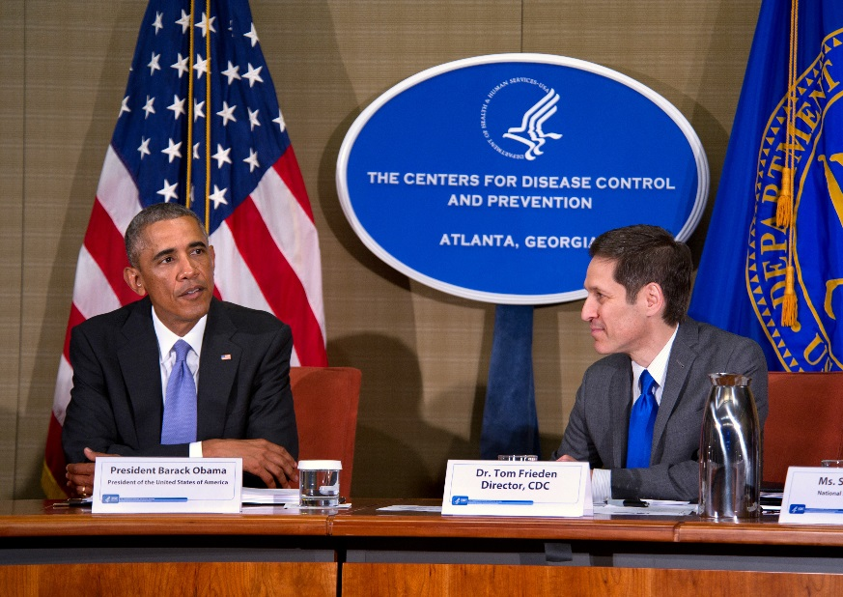
Images
Dr. Helene Gayle
President /CEO, CARE
Dr. Richard Besser
President/CEO, RWJF
Dr. Tom Frieden
Former Director, CDC
Notes:
Photo descriptor: Prominent EIS alumni include:
Tom Frieden – Former CDC Director (2009-2016), pictured here during briefing to President Obama on Ebola
Helene Gayle – President of CARE, a major international humanitarian agency, and formerly with the Bill and Melinda Gates Foundation
Richard Besser – President and CEO, Robert Wood Johnson Foundation; Former CDC Acting Director (2009)

Slide 21
If you are looking for an exciting career, take a look at EIS!
If you are looking for an exciting career, take a look at EIS!
EIS alumni are leaders in global public health, academia, research, foundations, public health practice, and the media
EIS graduates often stay with CDC (about 75%)
20% are in academia
<10% are in private practice
As an EIS alumnus, join an elite group (>3,600) recognized as world class problem-solvers

Slide 22
Everybody WANTS to make a difference
Everybody WANTS to make a difference.
EIS often IS the difference!
You can improve the lives of thousands and effect change and offer hope to communities or entire countries.

Slide 23
Choose EIS as your gateway to an exciting and rewarding career!
Choose EIS as your gateway to an exciting and rewarding career!
To learn more, please visit www.cdc.gov/EIS
or contact EIS at EIS@cdc.gov

Slide 24
For more information please contact: Epidemic Intelligence Service Program
For more information please contact: Epidemic Intelligence Service Program
1600 Clifton Road NE, Mailstop E-92, Atlanta, GA 30329
Telephone: 404-498-6110 Fax: 404-498-6535
Email: EIS@cdc.gov Web: www.cdc.gov/EIS
The findings and conclusions in this report are those of the authors and do not necessarily represent the official position of the Centers for Disease Control and Prevention.
Center for Surveillance, Epidemiology, and Laboratory Services
Division of Scientific Education and Professional Development

