Slide 1

Environmental Health Nexus Webinar
Radon Awareness
EH Nexus Webinar | January 24, 2022

Slide 2
EH Nexus Webinar
Today’s EH Nexus Webinar will be available to view on demand a few days after this webinar. You can find the video recording of today’s webinar at the CDC EH Nexus webpage at
cdc.gov/nceh/ehsp/ehnexus

Slide 3
Webinar Logistics
All attendees are muted. To adjust your audio settings in the webinar, click on Audio Options.
Please use the Q&A window to ask questions of the panelist.

Slide 4



Today’s Presenters
Adela Salame-Alfie, Ph.D.
Senior Service Fellow
Division of Environmental Health
Science and Practice
Radiation Studies Section
CDC
Thomas Michael Golden, M.D., M.P.H.
Epidemic Intelligence Service Officer
Office of the Director
Office on Smoking and Health
CDC
Bill Field, Ph.D., M.S.
Department of Occupational and Environmental Health
Department of Epidemiology
College of Public Health
The University of Iowa

Slide 5
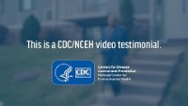
Jackie’s Story

Slide 6
Adela Salame-Alfie, Ph.D.
Senior Service Fellow
Division of Environmental Health Science and Practice
Radiation Studies Section
CDC

Slide 7
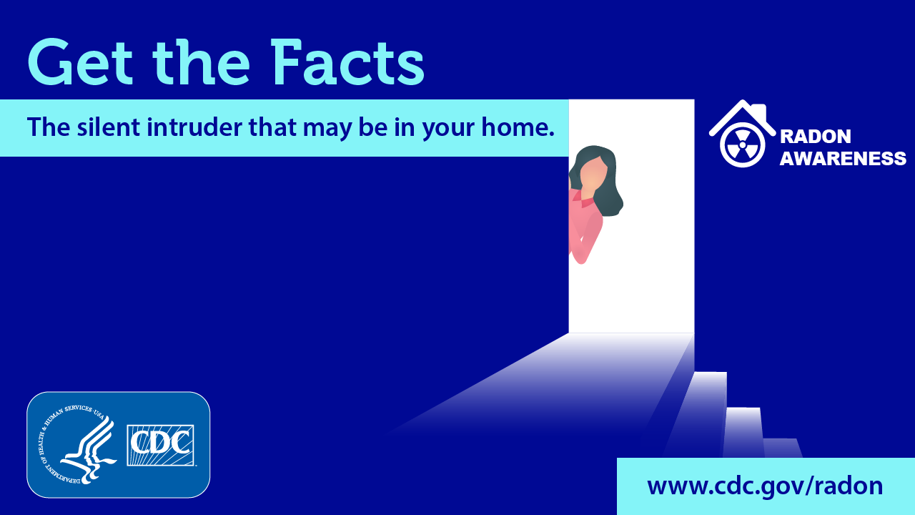
Radon Basics
Adela Salame-Alfie, Ph.D.
Radiation Studies Section
Division of Environmental Health Science and Practice

Slide 8

https://youtu.be/ts16okWUrCo

Slide 9
What is Radon?
Radon is an odorless and invisible radioactive gas naturally released from rocks, soil, and water. In outdoor environments, radon levels are very low and generally not considered harmful.
Radon can get into homes or buildings through small cracks or holes and build up to higher levels. Breathing in high radon levels over long periods can cause lung cancer.
Radon is the second leading cause of lung cancer in the United States after smoking.

Slide 10
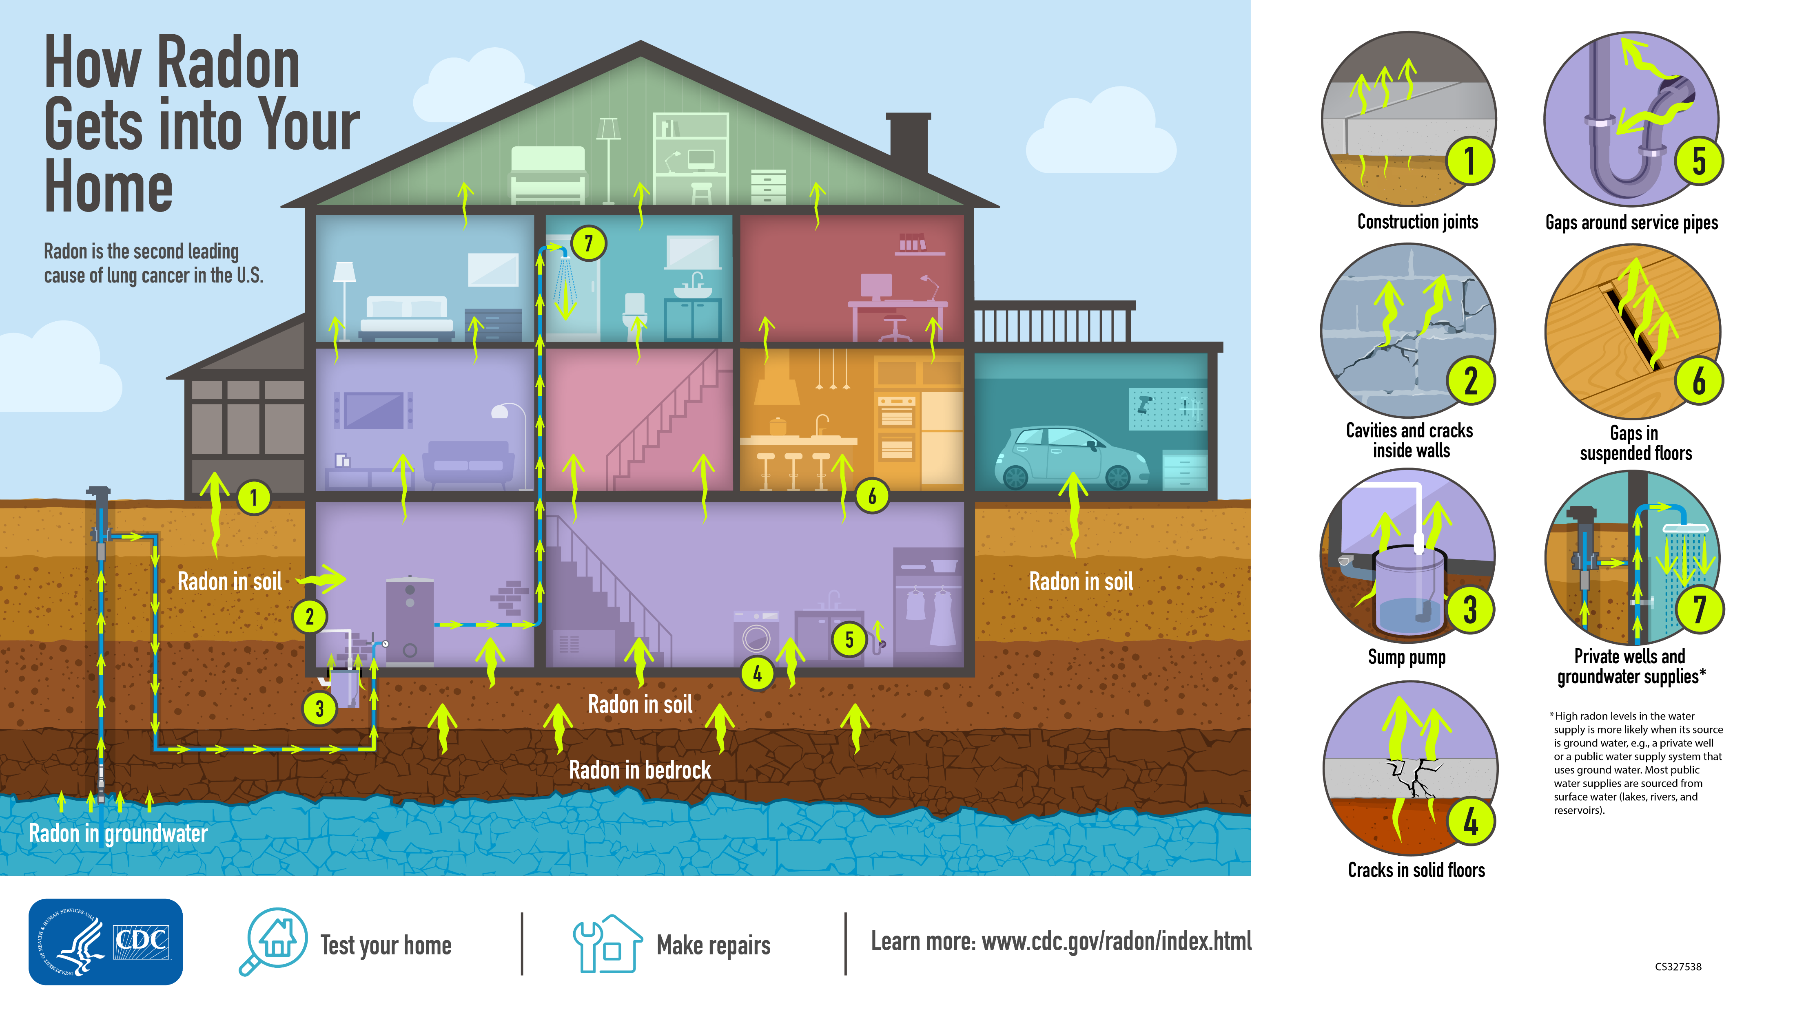
How radon gets into your home

Slide 11
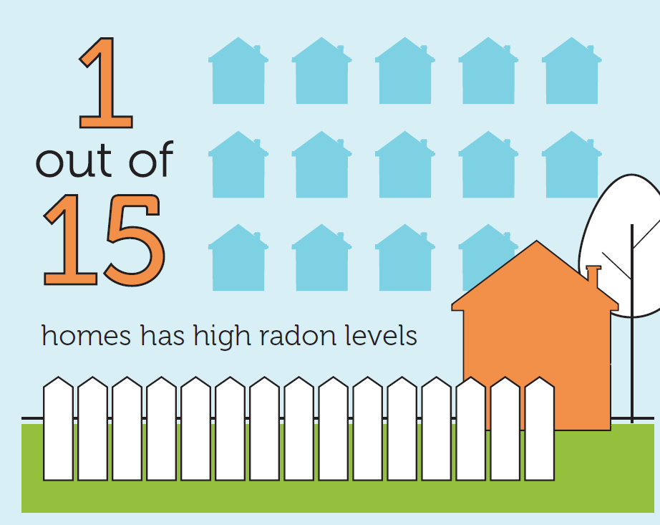
Did you know?
Data according to the Environmental Protection Agency (EPA)

Slide 12
Testing for Radon
What is your home radon level?
The only way to know if you have unsafe levels of radon in your home is by testing.
Contact your state radon office* for testing or purchase a test kit in a hardware store or online.
Radon is measured in picocuries per liter (pCi/L).
If your test shows that radon levels are above 4 pCi/L or you are interested in reducing radon in your home, contact your state radon office** to help you find a qualified or state-certified radon contractor in your area to fix your home.
Lowering high radon levels requires technical knowledge and special skills so you should rely only on a qualified professional for these repairs. Test radon levels again after any repairs to be sure they worked.
*https://www.epa.gov/radon/epa-map-radon-zones-and-supplemental-information
**https://cdn.ymaws.com/www.crcpd.org/resource/resmgr/docs/radon/radon_contacts_search_and_re.pdf

Slide 13
When to test your home
If it’s never been tested or radon levels are unknown
When preparing to buy or sell
Before and after any renovations, especially after making any repairs to reduce radon levels
Before making any lifestyle changes in the home that would cause someone to spend more time in the basement or lower level (like converting a basement to a bedroom)

Slide 14



Do it Yourself
Radon testing steps
Purchase a Radon Test Kit
Test your home or office
Send the kit to an approved laboratory to determine radon levels

Slide 15
What to Do if Your Test Shows Higher Radon Levels
Radon Level | What You Should Do
Higher than 4 pCi/L | If you used a short-term test, take a second test using either a short-term or long-term test. If you use a second short-term test, calculate the average of the two results. Contact a licensed professional to install a radon reduction system if The average of two short-term tests is higher than 4 pCi/L or Results from any long-term test are also higher than 4 pCi/L. Make sure you retest a few months after your home is fixed to see if radon levels were reduced.
Between 2 pCi/L and 4 pCi/L | Consider installing a radon reduction system. Make sure you retest a few months after your home is fixed to see if radon levels were reduced.
Lower than 2 pCi/L | No action needed. Test your home again if you start living on a lower level (for example, if you turn your basement into a home office or extra bedroom).

Slide 16
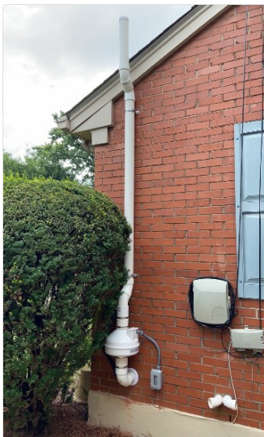
Radon Mitigation (Reducing Radon in Your Home)
Contact your state radon office* or one of EPA’s national radon proficiency programs** to find a qualified professional to fix your home. Contractors who do not specialize in radon reduction could make the problem worse.
There are several proven methods to reduce radon in your home.
  A soil depressurization system is a common method that uses a vent pipe to send radon from beneath the house to outside.
*https://www.epa.gov/radon/epa-map-radon-zones-and-supplemental-information
**https://nrpp.info/
Photo courtesy of Protect Environmental

Slide 17
Radon Mitigation
Reducing radon in your home
Sealing foundation cracks and other openings makes this kind of system more effective and cost-efficient.
The right system depends on the design of your home and other factors like whether your home has a basement.
Test your home again after installing a system to make sure it works.
Consider retesting your home every two years and after any remodeling.

Slide 18
Radon Mitigation (Reducing Radon in Your Home)
There are no known safe levels of radon. If your radon levels are not above 4 pCi/L you can still take actions to keep radon levels low:
Increase air flow in your house by opening windows and using fans and vents to circulate air.
  Natural ventilation in any type of house should not be considered radon mitigation since it is only a temporary strategy to reduce radon.
Seal cracks in floors and walls with plaster, caulk, or other mate­rials designed for this purpose.
Always test radon levels again after you’ve made any of these changes.

Slide 19
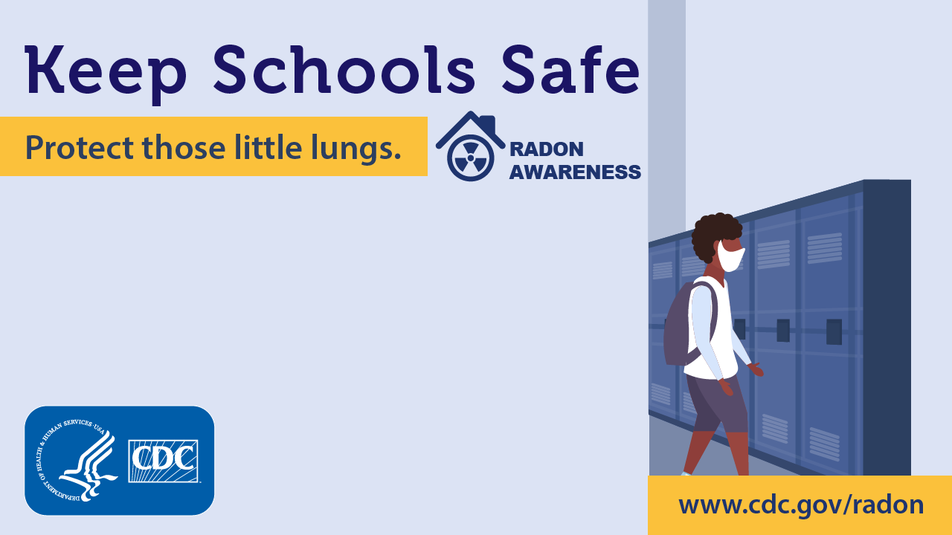
Radon in Schools
Ask if your school has been tested for radon.
If your school has not been tested, certified professional testing services or school personnel can test your school for radon.
Contact your state’s radon program before doing any school testing as some states have restrictions on who may conduct the tests.*
* https://www.epa.gov/radtown/radon-homes-schools-and-buildings

Slide 20
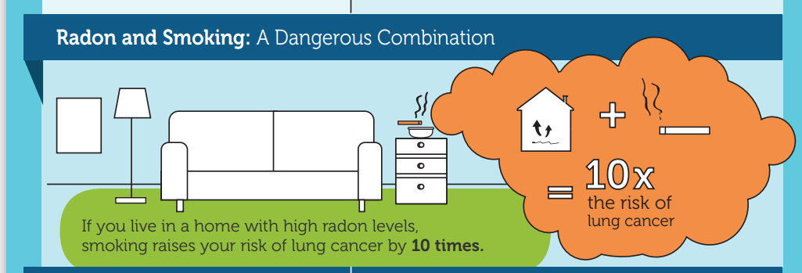
Did you know?

Slide 21
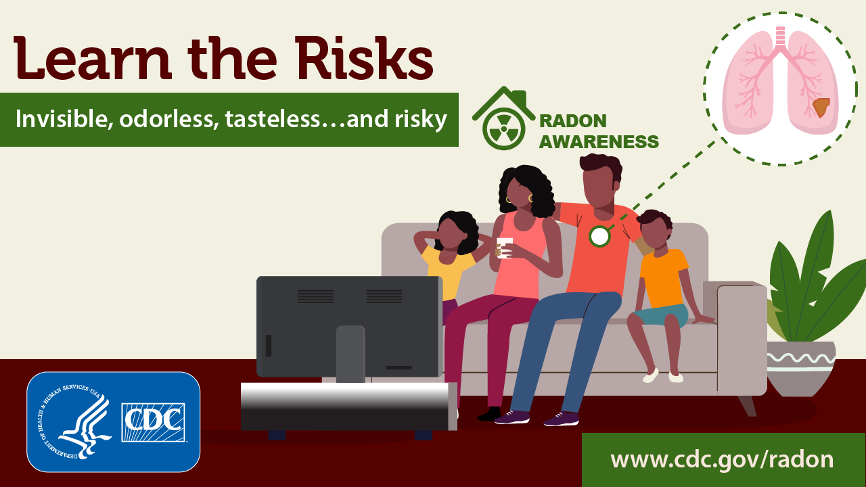
Radon and Lung Cancer
The EPA and the Surgeon General’s office estimate radon is responsible for more than 21,000 lung cancer deaths each year in the U.S.
Radioactive particles from the decay of radon gas can get trapped in your lungs. It takes many years for lung cancer to develop.
Most people don’t have symptoms until lung cancer is advanced and at that point it is harder to treat.
For these reasons, it is important to take steps to reduce radon exposure throughout your life to help prevent lung cancer.

Slide 22
Radon and Lung Cancer
Factors that increase your risk of getting lung cancer from radon include the following:
  High radon levels in your home or another building that you regularly spend time in
  High radon levels in the part of the home or building where you spend the most time (Radon levels are often higher in basements and lower levels.)
  Smoking cigarettes, currently or in the past
  Burning wood, coal, or other substances that add particles to air
Currently, no conclusive data show whether children are at greater risk than adults from radon.

Slide 23
Radon Awareness Week
January 24–28, 2022
Monday Get the Facts | Tuesday Learn the Risks | Wednesday Explore data and resources | Thursday Keep Schools safe | Friday Talk to your patients

Slide 24
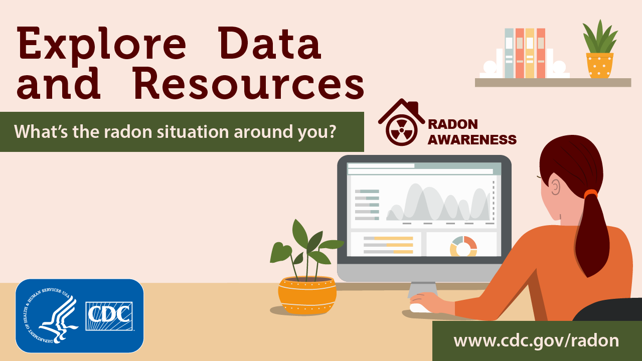
For additional information please visit:
www.cdc.gov/radon/

Slide 25
Thomas Michael Golden, M.D., M.P.H.
Epidemic Intelligence Service Officer
Office of the Director
Office on Smoking and Health
CDC

Slide 26
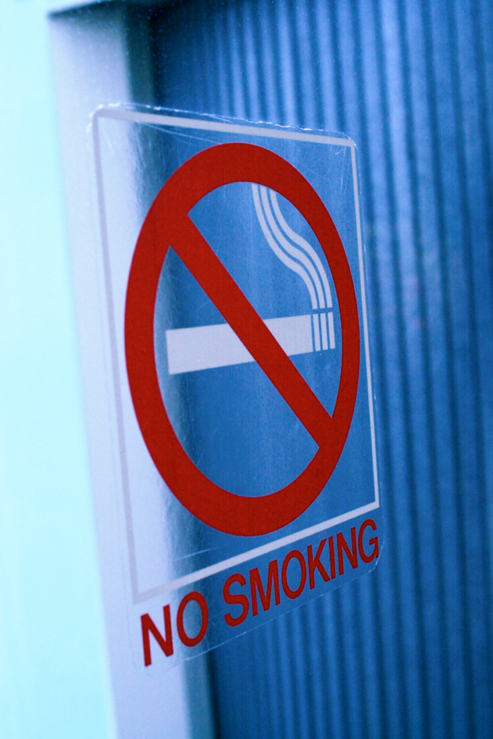

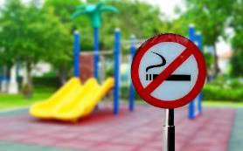

Radon and cigarette smoke Exposure: A dangerous combination
Thomas Michael Golden, MD, MPH|EIS Officer, Lieutenant Commander
Environmental Health Nexus (EH Nexus) Webinar| January 24, 2022
Office on Smoking and Health

Slide 27

AGENDA
Radon and smoking
1
What is secondhand smoke?
2
What can we do to reduce risk?
3

Slide 28
AGENDA
Radon and smoking
1
What is secondhand smoke?
2
What can we do to reduce risk?
3

Slide 29

Radon and Smoking
Lung cancer is the leading cause of cancer death in the United States; leading causes of lung cancer death are:
    Cigarette smoking/secondhand smoke
    Radon
Smoking and radon exposure each increase the risk of lung cancer, and the combination increases the risk even more.
Source: “Radon and your Health.” National Center for Environmental Health, Centers for Disease Control and Prevention. 3 Jan. 2022, Radon and Your Health (cdc.gov)

Slide 30
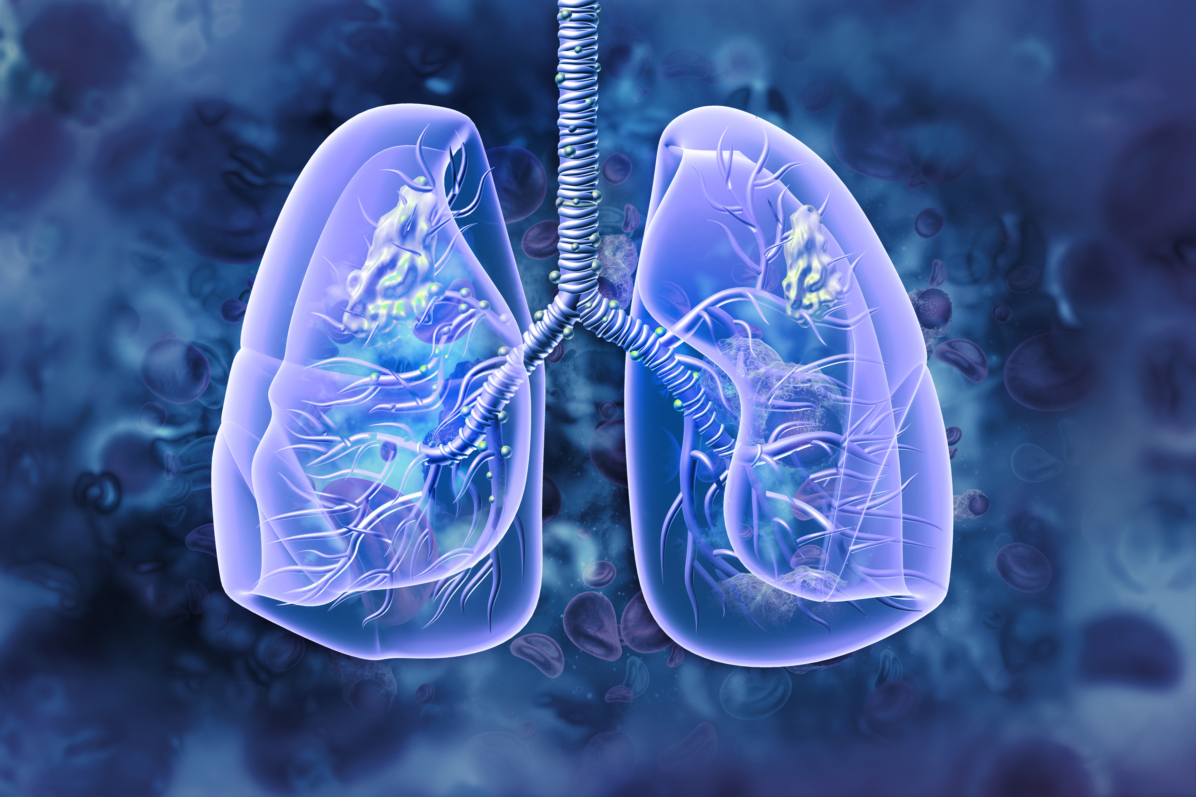
Radon and Smoking
Radon can cause lung cancer in anyone, regardless of smoking status.
Studies have demonstrated a combined effect between smoking and radon for lung cancer risk.
The National Cancer Institute estimates that around 90% of radon-related lung cancer deaths occur among people who smoke or used to smoke.
Source: Park, EJ et al. “Residential Radon Exposure and Cigarette Smoking in Association with Lung Cancer: A Matched Case-Control Study in Korea.” International Journal of Environmental Research and Public Health. 2020 Apr 24;17(8):2946
Source: “Radon and Cancer,” National Institutes of Health National Cancer Institute, 6 December 2011, Radon and Cancer - National Cancer Institute

Slide 31
AGENDA
Radon and smoking
1
What is secondhand smoke?
2
What can we do to reduce risk?
3

Slide 32
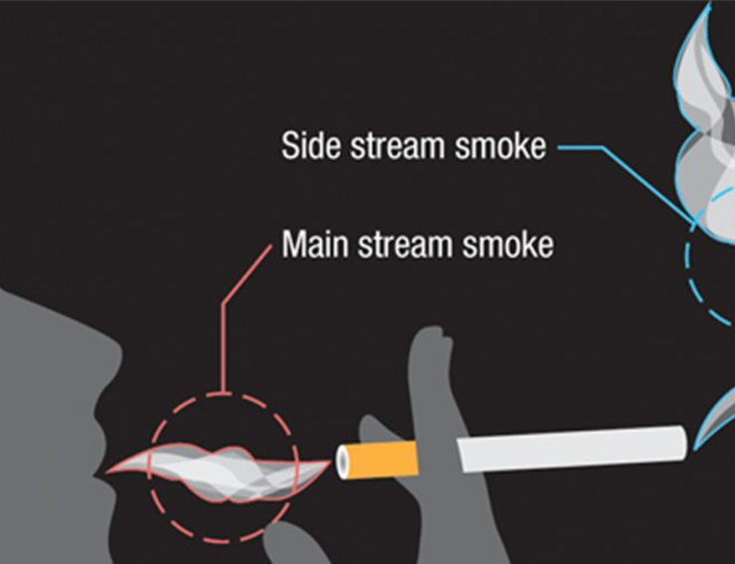
What Is Secondhand Smoke (SHS)?
It’s the combination of side stream smoke and main stream smoke.
SHS contains more than 7,000 chemicals.
Hundreds are toxic, and about 70 can cause cancer.
Source: The Health Consequences of Smoking – 50 Years of Progress: A Report of the Surgeon General – Atlanta, GA.: U.S. Department of Health and Human Services, CDC, Office on Smoking and Health, 2014.

Slide 33

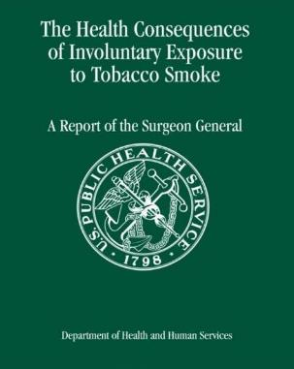





The Surgeon General Concluded …
there is NO safe level of secondhand smoke exposure.
Completely eliminating smoking indoors is the only way to protect people from involuntary exposure.
Separating people who smoke from those who do not
Opening windows
Using fans
Operating heating, air conditioning and ventilation systems
cannot eliminate exposure to secondhand smoke.
Source: The Health Consequences of Involuntary Exposure to Tobacco Smoke: A Report of the Surgeon General—Executive Summary. U.S. Department of Health and Human Services, CDC, Office on Smoking and Health, 2006.

Slide 34
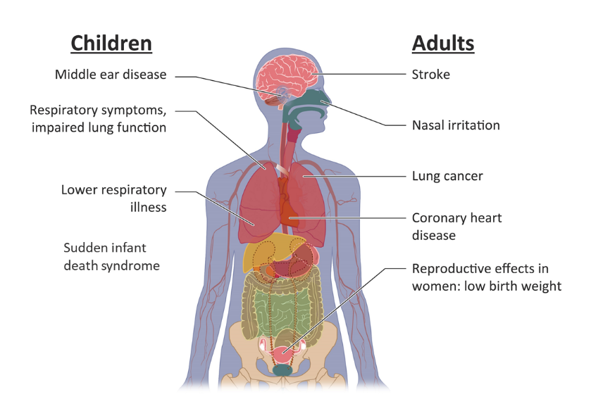
Secondhand Smoke Causes Disease & Death
Each year in the United States, SHS exposure contributes to approximately 400 deaths in infants and 41,000 deaths among adults who do not smoke.
Source: The Health Consequences of Smoking – 50 Years of Progress: A Report of the Surgeon General – Atlanta, GA.: U.S. Department of Health and Human Services, CDC, Office on Smoking and Health, 2014.

Slide 35
AGENDA
Radon and smoking
1
What is secondhand smoke?
2
What can we do to reduce risk?
3

Slide 36

Quitting Smoking Lowers Risk of Lung Cancer
Smoking cessation reduces the risk of lung cancer and numerous other adverse health outcomes.
Quitting is hard, but free resources can help with quitting: 1-800-QUIT-NOW, cdc.gov/quit, SmokeFreeTXT (text QUIT to 47848), quitStart app
There are evidence-based, FDA-approved medications that can help with smoking cessation. Talk to your physician about how these might help as part of a comprehensive cessation plan.
You can further reduce your and your family’s risk of lung cancer by testing and protecting your home from radon.
Source: Samet JM. The 1990 Report of the Surgeon General: The Health Benefits of Smoking Cessation. Am Rev Respir Dis. 1990 Nov;142(5):993-4.

Slide 37
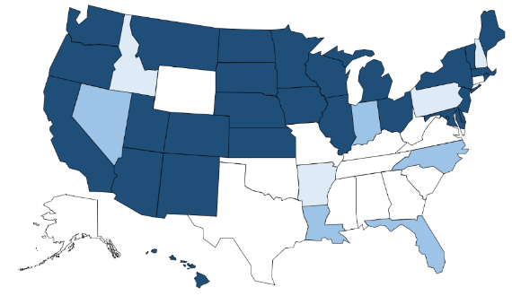
Comprehensive Smokefree Laws
United States
2000 – 2020
D.C
D.C.
2000
2020
No Law – designated areas - or separate ventilation law
100% smokefree in one location
100% smokefree in two locations
100% smokefree in three locations

Slide 38
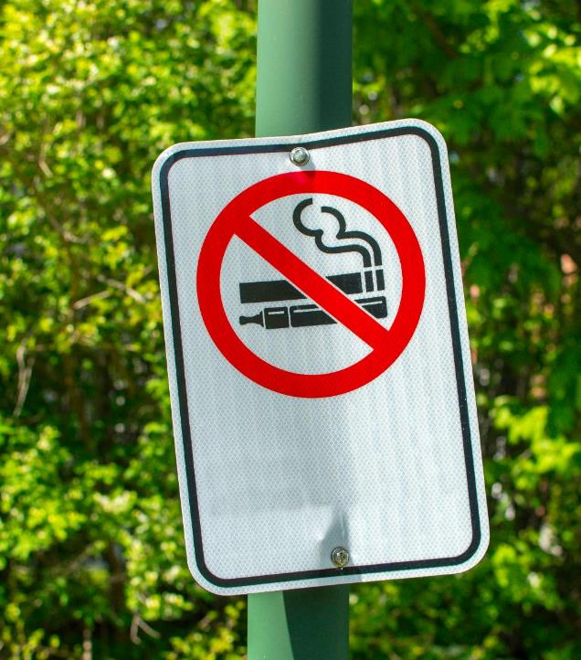
KEY TAKEAWAYS
1
Smoking and radon exposure each increase the risk of lung cancer, and the combination increases the risk even more
2
Reducing radon exposure can reduce the risk of lung cancer in everyone, including those who currently, formerly, or never smoked
3
You can protect yourself and your family by quitting smoking and testing your home for radon.
Secondhand smoke exposure increases the risk of lung cancer; secondhand smoke along with radon exposure increases this risk even more
4

Slide 39

Contact
Thomas Michael Golden, MD, MPH
Epidemic Intelligence Service Officer, Class of 2020
Lieutenant Commander, U.S. Public Health Service
www.cdc.gov/tobacco
Office on Smoking and Health

Slide 40
Bill Field, Ph.D., M.S.
Department of Occupational and Environmental Health
Department of Epidemiology College of Public Health
The University of Iowa

Slide 41

Educating Health Care Providers about Radon Risk to Reduce Lung Cancer
Bill Field, PhD, MS
Department of Occupational and Environmental Health
Department of Epidemiology
College of Public Health
The University of Iowa
Bill-field@uiowa.edu

Slide 42
Radon Education
Medical Schools/Nursing Schools/ Associations
National Media
Federal/State Government
Local Media
National Health Programs\NGOs
Medical Providers
Local Health Officials
National Association of Home Builders
State & Local Health Advocates
Builders
THE PUBLIC
National Real Estate Associations
Real Estate Agents
Health Insurers
Radon Mitigators/ Testers
Teachers
School Officials
Building Code Officials
National Teachers Labor Unions
AARST
Building Code Associations
School Associations

Slide 43

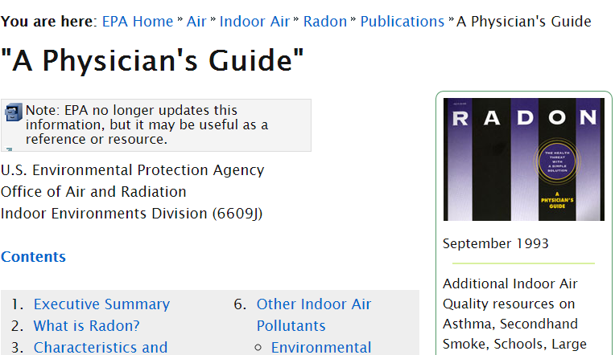
Google Search for “Radon” and “Physician”
U.S. Environmental Protection Agency, Office of Air and Radiation, September 1993

Slide 44
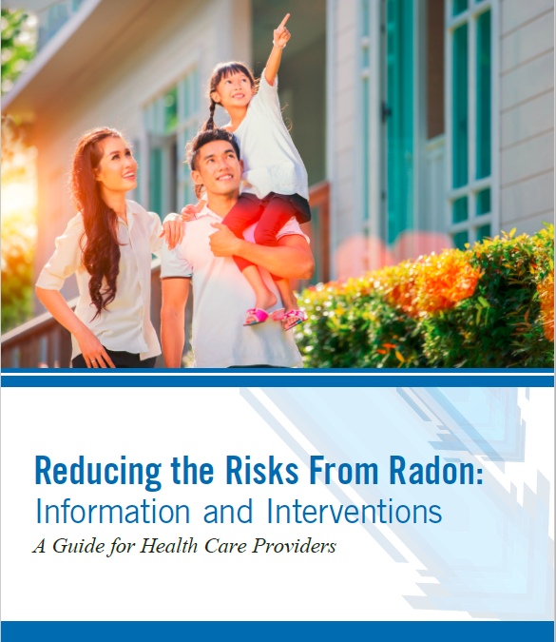

Focus Group Guided
PRIMARY CARE PROVIDERS
Physicians
Physician Assistants
Nurse Practitioners

Slide 45
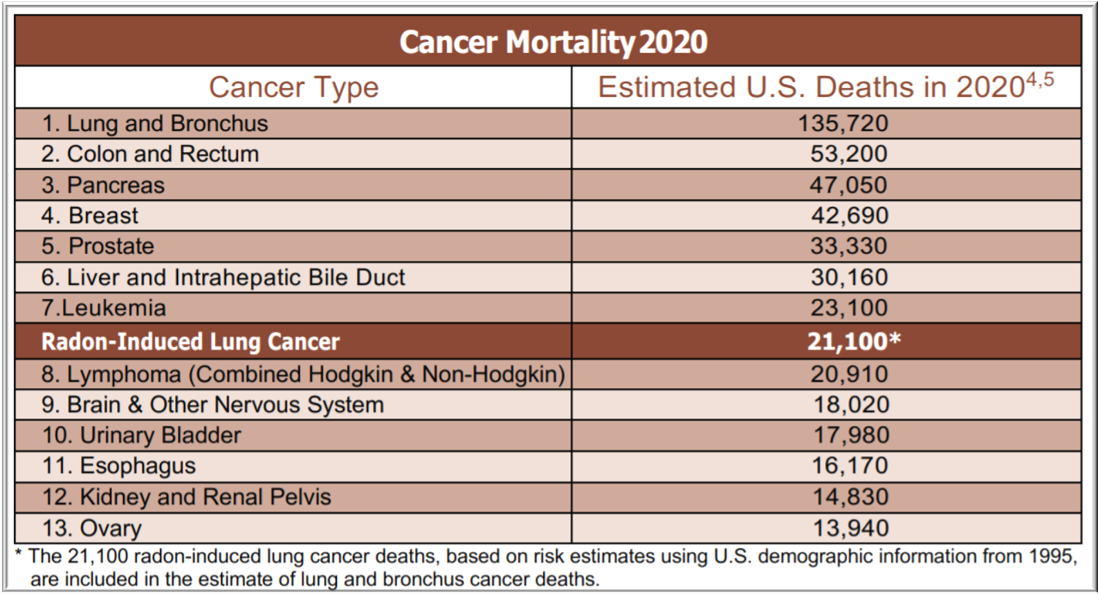
Radon Misperceptions
Radon Misperceptions
Providers often stated, “as compared to the number of deaths caused by smoking, the risk posed by radon is not a major public health problem” However, …………….

Slide 46
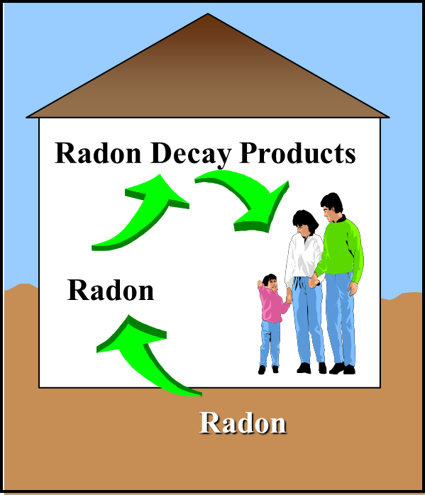
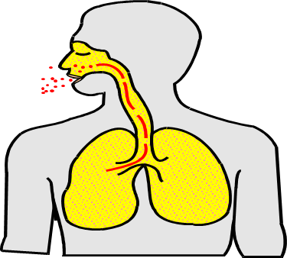
Radon Misperceptions
“Radon induced lung cancer is caused by inhalation of radon gas”
Lung cancer caused by the solid radioactive radon decay products

Slide 47
Radon Decay Products
Radon-222
4 day
a,g
Polonium-218
3 min
a,g
Lead-214
27 min
b,g
Bismuth-214
20 min
b,g
Polonium-214
0.2 ms
Po-218 and Po-214
deliver the majority of radiation dose to the lung
a,g
Lead-210
22 yrs
b,g
Bismuth-210
5 day
b,g
Polonium-210
138 day
a,g
Lead-206
Stable

Slide 48
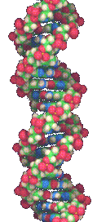
Alpha Particle
Ionizing radiation can directly and indirectly damage DNA
Double and single strand DNA breaks
Free radical formation
Notes:
GSTM1 reference: See: http://www.cheec.uiowa.edu/misc/radon.html

Slide 49
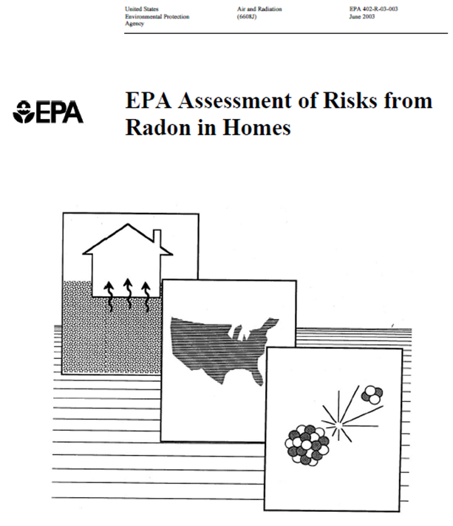
Radon Risk Misperceptions
Mortality Risk estimates are based solely on old studies of miners exposed to high levels of radon gas.
“Based on its analysis, EPA estimates that out of a total of 157,400 lung cancer deaths nationally in 1995, 21,100 were radon related.”

Slide 50
Cohort Studies (15) of Radon-Exposed Miners
Cornwall
E. Germany
Port Radium
Sweden
Newfoundland
Ontario
France
Czech Republic (2)
Beaverlodge
China
Colorado
New Mexico
Radium Hill
Brazil

Slide 51
Pooled Residential Radon Studies
Excess relative lung cancer risk per 2.7 pCi/L (100 Bq m⁻³) (95% CI)
Study | Primary Analysis | Restricted Analysis | Uncertainty Adjusted
European | 0.084 (0.03, 0.158) | 0.094 (0.034, 0.175) | 0.16 (0.05, 0.31)
North American | 0.11 (0.00, 0.28) | 0.18 (0.02, 0.43)
Chinese | 0.133 (0.01, 0.36) | 0.319 (0.07, 0.91)
Combined | 0.093 (0.04, 0.15) | 0.11 (0.05, 0.19)
Restricted Analysis - Individuals living in at most two residences during the past 30 years

Slide 52

Other Focus Group Findings
Few providers have received training about the risks posed by protracted radon decay product exposure and do not see many chapters in textbooks or review articles highlighting its risk.

Slide 53
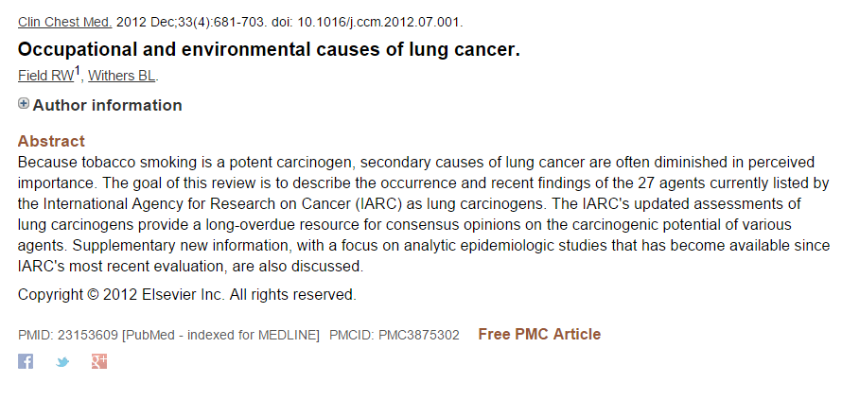
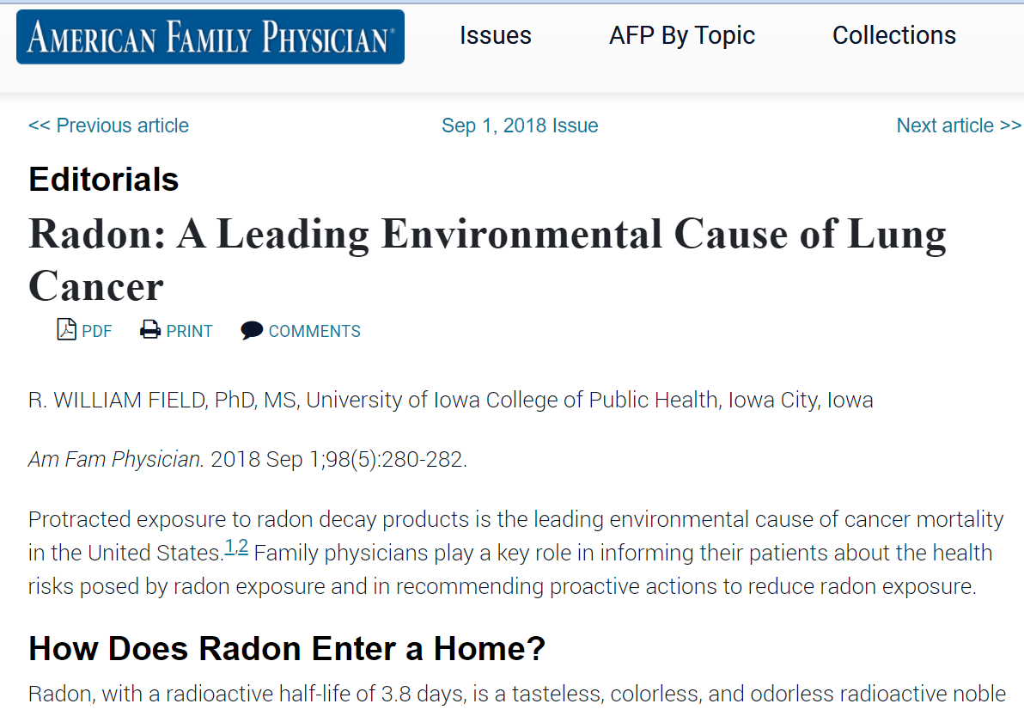
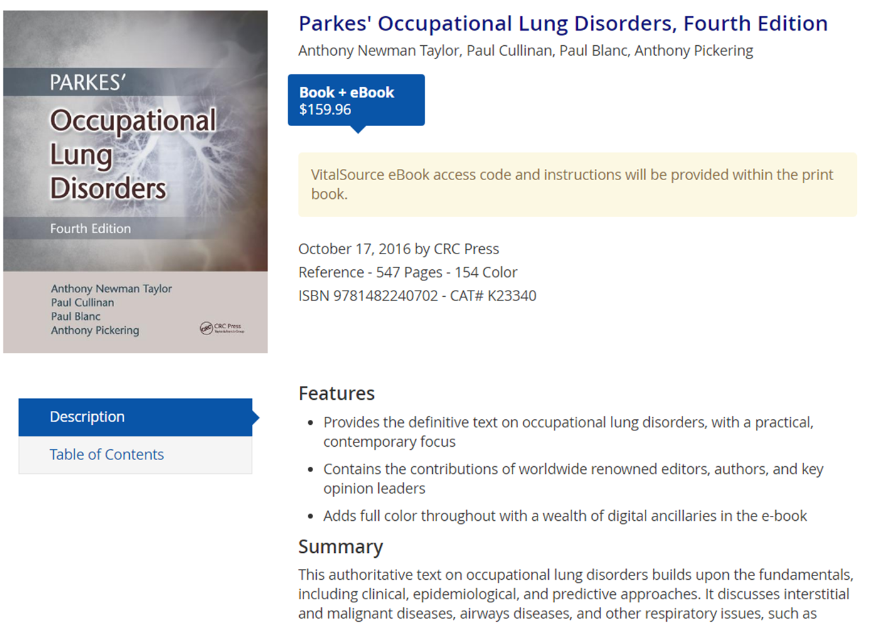
Updated Information on Radon

Slide 54

http://www.radonleaders.org/resources/reducingtheriskfromradon
Or – Search “EPA, Radon, Health”

Slide 55
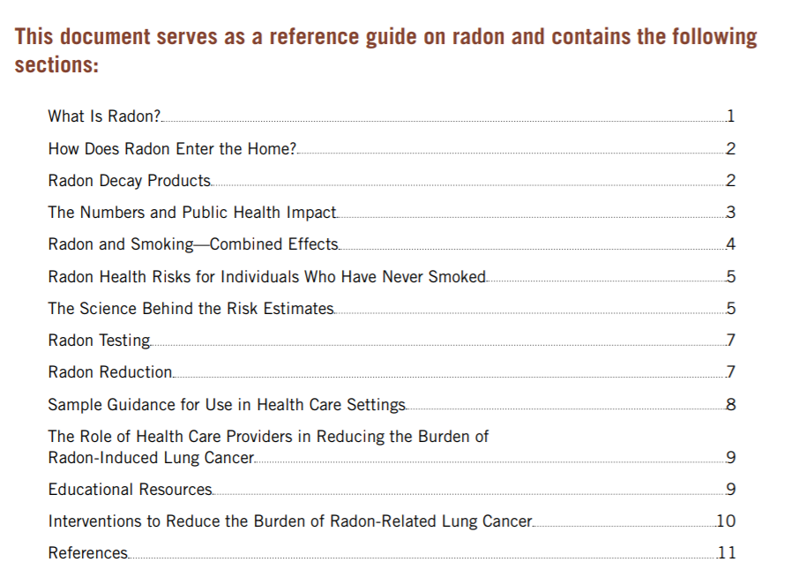
Reference Document on Radon

Slide 56
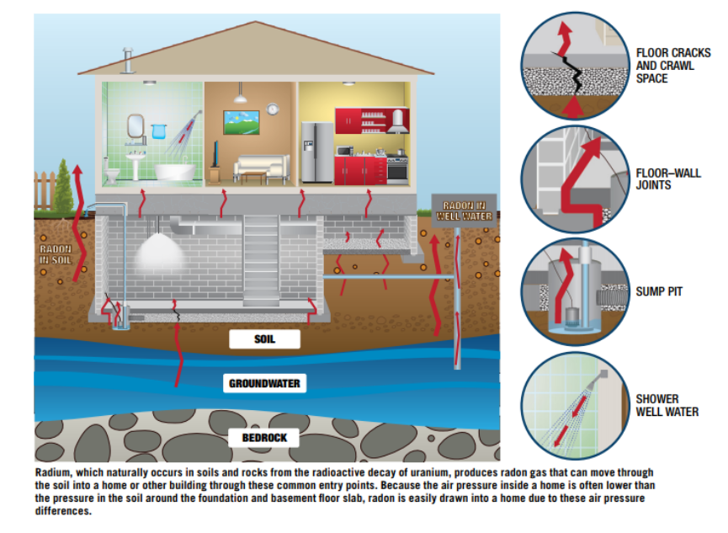
Radon Home

Slide 57
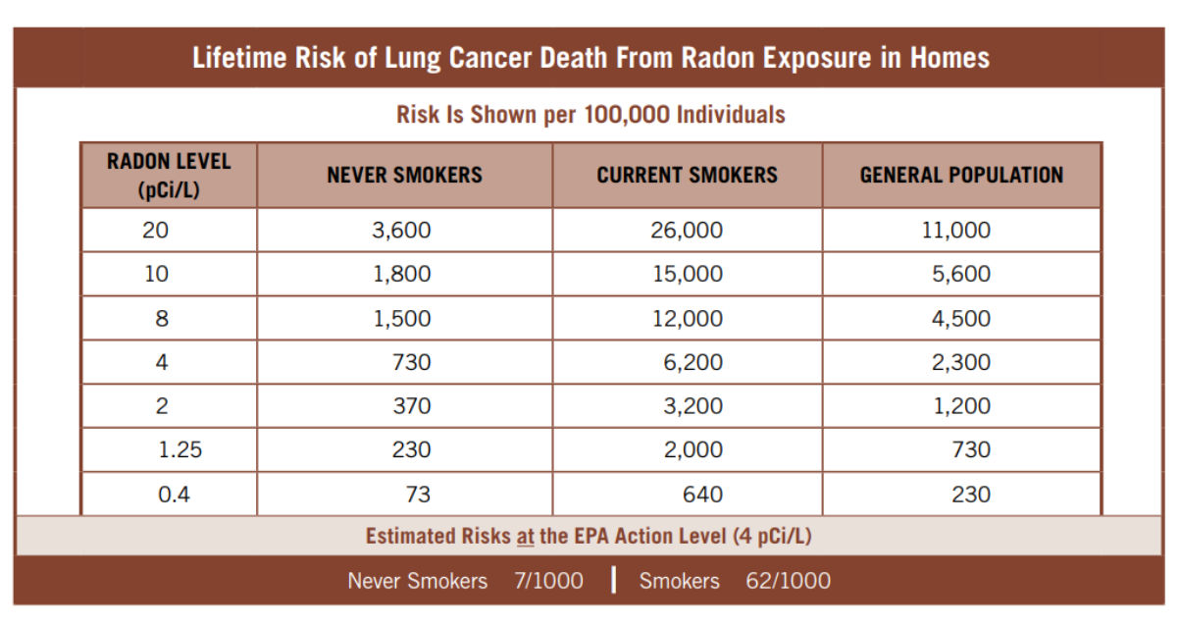
Updated Table

Slide 58
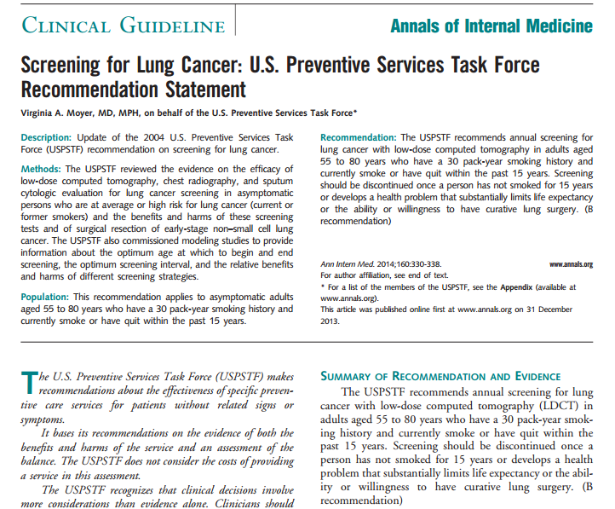
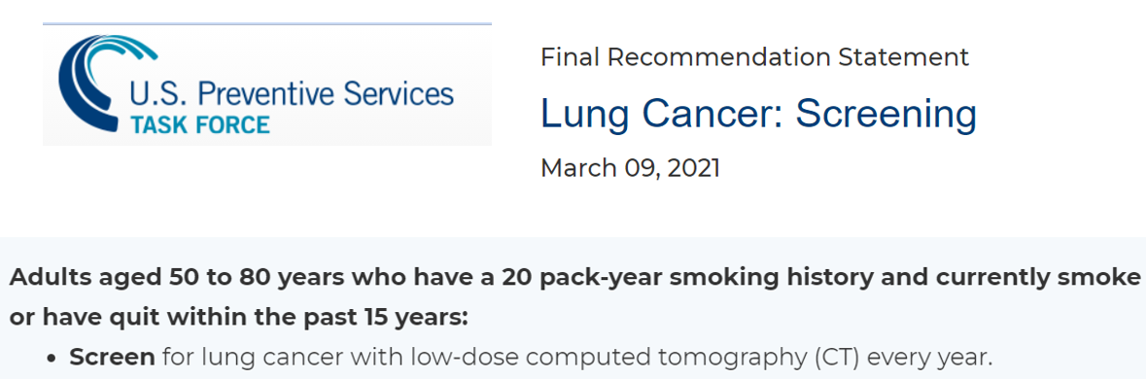
Clinical Publications

Slide 59

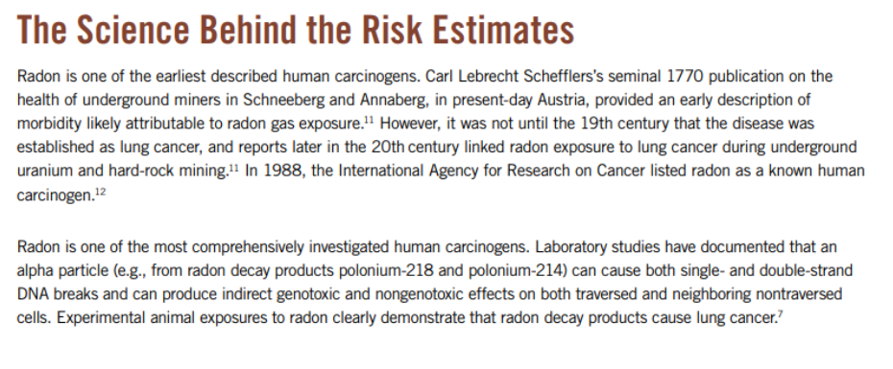
The Science Behind the Risk Estimates

Slide 60
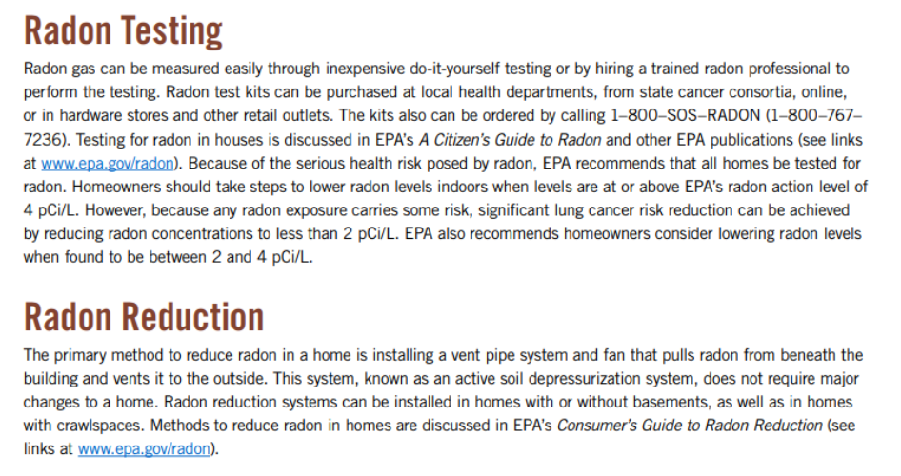
Radon testing and Reduction

Slide 61
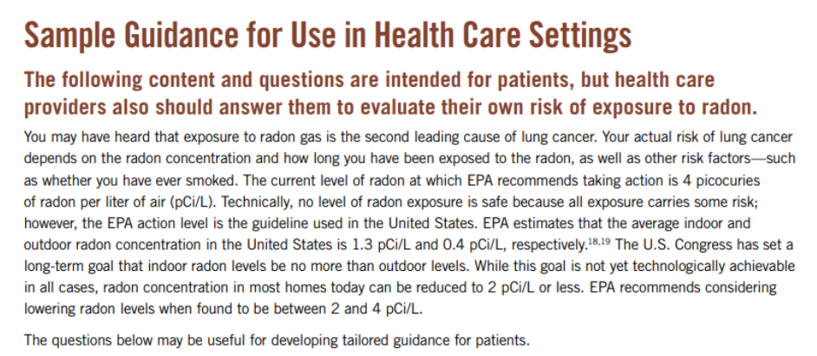
Sample guidance for use in health care settings

Slide 62
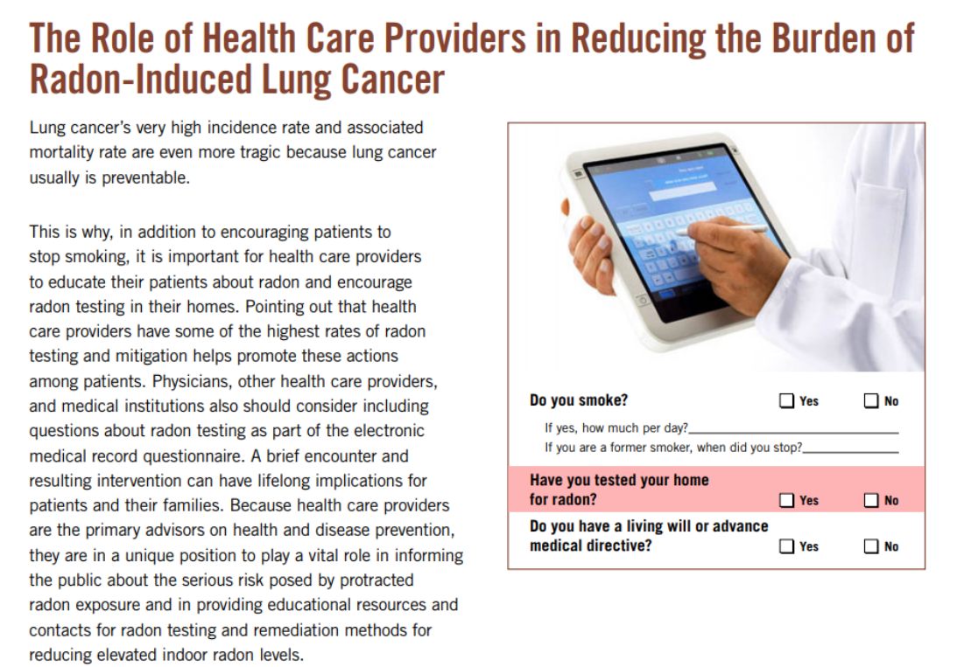
Role of Health care providers

Slide 63

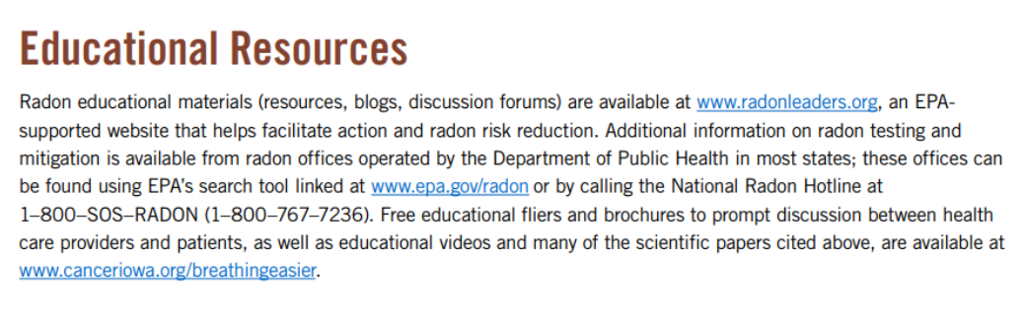
Educational Resources

Slide 64
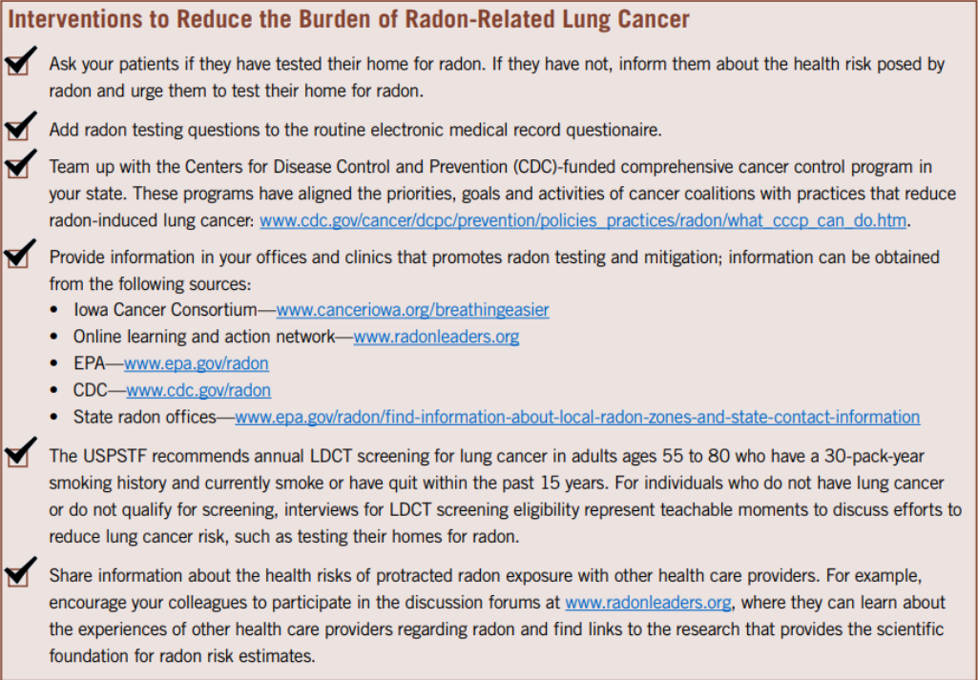
Interventions to Reduce the burden

Slide 65
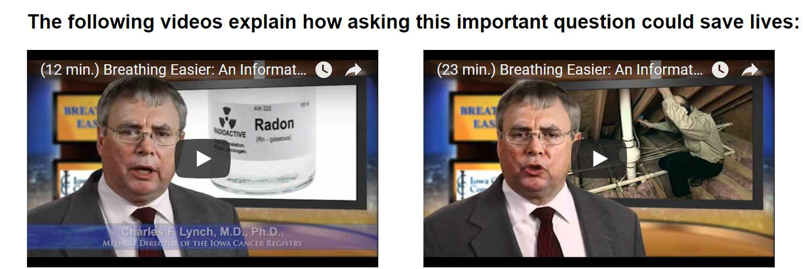
Availability of Guide
Radon Leaders - http://www.radonleaders.org/resources/reducingtheriskfromradon
http://breathingeasier.info website

Slide 66
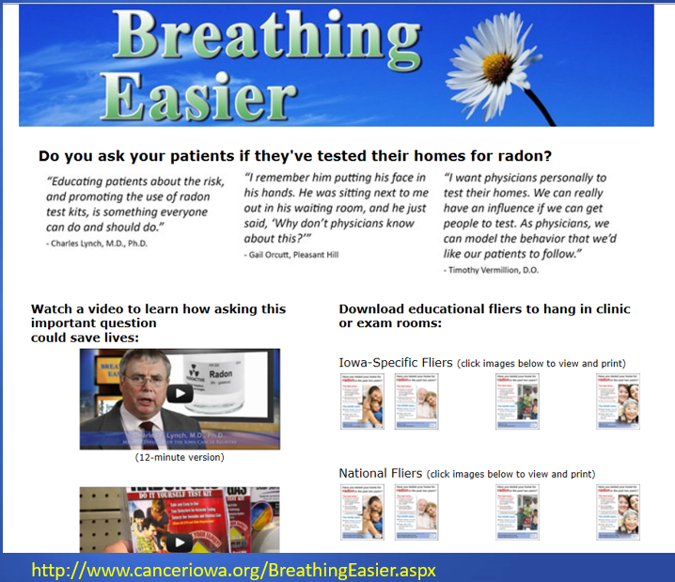
Next Steps - Continuing education credits will be available for reviewing the Guide, watching video for providers, and completing quiz.

Slide 67
Thank you!
Feel free to contact me directly
Bill Field, PhD, MS
Department of Occupational and Environmental Health
Department of Epidemiology
College of Public Health
The University of Iowa
Bill-field@uiowa.edu

Slide 68
Q&A
All attendees are muted. To adjust your audio settings in the webinar, click on Audio Options.
Please use the Q&A window to ask questions of the panelist.

Slide 69
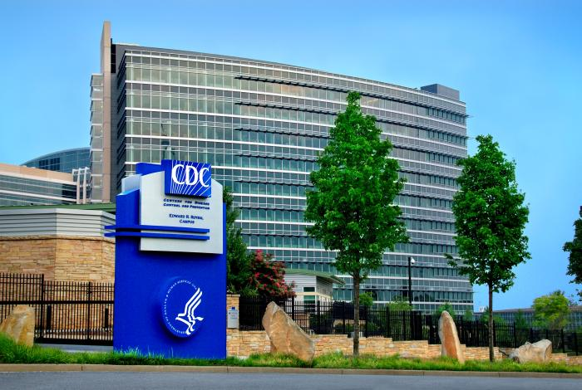
Thank you for joining us today!
EHNexus@cdc.gov

