Slide 1

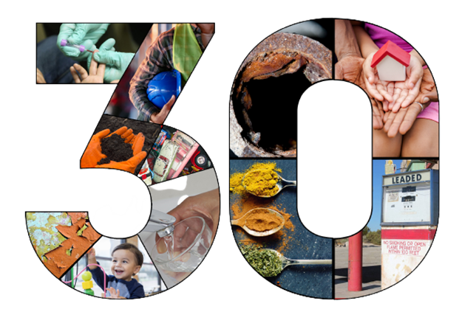
National Lead Poisoning Prevention Week:
Commemorating 30 Years of CDC Funding Childhood Lead Poisoning Prevention Programs (CLPPPs)
EH Nexus Webinar | October 27, 2021

Slide 2
EH Nexus Webinar
Today’s EH Nexus Webinar will be available to view on demand a few days after this webinar. You can find the video recording of today’s webinar at the CDC EH Nexus webpage at:
cdc.gov/nceh/ehsp/ehnexus
Notes:
Today’s EH Nexus Webinar will be available to view on demand shortly after this webinar. You can find the video recording of today’s webinar at the CDC EH Nexus webpage at the link displayed on this slide.
You may submit questions by emailing us at EHNexus@cdc.gov.

Slide 3
Webinar Logistics
All attendees are muted. To adjust your audio settings in the webinar, click on Audio Options.
Please use the Q&A window to ask questions of the panelist.
Notes:
You may submit questions at any time during today’s presentation. To ask a question using Zoom, click the “Q&A” button at the bottom of your screen, then type your question in the “Q&A” box.
For insurance coverage related questions, please contact the Centers for Medicare and Medicaid Services. For regulatory questions, please contact the Food and Drug Administration. If you’re a member of the media, please contact CDC media relations at media@cdc.gov or at 404-639-3286.
Our CDC subject matter experts are looking forward to addressing your CDC-specific questions during our Q&A session.

Slide 4

Today’s Presenter
Paul Allwood, Ph.D., M.P.H., RS
Branch Chief, Lead Poisoning Prevention and Surveillance Branch (proposed)
Notes:
Dr. Allwood will read from a previously-cleared script that is uploaded as a supporting file (eClearance ID: 0900f3eb81d302bd).

Slide 5
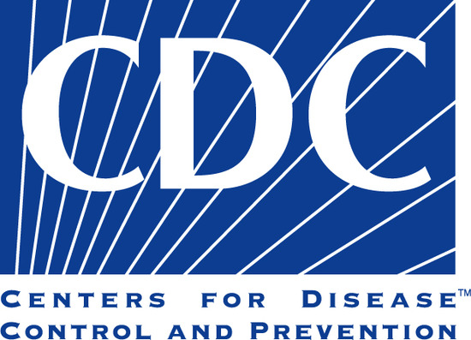
Overview
Key milestones achieved in lead poisoning prevention by CDC and our partners over the last 30 years
Current initiatives at CDC and our priorities for the future
Panel of CDC funded childhood lead poisoning prevention program recipients
Q&A
Notes:
Since 1991, CDC has supported state and local health departments through cooperative agreements to conduct childhood lead poisoning prevention activities in their jurisdictions. And these state and local programs are the foundation of the work that we do.
Today, we are gathered to commemorate 30 years of funding these state and local childhood lead poisoning prevention programs here at CDC. This is an incredible milestone – for CDC, for our partners, and the greater public health community. This milestone signifies years of coordinated efforts to protect children from lead poisoning through many noteworthy accomplishments achieved along the way. But this milestone is also an opportunity for us to think about the future and move toward our shared goal of eliminating childhood lead exposure as a public health problem.
We have some exciting items planned for the next hour:
We will begin by discussing some of the key accomplishments in lead poisoning prevention and current initiatives here at CDC.
We will then hear from some of our funded childhood lead poisoning prevention programs about the work they are doing in their communities.
We will conclude with a question-and-answer segment.
First, it is my pleasure to introduce Dr. Pat Breysse, the Director of CDC's National Center for Environmental Health and Agency for Toxic Substances and Disease Registry.

Slide 6

Opening Remarks
Patrick Breysse, Ph.D., CIH
Director, National Center for Environmental Health/Agency for Toxic Substances and Disease Registry
Notes:
Dr. Breysse will provide opening remarks. A back-up video will be played if he is unavailable. The cleared script for this video is uploaded as a supporting file (eClearance ID: 0900f3eb81d2b14c).

Slide 7

A look back over the last 30 years…
Notes:
Thank you, Pat.
Now, I‘d like to discuss some significant scientific and public health events in childhood lead poisoning prevention.
CDC has a long-standing role in childhood lead poisoning prevention. Over these last 30 years CDC and partners have made progress in reducing and eliminating childhood lead exposure in the United States, some of which will be highlighted in the next slides. Despite this progress, we are aware that much more work needs to be done.

Slide 8
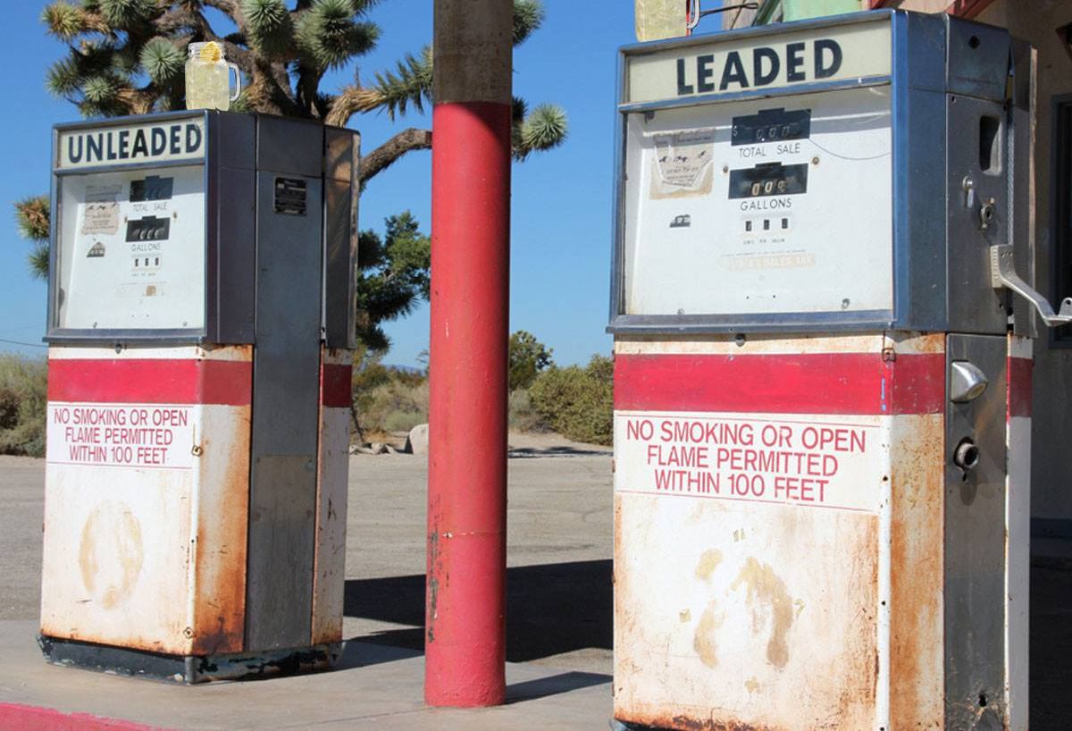
1970s
1972: Health-based regulation to remove lead from gasoline
1973: Hazardous amounts of lead banned in toys and other children’s products
1974: Safe Drinking Water Act
1978: Lead-based paint banned from homes and residences
Notes:
To begin, the fight against childhood lead exposure really took off in the 1970s, when we saw some of the first nation-wide initiatives to ban lead from various sources.
During this time, the EPA initiated a health-based regulation to remove lead from gasoline for on-road vehicles and began setting limits on the amount of lead in drinking water.
In 1973, the CPSC banned hazardous amounts of lead in toys and other products intended for use by children and required warning labels on other lead-containing products.
And most importantly, lead-based paint officially became banned from homes and residences in 1978.

Slide 9

1980s
1985: Updated screening recommendations and treatment guidelines
1988: The Lead Contamination Control Act of 1988
1989: Advisory Committee on Childhood Lead Poisoning Prevention (ACCLPP) established
Notes:
In the 1980s, CDC started disseminating screening recommendations and treatment guidelines to state and local public health agencies. the Lead Contamination Control Act of 1988 authorized CDC to support local and state agencies to develop comprehensive childhood lead poisoning prevention programs (CLPPPs). And then, in 1989, the Advisory Committee on Childhood Lead Poisoning Prevention (ACCLPP) was established.

Slide 10
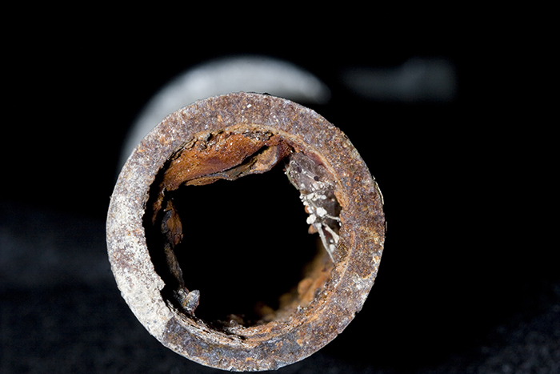
1990s
1991: CDC began funding state and local programs nationwide
1991: The Department of Health and Human Services (HHS) released the Strategic Plan for the Elimination of Childhood Lead Poisoning
1991: EPA published the Lead and Copper Rule
Notes:
The 1990s was a very pivotal decade for childhood lead poisoning prevention at CDC. In 1991, CDC began funding state and local childhood lead poisoning prevention programs.
Along with establishing CDC’s program, other federal agencies instituted some critical efforts.
HHS released the Strategic Plan for the Elimination of Childhood Lead Poisoning and set forth a comprehensive plan to eliminate childhood lead poisoning.
EPA published the Lead and Copper Rule.

Slide 11
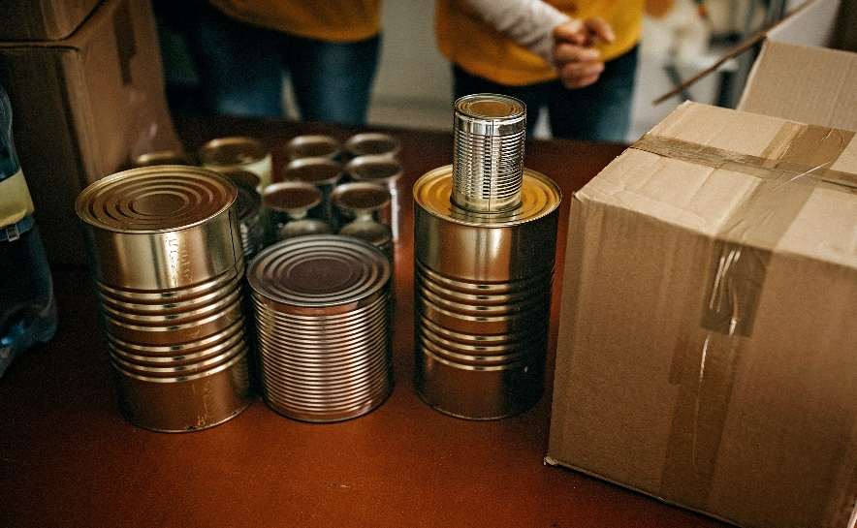
1990s (continued)
1993: CDC’s universal screening requirements adopted for children enrolled in Medicaid.
1995: Ban on food cans with lead solder became effective
1996: Ban on leaded gasoline for most motor vehicles became effective
Notes:
Additionally,
CMS adopted CDC's universal screening requirements for children receiving Medicaid benefits
A ban on food cans with lead solder became effective. ,
Leaded gasoline was phased out most motor vehicles.

Slide 12
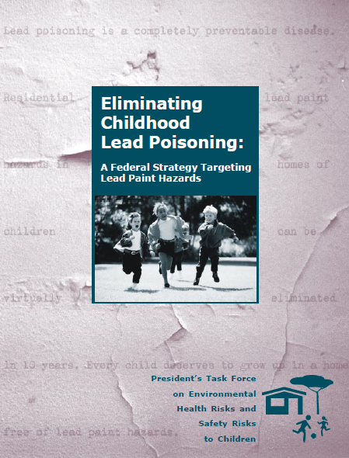
2000s
2000: “Eliminating Childhood Lead Poisoning: A Federal Strategy Targeting Lead Paint Hazards”
2008: EPA enacted the Renovation, Repair, and Painting Rule
2009: “Management of Lead Exposure in Pregnant and Lactating Women”
Notes:
At the start of the 21st century, the President's Task Force on Environmental Health Risks and Safety Risks to Children recommended aiming to eliminate childhood lead poisoning
Also, during this time, the EPA enacted the Renovation, Repair, and Painting Rule, which continues to protect children attending child-care centers and living in older homes undergoing renovation.
And then in 2009, CDC released its Guidelines for the Identification and Management of Lead Exposure in Pregnant and Lactating Women. These guidelines are still used today.

Slide 13

2010s
2010: Childhood lead poisoning prevention was named one of the “Ten Great Public Health Achievements in the United States”
2012: CDC established the Blood Lead Reference Value
2016: A federal emergency was declared in Flint, Michigan
Notes:
The years following 2010 marked a turning point for childhood lead poisoning prevention. By this time, lead poisoning prevention had been declared a public health success, as children with blood lead levels over 10 micrograms per deciliter constituted less than 1% of U.S. children. This is largely due to national policies aimed at controlling lead sources like paint, water, gasoline, and consumer products. With this, CDC eliminated the use of the term “blood lead level of concern” and replaced it with a population-based blood lead reference value to identify children with higher levels of lead in their blood compared to most children.
But the events in Flint, Michigan, led to a renewed attention on childhood lead poisoning and the need for efforts to identify and remove lead from children's environments. There is no safe lead level for children, and many children are still exposed and suffering from the harmful effects – even at extremely low blood lead levels.
With this renewed focus and shifted vision, CDC
Established the Flint Lead Exposure Registry to help connect victims of the Flint Water Crisis to necessary services.
Established the Lead Exposure and Prevention Advisory Committee or "LEPAC".
And re-instituted funding state and local lead poisoning prevention programs.
This is just a snapshot of all of the milestones that occurred over the last 50 years. A full timeline is available on our website, which I encourage you to check out.

Slide 14

Current Activities
Funding awarded to 62 state and local public health agencies
American Journal of Public Health (AJPH) Supplement
Redesigned lead poisoning prevention training center for public health staff
The Lead Exposure Risk Index (LERI)
Notes:
Where are we today?
Well, to begin, we recently awarded funds to the most expansive set of cooperative agreement partners in our program's history - 62 state and local public health agencies.
We have many other exciting things happening for childhood lead poisoning prevention at CDC.
In collaboration with the American Journal of Public Health (AJPH), we are preparing to publish a supplemental issue on the topic of lead hazards, prevention, mitigation programs, and emerging sources of exposure. We are currently accepting submissions. More information is available on our website.
Our branch is in the process of developing a new lead poisoning prevention training center for public health professionals. The anticipated launch date for the first portion of this training center is expected later this year.
The Lead Exposure Risk Index (LERI) – or the “leery” as it is referred to - will go live soon. The LERI will provide an interactive dashboard for individuals, the public, and professionals, that maps lead exposure across the country.

Slide 15
The Unfinished Agenda
Not all children are tested for blood lead, even when required by law
Millions of children are still exposed to lead
Significant disparities exist
Adverse health and developmental effects are being identified at increasingly lower blood lead levels
Children can be exposed from multiple sources
Notes:
As you can see, we've accomplished a lot over the past 30 years. However, there is still more work that needs to be done.
Not all children are receiving their required blood lead tests and getting connected with the services they need. This issue is especially timely right now as we are there is currently a shortage of point-of-care blood lead level testing kits due to an FDA recall – exacerbating an already existing issue. Right now, it is critical that we focus our efforts on ensuring children receive their required blood lead tests.
Aside from testing, millions of children are still exposed to lead in their environments. And the children affected by lead exposure are more likely to live in neighborhoods characterized by older homes, lower family incomes, lower housing values, higher population densities, higher proportions of rental properties, and higher proportions of minority, immigrant, and refugee residents.
Higher blood lead levels are also more prevalent among children from racial and ethnic minority groups, children from low-income households, and children who live in housing built before 1978.
And adverse health and developmental effects are being identified at increasingly lower blood lead levels, and children can now be exposed to lead from multiple sources.

Slide 16
Future of Lead Poisoning Prevention
Pursuing health equity and community-based interventions for lead poisoning prevention
Improving our data to be more timely, complete, and accurate.
Increasing blood lead testing, particularly among children at risk
Expanding awareness of childhood lead poisoning prevention as a major public health program, in the U.S. and abroad
Notes:
As certain populations bear a disproportionate burden of lead exposure and its associated risk factors; the future direction of our program is deeply rooted in health equity.
Looking to the future, our priorities include:
Pursuing health equity and community-based interventions for lead poisoning prevention
Improving our data to be more timely, complete, and accurate
Increasing blood lead testing, particularly among children at risk
And increasing awareness of childhood lead poisoning as a major public health program in the U.S. and abroad.
As childhood lead exposure in the United States has evolved, so has our program's approach to reducing and eliminating the problem.
We are pleased to have many partners working at the federal, state, and local levels to accomplish these priorities.
The wrap things up, we have one final video for you that further explains our priorities at CDC and our focus on promoting environmental justice as we work to eliminate childhood lead exposure.

Slide 17
Commentary from the Branch Chief
Paul Allwood, Ph.D., M.P.H., RS
Branch Chief, Lead Poisoning Prevention and Surveillance Branch (proposed)
Notes:
Dr. Allwood will read from a previously-cleared script that is uploaded as a supporting file (eClearance ID: 0900f3eb81d302bd).

Slide 18
CDC CLPPP PANEL DISCUSSION

Slide 19




Panel Members
Madeline Jones, M.P.H., CHES – CDC
On behalf of Beverly Drouin, B.S.
Healthy Homes & Environment Section, New Hampshire Department of Health & Human Services
Michelle Myer,
D.N.P., RN
South Carolina Childhood Lead Poisoning Prevention
Program (CLPPP)
Ed Norman, M.P.H.
North Carolina Childhood Lead Poisoning Prevention
Program (CLPPP)
Trina Evans Williams, Sc.D., M.P.H.
Louisiana Healthy Homes and Childhood Lead Poisoning Prevention Program (LHHCLPPP)
Notes:
Hello, I am Rio Schondelmeyer and I am a Health Scientist at the CDC Childhood Lead Poisoning Prevention Program. I would like to welcome our four panelists, each representing a CDC-funded state childhood lead poisoning prevention program. On our panel, we have Beverly Drouin from the Healthy Homes and Environment Section of the New Hampshire Department of Health and Human Services; Michelle Myer from the South Carolina Childhood Lead Poisoning Prevention Program; Ed Norman from the North Carolina Childhood Lead Poisoning Prevention Program; and Trina Evans Williams from the Louisiana Healthy Homes and Childhood Lead Poisoning Prevention Program. Thank you all for joining us today.

Slide 20
Panel Discussion
What is your greatest accomplishment/success?
What are you looking forward to working on in the future?
What obstacles has your program overcome?
How has lead poisoning prevention changed over the past 30 years?
How has CDC supported your CLPPP efforts?
Notes:
See attached script for recipient panel discussion.

Slide 21
Q&A
All attendees are muted. To adjust your audio settings in the webinar, click on Audio Options.
Please use the Q&A window to ask questions of the panelist.
Notes:
You may submit questions at any time during today’s presentation. To ask a question using Zoom, click the “Q&A” button at the bottom of your screen, then type your question in the “Q&A” box.
Our CDC subject matter experts are looking forward to addressing your CDC-specific questions during our Q&A session.

Slide 22
Closing Remarks
Paul Allwood, Ph.D., M.P.H., RS
Branch Chief, Lead Poisoning Prevention and Surveillance Branch (proposed)
Notes:
Dr. Allwood will read from a previously-cleared script that is uploaded as a supporting file (eClearance ID: 0900f3eb81d302bd).

Slide 23
For more information:
CDC’s Childhood Lead Poisoning Prevention Program
https://www.cdc.gov/nceh/lead/
EHNexus@cdc.gov

