Slide 1
Levels of Community Transmission Over Time
3
The following is a supplemental visualization to the Levels of Community Transmission displayed on the COVID Data Tracker County View page.
Updated March 13, 2023

Slide 2
How is the level of community transmission calculated?
Level of Community Transmission: This metric ** uses two indicators for categorization (1. Total number of new cases per 100,000 persons within the last 7 days and 2. Percentage of positive diagnostic and screening nucleic acid amplification tests (NAAT) during the last 7 days). 1NAAT remains the “gold standard” for clinical diagnostic detection of SARS-CoV-2 and includes viral testing such as Nucleic Acid Amplification Tests (NAATs), which include reverse transcriptase-polymerase chain reaction (RT-PCR) tests. Total number of new cases per 100,000 persons within the last 7 days is calculated by adding the number of new cases in the county (or other administrative level) in the last 7 days divided by the population in the county (or other administrative level) and multiplying by 100,000. Percentage of positive diagnostic and screening NAAT during the last 7 days is calculated by dividing the number of positive tests in the county (or other administrative level) during the last 7 days by the total number of tests resulted over the last 7 days. If the two indicators suggest different transmission levels, the higher level is selected. Transmission categories include Blue (Low Transmission): Control is achieved largely through individual prevention behaviors and the public health response to identify and isolate cases or clusters. Threshold: Counties with fewer than 10 cumulative cases per 100,000 population in the past 7 days, and a cumulative NAAT percent test positivity result below 5% in the past 7 days. Yellow (Moderate Transmission): Adherence to individual and selected community level prevention strategies are needed. Threshold: Counties with 10-49 cumulative cases per 100,000 population or a cumulative NAAT test positivity result between 5.0-7.9% in the past 7 days. Orange (Substantial Transmission): Everyday activities should be limited to reduce spread and protect the health care system. Threshold: Counties with 50-99 cumulative cases per 100,000 population or a cumulative NAAT test positivity result between 8.0-9.9% in the past 7 days. Red (High Transmission): Significant measures are needed to limit contact between persons, with priority given to maintaining essential community activities and services (e.g., health care, transportation, food and agriculture, schools). Threshold: Counties with cumulative cases =100 per 100,000 population or a cumulative NAAT test positivity result =10.0% in the past 7 days. The Level of Community Transmission table display the number of counties in each level and the change from the prior week.
Additional information about how these indicators and thresholds apply to K-12 school settings can be found here: Operational Strategy for K-12 Schools through Phased Mitigation | CDC. Additional information can be found on the Calculating Severe Acute Respiratory Syndrome Coronavirus 2 (SARS-CoV-2) Laboratory Test Percent Positivity: CDC Methods and Considerations for Comparisons and Interpretation webpage. Previously, CDC provided guidance for schools through the Indicators for Dynamic School Decision-Making. The current indicators and thresholds are an update to that document that reflect a focus on the past 7 days (rather than 14), and four (rather than five) categories of community transmission.

Slide 3
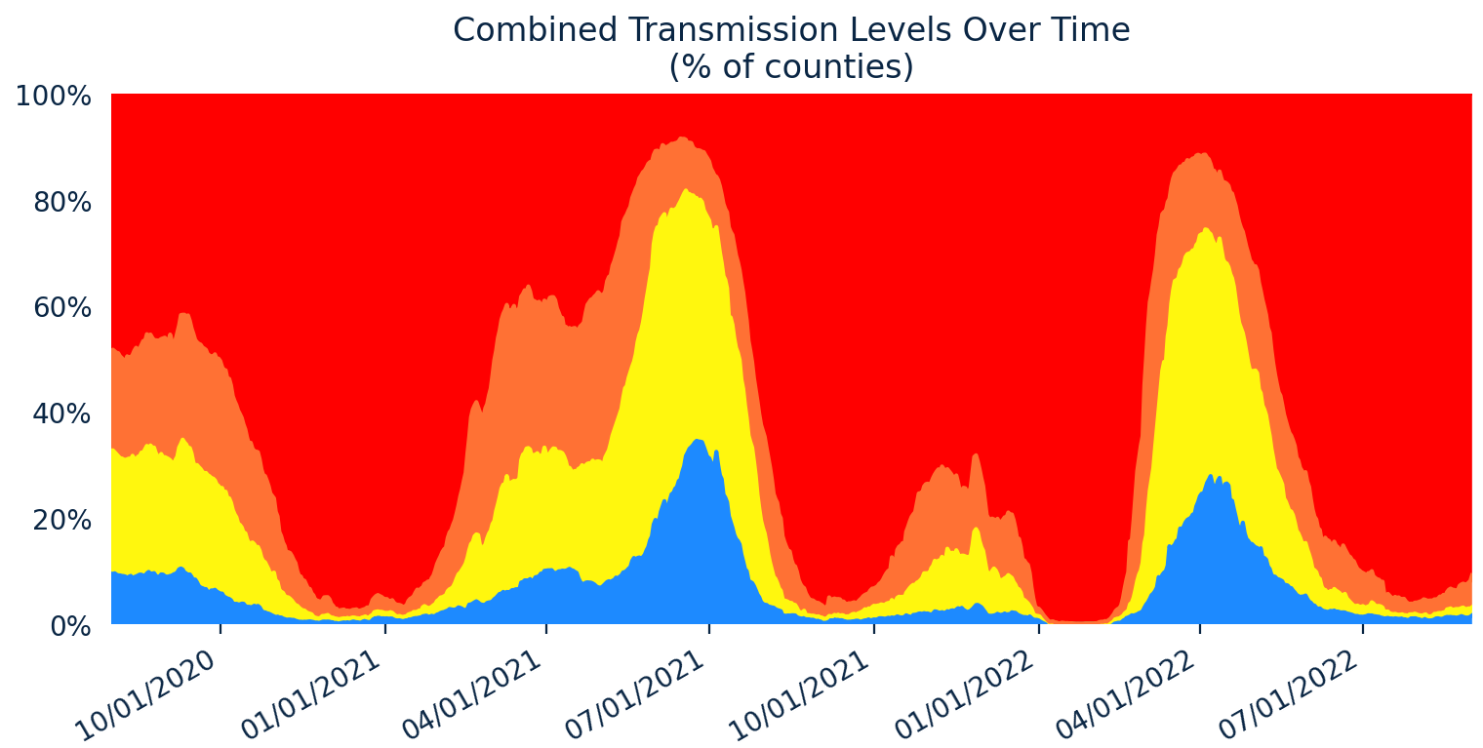
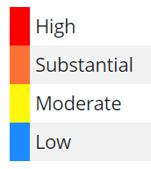
This slide was last updated September 2, 2022, and will not be updated going forward.

Slide 4
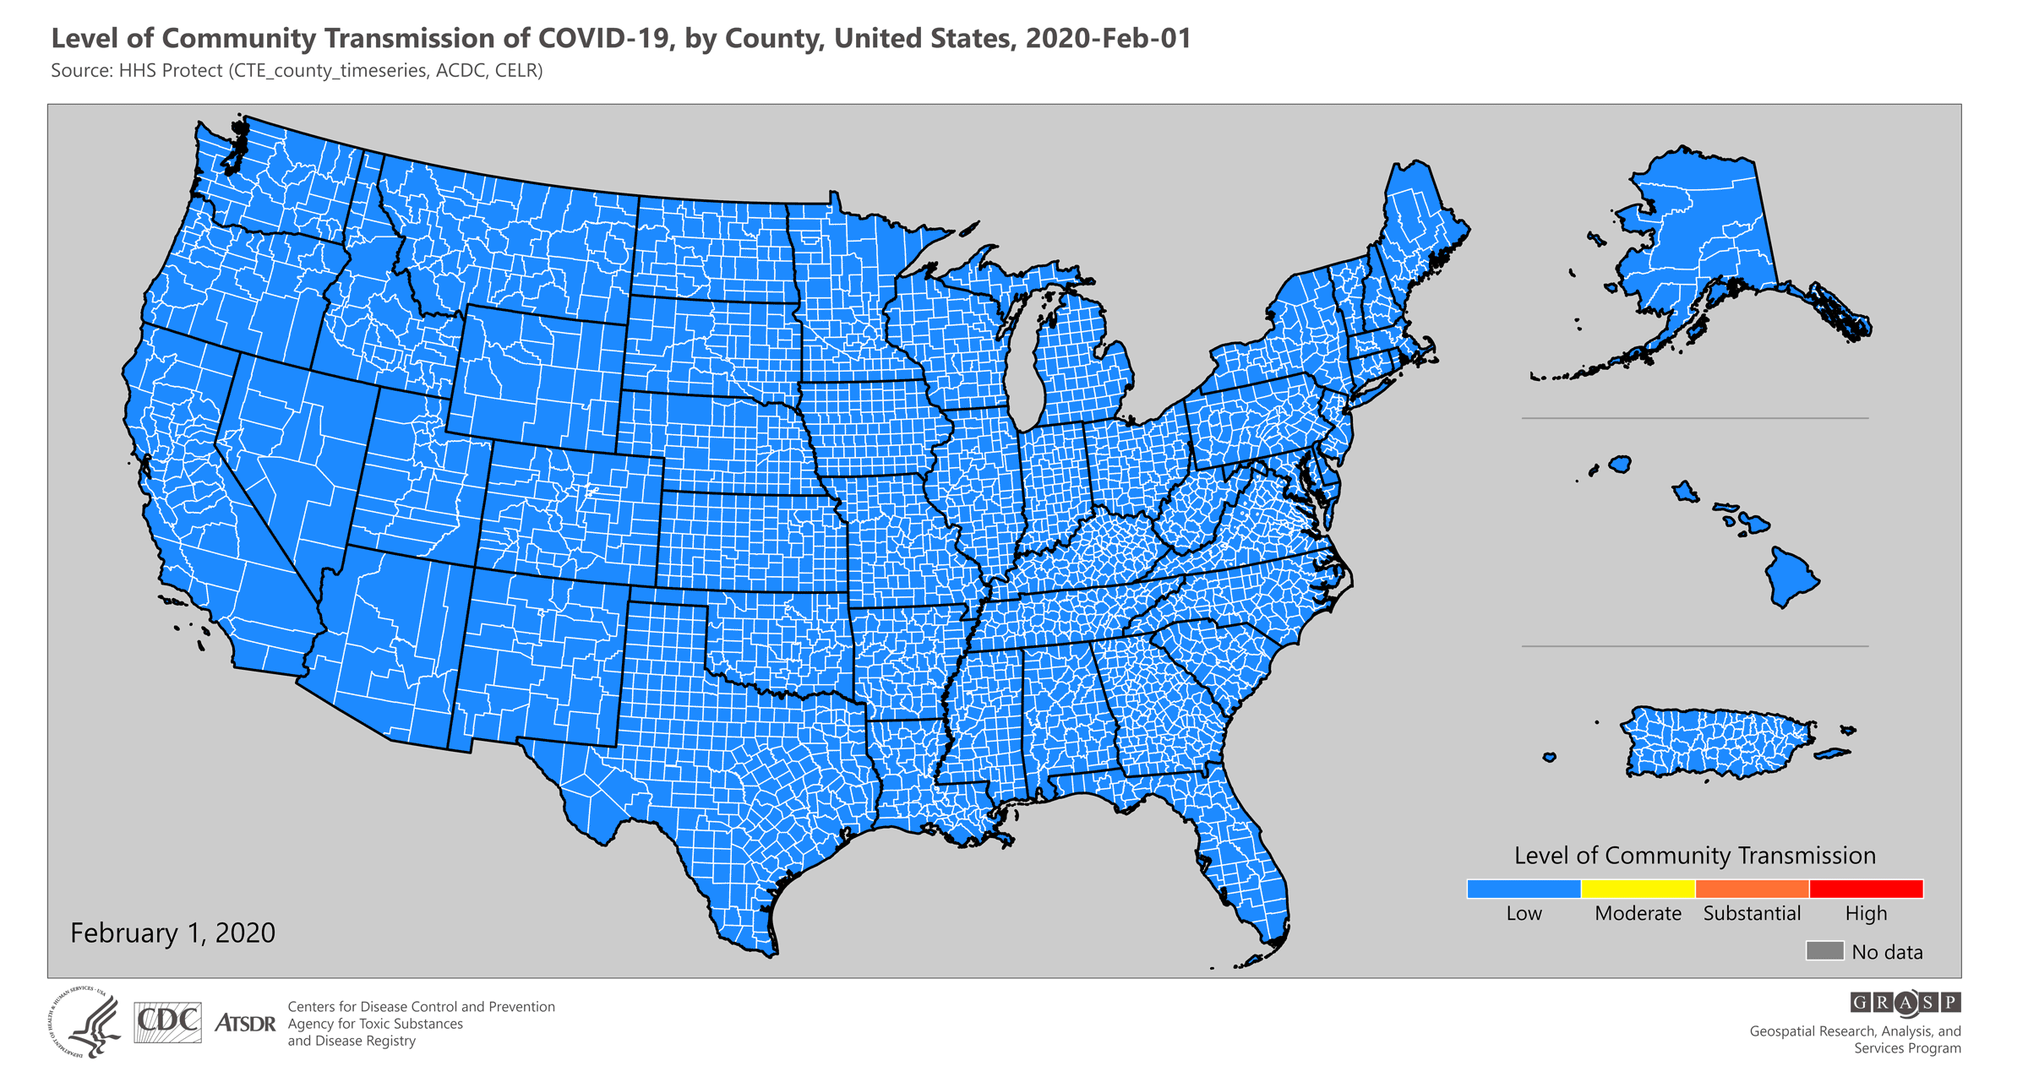

Slide 7
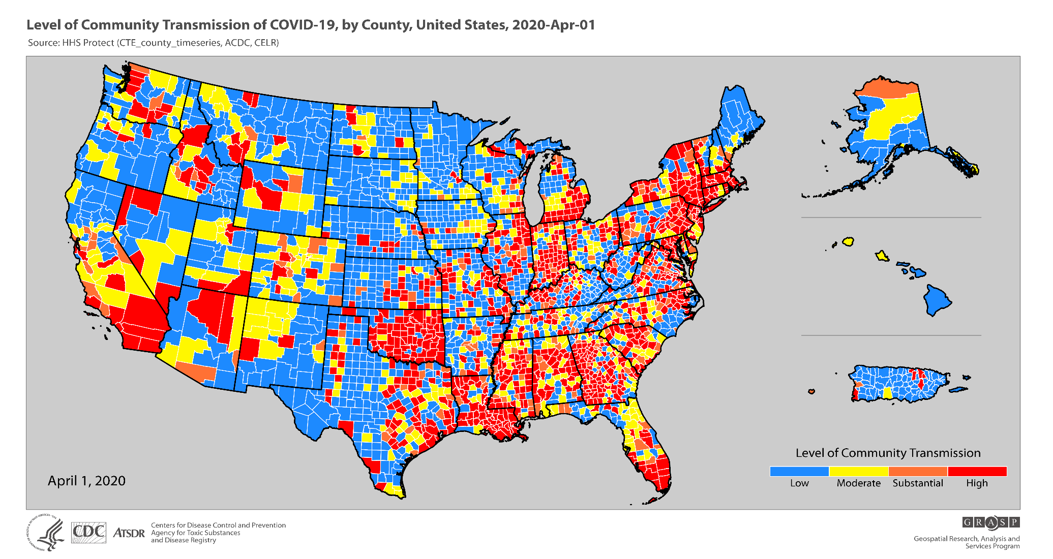

Slide 8
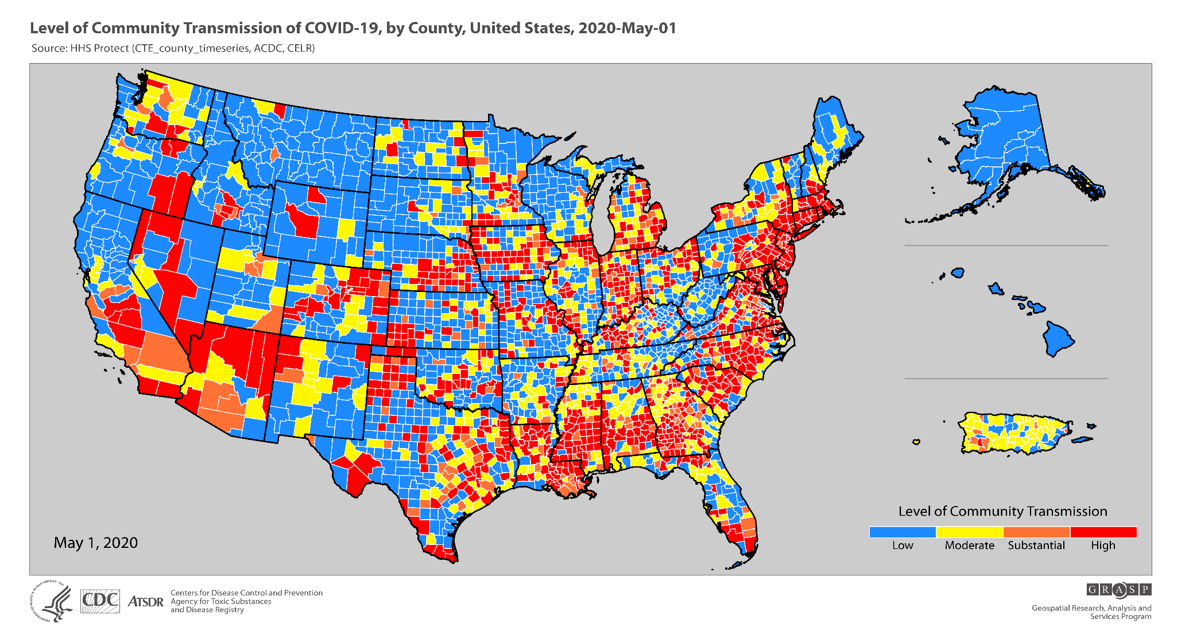

Slide 9
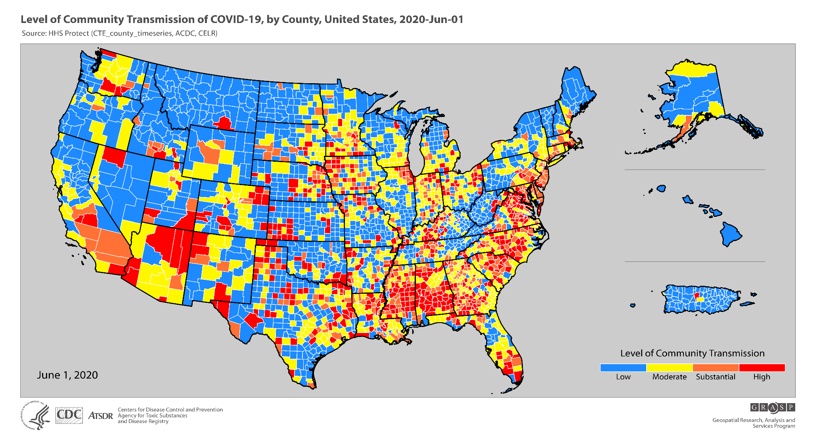

Slide 10
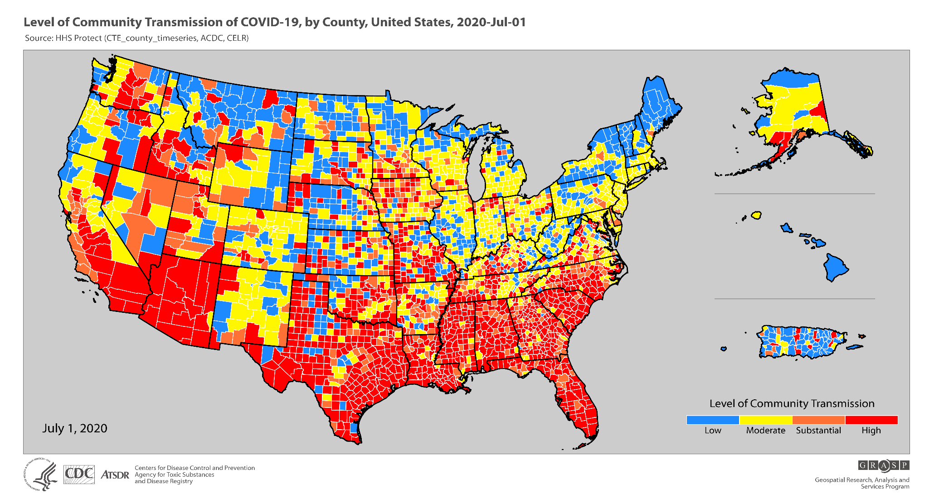

Slide 11
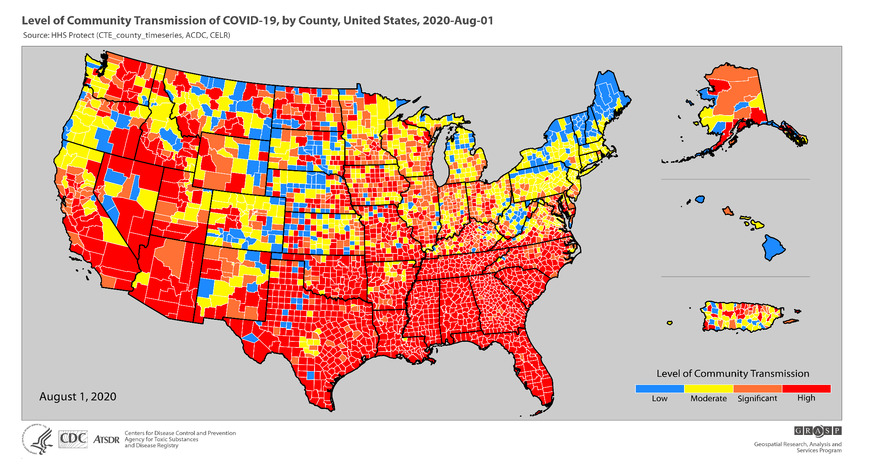

Slide 12
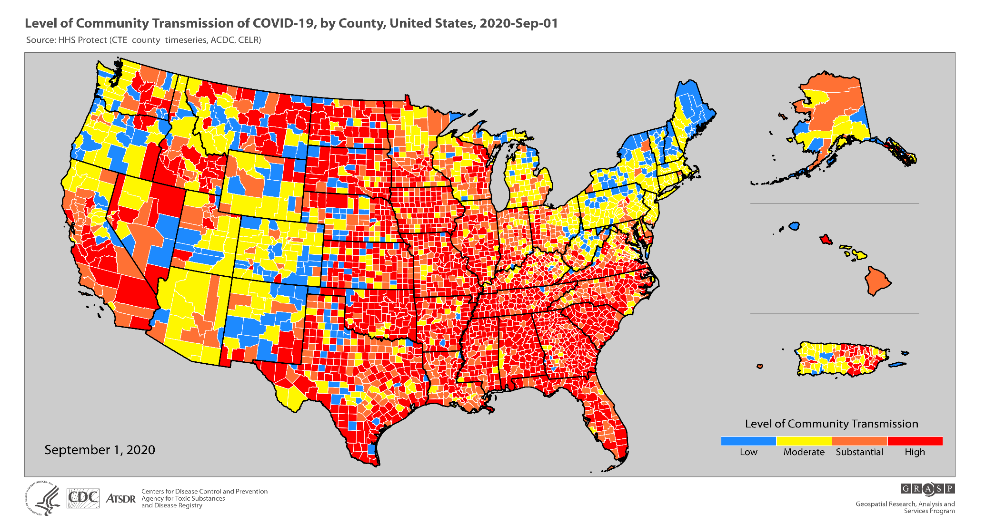

Slide 13
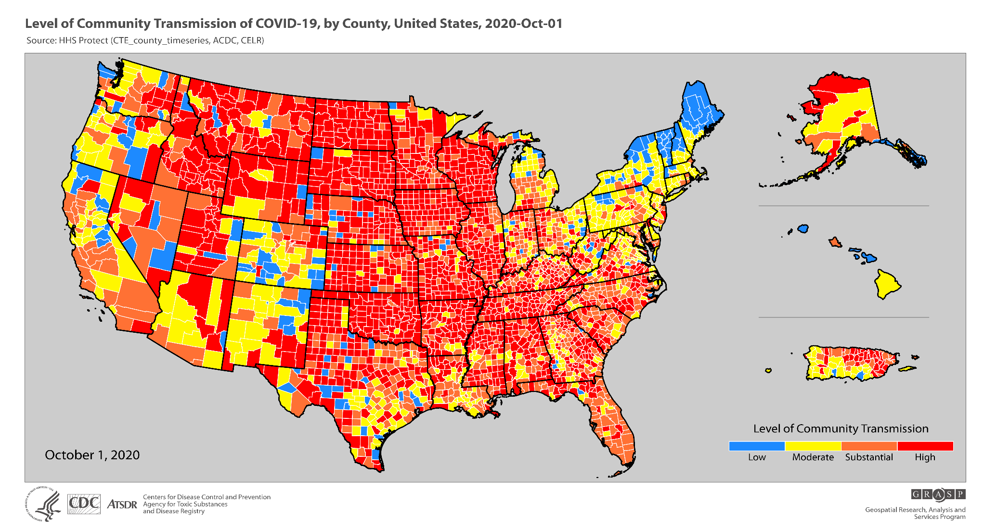

Slide 14
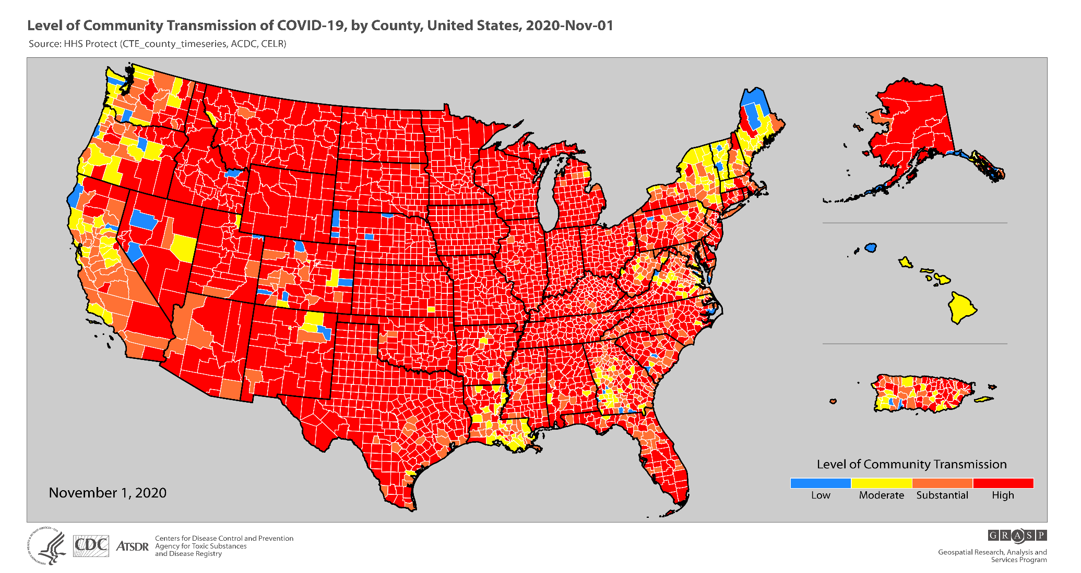

Slide 15
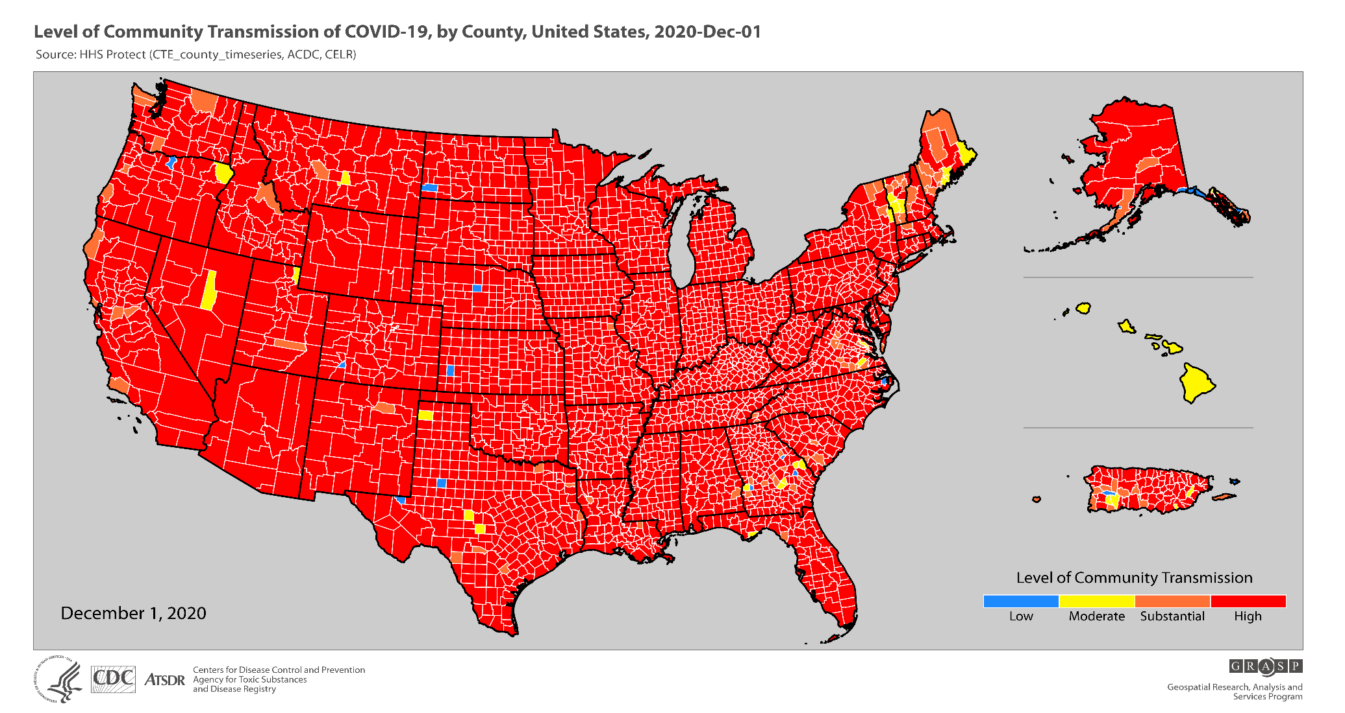

Slide 16
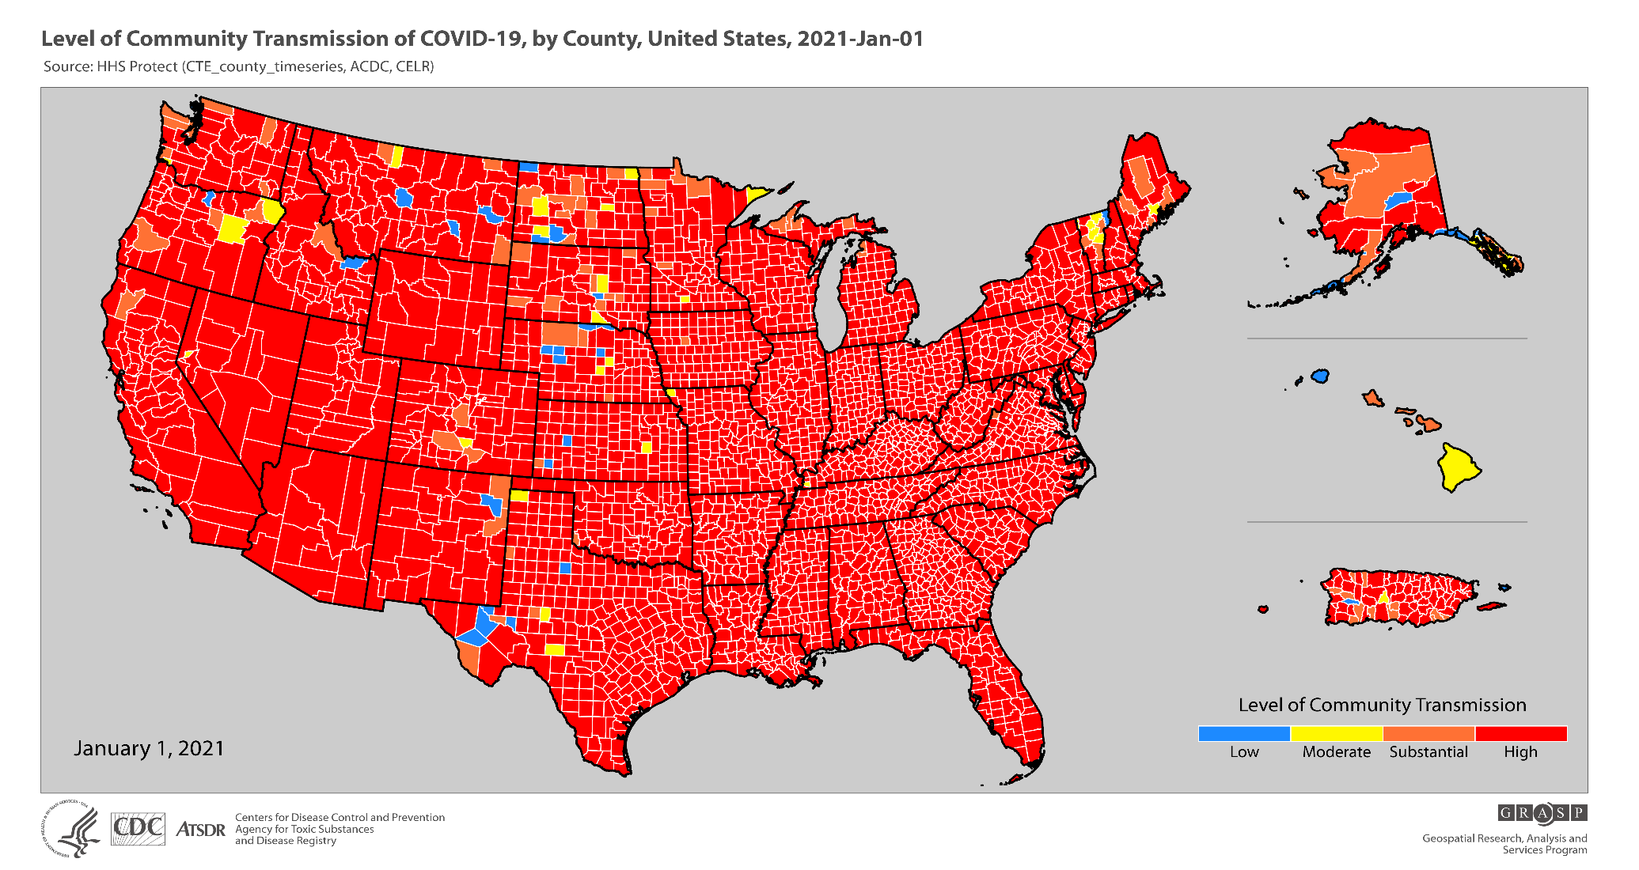

Slide 17
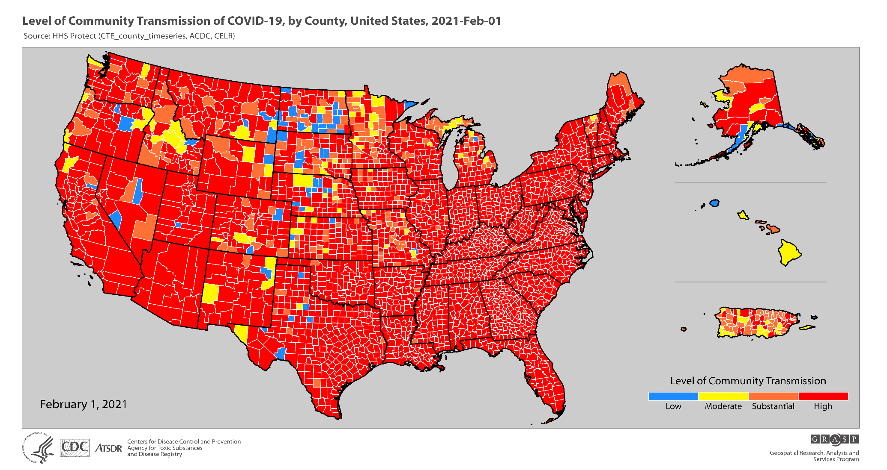

Slide 18
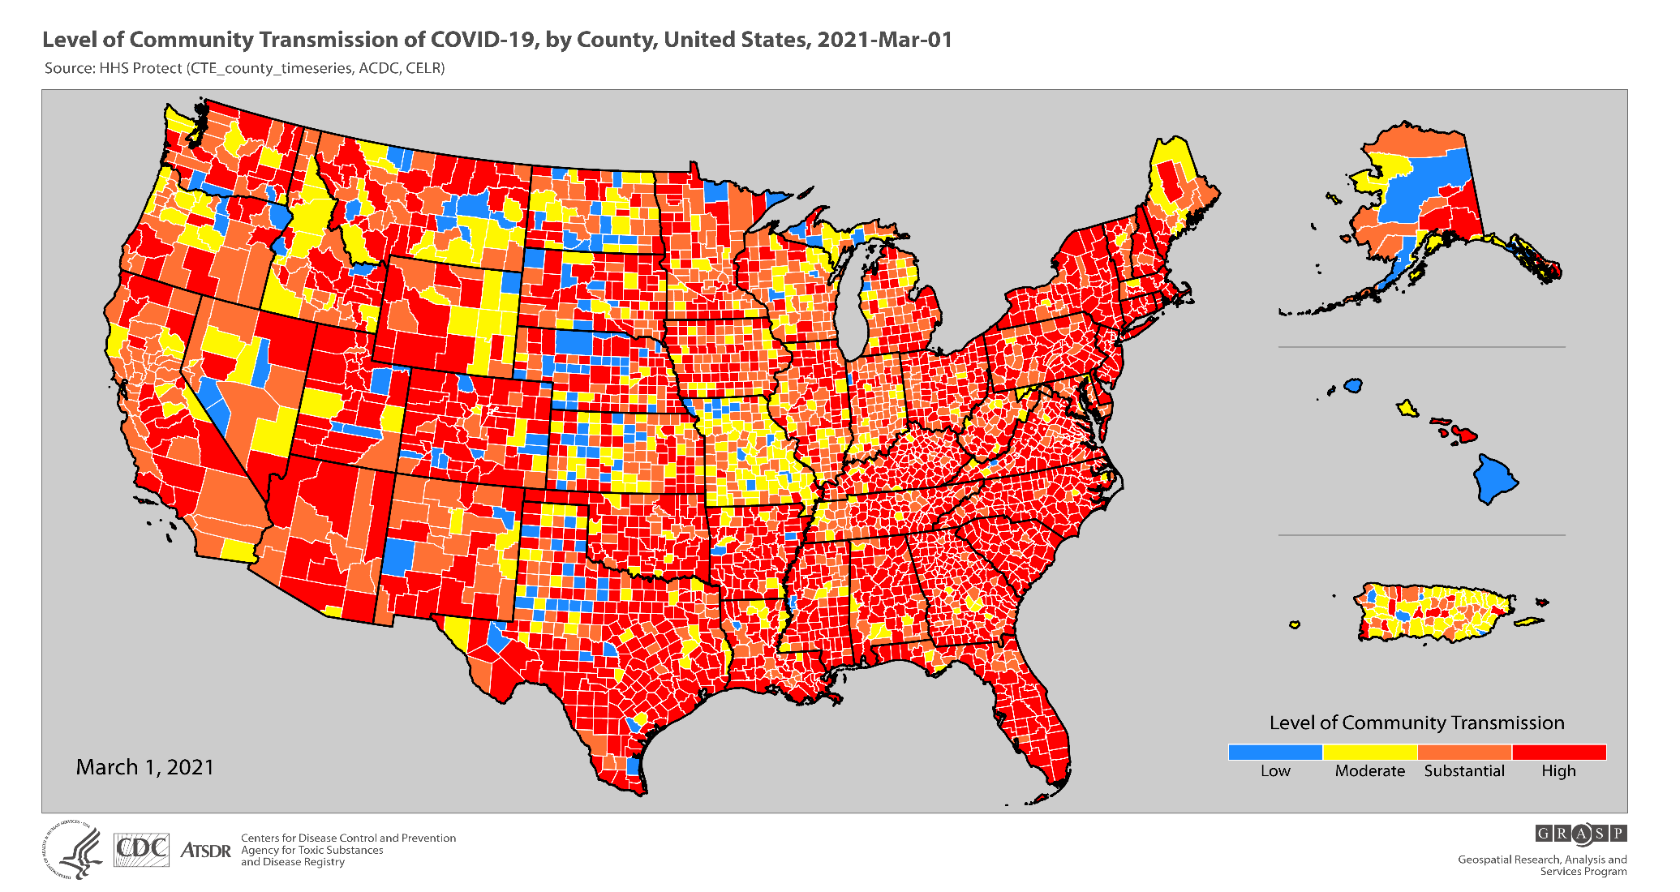

Slide 19
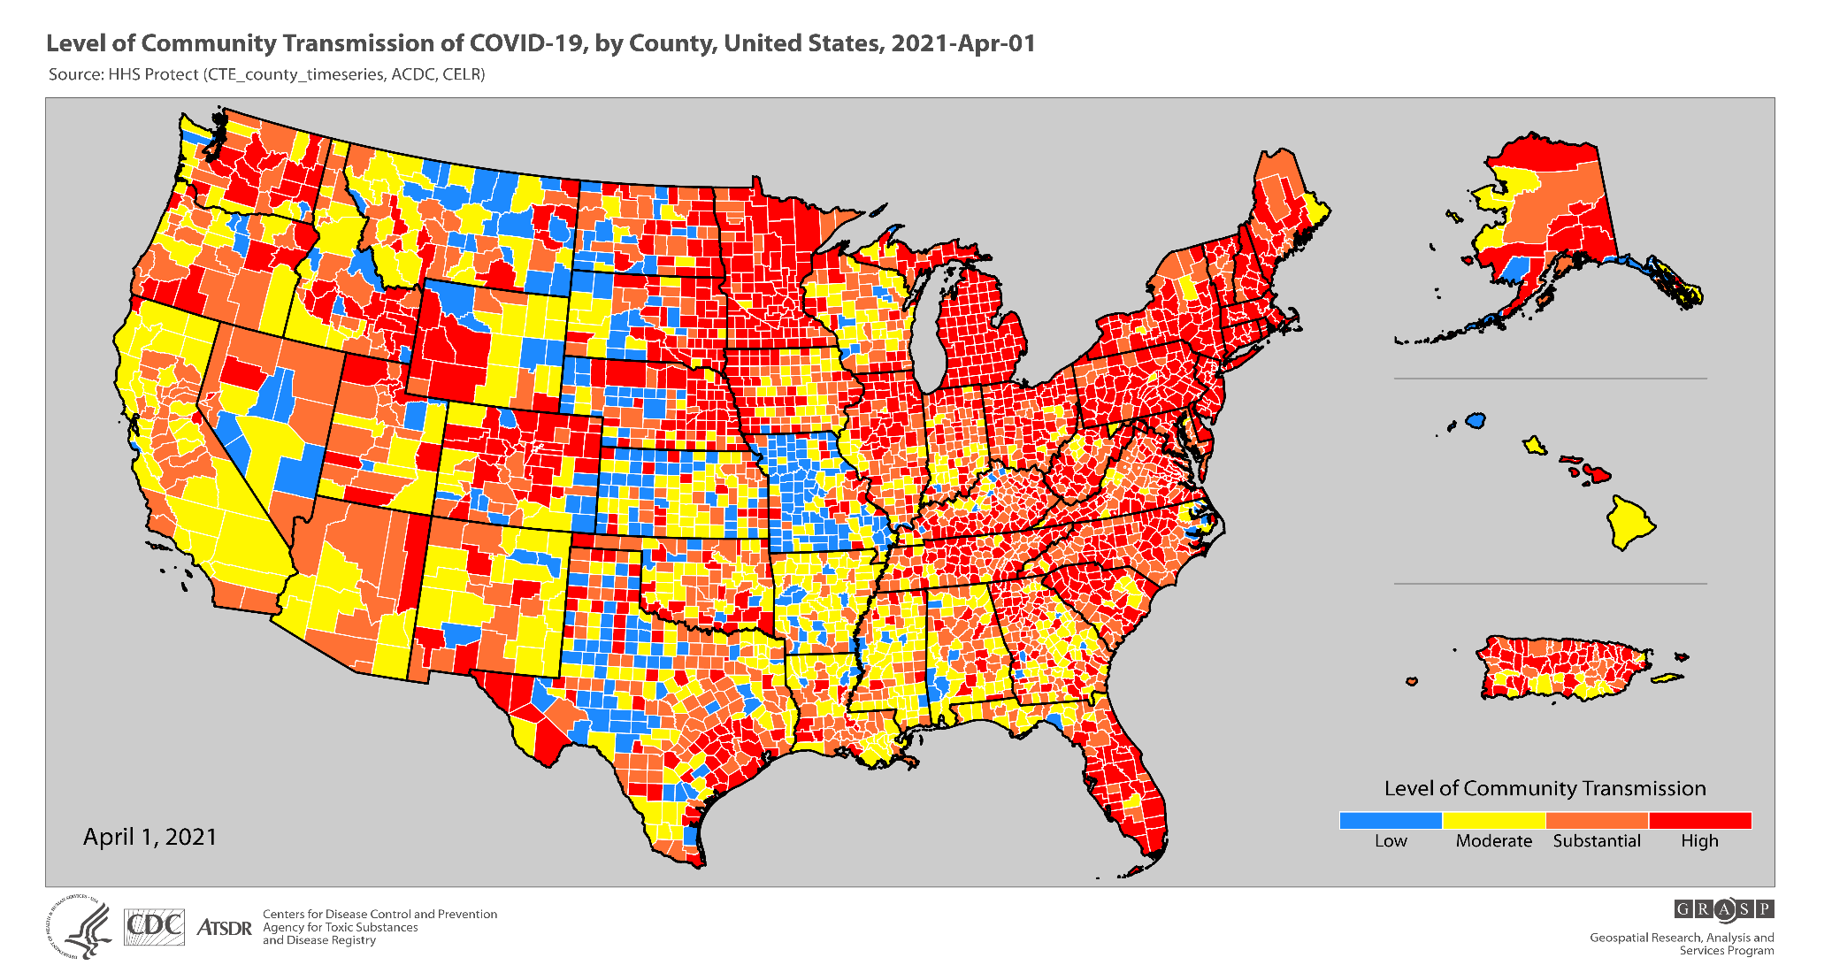

Slide 20
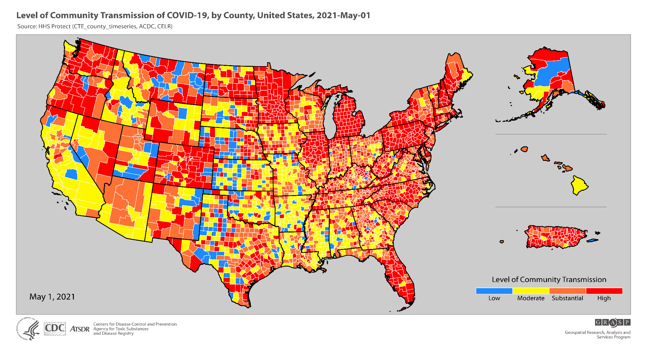

Slide 21
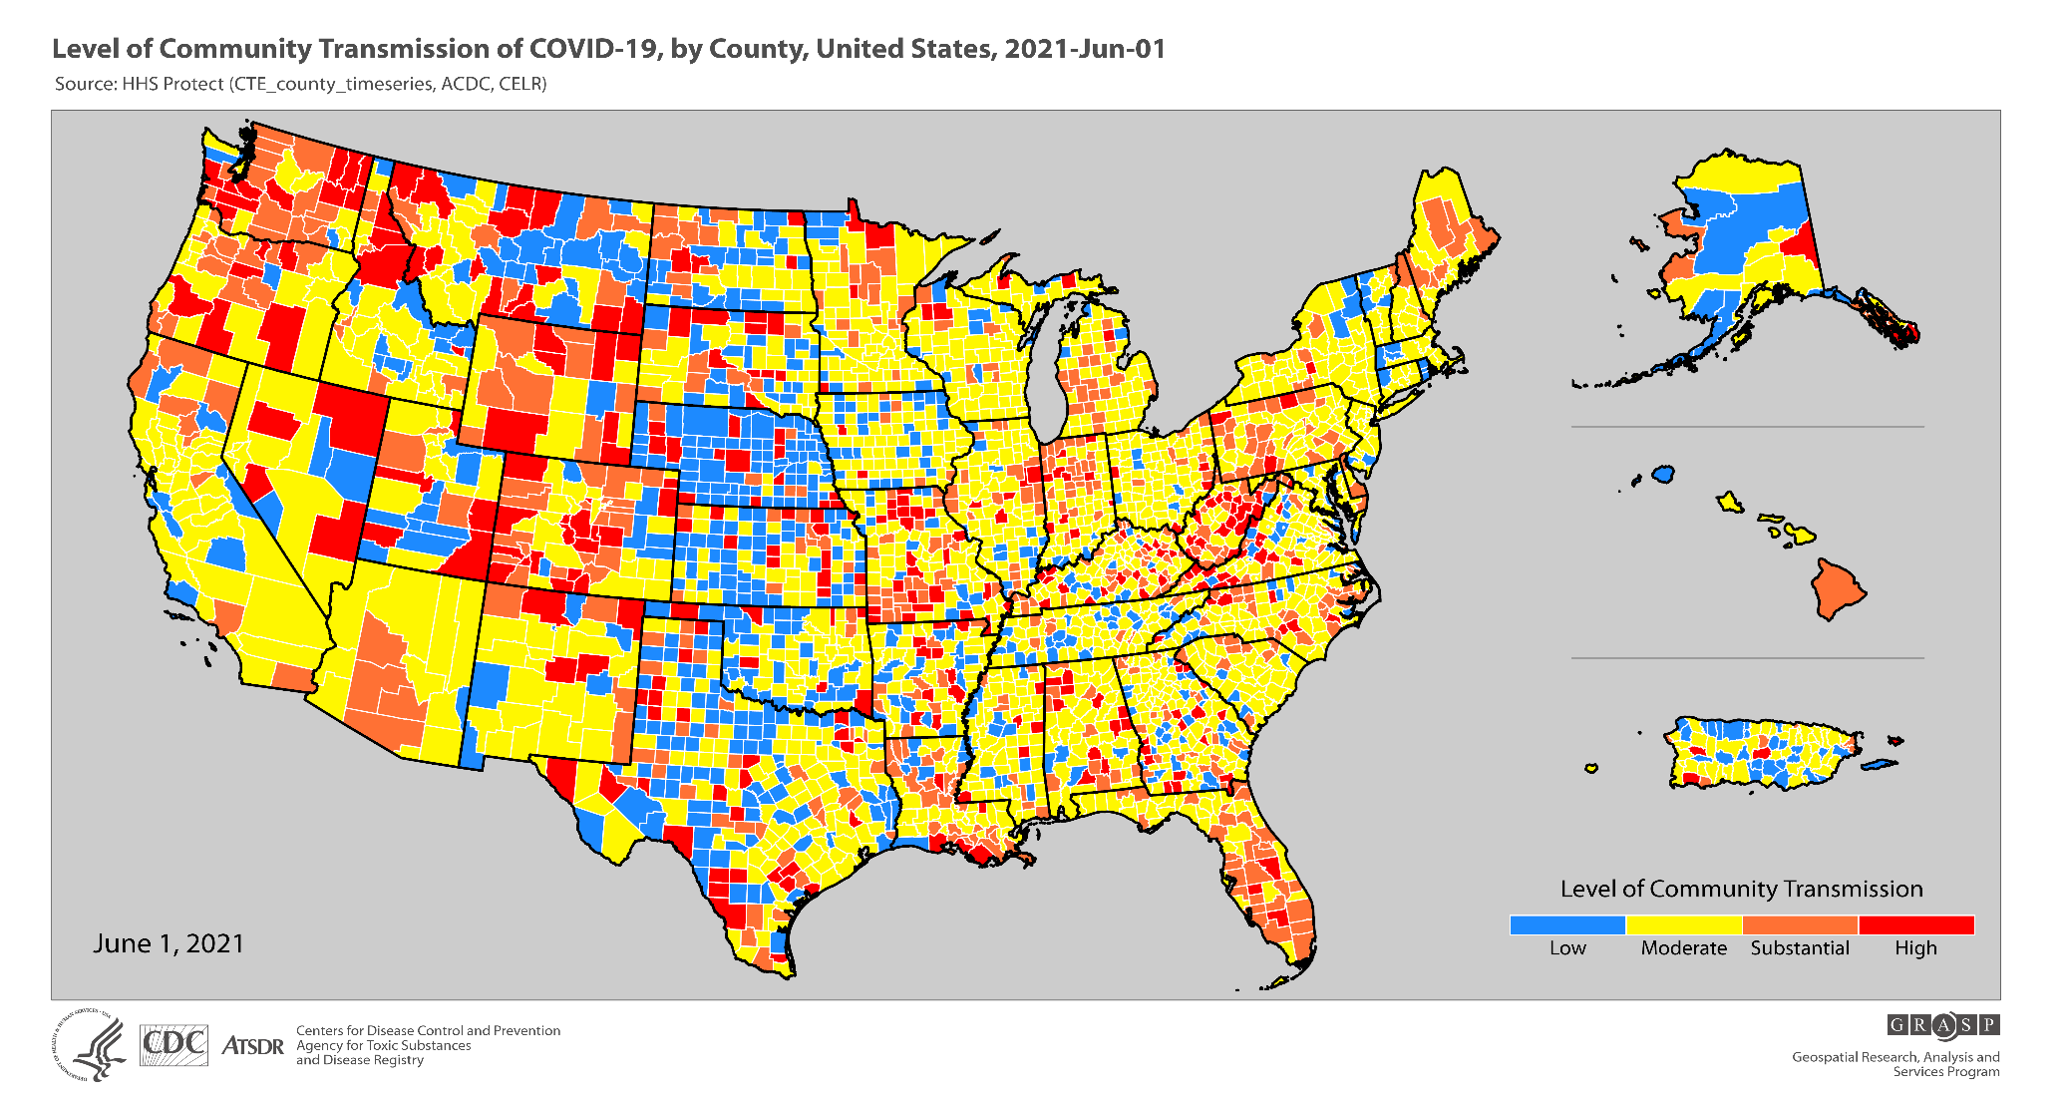

Slide 22
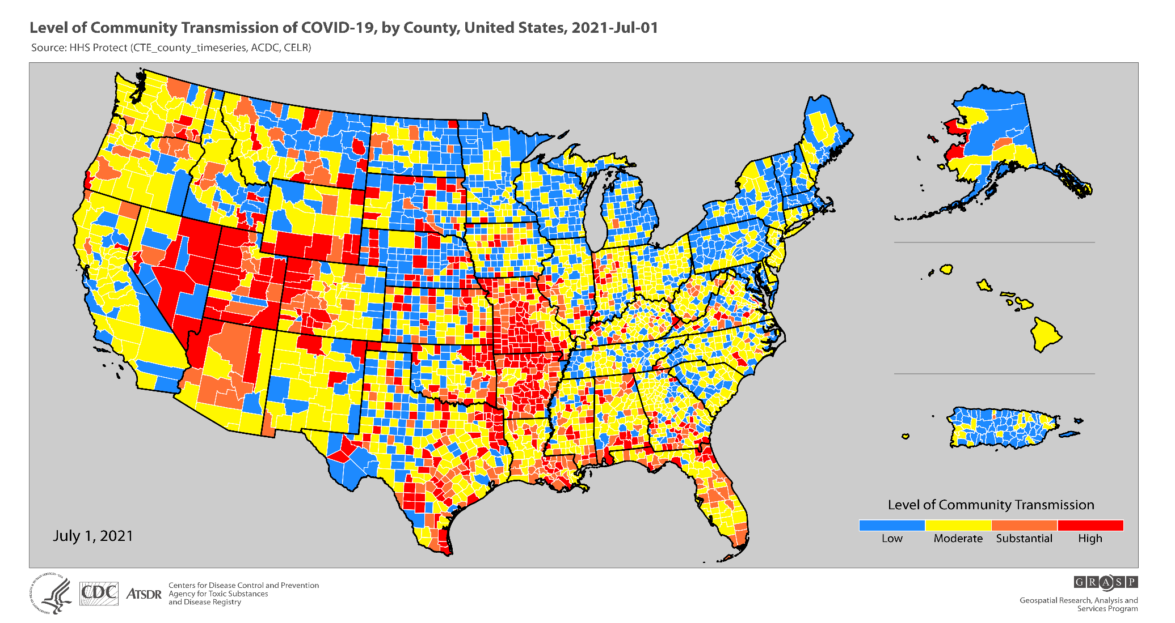

Slide 23
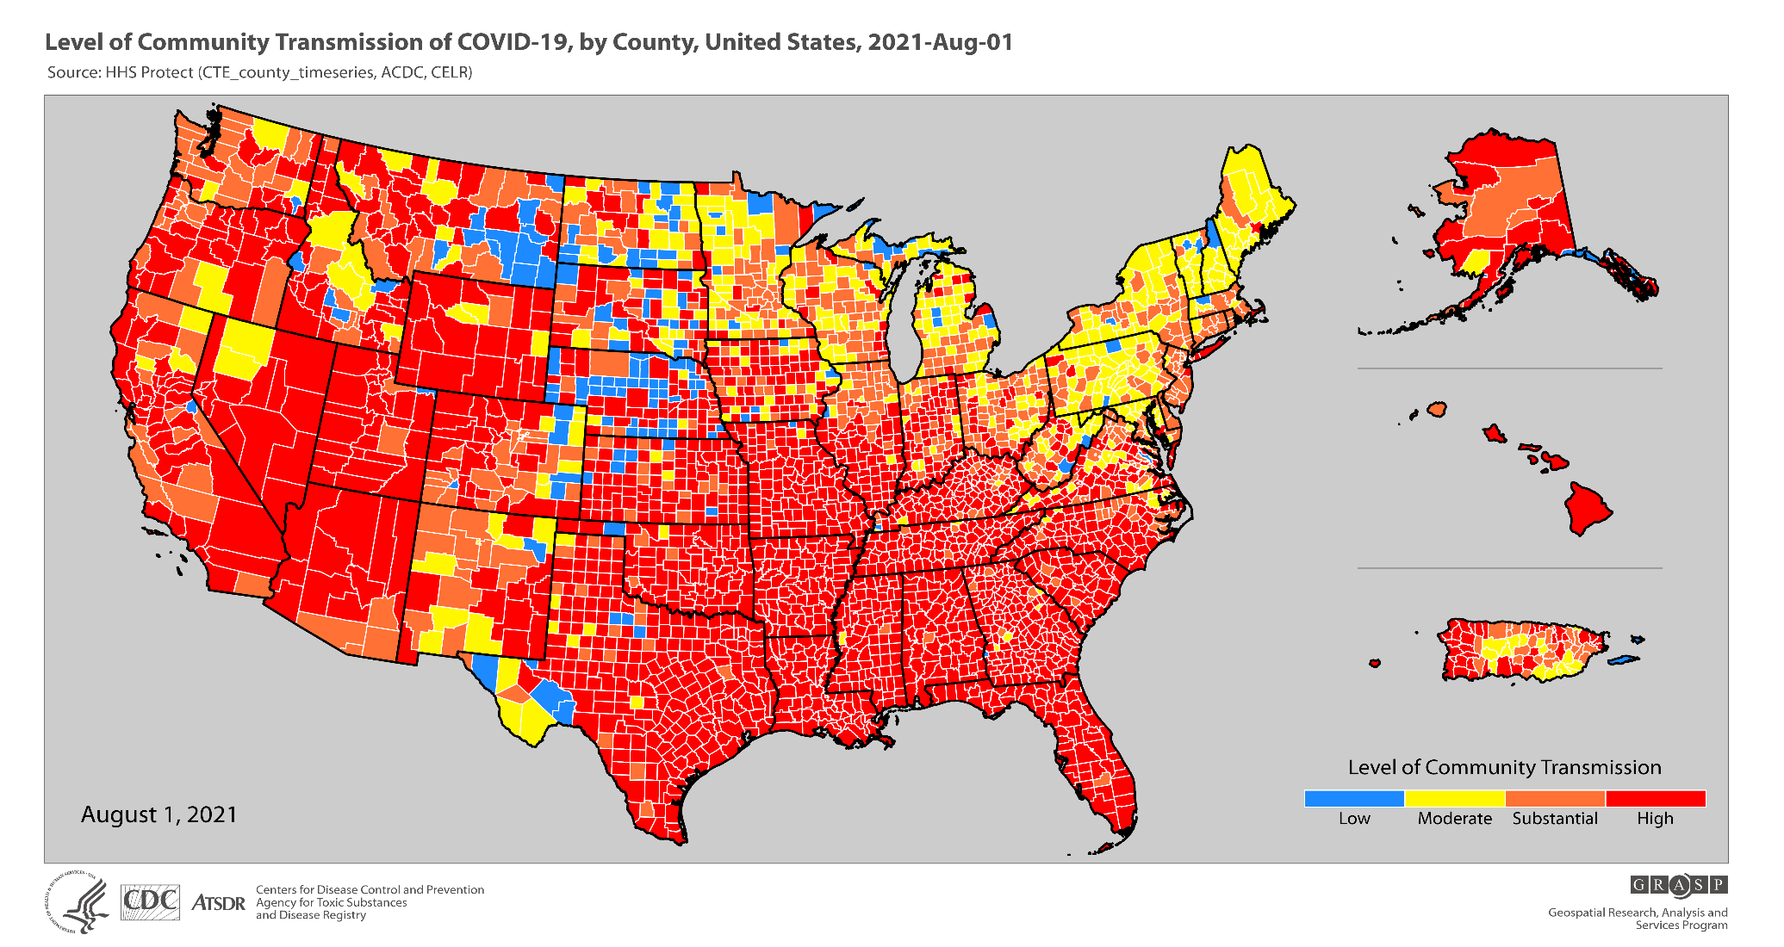

Slide 25
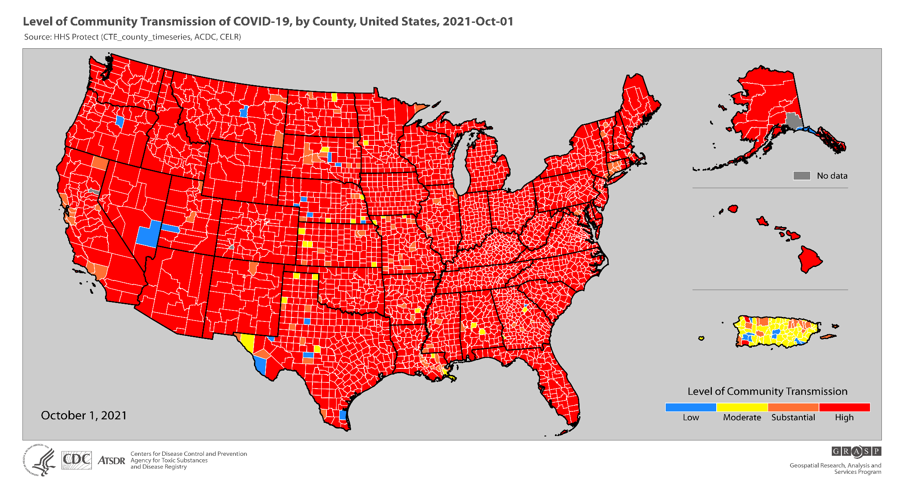

Slide 26
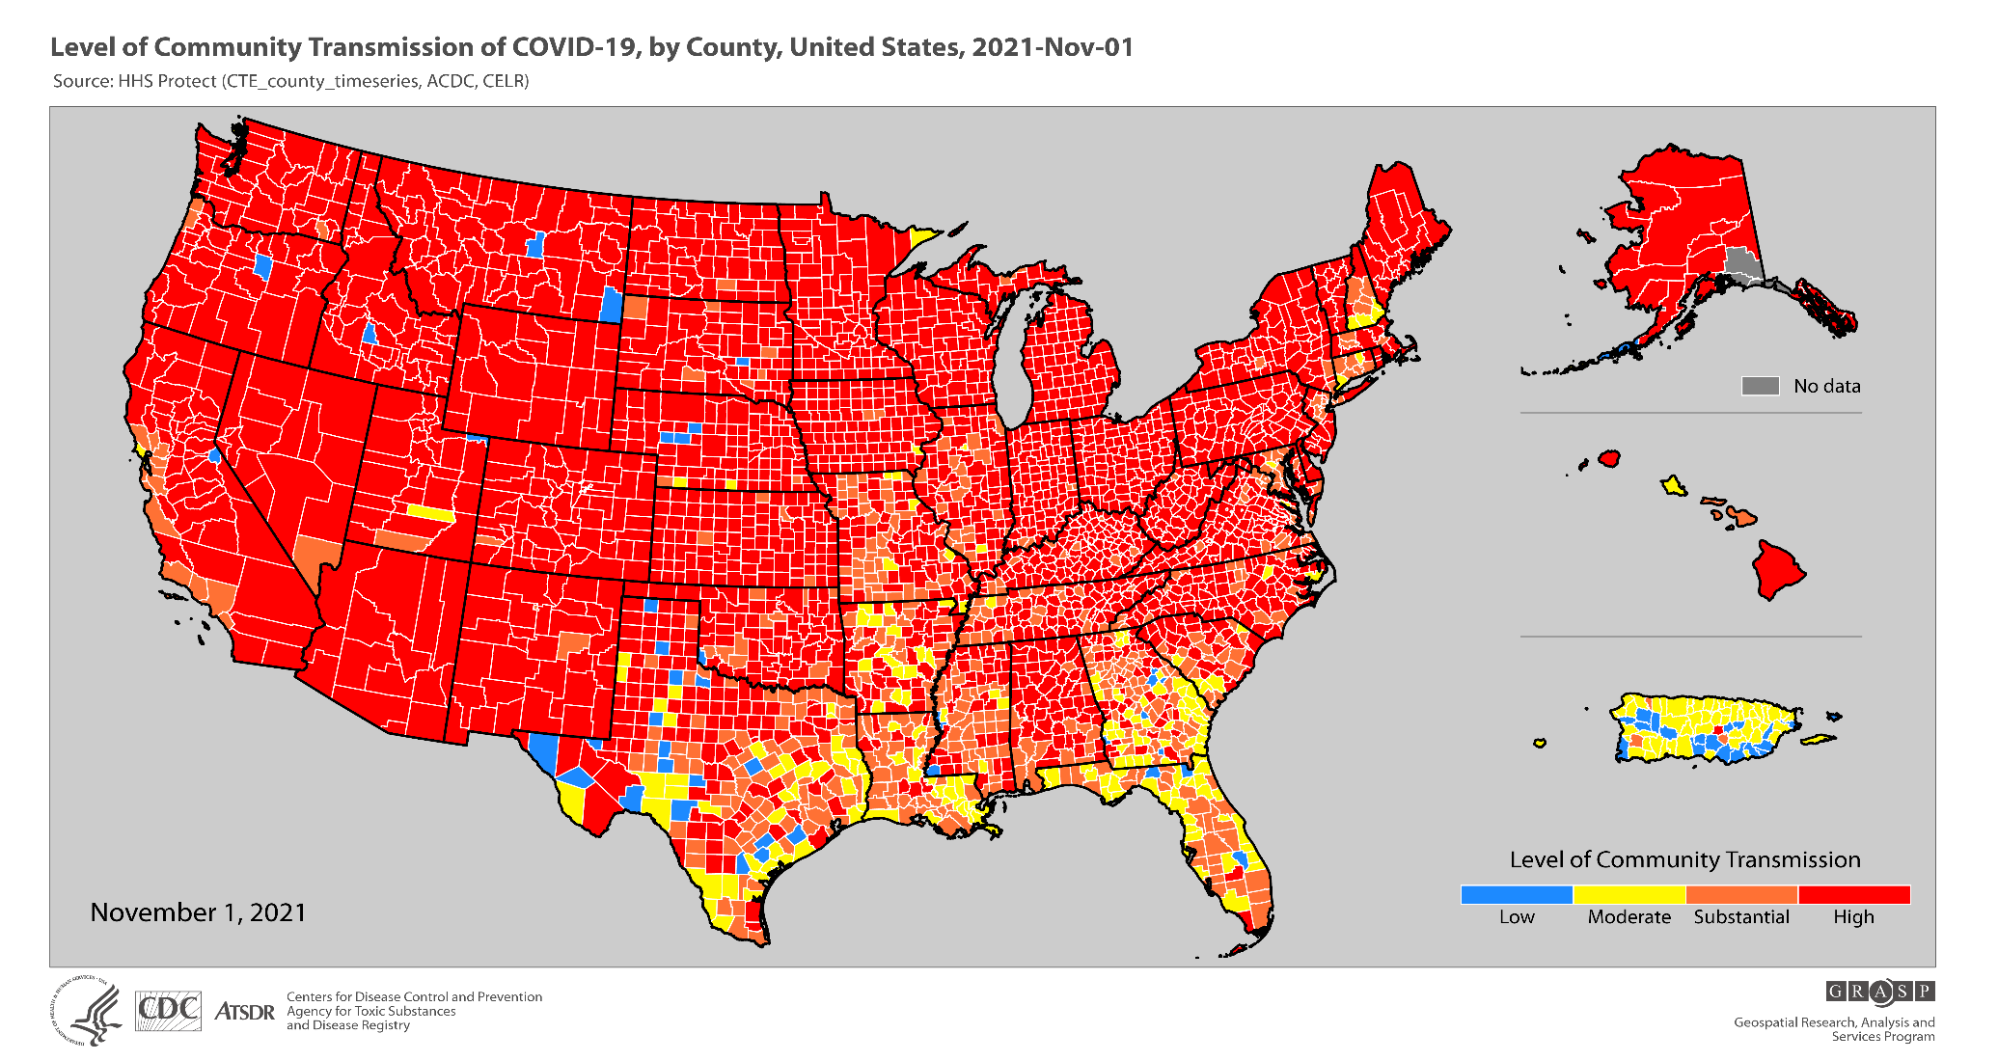

Slide 27
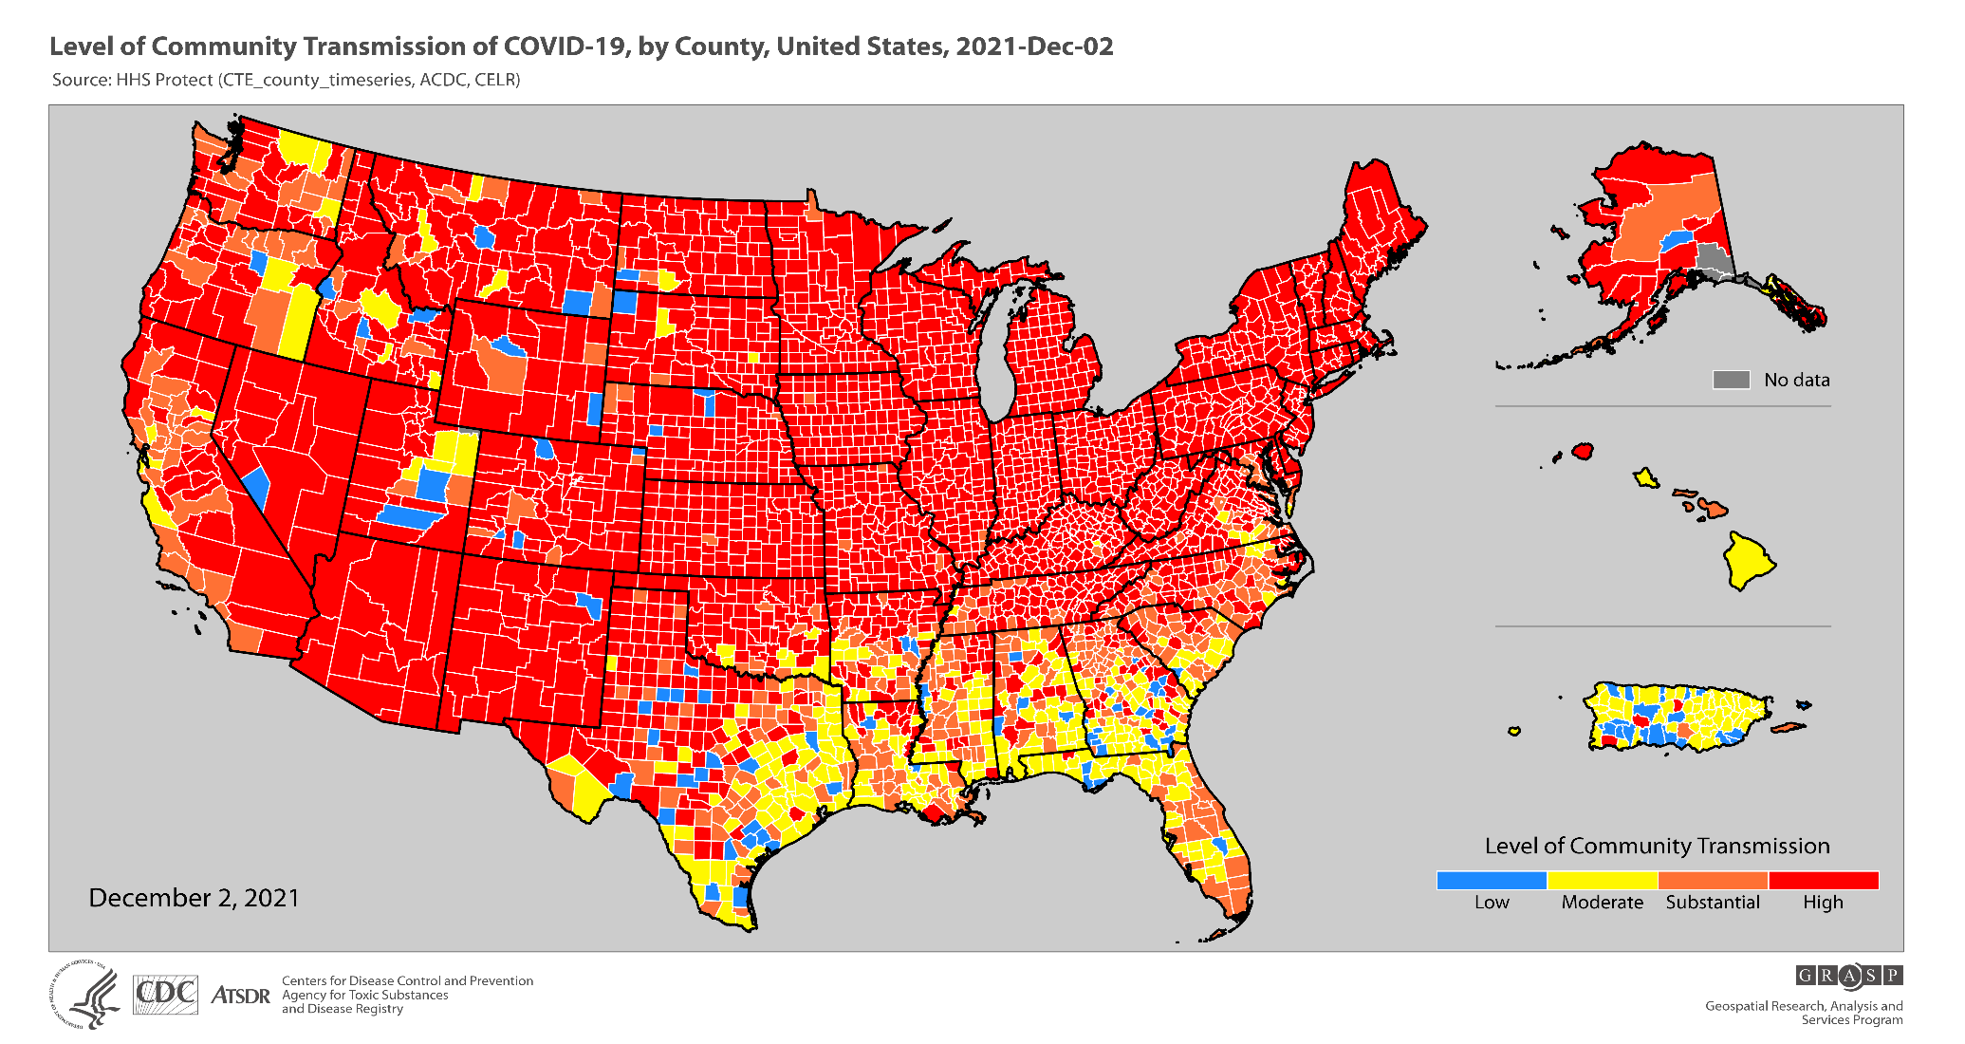

Slide 28
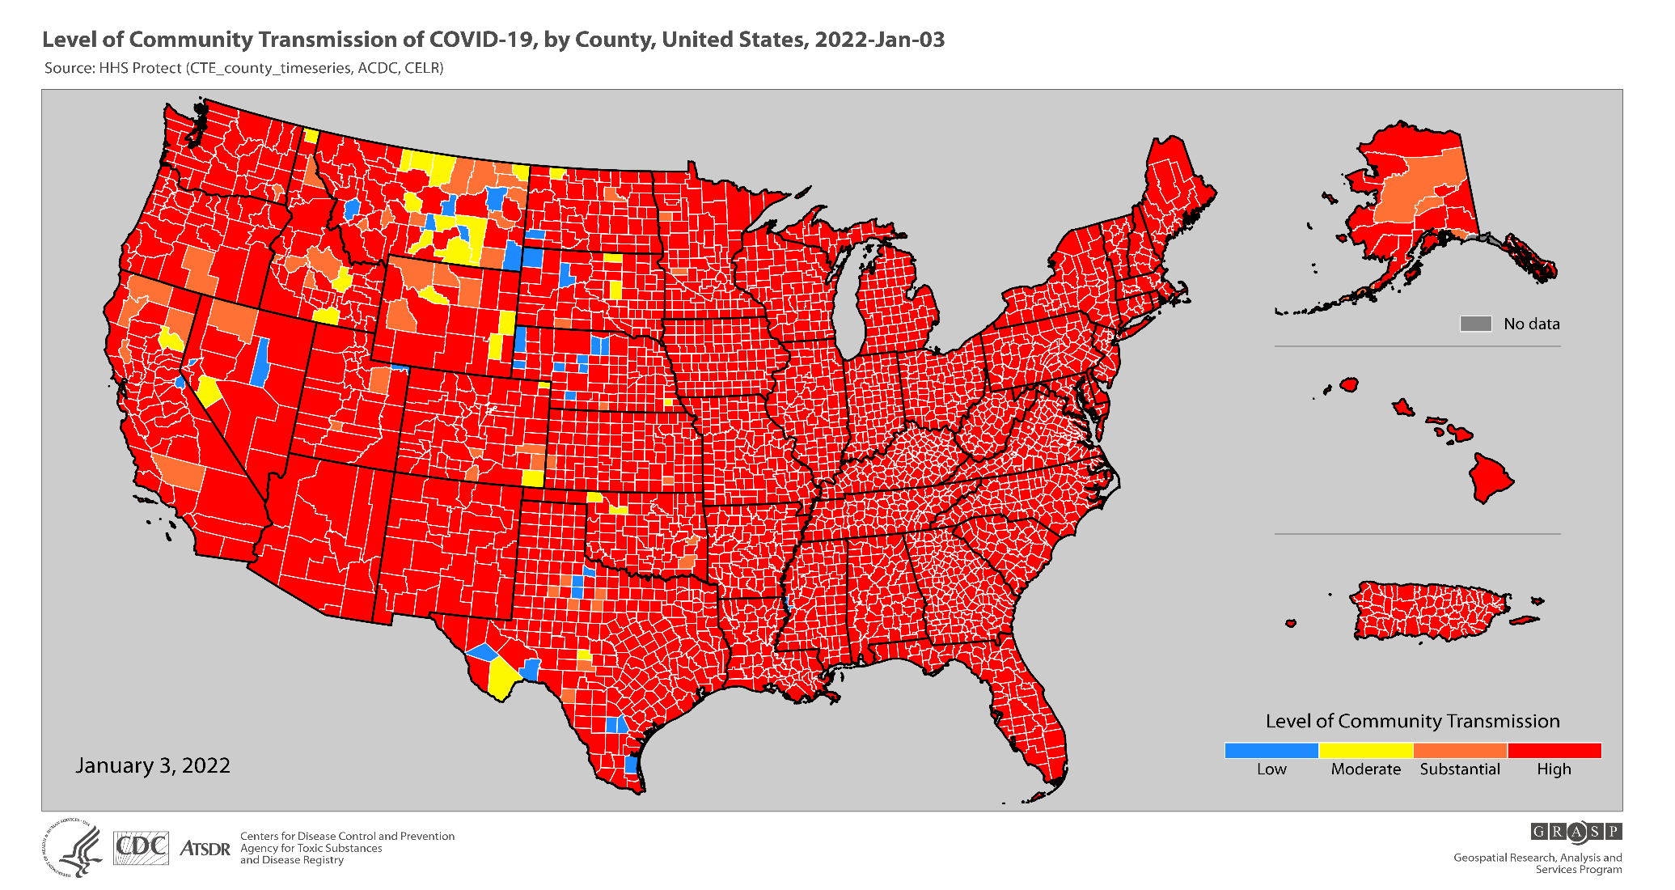

Slide 30
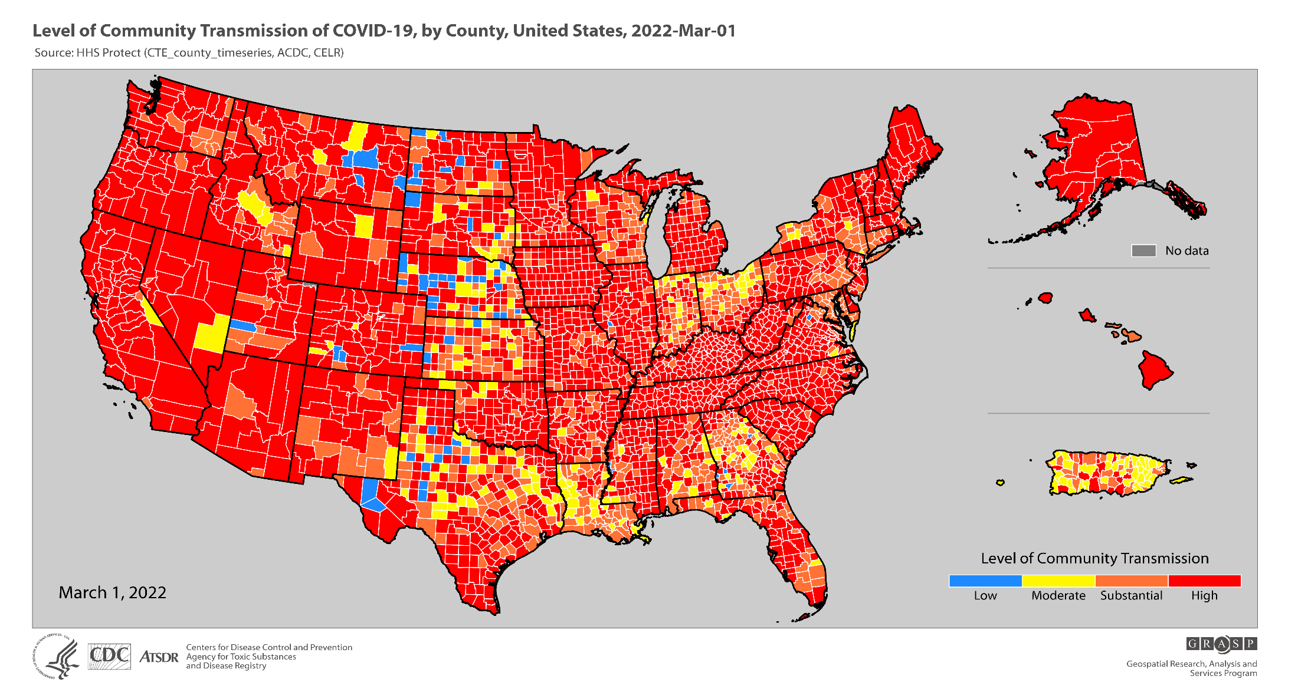

Slide 31
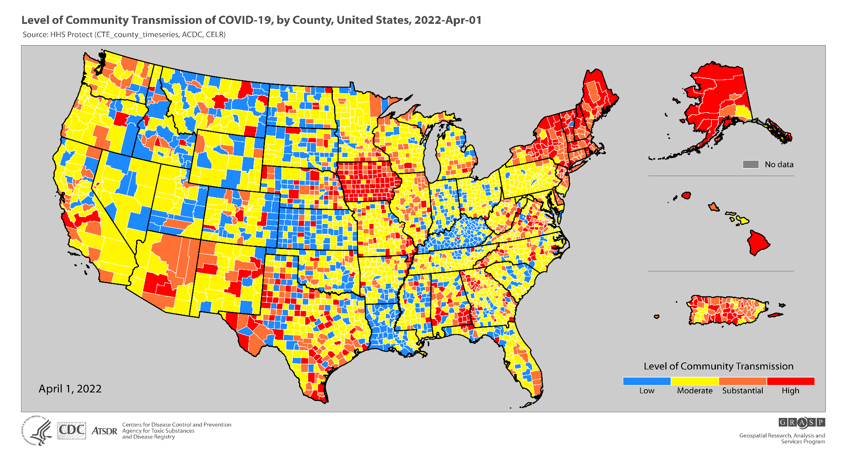

Slide 32
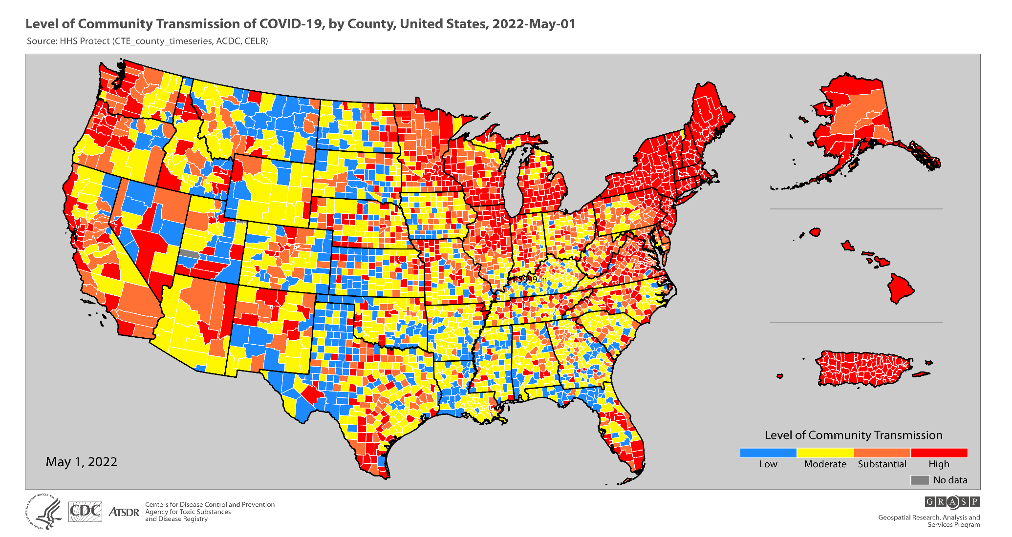

Slide 33
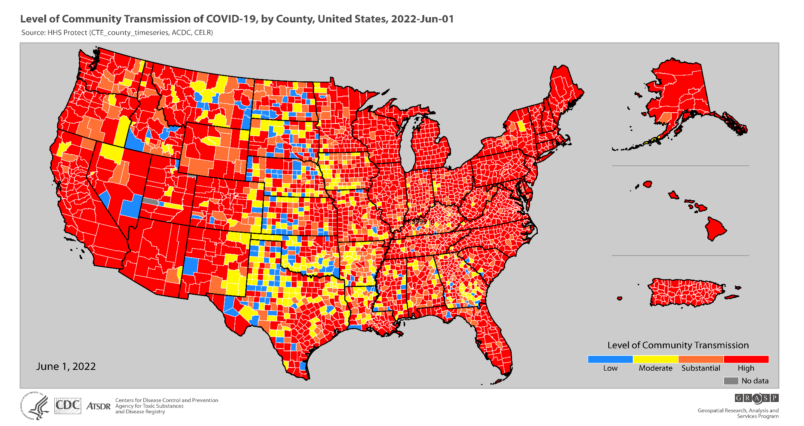

Slide 35
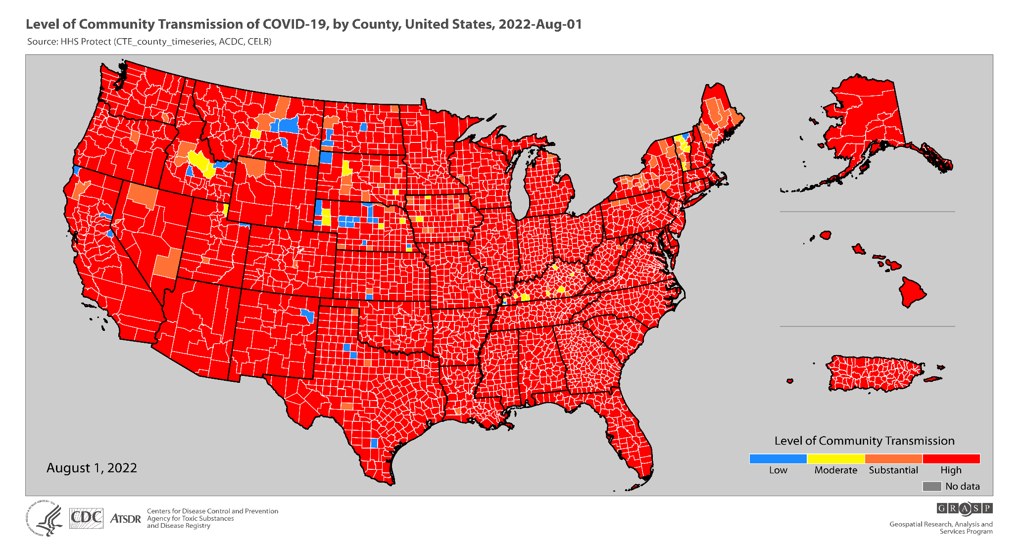

Slide 36
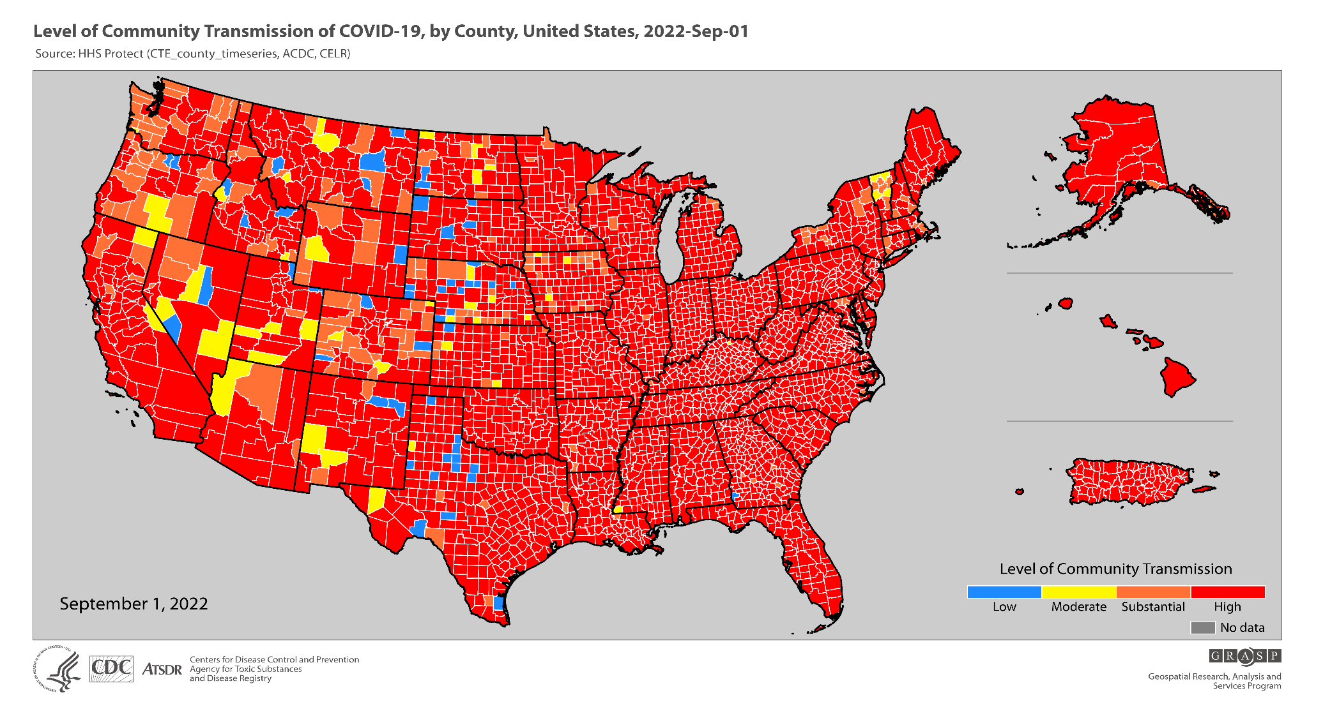

Slide 37
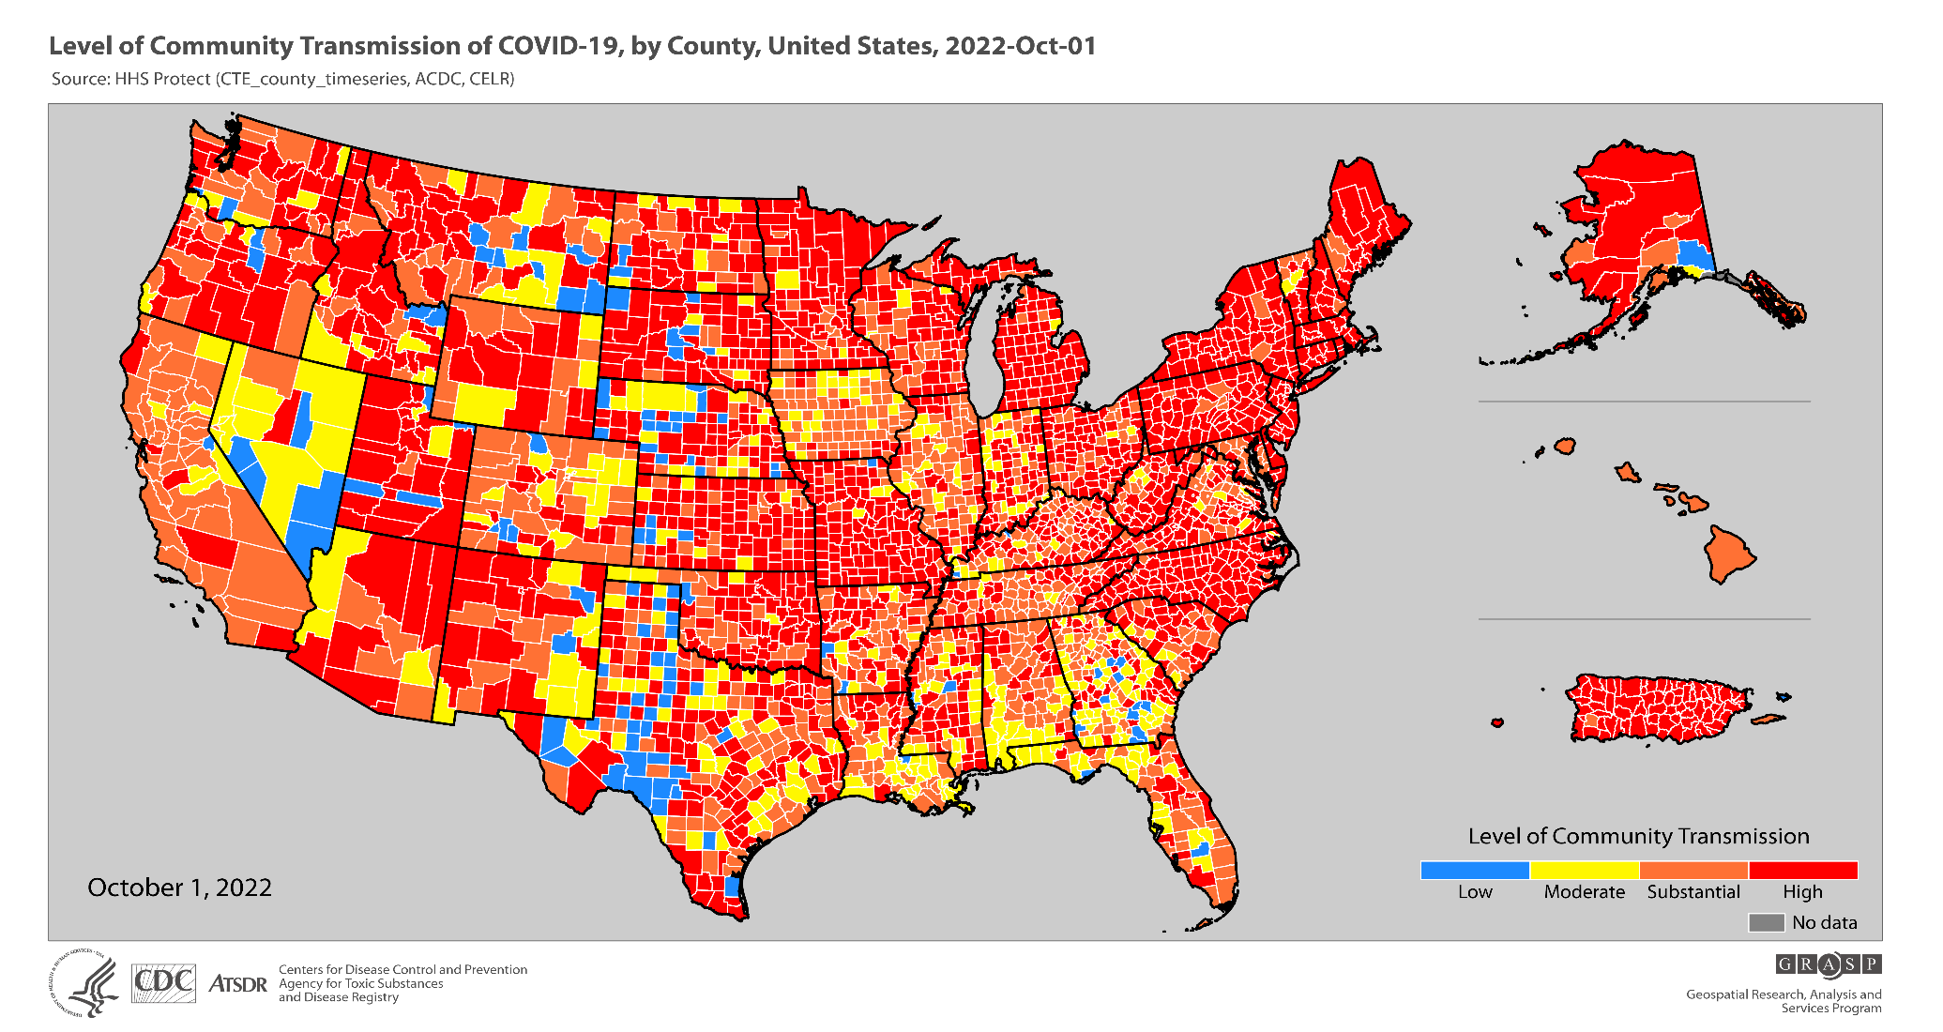

Slide 38
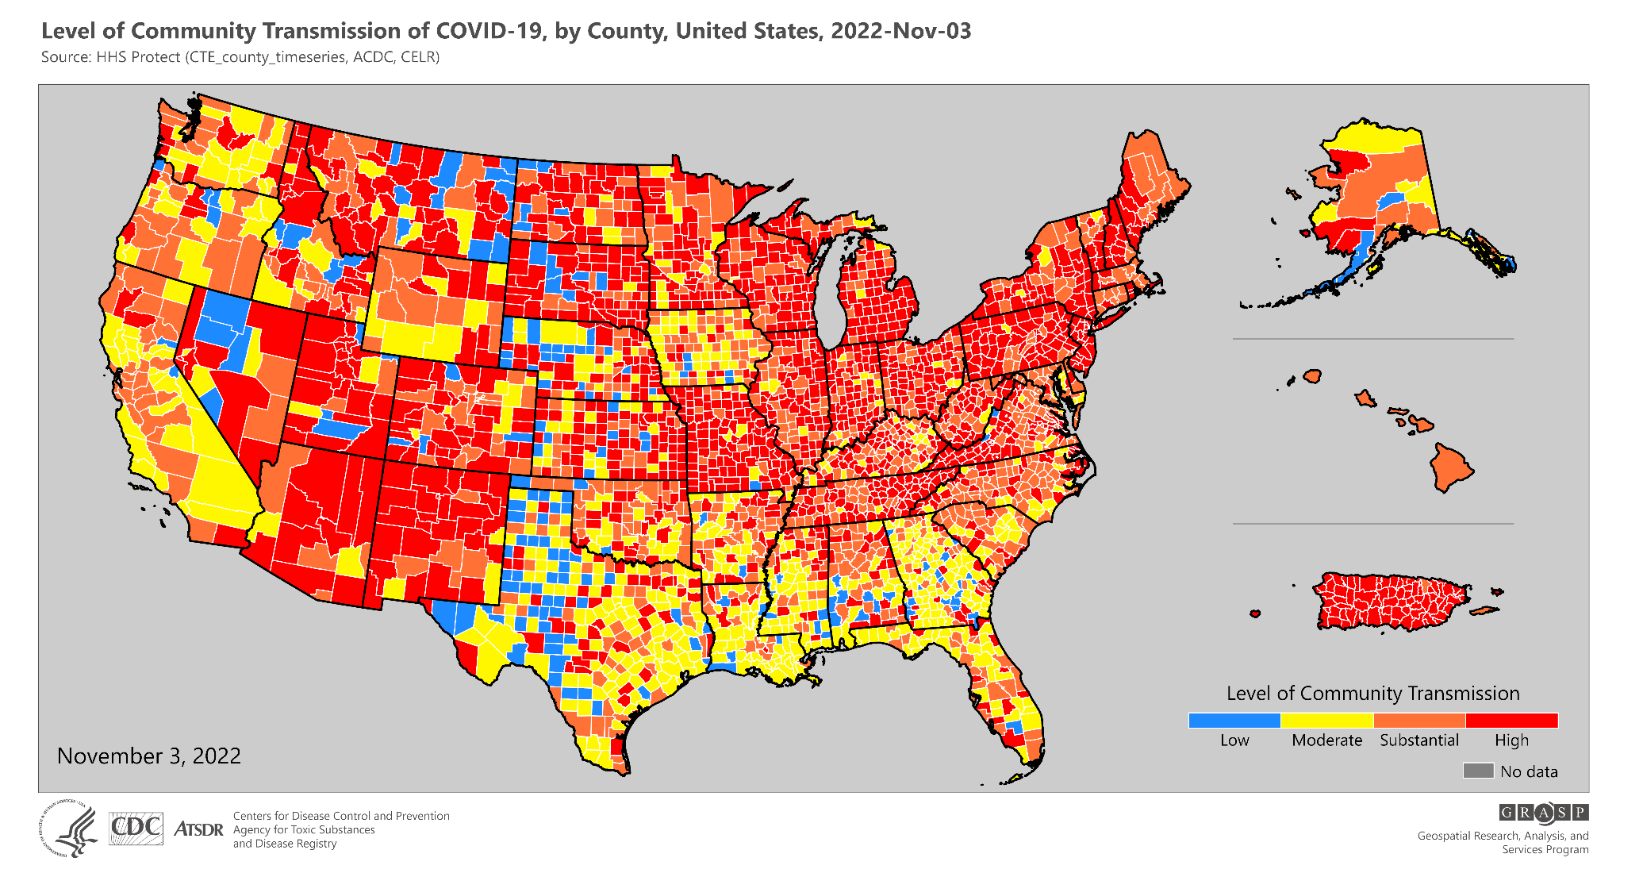

Slide 39
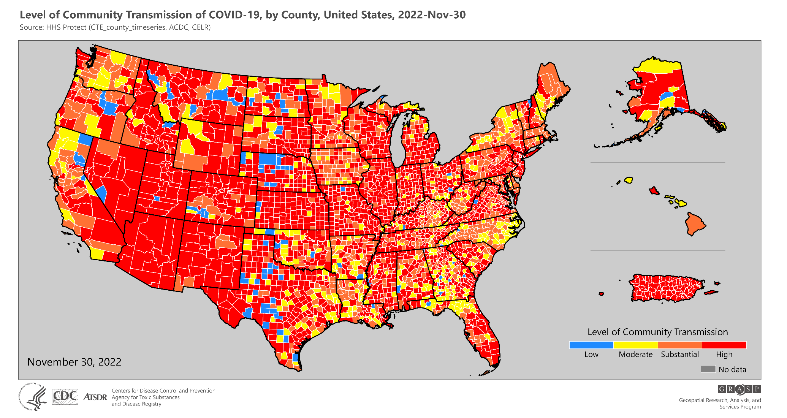

Slide 40
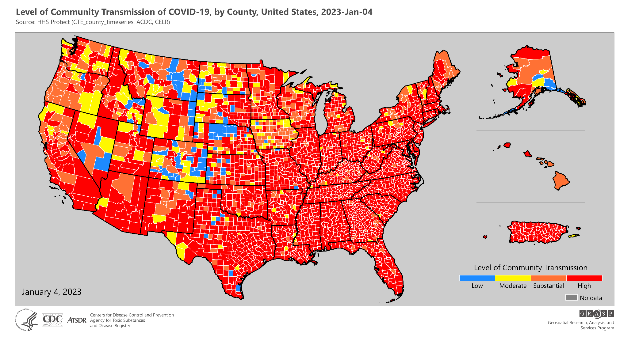

Slide 41
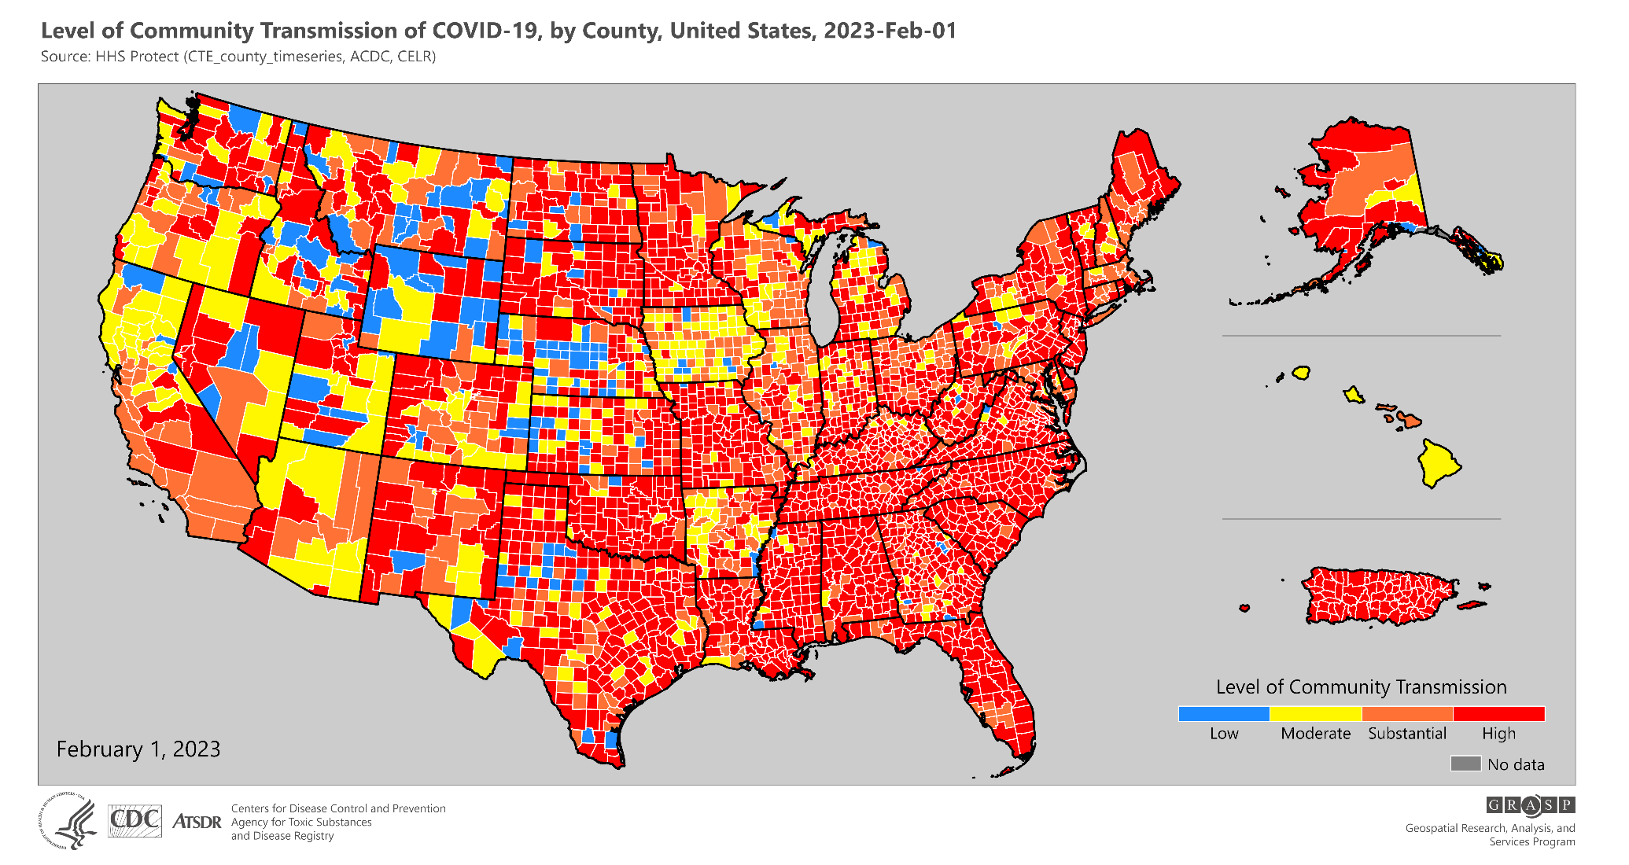

Slide 42
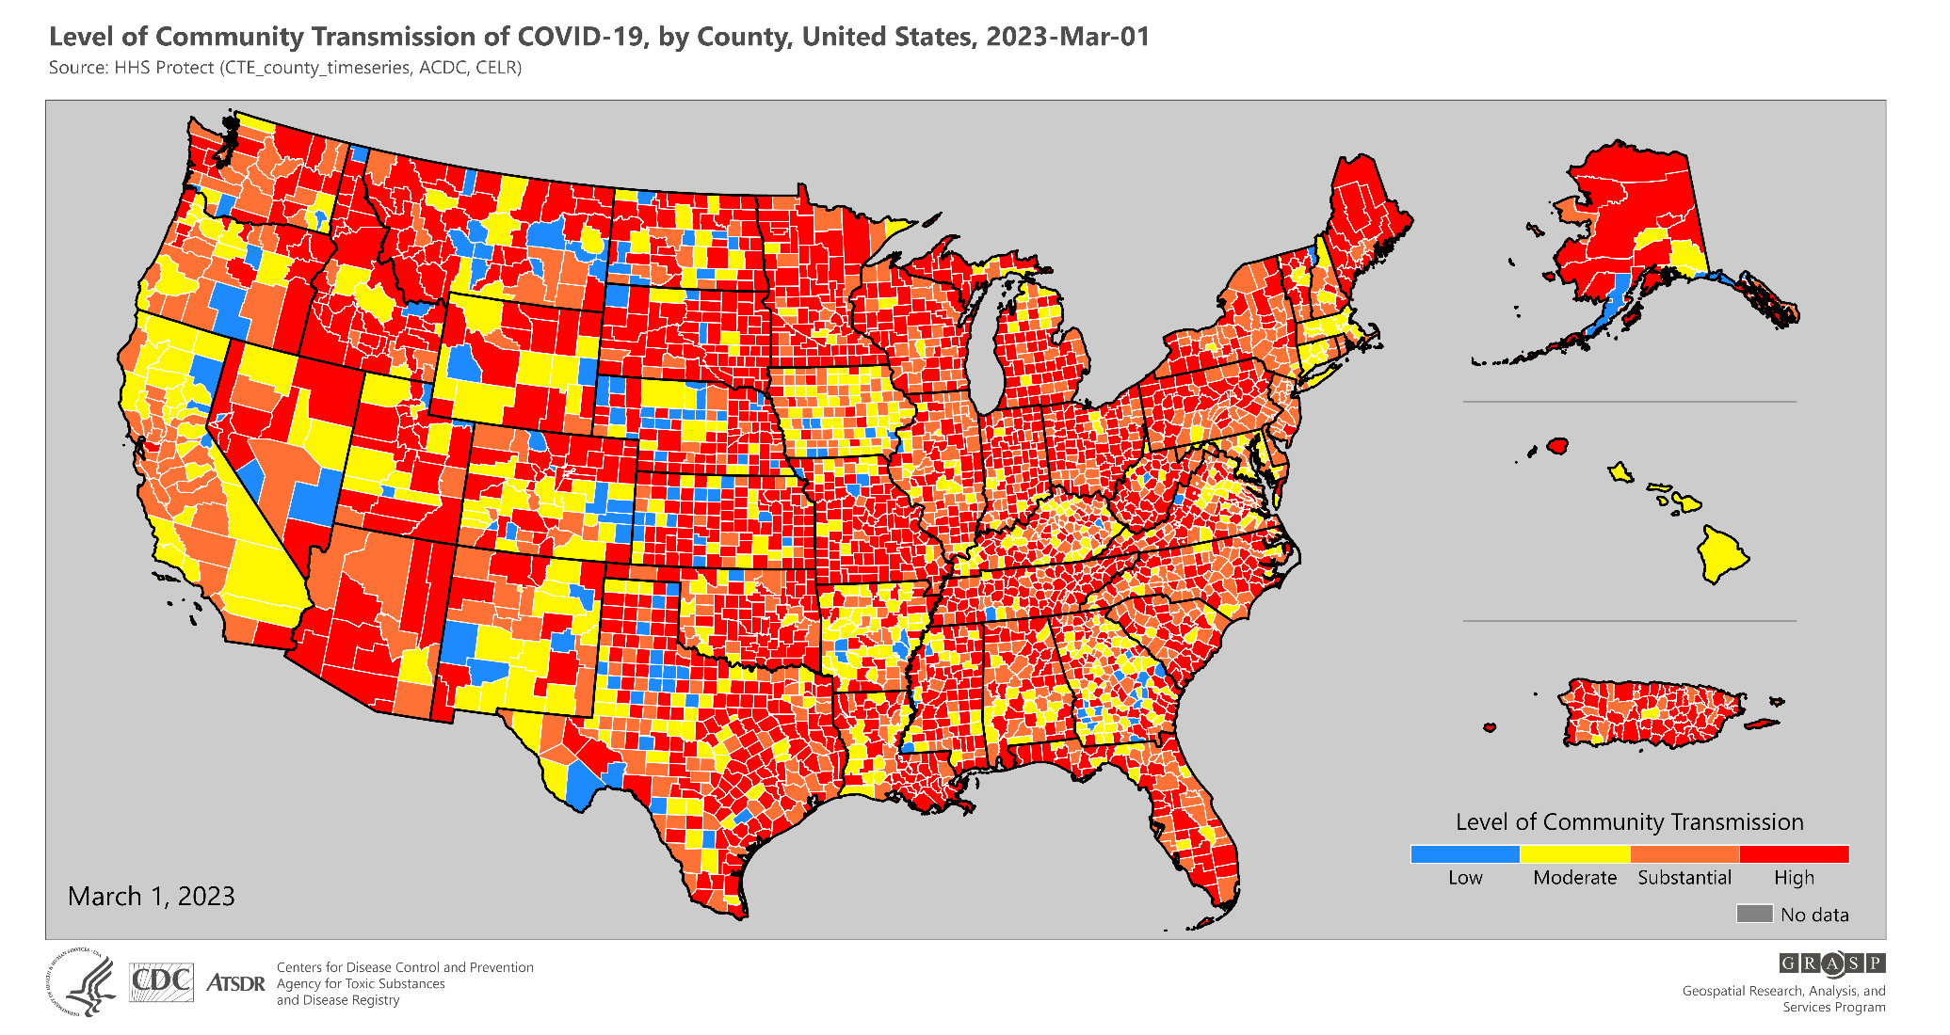

Slide 43
Data presented in these maps are not updated as data are updated historically.
For the most updated data on level of community transmission in the United States, visit CDC’s COVID Data Tracker.

