Slide 1
The Path of Yeast Resistance: Drug-resistant Candida on the Rise
Clinician Outreach and Communication Activity (COCA) Call
Thursday, September 18, 2025

Slide 2
MS Teams Platform
All participants joining us today are in listen-only mode.
To view live captions:
From menu bar, click “More”
Then choose “Language and Speech”
Then choose “Show live captions”
To remove thumbnail view of the gallery of attendees, you may enable “Focus Mode”:
From menu bar, click “View”
Then choose “Focus on Content”

Slide 3
Free Continuing Education
Free continuing education is offered for this webinar.
Instructions for how to earn continuing education will be provided at the end of the call.

Slide 4
Continuing Education Disclosure
In compliance with continuing education requirements, all planners and presenters/moderators must disclose all financial relationships, in any amount, with ineligible companies over the previous 24 months as well as any use of unlabeled product(s) or products under investigational use.
CDC, our planners, and presenters/moderators wish to disclose they have no financial relationship(s) with ineligible companies whose primary business is producing, marketing, selling, re-selling, or distributing healthcare products used by or on patients.
Content will not include any discussion of the unlabeled use of a product or a product under investigational use with the exception of Dr. Meghan Lyman's discussion of several antifungal medications in clinical trials for C. auris and availability of use under expanded access programs.
CDC did not accept financial or in-kind support from ineligible companies for this continuing education activity.
CDC complies with applicable Federal civil rights laws and does not discriminate based on race, color, national origin, age, disability, religion, or sex. To learn more visit: https://www.hhs.gov/civil-rights/for-individuals/nondiscrimination/index.html.

Slide 5
Objectives
At the conclusion of today’s session, the participant will be able to accomplish the following:
Describe the increasing prevalence of resistant Candida species.
Explain the epidemiology of emerging resistant Candida.
Outline appropriate testing including species identification, antifungal susceptibility testing, and whole genome sequencing.
Summarize treatment options and resources for resistant Candida species.

Slide 6
To Ask a Question
Using the MS Teams Platform
The ability to ask questions during the live webinar is limited to the first 1,000 attendees.
Questions may be submitted after the live session by emailing coca@cdc.gov.
If you are a patient, please refer your question to your healthcare provider.
If you are a member of the media, please direct your questions to CDC Media Relations at 404-639-3286 or email media@cdc.gov.

Slide 7
Today’s Presenters
Meghan Lyman, MD
Acting Deputy Branch Chief
Mycotic Diseases Branch
Division of Foodborne, Waterborne, and Environmental Diseases
National Center for Emerging and Zoonotic Infectious Diseases
Centers for Disease Control and Prevention
Dallas Smith, PharmD, MAS
Epidemiologist
Mycotic Diseases Branch
Division of Foodborne, Waterborne, and Environmental Diseases
National Center for Emerging and Zoonotic Infectious Diseases
Centers for Disease Control and Prevention

Slide 8
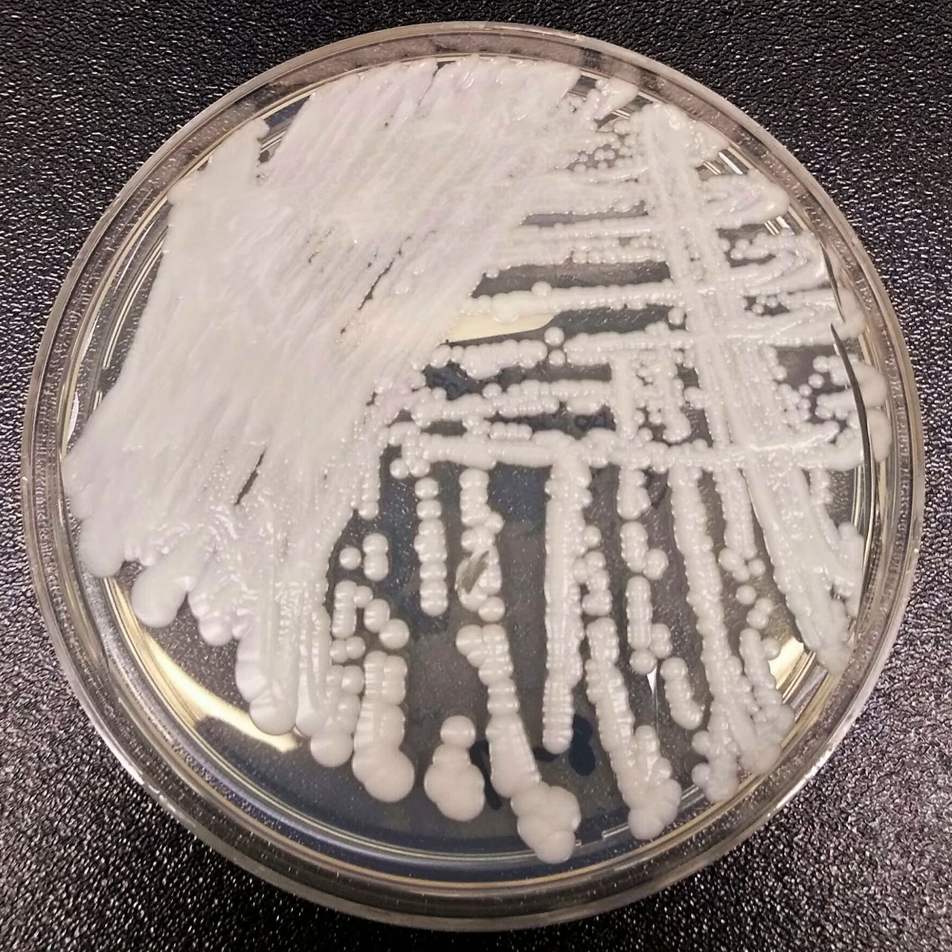
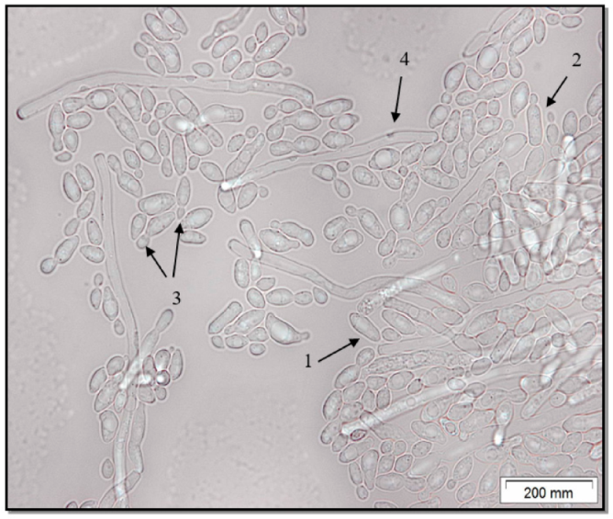
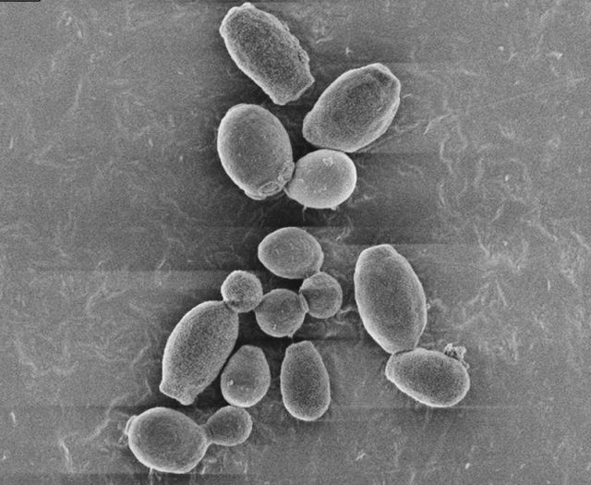
The Path of Yeast Resistance
National Center for Emerging and Zoonotic Infectious Diseases
Drug-resistant Candida on the rise
Meghan Lyman & Dallas Smith
Mycotic Diseases Branch | Centers for Disease Control and Prevention
Candida auris
Candida parapsilosis
Scanning Electron Micrograph of Candida auris
Notes:
Photo 1: FILE - This 2016 photo made available by the Centers for Disease Control and Prevention shows a strain of Candida auris, a potentially deadly superbug fungus, cultured in a petri dish at a CDC laboratory. (Shawn Lockhart/CDC via AP)
Photo 2: Candida parapsilosis as a Causative Agent of Onychomycosis in Patient with Cirrhosis of the Liver
Photo 3: Candida auris Outbreak in the United States | Tecolab

Slide 9
By the end of this session, you will be able to:
Describe increasing prevalence of resistant Candida species
Explain epidemiology of emerging resistant Candida
Outline appropriate testing, which include species identification, antifungal susceptibility testing (AFST), and whole genome sequencing (WGS)
Summarize treatment options and resources for resistant Candida species

Slide 10
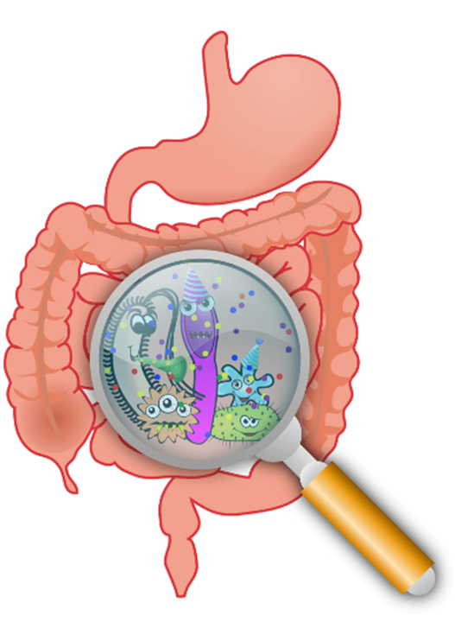
Typical Candida infections
Conventional wisdom: autoinfection with host flora, particularly from gut (not person-to-person transmission)
Outbreaks: rare
Low Resistance: generally low, but depends on the species

Slide 11
Background on Candida auris (C. auris)
Multidrug-resistant fungal pathogen
Prolonged colonization & environmental persistence
Healthcare-associated transmission & outbreaks
Invasive infections with High morbidity/mortality

Slide 12

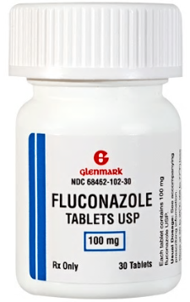
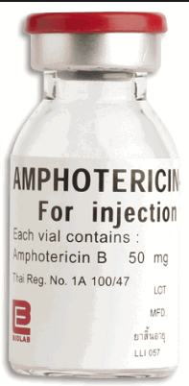

C. auris Resistance in the United States
95%
Azoles
15%
Polyenes
Echinocandins
(preferred treatment)
<1%
based on AR Lab Network data

Slide 13
C. auris breakpoints
There are currently no established C. auris-specific susceptibility breakpoints.
Breakpoints are defined based on those established for closely-related Candida species and on expert opinion.
Correlation between microbiologic breakpoints and clinical outcomes is not known currently.

Slide 14
Knowledge Check Question1
C. auris is most often resistant to which type of antifungal?
fluconazole
amphotericin B
echinocandins
flucytosine
Correct answer: a) fluconazole

Slide 15
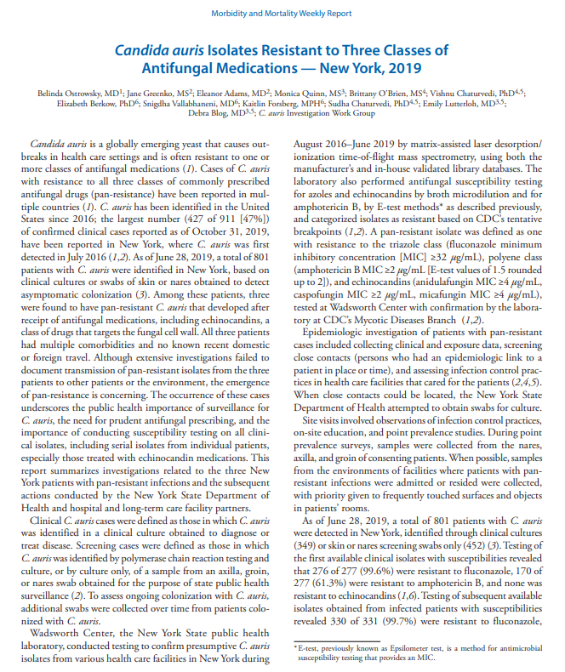
First Case of Pan-resistant C. auris
3 pan-resistant C. auris cases in NY before 2020
Cases unrelated with no epi links
Developed resistance after echinocandin treatment
No pan-resistance found among screened contacts or environmental sampling

Slide 16
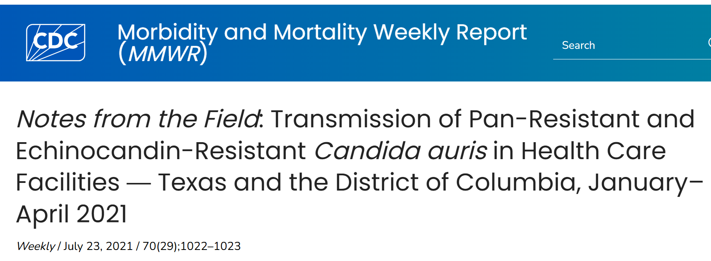


Clusters of echinocandin-resistant C. auris
2 independent clusters of pan- or echinocandin-resistant cases
None had prior echinocandin treatment
First evidence of spread of pan-or echinocandin-resistant strains
3 cases
7 cases

Slide 17

Increase in echinocandin-resistant C. auris Isolates through CDC's AR Lab Network, 2016–2024
Notes:
Photos: Antimicrobial Resistance Laboratory Network | ARLN | CDC

Slide 18



Epidemiologic Characteristics of Recent ech-r Cases
Among 93 cases (August 2023–December 2024):
85% of all specimens collected at acute care hospitals and 92% were clinical cases
Patients with resistant C. auris were mostly identified from clinical specimens at ACHs
Low echinocandin levels in urine may promote development of resistance in urinary track
>50% of all specimens collected were from urine samples
56% had prior echinocandin use documented (lower bound estimate)
Mix of resistance developed on treatment and acquired through transmission
Notes:
phylogenetic analyses illustrated that the echinocandin-resistant strains were closely related to other strains in the same patient Evolutionary accumulation of FKS 1 mutations from clinical echinocandin-resistant Candida auris – PubMed
Develop resistance on treatment in urine Whole genome sequencing analysis demonstrates therapy‐induced echinocandin resistance in Candida auris isolates - Spruijtenburg - 2023 - Mycoses - Wiley Online Library

Slide 19
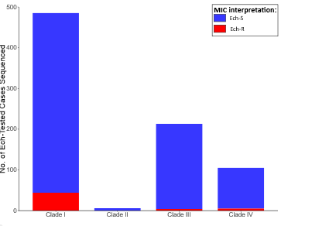
Genomic Epidemiology of echinocandin-resistant C. auris
C. auris overall demonstrates low genetic diversity within clades
Echinocandin resistance detected in all three major clades circulating in the U.S.
92% of ech-r isolates had an FKS1 mutation.
Cluster of ech-r isolates in same metro area were genetically related
Challenge: WGS-based mutation detection not CLIA-validated
Ech-r strains were closely related to other strains in the same patient and after echinocandin exposure*
Number of ech-R and ech-S cases per clade
(among US isolates 2013—2022 with WGS and AFST results, N-809)
In review
*Tian et al. Emerg Microbes Infect. 2024

Slide 20
Laboratory Testing to Detect Cases and Guide Treatment
Laboratory Testing to Detect Cases and Guide Treatment
Species identification in non-sterile specimens can enhance detection of C. auris
Antifungal susceptibility testing is necessary to identify resistance and guide treatment
Especially among patients not responding to treatment
Whole genome sequencing can identify mutations linked to echinocandin resistance, but often not available to guide treatment

Slide 21
Clinical data about antifungal treatment are limited.
Clinical data about antifungal treatment are limited.
Fosmanogepix: show promising results against echinocandin-resistant C. auris
Ibrexafungerp: approved for vulvovaginal candidiasis; show promising results against echinocandin-resistant C. auris
Combination treatment: in vitro data shows inconsistent results against echinocandin-resistant C. auris and no real clinical data
Higher doses of echinocandins
Rezafungin: anecdotal evidence that it works against echinocandin-resistant C. auris
More clinical data are needed. Echinocandin-resistant isolates added to CDC's AR bank.

Slide 22

IPC measures for echinocandin-resistant strains are the same as those for all other C. auris strains
IPC measures for echinocandin-resistant strains are the same as those for all other C. auris strains
BUT IPC adherence is even more important to prevent spread that could result in difficult-to-treat infections
Hand hygiene with alcohol-based hand sanitizer
Contact precautions (or Enhanced Barrier Precautions)
These IPC measures include:
Cleaning and disinfection with approved disinfectants

Slide 23
Knowledge Check Question 2
Are special infection control precautions needed for echinocandin-resistant C. auris?
No, only standard precautions are needed
Yes, contact precautions or enhanced-barrier precautions are needed, just like all strains of C. auris
Yes, but additional precautions are needed for echinocandin-resistant strains, above and beyond what is needed for all other echinocandin-susceptible strains.
Correct answer: b) Yes, contact precautions or enhanced-barrier precautions are needed, just like all strains of C. auris

Slide 24

Conclusion
Although not common, number of echinocandin-resistant cases is increasing
Mix of resistance developed on treatment AND transmission of resistant strains
Notes:
Candida auris | Candida auris (C. auris) | CDC

Slide 25
Knowledge Check Question3
How does echinocandin resistance develop among C. auris?
On treatment due to antifungal pressure
Resistant strain spread between patients
Both a & b
Neither a or b
Correct answer: c) Both a & b

Slide 26
Candida parapsilosis (C. parapsilosis)
Dallas Smith

Slide 27
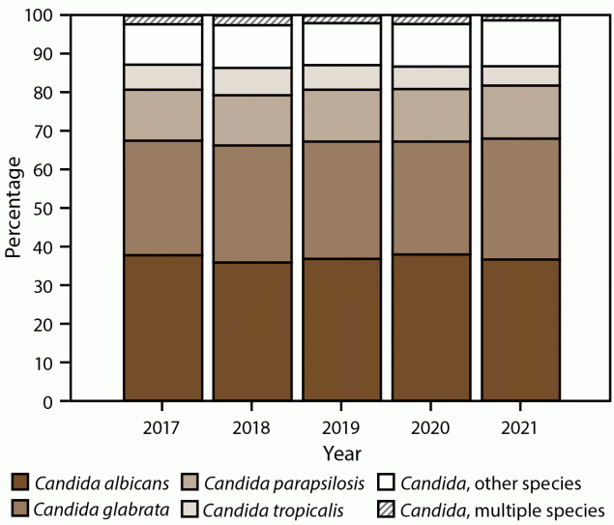
Candida parapsilosis & Bloodstream Infections
Third most common cause of fungal bloodstream infections (BSI) in the United States
Common in premature neonates, persons with cancer or COVID-19, and organ transplant recipients
Population-Based Active Surveillance for Culture-Confirmed Candidemia — 10 Sites, United States, 2017–2021 | MMWR

Slide 28
C. parapsilosis bloodstream infections
Risk factors are similar for candidemia in general:
Previous abdominal surgery
Total parenteral nutrition
Fungal colonization
Central venous catheters
Broad-spectrum antibiotics
Septic shock
Renal replacement therapy
Can persist on healthcare surfaces and healthcare workers' hands, facilitating spread among patients
Forms biofilms
Can cause outbreaks
Worldwide emergence of fluconazole-resistant Candida parapsilosis: current framework and future research roadmap - The Lancet Microbe

Slide 29
Historically, C. parapsilosis was mostly susceptible to fluconazole.

Slide 30
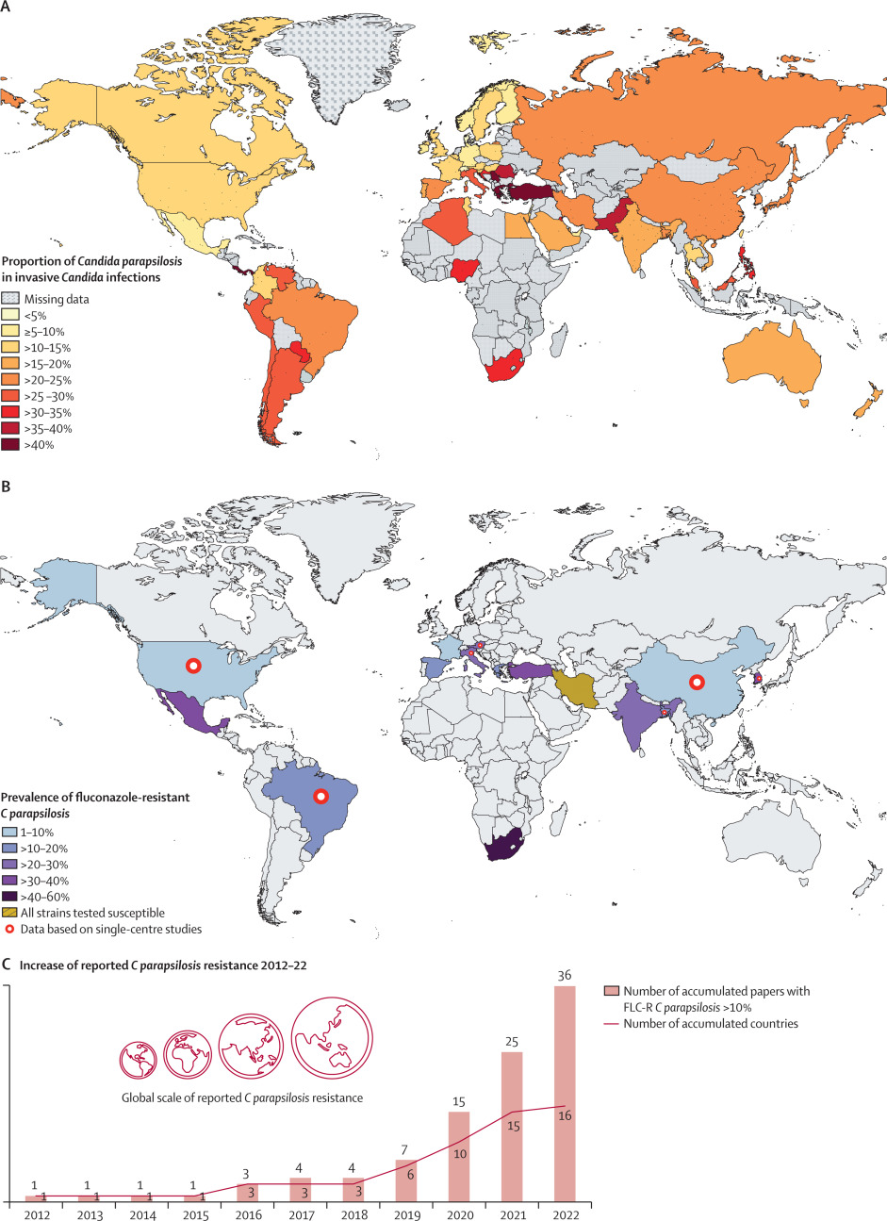
Global Emergence of fluconazole-resistant Candida parapsilosis – Some Countries as High as 60%
Worldwide emergence of fluconazole-resistant Candida parapsilosis: current framework and future research roadmap - The Lancet Microbe

Slide 31
Global Emergence of fluconazole-resistant Candida parapsilosis, 2012-2022
Reported in at least 16 countries
Worldwide emergence of fluconazole-resistant Candida parapsilosis: current framework and future research roadmap - The Lancet Microbe

Slide 32
Some estimates suggest that mortality rates for C. parapsilosis candidemia cases are twice as high for those with fluconazole-resistant isolates compared to susceptible isolates.

Slide 33
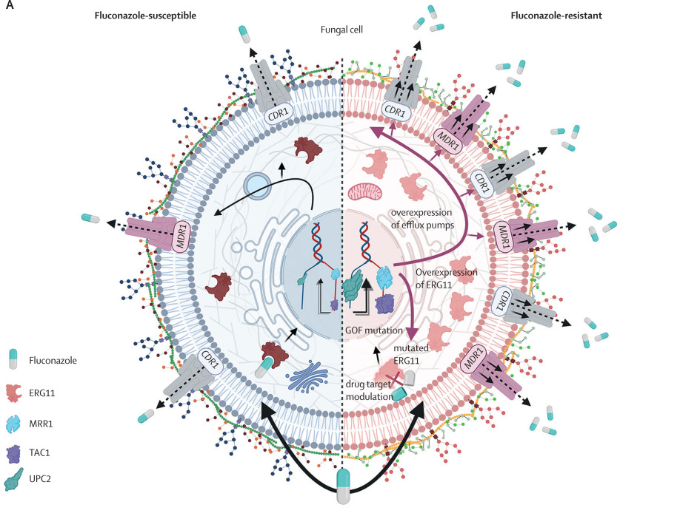
fluconazole-resistant C. parapsilosis Strains Often carry a ERG11 mutation
Erg11p is a key enzyme involved in the ergosterol biosynthetic pathway
Worldwide emergence of fluconazole-resistant Candida parapsilosis: current framework and future research roadmap - The Lancet Microbe

Slide 34
Overall Trend of fluconazole-resistant C. parapsilosis Prevalence Has Increased
*Data for 2024 is unavailable

Slide 35
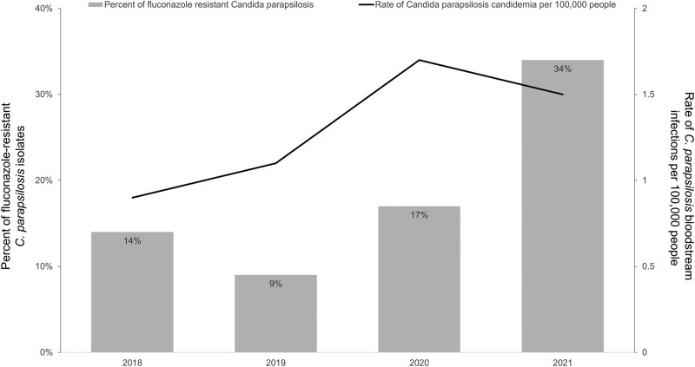
Cluster of fluconazole-resistant C. parapsilosis
Candidemia surveillance showed an increase in fluconazole-resistant C. parapsilosis BSIs in 2021 in Atlanta
30% of fluconazole-resistant cases had received azole treatment in the prior 30 days

Slide 36


fluconazole resistance was more common among patients:
Admitted to a long-term acute care hospital in the last 90 days
Mechanically ventilated in the 30 days prior

Slide 37
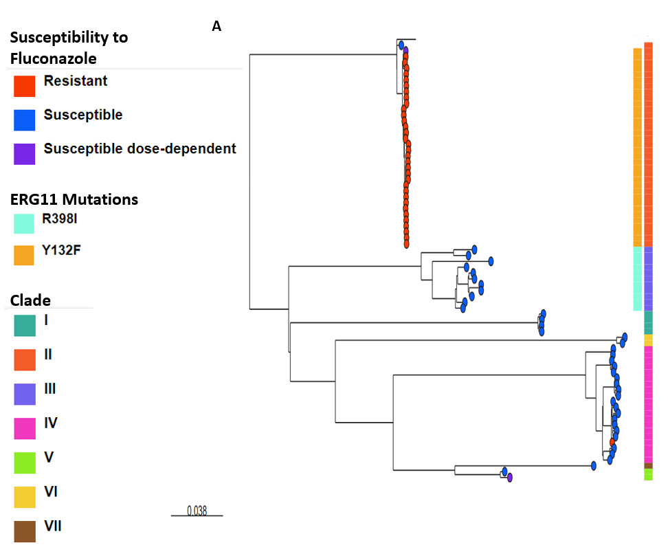
All fluconazole-resistant Isolates were Genetically- Similar by Whole Genome Sequencing
Suggests transmission of a single resistant strain to different facilities
Notes:
All had Y132F substitution in the ERG11 gene

Slide 38

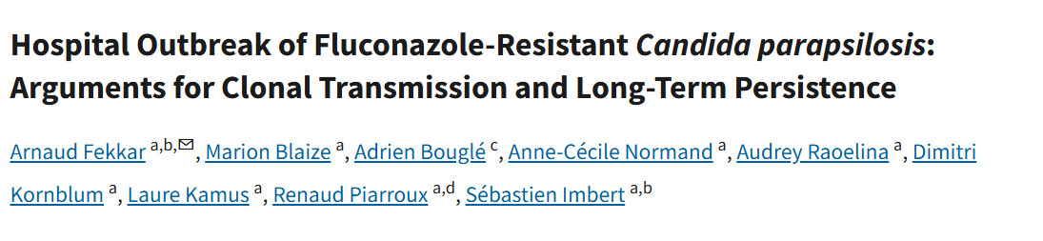

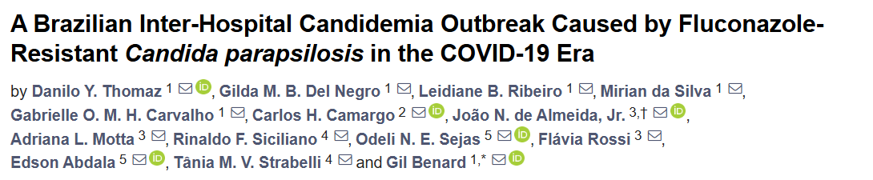
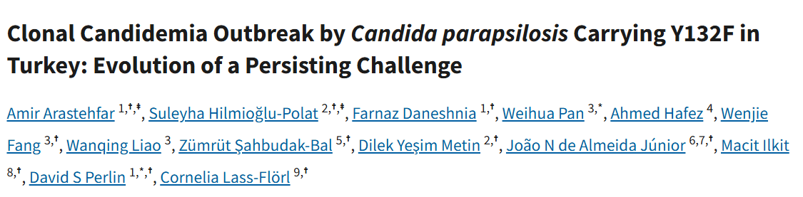
Healthcare Transmission of fluconazole-resistant C. parapsilosis globally

Slide 39


Clinicians Can Take Three Actions to Help Address fluconazole-resistant Candida parapsilosis
Prescribe echinocandins as empiric therapy for candidemia
Order species-level identification for all Candida
Send cultures for antifungal susceptibility testing

Slide 40
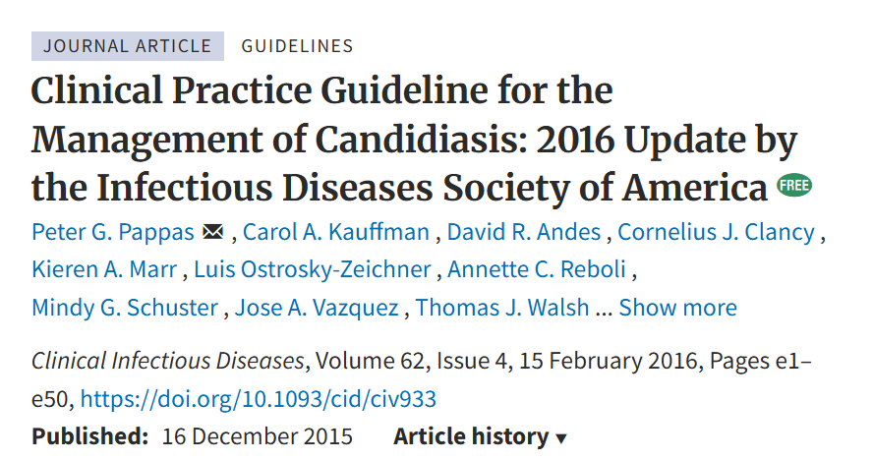
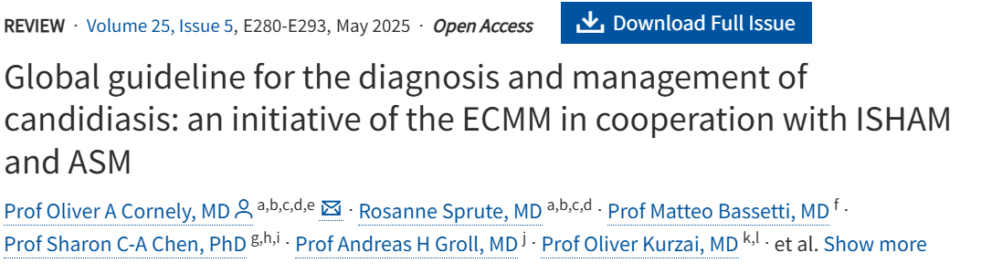
echinocandins recommended as initial treatment for candidemia
Data suggest 30% of candidemia is treated first with fluconazole in the United States
Growing azole resistance observed in several species
Data suggest lower mortality with echinocandins
Treatment Practices for Adults With Candidemia at 9 Active Surveillance Sites—United States, 2017–2018 | Clinical Infectious Diseases | Oxford Academic

Slide 41

Species-Level Identification on all Candida Isolates
Certain species, like C. parapsilosis, are increasingly resistant to antifungals
Clinicians should request species-level identification on all Candida isolates requiring treatment
Management may change based on species while antifungal susceptibility testing is pending

Slide 42

Antifungal Susceptibility Testing
Cultures should be sent for antifungal susceptibility testing
These results can inform step-down therapy
Public health and clinicians can monitor for antifungal resistance patterns regionally and at facility-level

Slide 43
Knowledge Check Question4
Which of the following is the primary mode of transmission for Candida parapsilosis in healthcare settings?
Airborne transmission through respiratory droplets
Direct contact with contaminated surfaces or medical equipment
Vector-borne transmission via insect
Transmission through contaminated food and water.
Correct answer: b) Direct contact with contaminated surfaces or medical equipment.

Slide 44
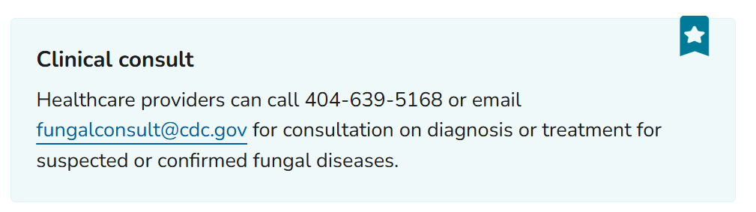
Have questions about fungal diseases? Contact CDC!
Clinical Care of Fungal Diseases: Antifungals | Fungal Diseases | CDC

Slide 45
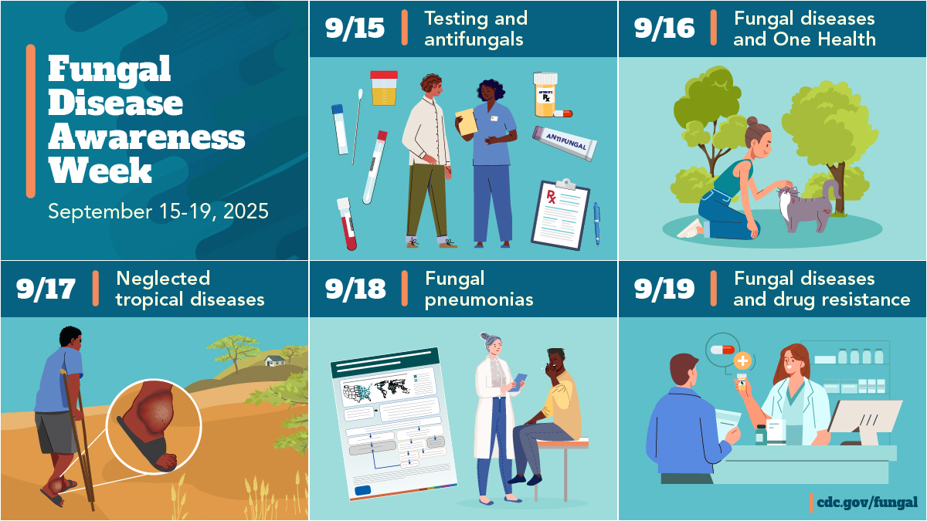
Thank you!
Special thanks to Anna Baker for her help in preparing this presentation
https://www.cdc.gov/fungal/fungal-disease-awareness-week/index.html
https://www.cdc.gov/fungal/index.html

Slide 46
To Ask a Question
Using the MS Teams Platform
The ability to ask questions during the live webinar is limited to the first 1,000 attendees.
Questions may be submitted after the live session by emailing coca@cdc.gov.
If you are a patient, please refer your question to your healthcare provider.
If you are a member of the media, please direct your questions to CDC Media Relations at 404-639-3286 or email media@cdc.gov.

Slide 47
TRAIN
CDC has fully transitioned from Training and Continuing Education Online (TCEO) to CDC TRAIN (https://www.train.org/cdctrain).
Transcripts & Certificates: You can access and download CE transcripts and certificates in TCEO through the end of 2025.
Instructions will be available on both platforms and a learner support team will be available to answer questions.

Slide 48
Continuing Education
All continuing education for COCA Calls is issued online through CDC TRAIN at CDC TRAIN (https://www.train.org/cdctrain).
To receive continuing education (CE) for WC4520R-091825—Clinician Update on Measles Cases and Outbreaks in the United States, please visit CDC TRAIN and search for the course in the Course Catalog using WC4520R-091825. Follow the steps below by October 20, 2025. The registration code is COCA091825.
To receive continuing education (CE) for WD4520R-091825—Clinician Update on Measles Cases and Outbreaks in the United States, please visit CDC TRAIN and search for the course in the Course Catalog using WD4520R-091825. Follow the steps below between October 21, 2025, and October 21, 2027.

Slide 49
Today’s COCA Call will be Available to View On-Demand
When: Next week
What: Closed captioned video and transcript
Where: On the COCA Call webpage: https://www.cdc.gov/coca/hcp/trainings/drug-resisitant-candida.html

Slide 50
Additional Resources
Continue to visit https://www.cdc.gov/coca/hcp/trainings/index.html to get more details about upcoming COCA Calls.
Subscribe to receive notifications about upcoming COCA calls and other COCA products and services at https://www.cdc.gov/coca/hcp/trainings/index.html.

Slide 51
Thank you for joining us today! Clinician Outreach and Communication Activity (COCA) | COCA | CDC

