Slide 1

November 2014

Slide 2

About Us
Breastcancer.org is a non-profit organization dedicated to providing the most reliable, complete, and up-to-date expertise on breast health and breast cancer. Our mission is to help women and their loved ones make sense of the complex medical and personal information about breast health and breast cancer, so they can make the best decisions for their lives.

Slide 3


The Need for Trusted Information Is Huge
Breast cancer is the MOST common cancer in women
The global
incidence is
projected to
double by
2040
and be diagnosed in
even younger women.
29% | BREAST (232,340 cases)
14% | Lung & bronchus
9% | Colon & rectum
6% | Uterine corpus
5% | Thyroid
4% | Non-Hodgkin lymphoma
4% | Melanoma of skin
3% | Kidney & renal pelvis
3% | Ovary
3% | Pancreas
20% | All other sites
American Cancer Society 2012 Estimated US Cancer Cases
Breast Cancer Facts & Figures 2013 – 2014
2,240 men in 2013

Slide 4
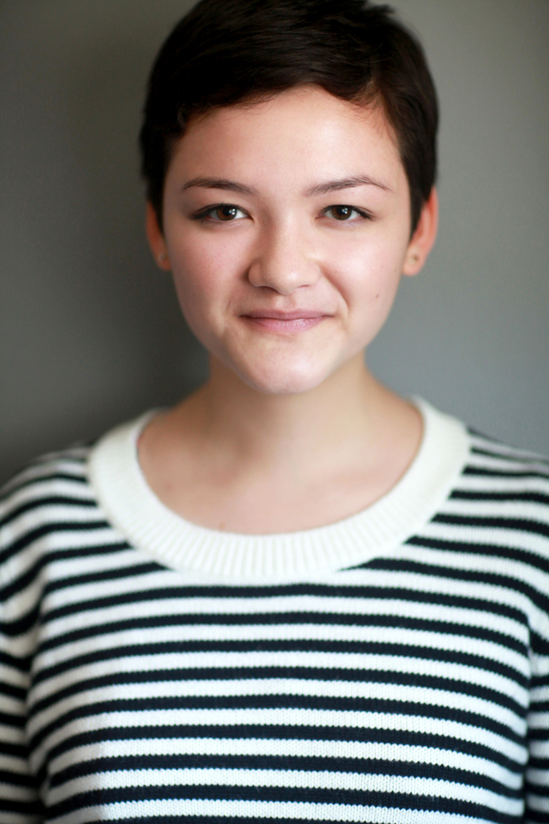
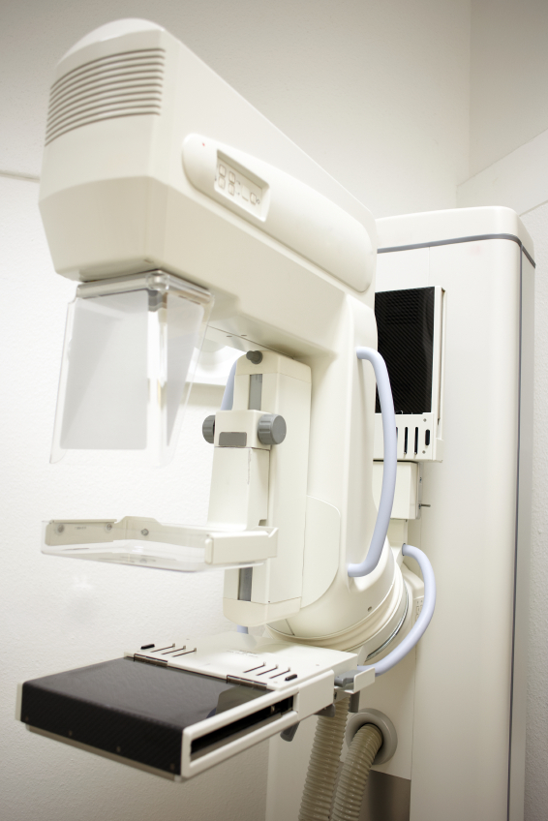
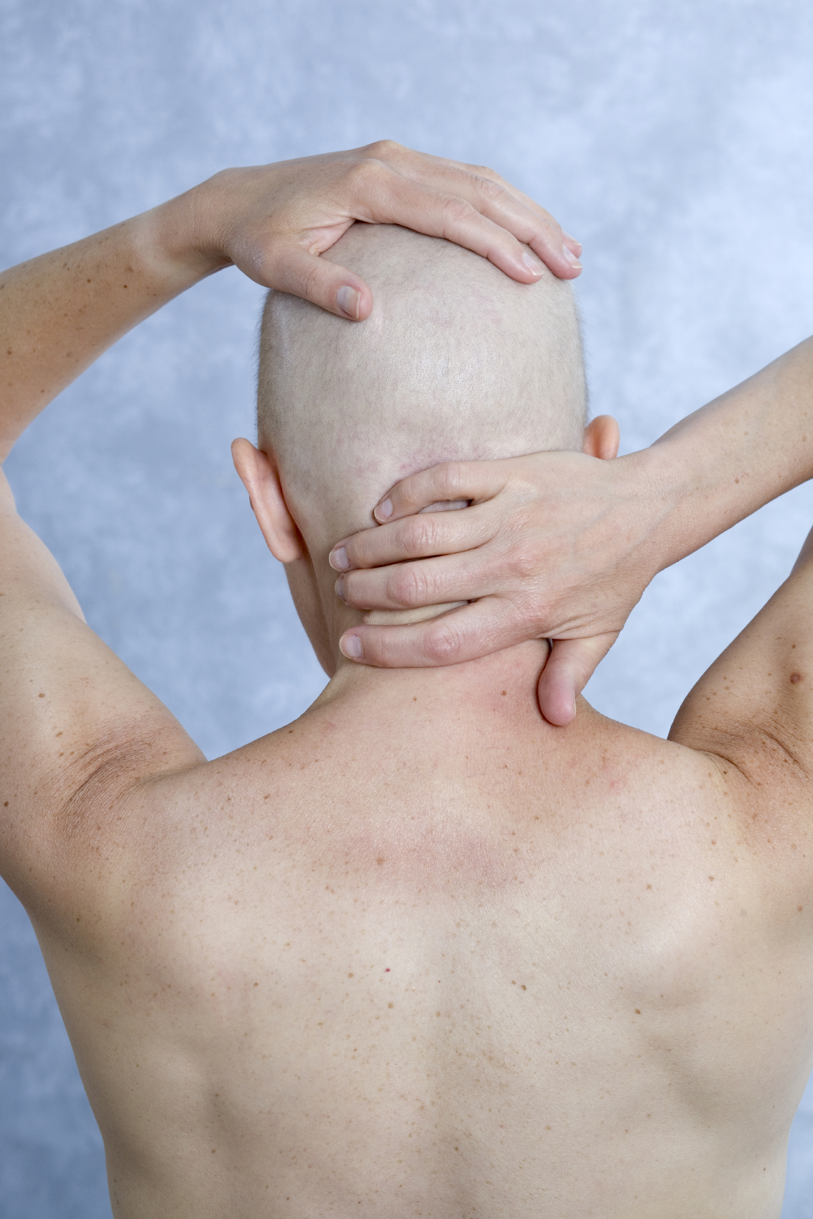

Closing the “PINK” Knowledge Gap
Awareness is high. Knowledge is LOW.
Prevention
Detection/Diagnosis
In Treatment
Survivorship
Notes:
Women need BCO. Awareness is high, but the knowledge about breast cancer is low.
Discuss our ongoing commitment to closing the knowledge gap with those in diagnosed or in treatment, with survivors, and with the women not thinking about bc.
Knowledge Gaps
Prevention (most bc runs in families)
In treatment ( reconstruction info, cold caps, exercise, nutrition)
Survivorship (nutrition, compliance, sexuality or sharing your life)

Slide 5
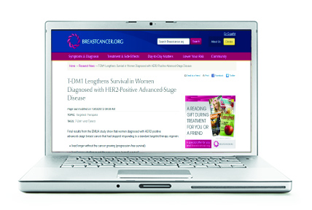
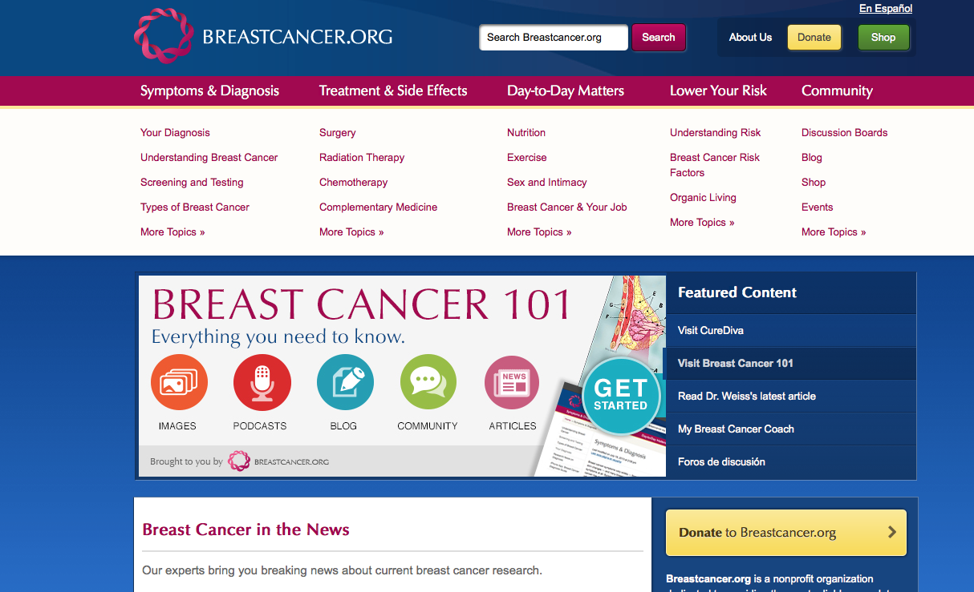
The Breastcancer.org Visitor
$
Nearly 40%
have an AHI of $75,000+
live in U.S.: 59%;
40% of traffic comes
from outside the U.S.
Most visitors
98%
female
44% report spending more than 15 minutes
on the site
64%
have college or
post-graduate degrees
Average age:
40–59
Source: Breastcancer.org 2013 online survey & Google Analytics 2013.

Slide 6

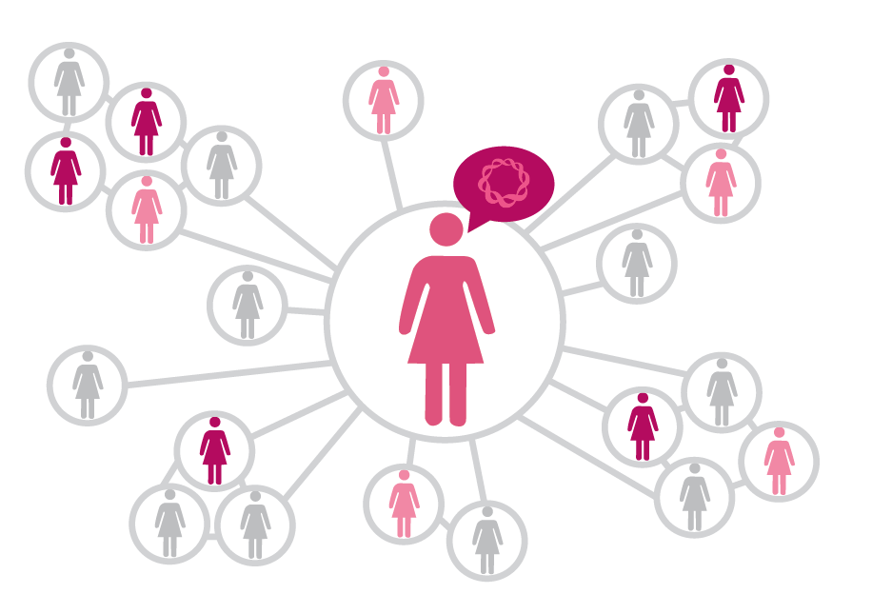
Breastcancer.org Impact
Reaching...
Visitors from 230
Over 1.2 million visits each month
countries
Over 15 million visits in 2013
Over 145,000
registered
Over 9 million unique visitors in 2013
members
in our online community
Over 56 million page views in 2013
In the 14 years since we started, Breastcancer.org has helped more than 47 million people from 230 different countries and territories around the world.
Source: Google Analytics 2013
Notes:
People come to us 24/7 with an urgent need. With all of this success, there is still so much more for Breastcancer.org to do.

Slide 7
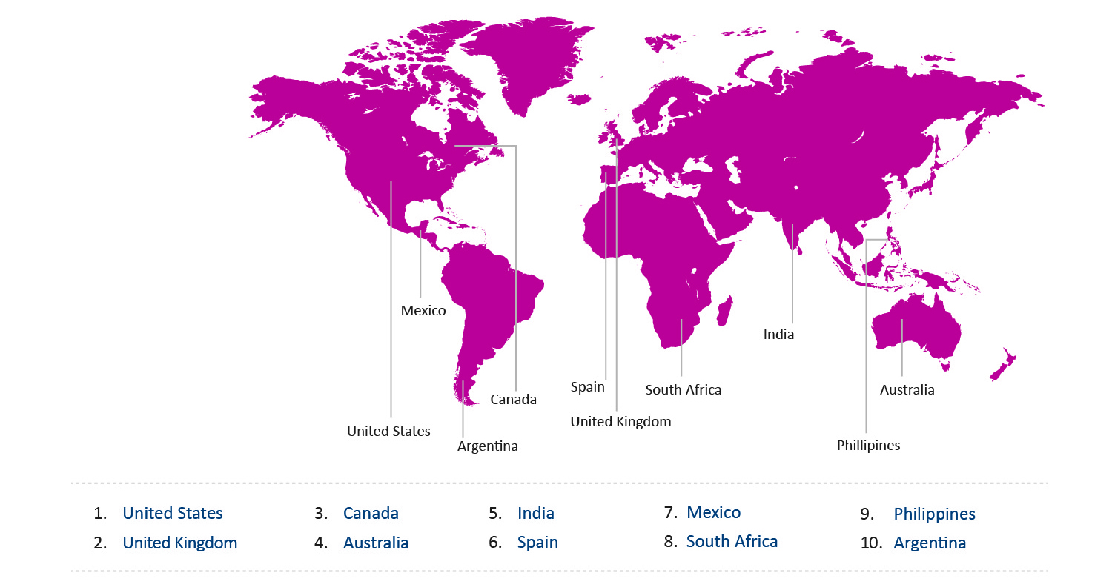
Breastcancer.org Global Impact
Breastcancer.org top 10 countries by visitor traffic
Source: 2013 Google Analytics

Slide 8
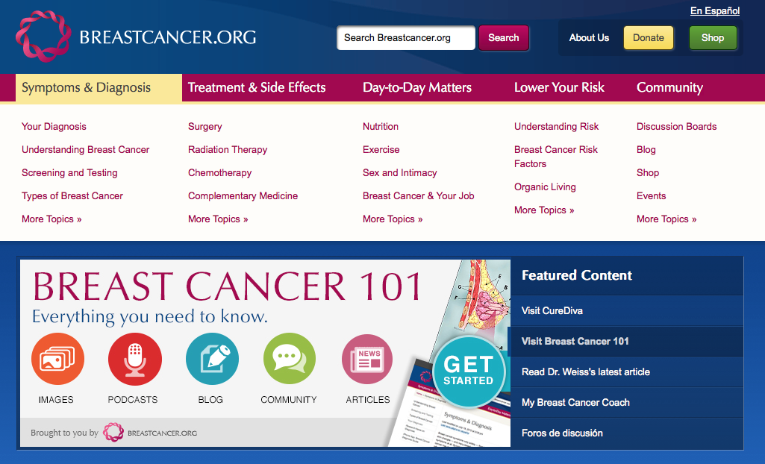
Breastcancer.org Site Features
Over 7,000 pages of expert medical information produced
in consultation with a Professional Advisory Board.

Slide 9
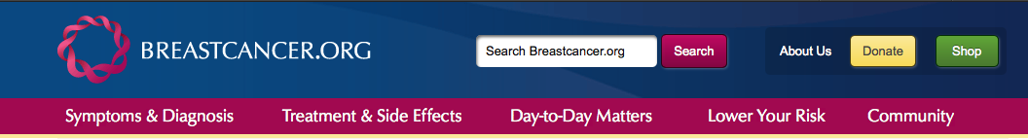
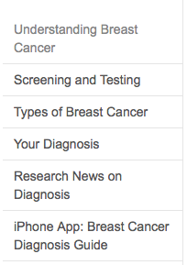
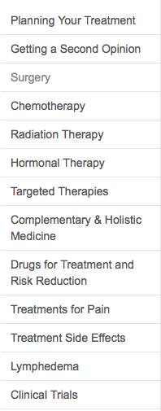
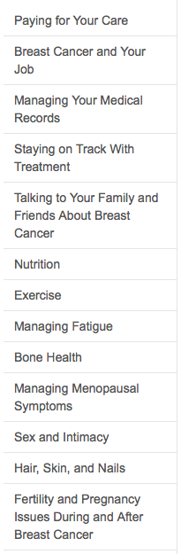
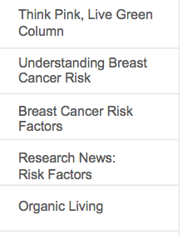
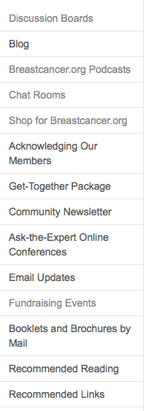
Content Based on Her Needs
More content…

Slide 10
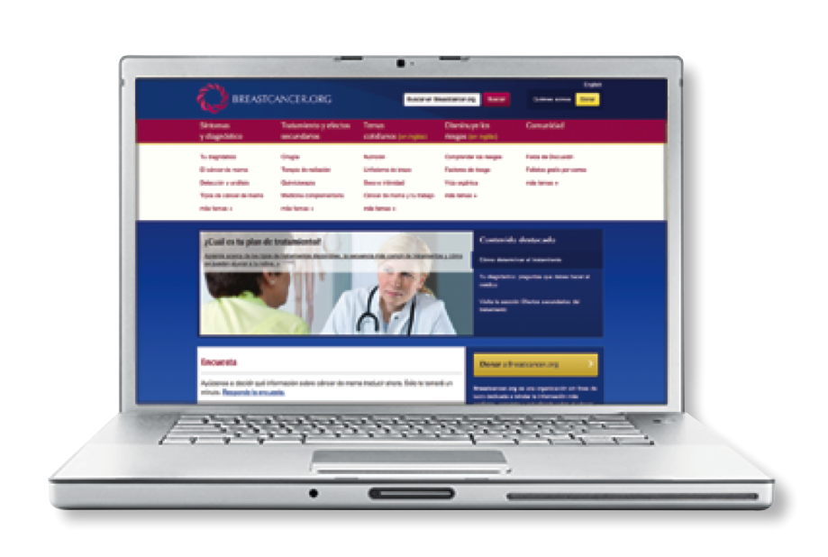
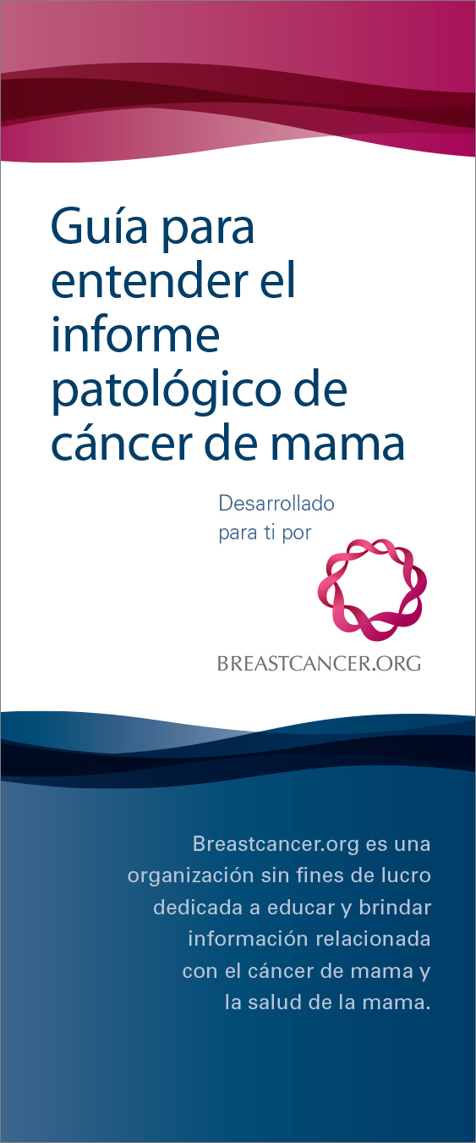
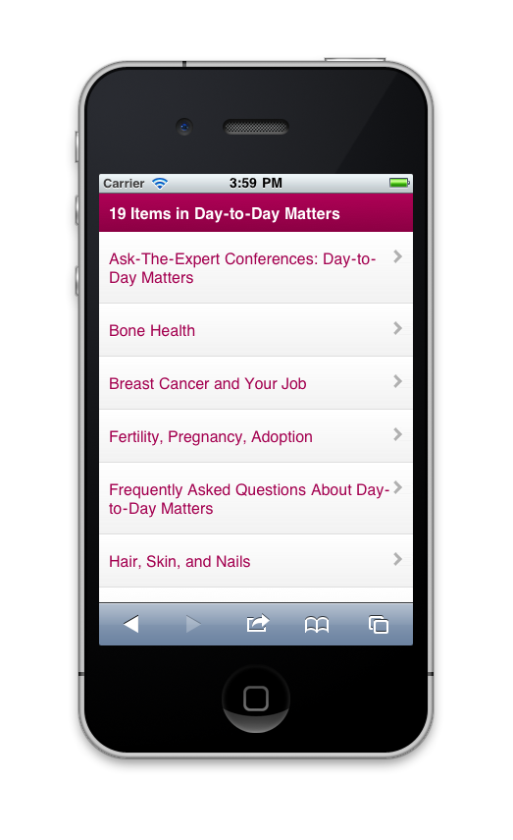
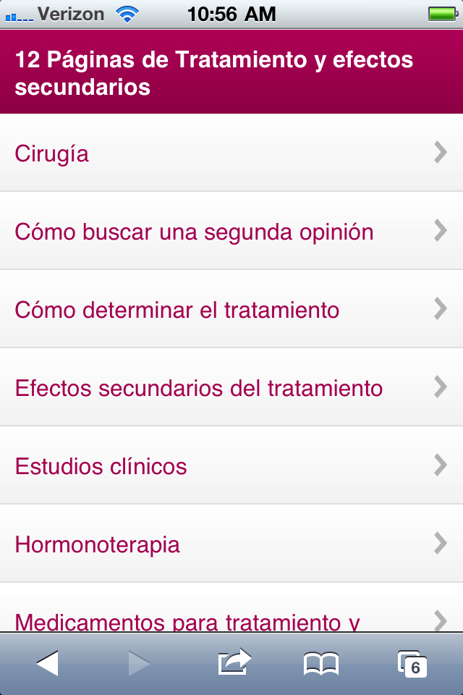
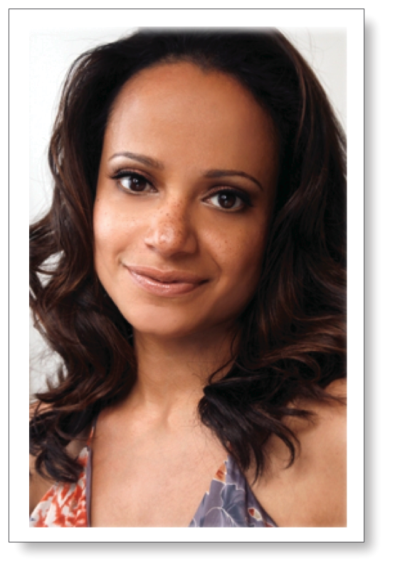
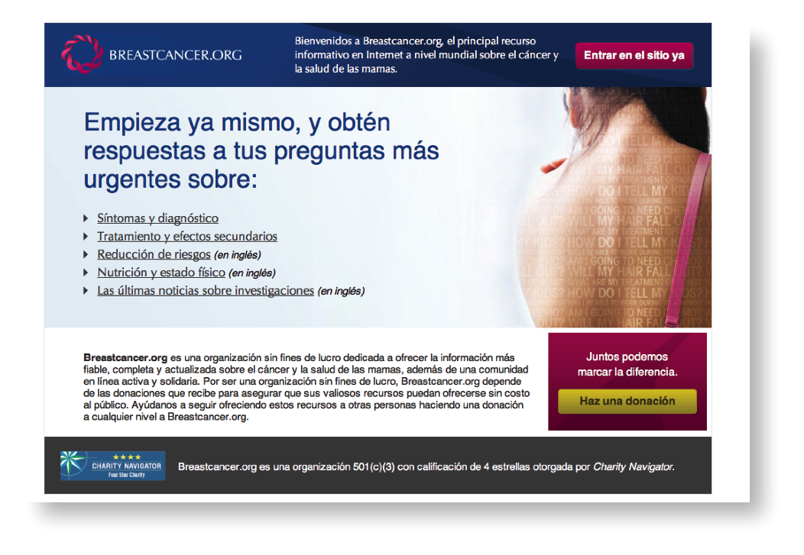
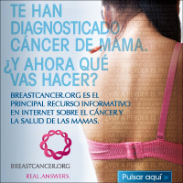
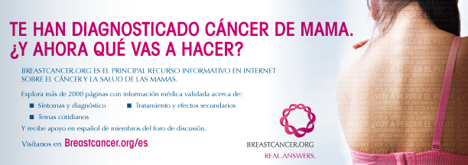
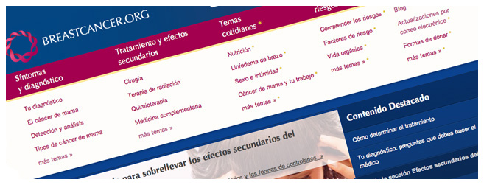
Reaching the Spanish-Speaking Audience
Mobile App
available in Spanish
Spanish Homepage
Spanish Pathology Booklet
Judy Reyes –
Hispanic Spokesperson
Campaign Destination Page
External Online Banner
Print & Marketing Collateral
Spanish Content

Slide 11

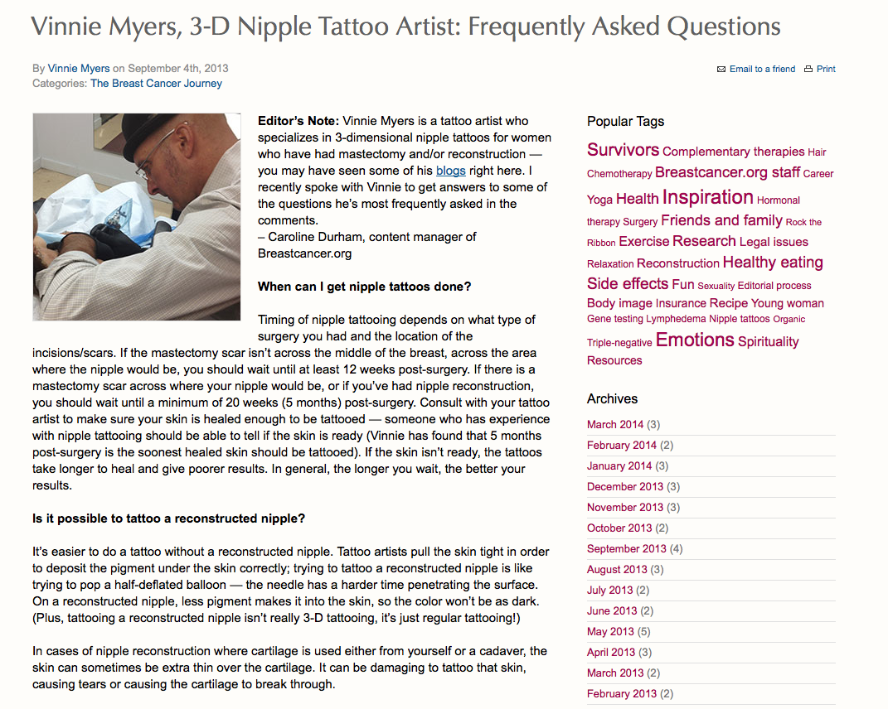
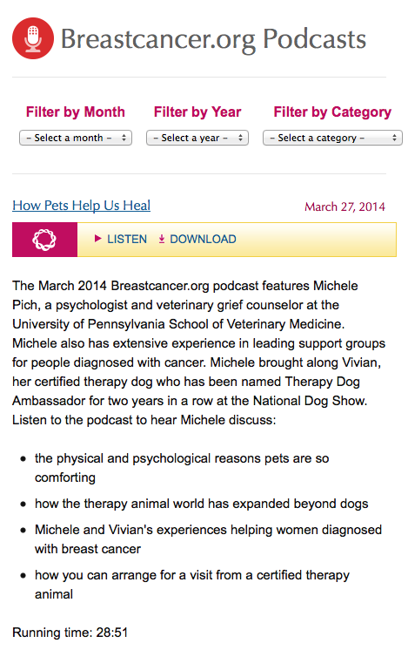


Blogs and Podcasts
Podcasts
Blogs

Slide 12
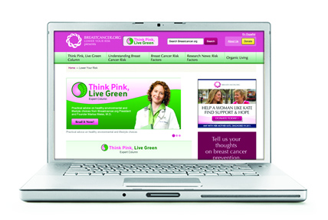
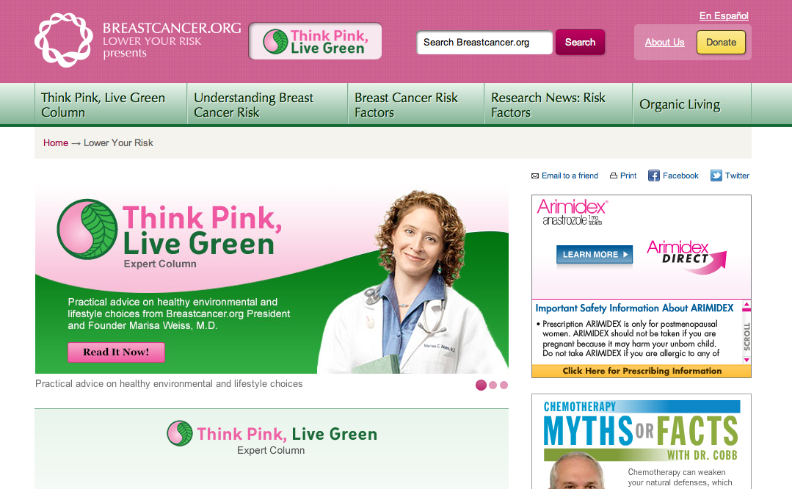
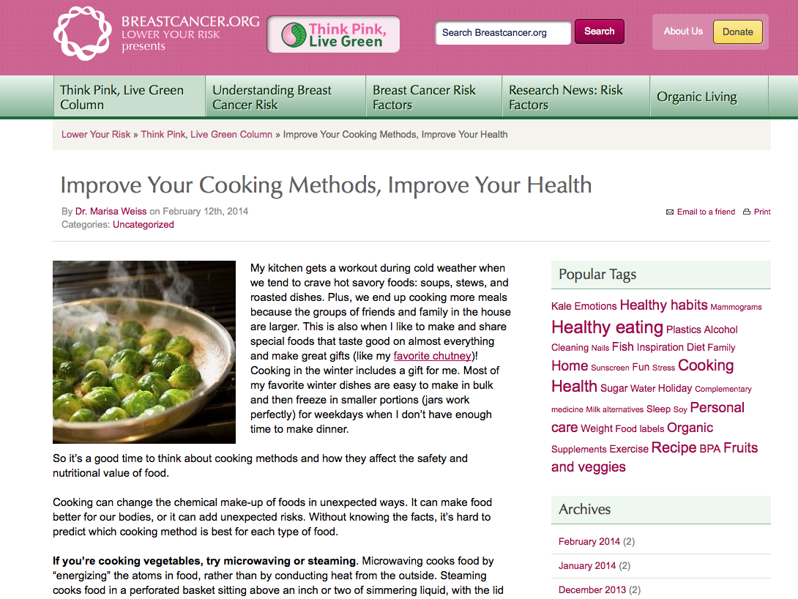

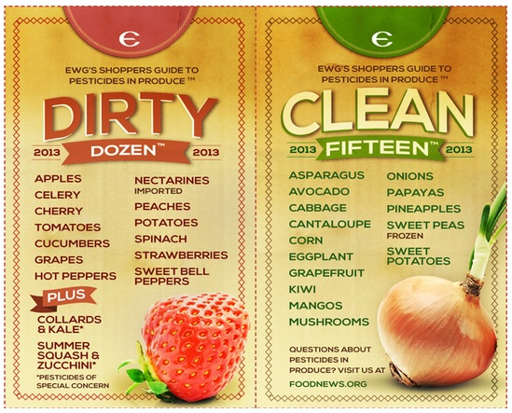
Breastcancer.org’s Prevention Program
Prevention Homepage
Think Pink, Live Green Column

Slide 13



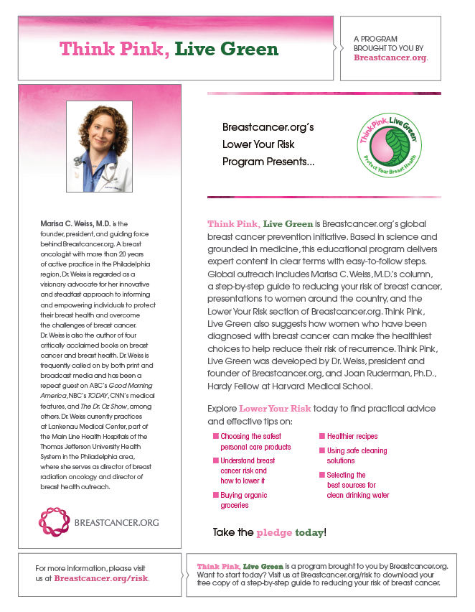
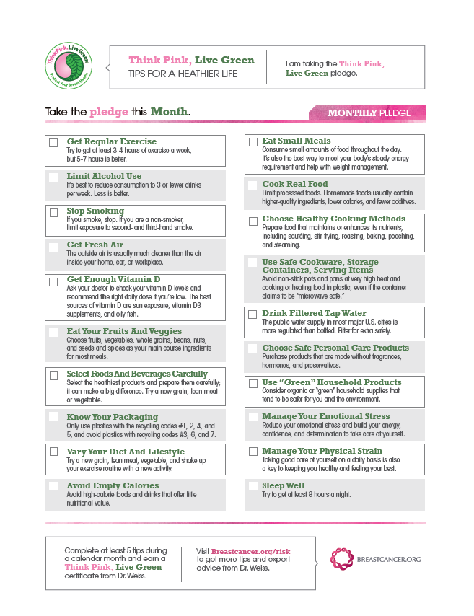
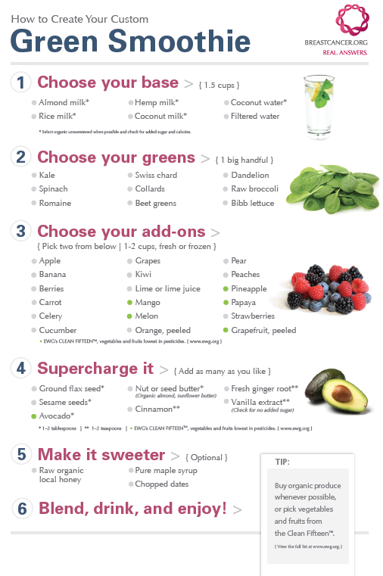
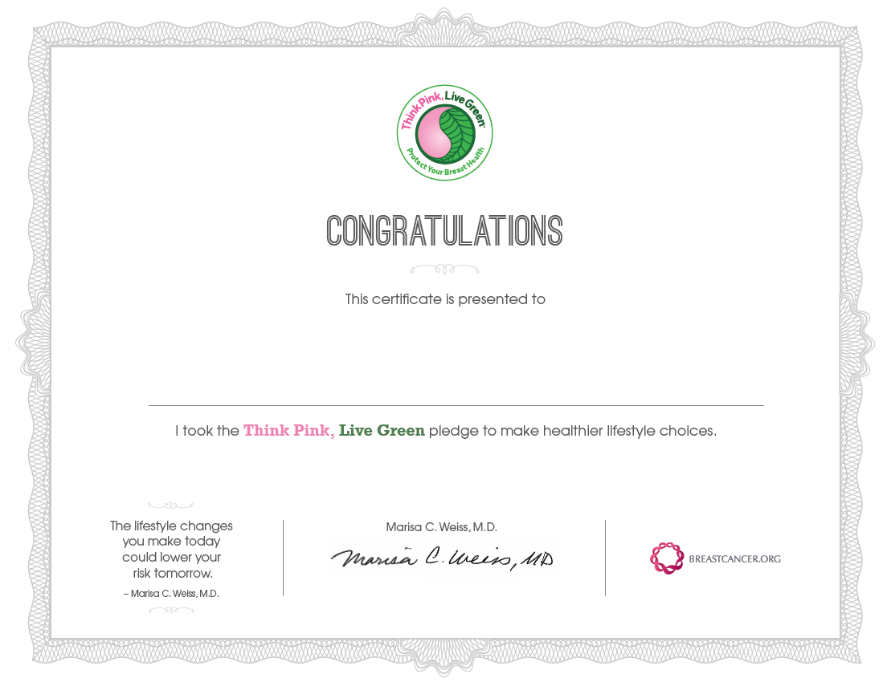
Think Pink, Live Green
TPLG booklet and TPLG toolkit materials
The program consists of:
Think Pink, Live Green presentation delivered
by Marisa Weiss, M.D. when available
30-page educational booklet: A step-by-step
guide containing actionable steps to lowering risk
A toolkit designed to easily implement this
program within your organization
Breastcancer.org has distributed thousands of
booklets to diverse audiences across the USA.

Slide 14
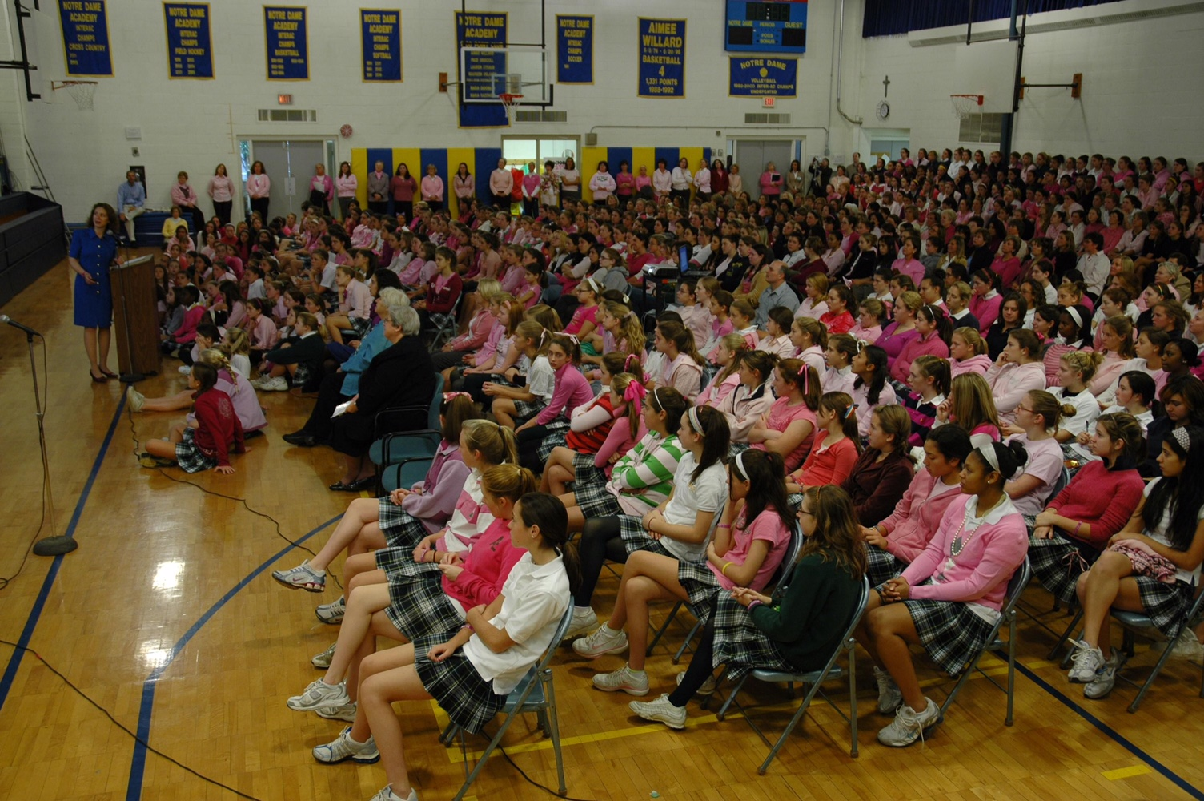


Slide 15
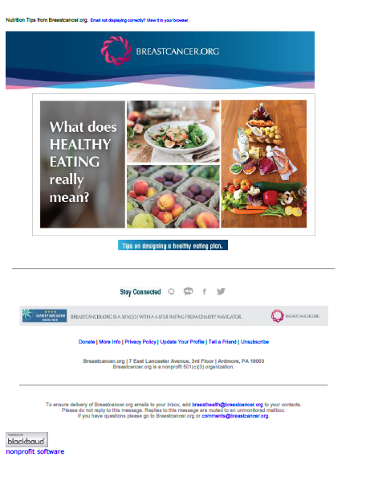
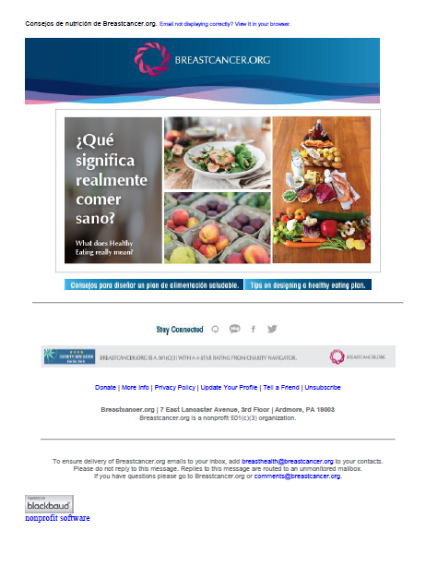
Breast Health & Wellness Email Campaigns

Slide 16

Breastfeeding meta-analysis: reduces risk of most aggressive breast cancer

Slide 17
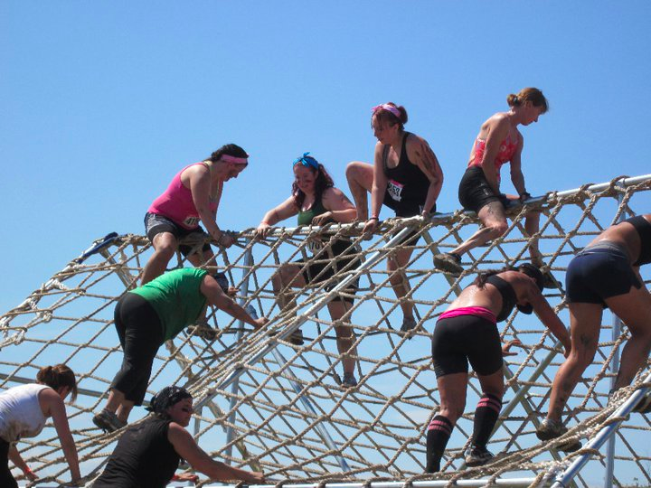
Challenges

Slide 18


Slide 19
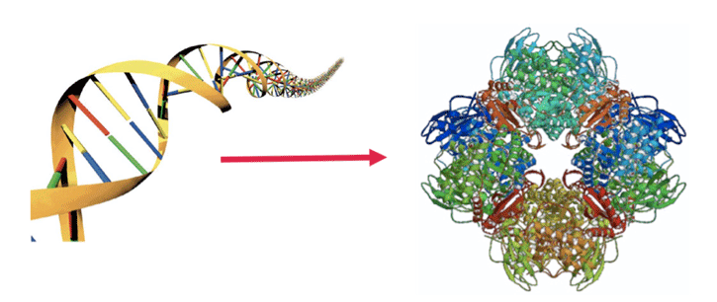
Plus, medical information is getting more complex!
Genetic & Protein Testing
Tests on normal cells: Cancer risk
Tests on cancer cells: Prognosis and Treatment

Slide 20
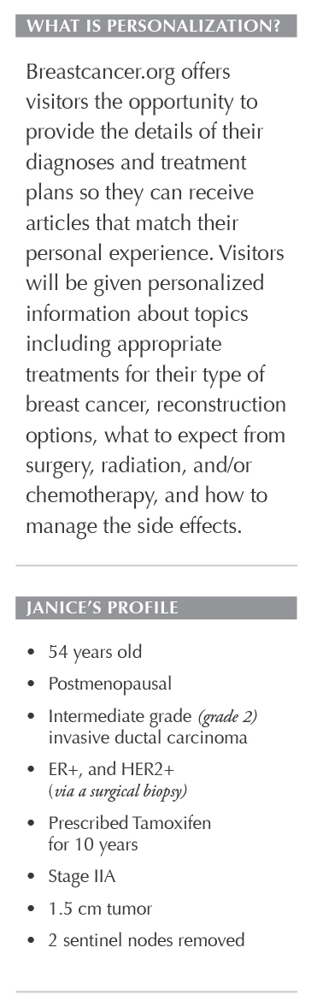
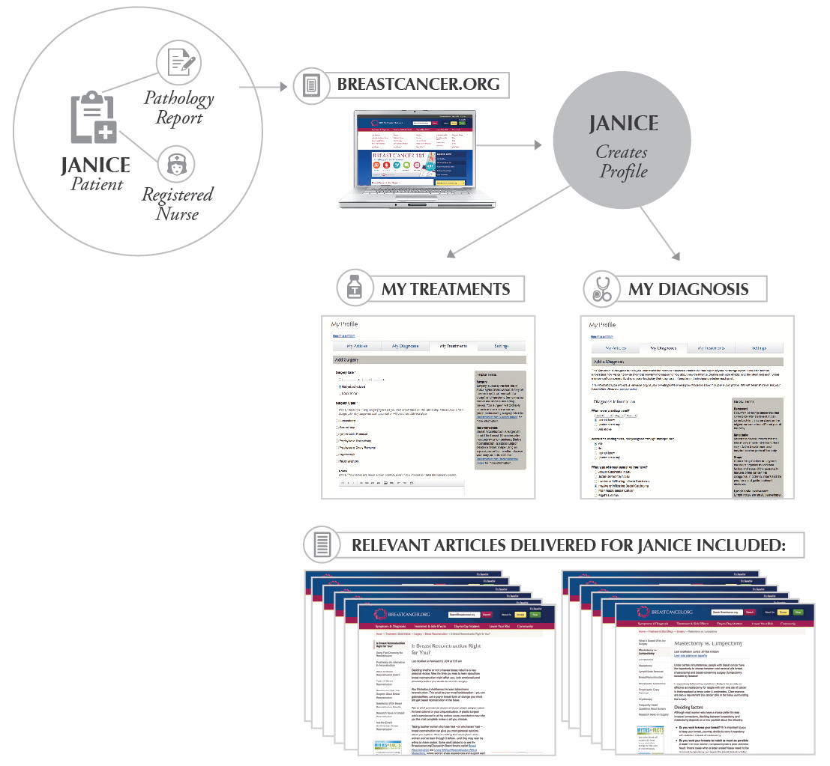
Personalized Articles

Slide 21



Slide 22



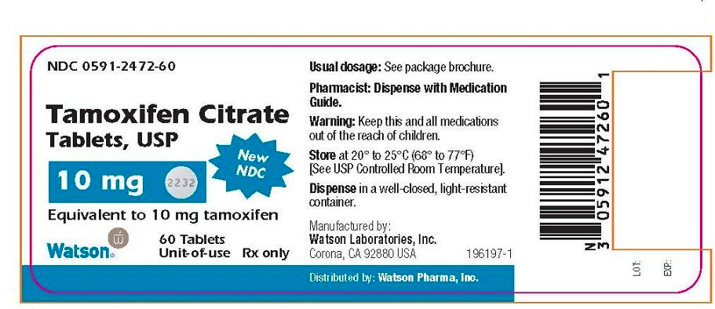




Fear of Recurrence;
Overwhelming demands from work, home, and community

Slide 23


Slide 24


Slide 25

Words, dose, tone, style and level of information is critical

Slide 26


Slide 27


Slide 28


Slide 29
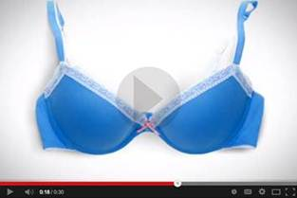
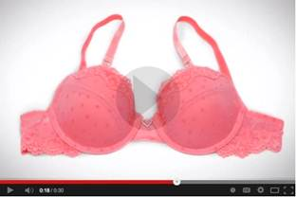
Closing the “PINK” Knowledge Gap
New PSA: Mythbusting the Breastcancer.org way
  Fresh approach to reach a younger audience and still demonstrate our place in the market
  as a medical authority
    Starts a new dialogue to help women to connect lifestyle choices with an increased risk of developing breast cancer
    Available in English & Spanish
    Builds a strong foundation for the continued growth of the prevention program
​
​

Slide 30




Thank You
Marisa C. Weiss, M.D.
mweiss@breastcancer.org | 610-642-6550

