Slide 1
Work Group on Messages for the General Population of
Young Women in the U.S.A
CDC ACBCYW

Slide 2
Who is the target audience for these messages?

Slide 3
U.S. Census: Size of Female Population, by age and decade
Age group | 1980 | 1990 | 2000 | 2010
20-24 | 10,655,000 | 9,344,716 | 9,276,187 | 10,571,823
25-29 | 9,816,000 | 10,617,109 | 9,582,576 | 10,466,258
30-34 | 8,884,000 | 10,985,954 | 10,188,619 | 9,965,599
35-39 | 7,104,000 | 10,060,874 | 11,387,968 | 10,137,620
40-45 | 5,961,000 | 8,923,802 | 11,312,761 | 10,496,987
All 20-45 | 42,420,000 | 49,932,455 | 51,748,111 | 51,638,287
1980-2010: population of women 20-45 years in US has grown by nearly ten million

Slide 4
Who is the target audience for these messages?
Answer: the target audience of women in the 20-45 year old age range has grown by nearly ten million from 1980-2010

Slide 5
What is the breast cancer burden of this target audience and has it been increasing over time?

Slide 6
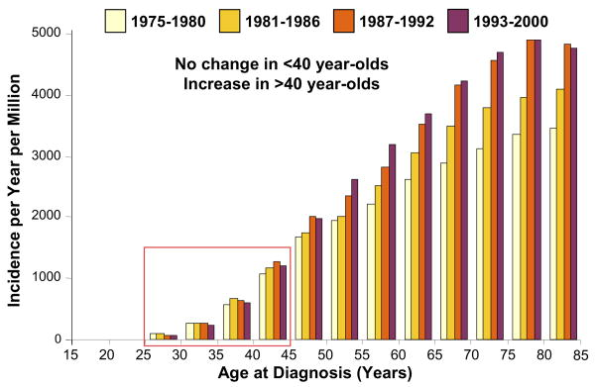
SEER Population-based breast cancer incidence rates, by age and timeline
From Anders et al, Semin Oncol 2009; 36:237-249

Slide 7
What is the breast cancer burden of this target audience and has it been increasing over time?
Answer: Incidence of breast cancer in young women is lower than that of older women and has been stable over past thirty years.

Slide 8
What are the race/ethnicity-associated variations in the breast cancer burden of young women?

Slide 9
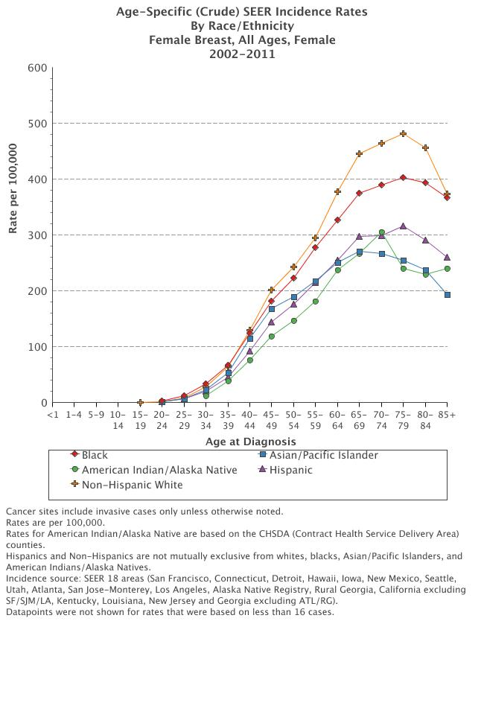

Slide 10
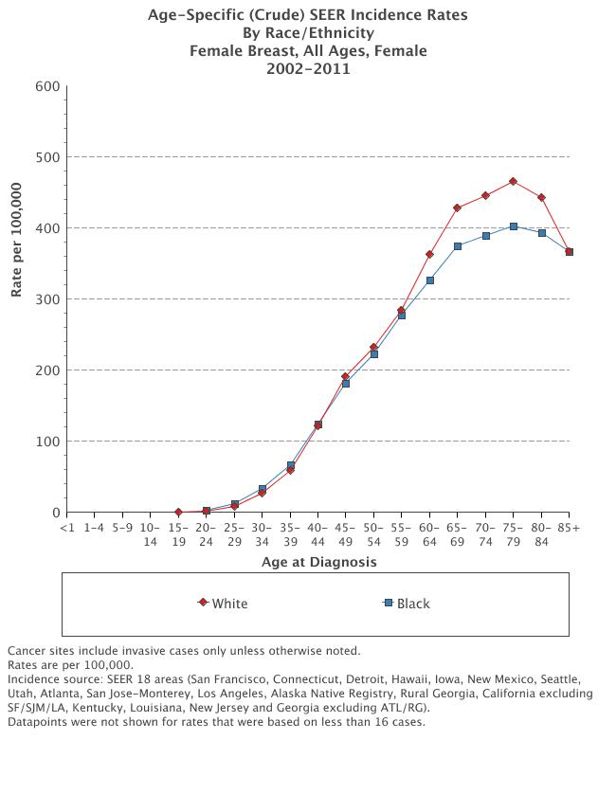

Slide 11
Breast Cancer in General Population of Young Women
Average age at breast cancer diagnosis
  White/Caucasians: 61 years
  African American: 57 years
Proportion of pts <50 years:
  1/5 WA; 1/3 AA
Population-based incidence rates by age
Age Range (yrs) | White American | African American
20-24 | 1.3 | 2.0
25-29 | 7.9 | 11.8
30-34 | 25.7 | 33.2
35-39 | 59.4 | 66.6
40-44 | 121.2 | 123.5

Slide 12
What are the race/ethnicity-associated variations in the breast cancer burden of young women?
Answer: Breast cancer incidence increases with age for ALL women, but among women younger than 45 years, incidence is higher for African American women

Slide 13
Are we seeing more young women with breast cancer?

Slide 14
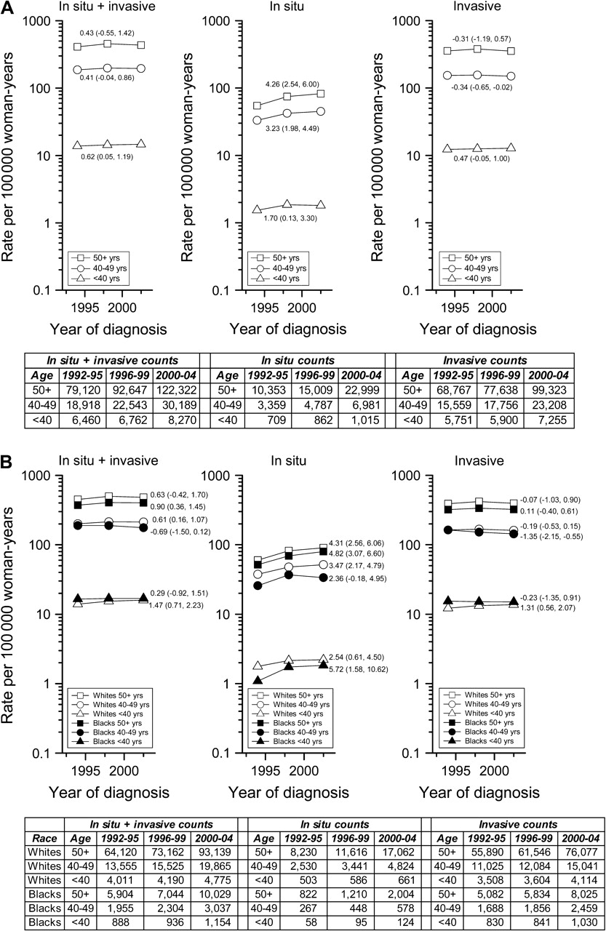

Are we seeing more
young women with breast cancer???
Annual percentage changes (APCs) for age-adjusted incidence rate trends and absolute numbers in the National Cancer Institute's Surveillance, Epidemiology, End Results Program 13-Registry database (1992–2004) for all breast cancers combined (in situ + invasive), in situ cancers only, and invasive cancers only
Brinton L A et al. JNCI J Natl Cancer Inst 2008;100:1643-1648
Notes:
Annual percentage changes (APCs) for age-adjusted incidence rate trends and absolute numbers in the National Cancer Institute's Surveillance, Epidemiology, End Results Program 13-Registry database (1992–2004) for all breast cancers combined (in situ + invasive), in situ cancers only, and invasive cancers only. A) APCs and absolute numbers by age (<40, 40–49, ≥50 years). B) APCs and absolute numbers by age (<40, 40–49, ≥50 years) and race (white, black). APCs are recorded with point estimates; 95% confidence intervals are in parentheses. Under the null hypothesis, non–statistically significant APCs indicate that the trend line for a given age group was no different than a horizontal or flat trend line with a slope of zero. Using Poisson regression models we also assessed whether trends varied by age group (A) or by race within age group, see text for details.

Slide 15
Notes:
Annual percentage changes (APCs) for age-adjusted incidence rate trends and absolute numbers in the National Cancer Institute's Surveillance, Epidemiology, End Results Program 13-Registry database (1992–2004) for all breast cancers combined (in situ + invasive), in situ cancers only, and invasive cancers only. A) APCs and absolute numbers by age (<40, 40–49, ≥50 years). B) APCs and absolute numbers by age (<40, 40–49, ≥50 years) and race (white, black). APCs are recorded with point estimates; 95% confidence intervals are in parentheses. Under the null hypothesis, non–statistically significant APCs indicate that the trend line for a given age group was no different than a horizontal or flat trend line with a slope of zero. Using Poisson regression models we also assessed whether trends varied by age group (A) or by race within age group, see text for details.

Slide 16
Notes:
Annual percentage changes (APCs) for age-adjusted incidence rate trends and absolute numbers in the National Cancer Institute's Surveillance, Epidemiology, End Results Program 13-Registry database (1992–2004) for all breast cancers combined (in situ + invasive), in situ cancers only, and invasive cancers only. A) APCs and absolute numbers by age (<40, 40–49, ≥50 years). B) APCs and absolute numbers by age (<40, 40–49, ≥50 years) and race (white, black). APCs are recorded with point estimates; 95% confidence intervals are in parentheses. Under the null hypothesis, non–statistically significant APCs indicate that the trend line for a given age group was no different than a horizontal or flat trend line with a slope of zero. Using Poisson regression models we also assessed whether trends varied by age group (A) or by race within age group, see text for details.

Slide 17
Are we seeing more young women with breast cancer?
Answer: we likely are seeing more young women with breast cancer because the size of the young female population has grown in the United States

Slide 18
Are breast cancers in young women associated with worse survival?
  What are the race/ethnicity-associated variations in survival among young breast cancer patients?

Slide 19
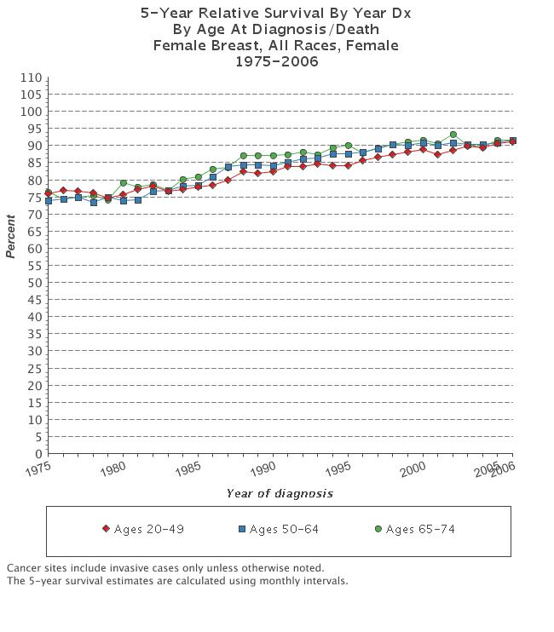

Slide 20
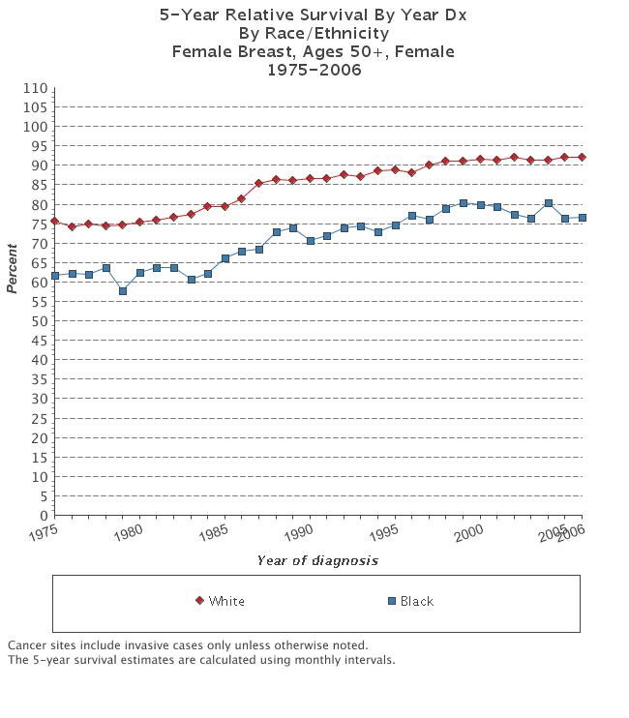

Slide 21
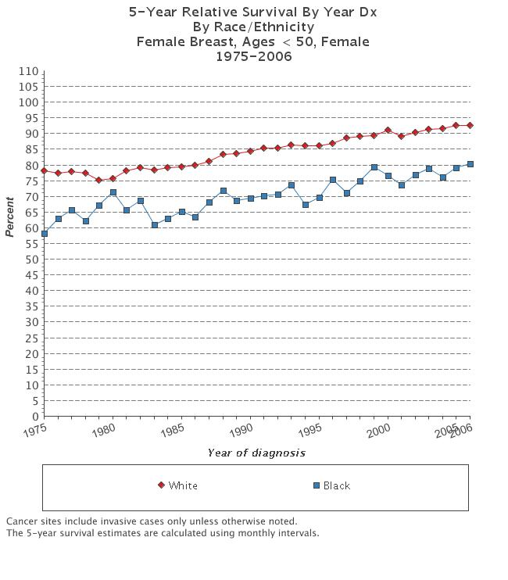

Slide 22
US Female Breast Cancer
Incidence & Mortality by Age and Race, 2002-2006
500.0
Incidence: White
400.0
Rate per 100,000
300.0
Incidence: African American
200.0
Mortality: African American
100.0
Mortality: White
0.0
25-29
30-34
35-39
40-44
45-49
50-54
55-59
60-64
65-69
70-74
75-79
80-84
85+
Age
Data sources: Incidence - North American Association of Central Cancer Registries, 2009. Mortality - National Center for Health Statistics, Centers for Disease
Control and Prevention, 2009.

Slide 23
Are breast cancers in young women associated with worse survival?
Answer: yes, but the survival rates have improved over time and age-related survival differences are decreasing
  What are the race/ethnicity-associated variations in survival among young breast cancer patients?
  Answer: Survival rates are worse for Afrcan American breast cancer patients at all ages

Slide 24
Other Relevant Patterns Related to Breast Cancer in the General Population of Young Women in the United States

Slide 25
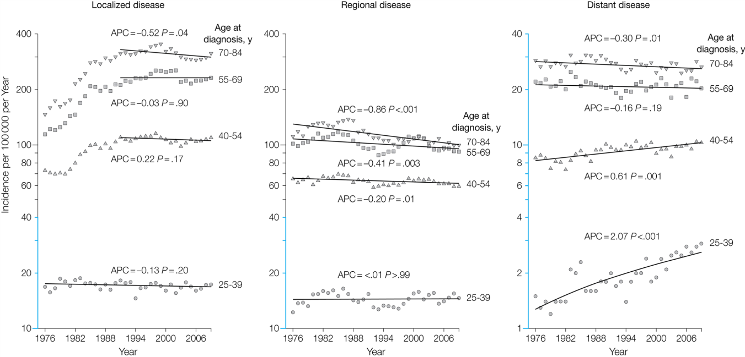
Increasing Incidence Rates of Young Breast CA Patients Diagnsosed with Stage 4 Disease
Johnson RH et al, JAMA 2013
  SEER Data, 1976-2009
  Incidence rates metastatic breast CA: women 25-39 yrs
    1976: 1.53 per 100,000
    2009: 2.90 per 100,000

Slide 26
Population-Based Incidence Rates of Triple Negative Breast Cancer, by Race/Ethnicity & Age
Population-based California Cancer Registry
(Amirikia et al, Cancer, 2011)

Slide 27
Message #1
Breast cancer is the most common malignancy diagnosed among women in the United States, and breast health awareness is therefore important for women of ALL ages
  Know: BRCA is a useful website for assessing individual breast cancer risk
  Women should be aware of genetic counseling services

Slide 28
Message #2
Breast cancer is relatively uncommon among the general population of women younger than 45 years in the United States.
  However it is slightly less uncommon among African American women younger than 45 years (compared to White American and Hispanic-Latina American and Asian American)

Slide 29
Enhancing Effectiveness of Message #2
For every 100,000 women in the United States between the ages of 20 and 44 years of age, about 50 are diagnosed with breast cancer each year, and about 5 will die from the disease.
In most cases, a woman’s greatest risk for developing breast cancer is her age: for example, in women ages 20 to 29 years, about 6 out of every 100,000 women develop breast cancer each year, compared with 46 women ages 30 to 39 years.
Being of African American race is also a risk factor for developing breast cancer at young ages.
  For every 100,000 women ages 20 to 44 years in the U.S., about 4 additional African American women develop breast cancer compared with white women.
  Risk of developing breast cancer increases with age for African American women as well as White American women

Slide 30
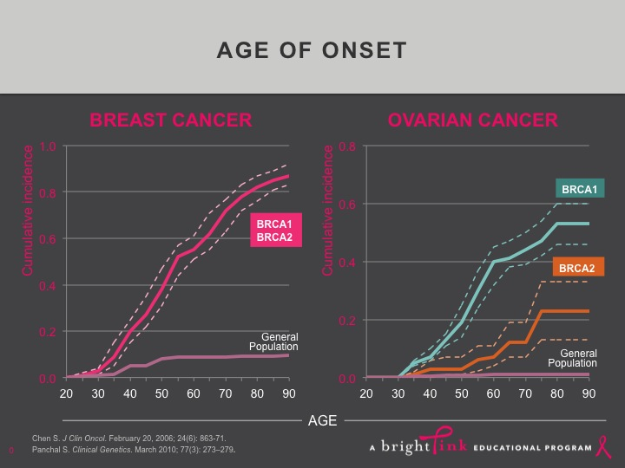

Slide 31
Age-Specific Probabilities of Developing Invasive Breast Cancer
 |  | The probability of
If current |  | developing breast cancer
age is…. |  | in the next 10 years is: |  |  |  |  |  |  |  | or 1 in:
20 |  |  | 0.06% |  |  |  |  |  |  | 1,760
30 |  |  | 0.44% |  |  |  |  |  |  | 229
40 |  |  | 1.44% |  |  |  |  |  |  | 69
50 |  |  | 2.39% |  |  |  |  |  |  | 42
60 |  |  | 3.40% |  |  |  |  |  |  | 29
70 |  |  | 3.73% |  |  |  |  |  |  | 27
Lifetime risk |  |  | 12.08% |  |  |  |  |  |  | 8

Slide 32
Message #3
Young women need to be aware of their individual risk profile and whether that profile suggests a breast cancer risk that is higher than that of the general population of young women.
  Family history of cancer and ancestral background
    Ashkenazi; African heritage
  Prior biopsy results that may have indicated increased risk (atypia; lobular carcinoma in situ)
  Prior chest wall radiation exposure that increases risk: possible consideration of intensified breast cancer screening

Slide 33
Message #4
Young women need to know that even though breast cancer is uncommon in the general population of American women younger than 45 years, that it CAN happen, and the signs may be subtle.
  Young women should therefore be aware of clinically-significant danger signs of breast cancer (bloody nipple discharge; new lump; patches of nipple-areolar skin that appear scaly/ eczematoid; new, persistent rash or inflamed breast skin)
  Young women undergoing mammographic screening should know that mammograms have an increased false negative rate for women younger than 50 years, and they should seek medical attention if a danger sign appears, regardless of most recent mammogram result

Slide 34
Message #5
Young women should know that there are several actions they can take to reduce their future risk of developing breast cancer:
  Breastfeeding. Any amount of breastfeeding is beneficial. The best level of protection comes from breastfeeding 12 months or more (across one or more pregnancies).
  Reduce alcohol intake. Drinking alcohol increases the risk of breast cancer, and the risk increases as the amount of alcohol consumed increases.
  Regular exercise. Exercising four or more hours per week may lower the risk of breast cancer, especially for women of normal or low body weight.

Slide 35
Enhancing Effectiveness of Message #5
Provide information regarding specific BMI goals and healthy body weights
Provide references

Slide 36
Message #6:
Areas for Additional Research
Impact of poverty/socioeconomic factors on breast cancer risk
Breast cancer risk among sexual and gender minority (lesbian/bisexual/transgender) populations
Access to risk counseling services
Improved/more efficient methods of detecting breast cancer and reducing its mortality among young women
  Primary and secondary prevention strategies

Slide 37
Message #7: Screening Mammography
Varying opinions within work group regarding role of the CDC ACBCYW
To be discussed further at CDC ACBCYW full committee meeting
Consensus:
  Women should discuss screening mammography with their physicians
  Workgroup on Provider Messages should be involved with this conversation

Slide 38
Message #7
Young women should know that routine screening mammography is associated with a range/spectrum of benefits that varies by age, with mammography becoming increasingly valuable as we get older.
The ACBCYW recognizes that many factors may impact on a woman’s decision to initiate mammographic screening at age 40 versus age 50, and that clinicians/health care providers also vary in their recommendations regarding the age at which routine mammography should be initiated.
For discussion: Should our Advisory Committee address the existing CDC position on screening mammography?

Slide 39
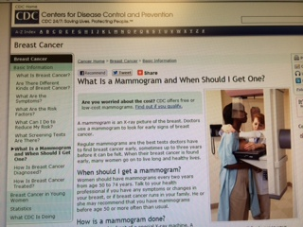
When should I get a mammogram?
Women should have mammograms every two years from age 50 to 74 years.

Slide 40
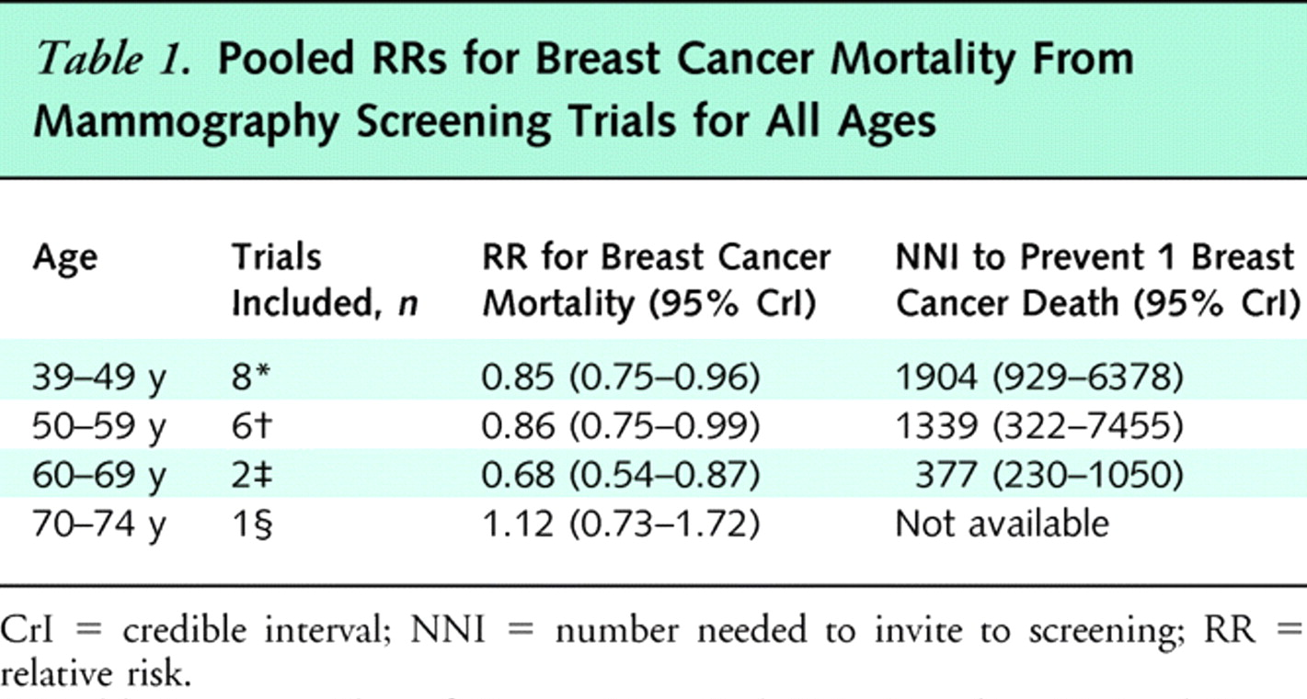
Meta analysis of invitation Screening RCT (USPSTF, includes Canadian )
Nelson H D et al. Ann Intern Med 2009;151:727-737
©2009 by American College of Physicians
Notes:
Pooled RRs for Breast Cancer Mortality From Mammography Screening Trials for All Ages

Slide 41
All RCTs of Screening Mammography
RandomizedTrial | Relative Risk | 95% Confidence Interval
HIP of NY | 0.79 | 0.61 – 0.97
Malmo | 0.81 | 0.62 - 1.07
Sw. 2 County | 0.68 | 0.59 - 0.80
Gothenburg | 0.86 | 0.54 - 1.37
Stockholm | 0.71 | 0.40 - 1.20
Edinburgh | 0.71 | 0.53 - 0.95
CNBSS-1 CNBSS-2 | 0.97 1.02 | 0.74 - 1.27 0.78 - 1.33
Age (GB) | 0.83 | 0.66 -1.04
All Trials 0.80 0.73 – 0.86

Slide 42
Pan-Canadian Screening Mammography
JNCI, October, 2014
85% of Canadian population
Breast cancer diagnoses and deaths, 1990-2009
2,796,472 screening participants analyzed

Slide 43
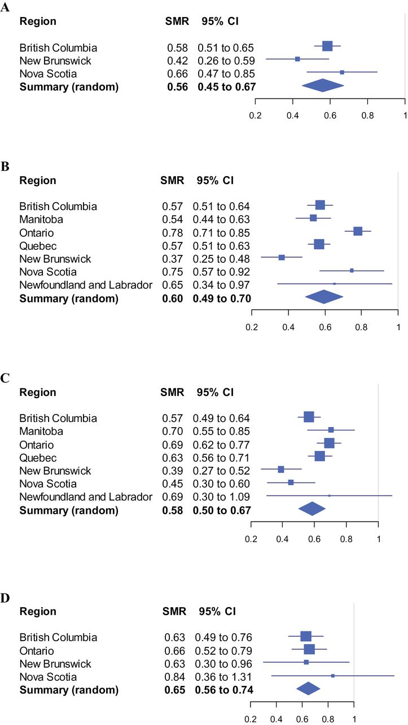
Forest plot of standardized mortality ratios (SMRs) by province for ages at entry: 40 to 49 years (A), 50 to 59 years (B), 60 to 69 years (C), and 70 to 79 years (D).
Coldman A et al. JNCI J Natl Cancer Inst 2014;106:dju261
© The Author 2014. Published by Oxford University Press. All rights reserved. For Permissions, please e-mail: journals.permissions@oup.com.
Notes:
Forest plot of standardized mortality ratios (SMRs) by province for ages at entry: 40 to 49 years (A), 50 to 59 years (B), 60 to 69 years (C), and 70 to 79 years (D). Summary estimates are based upon random effects models. All statistical tests were two-sided. CI = confidence interval; SMR = standardized mortality ratio.

Slide 44
Organizations and Societies Recommending Screening Mammography Beginning at Age 50 Years
American Academy of Family Physicians
American College of Physicians (qualified endorsement; defers to USPSTF screening guidelines)
Centers for Disease Control
United States Preventive Services Task Force (convened by the Agency for Healthcare Research and Quality)

Slide 45
Organizations and Societies Recommending Screening Mammography Beginning at Age 40 Years
American Medical Association
American Cancer Society
American College of Radiology
American College of Surgeons
American College of Obstetricians and Gynecologists
American Society of Breast Diseases
National Cancer Institute (qualified endorsement; not a guidelines organization)
National Comprehensive Cancer Network

Slide 46
International Mammography Screening Programs and Recommendations
Country/ Program | Mammography Screening (age)
Canada | 50
Czech Republic | 45
Denmark | 50
European Union | 50
Hungary | 45
Italy | 50
Netherlands | 50
Norway | 50
Portugal | 45
Spain | 45; 50 (regional variation)
Sweden | 40
United Kingdom | 47
Questionable relevance of international guidelines and practices to female population in the USA:
-different demographics with respect to age; racial/ethnic diversity; and disparities issues

Slide 47

MENU
The White House
Office of the Press Secretary
For Immediate Release
October 01, 2010
Presidential Proclamation--National Breast Cancer Awareness Month
While considerable progress has been made in the fight against breast cancer, it remains the most frequently diagnosed type of non skin cancer and the second leading cause of cancer deaths among women in our country. This year alone, over 200,000 Americans will be diagnosed and nearly 40,000 lives will be
In order to detect breast cancer early, we must ensure all women can access these important screenings. The Affordable Care Act, which I was proud to sign into law earlier this year, requires all new health insurance policies to cover recommended preventive services without any additional cost, including annual mammography screenings for women over age 40. The Affordable Care Act will also ensure that people who have been diagnosed with breast cancer cannot be excluded from coverage for a pre-existing condition or charged higher premiums.

Slide 48
To Be Discussed:Message #7 and
Individualized Screening Recommendation
Current CDC position:
  Endorses screening beginning at age 50 years
  Patients encouraged to discuss with their physician whether or not to “opt-in” for screening prior to age 50.
Alternative position:
  Endorse screening beginning at age 40 years
  Encourage patients to discuss with their physician whether or not to “opt-out” of screening until reaching age 50.

Slide 49
Diverse Opinions Expressed by
Work-Group Members
Opinions favoring initiation of screening mammography at age 50 years
Opinions favoring initiation of screening mammography at age 40 years
Opinions that our Advisory Committee should not address an existing CDC position that is unlikely to be changed
Opinions that our Advisory Committee should not address the screening mammography debate without conducting its own evidence-based review
  Acknowledging, we are not resourced for such an effort

Slide 50
ACBCYW and
Screening Mammography
Can the Advisory Committee to the CDC on Breast Cancer in Young Women endorse/support an IOM report to review the screening mammography evidence?

Slide 51
Rationale for a Re-look at the Evidence: Issues that have received less attention in existing reviews
Disparities in breast cancer incidence and mortality in the United States
  Although risk of breast cancer increases with age in all women, young African American women face a higher likelihood of being diagnosed with breast cancer compared to young White Americans, and they face an increased likelihood of being diagnosed with biologically-aggressive tumors.
  Breast cancer mortality disparities exist between African American and White Americans in all age categories
  Screening and early-detection of biologically-aggressive patterns of breast cancers is effective, and the impact of screening on breast cancer disparities in young women should be addressed.

Slide 52
Rationale for a Re-look at the Evidence: Issues that have received less attention in existing reviews
Absolute numbers of young women in the United States
  Population-based breast cancer incidence is lower for young women compared to older women, and screening mammography in young women therefore has a lower proportional yield.
  However, the absolute volume/number of young women in the United States has increased substantially over the past several decades, and the absolute volume/number of young breast cancer patients is rising.
  The impact of screening mammography in young women should address population changes and the absolute magnitude/numbers of women affected

Slide 53
Rationale for a Re-look at the Evidence: Issues that have received less attention in existing reviews
More Stage 4 breast cancers in young women
  Population-based data reveal rising rates of young breast cancer patients diagnosed metastatic disease
  Future studies should address the potential impact of screening mammography on efforts to reverse this trend

Slide 54
Many Thanks to the
Work Group Members!!!!!
Lindsay Avner
Ulrike Boehmer
Otis Brawley
Jennifer Croswell
Carli Feinstein
Sue Friedman
Susan Kutner
Jung-Min Lee
Jennifer Merschdorf
Ann Partridge
Jeanne Steiner
Rochelle Shoretz
Sarah Storey
Marisa Weiss

