Slide 1
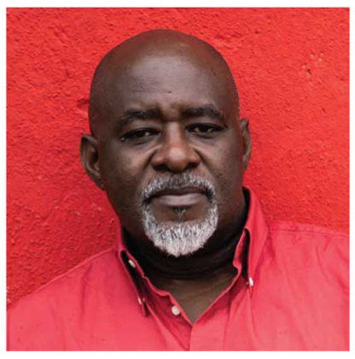
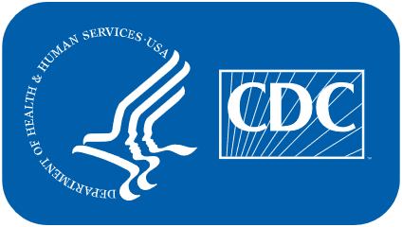
Surgeon General’s Call to Action to Control Hypertension
Event details
* This presentation includes speaker notes.
High blood pressure control is possible.
Notes:
Welcome and introductions
Good day. I am pleased to speak with you today about the Surgeon General’s release of the Call to Action to Control Hypertension.

Slide 2
The Surgeon General’s Call to Action to Control Hypertension
Summarizes recent hypertension control data
Focuses on adults who already have hypertension
Outlines goals and identifies strategies to achieve control
Goal 1. Make hypertension control a national priority.
Goal 2. Ensure that the places where people live, learn, work, and play support hypertension control.
Goal 3. Optimize patient care for hypertension.
Notes:
Today, I will be giving a brief overview of the Call to Action to Control Hypertension; key messages we want to promote; ways you, our partners, can help support and promote this work; and our vision for the rollout.
The Surgeon General’s Call to Action to Control Hypertension summarizes recent data on hypertension control for all populations, identifies the top 10 strategies for achieving control, and provides recommendations for improving control.
The Call to Action consists of a suite of materials including a main document, executive summary, sector guides for specific audiences, and partner and social media outreach tools.
The Call to Action is anchored in 3 primary goals:
Goal 1. Make hypertension control a national priority.
Goal 2. Ensure that the places where people live, learn, work, and play support hypertension control. AND
Goal 3. Optimize patient care for hypertension.

Slide 3
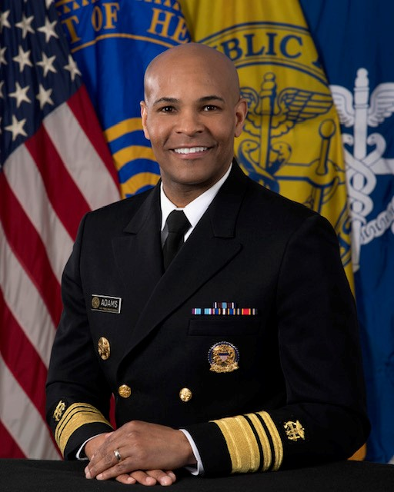
A Note from the U.S. Surgeon General
“The Surgeon General’s Call to Action…provides a roadmap for helping individuals, communities, health professionals, and others improve the heart health of our nation. [We can] reduce health disparities that persist by working together to eliminate differences in access to quality health care and addressing social factors that influence overall health.”
VADM Jerome M. Adams, M.D., M.P.H.
U.S. Surgeon General
Notes:
The current U.S. Surgeon General, VADM Jerome Adams summarized the Call to Action in this way: It “provides a roadmap for helping individuals, communities, health professionals, and others improve the heart health of our nation. [We can] reduce health disparities that persist by working together to eliminate differences in access to quality health care and addressing social factors that influence overall health.”

Slide 4
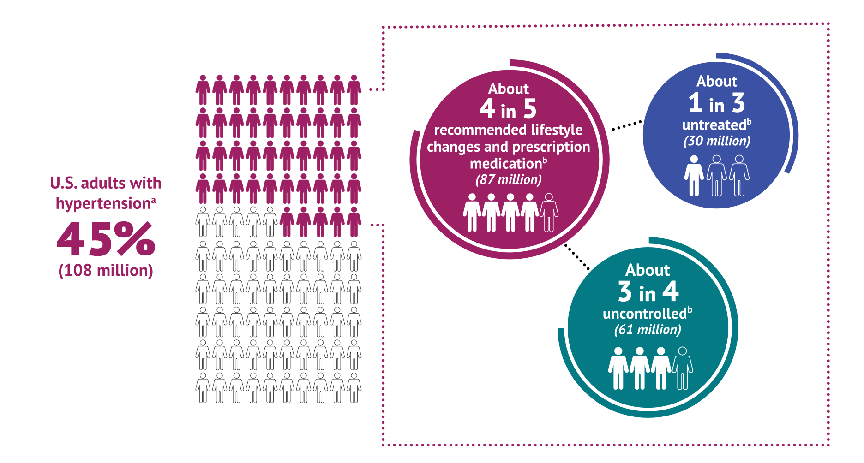
Key Messages
Hypertension control is possible.
Hypertension is common; control is not; together, we can change that.
Progress has stalled and disparities persist.
We know what works to control hypertension; we must tailor, replicate, and scale those interventions.
Partners are critical to achieving hypertension control among all Americans.
Figure 1. Prevalence, Control Status, and Treatment of Hypertension Among U.S. Adults, National Health and Nutrition Examination Survey, 2013–2016
ª Based on the American College of Cardiology and American Heart Association’s 2017 Hypertension Clinical Practice guideline for adults aged 18 years or older who have blood pressure ≥130/80 mmHg or who are currently using prescription medication to lower their blood pressure.
^{b} Among those recommended to take prescription medication and make lifestyle changes.
Notes:
Key messages
As you know, hypertension is very common. However, hypertension control is not.
Although significant gains have been achieved, our nation’s progress in hypertension control has stalled.
Between 1999 and 2010, national hypertension control rates increased, but little progress has occurred in the past 10 years, and control rates have actually declined in recent years.
Nearly 1 in 2 adults have hypertension, yet only about 1 in 4 have it under control to <130/80 mm Hg, which equates to over 82 million adult Americans with uncontrolled hypertension.
If left uncontrolled, hypertension can increase a person’s risk for heart disease, stroke, heart failure, kidney disease, pregnancy complications, and cognitive decline later in life.
We know that there are certain groups that are affected more than others by hypertension. It is important that we acknowledge these differences and work to address the factors that impact hypertension risk and hypertension control among these groups.
African Americans in particular, have a higher hypertension prevalence than any other race or ethnic groups.
They also develop hypertension at younger ages and have more severe outcomes than whites.
Hypertension prevalence (based on blood pressure ≥130/80 mm Hg) for non-Hispanic black adults is 54% compared to 46% for non-Hispanic white adults.
The Surgeon General’s Call to Action identifies some of the factors that negatively affect hypertension control in minority populations, including inequalities in the distribution of social, economic, and environmental conditions needed for health, as well as racial discrimination, racism, and external stressors that have been shown to increase the risk of hypertension.
Other psychosocial and socioeconomic stressors (including low SES, depression, job stress, financial stress, segregated neighborhoods, and neighborhood level), also play a role in the risk of hypertension among African Americans.
Despite these challenges, hypertension control is still possible. We know what works to control hypertension, and we need to tailor, replicate, and take these strategies to scale.
Our partners are critical to achieving hypertension control among all Americans.
The high burden of hypertension requires the federal government to expand our partnerships across public and private sectors to maximize our collective influence.

Slide 5
Main Call to Action Document
Section 1: Evidence and the Need for Action
Summarizes the current state of hypertension control
Includes effective solutions, barriers, and broad factors that influence burden and control
Section 2: Goals and Strategies: The Call to Action
Summarizes 3 goals and 10 associated strategies to improve hypertension control
Strategies intended to promote awareness and effective interventions
Section 3: Sector-Specific Actions
Acknowledges the need for diverse sectors (i.e., partners) to improve control
Linked with Sector Guides
Notes:
The main Call to Action document is divided into 3 sections.
One section focusing on the current state of hypertension control, providing evidence and the importance of taking action right now.
The second section, highlighting the three overall goals and 10 strategies needed to improve control; and
The last section, providing sector-specific recommendations and resources that partners can use to implement the strategies.

Slide 6
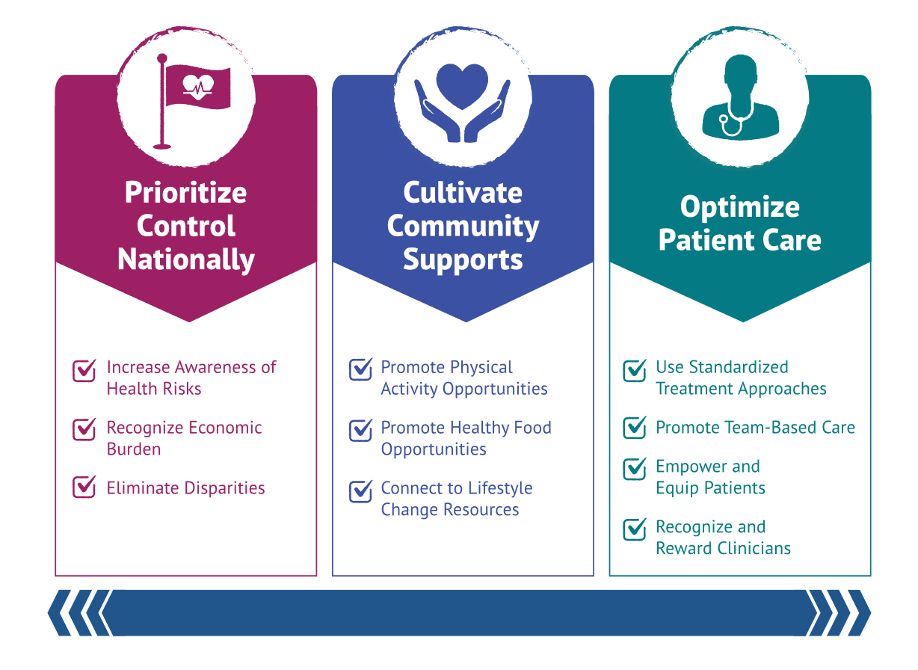
Goals and Strategies to Improve Hypertension Control
Promoting Health Equity
Notes:
This is the core of the Call to Action. There are three Goals and 10 associated strategies to accelerate progress meeting these goals.
These include:
Goal 1: Ensuring that hypertension control is a national priority (or, Prioritize Control Nationally)
Strategies include increasing awareness of the risks of uncontrolled hypertension, highlighting the economic costs, and working to eliminate disparities in treatment and control.
2) Goal 2: Ensuring that the places where people live, learn, work, and play support hypertension control (or, Cultivate Community Supports)
Strategies include promoting access to and availability of physical activity opportunities within communities, healthy food options within communities, and links between clinical services and community programs.
3) Goal 3: Optimizing patient care for hypertension control (or, Optimize Patient Care)
Strategies include advancing the use of standardized treatment approaches and guideline-recommended care, promoting the use of health care teams to manage hypertension, empowering and equipping patients to use self-measured blood pressure monitoring and medication adherence strategies, and recognizing and rewarding clinicians and health systems that excel in hypertension control.
Hypertension control is influenced by multiple factors, yet improvements in hypertension control can support broad health improvements — including the promotion of health equity.

Slide 7
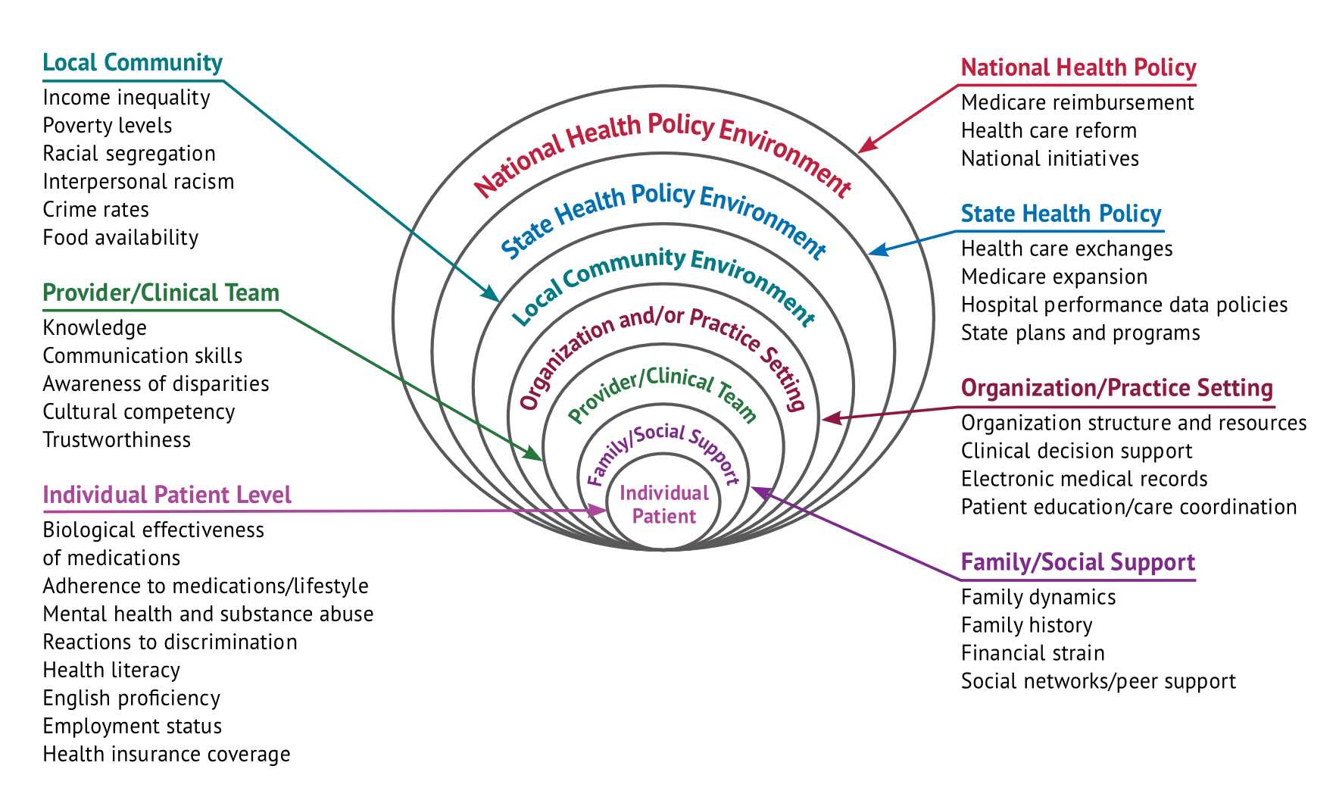
Many Factors Influence Hypertension Control
Figure 4. Multilevel Influences on Disparities in Hypertension Prevention and Control
Notes:
The main CTA document talks about the many factors that impact hypertension control.
Addressing these factors adequately will require a broad array of partnerships and diverse strategies that are adaptable and culturally appropriate.
For example, there are community level factors like poverty, crime, and healthy food availability, and clinician-level factors like cultural competency, perceived trustworthiness, and communication skills.
There are also individual patient-level factors such as health insurance status, reaction to discrimination, and mental health or substance abuse.
There are many interventions we can take to address these social determinants of health that will help individuals in our communities better manage and improve their blood pressure.
We must work together to eliminate differences in access to quality health care and address social factors that influence overall health.
This can be accomplished by clinicians and public health practitioners by offering culturally competent care, eliminating implicit biases, addressing patients’ psychosocial stressors, dispelling cultural myths, implementing multi-level culturally tailored interventions and policies, and promoting health literacy in patients.

Slide 8
Partnerships Central to Improving Control
Identifies specific partners to promote hypertension control
Highlights the many partners needed to improve hypertension control
Sector Guides:
Recommended Actions
Resources
Notes:
The Call to Action’s sector guides further highlight the multidisciplinary partners needed to improve hypertension control and provide tailored recommended actions that partners can implement with curated resources and tools to aid implementation.

Slide 9
Actions You Can Take
Put validated and calibrated automated blood pressure monitors with the correct-size cuffs in all exam rooms.
Provide regular training on how to measure and document blood pressure accurately.
Implement protocols to standardize patient care.
Include high blood pressure control in your quality improvement efforts.
Use data from clinician dashboards and patient registries to highlight gaps in care.
Ensure that the interventions you use are culturally and linguistically appropriate to the communities you serve.
Recognize and reward clinical teams that achieve high levels of success in high blood pressure control.
Selected Resources
American Heart Association: The Importance of Measuring Blood Pressure Accurately Webinar
Target: BP: In-Office Measuring Blood Pressure Infographic
Million Hearts®:
Hypertension Treatment Protocols
Hypertension Control Change Package
Notes:
This slide is an example of one of the Sector Guides, which were developed to provide specific recommendations and resources for partners. Eleven of these are available for a variety of partners, recognizing the need for diverse partnership to improve hypertension control. They are available for use on the Call to Action website.
Health Care Practices, Health Centers and Health Systems
How You Can Help
Clinical settings are the place where most people with high blood pressure are diagnosed. To help improve high blood pressure control in the United States, your health care practice, health center, or health system can commit to delivering patient care services in ways that have been proven to work. For example, you can use multidisciplinary care teams to ensure comprehensive care, as well as protocols to standardize patient care. You can also use high-quality data to track and encourage high performance among your health care professionals.
Listed on this slide are key actions you can take to improve hypertension control and selected resources that can support those actions.
Website addresses of nonfederal organizations are provided solely as a service to our readers. Provision of an address does not constitute an endorsement by the U.S. Department of Health and Human Services (HHS) or the federal government, and none should be inferred.

Slide 10
Working Together to Improve Hypertension Control
Resources to accelerate change
Sector-specific actions
Partner Toolkit
Download, share, and use the Call to Action report and resources to leverage and extend the work of improving hypertension control among those you serve.
Learn more at www.cdc.gov/hypertensionCTA.
Notes:
Numerous resources were developed to support the translation of the main Call to Action document to diverse audiences. These resources are available for review and distribution on the CDC’s Call to Action website, www.cdc.gov/hypertensionCTA. This site will also be used as additional resources are developed in the coming weeks and months.

Slide 11
For additional information: www.cdc.gov/hypertensionCTA
Notes:
Thank you for your attention.
For more information about the Call to Action and related resources, visit: www.cdc.gov/hypertensionCTA.

Slide 12
Optional Slides

Slide 13
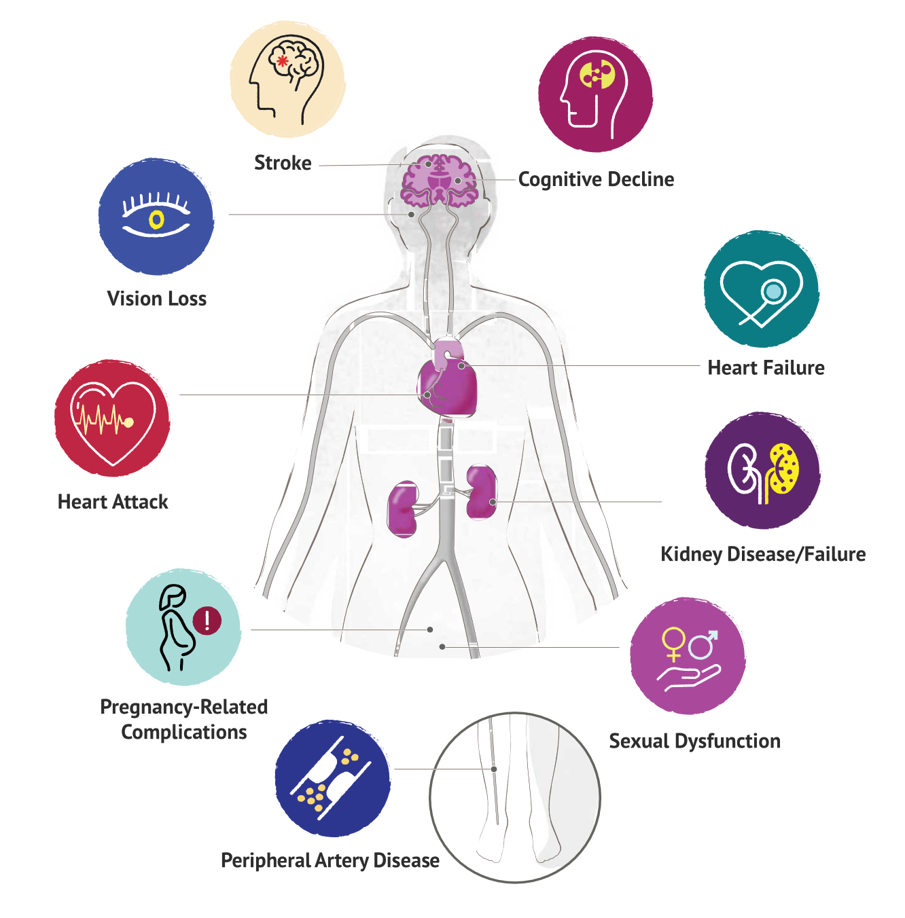
Health Problems Caused by Uncontrolled Hypertension
Figure 2. Health Problems Caused by Hypertension
Notes:
Hypertension has been called a “silent killer” because it generally has no noticeable signs or symptoms.
Without awareness and action, uncontrolled hypertension can damage many body systems and organs, including the heart, brain, kidneys, and eyes, and it can lead to a wide range of complications.
Awareness of the association between hypertension and negative health outcomes is generally higher for cardiovascular events such as heart attack, heart failure, and stroke than for conditions such as kidney disease, blindness, or cognitive decline.

Slide 14
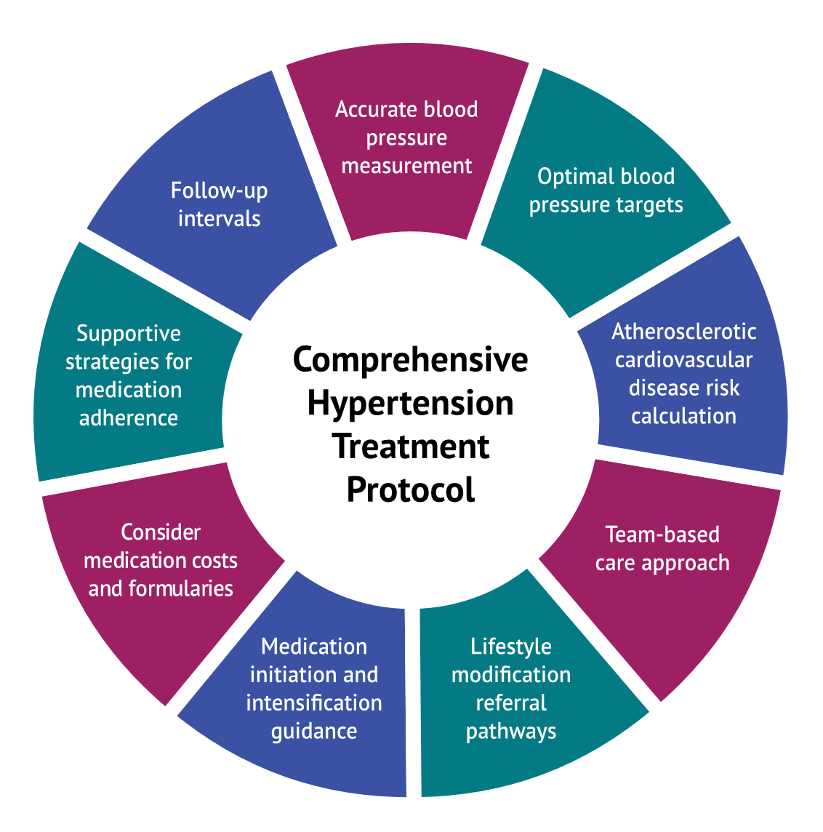
Essential Components of a Treatment Protocol
Figure 5. Characteristics of a Comprehensive Treatment Protocol for Hypertension Management
Notes:
Utilization of a standardized treatment protocol has been demonstrated to improve hypertension control. Essential components of a treatment protocol include accurate blood pressure measurement, optimal blood pressure targets, atherosclerotic cardiovascular disease (ASCVD) risk calculation, team-based care, lifestyle modification referral pathways, medication initiation and intensification guidance, use of low-cost medications aligned with formularies, supportive medication adherence strategies, and pre-set follow-up intervals.

Slide 15
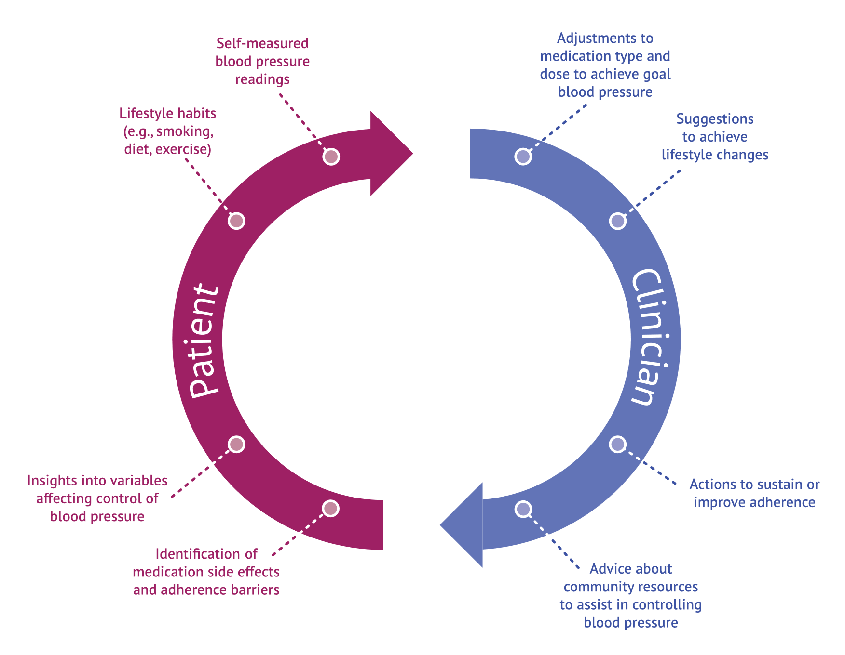
Self-Measured Blood Pressure Monitoring
Figure 6. Feedback Loop Supporting Effective Use of Self-Measured Blood Pressure Monitoring
Notes:
Self-Measured Blood Pressure (SMBP) is effective in managing hypertension. Use of SMBP outside of the clinical setting should include a feedback loop between the patient and clinician. Ideally, blood pressure measurement data would be electronically transmitted from the patient to the clinician.

Slide 16
Sources
Figure 1: Centers for Disease Control and Prevention (CDC). Hypertension Cascade: Hypertension Prevalence, Treatment and Control Estimates Among US Adults Aged 18 Years and Older Applying the Criteria From the American College of Cardiology and American Heart Association’s 2017 Hypertension Guideline—NHANES 2013– 2016. Atlanta, GA: US Department of Health and Human Services; 2019.
Top 10 Strategies: Adapted from the U.S. Department of Health and Human Services. The Surgeon General’s Call to Action to Control Hypertension. Washington, DC: U.S. Dept. of Health and Human Services, Office of the Surgeon General; 2020.
Figure 4: Mueller M, Purnell TS, Mensah GA, Cooper LA. Reducing racial and ethnic disparities in hypertension prevention and control: what will it take to translate research into practice and policy? Am J Hypertens. 2015;28(6):699–704.
Figure 2:
Whelton PK, Carey RM, Aronow WS, et al. 2017 ACC/AHA/AAPA/ABC/ACPM/AGS/APhA/ASH/ASPC/NMA/PCNA Guideline for the Prevention, Detection, Evaluation, and Management of High Blood Pressure in Adults: Executive Summary: A Report of the American College of Cardiology/American Heart Association Task Force on Clinical Practice Guidelines. Hypertension. 2018;71(6):1269-1324.
Virani SS, Alonso A, Benjamin EJ, et al. Heart Disease and Stroke Statistics—2020 Update: A Report From the American Heart Association. Circulation. 2020;141(9):e139-e596.
Wang, X., Huang, W. & Zhang, Y. Relation between hypertension and erectile dysfunction: a meta-analysis of cross-section studies. Int J Impot Res. 2018;30(3):141-146.
Bhargava, M., Ikram, M. & Wong, T. How does hypertension affect your eyes? J Hum Hypertens. 2012;26(2):71-83.
Figure 5: Figure adapted from Centers for Disease Control and Prevention. Hypertension Control Change Package. 2nd ed. Atlanta, GA: Centers for Disease Control and Prevention, U.S. Dept of Health and Human Services; 2020.
Figure 6: Centers for Disease Control and Prevention. Self-Measured Blood Pressure Monitoring: Actions Steps for Clinicians.

