Slide 1
Describing Your Program and Choosing an Evaluation Focus
Thomas J. Chapel, MA, MBA
Chief Performance Officer (Acting)
CDC/Office of the Director/OCOO
Presented December 17, 2008
Tchapel@cdc.gov
404-498-6073
Notes:
Tom is the Acting Chief Performance Officer at the Centers for Disease Control and Prevention. In that role he oversees the design and implementation of monitoring and evaluation systems CDC wide and for CDC’s many programs and initiatives. Prior to that he served as an Internal Expert Consultant in Technical Resource on Program Evaluation and Strategic Planning for CDC’s programs and partners conducting numerous trainings, workshops and individual consultations on planning and evaluation. Tom is well-known and a frequent national presenter and author on these topics. He’s active nationally in the discipline of program evaluation serving as a convener for the American Evaluation Association’s Local Affiliate Collaborative and Coordinator of their Summer Evaluation Institute. Tom received his B.A. from John Hopkins in Baltimore and his M.A. and M.B.A. from the University of Minnesota. Many of us have learned a great deal of program evaluation from Tom and I’m delighted that he’s our presenter today. Tom?
Great. Thanks Lani, I appreciate it.
Some folks may remember me. I did the introductory module for those who have been coming to all these modules. And certain things we’ll do today will take off on information presented by some other folks in Module One.
So next slide please.

Slide 2
Today’s Agenda
Why a clear program description is important to evaluation.
Logic models as one of several ways to describe a program.
Logic models as a visual tool.
How to use logic models to describe a program.
Notes:
Today’s focus is less about evaluation and more about what we call program description, which is an early step in utilization-focused evaluation. We’re going to try and show you, using logic models as an example, how important good program description is to move forward on anything--whether it’s evaluation, performance measurement, or strategic planning. Today we’re going to focus primarily on how clear program description is helpful for evaluation.
All right, next slide.

Slide 3
CDC Framework for Program Evaluation
STEPS
The CDC Framework Model is a utilization focused framework.
Engage stakeholders
Ensure use and share lessons learned
Describe the program
Standards
Utility
Feasibility
Propriety
Accuracy
Focus the evaluation design
Justify conclusions
Gather credible evidence
Notes:
Real quickly just to kind of set up where we are in this general sequence, we’re using as an organizing principle for these sessions the six-step CDC Program Evaluation Framework. And there’s nothing magical about it. It’s one of many what we call utilization-focused frameworks out there. And it picks up on the major points of utilization-focused evaluation…

Slide 4
The Goal: Step 6
STEP 1
The goal of good evaluation is to produce results that will be used.
Engage stakeholders
Ensure use and share lessons learned
Ensure use and share lessons learned
Describe the program
Standards
Utility
Feasibility
Propriety
Accuracy
Focus the evaluation design
Justify conclusions
Gather credible evidence
Notes:
which is that the goal of good evaluation is to get all the way around that circle to ensuring use and sharing lessons learned.

Slide 5
Evaluation Focus (Step 3)
STEP 1
Good focus produces information that will be useful.
How do you get good focus?
Engage stakeholders
Ensure use and share lessons learned
Describe the program
Standards
Utility
Feasibility
Propriety
Accuracy
Focus the evaluation design
Justify conclusions
Focus the evaluation design
Gather credible evidence
Notes:
And what we’ve learned probably the hard way is that the way to do that is to make sure that you have a very strong evaluation focus down in that third step.

Slide 6
Begin with the Stakeholders (Step 1)
STEP 1
As presented in last webinar, the first key to good focus is:
Identify and engage the stakeholders.
Be attentive to what the stakeholders need from the evaluation.
Engage stakeholders
Engage stakeholders
Ensure use and share lessons learned
Describe the program
Standards
Utility
Feasibility
Propriety
Accuracy
Focus the evaluation design
Justify conclusions
Gather credible evidence
Notes:
So we start off with engaging stakeholders, describing the program. That culminates in setting a really strong evaluation focus, what we call making sure that the questions we ask are the ones that matter most to the people that matter most.

Slide 7
Describe the Program (Step 2)
STEP 1
Equally important to good evaluation focus is a clear and agreed-upon description of the program.
Engage stakeholders
Ensure use and share lessons learned
Describe the program
Describe the program
Standards
Utility
Feasibility
Propriety
Accuracy
Describing the Program
is the topic of
today’s presentation.
Focus the evaluation design
Justify conclusions
Gather credible evidence
Notes:
And fundamental to getting those - that good focus are these early steps of engaging stakeholders, which we dealt with on the last module and today’s module “Describing the Program”.
Okay, next slide.

Slide 8
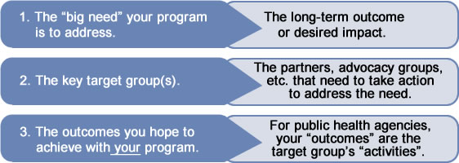
Elements of Program Description
A good program description requires clarity and consensus on:
Notes:
Whether you use a logic model or not, the elements you’re trying to walk out of this step with are clarity and consensus. Clarity at least and preferably consensus with you and stakeholders on these five elements, these six elements actually of your program.
First off, what’s the big need your program is trying to address? What’s that kind of big impact or outcome you’re looking to make a contribution to? A lot of programs resist putting this down for fear that writing it means they’re accountable for it. And when we turn to setting an evaluation focus we’ll see how describing the program and its aspirations clearly is different from deciding what part of that program you want to necessarily evaluate. So on the far right of a logic model or the most - the distant thing in your program description is this idea of what’s the big problem I’m trying to make a contribution to, understanding my efforts are necessary probably but not sufficient to accomplish that.
The next two bullets are sort of the heart of program description and that is, it’s very rare for what we do in the federal government and probably even state government to make a direct impact on that big need. Almost always what we do is trying to move some group or groups or organizations or individuals to take some sort of action we can name. So we call those folks target groups or targeted groups or priority groups whatever term you want to use. And we call the thing we’re trying to induce them to do an outcome, right, so the actions we want a voluntary actor who’s not us to take, right.

Slide 9
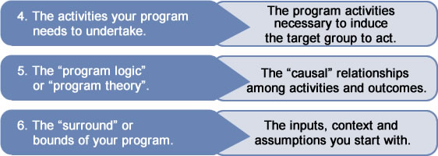
Elements of Program Description
A good program description requires clarity and consensus on:
Notes:
The fourth element you want to know in your program description is what is it you as a program bring to the puzzle. So what is it you’re going to do day in and day out that you hope will move some or all those groups to take some or all of those actions we call outcomes, right. Now these four bullets probably can happen in narrative or just in a bullet point outline. They don’t necessarily benefit from, from having a logic model and having all those boxes and arrows.
It’s that next bullet where I think the schematic is helpful. And we call that establishing what we call your program logic or your program theory. And these are the causal relationships between activities and outcomes. It’s very important. We’re not saying “cause” in the way we use “cause” in science. If we’ve got that kind of evidence base then awesome, it’s wonderful to be able to draw in arrows that represent what the evidence base tells us the cause is. Rather we think of "causal" in quotes. I’m doing my program. I’m hoping to move these groups to take these actions so I can make an impact on this downstream big need. Why do I think any of this is going to work? Put emphasis on why do I think or why do I speculate any of this is going to work, right.
So that fifth bullet we call your program theory or your program logic. Why do we think this program might work? At that point I think drawing the picture becomes an easier way than the narrative, right. The last bullet sometimes shows up in logic models, sometimes doesn’t. And I’ll talk a little bit about that later. But whether you have it in the picture or not you want to walk out of program description with a full understanding of what I call the “surround” of your program. Your program has activities, which aim to produce certain outcomes, and in some sort of sequence. But it’s bounded by, that is it’s constrained or moderated by inputs, the larger context, the assumptions about the nature of the problem, okay. So again while you don’t need a logic model, you need to have clarity on these sorts of things and we hope that by 3:01 I’ll persuade you that a logic model or something like it is the way to do it.
Next slide.

Slide 10
Describing a Program
A logic model is only one way of describing a program. There are other acceptable approaches.
The important thing is to have a clear program description, and a logic model is the easiest way to get there.
Notes:
We call our second step in our framework program description and not logic modeling because there are other ways of doing it besides logic models and there’re some people who are kind of opposed to drawing things, they don’t like to draw things, they find all these boxes and arrows confusing. And if you’re one of those people that’s great, I hope I’m going to persuade you that some sort of schematic is an effective way to do it. But the fact of the matter is you may not always need a logic model. What you really need out of this step is a clear program description. Okay and I think you’ll be persuaded that drawing a picture like a logic model is the easiest way to get there.
Next slide.

Slide 11
What Is a Logic Model?
A “logic model” is a graphic representation of the intended relationships between a program’s activities and their intended effects.
It visually represents the program theory—why we expect the program to work—and helps identify any gaps in the program logic.
Notes:
Okay there are lots of definitions of logic models. And this is a very simple one that we use from the CDC–that they’re graphic representations, i.e., pictures, of the intended relationships of your program’s activities and your program’s intended effects. And I bolded one word that really matters here, which is “intended”. Logic models start these discussions. At any point in time, what you’re laying out in a logic model is, why do I think my program’s going to work? Now as your program proceeds that speculation is going to have more and more of an evidence base to it. But even in the early stages or perhaps especially in the early stages of a program or for a new program that doesn’t have a strong evidence base logic models play a really important role because they say, “Before I let this out of the box, let me go through a disciplined act of trying to lay out on paper why I think this is going to work.” All right.
The result of doing that often is what we call process use. That’s a fancy name for a very obvious point, which is the act of having to draw in these boxes and arrows and lay out what we think the relationship is often causes us to realize that certain parts of our program don’t pass the laugh test. We're very unclear about other parts of it, et cetera, and so even before we jump into planning and evaluation the act of doing this program description can prove enormously clarifying, okay.
A word that’s not bolded there but is important in that definition is this idea of relationships. Lots of people are used to doing flowcharts or process maps or whatever, and those are very, very valuable for understanding what I call, the “What” of your program. How do my activities fit together? What’s the sequence within which they have to happen? Where might I experience log jams? Logic models try to do something even more ambitious, and they say not just what’s this “What” of my program but the “So what?” of my program. Let’s say I get these activities dead to rights. I do them efficiently, quickly, timely, et cetera. What does it mean? What’s the “so what” of that, okay?
So what you end up with as a result is a roadmap of some kind which says here’s the substance of my program and if I do this substance, my aspiration, my intention is that I’ll achieve X, Y, and Z. And the boxes and arrows, when you use that sort of logic model, are intended to depict what we call the logic or the theory. Why is this going to work? What’s supposed to lead to what?
Next slide.

Slide 12
Why a Logic Model?
A flow chart tries to describe the “what” of a program. “What steps are required to complete this process?’
A logic model tries to depict the steps and the relationships required to achieve the desired outcome.
Logic models try to answer the question:
“Why is this going to work? What is going to lead to what?”
Notes:
The result of doing that often is what we call process use. That’s a fancy name for a very obvious point, which is the act of having to draw in these boxes and arrows and lay out what we think the relationship is often causes us to realize that certain parts of our program don’t pass the laugh test. We're very unclear about other parts of it, et cetera, and so even before we jump into planning and evaluation the act of doing this program description can prove enormously clarifying, okay.
A word that’s not bolded there but is important in that definition is this idea of relationships. Lots of people are used to doing flowcharts or process maps or whatever, and those are very, very valuable for understanding what I call, the “What” of your program. How do my activities fit together? What’s the sequence within which they have to happen? Where might I experience log jams? Logic models try to do something even more ambitious, and they say not just what’s this “What” of my program but the “So what?” of my program. Let’s say I get these activities dead to rights. I do them efficiently, quickly, timely, et cetera. What does it mean? What’s the “so what” of that, okay?
So what you end up with as a result is a roadmap of some kind which says here’s the substance of my program and if I do this substance, my aspiration, my intention is that I’ll achieve X, Y, and Z. And the boxes and arrows, when you use that sort of logic model, are intended to depict what we call the logic or the theory. Why is this going to work? What’s supposed to lead to what?
Next slide.

Slide 13
Similar Concepts — Other Names
Program theory
Program roadmap
Means-end hierarchy
Theory of change
Logical framework (logframe)
Conceptual map
Blueprint
Rationale
Program theory
Program hypothesis
All address the question: “Can I lay out, at a conceptual level, what I think this program is about?” “Do we have clarity and consensus?”
Notes:
Logic model, is, there are lots of names for this fundamental concept of laying out a roadmap for your program. And almost all of them are scarier names than logic model, which is scary enough because people have a - you know - often are not keen on logic and not keen on modeling. So here’s some other names by which you may have heard the exact same thing: program theory, theory of change, program roadmap. In the international field people use what are called logical frameworks. And a portion of those look very much like logic models although they have some other intentions in mind as well. But all of it’s trying at this point to get the same sort of point across. Can I lay out at a conceptual, high level what I think this program is about to make it clear to myself and to bring others, my stakeholders in particular, to the table and see if we have a consensus about the program? This glides off the tongue, it’s such an obvious point, and yet if I had you for several hours I could regale you with horror stories where very important, very large programs spending millions of dollars didn’t go through this step of program description and it came back to haunt them when they came to the point of designing the evaluation or figuring out when they had the results if the program had been successful or not.
Okay, next slide.

Slide 14
A Simple Logic Model
Research,
staff, resources,
funding, etc.
Program activities
Tangible
products or
deliverables
Impacts
Notes:
There are lots of ways of doing it. Like everything else in planning and evaluation it’s not a science. It’s barely a craft. It’s a hybrid of lots of insights that came from different fields. And so if you came up out of engineering versus social sciences versus education, the terms you use in your logic modeling and the level of specificity may look very different. This is sort of a cut-to-the-chase, middle-of-the-road logic model that uses most of the terms that we generally see in logic models. This resource platform called inputs lead to actions or activities. Those produce some tangible products called outputs. And that starts knocking over a sequence of dominoes, which various people might call outcomes or impacts or impacts and outcomes. This idea of a sequence of dominoes that’s going to get me down to this big need. Right?
There’s an if-then relationship. That’s what we call the program logic or the program theory. I aspire to get the right inputs so I can mount the actions. I aspire to mount those actions so they’ll produce dependable outputs. And I aspire to have strong enough outputs that they’ll start knocking over this sequence of outcomes leading to impacts. Underlying all of this is this idea of context and assumptions. The fancy name in program theory for those are moderators, and we’ll talk about those later. But those are sort of the outside factors I don’t have control over, which get in the way or enhance the ability of this program logic to actually be achieved. Right? Now in time there are logic models--and we’ll build some today--that include all of these terms. But in my experience at CDC I think building them from the inside out - worrying first and foremost about that relationship between activities and outcomes-yields about to my mind 80, 50 to 80% of the insight in a yield of logic models.
So next slide.

Slide 15
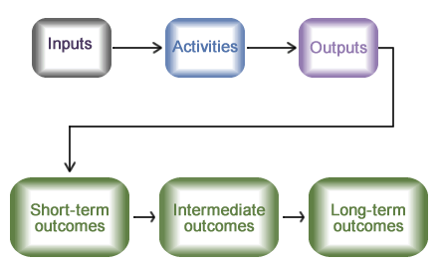
Logic Model with a Series of Desired Outcomes
Notes:
So that’s how we’re going to do it today. We’re going to build a simple logic model. Then we’re going to layer on some of these other terms and show what added value or added insight you get from layering them on. The two fundamental terms we’re going to start with are this distinction between activities and outcomes.

Slide 16
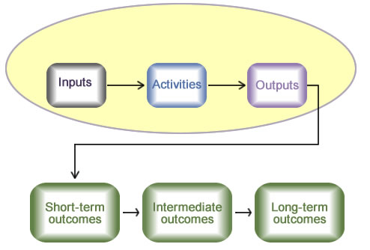
What We Control
Sphere of Control:
What the program and its staff actually do.
Notes:
I call activities what we call the “sphere of control”. Your program has some assets, it has control over what it does with those assets day in and day out, you know, staff or whatever, and the activities are no matter what your program is, what is it the program and its staff actually do?
Now next slide.

Slide 17
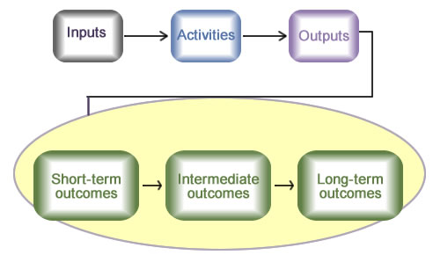
What We Influence
Sphere of Influence:
Results of activities: Who/what will change?
Notes:
Against that we have what we call the “sphere of influence”. I really want to do a good job at my activities and if I do a good job at my activities my aspiration is it will move those priority groups or targeted groups, it’ll influence them to take these actions we call outcomes. And I generally would sequence those as short-term, intermediate or midterm, and then long-term outcomes, which some people would call impacts, okay. So that’s the core of the logic model. And again as I said about 50 to 80% of the value of this comes from understanding that bright distinction between what do I control versus what do I influence, okay.
And the reason - so for example, think about your program, if it runs trainings, well if I run a training, clearly, that’s an activity. The fact that people learn something, behavior changes, I make an impact on my public health outcome. That’s really my sequence of outcomes. By contrast at CDC and probably a lot of folk at state level on the call, I may, I may develop curriculum or buy curriculums. I may form partnerships. I may do funding. I may do promotion. But it may be a partner or a community organization I’m counting on to do the training. Well in that case the training becomes my shortest-term outcome. People will learn something, behavior will change, et cetera, are the additional sequence of outcomes. The reason that distinction becomes so helpful to people is that if I don’t get those behavior changes, let’s say that’s what I’m locking onto. I’m going to take very different action in round two, if the training piece of this is under my control versus I did everything I was supposed to, but it wasn’t enough to lever that first outcome, to get this voluntary actor to actually step up and do things that I need them to do, in this case mount the training, okay.
So the first and foremost thing we do is a clear line between control and influence, and that’s half the time that’s one of the most enormous “Aha!”s one gets either for planning or evaluation. And you get that from your logic model.
Next slide.

Slide 18
How Do I Start Developing a Program Description?
Goals and Objectives can come from:
Performance Measures
Strategic Plan
Notes:
I do tons and tons of consultation at CDC and also with our partners in community-based organizations. And when people find this daunting it’s often like gosh, where would I even start coming up with this program description. Well it’s the rare organization that hasn’t done, even if they haven’t done evaluation or logic models, that hasn’t done one of these three processes. I’ll run into programs that have never done a logic model, or worried about evaluation. But they’re either blessed or afflicted with, you know, a hundred different performance measures. Well, you know, undoubtedly that’s way more performance measures than you need. But embedded in there is some sense of program logic, good or bad, well specified or not, such that I can extract from it some sense of what does this program do versus who or what is this program trying to influence. Most commonly you have a strategic plan often even if you haven’t done evaluation. Well I’ve shown these lining up exactly like, well, the goals in your plan are your long-term outcomes and the objectives are your short term. It often doesn’t line up that way as neatly as you’d like.
But the fact is if I have a strategic plan and I have to do a logic model, generally the germ of truth about that program, what does it do, who or what is it trying to move, is, is going to be in that strategic plan. Conversely when I teach my full-day course I always tell people if we do a logic model today for your program, your boss sees you in the hall and says I’ll give you 10,000 bucks if you can come up with a strategic plan in the next 48 hours, that’s really a bet worth taking.

Slide 19
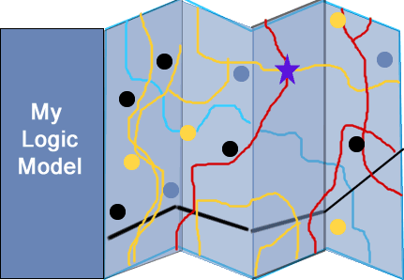
A Logic Model Serves as a Roadmap for Your Strategic Plan
Notes:
If the logic model is accurate then the ability to translate that roadmap into definable things like what are the goals of this program, what are the objectives, what are the actions, well that roadmap pretty much lays that out for you, okay. So it’s much less daunting. Again the word logic and model scare people to death a lot of times. And really we’re talking about very basic insights. You actually have a lot packed up in your head even though it may not use the terms we’re using today: impact, outcomes, outputs.
Next slide, okay.

Slide 20
Goals And Objectives Are Source Of Outcomes/Impacts In The Logic Model
Goals
What the program is ultimately trying to achieve.
General, “big picture”.
Source for our long-term or distal outcomes/impacts.
Objectives
Levers pushed to achieve the goal.
Source for short-term and intermediate outcomes.
S-M-A-R-T objectives.
Notes:
So here’s an example. I know a lot of people on this call are CDC grantees or grantees that have to set goals and objectives perhaps using the SMART, the SMART objective approach. Well again depending upon how your program or your funder has told you to define goals and objectives, it’s undoubtedly the case that embedded in those goals and objectives are probably most of what you need to populate a logic model. Now if you use those the way we use them at CDC, we try to get people to think of our goals as our long-term stuff, the health impacts we’re looking for. Well that’s going to clearly be the source, perhaps not verbatim, for the long-term, what we call the most distal, downstream outcomes and impacts. The objectives, by contrast, if they’re written the way we write them at CDC, and not everyone does, kind of describe what are the big levers I’m trying to press. The big pathways from my activities to actually make some of those goals happen, okay.

Slide 21
SMART Objectives
S: Specific
M: Measurable
A: Actionable
R: Realistic
T: Time-bound
Don’t need these to do a logic model, but if you have them, much work is done already.
Notes:
If they’re written in SMART lingo and that’s specific, measurable, actionable, I can’t remember the R and time bound--oh realistic-- and time bound, that’s not going to be terribly helpful actually for the logic model. It will be helpful for evaluation. Kind of gets you a head start on writing some indicators later, might even help you with some of your output creation, right. But embedded in those objectives and goals undoubtedly is a fairly detailed program logic to get you started.
OK. Next slide.

Slide 22
Asthma Intervention Logic Model Example
Identify and list:
Activities.
Intended effects or “outcomes”.
Arrange in a time sequence.
Elaborate by:
Add boxes to represent inputs and outputs.
Consider assumptions, context, and stage.
Draw arrows.
Review and refine.
Notes:
Great, okay so here’s the basic steps we’re going to go through today. And we’re going to do these in order. We’re going to identify and list the activities and the intended effects. And I brought with me a reprise of a case that got introduced on the last call. I’m going to show you - talk about arranging these in a time sequence. Then there are various elaborations that one can make to do this. First, we’re going to take those first two bullets and add some boxes and arrows just to turn it into a very, very simple for what I call a causal roadmap. You know laying out kind of the internal logic or theory of the program, right. Now notice on that last bullet, review and refine. I can’t emphasize this enough. This is really not hard stuff. It’s all embedded in your head. But if you’re new to it it’s really going to look sloppy and don’t be dissuaded. We’re going to do in a few minutes today what you typically would spend a couple hours doing. And it’s undoubtedly going to look very, very sloppy and then you’re going to refine it in subsequent versions.
Okay, next slide.

Slide 23
List Activities and Outcomes Approach #1
Achieve clarity about “sphere of control” vs. “sphere of influence”.
Remember:
Sphere of control = what the program does.
Sphere of influence = who or what is the program trying to influence?
Notes:
Okay, there are three ways to approach the creation of these models. And again there are a million ways of creating logic models. And the way I’m doing it is the way I found most helpful. But if you have other ways of doing it, you know, that’s cool. I think it doesn’t matter. It’s all going to lead you to the same place. I find that the key thing I’m trying to do at the outset of creating these models is clarity on sphere of control, sphere of influence. So no matter what I have in front of me sometimes it’s nothing, sometimes its conversations with a couple people, sometimes it’s a 200 page RFP. I’m always reading that with an eye or an ear towards what sounds like what the program does and what sounds like who or what the program is trying to influence, okay sphere of control, sphere of influence, right. There are two other ways to get to this same kind of simple two column table. And a lot depends on the situation you’re in.

Slide 24
List Activities and Outcomes Approach #2
You know the impact you want, but you must figure out how to get there.
This approach sometimes called “reverse logic” or “reverse mapping”.
Starting with outcomes, ask “how to” in order to generate the activities which produce them.
Again, identify “sphere of control” and “sphere of influence”.
Notes:
Often we’re given a situation where we know what the outcome or impact we’re looking for is but it’s what we call a formative evaluation. We really don’t have a lot of information on how to get there. The purpose of the logic model in this case is to sort of backup and say well how do I get there? What’s this roadmap look like? So there I’m going to start on the far right. I’m going to do what we call reverse mapping or reverse logic. I want to get to a world where morbidity and mortality due to actions gone down. Well how do I do that? Well how do we get to that? How do we get to that? And how do we get to that? Now it’d be nice if it kind of just bounced backwards in a very clean and neat fashion. It doesn’t. It’s usually a big mishmash. But eventually when you look at that you can say of all the stuff in this little conceptual map I drew, this looks like sphere of control, the stuff I get to do as a program. This looks like sphere of influence, ways in which someone or somebody else who’s not me has to change for me to make an impact downstream.

Slide 25
List Activities and Outcomes Approach #3
Starting with specific activities, “push the envelope” to identify more distal outcomes. What is the “so what?” of this program?
Sometimes called “forward logic” or “forward mapping”.
Often used with community-based organizations.
Ask "Then what happens?”
Notes:
The third way is exactly the opposite and we call that forward logic or forward mapping. And I find it works best with community-based organizations, organizations which is the narrow slice of the pie particularly if they’ve been doing it for a while. Where they have a really, really strong sense probably a process map or a flowchart of what they do day-to-day but they sort of lost track for a variety of reasons on why they bother, so what of their program. So there I take what looks like the simple, what the most downstream outcome listed and sometimes that’s often something very approximate like. If I do a good job, providers are trained or consumers are trained or people are linked to services. And we push them out and say we need to really get a better sense of this so what of your program. Then what happens? Then what happens? Then what happens, okay?

Slide 26
Activities and Outcomes: 2-Column Table
Activities
Outcomes
• Develop training
• Conduct community meetings
• Write fact sheets
• Identify stakeholders
• Lower medical costs
• Better code
enforcement
• Fewer ER visits
• Fewer ER visits
Notes:
In either case - at this point what I end up with is a very simple two column table. What does the program do? Who or what is it trying to influence, right?
Next slide.

Slide 27
Then…Do Some Sequencing…
Ask, “Is there a logical sequence to the activities or the outcomes?”
Divide the activities into 2 or more columns based on their logical sequence. Which activities have to occur before other activities can occur?
Do same with the outcomes. Which outcomes have to occur before other outcomes can occur?
Notes:
Okay, then and this is really helpful and I still do it even though I’ve been doing this for a long time. I ask myself is there any logical sequencing. Now it’s the same as time sequencing although often it is. But we call these logic models for a reason. We’re looking for the internal logic.

Slide 28
Sequenced Activities and Outcomes
Early
Activities
Later
Activities
Short-term
Outcomes
Long-term
Outcomes
• Write fact sheets
• Identify stake-holders
• Develop training
• Conduct community meetings
• Better code enforce-ment
• Fewer house fires
• Lower medical costs
• Fewer ER visits
Notes:
So I ask myself let’s say instead of a column of activities and a column of outcomes I had a couple columns to play with on the activity side and a couple columns on the outcome side. When I look at those activities do they sequence logically, do one or two have to happen first before this can happen? In a complex program even often the answer is no. The activities are important but they’re logically independent. They may rollout over time in a different sequence but logically they’re not dependent upon each other, okay. And so I have one column of activities. There’s nothing wrong with that.

Slide 29
The Major Benefits of Logic Models
Clarity: Helps develop clarity about sphere of influence vs. sphere of control.
Sequencing: Helps pinpoint what needs to happen first to make this other thing happen.
Notes:
On the outcome side I would say the second benefit of logic models, first one being clarity on the difference between sphere of control and sphere of influence. The second benefit of logic models is this idea of sequencing. If I have five, six, a dozen outcomes it is invariably the case that in the second step where I have to sequence them, whether I use two columns or three columns or whatever it is invariably the case I can say I expect these couple outcomes to happen first or they need to happen first to make this happen, to make this happen and get to the end, right.

Slide 30
Sequenced Activities and Outcomes
Early
Activities
Later
Activities
Short-term
Outcomes
Long-term
Outcomes
• Write fact sheets
• Identify stake-holders
• Develop training
• Conduct community meetings
• Better code enforce-ment
• Fewer house fires
• Lower medical costs
• Fewer ER visits
Notes:
I would say that even if you never proceed to evaluation this is probably the most beneficial process use of logic models because you would be shocked how often when you bring your stakeholders to the table they see a different sequence in which things are going to occur. And or they see the same sequences you do but they have a different take on how far down that chain we need to get to be successful at this point in time, all right. So this is a really, really helpful exercise even if you don’t take it down the evaluation road, right.
Next.

Slide 31
Asthma Intervention Case Study
Briefly review the linked case study scenario and ask yourself:
What are the activities?
What are the outputs?
What are the outcomes?
What would the roadmap look like?
Notes:
Now my thanks to Leslie who doctored up and kind of trimmed an exercise that we used as a case I think on the last call. And it’s a fairly simple straightforward intervention to change indoor air quality at home. And I just want you to skim it to be roughly familiar with it because I’m going to use it and show you kind of what a logic model, what it would look like and then as we proceed I’ll say golly, you know, now we have these activities and outcomes. What would the roadmap look like? What would the outputs look like? So take just 30 seconds to skim this. This lays out sort of what the outcome side of things looks like and just kind of get a sense of what that sphere of influence is. If this program works who’s it trying to change and what’s it trying to change?

Slide 32
Asthma Intervention Case Study
Go to case study scenario. (PDF file)
Continue webinar without reading case study.
Notes:
See PDF file.

Slide 33
What Are The Components of This Intervention?
Provide customized educational sessions targeted to various stakeholders.
Create smoking cessation materials for tenants.
Influence political climate for improved housing codes and housing code enforcement.
Notes:
Okay now hopefully on that last slide you recognized that most of those sounded like things that belonged in the sphere of control. Although there’s a reference to, they’ve designed a multi-component intervention, right, we’re going - this is what the multi-component intervention consists of. What that previous slide showed was let’s say our stuff goes well. What are some of the things we’re hoping to influence? Here we’re going to talk about, again, what is it we’re going to actually bring to the puzzle. And there’s sort of three clumps to this. There’s customized educational sessions targeted to all those audiences that were sort of implied or mentioned explicitly in that last slide. Then there’s this smoking cessation piece for tenants and of course obviously householders as well if they’re smokers. And this is trying to reduce environmental tobacco smoke obviously in the apartment where the kid lives. But also this idea of people trying to do the right thing by stepping outside, creating this huge cloud and blanket of smoke that a kid with asthma would have to proceed through. And then finally a big portion of this intervention is not to do with what’s going on in the complex, but to influence the complex by influencing a larger political climate of housing code, improved housing codes, and housing code enforcement, okay.

Slide 34
How to Begin
Step 1: Identify and list:
Activities.
Intended effects or “outcomes”.
Step 2: Arrange in a time sequence.
Notes:
I’m going to show you, I walk through creation of a logic model using those two steps I just showed. What are the activities, what are the outcomes: sphere of control, sphere of influence, and a little bit of sequencing.

Slide 35
Asthma Intervention Activities
Activities
Outcomes
Impacts
Education & training on IAQ for apt owners, code enforcement, maintenance providers, and tenants.
Smoking cessation program for tenants.
Collaborative meetings with city officials to enhance housing code.
Fewer
adverse asthma events
Notes:
So here if I had you for more than 90 minutes I’d say okay, when you read that narrative, what looked like the activities and outcomes of this intervention? But hopefully you’d come up with something very similar to this. Those three big clumps of activities: 1) education and training related to IAQ for those three big, no those four big categories: apartment owners, code enforcers, maintenance providers (the caretakers), and then the tenants themselves--either the neighbors of the kid or, you know, the householders of the child; 2) smoking cessation program for tenants, again both householders and neighbors; 3) and then the third piece, kind of the advocacy piece, collaborative meetings with city officials that’s geared to doing stuff related to the housing code.
35

Slide 36
Asthma Intervention Activities and Outcomes
Activities
Outcomes
Impacts
Education & training on IAQ for apt owners, code enforcement, maintenance providers, and tenants.
Smoking cessation program for tenants.
Collaborative meetings with city officials to enhance housing code.
Increased awareness of indoor asthma triggers.
Improved understanding of methods to reduce exposure to triggers.
Housing codes emphasizing improved IAQ available.
Tenants conduct activities to improve IAQ.
Improved enforcement of housing codes.
Reduced exposure to asthma triggers.
Fewer
adverse asthma events.
Notes:
Then there’s a whole series of outcomes here and I think they’ve ended up sort of sequencing in a logical sequence. But they needn’t at this point. We’re just brainstorming. So take a quick look at those and just make sure you can see at least the hint of those in the narrative that you just read, all right. Now some of these are a little bit more specific. We made explicit some things that were perhaps a little bit implicit in the narrative, okay. Okay.
36

Slide 37
Sequencing
Activities
Short-term
Intermediate-
term
Long-
term
Education & training on IAQ for apt owners, code enforcement, maintenance providers, tenants..
Increased awareness of indoor asthma triggers.
Better maintenance of housing complex.
Reduced exposure to asthma triggers.
Improved understanding of methods to reduce exposure to triggers.
Tenants conduct activities to improve IAQ.
Smoking cessation program for tenants.
Housing codes emphasizing improved IAQ available.
Improved enforcement of housing codes.
Collaborative meetings with city officials to enhance housing code.
Notes:
Now in the next slide, which we’re going to turn to, you’ll see all I’ve done is a little bit of sequencing.
I’ve tried to lay out more of the story line. I determined that on the activity side they’re probably a bunch of activities we haven’t named here that are implicit and probably have to happen to lever these. But these activities themselves are logically independent. They may roll out over time in a sequence, but they’re logically independent, right. Now you can dispute that and persuade me I’m wrong. But for the moment let’s just assume that’s correct. On the outcome side you can see we’ve really got a good germ already of a program logic here. Those outcomes we had sequenced sort of nicely. In that first column there’s all this stuff related to changing awareness and understanding, then actually the availability of these housing codes we hope will result from those collaborative meetings.
And then what’s the “so what” of that? Well then we hope that’s going to turn over into some behavioral change. Caretakers will actually maintain the complex better or because owners presumably will make them if they’re not so inclined. Tenants will do things to improve IAQ, in particular they’ll stop smoking. And then hopefully as a result of these new codes the people who do code enforcement will actually enforce them. Those independently are ways to reduce exposure to asthma triggers, which of course gets us at the fewer adverse asthma events, which is the whole intention of this program, okay.
37

Slide 38
For Planning and Evaluation “Causal” Arrows Can Help
Causal arrows can be used to enhance a logic model. Not a different logic model, just a different format.
Arrows can go from:
Activities to other activities: Which activities feed which other activities?
Activities to outcomes: Which activities produce which intended outcomes?
Early effects/outcomes to later ones: Which early outcomes produce which later outcomes?
Notes:
It’s very important to understand that there’s no right way to do logic models. It really depends upon your audience. And that prior slide may be all you need. So don’t go jumping into these flowchart models I’m about to show you unless you’re sure the audience really is looking for it. And I learned the very hard way. I love these things and I love drawing them, and it’s not too hard for them to turn into what looks like wiring diagrams for a piece of electronic equipment. And at that point you probably lost anyone you’re going to show it to.
For today I really want to take the perspective of doing these for purposes of planning and evaluation, meaning drawing these for people who need them because they’re close to operating the intervention. And there I think the traditional kind of flow charty model really helps. The important thing is to understand: we’re not drawing a different logic model, we’re simply reformatting the one we have. So if you think of the one before as sort of the MapQuest driving directions, we’re drawing the Map-Quest map here. And again the important thing here is not every single activity is there because it leads to an outcome which leads to an outcome which leads to an impact, right.
In other - in some cases the activities are connected because one activity levers another. Not in this case but in a lot of logic models activities exist because they’re trying to lever later activities. Other activities and probably the preponderance of them exist to lever an outcome. But then a third type of arrow doesn’t go from activity to an outcome. It goes from an early outcome to a later outcome. So why am I - so if we turn the page.
I’m sorry, next slide.

Slide 39
Sequencing Plus Causal Arrows
Activities
Short-term
Intermediate-
term
Long-
term
Education & training on IAQ for apt owners, code enforcement, maintenance providers, tenants..
Increased awareness of indoor asthma triggers.
Better maintenance of housing complex.
Reduced exposure to asthma triggers.
Improved understanding of methods to reduce exposure to triggers.
Tenants conduct activities to improve IAQ.
Smoking cessation program for tenants.
Housing codes emphasizing improved IAQ available.
Improved enforcement of housing codes.
Collaborative meetings with city officials to enhance housing code.
Notes:
I haven’t moved anything here. What I’ve tried to lay out is a little bit of the internal logic of internal program theory or program logic of this effort. And you see your eye is drawn on that right hand side to the big lever I’m trying to press is reduce exposure to asthma triggers. And that’s going to happen through these three streams of better maintenance, tenants and householders actually taking behavioral actions, and improved enforcement of housing codes. How am I going to get there? Well this big clump of awareness and knowledge change is going to occur in these different audiences and that’s either jointly or singly going to affect those intermediate outcomes, right. Now if you look to the left you can see this is a relatively straightforward program. The smoking cessation program for tenants I have is levering two different outcomes, you know, find - that top one of course is going to really change broad awareness of indoor asthma triggers. And that bottom one, the efficacy piece is supposed to result in sort of a named outcome about changing or making available improved IAQ related housing codes, okay. Now what might we learn already? From this one not much. I don’t think we gain a whole lot from this one versus laying it out without the boxes and arrows. But a lot of times you do.
And what you’ll realize sometimes is, you know I’ve got this big downstream outcome. When I draw these arrows in I don’t have a whole bunch - whole bunch that’s going to lever that. Or I’ve got these big short term outcomes like here we have sort of three pieces to the story. It could be that in another program I realize I have something to lever that northern most outcome but I don’t have anything really pushing that lower outcome or I have a quick - real disproportionality. I have tons of stuff that’s going to move knowledge, attitude and belief of tenants or caretakers but very little that’s sort of going to move and motivate the housing enforcers, okay. So at this early date having to lay this out on paper can sort of point out to you kind of big holes in your program logic. And again our process use here, this isn’t out of the barn yet, golly am I really ready for prime time. If it is out of the barn you’re getting ready to evaluate it. You know gulp, here’s some things I want to be testing with my evaluation because when I wrote them down on paper I started feeling a little bit queasy.
Okay, next slide.
39

Slide 40
Note!
You don’t always need a logic model, but you do always need a program description.
Logic models make the program theory clear, not true! The truth of the model must be determined through evaluation, research, and practice wisdom.
Notes:
This is very important: mantra one is you don’t always need a logic model; you always need a program description. Mantra two is if you do take the logic model route, remember the purpose of this step is to make the theory or the logic clear. That doesn’t make it true. At this point we don’t know if any of this stuff is going to work. As the program progresses we’ll learn that through evaluation, through research, through what we call practice wisdom, School of Hard Knocks. And of course the program will change and the logic model will change accordingly. We may find out if we had a reunion of this group two years from now after doing this program. I’ll tell you what if you get the housing enforcers on board everybody else falls inline. You can skip all that training or caretakers and stuff. The code enforcer breathes down their neck. They, you know, get inline. Or you could determine exactly the opposite. Really it’s advocacy by apartment complex owners who want competitive rates so ones that want to do the right thing or pushing the code enforcers to step up. And so it’s a very different logic than we laid out here, which is we have these three audiences. We’re trying to move all of them concurrently, okay. But that makes it clear at this point, not true, okay.
Next slide.

Slide 41
Key Benefits of Even Simple Logic Models
Benefit 1: Clarity for you.
What is the real purpose of this program?
Benefit 2: Clarity and consensus among stakeholders.
Does my picture look like your picture?
Does this look like a reasonable sequence of outcomes?
What constitutes “success” at various time points of the program?
Notes:
Here’s the benefits you get from even these simple logic models. Clarity for you, and clarity is not to be undervalued. Trust me. I’m sure all of you realize how hard it is to often get everyone to agree or even for you to understand yourself, what am I really driving at here, what’s really the purpose of this program, right. And these logic models are enormously helpful because programs will often have multiple purposes, which conflict or multiple purposes that kind of expand that rollout over time. The second really, really big benefit of these is clarity and consensus among stakeholders. I drew this picture; does it look like a picture you have. If I think we’re about these outcomes, does that look like the sequence? I think we ought to be here at this point in our program. Do you agree that’s what constitutes success?

Slide 42
Causal Arrows Help Identify Gaps in Program Logic
Is the level of effort consistent with the importance of the outcome?
Major
outcome
Minor
outcome
Notes:
Alright, so what we have at this point is a relatively straightforward logic model. We’ve kind of laid out a very, very basic program theory, what do I do, what are the sequence in which I want my outcomes to happen? That’s going to - those are still at a very high level. And I’ve kind of laid that out.

Slide 43
Asthma Intervention:
Basic Logic Model
Short-term
Outcomes
Intermediate
Outcomes
Long-term
Outcomes
Activities
Education & training on IAQ for apt owners, code enforcement, maintenance providers, tenants..
Increased awareness of indoor asthma triggers.
Better maintenance of housing complex.
Reduced exposure to asthma triggers.
Improved understanding of methods to reduce exposure to triggers.
Tenants conduct activities to improve IAQ.
Smoking cessation program for tenants.
Housing codes emphasizing improved IAQ available.
Improved enforcement of housing codes.
Collaborative meetings with city officials to enhance housing code.
Notes:
Now we’re going to just walk through the different things we often would do to frame that or elaborate it more fully, okay. And so, you know, program theorists vary in the level of scrutiny to which they think something has to rise to be a program theory. What I’m going to do is just kind of introduce terms of trade that are often used in logic models. And just kind of show what they mean and how using them in your logic model can add some value to it.
43

Slide 44
Elaborating the Logic Model
Our basic logic model answers these questions:
What do I do?
What is the sequence in which I want things to happen?
We will now define some terms and describe how to elaborate the basic logic model to improve its value.
Notes:
So the first one is what we call mediators. And in the logic model we developed, we already pretty much accounted for that. I think we have a decent number of what we call intermediate outcomes, things that happen between the program and the big need that we’re trying to accomplish. But it’s not always the case and especially when I first started working at CDC the situation we’d find was often like this next slide.

Slide 45
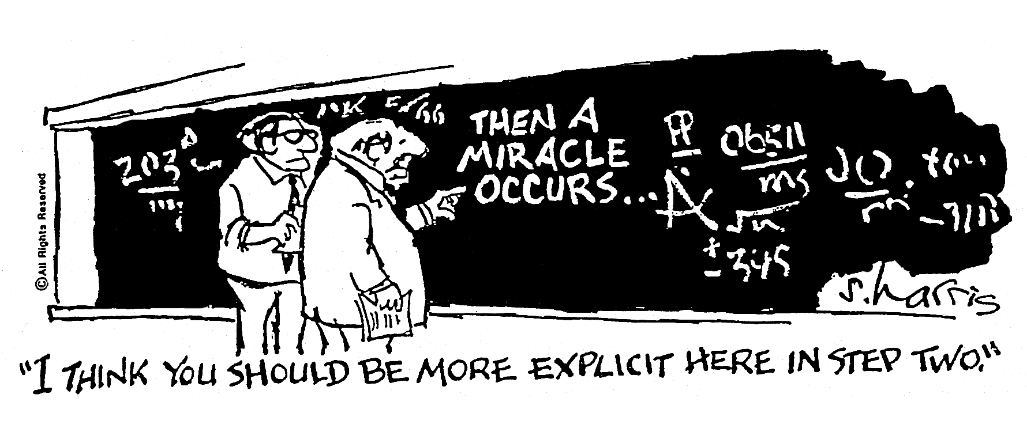
Filling in the Blanks…
ScienceCartoonsPlus.com
Notes:
This is a famous slide. I’m sure all of you have seen this cartoon before about step one; step two--a miracle occurs; and then, you know, step three-- conclusion. And the caption is correct. It says, you know, I think you need a little bit more detail on step two.

Slide 46
Mediators Link the Program to the Health Impacts
The long-term health impact is well defined.
Our program
is well defined.
The “mediators” or intermediate outcomes are missing.
Notes:
Well when I first joined CDC and started doing this kind of consultative work back when even when I was a contractor, people would have very explicit ideas of what they did as a program. But often the only outcome they could really name with certainty was something that looked very much like the downstream health impact, right. And so what they were missing was this idea of mediators or intermediate outcomes. That became - came back to haunt them for a variety of reasons, the main one being it’s often very hard to get our outcomes if they’re very long term.

Slide 47
Why Mediators?
Mediators help to convince stakeholders, authorizers, and funders that we're heading in the right direction.
For planning purposes, mediators indicate the milestones we expect to see along the way.
Notes:
And so both for defensive purposes to convince stakeholders and funders and authorizers we’re heading in the right direction, and also for planning purposes to understand, you know, how I’m proceeding downstream-- what are the milestones or markers I expect to see on my way to this very distal destination is most helpful.

Slide 48
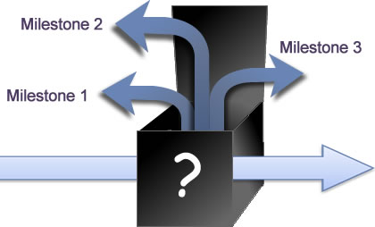
Mediators Unpack the “Miracle”
Long-term health impact
Our
program
Notes:
And so that’s what we call “unpacking the miracle”. The miracle isn’t the hard stuff about your program. A lot of what we do is very hard. We’d benefit from having, you know, divine help. What we’re talking about here instead is laying out that program logic. I’m going to do this program. I want to get to that big contribution. Why is any of this supposed to work? So we call that mediators.

Slide 49
Prevention Program:
Simple Logic Model
Initial
Activities
Later
Activities
Intermediate
Outcomes
Long-term
Outcomes
Capacity Building
Surveillance
Change Physical
Environments
Communication
Prevent and
Control Problem
Research and
Development
Change Social
Environments
Partnership
Leadership
Notes:
All right so what we have at this point is a relatively straightforward logic model. We’ve kind of laid out a very, So here's a good example of a very simple prevention program, and this is something I worked on probably more than a decade ago. And if you looked at the mission statement for this program, and this happens to be an injury program but it can be lots of programs, the goal of the program was to prevent and control the problem by changing physical environments and social environments, and then those other first two columns are basically the six sort of clumps of activity by which this program hopes to accomplish that, okay.
Now clearly in that clump -- in that space between column two and column three -- there’s a big miracle going on here. There’s not a lot of specificity about the magical way in which those six things singly or jointly will make any of that happen.
So next slide.

Slide 50
Prevention Program:
Simple Logic Model
Initial
Activities
Later
Activities
Intermediate
Outcomes
Long-term
Outcomes
Capacity Building
Surveillance
Change Physical
Environments
Communication
?
Prevent and
Control Problem
Research and
Development
Change Social
Environments
Partnership
Leadership
Notes:
So here you’ll see we’ve just - here you’ll see on the right hand side I’ve bolded those same three boxes, those original goals, those original kind of downstream outcomes still exist. On that left hand side I’ve kept intact those six labels for what the program does. The rest of this is sort of elaboration. And particularly on the effect side what we tried to do is to be very much specific about, if I do a good job in any of those activities -- and again we’ve defined them with a little bit more certainty and specificity -- what are the milestones and markers? What are the preliminary outcomes we expect to happen that’s going to lever these three big things that the program’s committed to in its mission and vision? Right.

Slide 51
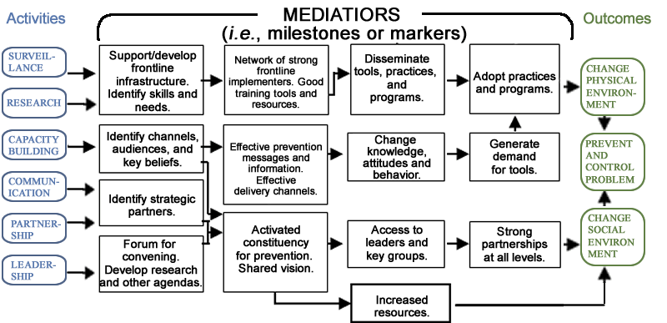
Prevention Program:
Elaborated Logic Model
Notes:
So that’s really what mediators lend themselves to. I’d say in the model that we use today we already have those mediators. And so we don’t really have to worry about it too much. You can see we’ve been fairly elaborate about how we’re going to get all the way over from activities, to those fewer adverse asthma events.
Next slide. Okay.

Slide 52
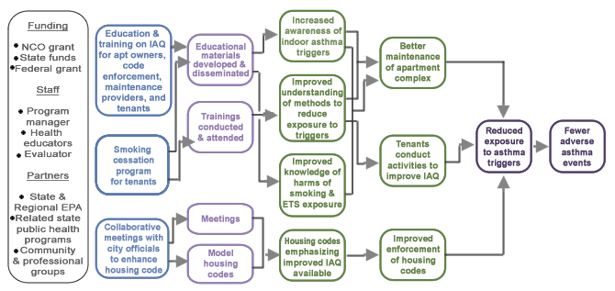
Asthma Intervention
Elaborated Logic Model
Look for black arrow from activities to outputs
Notes:
The second thing we want to introduce, and this is where we start introducing terms you’re probably familiar with that show up actually in the logic model, is this idea of outputs. And I often will not use outputs in my work at CDC because a lot of times I’m dealing with a program generally early on at the conceptual level and so my goal is, as I said before, to kind of get them clear on the sphere of control, sphere of influence. And because you only have an 8.5 by 11 page to play with, to me the highest use of that page is leaving enough white space to lay out those boxes and arrows and show what leads to what, right. Lots of people disagree with me, and I’m increasingly persuaded that there’s a big role for these outputs if you do it right. But what those outputs need to be viewed as is separate from outcomes. And so I view the outputs as a different way of thinking about your activities. I do all these processy-sounding activities, okay, I train, I advocate, et cetera.
Well the output column is the point at which I would say, and so what’s the tangible kind of product I’m going to produce? What’s the documentary evidence that I did those activities? Okay, now it’s not an outcome. I haven’t necessarily changed anyone or anything. Rather it lays out what’s the potential energy my program is going to create that I hope will be powerful enough to turn over or to knock over those dominoes we call outcomes? And that’s a very, very important thing to add to the logic model.
So turn to the page we’ll see - next slide and we’ll see what we did for asthma.
52

Slide 53
Elaborating the Logic Model:
Outputs
Outputs are
the tangible products of
actions.
Notes:
It plays a really crucial role in especially the planning of a program before we proceed to evaluation, but it’s also as we’re starting to set up the evaluation. If you haven’t thought a lot about the outputs, thinking about those outputs will often remind you, what is it my program is promising to produce? What was sort of the on-the-ground stuff we were going to produce that we thought would be powerful enough to knock over these outcomes? Okay.

Slide 54
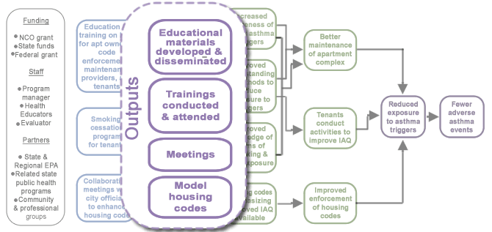
Asthma Intervention: Outputs
Look for black arrow from activities to outputs
Notes:
And so the outputs are often where you start to get the skeletal framework for what will become what we call your process evaluation, right. Now the crucial role of those outputs and the crucial role of process evaluation as we talked about in the first session was, let’s say I don’t get any of those outcomes. If I’ve defined really strong outputs that I can measure then, you know, and that they hold themselves open to be translated into measurable indicators later, then I allow myself the ability to determine, was my program based on false assumptions? This really wasn’t a training problem or it wasn’t an advocacy problem. Or was my program based on the correct assumptions, it’s just I couldn’t get those outcomes because I couldn’t make those outcomes happen - those outputs happen. I just couldn’t implement those outputs, that potential energy to make the outcomes happen. So I call the output column the “laugh test” column. And my friends who love outputs say, you know it’s not hard to get people to agree on the outcomes of a program although that’s not my experience. I find that to be very difficult in a lot of cases. But they say even if that goes smoothly, the output point is the point at which you say, but what is this program really about, what’s it really going to produce? And when you start drawing in the stuff that goes in those boxes you often will say, gosh, I don’t have a chance in heck of getting that, or I’m not going to produce enough of that to knock over those dominoes at all, okay.
54

Slide 55
Why Outputs?
Outputs form the skeletal framework for your process evaluation.
Outputs are what the program is going to produce.
Well-defined outputs allow you to determine if your program was based on false assumptions.
If you can't achieve the outputs, you may have to go back and rethink your plan.
Notes:
Now I’ve kept these outputs at a very, very conceptual level. But to the point raised by the questioner earlier, that’s not often the case. Generally you’ll see these outputs framed in measurable terms. The number of this, the percentage of that, or whatever, okay. That’s great and it doesn’t hurt at all, probably helps you. But the main thing you’re trying to get here is, as I said, this idea of potential energy. If I do all this good stuff in column one, what’s the tangible, the tangible observable thing I’m going to observe - I’m going to see as a result of that?
What I’m going to see is educational materials are actually developed, disseminated. The trainings are conducted and attended, right. I’m going to do these collaborative meetings. What’s going to come out of that? Well some number of meetings. There’s some meetings with the right folks and some germ of model housing codes that get introduced in those meetings, okay. Now you can see if you follow that logic that those things are the big potential energy that this program is bringing to the puzzle that it hopes will have the power to knock over those outcomes. Now even before we let this out of the box we may say, geez, you know, I know who those meetings need to be with, and I can’t get to that person, or I know what the housing codes look like, and the idea that they're going to adopt my model housing codes are pretty remote. Well if that’s the case, and then we’re still in planning mode, then we rethink the program. If we’re in retrospective mode it just reminds us, okay those are the key dimensions about those outputs I want to be sure to measure so that, when I don’t get the outcomes, I’m able to determine, was this program just a bad idea or could it not just be fully implemented?
Okay next slide.

Slide 56
Elaborating the Logic Model:
Inputs
Inputs are the resources you need to mount your activities.
Notes:
The second thing I want to introduce, which is a term we see in evaluation all the time, is this idea of inputs. And inputs, when I add any columns to my logic model other than the activities and outcomes, generally it’ll be the input column. And again these logic models are aspirational, so the reasoning in adding the input column is to remind yourself, what was I counting on from other people to mount my activities? My logic model says if I get the resources I need, then my intent is to mount these activities correctly, which should lead to these outputs, which should get me my outcomes. So I like the input column because it’s often a focus for the planners or the implementers or the evaluators to be in touch with how strongly they feel about whether they got those inputs or not.
Okay, so next slide.

Slide 57
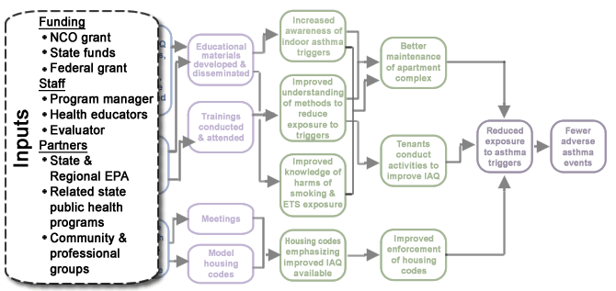
Asthma Intervention: Inputs
Notes:
So you can see in this logic model here we’re saying, gosh, we really want to do a good job at those activities and produce those strong outputs, but it makes the presumption -- again we’re talking aspirationally -- that we’ll get funding and sufficient funding in all three of those categories. We’ll get staff and enough staff in those three categories. And that we will have engaged - the presumption is we not only have partners, they’re engaged partners in those three categories, okay. So again process use, meaning this isn’t out of the box yet, what I do with this part of the examination might be, golly, I feel really queasy as I write funding or staff or I know my partners just don’t have the political will or they don’t share my passion for this. Well if I’m still planning the program that might cause me to scale back or cause me to target the program or make any sort of numbers of changes in the program. If I’m doing this retrospectively it just reminds me, gosh, before I let anyone pressure me to start doing an evaluation focusing on those downstream outcomes, I want to make sure I have permission to actually look at, did this input platform come true? A lot of programs fail not for lack of passion on our part as program implementers to do the activities that produce the outputs, but because that input platform on which we’re dependent primarily on others, we’re certainly influential in our funds, our staff, et cetera. But, you know, ultimately someone else gives us money usually. And someone else that make decisions on how many staff and when we get them and what the mix is. You know, how much of my failure to achieve my outcomes is attributable to failure to get the inputs? Right.
Next slide.
57

Slide 58
Elaborating the Logic Model:
Moderators
Moderators are contextual factors (political, social, etc.) over which the program has no control.
They can either facilitate or hinder getting our outcomes depending on their context.
They can affect some parts of a program and not others.
Notes:
Okay. Last term I want to introduce is this idea of moderators. And moderators are based on the assumption, that if I think of my program as a good seed and I plant it in ten plots of ground and it thrives in five and it just doesn’t get anywhere in the five others, I think we would all understand that some characteristic of that soil that makes it barren or fertile and my program is sort of dependent upon that. My program doesn’t have control necessarily over the characteristics of the soil, but yet the ability of that plant to thrive is dependent totally on that contextual environment. Well this program is likewise in that case. If I take this program we just described and I implement it in ten different parts of town, ten different neighborhoods or ten different apartment complexes, it may work well in five, it may do poorly in five. Well, we’d understand that there’s something going on in this larger context that we need to be attentive to, right.
Next slide.

Slide 59
Examples of Moderators
Moderators are factors that have different effects depending on the context. They may differ from group to group, neighborhood to neighborhood, and so on.
Political
Economic
Social
Technological
(Mnemonic = P.E.S.T.)
Notes:
Right, and typically this is a simple mnemonic that spells pest, which is unfortunate. It probably should spell pets or step or something more asset-based. But I kind of like pest because it reminds us of the importance of these contextual factors. We tend - while they certainly can enhance our program, they tend to be the thing that get in the way. We have the best of intentions that these activities will lead to these outcomes. In reality I’m dependent upon the convergence of the planets, political planets, economic, social, technological, okay. So think about in the case of our program and again if I had you longer this is actually an interesting exercise to go through. Think about that asthma logic model and ask yourself, where in that logic model do these moderators play a role, all right?

Slide 60
Accounting For Moderators Is Good Strategy
Moderators can affect some elements of the program but not others.
Can enhance, but more often hinder, program.
Rarely sink program.
A logic model helps to identify the potentially affected elements.
Then you can plan alternative strategies to achieve your outcomes.
Notes:
Now I used to tend to see these moderators as sort of all the reasons my program can’t work, and I just saw it as the backdrop, the big wallpaper in which my program - that backed up my program. I see them much more strategically now. And the fact is, political factors can get in the way, but they often wouldn’t influence the entire program. And so by being able to be place in the logic model which links are hurt or are helped or hindered by presence or absence of political will is helpful. And if it turns out that northerly route is stymied because I don’t have the political will, well the logic model reminds me, what are the other roadways, what are other alternate routes to this roadmap that I can still get downstream, okay? Likewise it could be the social piece, the cultural norms, or literacy rates, or whatever are really going to interfere with the ability of some of my training to make a difference. Well, again, if I have this roadmap, it reminds me of the alternate ways by which I can get to those outcomes, okay. So the best way to think of these contextual factors is not as the big backdrop or the things that sink the entire program, but these outside factors that link by link might make parts of your model hard to achieve. So here’s some ones I came up with just naturally.
Next slide. Yeah, there we go.

Slide 61
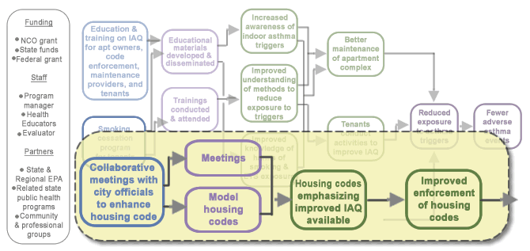
Moderator:
Political Will
Look for black arrow from activities to outputs
Notes:
So my feeling was, golly, you know, I have the best of intents. I really want these collaborative meetings to turn into a number of meetings and model housing codes. They’re not only available, but they’re enforced. Well, you know, again I may create all kinds of passion but there may be contextual factors about political will. It could be these guys are overwhelmed with, you know, asbestos and toxic mold and a host of other things that are going to take precedence over this. And so consequently I may not get that, that result, okay. What would I do with that information? Well find some way to kind of up the ante, get this asthma stuff, indoor air quality stuff on the radar screen in the way that these other issues are, or perhaps I only target those parts of town where I have willing conspirators in the housing authority, okay.
61

Slide 62
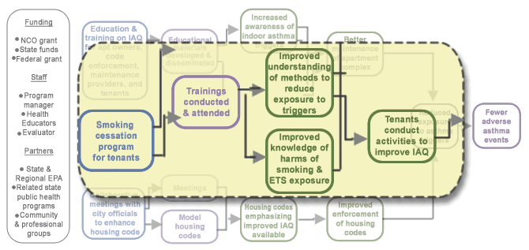
Moderator:
Readiness to Change
Look for black arrow from activities to outputs
Notes:
The knowledge, attitude, and belief turning into actual behavior change by tenants, well with smoking cessation we all know there’s a whole stages of change issue there going on about readiness to change, right. If I know that in advance I either try and deal with tenants who are already poised for change, or I do all those good stages of change things that create the burning platform that move people even further towards behavioral change. Those are just two real quick examples where the understanding of contextual factors will help me understand what parts of this model might go right, might go wrong; doesn’t sink my whole program. What I would say to myself is, gosh, if because of political will that housing piece can’t go anywhere, do I dump this program, or can I make those northerly two routes happen powerfully enough I can still make significant reduction in exposure to asthma triggers, okay.
And then I want to try and apply this to the idea of focusing your evaluation.
62

Slide 63
CDC’s Evaluation Framework
STEPS
Engage stakeholders
Ensure use and share lessons learned
Describe the program
Standards
Utility
Feasibility
Propriety
Accuracy
Step 3
Focus the evaluation design
Justify conclusions
Gather credible evidence
Notes:
All right, let’s turn to the focus discussion. And I’m going to go through this quickly, but I want to show you how the time and effort spent in program description can help the focus. Now again, remember, we separate out describing the program from setting the focus because we want people to think big thoughts and think comprehensively about their program, but we don’t want them to get, you know, get dizzy thinking they have to evaluate every single thing in that program. Reality is, you always have the right to look at every box and arrow, but the focus step says, at any point in time there’s probably some but not all parts of this program that need to be in play for evaluation, okay.
Next slide.

Slide 64
Focusing the Evaluation
“Setting the evaluation focus” means establishing priorities for the evaluation.
Who is going to use these results?
Not all parts of the program need to be evaluated at the same time or in the same way.
Each evaluation focus should be based on how the evaluation results will be used and by whom.
There are 4 basic types of evaluation focus.
Notes:
So the focusing process basically is a process of establishing priorities for the evaluation. But because it’s utilization-focused evaluation, it means that the setting of those priorities is often not something that comes out of my head. Its often is not my choice. A huge problem at CDC, and one reason we got so little use of some of our evaluations, was that we thought the questions were plausible. Oops we’re not the ones that really made a difference in frontline implementation of the program. And we guessed at questions that were not important to others. So this focusing process really tries to pick up on this idea of: I will do no evaluation unless I have a clear idea of who’s going to use these results, okay. Now having said that, there are four sort of emphases or flavors to evaluation.
Next slide.

Slide 65
Evaluation Focus 1:
Process Evaluation Questions
“Did I get the inputs I needed?”
“Could I mount the activities and outputs as I intended?”
Notes:
And the cool thing is any one of these can be - can affect part of the logic model, but no one of them encompasses the whole logic model. So at any point in time a program may be subjected to one or two. Over the life of the program it’s undoubtedly the case you’ll probably be asked questions in all four of these emphases. But for any single evaluation generally you’ll see that there’s one emphasis more than the other.
So the first one is the classic process evaluation. Did I get the inputs I needed or were promised? Could I mount the activities and outputs as I intended? Okay, you’re not getting into the outcome piece at this point. It’s really just about, could I mount the program effectively. And that’s important because when we don’t get our outcomes, we want to have enough process evaluation, that’s why these outputs are so important when you have them, that I can tell, was my program a bad idea, simply the wrong type of program? Or is it a great idea, I simply couldn’t implement it as I intended.
Okay, next slide.

Slide 66
Evaluation Focus 2:
Outcome Evaluation Questions
“Did the program work?”
“Was it effective?”
Notes:
By contrast when we think of evaluation we almost always think of outcome evaluation. That’s often the way that evaluation questions are framed to us by funders, authorizers, or our bosses. I want to know if your program worked. I want to know if it’s effective. Well here you can see, often on the accountability side, people don’t really care about that left side at all. They’re really just interested in, did I get the outcomes I was asked to get? Well the advantage of the logic model here, and this is like in the P.A.R.T. process, which is a big OMB process that federal agencies are subjected to, these logic models really help, because left to our own devices, we often will assume that all questions about outcomes are really about, did I get that distal outcome: morbidity and mortality reduction.
Well when you press people on this, they’ll often accept that there’s a chain of outcomes. And you’ll be amazed how often authorizers, funders, stakeholders are saying, well sure morbidity and mortality, in time. Or reducing adverse asthma effects, in time. But right now if you can even get the codes changed or if you can even get the enforcer, code enforcers to adopt these new codes, if you can even get people to show up for training and think of smoking cessation, I would think this program is successful. So that’s the second emphasis in evaluation, okay.
Next slide.

Slide 67
Evaluation Focus 3:
Efficiency Evaluation Questions
“If I give you this much input, how many activities or how much output could you produce?”
Notes:
Those first two emphases focus on the boxes in the logic model. The next two emphases focus on the arrows, all right. And this next one I call efficiency evaluation, right. Now the day will come when someone wants to know, for every more hundred thousand bucks I give you in money how much will I get as a long-term outcome? The efficiency question doesn’t ask that. It’s asking something less ambitious. And it’s just what I call the “juice versus squeeze” question. If I gave you this much input, how much activity and output could you produce? You said you would - I gave you this money to hold trainings; how many trainings did you hold? I gave you this money to do advocacy and hold meetings; how many meetings were actually accomplished? Okay, it’s important to know in the beginning if you’re asked efficiency questions, which increasingly we are, because the act of collecting that data retrospectively, that cost data is often pretty hard and pretty muddy, right.
Next one.

Slide 68
Evaluation Focus 4:
Causal Attribution Evaluation
“Did outcomes occur because of our activities and outputs?”
Notes:
And finally, causal attribution. And a lot of people think when they come to evaluation this is the only evaluation question ever being asked. And sometimes that is the case. Sometimes someone’s asking you to demonstrate not only that outcomes occurred, but they occurred because of your program. But often they’re not asking that. They’ll be willing to accept that if your program was well implemented and the outcomes occurred sort of in the sequence over time, that you get the credit. Or if they are asking for that causal attribution question, they’re not asking with the level of rigor that we ask it, say, in a research design or in a science, you know, in a science program, right. But again same thing, you want to understand if you’re being asked that kind of question from the start, you want to understand the level of rigor, because if you’re being asked it and with a great degree of rigor, that has very, very dire, i.e., expensive implications for evaluation design and data collection, okay.
Next slide.

Slide 69
CDC’s Evaluation Framework
STEPS
Two of the standards generally have the most influence when focusing the evaluation:
Utility
Feasibility
Engage stakeholders
Ensure use and share lessons learned
Describe the program
Standards
Utility
Feasibility
Propriety
Accuracy
Focus the evaluation design
Justify conclusions
Gather credible evidence
Notes:
Now on the first call we talked a little bit about the evaluation standards: utility, feasibility, ethics or propriety, and accuracy. Two of those standards, above all, come into play in setting our focus. So we have those four emphases, a whole bowl of some potential questions that could be in any evaluation. The rules that we apply to decide on which questions to add to this evaluation this time are the utility standard and the feasibility standard. Now when we first got into this business because we call it utility or utilization-focused evaluation. We made the utility standard king.

Slide 70
Setting the Focus: The Utility Standard
A “utilization-focused evaluation” asks:
“What is the Purpose?” Toward what end is the evaluation being conducted?
“Who is the User?” Who wants the info and what are they interested in?
“What Use will they make of it?” How will they use the info?
Remember: Purpose/User/Use
Notes:
And that still governs a lot of what should end up in any evaluation. What’s the purpose, who’s the user, what’s the use? So why is this evaluation being conducted? Who’s going to use the information? How are they going to use it? And that can be very definitive in defining what part of the logic model you’re going to put into play, okay. However we learned the hard way that you still have to ask the feasibility standard questions because there are lots of users or potential users who really have unreasonable questions that they’re asking. So we’ll turn to that in a second. But first let’s look at where utility alone can lead us.
So next slide.

Slide 71
The Utility Standard: Typical Applications
Show accountability– usually means focus questions on outcomes.
Test program implementation– classic process evaluation questions.
Continuous program improvement– focus questions on process evaluation and some early outcomes.
And many others…
Notes:
So here’s some potential purposes and uses, and these are just three or four of, probably, ten very valid and viable uses of evaluation, meaning why someone would do one. First one: show accountability. Well almost invariably in the current federal accountability environment that means pretty much focusing on outcomes. Not necessarily causal attribution, but focusing primarily on outcomes. Not a lot of interest in the pain and suffering it takes to mount the program.
By contrast that second bullet, test program implementation, is probably going to be the classic process evaluation. I may not look at any outcomes at all. I’m going to look primarily on outputs. Could I really implement the program as I intended? That third bullet, continuous program improvement, I’m probably going to expand that program implementation one in the second bullet and include some of those first-fruit outcomes. How do I know if my program needs improving? Well, gosh, I know those early levers to drive those downstream outcomes. If I’m not even getting those, I want to really zoom in and figure out what’s wrong with the program that it’s not producing it. Okay so those are three potential purposes and uses, very different from each other and each one, to emphasize the focus point, will lead us to a different part of the logic model, okay.
Next slide.

Slide 72
The Feasibility Standard: “Reality Checking” the Focus
Evaluation questions can be useful but not feasible depending on:
Stage of development – how long has the program been in existence?
Program intensity – how intense is the program? How much impact is reasonable to expect?
Resources – how much time, money, expertise are available?
Notes:
Now here’s the important step you have to introduce and this is why it’s really helpful to have this discussion at the outset of an evaluation if you can. Right, so even in a retrospective evaluation, when you sit down with whoever and start planning this, this is really where you want to have this discussion about focus, right. And this is where most things come back to haunt us. Where people either don’t think through the program description, so they just come up with plausible questions using the utility standard. Or they let out of the box questions that are simply, you know, just unreasonable questions to ask. So very, very useful questions, meaning some stakeholder really wants to know it or some user really wants to know it, can be infeasible for any of these three reasons. Stage of development, you know, the program simply not in existence long enough to lever that, okay.
So in my asthma case, you know, it could be that it’s just not long enough to expect to see demonstrable changes in adverse asthma events, okay. Program intensity, by contrast, says, even when this program is mature, it’s not really going to lever those downstream outcomes. This is really a program that’s going to get into the heads of people and change knowledge, attitudes, and belief, but I don’t think it’s going to be powerful enough to move the behavior or move policy or whatever. Program intensity is the most important reality check I would always ask you to pay attention to in your evaluations, all right. Because that’s really where push can come to shove, where stakeholders have very different expectations of what your program can achieve than you know realistically can achieve from the resources you’ve been given or the level of effort you can put into your effort - into your program.
And the final one is resources. This doesn’t buy us much anymore in the accountability environment. But there are occasions where you could say to someone, look I know you want to look at X, Y, Z. I don’t have the money to do it. It’s going to cost a lot. Can we look at this proxy measure on which I do have information? And often a stakeholder will buy that, okay. Now I’m going to lay out two scenarios, and I just want to show you in the case of this case where it might lead us, okay. We were going to poll you, but I think we’re not going to have time because we didn’t get started until about 15 after the hour, so I’m just going to lay it out and show how in the logic model it might lead us to a different place.
So next slide.

Slide 73
Evaluation Scenario 1
Scenario 1:
At Year 1, other communities/organizations want to adopt your model but want to know “what are they in for”.
Notes:
And I drew these from sort of the kind of calls I get when people draw me in for consults. This first scenario is a very common one especially in public health where we’re often looking for buzz or we’re looking for the next big thing that’s going to work because a lot of our problems are so intractable. So here it’s year one. Other communities or organizations have heard about this indoor air quality thing you’re doing. But they want to know what they’re in for.
So next slide.

Slide 74
Scenario 1: Purpose/User/Use
Purpose: To examine program implementation.
User: The “other community”.
Use: To make a determination, based on your experience, as to whether they want to adopt this project or not.
Notes:
So quickly I translate that into purpose/user/use. Well they’re really asking about program implementation. The user is this other community. What’s the use they’re going to make of it? After hearing your experience they’re going to make the decision if they want to jump in and try this, or if it has too much pain and suffering for them to do it, okay.
So next slide.

Slide 75
Scenario 1:
Focus on Process Evaluation
“Did I get the inputs I needed?”
“Could I mount the activities and outputs as I intended?”
“What level of effort was required?”
“Money?”
“Staff?”
“Did anyone attend the smoking cessation classes?”
“How did those meetings go? Did they let you in the door?”
Notes:
So if you look at this logic model I think we would all decide - we would all guess that what they’re really asking is a classic process evaluation question. And my guess is, if you and they are both close to this phenomenon, there may be some of these activities more than others that people close to trying to change indoor air quality are going to say, this sounds like a great idea, but frankly we all know how that smoking cessation stuff goes. Or, the education is going to go great, but how do those meetings go? Did anybody even let you in the door, okay? But again look at the motivation here. This is a classic process evaluation where someone’s asking you, I don’t really care about if you got the outcomes.
Even looking at what you’re trying to mount here, even at year one, before I jump in with both feet to try this, I want to know, do you have any evidence at all that you’re going to get those meetings? Do you have any evidence at all that someone will show up for smoking cessation or that the complex owners are going to do anything but resist this? And then, of course, the other obvious question that we’re going to ask is probably an input question. And realistically what was the level of effort you had to put in terms of staff and money to do this, okay. All of those are really good evaluation questions. They’re all answered without any jot or tiddle of information about outcomes, okay.

Slide 76
Evaluation Scenario 2
Scenario 2:
At Year 5, declining state revenues mean you need to demonstrate to legislators the importance of your efforts so as to justify continued funding.
Notes:
By contrast, scenario two, in scenario two it’s five years, so it’s five years after this program’s been out of there. You’re getting some money from sources like the state, but it’s time to sort of get them to pony up some more money so you can either continue or expand your efforts, okay.
So next slide.

Slide 77
Scenario 2: Purpose/User/Use
Purpose: To determine program’s impact.
User: Your organization and/or the legislators.
Use:
You want to muster evidence to convince legislators that you are effective enough to warrant continued funding, or
Legislators want you to show evidence that proves sufficient effectiveness to warrant funding.
Notes:
Here again I think we have a very different situation. Here I think we’d all conclude after talking to some other stakeholders that this is really about something on the outcome side, probably fairly downstream. The user in this case you can view two ways, the user and use, either you or the legislators. You’re mustering evidence you think will get them to, you know, keep funding you, pull their wallet out. Or from their point of view they - you need to provide - they need evidence from you that tells them this is still worth doing, okay. So again to our logic model.

Slide 78
Scenario 2:
Focus on Outcome Evaluation
“Did the program work?”
“Was it effective?”
“After 5 years, can you provide the funders and other stakeholders with evidence to show that this program is worth continuing?”
“Did you achieve any short-term or intermediate outcomes?”
Notes:
Again in my experience five years into a program, particularly a program like this, I think you’re going to find that the funder, the authorizer, and the stakeholder are really expecting to see some of those distal outcomes occur, okay. Now in that first one I don’t think we have a big - in that first scenario I doubt that we have a big disparity between where the utility standard and the feasibility standard would land us. Meaning, here’s what the user wants: they want to know about this process stuff. Well at year one, can I produce that information? Probably with enough certainty that can persuade another community they should not try this, or they should not try it unless X, Y, Z are in place, or they should try it - it’s going just swell. In this case at year five, it’s often the case that stakeholders or funders or authorizers might be expecting that far right thing and from the feasibility standard it may be that the program wasn’t intense enough to do it, the program’s not at a stage of development enough to do it. Well, again, by going through this exercise you get clarity on what it takes to persuade that stakeholder so they can proceed with their use, which in this case is, should they fund you again, okay. And if you have this early warning that, gosh, you don’t know if you’re going to get there, then you have an opportunity to say, you know, I’m not going to get the fewer adverse asthma events for a variety of reasons, but I can show that we’re reducing triggers, and will you accept that reducing triggers is an important milestone on the way to that? And sometimes the answer will be yes, sometimes the answer will be no, come back in another year when you’ve got more evidence, okay. But the point is to have this conversation early, figure out purpose/user/use and against that identify early whether people have unrealistic expectations of the program or not, okay.
So we’re right at the stopping point and again I apologize. I wanted to actually do some engagement with you on this. Like I said we did some other polling and just the general logistics lost some time. So let’s turn to the last slide to kind of summarize where we are and I’ll turn it back to the logistics folks.

Slide 79
Session Summary
The program description identifies all the program components and its environment, though not all components must be evaluated at any one time.”
Logic model is a graphic depiction of the “program theory”—why should this program work?
Program description/logic modeling foster clarity and consensus on the program and its evaluation.
Thinking through trade-offs between utility and feasibility produces the best evaluation focus.
Logic models help guide the focus discussion.
Notes:
So program description identifies all the components of the program and its larger environment, okay. And remember when you identify the components of the program being evaluated, it doesn't mean that all those components are going to be part of the evaluation at any point in time. The logic model is the way of depicting in a picture this program theory. I think it’s a great way. I hope this last 90 minutes has persuaded you. But so long as you come up with a program theory, a decent program description, whether you draw it out or not isn’t going to matter too much.
One of the big payoffs for this is clarity for you, but especially clarity and consensus for you and the other folk that matter: stakeholders, funders, authorizers, users, okay. But the act of clarity alone is worth it, and you’ll be surprised how often having to draw this on paper points out to you parts about your program you really don’t understand, right. A focus is the most important thing in evaluation. It helps you limit your evaluation down from 50 boxes and arrows to the couple that matter in this situation. And to get to that point we trade off this idea of utility, purpose/user/use, with feasibility. Are these reasonable questions that can be expected in the program at this point in time? And I think that’s easier to do with a logic model. It’s easier to have those discussions than to just have it in a general narrative way. All right? So that concludes what I was going to talk about. Again I don’t know how long we have people on the line. I can certainly linger on if there’s questions people would like to stay, ask and get answers to.

