Slide 1
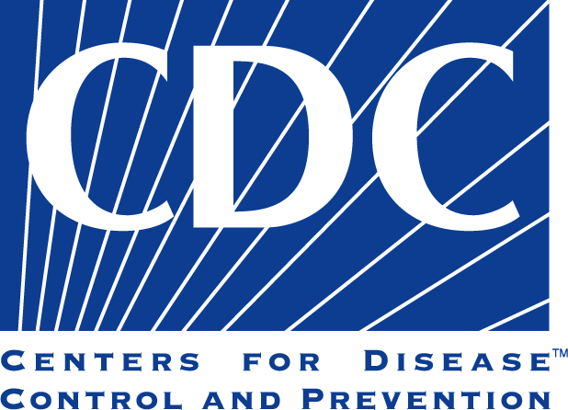
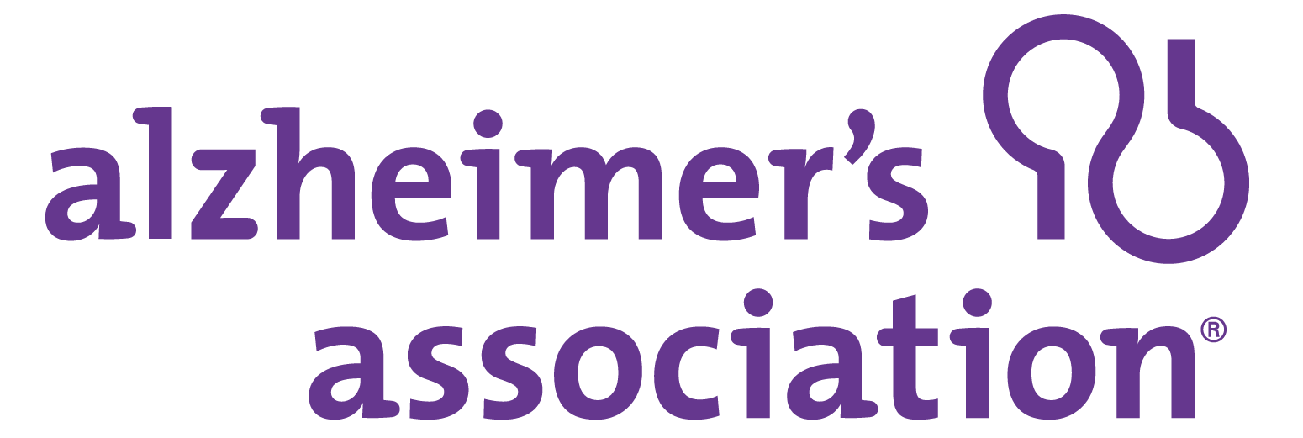
A Public Health Approach to Alzheimer’s and Other Dementias
Alzheimer’s & Other Dementias –
The Basics
Notes:
DISCLAIMERS
This publication was supported by Cooperative Agreement Number 5U58DP002945-05, funded by the Centers for Disease Control and Prevention. Its contents are solely the responsibility of the authors and do not necessarily represent the official views of the Centers for Disease Control and Prevention or the Department of Health and Human Services.
The mark "CDC” is owned by the US Dept. of Health and Human Services and is used with permission. Use of this logo is not an endorsement by HHS or CDC of any particular product, service, or enterprise.
Talking Points:
This presentation entitled, Alzheimer’s and Other Dementias – The Basics is part of a curriculum for public health students entitled, A Public Health Approach to Alzheimer’s and Other Dementias. It was developed by the Emory Centers for Training and Technical Assistance for the Alzheimer’s Association with funding from the Centers for Disease Control and Prevention.
This module provides background information on cognitive health, cognitive impairment, dementia, and Alzheimer’s disease. It provides essential information on Alzheimer’s disease, including what is known about its causes, its progression, risk factors, and care.

Slide 2
Learning Objectives
Define cognitive health
Define and differentiate between dementia and Alzheimer’s
List at least 5 common symptoms of Alzheimer’s
Describe the changes that occur during the course of Alzheimer’s
Identify at least 3 risk factors associated with Alzheimer’s
Describe the role of caregivers
Notes:
By the end of the presentation, you will be able to:
Define cognitive health
Define and differentiate between dementia and Alzheimer’s
List at least 5 common symptoms of Alzheimer’s
Describe the changes that occur during the course of Alzheimer’s
Identify at least 3 risk factors associated with Alzheimer’s
Describe the role of caregivers

Slide 3
COMPETENCIes
Association for Gerontology in Higher Education (AGHE):
1.2.1 Distinguish normal biological aging changes from pathology including genetic factors.
1.3.3 Demonstrate knowledge of signs, symptoms, and impact of common cognitive and mental health problems in late life (e.g., dementia, depression, grief, anxiety).
1.2.4 Recognize common late-life syndromes and diseases and their related bio-psycho-social risk and protective factors.
Association of Schools and Programs of Public Health (ASPPH):
Domain 1: Describe risk factors and modes of transmission for infectious and chronic diseases and how these diseases affect both personal and population health.
Notes:
(THIS SLIDE CAN BE EDITED AS NEEDED)
The content in this presentation supports the development of the following competencies:
Association for Gerontology in Higher Education (AGHE):
1.2.1 Distinguish normal biological aging changes from pathology including genetic factors.
1.3.3 Demonstrate knowledge of signs, symptoms, and impact of common cognitive and mental health problems in late life (e.g., dementia, depression, grief, anxiety).
1.2.4 Recognize common late-life syndromes and diseases and their related bio-psycho-social risk and protective factors.
Association of Schools and Programs of Public Health (ASPPH):
Domain 1: Describe risk factors and modes of transmission for infectious and chronic diseases and how these diseases affect both personal and population health.

Slide 4
COMPETENCIes Cont.
National Association of Chronic Disease Directors (NACDD):
Domain 7: Discuss the underlying causes and management of chronic diseases, including behavioral, medical, genetic, environmental and social factors.
Domain 7: Articulate key chronic disease issues.
Domain 7: Describe socioeconomic and behavioral determinants of health disparities.
National Commission for Health Education Credentialing, Inc. (NCHEC):
7.1.1 Identify current and emerging issues that may influence health and health education
Notes:
(THIS SLIDE CAN BE EDITED AS NEEDED)
National Association of Chronic Disease Directors (NACDD):
Domain 7: Discuss the underlying causes and management of chronic diseases, including behavioral, medical, genetic, environmental and social factors.
Domain 7: Articulate key chronic disease issues.
Domain 7: Describe socioeconomic and behavioral determinants of health disparities.
National Commission for Health Education Credentialing, Inc. (NCHEC):
7.1.1 Identify current and emerging issues that may influence health and health education

Slide 5
Discussion Question
What is cognitive health?
Notes:
Ask: What is cognitive health?

Slide 6
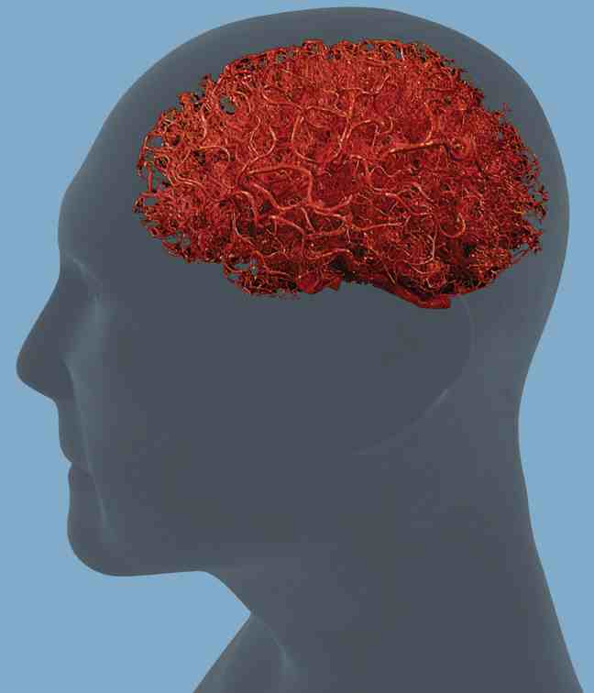
Cognitive Health
Cognition: the ability to think, learn, and remember
Cognitive health continuum:
“optimal functioning” to severe disability
Linked to brain health
¹ Centers for Disease Control and Prevention, Division of Healthy Aging. What is a Healthy Brain? New Research Explores Perceptions of Cognitive Health Among Diverse Older Adults.
Notes:
To understand what happens to a person when he or she develops Alzheimer’s or dementia, it is helpful to first consider cognitive health.
Cognition refers to the ability to think, learn, and remember.
Cognitive health can be viewed along a continuum. At one end is “optimal functioning,” which refers to a healthy brain that can perform the following mental processes:
Ability to learn new things
Intuition
Judgment
Language
Remembering
At the other end of the spectrum are people with severe Alzheimer’s, dementia, and other brain injuries that render that person unable to function cognitively.
Cognitive health is linked to brain health in terms of the physiologic health of the brain and overall functioning.

Slide 7
Cognitive Aging
The brain changes as it ages
Increase in wisdom and expertise
Speed of processing, making decisions, remembering may decline
Normal part of aging
² Institute of Medicine. (2015) Cognitive Aging: Progress in Understanding and Opportunities for Action. ³ National Institute on Aging. (2013) Understanding Memory Loss: What To Do When you Have Trouble Remembering.
Notes:
Like other organs in the human body, the brain changes as it ages. Physical structures in the brain change, and its ability to carry out various functions tends to decline.
Wisdom and expertise can increase with age, while the speed of processing information, making decisions, and remembering certain things can decline.
This process is known as cognitive aging – a decline in memory, decision-making, processing speed, and learning. For example, a person might have trouble following a recipe, remembering certain words, or finding common items such as glasses or keys.
These changes are considered a normal part of aging, are different for different people, and may vary from day to day.

Slide 8
Mild Cognitive Impairment (MCI)
Difficulty with cognitive processes
Not severe enough to interfere with daily life
Increased risk of Alzheimer’s or dementia
May be caused by external factors (vitamin B12 deficiency, depression)
⁴ Alzheimer’s Association. (2012) Mild Cognitive Impairment. ⁵ National Institute on Aging, About Alzheimer’s Disease: Mild Cognitive Impairment. Accessed June 10, 2015 from website: https://www.nia.nih.gov/alzheimers/topics/mild-cognitive-impairment.
Notes:
Mild cognitive impairment (MCI) is a condition in which people have more memory or other thinking problems than normal for their age, but their symptoms are not severe enough to interfere with daily life or their ability to function independently.
Symptoms of MCI may include: forgetting important information that he or she would previously have easily recalled (such as appointments, conversations, or recent events), or a decreased ability to make sound decisions, judge the time or sequence of steps needed to complete a complex task, or have trouble with visual perception.
A person with MCI is at an increased risk of developing Alzheimer’s or other dementia.
In some cases, however, the condition may be caused by external factors, such as medication, vitamin B12 deficiency, and depression. In these cases, the condition can be reversed, reverse on its own, or remain stable.

Slide 9
Cognitive Impairment
Difficulty with cognitive processes that affect everyday life
Spans wide range of functioning
Can occur as a result of
Alzheimer’s, dementia, stroke,
traumatic brain injury
⁶ Alzheimer’s Association and Centers for Disease Control and Prevention. (2013) The CDC Healthy Brain Initiative: Public Health Road Map for State and National Partnerships, 2013-2018.
Notes:
Further along the cognitive health continuum is cognitive impairment.
When a person has trouble with cognitive processes that begin to affect the things he or she does in everyday life, it is often referred to as cognitive impairment.
Cognitive impairment spans a wide range of functioning. It can occur as a result of Alzheimer’s or other dementias, or with other conditions such as stroke and traumatic brain injury.

Slide 10
Dementia
Alzheimer’s and Other Dementias – The Basics
Notes:
Next we turn to dementia.

Slide 11
Dementia
Decline in mental ability severe enough to interfere with daily life
Not a specific disease
Not normal aging
Caused by damage to brain cells from disease or trauma
Many dementias are progressive
⁷ Alzheimer’s Association. What is Dementia? Accessed June 8, 2015 from website: http://www.alz.org/what-is-dementia.asp#causes
Notes:
Dementia is a general term for a decline in mental ability severe enough to interfere with daily life.
Dementia is not a specific disease. It’s an overall term that describes a wide range of symptoms associated with a decline in memory or other thinking skills.
Dementia is NOT normal aging.
It is caused by damage to brain cells from disease or trauma (such as a brain injury or stroke). This damage interferes with the ability of brain cells to communicate with each other. When brain cells cannot communicate normally, thinking, behavior, and feelings can be affected.
Many dementias are progressive, meaning symptoms start out slowly and gradually get worse.

Slide 12
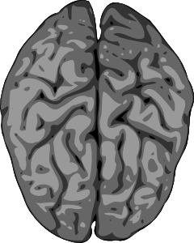
Types of Dementia
Alzheimer’s disease
Vascular dementia
Dementia with Lewy Bodies (DLB)
Mixed dementia
Parkinson’s disease
Frontotemporal dementia
Creutzfeldt-Jakob disease
Normal pressure hydrocephalus
Huntington’s disease
Wernicke-Korsakoff Syndrome
⁸ Alzheimer’s Association. Types of Dementia. Accessed June 8, 2015 from website: http://www.alz.org/dementia/types-of-dementia.asp. National Institute on Aging. (2015) Alzheimer’s Disease Fact Sheet.
Notes:
(Provide descriptions as needed):
There are numerous types of dementia:
Alzheimer’s disease: description begins on slide #12
Vascular dementia: description on slide #11
Dementia with Lewy bodies (DLB): memory loss and thinking problems common in Alzheimer’s disease; more likely to have initial or early symptoms such as sleep disturbances, well-formed visual hallucinations, and muscle rigidity or other parkinsonian movement features
Mixed dementia: abnormalities linked to more than one type of dementia occur simultaneously in the brain; researchers increasingly believe a large number of dementia cases are of mixed pathology
Parkinson’s disease: brain changes begin in a region that plays a key role in movement; as changes gradually spread, they often begin to affect mental functions, including memory and the ability to pay attention, make sound judgments and plan the steps needed to complete a task
Frontotemporal dementia: typical symptoms include changes in personality and behavior and difficulty with language; nerve cells in the front and side regions of the brain are especially affected
Creutzfeldt-Jakob disease: rapidly fatal disorder that impairs memory and coordination and causes behavior changes; variant CJD (“mad cow disease”) occurs in cattle and has been transmitted to people under certain circumstances
Normal pressure hydrocephalus: symptoms include difficulty walking, memory loss, and inability to control urination; caused by the buildup of fluid in the brain
Huntington’s disease: progressive brain disorder caused by a single defective gene on chromosome 4; symptoms include abnormal involuntary movements, a severe decline in thinking and reasoning skills, irritability, depression, and other mood changes
Wernicke-Korsakoff Syndrome: a chronic memory disorder caused by severe deficiency of thiamine (vitamin B-1); most common cause is alcohol misuse; memory problems may be strikingly severe while other thinking and social skills seem relatively unaffected
Alzheimer’s disease and vascular dementia are the most common types of dementia.

Slide 13
Vascular Dementia
2nd most common cause of dementia
20% - 30% of cases
Caused by conditions that block or reduce blood flow to the brain
Symptoms may occur suddenly following strokes or slowly as a result of cumulative damage
⁹ Alzheimer’s Association. (2015) Vascular Dementia.
Notes:
Vascular dementia is widely considered as the second most common cause of dementia after Alzheimer’s disease, accounting for 20% to 30% of cases.
Vascular dementia is a decline in thinking skills caused by conditions that block or reduce blood flow to the brain, depriving brain cells of vital oxygen and nutrients.
In vascular dementia, changes in thinking sometimes occur suddenly following strokes that block major brain blood vessels. Thinking problems may also begin as mild changes that worsen gradually as a result of multiple minor strokes or other conditions that affect smaller blood vessels, leading to cumulative damage.
Researchers increasingly believe that many people have mixed vascular dementia and Alzheimer’s.

Slide 14
Alzheimer’s disease
Alzheimer’s and Other Dementias – The Basics
Notes:
The most common type of dementia is Alzheimer’s disease. We will focus our attention on understanding more about the stages of Alzheimer’s as well as risk factors, treatment and management of the disease.

Slide 15
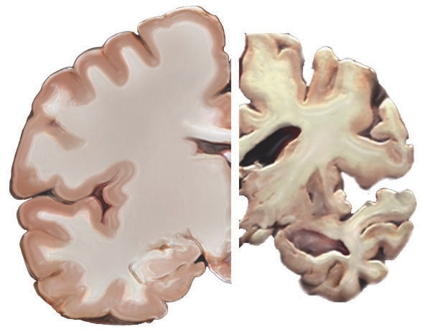
Alzheimer’s Disease: Overview
Most common type of dementia
60% - 80% of cases
Progressive – symptoms gradually worsen over number of years
¹⁰ Alzheimer’s Association. What is Alzheimer’s? Accessed June 8, 2015 from website: http://www.alz.org/alzheimers_disease_what_is_alzheimers.asp
Notes:
Alzheimer’s disease is the most common type of dementia. It accounts for an estimated 60% to 80% of cases.
Alzheimer’s disease is a progressive disease, in which dementia symptoms gradually worsen over a number of years.
In its mild (early) stages, people experience some memory loss, but with severe (late-stage) Alzheimer’s disease, individuals lose the ability to carry on a conversation and respond to their environment. The degenerative nature of the disease means many in the severe stage have difficulty moving, often become bed-bound, and need around-the-clock care.
*Note: The image on the slide shows a healthy brain (left side) as compared to a severe Alzheimer’s brain (right side). The Alzheimer’s brain is significantly smaller than the healthy brain.

Slide 16
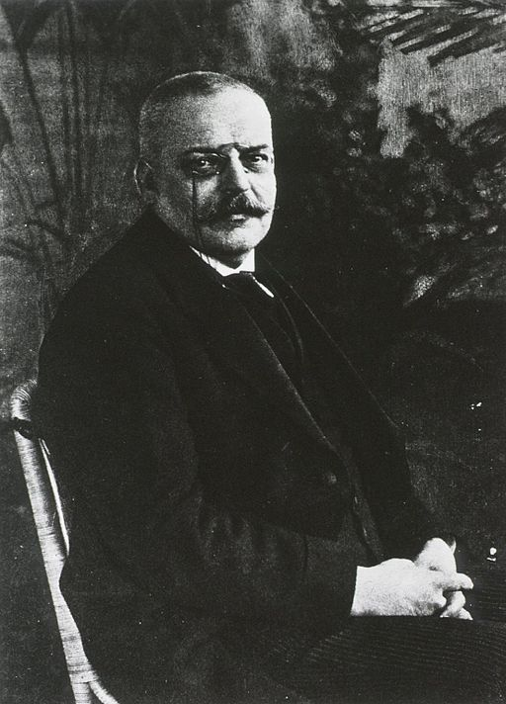
Alzheimer’s Disease: History
Identified in 1906 by Dr. Alois Alzheimer
Examined brain of woman who died after mental illness
Found abnormal clumps (plaques) and tangled fibers (tangles)
¹¹ National Institute on Aging. (2015) Alzheimer’s Disease Fact Sheet.
Notes:
Alzheimer’s disease was first identified in 1906 by Dr. Alois Alzheimer. He noticed certain changes in the brain tissue of a woman who had died after a mental illness that included symptoms of memory loss, language problems, and unpredictable behavior.
Dr. Alzheimer examined her brain after her death and found many abnormal clumps (now called amyloid plaques) and tangled bundles of fibers (now called neurofibrillary, or tau, tangles).
These plaques and tangles in the brain are still considered some of the hallmarks of Alzheimer’s disease, along with the loss of connections between nerve cells (neurons) in the brain.

Slide 17
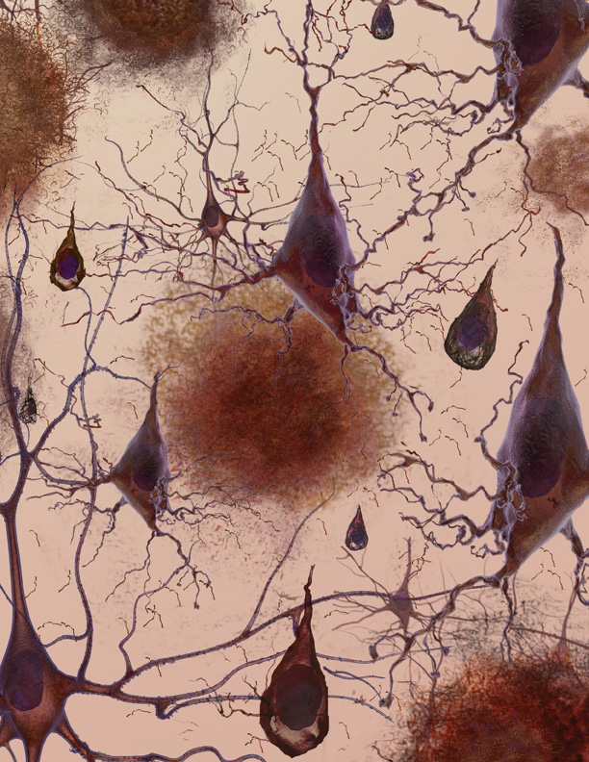
Alzheimer’s Disease: Physical Changes
Brain shrinks dramatically
Nerve cell death
Tissue loss
Plaques: abnormal clusters of protein fragments
Tangles: twisted strands of another protein
¹² Alzheimer’s Association. Brain Tour. Accessed July 1, 2015 from website: http://www.alz.org/braintour/3_main_parts.asp
Notes:
Alzheimer’s disease leads to nerve cell death and tissue loss throughout the brain. Over time, the brain shrinks dramatically, affecting nearly all its functions.
Scientists are not absolutely sure what causes cell death and tissue loss in the Alzheimer’s brain, but plaques and tangles are prime suspects.
Plaques, abnormal clusters of protein fragments, build up between nerve cells in the brain. Plaques form when protein pieces called beta-amyloid clump together.
Dead and dying nerve cells contain tangles, which are made up of twisted strands of another protein.
Plaques and tangles tend to spread through the brain in a predictable pattern as Alzheimer’s disease progresses.
*Note: The image on the slide shows a microscopic illustration of Alzheimer’s tissue with plaques and tangles.
Video Supplement: Inside the Brain: Unraveling the Mystery of Alzheimer Disease”. National Institutes of Health, NIH Senior Health.
Link: http://nihseniorhealth.gov/alzheimersdisease/whatisalzheimersdisease/video/a2_na.html?intro=yes

Slide 18
Alzheimer’s Disease: Causes
Precise changes in brain largely unknown
Probably develops as a result of complex interactions among:
Age
Genetics
Environment
Lifestyle
Coexisting medical conditions
¹³ Alzheimer’s Association. Risk Factors. Accessed June 8, 2015 from website: http://www.alz.org/alzheimers_disease_causes_risk_factors.asp
Notes:
Although research has revealed a great deal about Alzheimer’s disease, the precise changes that occur in the brain and trigger the development of the disease remain largely unknown.
Experts agree that in the vast majority of cases, Alzheimer’s disease, like other common chronic conditions, probably develops as a result of complex interactions among multiple factors, including age, genetics, environment, lifestyle, and coexisting medical conditions.
It is likely that damage to the brain starts a decade or more before symptoms begin to appear.

Slide 19
Younger-Onset Alzheimer’s Disease
Affects people younger than 65
Many are in their 40s and 50s
200,000 have younger onset (in U.S.)
4% of population with Alzheimer’s
¹⁴ Alzheimer’s Association. Younger/Early Onset Alzheimer’s & Dementia. Accessed June 8, 2015 from website: http://www.alz.org/alzheimers_disease_early_onset.asp
Notes:
Alzheimer’s disease is not just a disease of old age.
Younger-onset (also known as early-onset) Alzheimer’s disease affects people younger than 65. Many people with early onset Alzheimer’s disease are in their 40s and 50s.
In the U.S., it is estimated that approximately 200,000 people have younger onset Alzheimer’s disease – up to 4% of the population with Alzheimer’s disease.

Slide 20
Discussion Question
What are the characteristics of Alzheimer’s disease?
Notes:
Ask: What are the characteristics of Alzheimer’s disease?

Slide 21
10 Warning Signs of Alzheimer’s
Memory loss that disrupts daily life
Challenges in planning or solving problems
Difficulty completing familiar tasks
Confusion with time or place
Trouble understanding visual images and spatial relationships
¹⁵ Alzheimer’s Association. (2009) Know the 10 Signs.
Notes:
Alzheimer’s disease affects people in different ways. Symptoms also change and become more severe as the disease progresses.
The most common symptom begins with gradually worsening ability to remember new information. As damage spreads, individuals experience other difficulties.
The following are ten warning signs of Alzheimer’s disease:
Memory loss that disrupts daily life
One of the most common signs of Alzheimer’s disease, especially in the early stages, is forgetting recently learned information.
Others include: forgetting important dates or events; asking for the same information over and over; relying on memory aids (e.g., reminder notes or electronic devices) or family members for things they used to handle on their own.
Challenges in planning or solving problems
Some people may experience changes in their ability to develop and follow a plan or work with numbers.
They may have trouble following a familiar recipe or keeping track of monthly bills.
They may have difficulty concentrating and take much longer to do things than they did before.
3. Difficulty completing familiar tasks at home, at work or at leisure
People with Alzheimer’s disease may have a hard time completing daily tasks. Sometimes, people may have trouble driving to a familiar location, managing a budget at work, or remembering the rules of a favorite game.
4. Confusion with time or place
People with Alzheimer’s disease can lose track of dates, seasons, and the passage of time. They may have trouble understanding something if it is not happening immediately. Sometimes they may forget where they are or how they got there.
5. Trouble understanding visual images and spatial relationships
For some people, having vision problems is a sign of Alzheimer’s disease. They may have difficulty reading, judging distance and determining color or contrast. In terms of perception, they may pass a mirror and think someone else is in the room. They may not recognize their own reflection.

Slide 22
10 Warning Signs of Alzheimer’s (continued)
New problems with words in speaking or writing
Misplacing things and losing the ability to retrace steps
Decreased or poor judgment
Withdrawal from work or social activities
Changes in mood and personality
¹⁶ Alzheimer’s Association. (2009) Know the 10 Signs.
Notes:
6. New problems with words in speaking or writing
People with Alzheimer’s disease may have trouble following or joining a conversation. They may stop in the middle of a conversation and have no idea how to continue, or they may repeat themselves. They may struggle with vocabulary, have problems finding the right word, or call things by the wrong name (e.g., calling a watch a “hand clock”).
7. Misplacing things and losing the ability to retrace steps
A person with Alzheimer’s disease may put things in unusual places. They may lose things and be unable to go back over their steps to find them again. Sometimes, they may accuse others of stealing. This may occur more frequently over time.
8. Decreased or poor judgment
People with Alzheimer’s disease may experience changes in judgment or decision-making. For example, they may use poor judgment when dealing with money, such as giving large amounts to telemarketers. They may pay less attention to grooming or keeping themselves clean.
9. Withdrawal from work or social activities
A person with Alzheimer’s disease may start to remove themselves from hobbies, social activities, work projects or sports. They may have trouble keeping up with a favorite sports team or remembering how to complete a favorite hobby. They may also avoid being social because of the changes they have experienced.
10. Changes in mood and personality
The mood and personalities of people with Alzheimer’s disease can change. They can become confused, suspicious, depressed, fearful or anxious. They may be easily upset at home, at work, with friends, or in places where they are out of their comfort zone.

Slide 23
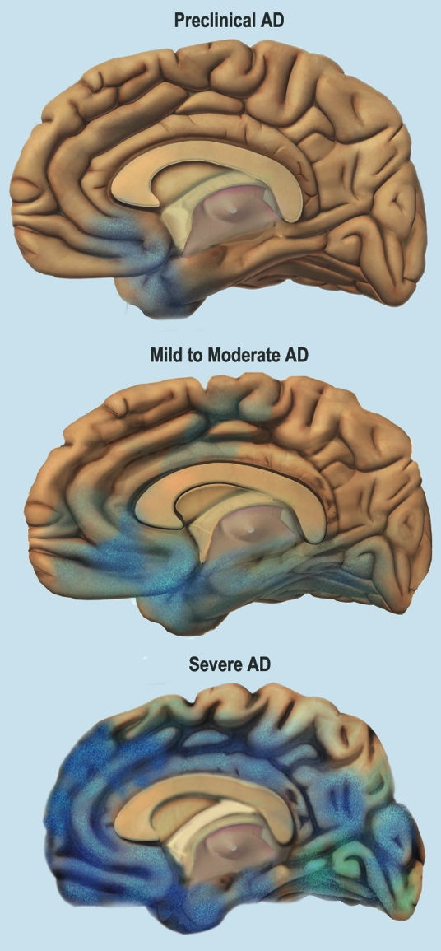
Stages of Alzheimer’s Disease
Average lifespan 4-8 years after diagnosis; as long as 20 years
Progresses slowly in 3 stages:
Mild (early-stage)
Moderate (middle-stage)
Severe (late-stage)
¹⁷ Alzheimer’s Association. Stages of Alzheimer’s. Accessed June 8, 2015 from website: http://www.alz.org/alzheimers_disease_stages_of_alzheimers.asp
Notes:
On average, a person with Alzheimer’s disease lives four to eight years after diagnosis, but can live as long as 20 years, depending on many factors (such as the progression of the disease, other co-occurring conditions, infections, and unintentional injuries).
The symptoms of Alzheimer’s disease worsen over time, although the rate at which the disease progresses varies.
Alzheimer’s disease typically progresses slowly in three general stages – mild (early-stage), moderate (middle-stage), and severe (late-stage).
*Note: The image on the slide shows the progression of changes to the brain, from preclinical Alzheimer’s (top), mild to moderate (middle), to severe (bottom).

Slide 24
Mild Alzheimer’s (Early-Stage)
Able to function independently
Common difficulties:
Forgetting familiar words
Losing everyday objects
Trouble remembering names
Greater difficulty performing tasks
Forgetting material just read
Increasing trouble with planning, organizing
¹⁸ Alzheimer’s Association. Stages of Alzheimer’s. Accessed June 8, 2015 from website: http://www.alz.org/alzheimers_disease_stages_of_alzheimers.asp
Notes:
In the mild stages of Alzheimer’s disease, a person may function independently. He or she may still drive, work and be part of social activities.
Despite this, the person may feel as if he or she is having memory lapses, such as forgetting familiar words or the location of everyday objects.
Other common difficulties in the mild stage of Alzheimer’s disease include:
Trouble remembering names when introduced to new people
Having greater difficulty performing tasks in social or work settings
Forgetting material that one has just read
Increasing trouble with planning or organizing

Slide 25
Moderate Alzheimer’s (Middle-Stage)
Requires increasing care
Symptoms include:
Forgetfulness of personal history
Confusion about place or time
Need for help with bathing, toileting, dressing
Changes in sleep patterns
Increased risk of wandering
Personality and behavioral changes
¹⁹ Alzheimer’s Association. Stages of Alzheimer’s. Accessed June 8, 2015 from website: http://www.alz.org/alzheimers_disease_stages_of_alzheimers.asp
Notes:
As the disease progresses, a person with Alzheimer’s disease will require a greater level of care.
In the moderate stage, damage to nerve cells in the brain can make it difficult to express thoughts and perform routine tasks.
During this stage, symptoms will be noticeable to others and may include:
Forgetfulness of events or about one’s own personal history
Confusion about where they are or what day it is
The need for help choosing proper clothing for the season or the occasion
Trouble controlling bladder and bowels in some individuals
Changes in sleep patterns, such as sleeping during the day and becoming restless at night
An increased risk of wandering and becoming lost
Personality and behavioral changes, including suspiciousness and delusions or compulsive, repetitive behavior like hand-wringing or tissue shredding

Slide 26
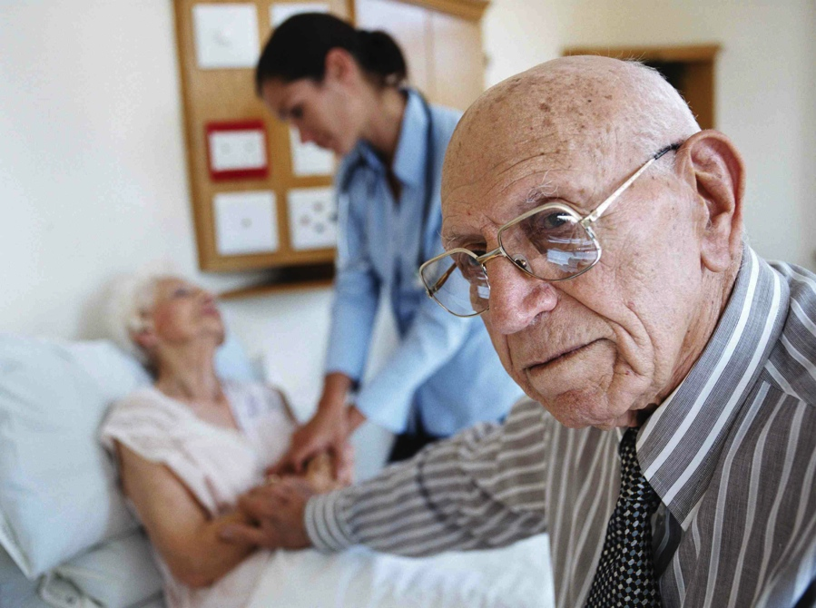
Severe Alzheimer’s (Late-Stage)
Typically longest stage
Requires full-time care
Loss of awareness of recent experiences and surroundings
Changes in physical abilities (walking, sitting, swallowing)
Vulnerable to infections
²⁰ Alzheimer’s Association. Stages of Alzheimer’s. Accessed June 8, 2015 from website: http://www.alz.org/alzheimers_disease_stages_of_alzheimers.asp
Notes:
The severe stage of Alzheimer’s disease is typically the longest stage and can last for many years.
In the severe stage of Alzheimer’s disease, individuals lose the ability to respond to their environment, to carry on a conversation, and, eventually, to control movement.
They may still say words or phrases, but communicating becomes difficult.
As memory and cognitive skills continue to worsen, personality changes may take place, and individuals need extensive help with daily activities.
At this stage, individuals may:
Require full-time, around-the-clock assistance with daily personal care
Lose awareness of recent experiences as well as of their surroundings
Experience changes in physical abilities, including the ability to walk, sit, and eventually, swallow
Become vulnerable to infections, especially pneumonia

Slide 27
Risk factors
Alzheimer’s and Other Dementias – The Basics
Notes:
Next we turn to risk factors for Alzheimer’s disease.

Slide 28
Risk Factors: Age
#1 risk factor is advancing age
Approximately doubles every 5
years after age 65
1 in 3 people age ≥85
²¹ Alzheimer’s Association. Risk Factors. Accessed June 8, 2015 from website: http://www.alz.org/alzheimers_disease_causes_risk_factors.asp ²² Alzheimer’s Association, 2015 Alzheimer’s Disease Facts and Figures, March 2015
Notes:
Currently, researchers don’t fully understand what causes Alzheimer’s disease in most people. As described earlier, in most cases it is likely a combination of genetic, environmental, and lifestyle factors that take place over a long period of time.
A number of risk factors have been identified that contribute to the development of Alzheimer’s disease. Other risk factors show evidence of decreased risk pending further research.
The greatest risk factor for Alzheimer’s disease is advancing age. Most individuals with the disease are age 65 or older. However, Alzheimer’s and dementia are not normal parts of aging.
The risk of developing Alzheimer’s disease increases with age – it approximately doubles every five years after age 65. In persons age 85 or older, about one in three have Alzheimer’s disease.

Slide 29
Risk Factors: Family History, Education
Family history
Hereditary/Genetics
Education, cognitive engagement
²³ Alzheimer’s Association. Risk Factors. Accessed from website: http://www.alz.org/alzheimers_disease_causes_risk_factors.asp
Notes:
In addition to advancing age, another strong risk factor is family history. People who have an immediate family member – a parent, brother, sister, or child – with Alzheimer’s disease are more likely to develop the disease. This risk increases if more than one family member has the disease.
When diseases tend to run in families, either hereditary (genetics) or environmental factors, or both, may play a role.
Scientists have identified numerous hereditary genes that either increase the likelihood or guarantee that people with the gene will develop Alzheimer’s disease.
Risk genes: increase the likelihood of developing a disease, but do not guarantee it will happen. Scientists have identified several risk genes, including APOE-e4, tied to Alzheimer’s disease.
Deterministic genes: directly cause a disease, guaranteeing that anyone who inherits them will develop the disorder. Scientists have discovered variations that directly cause Alzheimer’s disease in the genes of three proteins. This is very rare, representing perhaps 1% of Alzheimer’s cases. Onset for Alzheimer’s disease related to these genes tends to occur at a very young age, including people in their 30s.
Researchers are trying to determine the link between dementias and possible environmental factors such as exposure to pesticides, food additives, air pollution and other problematic chemical compounds.
Several studies have demonstrated that fewer years of formal education and lower levels of cognitive engagement are indicators of risk for dementia. People who have more years of formal education have lower rates of Alzheimer’s and other dementias than those with less education. Additional studies suggest that remaining socially and mentally active throughout life may support brain health and possibly reduce the risk of Alzheimer’s and other dementias.
Some researchers have proposed a “cognitive reserve” hypothesis, in which ongoing mental activity and stimulation, such as through education, occupation, leisure activity, mental and physical activity, may help protect the brain against damage and decline.

Slide 30
Risk Factors: Race & Ethnicity
African-Americans: 2 times greater risk
Hispanics: 1.5 times greater risk
Cardiovascular risk factors more common
Lower levels of education, socioeconomic status
²⁴ Alzheimer’s Association (2016) Alzheimer’s Disease Facts and Figures
Notes:
Race and ethnicity may also contribute to increased risk of developing Alzheimer’s and other dementias.
In the U.S., older African-Americans are about two times more likely than older whites to have Alzheimer’s disease. First-degree relatives of African-Americans with Alzheimer’s disease have a 43% chance of developing dementia.
Older Hispanics are about one and one-half times more likely than older whites to have Alzheimer’s disease.
Variations in health, lifestyle and socioeconomic circumstances across racial groups likely account for most of the difference in risk of Alzheimer’s and other dementias by race. African-American and Hispanic communities have a higher incidence of certain Alzheimer’s risk factors:
Conditions such as high blood pressure and diabetes which are risk factors for Alzheimer’s disease, are more common in African-Americans and Hispanic populations than in whites.
Lower levels of education and other socioeconomic characteristics (such as lower income, access to quality care) among older racial and ethnic minorities may also contribute to increased risk.
Some studies suggest that differences based on race and ethnicity do not persist in rigorous analyses that account for such risk factors.

Slide 31
Risk Factors: Women
2/3 of affected population
16% of women age ≥ 71 (11% of men)
At age 65 have more than 1 in 6 chance (1 in 11 for men)
Age ≥ 60, are twice as likely to develop Alzheimer’s than breast cancer
²⁵ Alzheimer’s Association, AAIC Press Release, July 21, 2015 ²⁶ Alzheimer’s Association, Public Health E-News, July 22, 2015
Notes:
Almost 2/3 of U.S. adults with Alzheimer’s disease are women.
Among those aged 71 and older, 16% of women have Alzheimer’s and other dementias, compared with 11% of men.
At age 65, women without Alzheimer’s disease have more than a one in six chance of developing Alzheimer’s disease during the remainder of their lives, compared with a one in 11 chance for men.
Women in their 60s are about twice as likely to develop Alzheimer’s disease over the rest of their lives as they are to develop breast cancer.
This may be primarily explained by the fact that women live longer, on average, than men.
However, researchers are increasingly questioning whether there may be other reasons for the difference in the number of women and men who develop the disease.

Slide 32
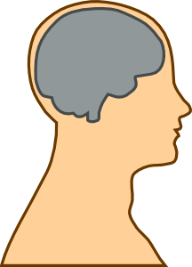
Modifiable Risk Factors: Head Trauma
Moderate and severe traumatic brain injury
Moderate injury: 2.3 times greater risk
Severe injury: 4.5 times greater risk
Risk remains for years after injury
²⁷ Alzheimer’s Association. (2015) Traumatic Brain Injury.
Notes:
There are some risk factors that may be changed or prevented to help reduce the risk of developing Alzheimer’s disease.
Research has linked moderate and severe traumatic brain injury to a greater risk of developing Alzheimer’s or another type of dementia years after the original head injury.
One of the key studies showing an increased risk found that older adults with a history of moderate traumatic brain injury (unconsciousness lasting more than 30 minutes) had a 2.3 times greater risk of developing Alzheimer’s disease than seniors with no history of head injury.
Those with a history of severe traumatic brain injury (unconsciousness lasting more than 24 hours) had a 4.5 times greater risk. Also, people with repeated head injuries (such as boxers, football players, and combat veterans) are at an even higher risk of developing dementia.

Slide 33
Modifiable Risk Factors: Lifestyle
Increases risk
Current smoking
Midlife obesity
Decreases risk
Physical activity
Heart-healthy diets: DASH, Mediterranean diet
Mental and social activity
²⁸ Alzheimer’s Association. (2014) Alzheimer’s and Public Health Spotlight: Heart Health and Brain Health. ²⁹ Alzheimer’s Association. Prevention and Risk of Alzheimer’s & Dementia. Accessed July 16, 2015 from website: http://www.alz.org/research/science/alzheimers_prevention_and_risk.asp
Notes:
Certain lifestyle factors may help to protect against developing Alzheimer’s and other dementias.
There is fairly strong evidence that current smoking increases the risk of cognitive decline and possibly also dementia, and that quitting smoking may reduce the associated risk to levels comparable to those who have never smoked.
Diet and physical activity may help to prevent against obesity; midlife obesity has been shown to increase risk for Alzheimer’s and other dementias.
Exercise may also directly benefit brain cells by increasing blood and oxygen flow in the brain.
Current evidence also suggests that eating a heart-healthy diet may also help protect the brain against cognitive decline.
Two diets that have been studied and may be beneficial are the DASH (Dietary Approaches to Stop Hypertension) diet and the Mediterranean diet.
The DASH diet emphasizes vegetables, fruits, and fat-free or low-fat dairy products; includes whole grains, fish, poultry, beans, seeds, nuts, and vegetable oils; and limits sodium, sweets, sugary beverages, and red meats.
The Mediterranean diet includes relatively little red meat and emphasizes whole grains, fruits and vegetables, fish and shellfish, and nuts, olive oil and other healthy fats.
Some studies have also indicated that staying cognitively and socially active may help reduce the risk of cognitive decline. This involves mentally stimulating activities and social connections.

Slide 34
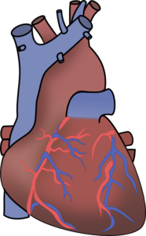
Modifiable Risk Factors: Cardiovascular
Heart-head connection
Cardiovascular risk factors:
High blood pressure in midlife
Heart disease
Stroke
Diabetes
³⁰ Alzheimer’s Association. Prevention and Risk of Alzheimer’s & Dementia. Accessed July 16, 2015 from website: http://www.alz.org/research/science/alzheimers_prevention_and_risk.asp
Notes:
Growing evidence suggests that the health of the brain is closely linked to the overall health of the heart and blood vessels.
The brain is nourished by one of the body’s richest networks of blood vessels. With every beat, the heart pumps about 20% to 25% of the blood to the head, where brain cells use at least 20% of the food and oxygen carried by the blood in order to function normally.
As a result, many factors that damage the heart or blood vessels may also damage the brain – and may increase the risk for developing Alzheimer’s and other dementias.
Several conditions known to increase the risk of cardiovascular disease – including high blood pressure, heart disease, stroke, and diabetes– appear to increase the risk of developing Alzheimer’s disease.
Some autopsy studies show that as many as 80% of individuals with Alzheimer’s disease also have cardiovascular disease.

Slide 35
Treatment & Management
Alzheimer’s and Other Dementias – The Basics
Notes:
Next we will discuss how Alzheimer’s disease is diagnosed, treated, and managed.

Slide 36
Diagnosing Alzheimer’s Disease
No single test
Medical evaluation
Medical history
Mental status testing
Information from family and friends
Physical and neurological exams
Rule out other causes
³¹ Alzheimer’s Association. Diagnosis of Alzheimer’s Disease and Dementia. Accessed June 8, 2015 from website: http://www.alz.org/alzheimers_disease_diagnosis.asp
Notes:
Physicians can almost always determine if a person has dementia; however it can be difficult to identify the exact cause.
Establishing a diagnosis for Alzheimer’s disease can be more challenging. There is no single test that can show whether a person has Alzheimer’s disease.
A careful medical evaluation is required, which includes:
A thorough medical history
Mental status testing
Information from family and friends
A physical and neurological exam
Tests (such as blood tests and brain imaging) to rule out other causes of dementia-like symptoms.

Slide 37
Treating & Managing Alzheimer’s
No cure
Drug and non-drug treatments
Primary goals of treatment:
Maintain quality of life
Maximize function in daily activities
Enhance cognition, mood, behavior
Foster safe environment
Promote social engagement
³² Alzheimer’s Association. Health Care Professionals and Alzheimer’s. Accessed June 8, 2015 from website: http://www.alz.org/health-care-professionals/medical-management-patient-care.asp
Notes:
Currently, there is no cure for Alzheimer’s disease and no treatment that slows the progression of the disease. Drug and non-drug treatments may help with both cognitive and behavioral symptoms, but don’t affect the underlying disease.
Medications are used to treat symptoms and are more effective if administered after early diagnosis.
The chief goals of treatment are to:
Maintain quality of life
Maximize function in daily activities
Enhance cognition, mood and behavior
Foster a safe environment
Promote social engagement, as appropriate

Slide 38
Alzheimer’s: Co-Morbidities
Additional chronic conditions (e.g., heart disease, diabetes, depression)
Difficult to manage
Higher rates of hospitalizations and costs
3 times as many hospital stays
3 times average Medicare costs
Preventable hospitalizations
³³ Alzheimer’s Association. (2013) Combating Alzheimer’s Disease: A Public Health Agenda.
Notes:
Treating people with Alzheimer’s often requires the management of co-morbidities. Co-morbidities refer to additional chronic conditions – such as heart disease, diabetes, depression, and arthritis – that are present in combination with a primary disease.
People with Alzheimer’s’ and dementia are more likely to have co-morbidities than other older people without dementia.
The cognitive problems associated with Alzheimer’s disease and dementia can lead to poor management of co-morbidities.
On average, people with dementia have three times as many hospital stays and have three times the average Medicare costs of other older people.
Most of the hospitalizations are not for Alzheimer’s disease itself, but for these other conditions that are often complicated by, or result from, Alzheimer’s disease. Many of these hospitalizations are preventable (or potentially avoidable) with better quality care and management of co-morbidities.

Slide 39
Unique Aspects
Alzheimer’s and Other Dementias – The Basics
Notes:
There are various unique aspects and hardships that may accompany Alzheimer’s and other dementias.

Slide 40
Alzheimer’s: Unique Aspects
Financial hardship
May lose income and savings
Increased reliance on public programs
Stigma
Vulnerability to abuse
³⁴ Alzheimer’s Association. Abuse. Accessed July 16, 2015 from website: https://www.alz.org/care/alzheimers-dementia-elder-abuse.asp
Notes:
People with younger-onset dementia may lose income and savings when they become unable to work. Those with dementia at any age may need to pay for additional services, especially as the disease progresses.
As the need for care intensifies, many people with Alzheimer’s and dementia may live in nursing homes for long periods of time. The financial burden of this care can result in turning to Medicaid and other public programs to help pay for their services and support.
People with dementia report being afraid of the reactions of others and a lower perceived status within society because of the diagnosis. The stigma associated with dementia may contribute to social exclusion, a reluctance to seek help or even a diagnosis, a sense of shame and inadequacy, and low self-esteem.
People with Alzheimer’s and other dementias tend to be especially vulnerable to abuse because the disease may prevent them from reporting the abuse or recognizing it. Abuse can occur anywhere, including at home and in care settings.
Abuse can take many forms:
Physical: physical pain or injury
Emotional: verbal assaults, threats of abuse, harassment and intimidation
Neglect: failure to provide necessities, including food, clothing, shelter, medical care or a safe environment
Financial: the misuse or withholding of the person’s financial resources (money, property) to his or her disadvantage or the advantage of someone else

Slide 41
Caregivers
Alzheimer’s and Other Dementias – The Basics
Notes:
Most people with Alzheimer’s disease have a primary caregiver – often a family member – who is crucial to ensuring appropriate care. As the person with Alzheimer’s declines, the primary caregiver(s) often takes on an increasing role in advocating for and attending to all aspects of the person’s health and well-being as well as all their financial affairs.

Slide 42
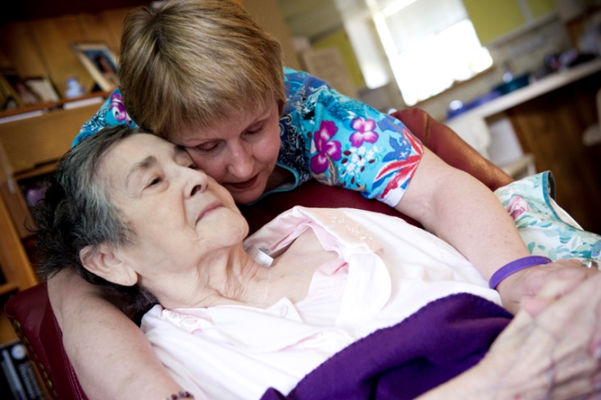
Alzheimer’s: Caregivers
Responsibilities:
Dressing, bathing, toileting, feeding
Shopping, meal preparation, transportation
Medication
Financial management
Emotional support
Increasing levels of care
Results in complete dependence
³⁵ Alzheimer’s Association. (2015) Alzheimer’s Disease Caregivers.
Notes:
The term caregiver is used to describe a person who provides a level of care and support for another that exceeds typical responsibilities of daily life.
Caregiving responsibilities, especially in the moderate and severe stages, often include:
Helping with dressing, bathing, toileting, and feeding
Shopping, meal preparation, transportation, medication management, and financial management
Providing emotional support
People with Alzheimer’s require increasing levels of caregiving as the disease progresses; more severe stages may require constant supervision and result in complete dependence on caregivers (paid or unpaid).

Slide 43
Caregivers: Challenges
Physical, financial, psychological challenges
$10.2 billion additional annual health care costs (2015)
60% rate emotional stress as high or very high
40% suffer from depression
³⁶ Alzheimer’s Association. 2016 Alzheimer’s Disease Facts and Figures.
Notes:
Being a caregiver for someone with Alzheimer’s disease can take a significant physical and emotional toll.
Due to the physical and emotional toll of caring for someone with Alzheimer’s or other dementias, these caregivers had $10.2 billion in additional health care costs in 2015.
Nearly 60% of Alzheimer’s and dementia caregivers rate the emotional stress of caregiving as high or very high.
About 40% of Alzheimer’s and dementia caregivers suffer from depression.

Slide 44
Conclusion: Key Points
Disease likely develops as result of multiple factors
Symptoms worsen over time; average lifespan 4-8 years (up to 20)
Risk factors include: age, family history, head trauma, education, lifestyle, cardiovascular conditions
African-Americans, Hispanics, women more likely to develop
Notes:
In conclusion, a review of key points from Module 2:
Experts agree that in the vast majority of cases, Alzheimer’s disease, like other common chronic conditions, probably develops as a result of complex interactions among multiple factors, including age, genetics, environment, lifestyle, and coexisting medical conditions.
The symptoms of Alzheimer’s disease worsen over time, although the rate at which the disease progresses varies.
On average, a person with Alzheimer’s disease lives four to eight years after diagnosis, but can live as long as 20 years, depending on other factors.
Risk factors for Alzheimer’s disease include:
Age
Years of formal education
Family history
Head trauma
Education
Lifestyle (current smoking, physical activity, diet, mental and social activity)
Cardiovascular conditions (including high blood pressure, heart disease, stroke, and diabetes)
African-Americans, Hispanics, and women are more likely to develop Alzheimer’s disease.
In the U.S., older African-Americans are about two times more likely than older whites to have Alzheimer’s disease. First-degree relatives of African-Americans with Alzheimer’s disease have a 43% chance of developing dementia.
Older Hispanics are about one and one-half times more likely than older whites to have Alzheimer’s disease.
Almost 2/3 of U.S. adults with Alzheimer’s disease are women.

Slide 45
Role of Public Health
3 key public health intervention tools:
Surveillance/monitoring
Primary prevention (risk reduction)
Early detection and diagnosis
Notes:
Public health plays an important part in addressing Alzheimer’s. Three key public health intervention tools that can reduce the burden of Alzheimer’s disease:
Surveillance/monitoring that allows public health to compile data and use it to:
Develop interventions
Inform public policy
Guide research
Educate populations
Promoting primary prevention can be used to promote risk reduction and promote cognitive health.
Public health may play an important role increasing early detection and diagnosis of Alzheimer’s disease

Slide 46
Dementia Capable Systems and dementia friendly communities
Dementia capable systems
Public health research and translation
Support services
Workforce training
Dementia friendly communities
Notes:
At a larger level, states and communities can become dementia capable in accommodating the needs of a population with Alzheimer’s and dementia.
A dementia capable system is a system or infrastructure that works to meet the needs of a people with dementia and their caregivers through providing education, support and services.
Public health can contribute to a dementia capable system through:
Public health research and translation
Ensuring access to support services for people with dementia and their caregivers
Workforce training and education
Supporting the creation of dementia friendly communities which describes communities that have taken steps to make their community safe for and accessible to people with Alzheimer’s and other dementias as well as support and empower people with Alzheimer’s and dementia to continue living high-quality lives with as much independence as possible.
Note to presenter: Module 4 addresses dementia capable systems and dementia friendly communities.

Slide 47
For More Information
For more information, please visit the Alzheimer’s Association website at: http://www.alz.org
Notes:
For more information on the topics covered in this presentation, please go to the Alzheimer’s Association website at www.alz.org. There you can find resources, latest research and information.

