Slide 1
Respiratory Syncytial Virus (RSV) Immunization Recommendations to Protect Infants and Children
Slide Deck
Audience: Healthcare Professionals who Provide Care to Pregnant Patients

Slide 2
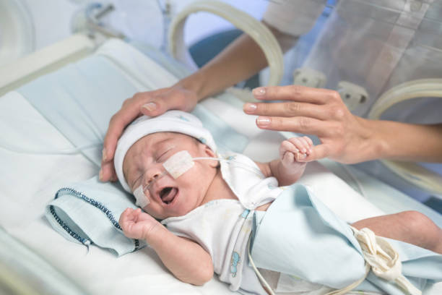
RSV is a leading cause of hospitalization in US infants
About 2-3% of young infants will be hospitalized for RSV
About 58,000-80,000 US children aged <5 years are hospitalized with RSV each year
RSV-associated hospitalization highest in infants aged <3 months and then decreases with increasing age
Preterm infants experience higher hospitalization and ICU rates
Hall et al. (2013); Langley & Anderson (2011); CDC NVSN data
Notes:
RSV can be dangerous for infants and young children. Each year in the United States, an estimated 58,000-80,000 children younger than 5 years are hospitalized due to RSV infection. Nearly 80% of those hospitalized <2 years had no underlying medical condition. RSV leads to 100-300 deaths among children younger than 5.
The highest incidence of RSV-associated hospitalization occurs in infants aged <3 months and then decreases with increasing age.
Preterm infants experience higher hospitalization and ICU admission rates

Slide 3
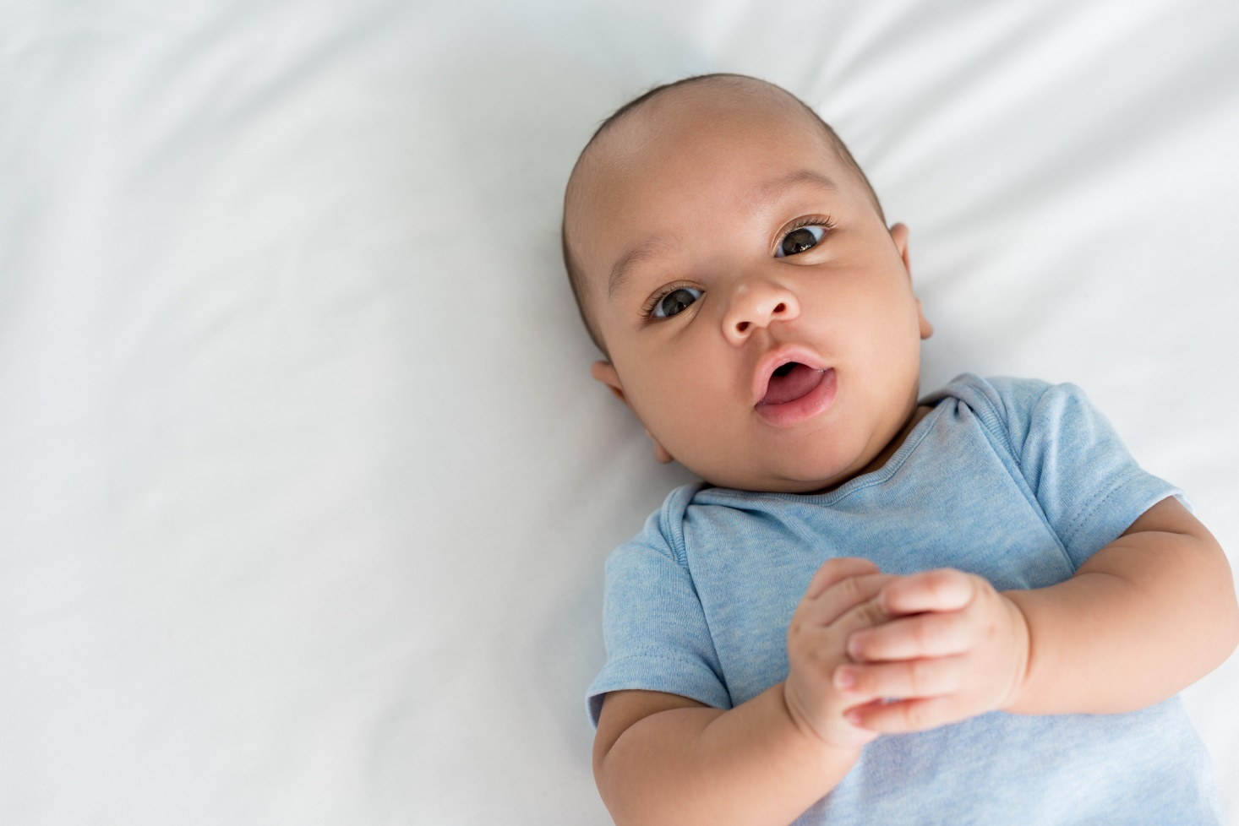
FDA approved and CDC recommends two ways to protect infants from severe RSV disease
RSV vaccine given during pregnancy
RSV
antibody
given to
the infant
Notes:
CDC recommends you use one of these two tools to protect your baby from getting very sick with RSV:
An RSV vaccine given during pregnancy
An RSV immunization given to infants and older babies
Most infants will not need both.

Slide 4
Abrysvo (Pfizer) is the ONLY RSV vaccine approved for pregnant people
CDC recommends maternal RSV vaccination during 32 weeks + 0 days through 36 weeks + 6 days gestation, with seasonal administration
During September through January in most of the continental United States
According to local guidance in jurisdictions where seasonality differs from most of the continental US
Abrysvo (Pfizer) RSV vaccine can be simultaneously administered with other indicated vaccinations
Notes:
The Abrysvo (Pfizer) is the ONLY RSV vaccine approved for pregnant people; the GSK RSV vaccine is NOT approved for use in pregnant people. The Abrysvo vaccine is recommended starting at 32w0d through 36w6d and is recommended to be given to pregnant persons during the September-January months to capture most infants born during peak RSV season. Seasonality may differ depending on which state or jurisdiction you come from (e.g. Puerto Rico, Alaksa, etc.). Vaccine can be administered with other vaccinations include flu, Covid

Slide 5
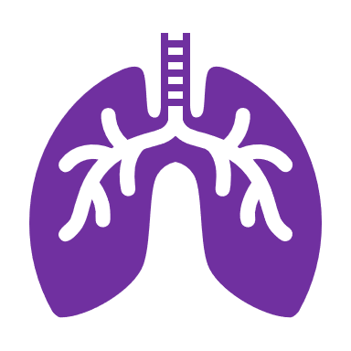
Maternal Abrysvo (Pfizer) RSV vaccine is efficacious against severe RSV disease in infants up to 6 months
Abrysvo (Pfizer) RSV vaccine: Phase 2b and 3 trials (included >7500 people)
Full trial dosing interval included administration 24–36 weeks gestation
Additional analyses conducted during approved dosing interval (32–36 weeks)
Vaccine efficacy estimates (through 180 days of life):
Severe medically attended RSV-associated lower respiratory tract infections (LTRI):
69.4% (97.58% CI = 44.3%–84.1%) when vaccinated during full trial dosing interval
(24-36 weeks)NEJM.
Hospitalization for RSV-associated LRTI:
56.8% (99.17% CI = 10.1%–80.7%) when vaccinated during full trial dosing interval
(24-36 weeks)
Fleming-Dutra KE, Jones JM, Roper LE, et al: https://www.cdc.gov/mmwr/volumes/72/wr/mm7241e1.htm
Notes:
A clinical trial including more than 7500 pregnant people compared more than 3,600 people who received the Abrysv (Pfizer) RSV vaccine between 24 and 36 weeks of pregnancy to a similar group that did not receive the vaccine but received a placebo.
To ensure we are all on the same page about terms on this slide– vaccine efficacy is a measure of how well a vaccine prevents certain health outcomes. For example, if we say a vaccine has an efficacy of 50%, that means there was a 50% reduction in the health outcome of interest in the vaccinated group compared with the placebo group during the clinical trial.
For the GRADE assessment which informed these recommendations, data were included from phase 2b and 3 trials using the trial dosing interval of 24–36 weeks’ gestation. Using all available data from the trial dosing interval provided increased power to detect potential benefits and harms. Efficacy against severe medically attended RSV-associated LRTI was 69.4% among the full trial population (trial dosing interval of 24–36 weeks’ gestation), and efficacy against hospitalization for RSV-associated LRTI was 56.8% during the full trial dosing interval.

Slide 6
Benefits of maternal vaccination with Abrysvo (Pfizer) RSV vaccine outweigh potential risks
Most common side effects: pain at injection site, headache, myalgia, nausea
What did clinical trial data show about risks during pregnancy?
More preterm births and reports of hypertension during pregnancy were observed among those who received vaccine during weeks 24-36 gestation versus placebo. The imbalance was not statistically significant.
How do we interpret this?
Available data are insufficient to establish or exclude a causal relationship between these outcomes and Abrysvo.
To reduce the potential risk of preterm birth, vaccine was approved for use during weeks 32 through 36 of pregnancy.
Fleming-Dutra KE, Jones JM, Roper LE, et al: https://www.cdc.gov/mmwr/volumes/72/wr/mm7241e1.htm
Notes:
Between the two groups, there were no significant differences in pregnancy-related problems, such as low birth weight (weighing less than 5 pounds, 8 ounces [2500 grams] at birth). Slightly more preterm deliveries were seen in those who received the vaccine compared to those who did not. In most cases, the preterm deliveries happened a month or more after getting the vaccine. It is not clear from this study if preterm deliveries were due to the vaccine or to other factors. The recommendation to get the vaccine closer to the end of pregnancy (at 32-36 weeks) allows time for antibodies to pass to the baby before delivery but lowers the chance (if there is one) of delivering early from the vaccine, since the vaccine is given closer to full term.
This difference in preterm birth was seen in the approved group 32-36 but in a smaller scale of difference and again with no statistical significance.

Slide 7
Monitoring safety and effectiveness of maternal RSV vaccine will continue
Pfizer’s pregnancy registry: Individuals who received Abrysvo during pregnancy are encouraged to contact, or have their healthcare provider contact, 1-800-616-3791 to enroll in or get information about the registry.
Vaccine Adverse Event Reporting System (VAERS): Advise vaccine recipient to report any adverse events to their healthcare provider or to the VAERS at 1-800-822-7967 and www.vaers.hhs.gov.
V-safe: Encourage pregnant individuals to register for v-safe, a digital platform that conducts health check-ins following RSV vaccination.
Notes:
*Note, v-safe is currently available for adults 60+ who received RSV vaccine, but soon will be available for pregnant people who receive Abrysvo (Pfizer) vaccine.

Slide 8
Promote V-safe – we need your help!
Materials are available to share information about V-safe​
Information sheets​
Social media posts​
Communications to vaccine recipients​
Materials and more information available at:​
https://www.cdc.gov/vaccinesafety/ensuringsafety/monitoring/v-safe/index.html

Slide 9
Nirsevimab (Sanofi and AstraZeneca) is recommended for infants this season and young children at increased risk
For infants born October 2023 through March 2024, immunize within 1 week of birth
Immunize infants with prolonged birth hospitalizations shortly before or promptly after discharge
For all other infants younger than 8 months this season, administer as soon as nirsevimab is available assuming sufficient availability
For children 8–19 months and at increased risk for severe disease, administer as soon as nirsevimab is available assuming sufficient availability
Jones JM, Fleming-Dutra KE, Prill MM et al: https://www.cdc.gov/mmwr/volumes/72/wr/mm7234a4.htm
Notes:
Nirsevimab, also know as Beyfortus, is the second option to protect infants and children at increased risk from RSV. The administration recommendations are shown on this slide. For this season, it will be important to encourage patients to inquire from their chosen pediatrician about availability of nirsevimab prior to delivery when possible. Interim recommendations for this season due to limited availability will be discussed shortly.

Slide 10
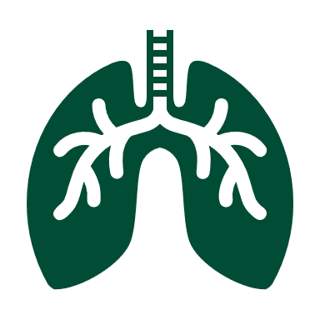
Nirsevimab (Sanofi and AstraZeneca) is efficacious against severe RSV among infants entering their first RSV season
Two placebo-controlled, randomized trials including pre-term and term infants
Vaccine efficacy estimates (through 150 days after injection):
Medically attended RSV-associated lower respiratory tract infections (LTRI):
79.0% (95% CI = 68.5%–86.1%)
Hospitalization for RSV-associated LRTI:
80.6% (95% CI = 62.3%–90.1%)
Griffin MP, Yuan Y, Takas T, et al. https://doi.org/10.1056/NEJMoa1913556
Muller WJ, Madhi SA, Seoane Nuñez B, et al. https://doi.org/10.1056/NEJMc2214773
Jones JM, Fleming-Dutra KE, Prill MM, et al. https://www.cdc.gov/mmwr/volumes/72/wr/mm7234a4.htm
Notes:
Nirsevimab, the monoclonal antibody has been shown to be efficacious in preventing severe RSV disease in infants. Two placebo-controlled trials were conducted; the efficacy rates are shown here from.
MMWR link: https://www.cdc.gov/mmwr/volumes/72/wr/mm7234a4.htm#B1_down
*Phase 2b included 24-34w, phase 3 35w up to term = pooled results shown above included both but only infant that received correct dosing v. placebo

Slide 11
Benefits of nirsevimab administration outweigh potential risks
Most common side effects: injection site reactions, rash
What did clinical trial data show about safety of nirsevimab?
The incidence of serious adverse events was not increased in those who received nirsevimab compared with those who received placebo
How do we interpret this?
We anticipate side effects to be mild or moderate and like those experienced after routine vaccinations
Jones JM, Fleming-Dutra KE, Prill MM et al: https://www.cdc.gov/mmwr/volumes/72/wr/mm7234a4.htm
Notes:
Most common side effects included injection site reactions and rash.
Clinical trial data showed no increase of serious adverse events in infants who received nirsevimab compared to those who received the placebo. We anticipate side effects to be mild or moderate and like those experienced after routine vaccinations.

Slide 12
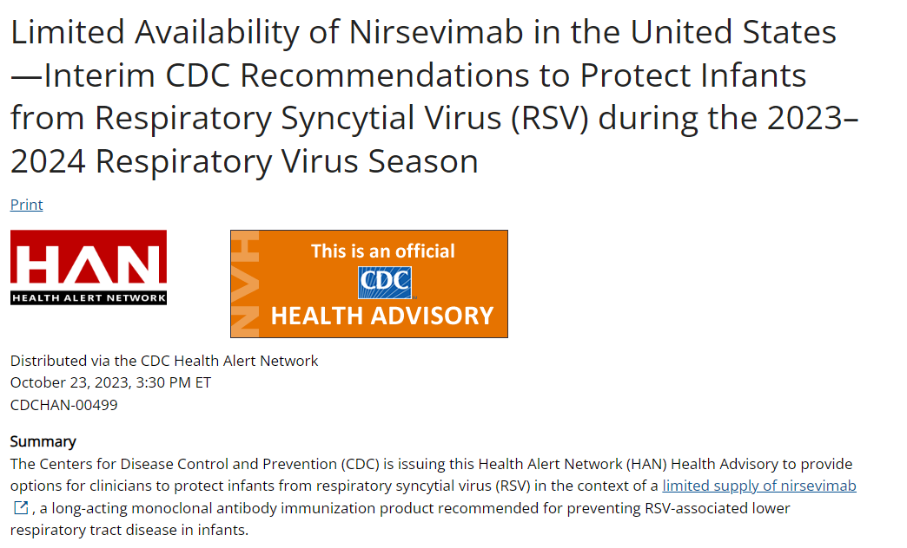
Limited supply of nirsevimab is a challenge this season
https://emergency.cdc.gov/han/2023/han00499.asp
Notes:
On October 23, 2023, CDC released a HAN Health Advisory describing interim recommendations to provide options for clinicians to protect infants from RSV in the context of a limited supply of nirsevimab.

Slide 13
Other barriers may exist this season
Your clinic or hospital may or may not have these products available.
Your local pharmacy may or may not have these products available.
Pharmacies may require a prescription.
Insurers have a year to cover newly approved products.
Out-of-pocket costs are expensive to individuals (e.g., $295 for Abrysvo; $495 for nirsevimab).
Lack of documentation of maternal vaccination might be a barrier to informed decision making for young infants.

Slide 14
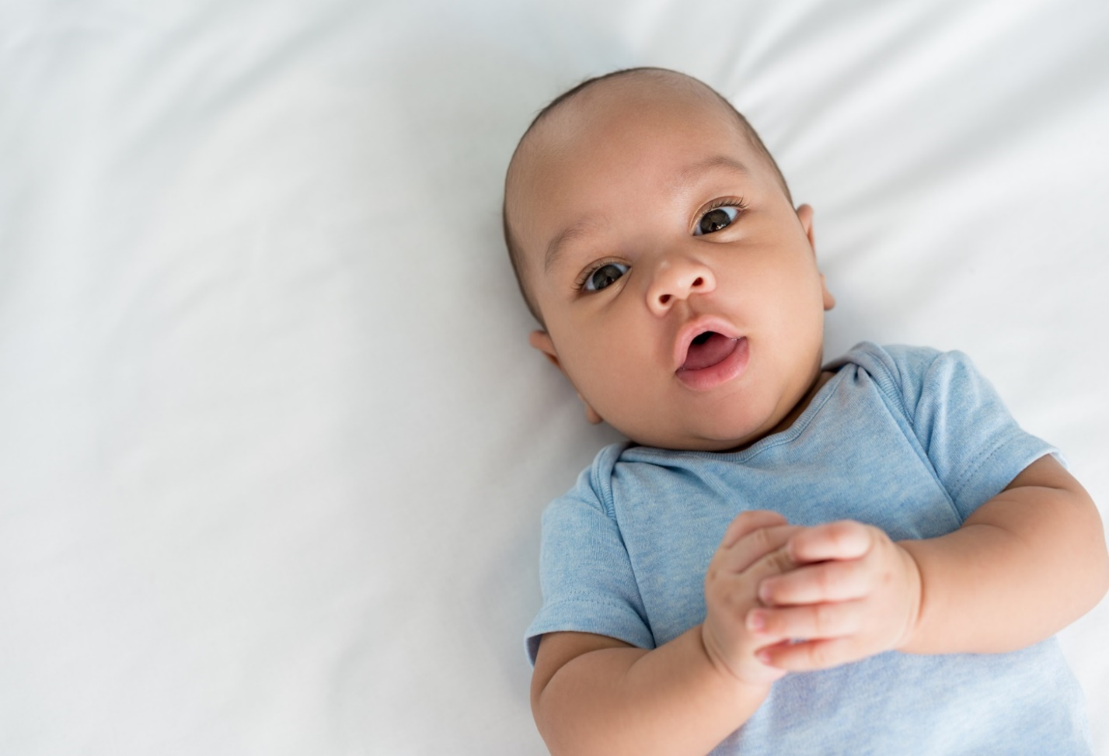
Summary: Two ways to protect infants from severe RSV disease
Abrysvo (Pfizer) is the only RSV vaccine for use during pregnancy
Nirsevimab, an RSV antibody, is only given to infants
Notes:
To summarize, CDC recommends two ways to protect infants from severe RSV disease. Abrysvo, from Pfizer, is the only RSV vaccine given to pregnant people to prevent RSV in infants. I want to emphasize this point, because there is another RSV product for use in older adults that is not approved for use in pregnant people. The second option to protect infants from severe RSV is nirsevimab, which is an RSV monoclonal antibody, and is only given to infants.

Slide 15
Counseling pregnant patients this season

Slide 16
Healthcare providers are trusted source

Slide 17
Consider raising these key points during shared decision-making conversations with pregnant patients
Risk of severe RSV for young infants
Known benefits of the approved products to help prevent severe RSV
Relative advantages and disadvantages of each product
Patient preferences
Local availability of nirsevimab
Notes:
Shared decision-making is an important component of counseling pregnant patients and their families about their options to help prevent severe RSV in young infants. On this slide are key points to consider during your shared decision-making conversation.

Slide 18
Sample script to counsel patients
At this point in your pregnancy, you are eligible to get the RSV vaccine to protect your baby from a severe respiratory illness called RSV. RSV is a common seasonal viral infection that can cause babies to get very sick. It can make it hard for babies to breathe. We have two options for preventing severe RSV illness in babies.
One option is a new vaccine that we give you during pregnancy. The vaccine causes you to make antibodies that you pass to your baby through the placenta. These antibodies help protect your baby early in their life.

Slide 19
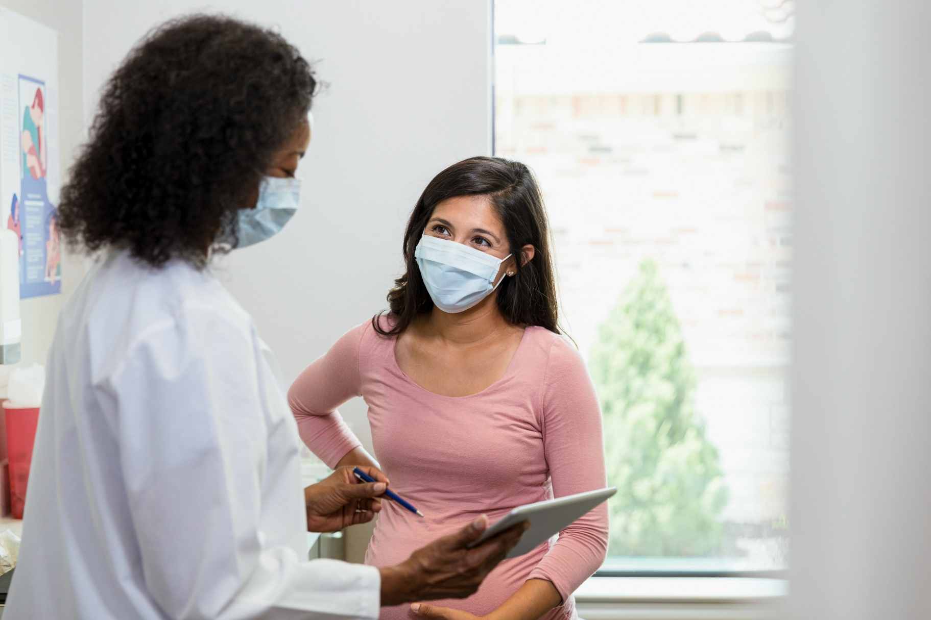
Sample script to counsel patient continued
The other option called nirsevimab can be given to your baby after birth and works similarly to protect your baby from RSV illness after delivery.
One or the other is recommended, but both are not needed for most babies. Keep in mind though that there may be limited availability of nirsevimab this season once your baby is born.

Slide 20
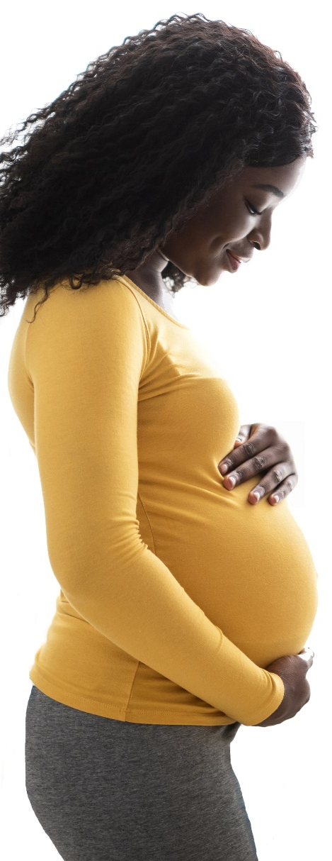
Advantages and disadvantages of Abrysvo (Pfizer) during pregnancy
Advantages
Immediate protection after birth
Might be more resistant to potential changes in the virus, or variants
Disadvantages
Potentially reduced protection in some situations (e.g., if birth of baby happens within 14 days of vaccination)
Potential risk for preterm birth and hypertensive disorders of pregnancy
Notes:
As part of these conversations, discuss the relative advantages and disadvantages of both maternal RSV vaccination and nirsevimab. Consider patient preferences when determining whether to vaccinate your pregnant patient or to rely on administration of nirsevimab to the infant.
Abrysvo (Pfizer) provides more immediate protection after birth and might be more resistant to potential mutations in RSV’s F protein. It might have reduced protection in some situations (e.g., in immunocompromised pregnant persons, if delivery of infant <14d after administration). It might increase the risk for preterm birth and hypertensive disorders of pregnancy. However, to reduce the potential risk of preterm birth and complications from it when administering RSV vaccine, FDA approved the vaccine for use during weeks 32 through 36 of pregnancy.

Slide 21
Advantages and disadvantages of nirsevimab for young infants
Advantages
Protection might last longer than protection from maternal RSV vaccine
Assures direct receipt of antibodies
No potential risk for adverse pregnancy outcomes
Disadvantages
Potentially limited availability during 2023-24 RSV season
Requires infant injection
Notes:
As it relates to nirsevimab’s advantages, protection might wane more slowly than protection from maternal RSV vaccine. This option also assures direct receipt of antibodies and is not associated with any increased risk for adverse pregnancy outcomes. For the 2023-2024 season, nirsevimab shortages have been identified, potentially limiting its availability. It also requires an infant injection.

Slide 22
Common questions
Which product is better – nirsevimab or maternal RSV vaccine? Does one work better than the other? Is one safer than the other?
No studies have directly compared the two products.
However, both products have been shown to provide significant protection against severe RSV in young babies.
Let’s talk about which option might be best for you and your family.
Notes:
Now we’ll cover some common questions we’ve heard and suggestions for how you might respond to your patients.

Slide 23
Common questions: What is it?
What is the maternal RSV vaccine made of and how does it work?
Abrysvo is a recombinant protein vaccine. It targets two F-proteins of the virus (RSVpreF A and RSVpreF B).
If you get vaccinated during pregnancy, your body will build antibodies against these two RSV proteins.
These antibodies will transfer across your placenta to your baby while you are pregnant.
After birth, if your baby is exposed to RSV early in life, your baby will use the antibodies it got from you to recognize RSV and fight against it.

Slide 24
Common questions: Coadministration
Can the RSV vaccine be given at the same time as other maternal vaccines?
Yes, you can receive RSV vaccine at the same time as other routine vaccinations, like Tdap, COVID-19, and flu.

Slide 25
Common questions: Receiving both products
Can a baby receive nirsevimab if their mother received the RSV vaccine?
Both products protect babies from severe RSV by providing antibodies, either from the mother to the baby or directly to the baby.
Most babies will likely only need protection from either the maternal RSV vaccine or nirsevimab (not both).
However, there may be some situations in which nirsevimab would be recommended for a baby after the mother received an RSV vaccine.
Notes:
These circumstances may include:
Pregnant people who may not have an adequate immune response to vaccination (for example, if the mother is immunocompromised) or who have conditions that may cause fewer antibodies to be transferred to the developing baby across the placenta (for example, if the mother is living with HIV)
Infants at substantially higher risk for severe RSV disease (for example, infants with severe heart disease; infants admitted to intensive care and requiring home oxygen after discharge)
Infants who undergo procedures that can remove RSV antibodies from their blood (for example, cardiopulmonary bypass—during heart surgery the blood is drained from the body and a machine performs the function of the heart and lungs)
Also, if the mother’s vaccine history is unknown, the baby should receive nirsevimab.

Slide 26
Common questions: Prior infection
Should I get the RSV vaccine if I’ve already had RSV before?
Even if you had RSV infection in the past, RSV vaccination can help protect infants from severe RSV.
There is no specific length of time that you need to wait after having RSV infection before you can receive an RSV vaccine.
Generally, if you have a moderate or severe illness, you should wait until you recover before receiving an RSV vaccine.
If you have a minor illness, such as a cold, you can get an RSV vaccine.

Slide 27
Common questions: Insurance coverage
Are these both covered by insurance and/or Medicaid?
Maternal RSV vaccine is covered
By Medicaid without cost-sharing for nearly all full-benefit adult beneficiaries with traditional Medicaid
By the Vaccines For Children (VFC) program for people younger than 19 years
By most private insurance plans, but companies have one year to comply with new recommendations
Nirsevimab is covered
By the VFC program
By most private insurance plans, but companies have one year to comply with new recommendations

Slide 28
As a provider, you can facilitate implementation
Document receipt of maternal RSV vaccination (e.g., via immunization information system, electronic health records, written documentation)
Routinely provide prescriptions for RSV vaccine for pregnant individuals who are 32-36 weeks gestation. Clearly indicate pregnancy on the prescription to ensure receipt of correct vaccine – Abrysvo (Pfizer).
Get familiar with your local access
Call local pharmacies to assess availability of RSV-prevention products
Ask local hospital about prioritization and availability of nirsevimab
If your practice does not carry these products or has insufficient supply, refer patients to local resources
Notes:
If you have questions about ordering, costs, insurance, storage, handling, administration, etc, visit CDC website or Pfizer website (www.pfizervax.com)
Vaccines.gov
Pfizer call line?

Slide 29
Thank you

