Slide 1
eSHARE Webinar:
Message Validation, Processing, and Provisioning System Trainings
Conference Number: 800-779-9623
Participant Code: 9740330
NOTE: Adobe Connects Audio is not available.
Join the Adobe Connects meeting at: https://virtualsepd.adobeconnect.com/nmieshare/. Click “Enter as a Guest,” provide your name, and click “Enter Room.”
May 19, 2016

Slide 2
Agenda
  Welcome, Announcements, and Introductions
  Message Validation, Processing, and Provisioning System (MVPS)-related trainings
Questions

Slide 3
Introduction to MVPS
Introduction to MVPS

Slide 4

Training Introduction and Objectives
Welcome to the 2016 MVPS Training
Training Facilitator: Ariel Powell (MVPS Team)
At the end of this training, you will be able to do the following:
  Understand the features and benefits of MVPS.
  Navigate the Message Evaluation and Testing Service (METS) tool and MVPS Dashboard.

Slide 5
Agenda
Agenda
Agenda Items
1. Training Introduction and Objectives
2. Introduction to MVPS
3. Using the METS Tool
4. Secure Access Management Services (SAMS) Access to MVPS
5. Using the MVPS Dashboard
6. Next Steps and Questions

Slide 6
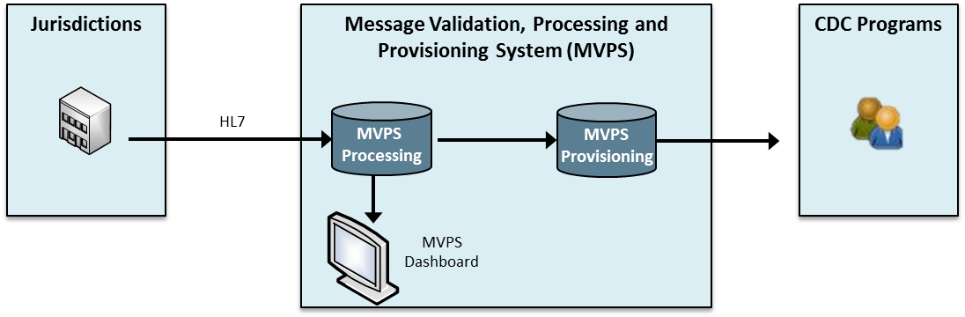
MVPS Overview
The Message Validation, Processing, and Provisioning System validates and processes nationally notifiable disease data messages sent by jurisdictions and provisions the data to CDC programs.
The MVPS Dashboard
  receives and processes HL7 messages from jurisdictions via a transport service,
  validates messages based upon structural and content rules (errors and warnings), and
  provisions data to CDC programs to support reporting and analysis.

Slide 7
MVPS Benefits
  MVPS will provide several benefits to jurisdictions and CDC programs:
  Reduce the number of systems processing data at CDC.
  Streamline message processing from jurisdictions to CDC.
  Ensure data security and compliance with federal regulations.
  Ensure that standards-based data are processed at CDC.
  Increase efficiency to receive, process, store, access, share, and analyze data.
  Increase visibility of jurisdictions to view data submitted and identify data quality issues.

Slide 8
Common MVPS Terminology
MVPS Term | Definition
Message Mapping Guides (MMGs) | Data dictionaries defining the required data elements a Health Level 7 (HL7) message should contain for a specific type of notifiable disease.
Message Processing | Messages submitted by jurisdictions are processed, validated for errors and warnings, and stored on the MVPS Dashboard. Message Processing: Successful Message Processing: Warnings Signals the user that something could be wrong with the values in the data; the data will still pass in MVPS and go into the provisioning tables but will trigger a warning in case the user wants to resend/update the message. Message Processing: Errors A message is missing a required data element or does not properly follow HL7 structure and will not be processed or provisioned in MVPS.
Message Provisioning | HL7 messages submitted by jurisdictions are provisioned into the appropriate format for respective programs.
Functional Testing | Functional testing is an internal way of checking software to ensure that it has all the required functionality that is specified within its functional requirements.
User Acceptance Testing | End users (CDC programs and jurisdictions) test the software to make sure it can handle required tasks in real-world scenarios, according to specifications.

Slide 9
Roles and Responsibilities of MVPS Users:
Data Manager
User
Will be granted access by the MVPS User Support Manager or the MVPS Support Manager
Will have access to MMG data (i.e., multiple MMGs) through the MVPS Dashboard
Can add authorized users to MVPS
Can add and/or edit users and access their conditions
Can access data for one or more conditions through the MVPS Dashboard as assigned by the data manager
Can see all messages sent to the MVPS Dashboard for assigned conditions
Can see the HL7 message detail as assigned by the data manager
Key Points
  Neither the data manager nor user can see or access information that they do not have access rights to see (including other messages).

Slide 10
Using the METS Tool
Using the METS Tool

Slide 11
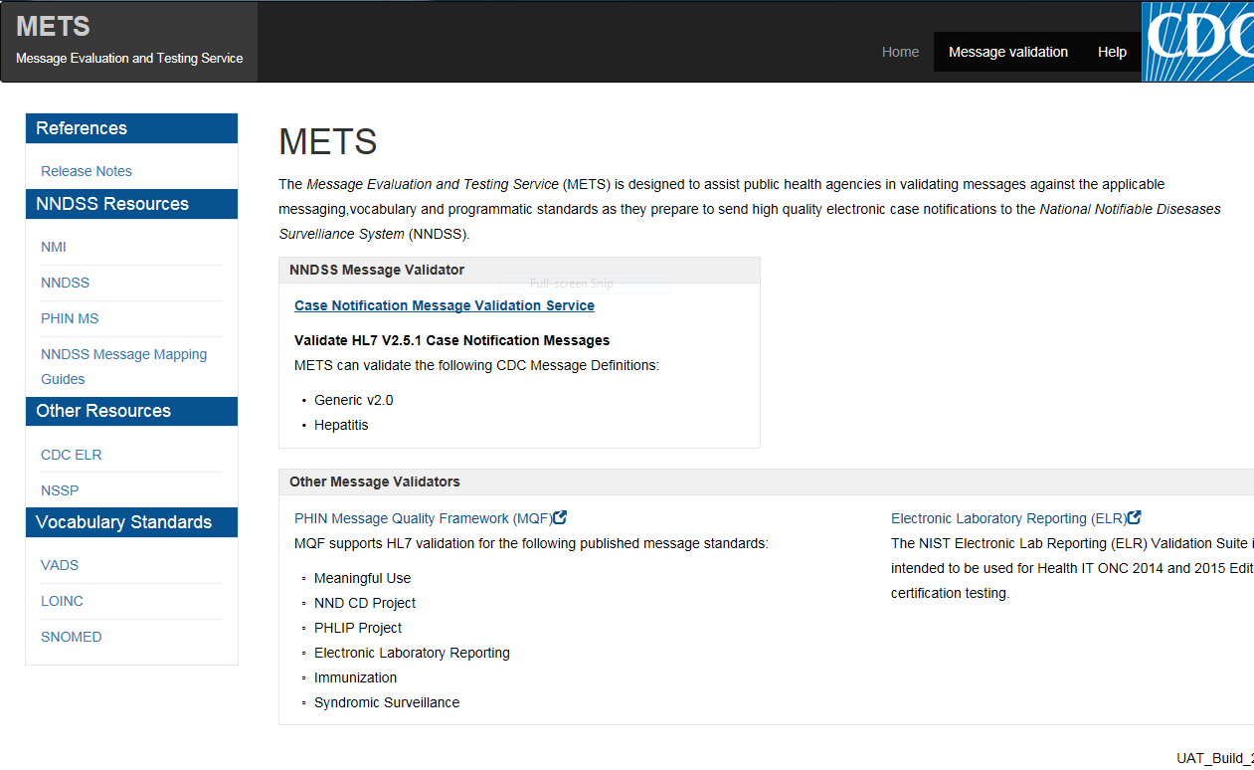
METS Overview
Name: | Message Evaluation and Testing Service
Description | A tool for jurisdictions to use to validate and receive feedback on messages before submitting to MVPS

Slide 12
METS Access
2
Users have two options to access the Message Validation Tool on the METS Landing Page
1

Slide 13
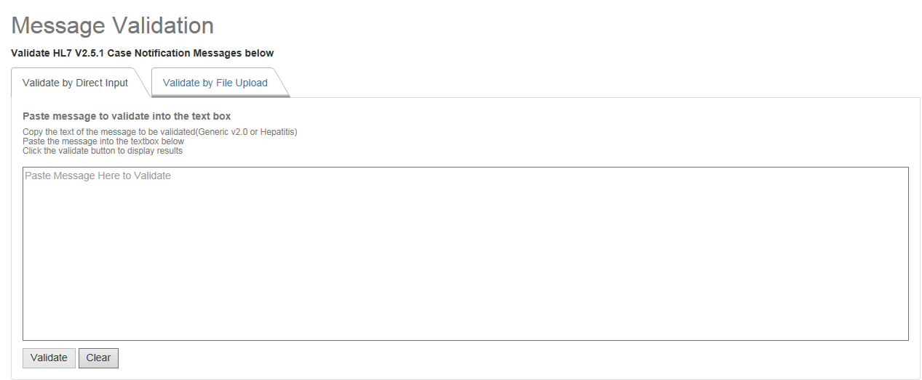
METS Message Validation
Users may input a message directly into METS by using the Validate by Direct Input feature or upload a message file by using the Validate by File Upload
Select the Validate button to complete the message validation

Slide 14
SAMS Access to MVPS
SAMS Access to MVPS

Slide 15
MVPS Dashboard Access for User with SAMS UserID
MVPS Dashboard Access for User with SAMS UserID
For a complete list of SAMS training documents and resources, please use the following link: https://www.cdc.gov/nndss/trc/data-systems/sams.html
Jurisdiction User
Jurisdiction Data Manager
MVPS Support Manager
Submits MVPS Access Request to MVPS Support Manager via EDX@cdc.gov
Verifies SAMS User ID; activates MVPS link in SAMS
Contacts the jurisdiction data manager to request access to MVPS Dashboard
Jurisdiction Data Manager
Grants user access to MVPS based on jurisdiction’s authorization process
2
4
1
3
5
User logs on to MVPS by using the SAMS portal

Slide 16
Using the MVPS Dashboard
Using the MVPS Dashboard

Slide 17
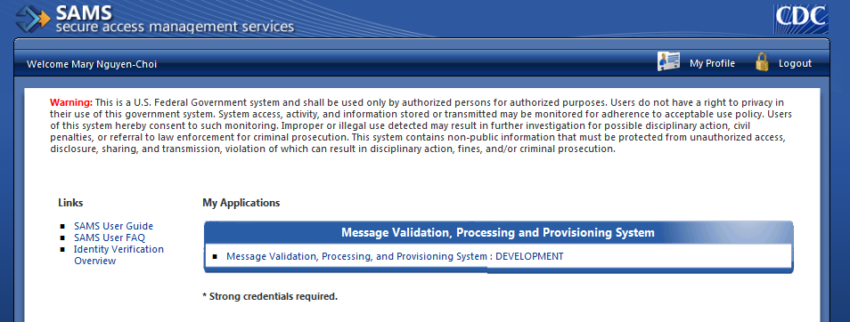
MVPS Dashboard Access:
Website and Login for Jurisdictions
  Testers will be granted access to the MVPS Dashboard.
  Jurisdiction testers login with SAMS Credentials: https://sams.cdc.gov/.
  Click the “Message Validation, Processing, and Provisioning System: UAT” link.
  Successful access will take testers to the “Dashboard Snapshot” landing page.
  Unsuccessful access will take testers to an error page.
  If unable to access the MVPS Dashboard, please contact: EDX@cdc.gov.

Slide 18
MVPS Dashboard Access:
Website and Login for CDC Programs
Internal program users may access the MVPS Dashboard at https://mvpsuat.cdc.gov by using their CDC network access, WIA.
Successful access will take testers to the “Dashboard Snapshot” landing page.
Unsuccessful access will take testers to an error page.
If unable to access the MVPS Dashboard, please contact: EDX@cdc.gov.

Slide 19
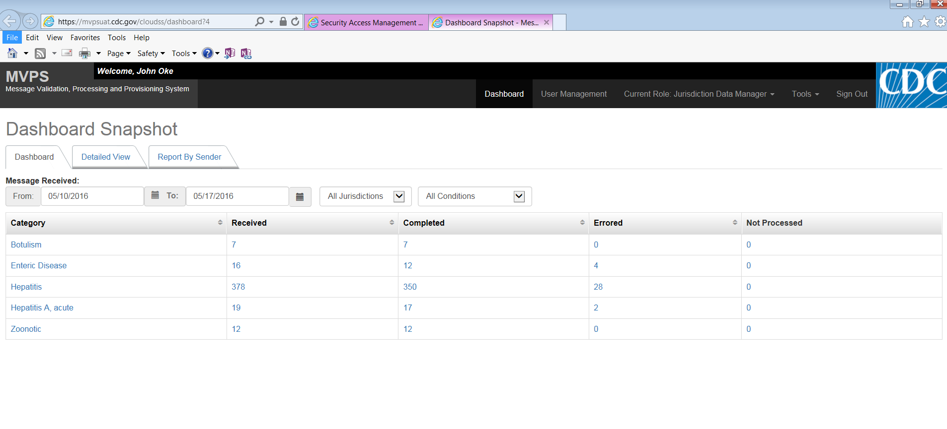
MVPS Dashboard Orientation:
MVPS Dashboard Landing Page—Dashboard Snapshot
Dashboard Snapshot view provides three ways to access and view message data.
When users log into MVPS, they will be taken to the MPVS Dashboard landing page. From here users will be able to do the following:
See User name.
Access Dashboard Snapshot.
Access User Management.
Change Current Role (if applicable).
Access Tools and Additional Resources.

Slide 20
MVPS Dashboard Orientation:
MVPS Dashboard Tab—Dashboard
Using the Dashboard tab allows the user to filter and search on message transactions
Message Received date range can be adjusted by the user; defaults to week ending in today’s date

Slide 21
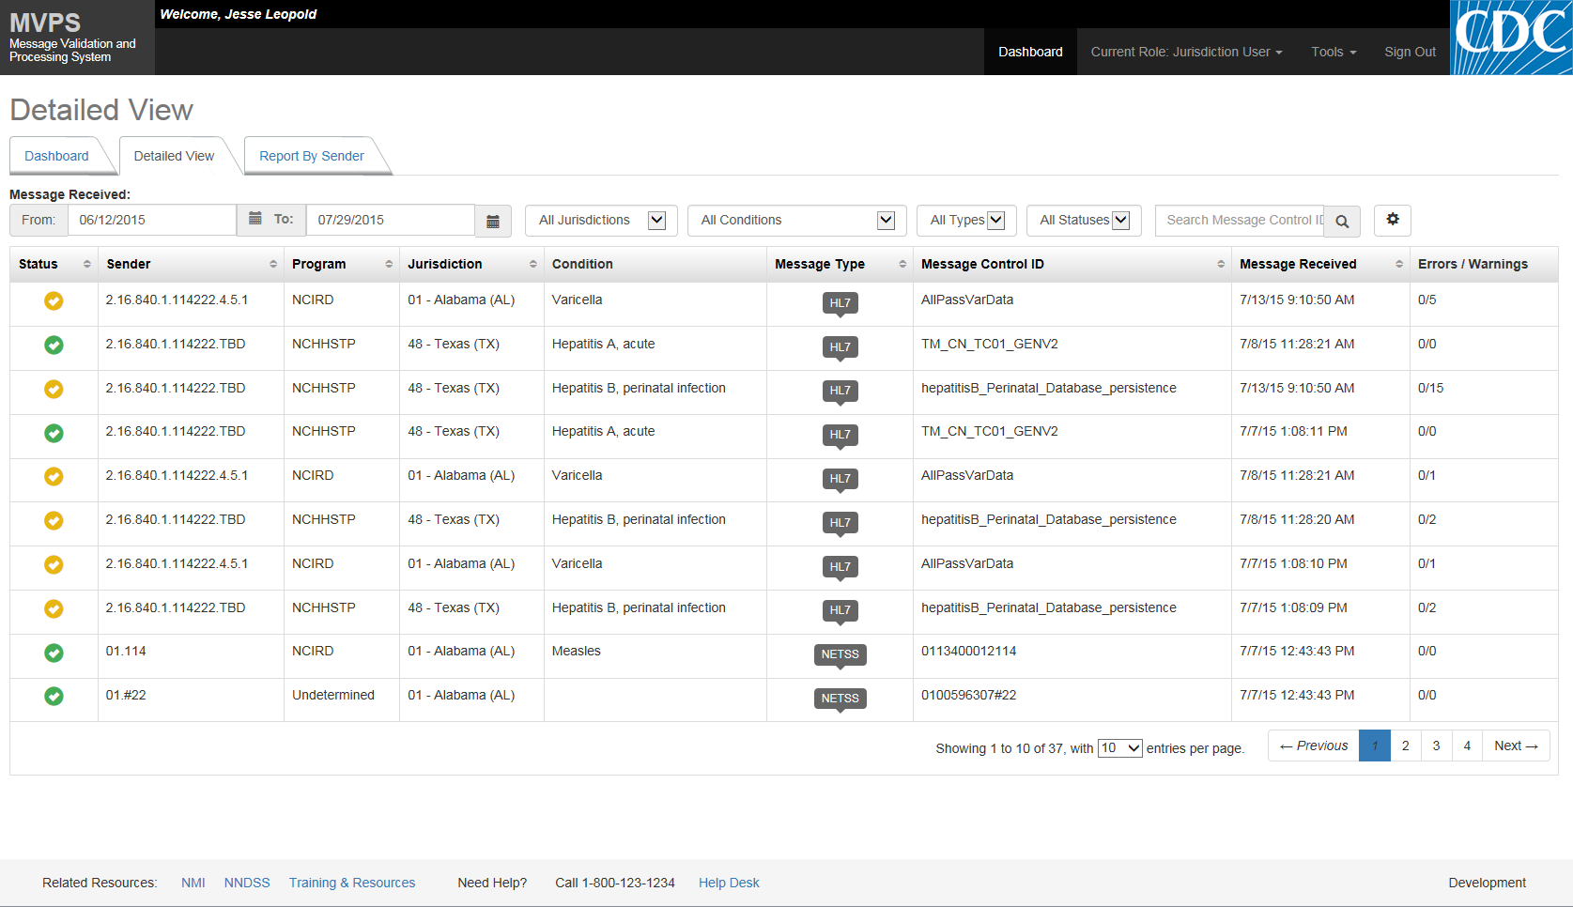
MVPS Dashboard Orientation:
MVPS Dashboard Tab—Detailed View
The Detailed View tab allows the user to search for and display message data by various criteria such as:
Message Received date range
Program/ Jurisdiction/ MMG
Message Type (HL7, NEDSS Base System [NBS], National Electronic Telecommunications System for Surveillance [NETSS)
Status
Number of Errors/Warnings
The message status is: No Errors
Warnings
Errors
Processing
21

Slide 22
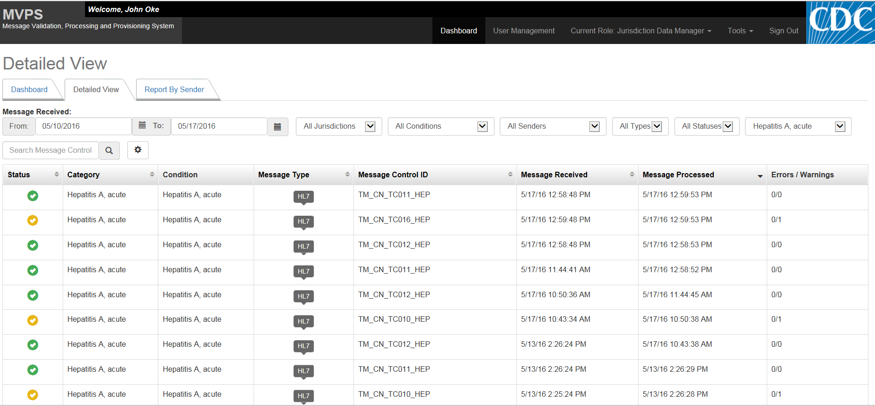
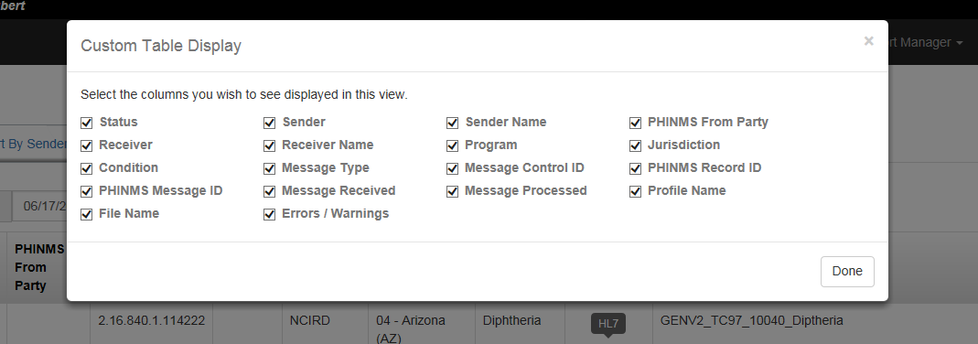
MVPS Dashboard Orientation:
MVPS Dashboard Tab—Detailed View
Selecting the setting icon will allow a user to select/deselect which columns appear in the Detailed View Table to display the results of the search. The display can be changed as needed.
Users will be able to view message data for conditions they have been granted access to view.

Slide 23
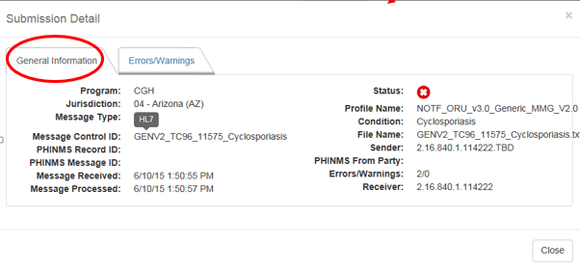
MVPS Dashboard Orientation:
MVPS Dashboard Tab—Detailed View
Clicking on any part of the message line within the Detailed View will display the Submission Detail popup window.
The Submission Details page has two sections: General Information (as displayed) and Errors/Warnings.
The General Information tab displays data regarding message receipt, record data, etc.

Slide 24
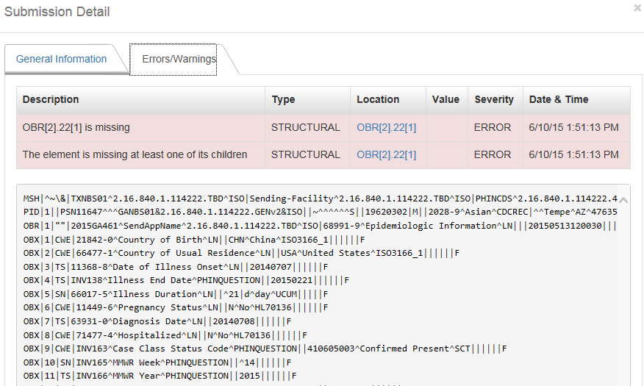
MVPS Dashboard Orientation:
Detailed View—Submission Details/Errors and Warnings
The Errors/Warnings tab shows the raw message received
Users can click on a error or warning message to get more information and locate the error or warning within the raw message.

Slide 25
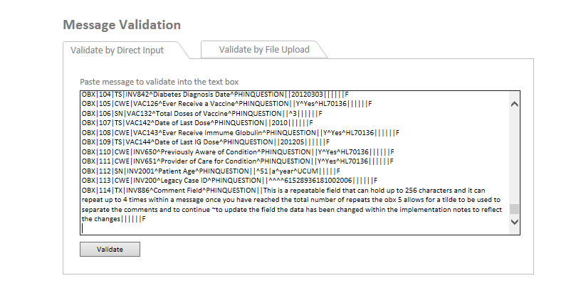
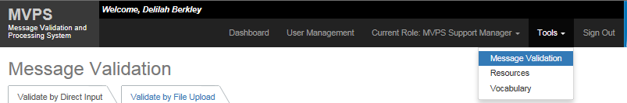
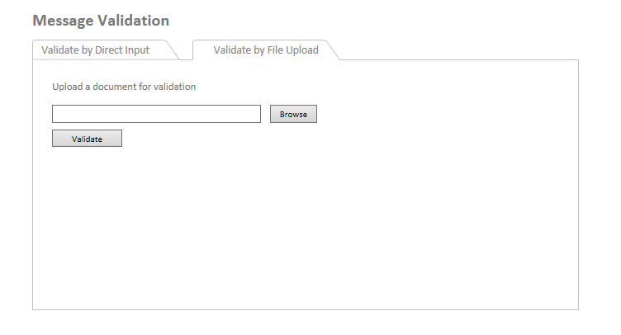
Additional Resources
Message Validation: Uploading Test Message
Users can access the Message Validation feature by clicking on the Tools dropdown, then selecting Message Validation
There are two ways to validate the message:
Paste message into the text box under “Validate by Direct Input” tab
Upload document to the “Validate by File Upload” tab

Slide 26
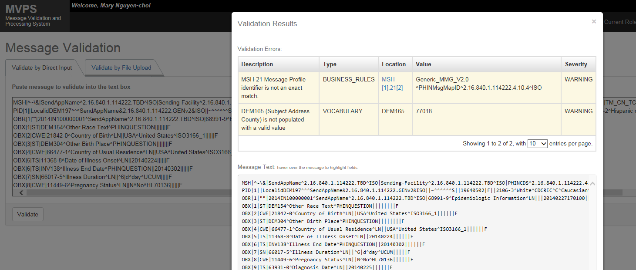
Additional Resources
Message Validation: Validation Results
After the user inputs the message to be validated, a pop-up window with the Validation Results will appear. It will include:
  Validation Errors
  Message Text

Slide 27
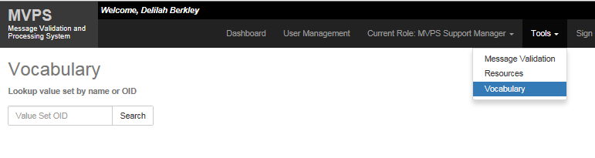
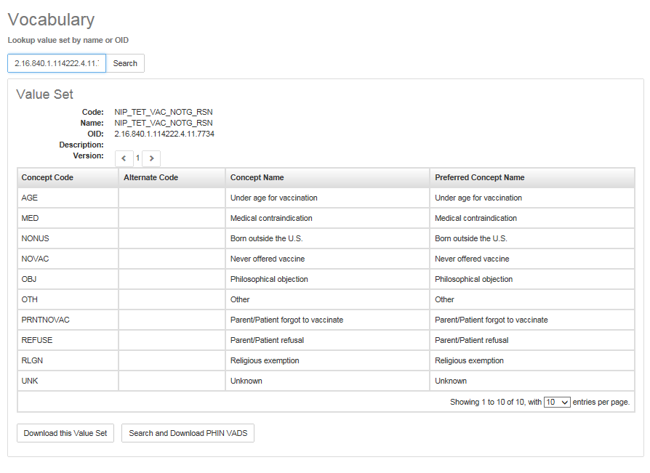
Additional Resources
Vocabulary: Look up of OIDS and Results
Users will be able to access the Vocabulary feature by clicking on the Tools dropdown, then selecting Vocabulary.
Users will be able to look up values by entering the Value Set ID
Information about the Value Set will appear regarding the Code, Name, OID, Description, and Version.
Users also will be able to Search and Download PHIN Vocabulary Access and Distribution System (VADS) data

Slide 28
Next Steps and Questions
Next Steps and Questions

Slide 29
Next Steps
Owner | Activity | Comments
Jurisdiction | Develop and communicate policy for adding jurisdiction users to the MVPS Dashboard. | Do not send to CDC. Policy is for internal jurisdiction purposes only.
Jurisdiction | Identify jurisdiction data manager and alternate data manager if applicable; send names to MVPS Support Manager via EDX@cdc.gov. | Subject line = MVPS Jurisdiction Data Manager
Jurisdiction Data Manager | Identify potential MVPS users and send to MVPS Support Manager via EDX@cdc.gov. | Subject line = MVPS Jurisdiction Users
Jurisdiction Data Manager | Complete the SAMS registration process if not already registered. Review the SAMS Training at https://www.cdc.gov/nndss/trc/data-systems/sams.html. | Contact MVPS Support Manager via EDX@cdc.gov if you need help in this process
Jurisdiction User | Look for invite from SAMS to begin registration process (if applicable); complete the registration process as soon as possible. | Jurisdiction users involved in MVPS User Acceptance Testing (UAT) must have completed the SAMS registration.

Slide 30
Contacting MVPS
Please contact EDX@cdc.gov with any question related to MVPS.

Slide 31

Questions? Email EDX@cdc.gov

Slide 32
End
For more information, please contact Centers for Disease Control and Prevention
1600 Clifton Road NE, Atlanta, GA 30333
Telephone: 1-800-CDC-INFO (232-4636)/TTY: 1-888-232-6348
Visit: http://www.cdc.gov | Contact CDC at: 1-800-CDC-INFO or http://www.cdc.gov/info
The findings and conclusions in this report are those of the authors and do not necessarily represent the official position of the Centers for Disease Control and Prevention.
Center for Surveillance, Epidemiology, and Laboratory Services
Division of Health Informatics and Surveillance

