Slide 1

People with disabilities: a comparison between the results for the 2000 and 2010 Population Censuses
Andréa Borges Paim, IBGE/Brazil
15th Meeting of the Washington Group on Disability Statistics
October 27th – 29th, 2015

Slide 2
Disability questions in 2000 and 2010 Censuses
Disability prevalence, 2000 and 2010 Censuses
Eight-digit code analysis
Age and sex composition
Disability by geographical areas

Slide 3
Disability questions in 2000 and 2010 Censuses
Seeing
  2000
  How do you evaluate your ability to see?
  (If you wear glasses of contact lens, please make your evaluation while using it)
  1 – Unable
  2 – A lot of permanent difficulty
  3 – Some permanent difficulty
  4 – No difficulty
2010
  Do you have permanent difficulty to see? (If you wear glasses of contact lens, please make your evaluation while using it)
  1 – Yes, cannot do at all
  2 – Yes, a lot of difficulty
  3 – Yes, some difficulty
  4 – No, no difficulty

Slide 4
Disability questions in 2000 and 2010 Censuses
Hearing
  2000
  How do you evaluate your ability to hear?
  (If you use hearing aid, please make your evaluation while using it)
  1 – Unable
  2 – A lot of permanent difficulty
  3 – Some permanent difficulty
  4 – No difficulty
2010:
  Do you have permanent difficulty to hear? (If you use hearing aid, please make your evaluation while using it)
  1 – Yes, cannot do at all
  2 – Yes, a lot of difficulty
  3 – Yes, some difficulty
  4 – No, no difficulty

Slide 5
Disability questions in 2000 and 2010 Censuses
Mobility
  2000
  How do you evaluate your ability to walk/climbing stairs?
  (If you use a can or walking aid, please make your evaluation while using it)
  1 – Unable
  2 – A lot of permanent difficulty
  3 – Some permanent difficulty
  4 – No difficulty
2010
  Do you have permanent difficulty to walk or climbing steps? (If you use a can or walking aid, please make your evaluation while using it)
  1 – Yes, cannot do at all
  2 – Yes, a lot of difficulty
  3 – Yes, some difficulty
  4 – No, no difficulty

Slide 6
Disability questions in 2000 and 2010 Censuses
Mental
  2000
  Do you have any permanent mental disability that limits your habitual activities? (Such as working, attending school, playing, etc.)
  1 – Yes
  2 – No
2010
  Do you have any permanent mental/intellectual disability that limits your habitual activities, such as working, attending school, playing, etc.?
  1 – Yes
  2 – No

Slide 7
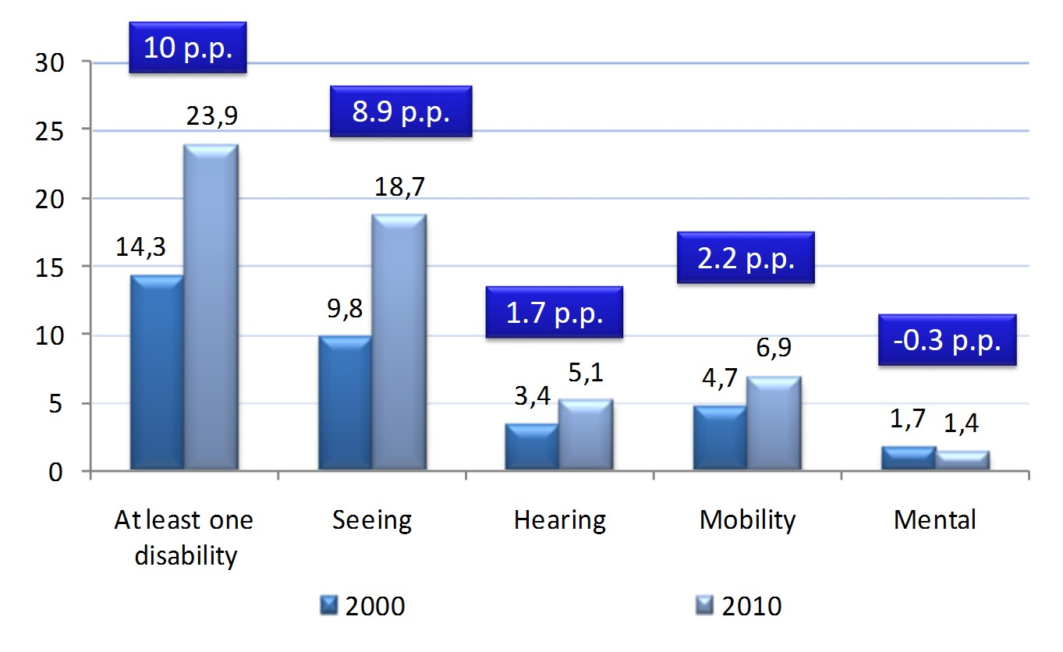
Disability prevalence, 2000 and 2010 Censuses
Brazil
%2010 - %2000

Slide 8
Disability prevalence, 2000 and 2010 Censuses
Brazil
2000/2010

Slide 9
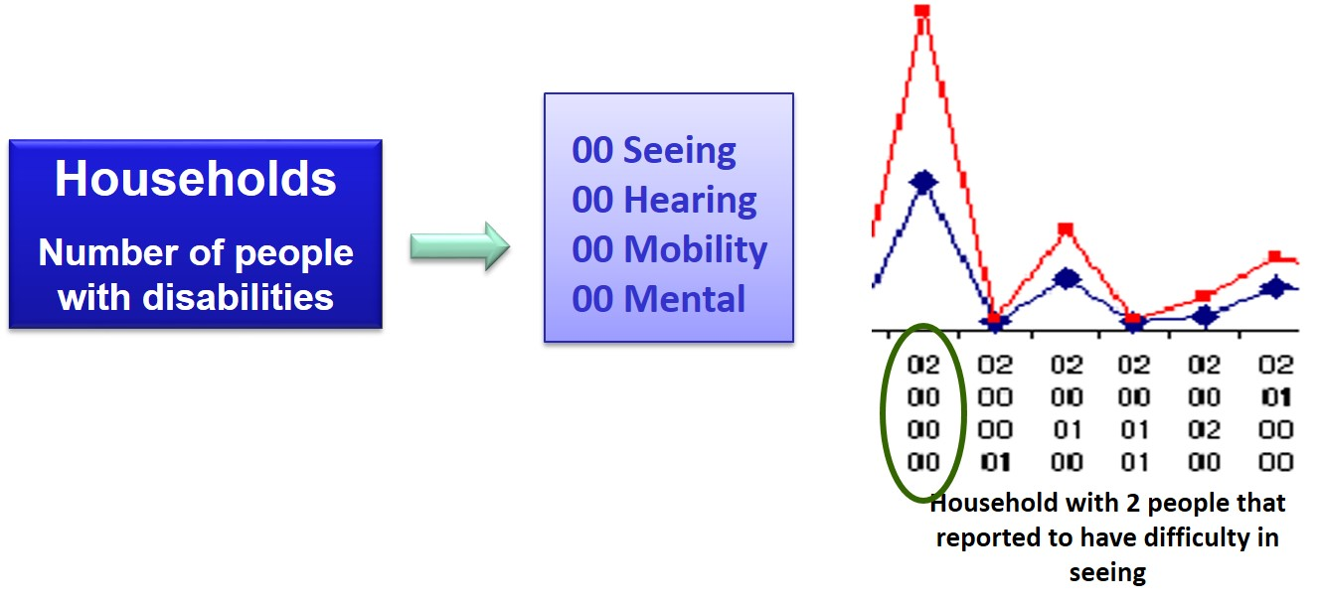
Eight-digit code analysis

Slide 10
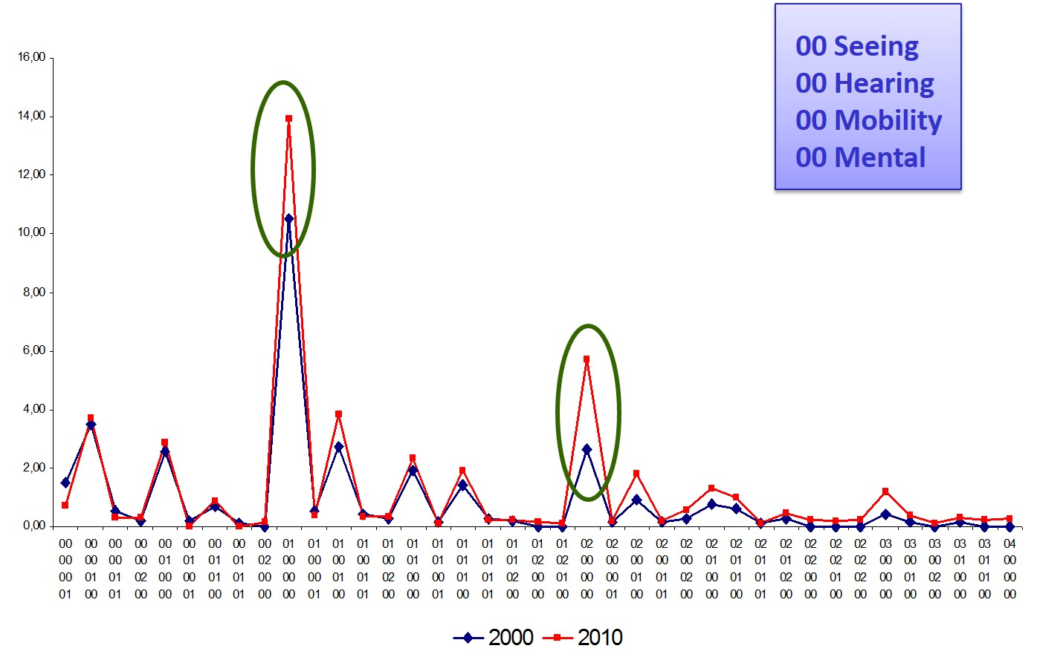
Eight-digit code analysis
Brazil
%2010 - %2000

Slide 11
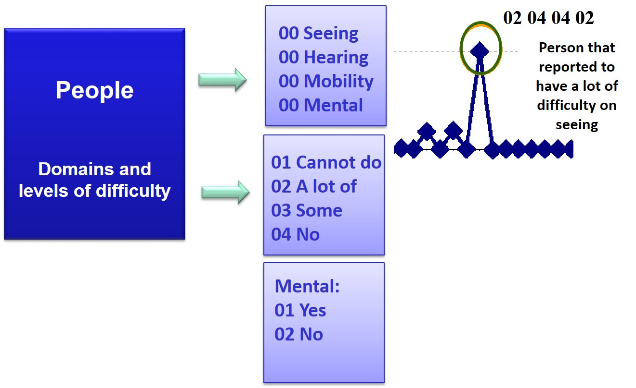
Eight-digit code analysis

Slide 12
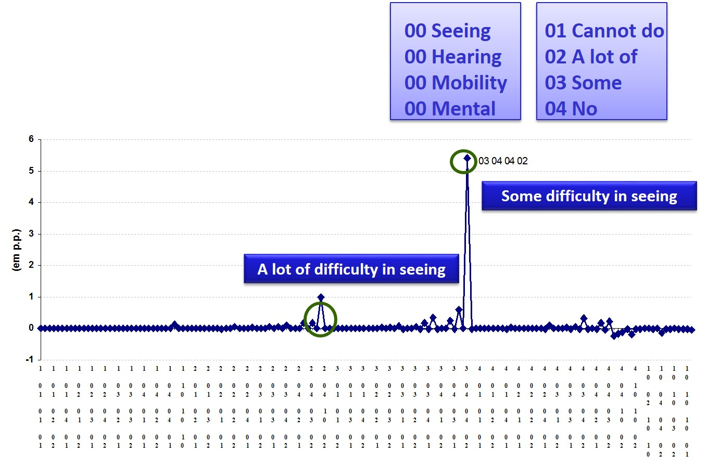
Eight-digit code analysis
Brazil
%2010 - %2000

Slide 13
Age and sex composition
People that reported difficulty in seeing: Brazil, 2000-2010
00 Seeing
00 Mental

Slide 14
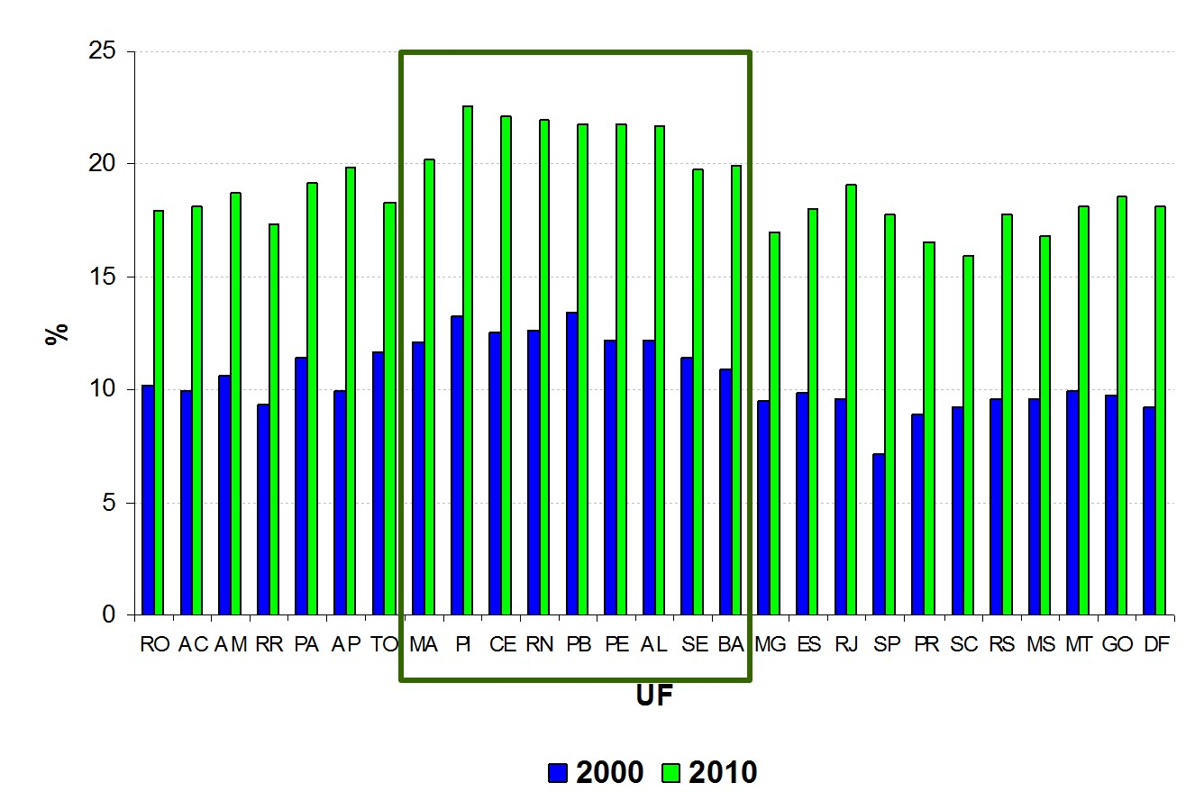
Disability by geographical areas
People that reported to have difficulty to see.
Brazilian Federation Units, 2000-2010

Slide 15

Thank you! andrea.borges@ibge.gov.br

