Slide 1
Practical experiences from the Danish disability registry
Microdata on services provided on the basis of the social service law

Slide 2
Three core concepts
A service – An actual service provided to an individual citizen, such as a specific instance of pedagogical support.
A service provider – A specific nursing home or rehabilitation center.
A target group – The category of disability that forms the basis of the municipality’s decision to award a specific service to a citizen.

Slide 3
The data
Longitudinal data on individuals and services
In principal, for all services which have been active since 2013-07-01
Every service has basic background information, information about the service provider and information about the target group.
All service types map to paragraphs in the law on social services.

Slide 4
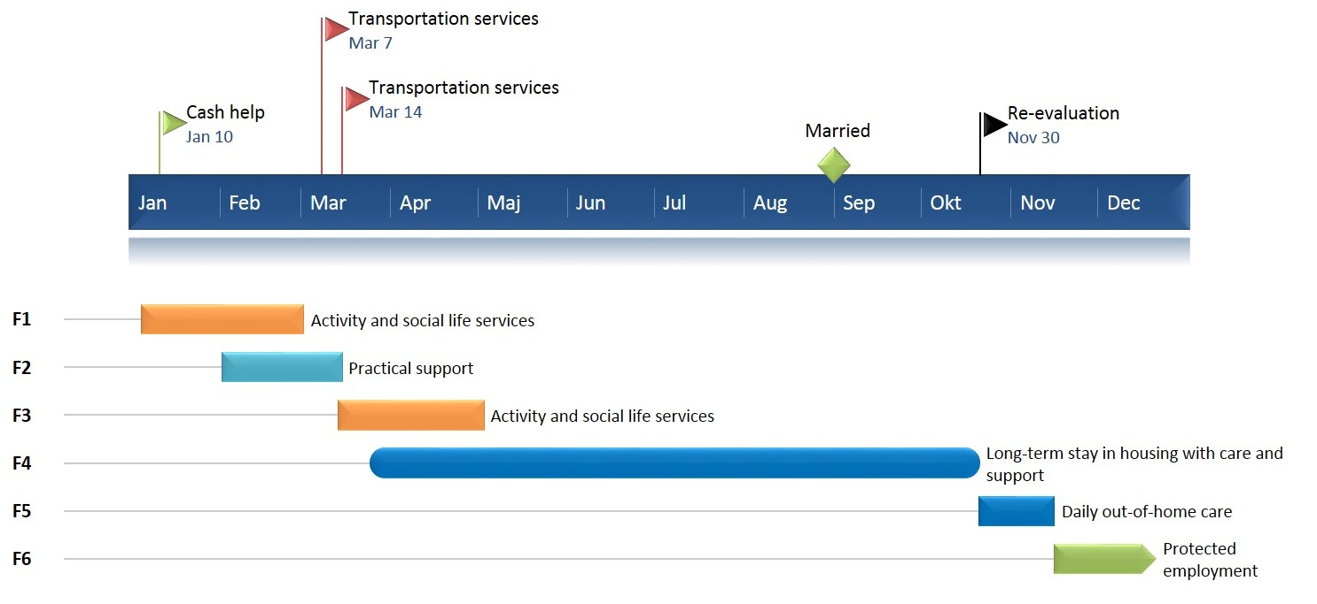
Example of longitudinal data

Slide 5
The law on social services
Describes the obligations of municipalities with regard to their citizens including their disabled citizens. Some requirements are specific, others less so.
§107 and §108 describe the municipalities’ obligation to provide long and short term residence with appropriate support.
§85 describes the obligation of the municipality to ‘provide help, care and support’ as well as training for individuals with significant disability or particular social problems.

Slide 6
Controversial design decisions
Disability definitions based on service law
Target groups based on VUM specifications
Basic unit is services and not individuals
No primary target group

Slide 7
Analytical perspective
Sample size = N and the personal ID number enables
unique research opportunities
Input measures | Outcome measures
What services were provided To whom By whom On what basis | Changes in income Changes in employment status Educational attainment etc….

Slide 8
Example outcome measure

Slide 9
Future perspectives on data about service providers
The data in principle allows us to identify the specific service provider delivering a service.
IT providers and municipalities are struggling to deliver this data
The national registry of service providers is still undergoing quality checks
In 2016, better quality is expected
New possibilities
More information about the contents of services
More information about the price of services

Slide 10
Target groups occurence
Target groups are not, by definition, indicative of a medical diagnosis.
By far the largest groups are cognitive disabilities and psychiatric disabilities.

Slide 11
Target groups – log10

Slide 12
Target groups – linear scale

Slide 13
Data coverage
The first publication in May 2015 contained data from 13 municipalities
Some data has arrived from close to 70 municipalities – this is available to researchers
More than double the initial publication size is expected for the next publication in December 2015

Slide 14
Why is it hard to deliver data?
There were two assumptions about data that were made on the basis of an initial consultant report.
All municipalities would store their data in some systematic way, as they all have to provide services according to the same rules.
The providers of the IT system would relatively easily be able to extract the information in a standardized way.
Turns out : They didn't and they weren't.

Slide 15
Data available to scientific community
All microdata is available on DST servers
Data is categorized for quality
Available for foreign researchers through accredited Danish institutions

Slide 16
Improving data
Constant communication with municipalities
Municipalities must verify their own data
Updating the specifications as new issues arise
Extensive error-checking using statistical and logical models

Slide 17
Number of services vary greatly

Slide 18
Questions?
Contact:
ogd@dst.dk
+45 39 17 31 09

