Slide 1
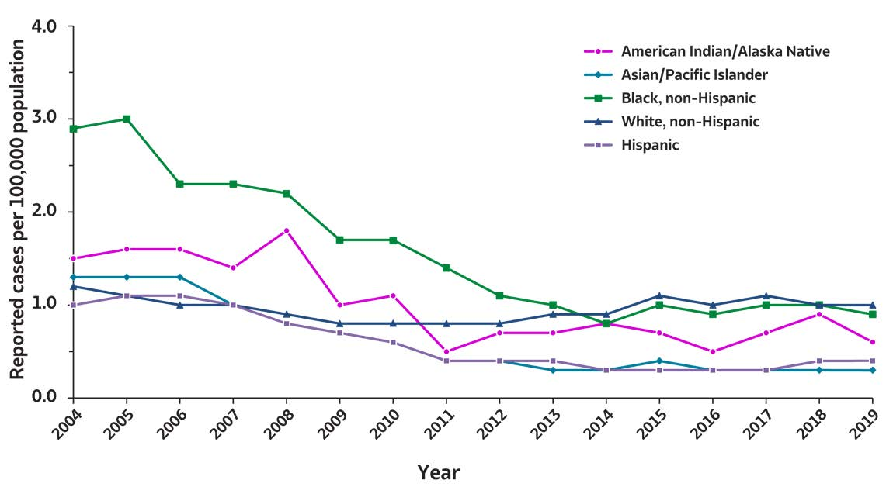
2019 VIRAL HEPATITIS
SURVEILLANCE REPORT
Figure 2.6. Rates of reported acute hepatitis B virus infections, by race/ ethnicity — United States, 2004–2019
Race/Ethnicity | 2004 | 2005 | 2006 | 2007 | 2008 | 2009 | 2010 | 2011 | 2012 | 2013 | 2014 | 2015 | 2016 | 2017 | 2018 | 2019
American Indian/ Alaska Native | 1.5 | 1.6 | 1.5 | 1.4 | 1.8 | 1.0 | 1.1 | 0.5 | 0.7 | 0.7 | 0.8 | 0.7 | 0.5 | 0.7 | 0.9 | 0.6
Asian/Pacific Islander | 1.3 | 1.3 | 1.2 | 0.9 | 0.8 | 0.7 | 0.6 | 0.4 | 0.4 | 0.3 | 0.3 | 0.4 | 0.3 | 0.3 | 0.3 | 0.3
Black, non-Hispanic | 2.9 | 3.0 | 2.3 | 2.3 | 2.2 | 1.7 | 1.7 | 1.4 | 1.1 | 0.9 | 0.8 | 1.0 | 0.9 | 1.0 | 1.0 | 0.9
White, non-Hispanic | 1.2 | 1.1 | 1.0 | 1.0 | 0.9 | 0.8 | 0.8 | 0.8 | 0.8 | 0.9 | 0.9 | 1.1 | 1.0 | 1.1 | 1.0 | 1.0
Hispanic | 1.0 | 1.1 | 1.1 | 1.0 | 0.8 | 0.7 | 0.6 | 0.4 | 0.4 | 0.4 | 0.3 | 0.3 | 0.3 | 0.3 | 0.4 | 0.4
Source: CDC, National Notifiable Diseases Surveillance System.

