Slide 1
A Bayesian change point analysis of prevalence rates of chronic diseases by gender and race
Trivellore Raghunathan
Chair and Professor of Biostatistics, School of Public Health
Research Professor, Institute for Social Research
University of Michigan
Presented at the National Conference on Health Statistics, August 16-18, 2010

Slide 2
Setup
Need for assessing the health of the nation cannot be understated
NCHS has been in the forefront of collecting data needed
A look back on one such long series
National Health Interview Survey (as it is currently known)
Began in 1957
Limited Data available prior to 1962
Relate the prevalence information to time line of our history

Slide 3
Data
Diseases
Diabetes (1957-1959, 1962-2008)
Asthma and Hypertension (1962-2008)
Populations
Overall
Male/Female
White/Black
Time line
Important events (health and economic)
The analysis is preliminary

Slide 4
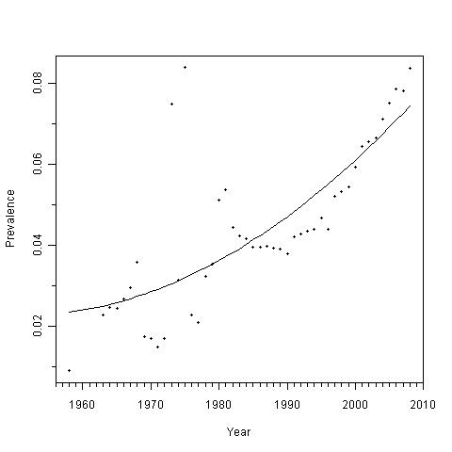
Prevalence of Diabetes
Recession (97)
Hostage (79)
Recession (80)
Vietnam
War
Civil Rights (64)
Medicare (66)
Gulf war
Recession (90)
Recession (74)
Oil crisis (73-75)
9/11
Medicaid/AA (65)

Slide 5
Model

Slide 6
Analysis
Fit the model using MCMC or MLE
Calculate
Choose knots based on the time-line
For this analysis choose 5 knots (1965, 1974, 1980, 1990, 2001)
Modification (in progress)
Treat knots as unknown parameters and estimate them from the data

Slide 7
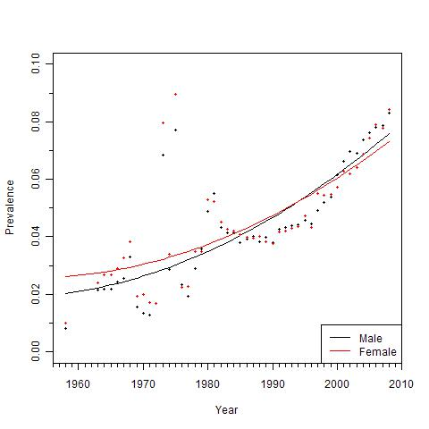
Diabetes by Gender

Slide 8
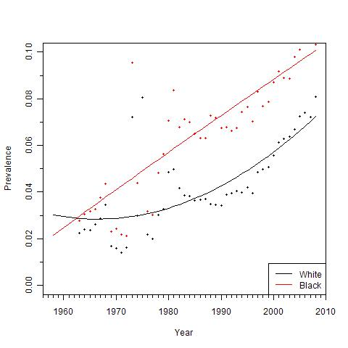
Diabetes by Race

Slide 9
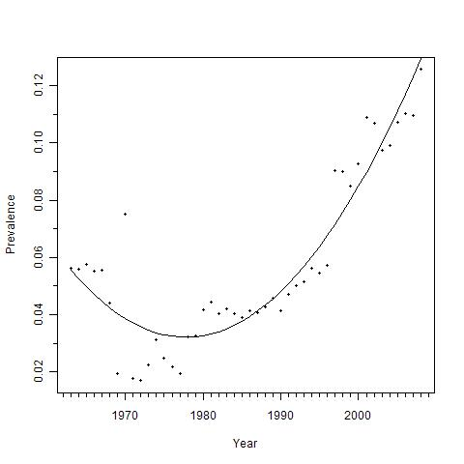
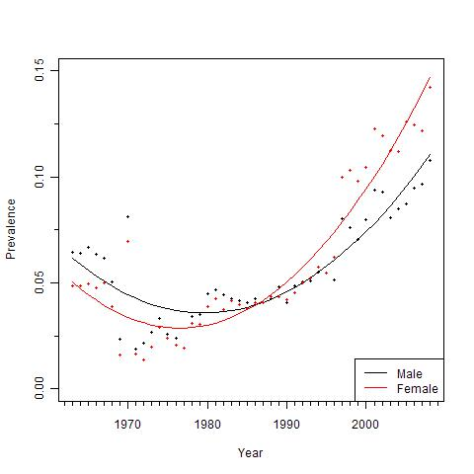
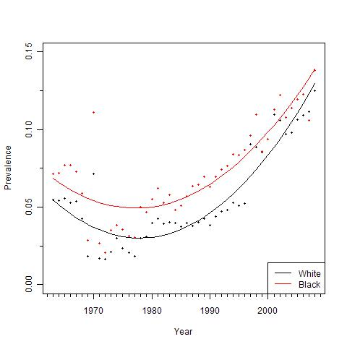
Prevalence rates of Asthma

Slide 10
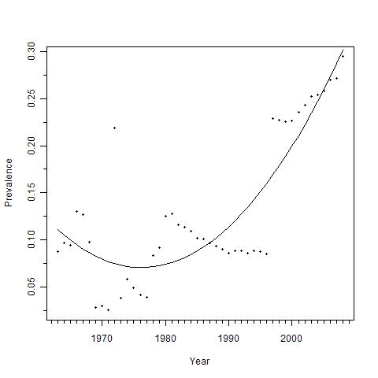
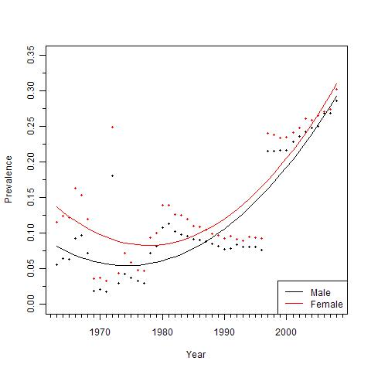
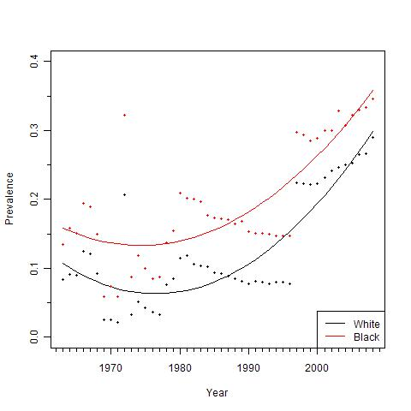
Prevalence rates of Hypertension

Slide 11
Diabetes by administration
Nixon
/Ford
Carter
Johnson
Reagan/
Bush
Clinton
Bush

Slide 12
Asthma
Nixon
/Ford
Carter
Johnson
Reagan/
Bush
Clinton
Bush

Slide 13
Hypertension
Nixon
/Ford
Carter
Reagan/
Bush
Johnson
Clinton
Bush

Slide 14
Issues and Concerns
Major design changes, instruments, definitions etc
Reflecting such changes in the model development
Any policy change takes time to have an impact. Incorporation of time lag in the model
Outliers
Regardless of these concerns:
Persistent differences between race
Lessening of differences between men and women

Slide 15
Discussion
Relating the time series data to important epics/events can be useful to understand potential effects of policy/cultural changes
Investigation of health disparities across various subpopulations
Subgroups can be determined based on economic, social, cultural aspects of the society
Useful exercise for any democratic society to look at the health of the nation
Thank you NCHS, for this great data source!!

