Slide 1
Measuring Environmental Factors and School Participation for Children with Disability

Slide 2
Rationale
The WG and UNICEF have started working on an extended set of questions on child disability that will focus on environmental factors and participation
to provide information that can inform policy
to provide a statistical summary of environmental influences on participation in school
to identify areas with key bottlenecks

Slide 3
Basic principles
This set of questions will:
Be a module that can be added to another survey
To be used in conjunction with the module on child functioning and disability
Take approximately 10 minutes
Focus on formal education and environmental factors that influence participation
Be designed to capture the interaction between the participant and the environment

Slide 4
Conceptual framework
The International Classiﬁcation of Functioning, Disability and Health (World Health Organization, 2001) outlines five categories of environmental factors that influence participation:
Products and technology;
Natural environment and human-made changes to environment;
Support and relationships;
Attitudes; and
Services, systems and policies.

Slide 5
The Conceptual Framework
1. Attitudes
- parent’s perceptions - their perceptions of - other’s attitudes - societal and cultural norms - other children’s attitudes - school staff perceptions
2. Getting to School
- transportation (characteristics of all aspects of the system and the need for assistance) -environmental and social safety -weather/seasonality
3. Accessibility within the School
- physical accessibility (entryway, corridors, bathrooms, lunch room, classroom, common areas etc.) - information accessibility - communication accessibility - programmatic accessibility/adaptability - teacher and school attitudes towards disability
4. Affordability
- fees, costs, and competition for resources associated with attendance - the availability of types of assistance (financial, assistive devices, rehabilitation) - non-educational benefits (e.g., meals)

Slide 6
Review of existing questions
Measures with information about environmental factors
Grouped into the four themes: Attitudes, Getting to school, Accessibility within the school, and Affordability
Plus, measures of education and school participation
Focus on MICS, DHS and EdData

Slide 7
Data sources
Database search (PsycInfo, Google Scholar):
search terms : environment, support, facilitator, barrier, attitudes, assessment, measurement, survey, self-report, participation, disability/ies.
Reference lists from retrieved publications
Experts
UNICEF database on disability data collection

Slide 8
Results
32 measures
668 questions related to environmental factors
primarily used in smaller scale research studies, and answered by a proxy respondent;
typically the parent or primary caregiver

Slide 9
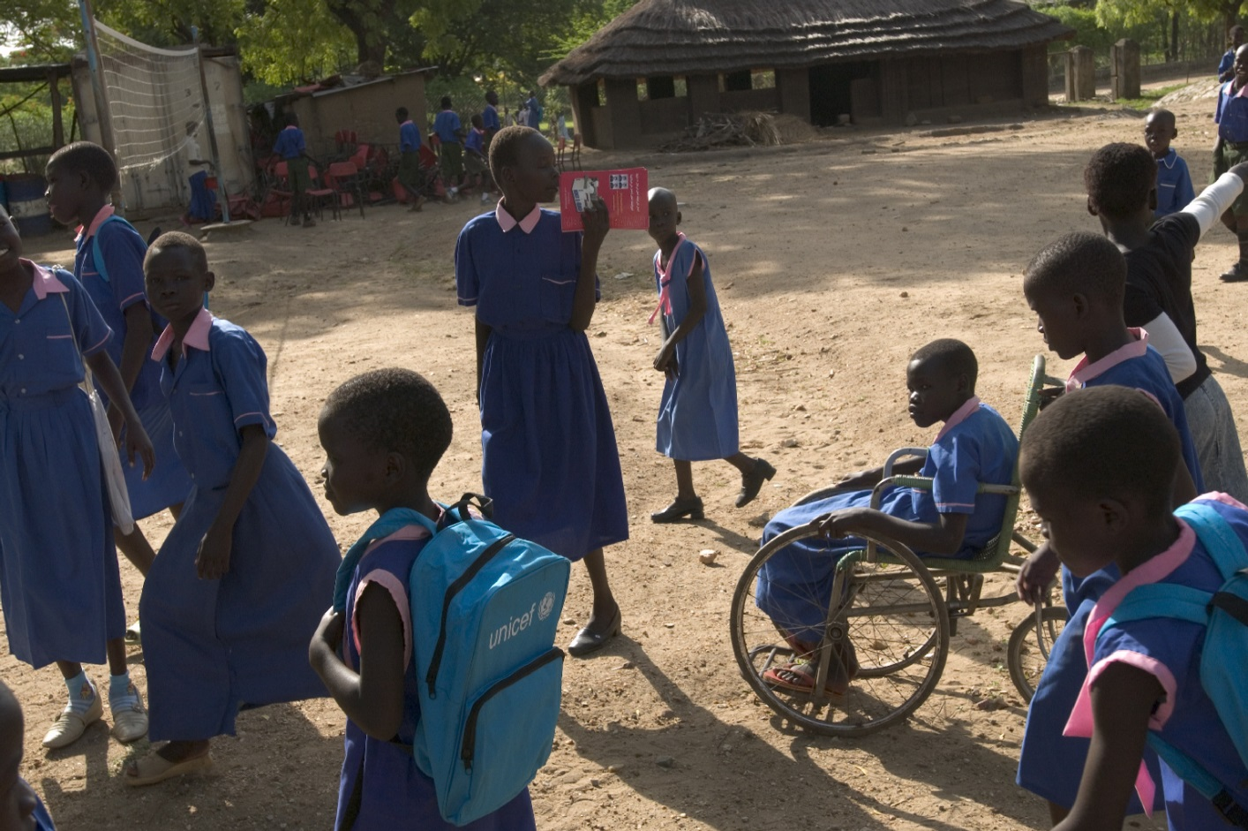
Some examples of questions

Slide 10
“Why is [name] not attending school?”
Country | Time Period | Survey | Response options to the question: “Why is [name] not attending school?”
Dominica | 2002 | Survey of Living Conditions | Illness/ disability Financial problems Failed exams Problems at school Other

Slide 11
“Why is [name] not attending school?”
Country | Time Period | Survey | Response options to the question: “Why is [name] not attending school?”
Tanzania | 2008 | Tanzania Disability Survey | Disability Poverty situation of my family Environment of school conditions Transport allocation Distance to the school Lack of assistive devices Lack of Personal assistance/care Lack of disable school/class Other (specify)

Slide 12
School participation
Child and Adolescent Scale of Participation (CASP)

Slide 13
School participation
Child and Adolescent Scale of Participation (CASP)

Slide 14
Generic questions on environment
Child and Family Follow-Up Survey (CFFS)

Slide 15
Attitudes of society
Would a family have concern about disclosure if one of their children had a disability?
Would having a family member with a disability be a problem for a person to get married?
Would a parent that has a child with a disability keep others from knowing, if possible?
Would a family with a new born child with a disability be expected from society to place the disabled child in an institution?
Would other people in your community avoid a child with a disability?

Slide 16
Attitudes of the respondent about children with disabilities
I wouldn’t mind if a handicapped child sits next to me
Handicapped children can do lots of things for themselves
I would be afraid of a handicapped child
I feel upset when I see a handicapped child
I would talk to a handicapped child I didn’t know
Chedoke-McMaster Attitudes Towards Children with Handicaps
Agree
Neutral
Disagree

Slide 17
Attitudes of respondent about his/her own child with disability
Yes/No
Did you hide your child from around when you understood that your child was different?
Baskanligi, O. I. (2002). Turkey disability survey. Ankara: Basbakanlik Yayinlari.

Slide 18
Attitudes of the respondent Multiple Choice and Yes/No
UNICEF for Children with Disabilities in Armenia

Slide 19
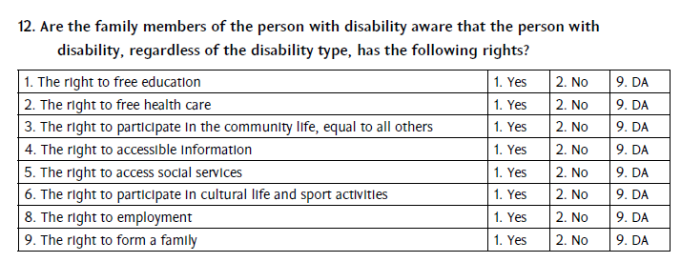
Attitudes of family members
UNICEF for Children with Disabilities in Armenia

Slide 20
Getting to school
DID you require specialized transportation to attend school? | Yes/No
WAS specialized transportation available to you? | Yes/No
Do you regularly use public transit, such as a public bus, subway, Sky Train, metro, street car, or light rail transit | Yes/No
Is regular public transit available in your city or local community? | Yes/No
Do you regularly use specialized transit service, such as a special bus, van or subsidized accessible taxi service? | Yes/No
Is specialized transit service available in your city or local community? | Yes/No
Because of your condition, do you experience any difficulty using public transit or specialized transit service? | 1. No difficulty 2. Some difficulty 3. A lot of difficulty
What are the reasons you have difficulty using public transit or specialized transit service? | 1. Service is not available when you need it 2. Booking rules don’t allow for last minute arrangements 3. Difficulty getting to or locating bus stops 4. Difficulty getting on or off the vehicle 5. Difficulty seeing signs or notices, stops or hearing announcements 6. Overcrowding 7. Difficulty requesting service 8. Difficulty interpreting schedules 9. Difficulty transferring or completing complicated transfers 10. condition or health problem is aggravated when you go out 11. Too expensive 12 Other reason DK, RF
Canadian Survey on Disability (CSD)

Slide 21
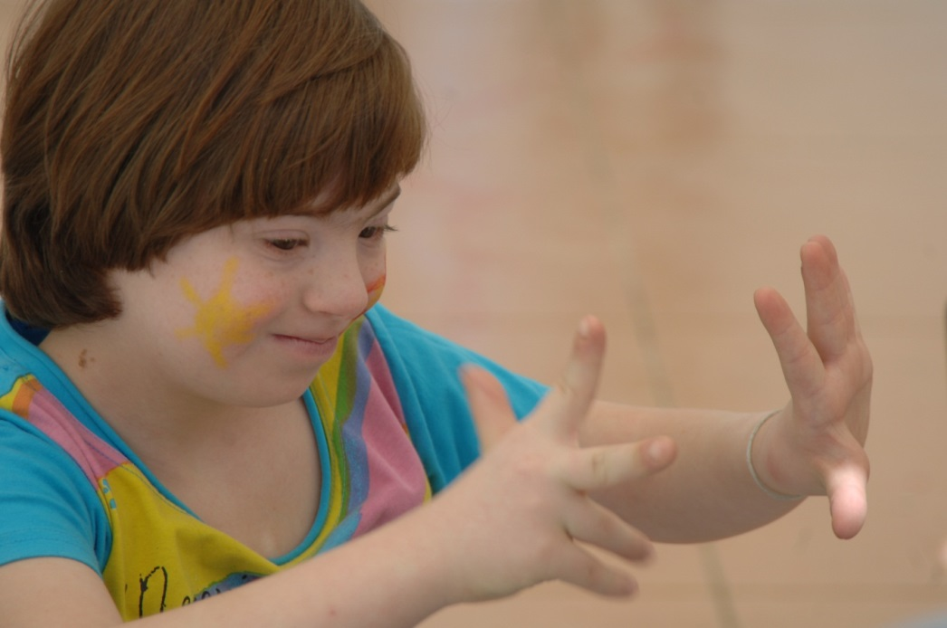
Draft module

Slide 22
General structure
Module to be used in conjunction with:
module on school attendance
module on child functioning and disability
Structured around four domains
Format:
Generic questions addressed to all mothers/caregivers
Specific questions addressed to mothers/caregivers of children with activity limitations
Specific questions addressed to mothers/caregivers of children of who do not attend school or missed school days

Slide 23
Attitudes
1a) Should all children attend primary school?
1b) Should all children attend secondary school?
2a) Should children with disabilities go to primary school?
2b) Should children with disabilities go to secondary school?
2c) Should children with disabilities go to the same school as other children?
IF THE CHILD SCREENED POSITIVE FOR ACTIVITY LIMITATIONS:
3a) I want my child to attend school (Attitude of parents)
3b) Teachers are committed to teaching children with disabilities (Attitude of teachers)
3c) Children/parents are accepting of children with disabilities in school (Attitude of other children/parents)
IF THE CHILD HAS MISSED SCHOOL:
4) Are any of the above reasons [questions 1,2,3] your child has missed school?
IF THE CHILD IS NOT IN SCHOOL:
5) Is [questions 1,2,3] why your child does not attend school?

Slide 24
Going to school
In your community, how do children typically get to school?
How does your child get to school?
IF THE CHILD SCREENED POSITIVE FOR ACTIVITY LIMITATIONS:
3a) Is [question 2] a reliable means of transportation (are you satisfied)?
3b) What is the reason you are not using other modes of transportation?
IF THE CHILD HAS MISSED SCHOOL:
4) Are any of the above reasons your child has missed school?
IF THE CHILD IS NOT IN SCHOOL:
5a) Is the availability of [questions 1,2,3] why your child does not attend school?
5b) Are the characteristics of [questions 1,2,3] why your child does not attend school?

Slide 25
Accessibility
IF THE CHILD SCREENED POSITIVE FOR ACTIVITY LIMITATIONS:
1a) Does your child attend a special school?
1b) Does your child attend a special class?
1c) Does your child receive a special curriculum?
2) Are you aware of any problems with:
Educational (academic) activities with other children in his or her classroom at school
Social, play and recreational activities with other children at school (e.g., “hanging out,” sports, clubs, hobbies, creative arts, lunchtime or recess activities)
Getting in and moving around at school (e.g., to get to and use bathroom, playground, cafeteria, library or other rooms and things that are available to other children his or her age)
Using educational materials and equipment that are available to other children in his or her classroom/s
Using educational materials and equipment that have been modified for your child (e.g., books, computers, chairs and desks)
Communicating with other children at school
Communicating with adults at school
IF THE CHILD HAS MISSED SCHOOL:
3) Are any of the above reasons your child has missed school?
IF THE CHILD IS NOT IN SCHOOL:
4) Is [questions 1,2] why your child does not attend school?

Slide 26
Affordability
1a) Are there fees associated with attending school? (tuition, materials, uniforms, etc. )
1b) Are there fees associated with transportation to school?
1c) Can you afford these fees?
2) Do you have to miss work to get your child to and from school?
IF THE CHILD HAS MISSED SCHOOL:
Are any of the above reasons your child has missed school?
IF THE CHILD IS NOT IN SCHOOL:
Is [questions 1,2,3 ] why your child does not attend school?

Slide 27
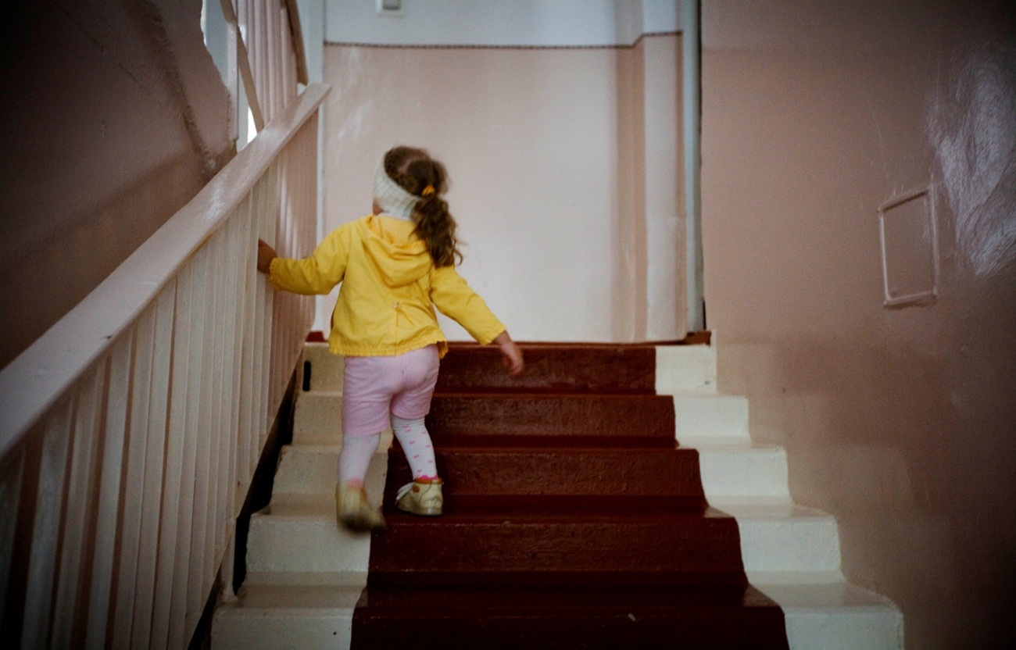
Next steps

Slide 28
Next steps
Preparation of a draft module
Meetings with key stakeholders to finalize a module for testing
Cognitive testing
Field testing
Module to be finalized by end of 2014

Slide 29
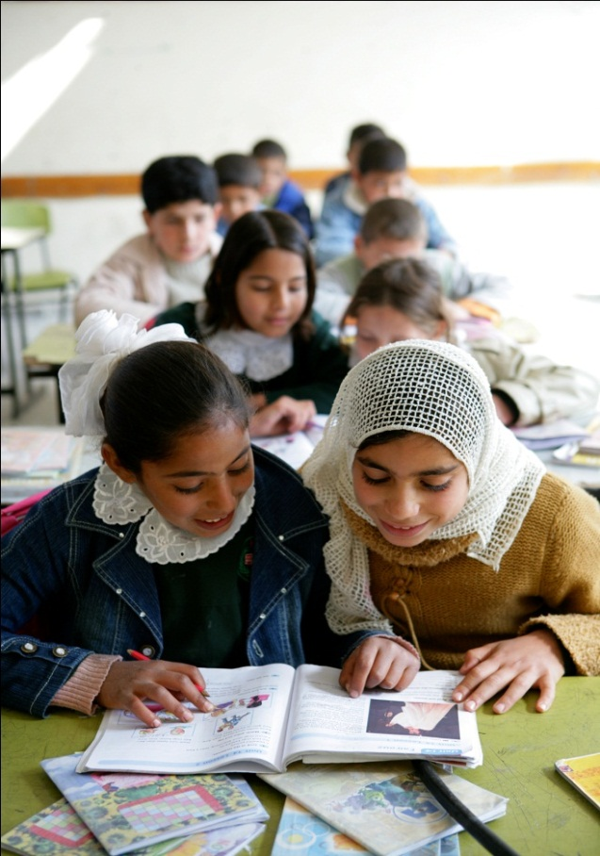
THANK YOU!

