Slide 1
Measuring the Environment Cross-Culturally
Barbara M. Altman
U.S.A.

Slide 2
The Person, The Environment, The Interaction
Participation in the social system requires that a person move outside their home and interact with other people and the physical environment that surrounds them.
In most surveys today, measurement at this level reflects social role performance, from a person orientation, within a context that usually goes unelaborated.
While we may know limitations a person brings to the attempt to use public transportation, we know nothing about the transportation system itself, the regularity, the type of vehicles, the routes they travel, the fares they charge, etc.
Questions used to try to get at these more complicated aspects of social integration and participation are relatively basic, not necessarily applicable to all types of limitations or in all cultures, and do not include the element of choice.
Using such measures provide a false sense of having measured the environmental concept.

Slide 3
Where Does One Begin?
One begins by recognizing that the issue is not the sophistication or simplicity of the transportation system or the variety of architectural styles or the various topographies of separate regions, but rather, how what is available works to inhibit or facilitate the participation of the individual with a specific functional limitation.
It is necessary to create an approach that is culturally neutral while at the same time recognizing that physical topography and weather, building structure, means of transportation and culturally approved methods for doing things are what create the barriers we seek to identify.

Slide 4
Elements that Influence Environment

Slide 5
Models and Taxonomies of Environment
MODEL | Cultural Component | Natural Component | Natural/Cultural Combination
ICF Model (WHO, 2001) | Attitudes and Services Systems and Policies Support and Relationships | Natural Environment | Products and Technology
Quebec Model (Fougeyrollas, 1993) | Political-economic factors Sociocultural factors | Natural factors | Development factors
Whiteneck, et al (2004) | Resource availability Social support Equality |  | Accessibility Accommodations
IOM Model | No taxonomy of environment provided

Slide 6
Current Approaches to Measuring Environment
Focus on the relationship of the individual to his/her environment primarily coming from a rehabilitation perspective, particularly from the perspective of an individual with a mobility limitation.
As proposed by Stark et al (Stark, 2007) the purpose of the environmental questions were to examine the ecological validity or receptivity of physical features from the perspective of individuals with mobility impairments.
A very different approach is that of Clark and George who focused on what are called the 3 Ds, density, diversity and design, environmental conceptions that are used to represent the built environment in many study areas such as examinations of transportation use, poverty, and crime and violence (Clarke, 2005).
Another frequently used measure of environment for the aging population is associated with the use of assistive devices to mitigate some of the limitation (Agree, 1999)

Slide 7
Three Orientations of Environmental Questions
The first approach focuses on the self-reported (or community representative’) description of the characteristics of the home, community, and transportation system, use of assistive devices and appraisal of people’s attitudes in the community.
The second approach focuses on the personal experience of encountering the environmental components.
The third approach is concerned with the evaluation of that experience.

Slide 8
Examples of Description
Respondent description HACE instrument (Keysor, 2005)
How many steps are at the main entrance of your home ?(none, one or two, several, 10 or more)
CHEC describes community receptivity which through a rank ordered checklist (Stark, 2007)
Are the distances between personal transportation (cars) drop off areas and the building as short as possible? (Yes, No, NA)

Slide 9
Examples of Personal Experience
Gray, Hollingsworth, Stark and Morgan (2008) Facilitators and Barriers Survey (FABS)
In your home, do the following influence your participation in activities? Stairs? (Yes, No, NA)
Whiteneck et al (2004) Craig Hospital Inventory of Environmental Factors (CHIEF)
In the past 12 months, how often has the design and layout of your home made it difficult to do what you want or need to do? (Daily to never)

Slide 10
Examples of Personal Evaluation*
Gray, Hollingsworth, Stark and Morgan (2008) Facilitators and Barriers Survey (FABS).
If Yes - How much? (Helps a lot, help some, limit some, limit a lot)
How often? (Daily, Weekly, Monthly, Less than monthly)
Whiteneck et al (2004) Craig Hospital Inventory of Environmental Factors (CHIEF).
When this problem occurs has it been a big problem or a little one? (Little, Big)
* Questions are paired with previous questions on personal description

Slide 11
Differences Between a Rehabilitation Approach and a More General Survey Approach
Descriptive questions document characteristics of the built environment emphasizing aspects that would provide difficulty for those with mobility limitations. As a data point it is a characteristic of the environment.
Paired personal experience and evaluation questions document the individual interaction in the environment and measure individual “disability” as identified by the IOM model. As a data point it is a characteristic of the person.

Slide 12
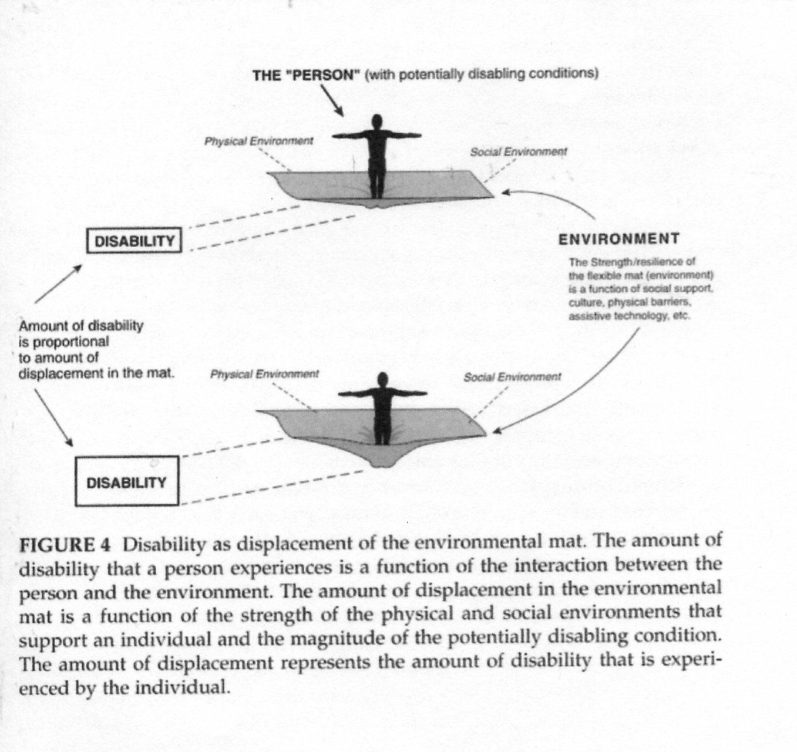

Slide 13
Alternative Approaches
Census and survey approaches to data seek to provide aggregate information that reflects population experience rather than individual experience.
Other approaches ask different questions of the data for prevalence estimates and policy purposes
What types of building components create inaccessibility for persons with various types of disabilities?
Which type of limitation experiences the greatest difficulty in a home or community setting?
What type of environmental barriers are associated with reduced participation?

Slide 14
Alternative Approach cont.
Data identifying problem areas (or helpful areas) in selected contexts give a description of the experience but in terms of environmental characteristics rather than personal ones. (the difference of indicating that bathroom facilities are difficult to use rather than indicating how difficult they are to use or how often they are difficult.

Slide 15
Other Types of Questions Found in Surveys that Address Alternatives
Questions from the 2002 NHIS
Thinking of your home situation, do problems with any of the things on the list, NOW limit or prevent your participation in home activities or household responsibilities?
LIST: Building design (stairs bathrooms, narrow or heavy doors); Lighting (too dim to read, too bright, too distracting); Sound (background noise); Household equipment hard to use; Crowds; Sidewalks and curbs; Transportation; Attitudes of other people; Policies (rental policies, rules); Other

Slide 16
Other Types of Questions Found in Surveys
Questions from the Life Opportunity Survey
Discrimination may occur when people are treated unfairly because they are seen as being different from others. Do you feel that you have experienced discrimination or been treated unfairly by others for any of the following reasons?
Age, Sex, Health problem/disability, Ethnicity or race, Religion, Sexual orientation, Other reasons

Slide 17
Life Opportunity Survey Cont.
In the past twelve months, who discriminated against you because of a health problem or disability? Code all that apply:
Employer Bank Managers
Work colleagues Insurance agents
Employment agencies Mortgage brokers
Health services staff Travel Agents
Local government officials Etc.

Slide 18
UN Convention Provides Us with Several Examples of Approaches to Environmental Context
Article 9 – State Parties shall take appropriate measures to ensure to persons with disabilities access, on an equal basis with others, to the physical environment, to transportation, to information and communications and to other facilities and services open or provided to the public, in both urban and rural areas.
Article 29 - State Parties shall guarantee to persons with disabilities political rights and the opportunity to enjoy them on an equal basis with others

Slide 19
Choice of Question Objectives
Accessibility – whether self described in a survey context or gathered through an examination of representative contexts.
Identification of problem areas - personal experience of actual buildings, interactions or other contexts as representative samples of population experience.
Evaluation of problem areas – personal descriptions of the level of disability in the person/context experience.

Slide 20
Environmental Matrix
 | Environmental Components
 | Home | Transport | Work | Equipment | Social Settings or Relationships |  |  | Civic | Value | Nature
 |  |  |  |  | Church Religion | Friends Entertain | Shop or Service Systems
Physical Description
Person
Observer
Personal Experience
Personal Evaluation
Personal Choice/ Expectation

Slide 21
Recommendations for Types of Questions
Use and need for assistive devices
Identification of experiences of problem areas in home and community
Home
Transportation
Discrimination
Possibly some social settings/activities
Possibly civic settings/activities
Question about safety in a natural disaster

