Slide 1
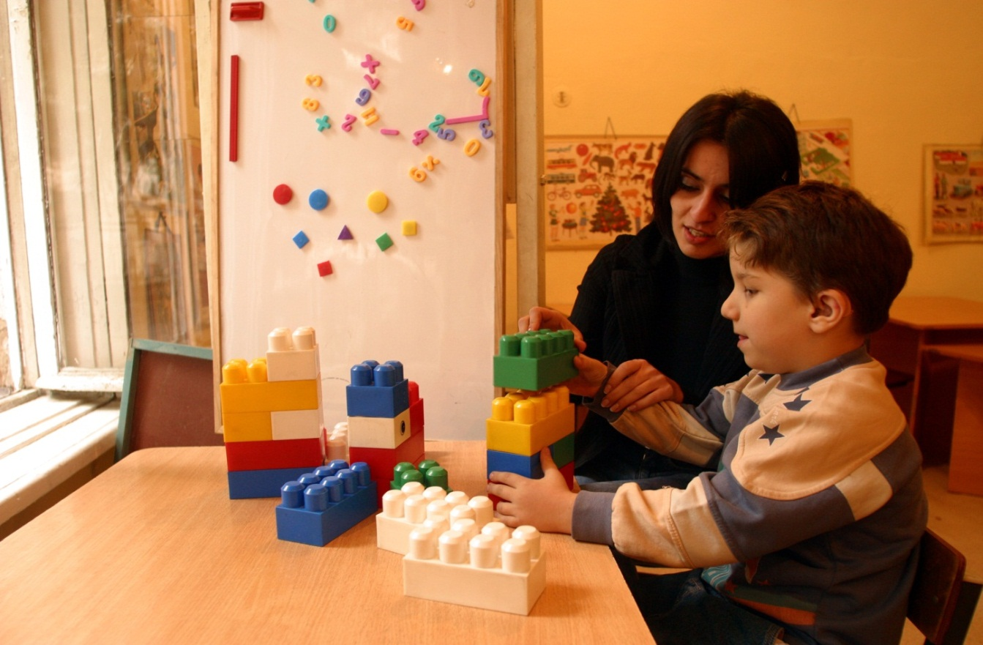
UNICEF’s work and planned activities for the production of data on children with disabilities Claudia Cappa,
Data and Analytics Section, UNICEF, NY

Slide 2
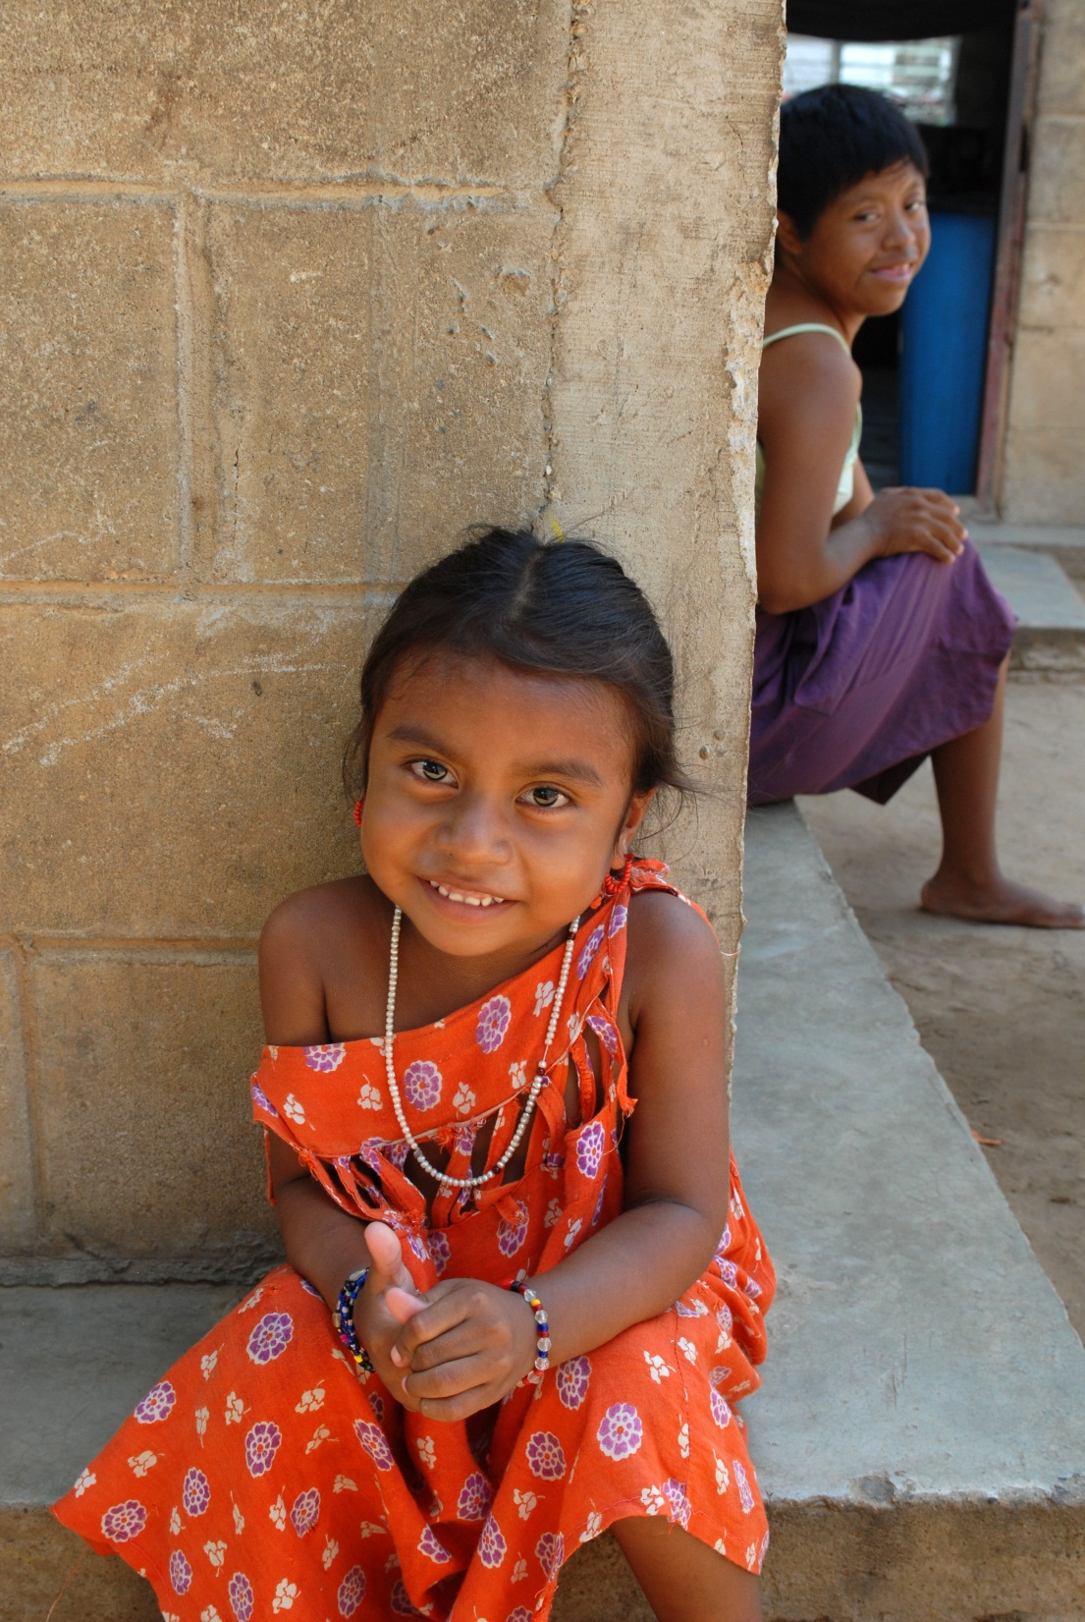
Component 1:
Development of a new survey module
Component 2:
Guidelines and manuals for data collection
Component 3:
Capacity building

Slide 3
Module to measure environmental factors
and school participation

Slide 4
Rationale
The WG and UNICEF have started working on an extended set of questions on child disability that will focus on environmental factors and participation
to provide information that can inform policy
to provide a statistical summary of environmental influences on participation in school
to identify areas with key bottlenecks

Slide 5
Basic principles
This set of questions will:
Be a module that can be added to another survey
To be used in conjunction with the module on child functioning and disability
Take approximately 10 minutes
Focus on formal education and environmental factors that influence participation
Be designed to capture the interaction between the participant and the environment

Slide 6
Conceptual Framework
Attitudes
parents’ perceptions
their perceptions of others’ attitudes, including school staff
societal and cultural norms
other children’s attitudes

Slide 7
Conceptual Framework
School Environment
a) getting to school
transportation (characteristics of all aspects of the system and the need for assistance)
environmental and social safety

Slide 8
Conceptual Framework
School Environment
b) accessibility within the school
physical accessibility (entryway, corridors, bathrooms, lunch room, classroom, common areas etc.)
information accessibility
communication accessibility
programmatic accessibility/adaptability
teacher and school attitudes towards disability

Slide 9
Conceptual Framework
School Environment
c) affordability
fees, costs, and competition for resources associated with attendance
the availability of types of assistance (financial, assistive devices, rehabilitation)
non-educational benefits (e.g., meals)

Slide 10
Conceptual Framework
Out of school
Reasons for not attending school

Slide 11
Completed tasks and next steps
Review of existing questions finalized (32 measures and 668 questions related to environmental factors reviewed)
Preparation of a draft module ongoing
Meetings with key stakeholders to finalize a module for testing : December 2014
Cognitive and field testing will follow
Module to be finalized by end of 2015

Slide 12
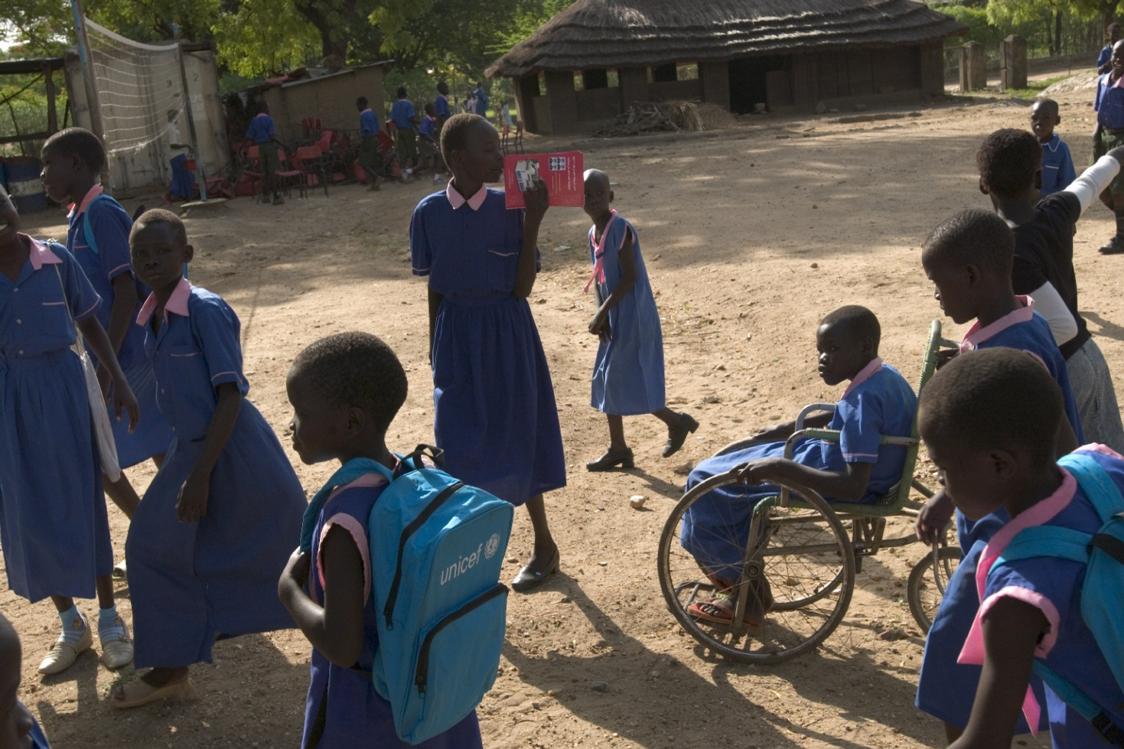
Development of Guidelines and Manual for data collection

Slide 13
Guidelines for producing statistics on children with disabilities
Objective: Provide guidance for those considering collecting data on children with disabilities
Discusses conceptual and theoretical issues related to measuring disability
Includes considerations for designing, planning, and implementing the collection of data on children with disabilities
Expected to be ready in late 2014/early 2015

Slide 14
Table of contents
Chapter 1: Overview
Chapter 2: The importance of monitoring child development and disability
Chapter 3: Concepts and definitions
Chapter 4: Assessing factors of the environment and participation in child disability
Chapter 5: Key domains of child development and disability
Chapter 6: Review of methods and tools used to date to measure disability in children
Chapter 7: Key considerations in planning, designing, and implementing the collection of data on disability in children
Chapter 8: Data analysis and dissemination
Chapter 9: Translating knowledge into action
Chapter 10: Conclusions

Slide 15
Manual/User’s Guide for the UNICEF/WG child functioning and disability module
Objective: This manual provides background information on the development of the module, as well as technical information that will be useful for countries intending to implement it.
The manual should be used in conjunction with the general Multiple Indicator Cluster Survey (MICS) manual which discusses the overall survey methodology in detail.
Expected to be ready in late 2014/early 2015

Slide 16
Table of contents
Chapter 1: The Importance of Disability Statistics for Children: discusses the need for reliable data that is comparable across countries; the complexities in collecting such data and findings from previous data collection efforts.
Chapter 2: Background: presents the International Classification of Functioning, Disability and Health (ICF) as the conceptual framework for the child functioning and disability module and describes the steps that UNICEF and the Washington Group on Disability Statistics used to design, test and validate the instrument.
Chapter 3: How to Use the Module: presents options for using the questionnaire as a module in an ongoing household survey such as the MICS or the Demographic Health Survey (DHS), as a screening tool for a two-stage data collection process or as a stand-alone module in a health or disability survey.

Slide 17
Table of contents
Chapter 4: Content of the Module: describes the rationale behind each question and how the module differs from questionnaires designed to measure disability among adults.
Chapter 5: Implementing the Module: provides special instructions about translation, pretesting, sample requirements, identification of respondents and eligible children and guidelines for customization
Chapter 6 Data processing: provides guidance and for entering the data and syntaxes for data processing.
Chapter 7 Data analysis and dissemination: provides guidance for analysing and interpreting the findings, calculating indicators, and tabulating and reporting the data.

Slide 18
Capacity Building

Slide 19
Workshops on the measurement of child disability
Purpose: To build/strengthen local capacity for data collection, interpretation, and use.
Content: Concepts, models and measures of disability, survey design, data processing, data analysis, data dissemination and data use.
Audience(s): National Statistics Offices, other Government staff, local researchers, DPOs, etc.
When: The workshops are expected to take place in 2015/2016.
Where: All 7 UNICEF regions (Latin America and the Caribbean, West and Central Africa, East and Southern Africa, Middle East and North Africa, CEE/CIS, East Asia and the Pacific, and South Asia).

Slide 20
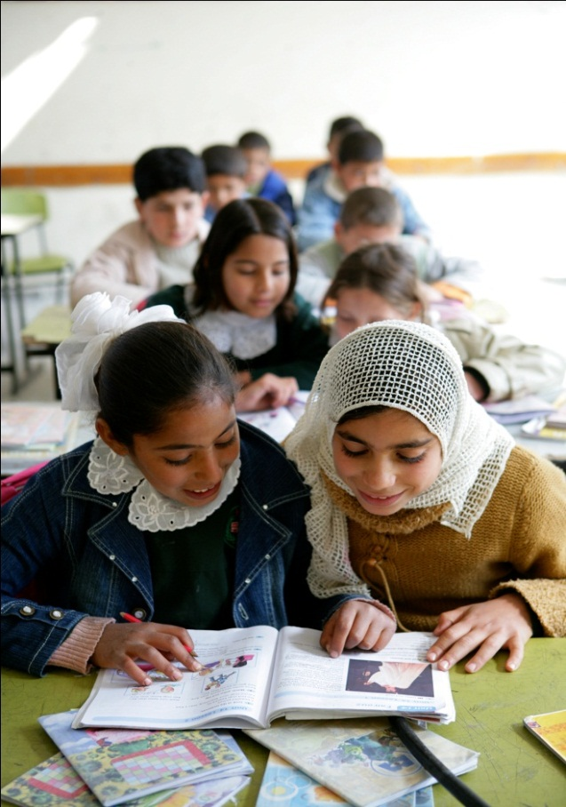
THANK YOU!

