Slide 1
Hot Topic: Arboviral-related Updates
Ruth Jajosky
Sundak Ganesan
Jerry Sable
NMI eSHARE
February 18, 2016
Center for Surveillance, Epidemiology, and Laboratory Services
Division of Health Informatics and Surveillance

Slide 2
Arboviral Case Notification Message Mapping Guide (MMG) Update (1 of 3)
For the last several months, CDC has been working on the Arboviral version 2 MMG.
However, the timeline for implementation of the Arboviral version 2 MMG and the need to update data elements for routine national surveillance of Arboviral diseases caused us to rethink our strategy.
New Strategy: Develop and implement the Arboviral version 1.3 MMG (an update of the version 1.2 MMG currently in production) and put the Arboviral version 2 MMG on hold.

Slide 3
Arboviral Case Notification MMG Update (2 of 3)
The new Arboviral v1.3 MMG will contain all the current ArboNET data elements, including new laboratory tests and clinical signs and symptoms.
Expected timeline in 2016:
Updated Arboviral version 1.3 MMG available: March
Webinar to provide an overview of Arboviral v1.3 MMG: April
Message Quality Framework (MQF) updated to test the new message: April
CDC systems ready to accept the new messages: May

Slide 4
Arboviral Case Notification MMG Update (3 of 3)
CDC would provide technical assistance to jurisdictions using the v1.2 message to update to the v1.3 message and to help other jurisdictions implement the v1.3 message.
If you have any questions, please send an e-mail to edx@cdc.gov with “Arboviral MMG” in the subject line.

Slide 5
Electronic Lab Reporting (ELR)
CDC Arboviral Diseases and Dengue Branch have published an updated diagnostic testing guidance for Zika, Chikungunya, and Dengue virus at http://www.cdc.gov/zika/state-labs/index.html.
PHIN Vocabulary Access and Distribution System (PHIN VADS) has published standard vocabulary (LOINC lab tests and SNOMED lab result codes) associated with the new testing algorithm for detecting suspected cases of Dengue, Chikungunya, and Zika.
Systems involved in ELR such as state/local public health lab information systems (LIS), state public health surveillance systems, and electronic health records systems can download the ELR vocabulary from PHIN VADS at http://phinvads.cdc.gov under the “Hot Topics” section.
The PHIN VADS team expects to host a webinar on March 3, 2016 to discuss ELR vocabulary in detail with the ELR community.

Slide 6
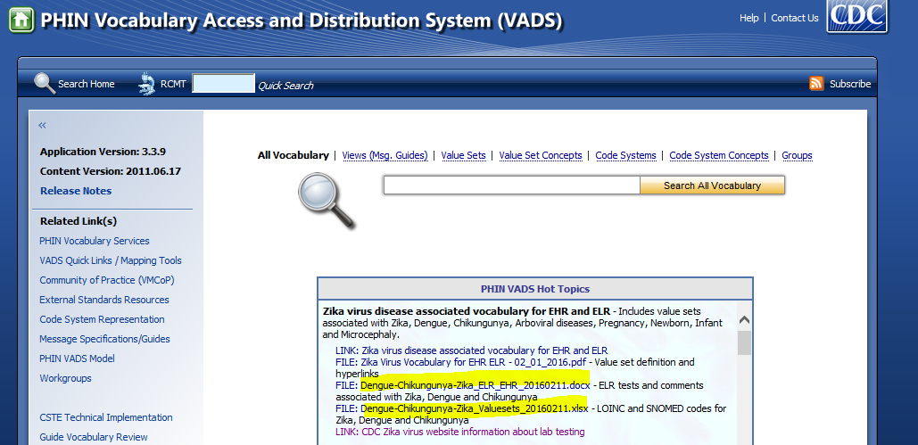
PHIN VADS ELR Vocabulary Download Information
PHIN VADS URL: http://phinvads.cdc.gov
Download the following two files from the PHIN VADS Hot Topics section:
Dengue-Chikungunya-Zika_LabTests_Information_20160217.pdf – This file has information for epidemiologists and lab subject matter experts.
Dengue-Chikungunya-Zika_Valuesets_20160217.xlsx – This file could be used by system developers to import the vocabulary into their surveillance system and LIS.

