Slide 1
Winnable Battles: Nutrition, Physical Activity, & Obesity
U.S. Department of Health and Human Services
Centers for Disease Control and Prevention

Slide 2
Health Benefits of Healthy Eating and Active Living
Helps control weight
Reduces the risk of cardiovascular disease
Reduces the risk of type 2 diabetes and metabolic syndrome
Reduces the risk of some cancers
Increases the chances for living a longer and healthier life
Eating healthy and getting regular physical activity are two of the most important things people can do for their health.
Notes:
Eating healthy and getting regular physical activity are two of the most important things people can do for their health. The health benefits of these two activities are many, including: helps control weight; reduces the risk of cardiovascular disease; reduces the risk of type 2 diabetes and metabolic syndrome; reduces the risk of some cancers, and increases the chances for living a longer and healthier life.

Slide 3
HEALTHY NUTRITION

Slide 4
Healthy Nutrition Starts With Breastfeeding
Breastfeeding reduces babies’ risk of hospitalizations for respiratory infections by 72%.
Breastfeeding lowers the risk of Sudden Infant Death Syndrome (SIDS) by 36%.
Breastfeeding for 9 months reduces a baby’s odds for becoming overweight by more than 30%.
One of the most effective preventive measures a mother can take to protect the health of her infant is to breastfeed.
Notes:
Breastfeeding is one of the most effective preventive measures a mother can take to protect the health of her baby. Here are just a few reasons why:
Breastfeeding reduces babies’ risk of hospitalizations for respiratory infections by 72%.
Breastfeeding lowers the risk of Sudden Infant Death Syndrome (SIDS) by 36%.
Breastfeeding for 9 months reduces a baby’s odds for becoming overweight by more than 30%.

Slide 5
American Academy of Pediatrics Breastfeeding Recommendations
The American Academy of Pediatrics recommends mothers exclusively breastfeed for about the first six months of a baby's life, and then gradually add solid foods while continuing breastfeeding until at least the baby's first birthday.
Notes:
According to the American Academy of Pediatrics, “infant nutrition should be considered a public health issue and not only a lifestyle choice”. The American Academy of Pediatrics recommends exclusive breastfeeding for about 6 months, followed by continued breastfeeding as complementary foods are introduced, with continuation of breastfeeding for 1 year or longer as mutually desired by mother and infant.

Slide 6
U.S. Breastfeeding Rates Among Children Born in 2011
 | Any BF at 6 months | *Exclusive BF through 6 months | BF at 12 months
US National | 49.4% | 18.8% | 26.7%
White (Non-Hispanic) | 52.3% | 20.3% | 28.4%
Black (Non-Hispanic) | 35.0% | 13.7% | 16.4%
Hispanic | 48.4% | 17.1% | 24.8%
Asian (Non-Hispanic) | 71.2% | 26.6% | 47.3%
Source: National Immunization Survey.
*Exclusive breastfeeding is defined as ONLY breast milk – NO solids, no water, and no other liquids.
Notes:
This slide shows breastfeeding rates among children born in 2011. The chart highlights national breastfeeding rates, as well as rates by white, black, Hispanic, and Asian women. Rates are broken down by categories of 1) any breastfeeding at 6 months; 2) exclusive breastfeeding through 6 months; and 3) breastfeeding at 12 months.

Slide 7
Breastfeeding Support Strategies
Maternity care practices in hospitals
Professional education for healthcare providers
Support from health care professionals
Peer support programs
Breastfeeding support in the workplace
Breastfeeding support in childcare settings
Breastfeeding education
Social marketing campaigns
Addressing the marketing of infant formula
The CDC Guide to Strategies to Support Breastfeeding Mothers and Babies
http://www.cdc.gov/breastfeeding/pdf/BF-Guide-508.PDF
Notes:
Here are some CDC-recommended strategies that can be used to increase breastfeeding rates across the nation. For more details on each of these areas, see the CDC Guide to Strategies to Support Breastfeeding Mothers and Babies at: www.cdc.gov/breastfeeding/pdf/BF-Guide-508PDF

Slide 8
Baby-FriendlyTM Hospital Initiative The Gold Standard of Care
Developed by the World Health Organization and UNICEF to encourage increased support for breastfeeding in the healthcare system.
Designates hospitals as ‘Baby-Friendly’ for adopting Ten Steps to Successful Breastfeeding.
CDC is helping to increase the number of hospitals designated as ‘Baby-Friendly’ every year.
To learn more about promoting or becoming a
Baby-Friendly hospital, go to www.babyfriendlyusa.org
Notes:
CDC is working with partners to advance the Baby-Friendly Hospital Initiative in hospitals across the country. This program was developed by the WHO and UNICEF to encourage improved maternity care practices in hospitals in support of breastfeeding. The program awards hospitals with a Baby-Friendly designation if they successfully implement a set of 10 Steps proven to increase breastfeeding. CDC dedicates significant resources to increase the number of hospitals designated as Baby-Friendly each year. For more information on the Baby-Friendly Hospital Initiative, go to: www.babfriendlyusa.org.

Slide 9
How much fruit and vegetables do children need daily?
Notes:
This slide shows a chart of how much fruit and vegetables children (aged 2 – 18) should be eating on a daily basis. The amount varies by age and sex of the child.

Slide 10
Fruit & Vegetable Consumption Among Children
6 in 10 children don’t eat enough fruit. *
9 in 10 children don’t eat enough vegetables. *
The amount of whole fruit children eat has increased by 67% from 2003 to 2010, but the amount eaten still remains low. **
Experts recommend that most fruit come from whole fruit, rather than fruit juice. The amount of fruit juice children drank from 2003 to 2010 decreased by one-third. **
*NHANES, 2007-2010
**Vital Signs, NHANES, 2003 to 2010
Notes:
Children are not eating enough and fruits and vegetables, however, there has been progress lately. The amount of whole fruits children consume has increased since 2003, while the amount of fruit juices has decreased.

Slide 11
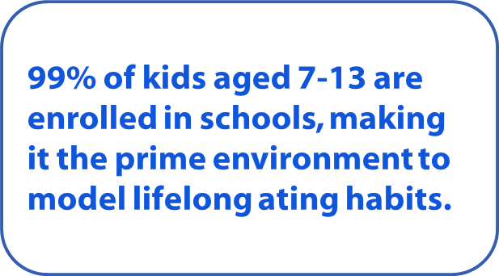
Healthy Hunger Free Kids Act of 2010: School Provisions to Improve Nutrition
School Meal Standards (breakfast and lunch)
Competitive Foods Standards (“Smart Snacks”)
Local Wellness Policies
Notes:
In order for children to make healthier choices, it is important that healthy foods and beverages are available and accessible to them. As most children between the ages of 7 – 13 spend much of their day in childcare settings or schools, improving foods offered in these settings will go a long way towards improving our children’s health and modeling lifelong eating habits. Several national standards were put in place through the Healthy Hunger Free Kids Act of 2010 to improve school food offerings for children.

Slide 12
How Much Fruit and Vegetables Do Adults Need Daily?
Women
Men
Age | Fruit | Vegetables
19-30 | 2 cups* | 2 ½ cups*
31-50 | 1 ½ cups* | 2 ½ cups*
51+ | 1 ½ cups* | 2 cups*
Age | Fruit | Vegetables
19-30 | 2 cups* | 3 cups*
31-50 | 2 cups* | 3 cups*
51+ | 2 cups* | 2 ½ cups*
*These amounts are appropriate for individuals who get less than 30 minutes per day of moderate physical activity, beyond normal daily activities. Those who are more physically active may be able to consume more while staying within calorie needs.
United States Department of Agriculture
http://www.choosemyplate.gov/
Notes:
This slide outlines how much fruit and vegetables men and women need daily to maintain health by age. The amounts vary based on gender and age.

Slide 13
Fruit & Vegetable Consumption Among Adults
86% of men do not meet fruit consumption recommendations.
76% of women do not meet fruit consumption recommendations.
88% of men do not meet vegetable consumption recommendations.
84% of women do not meet vegetable consumption recommendations.
NHANES, 2007-10
Notes:
Most adult men and women do not eat enough fruits or vegetables:
86% of men do not meet fruit consumption recommendations; 76% of women do not meet fruit consumption recommendations.
88% of men do not meet vegetable consumption recommendations; 84% of women do not meet vegetable consumption recommendations.

Slide 14
Health & Sustainability Guidelines Adopted by the federal government in 2010
Set standards for vendors who provide food concessions or vending services in federal government facilities.
Help vendors maximize a healthier and sustainable food service by:
Increasing offerings of healthier food and beverage choices.
Eliminating industrially-produced trans fats.
Decreasing sodium content in available foods.
Allowing individuals to make informed decisions about what they are purchasing and eating by labeling food items.
Notes:
In order for people to make healthier choices, it is important that healthy foods and beverages are available and accessible to them. In 2010, HHS and GSA released the Health and Sustainability Guidelines for Federal Concessions and Vending Operations. The goal of the Guidelines is to provide standards for vendors on what kind of foods and beverages are expected to be provided through their contracts to government employees whom they serve.

Slide 15
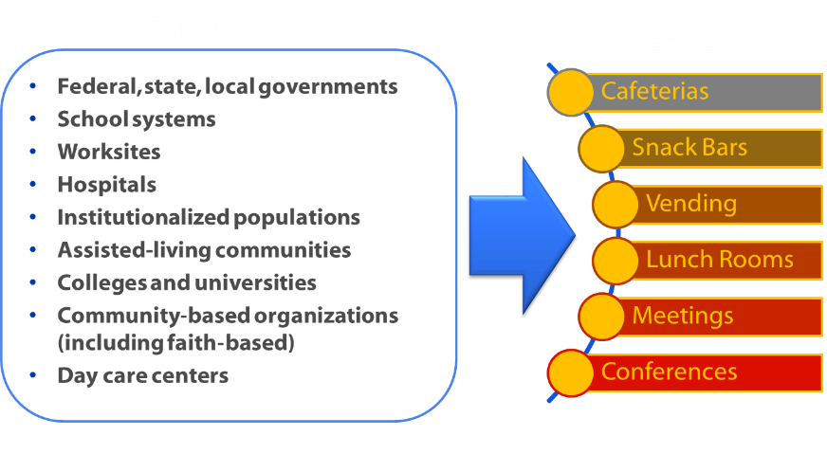
Guidelines Can Also Be Used By Non-Federal Government Entities
Find the Health and Sustainable Guidelines at: www.cdc.gov/chronicdisease/pdf/guidelines_for_federal_concessions_and _vending_operations.pdf
Notes:
It is hoped that non-federal government entities will follow the lead of the federal government in applying the Health & Sustainability Guidelines in various settings and venues across the nation.

Slide 16
Reductions in Salt Intake Can Reduce High Blood Pressure
Increased sodium in the diet = increased blood pressure = increased risk for heart attack and stroke.
Generally, lower consumption of salt means lower blood pressure.
Within the span of a few weeks, most people experience a reduction in blood pressure when salt intake is reduced.
Even people with blood pressure in the normal range benefit from sodium reduction; there appears to be no threshold.
Notes:
Reducing salt intake can reduce blood pressure and therefore reduce the risk for heart attack and stroke. Even people with normal blood pressure can benefit from reducing salt in their diets. Within the span of a few weeks, most people have lower blood pressure when they reduce their salt intake.

Slide 17
Most Children and Adults in the U.S. Consume Too Much Sodium
Average sodium intake in the US is 3,500 mg per day.
The majority of sodium comes from packaged and restaurant foods.
44% of US sodium intake comes from only ten types of foods.
Rank | Food Types | %
1 | Bread and rolls | 7.4
2 | Cold cuts and cured meats | 5.1
3 | Pizza | 4.9
4 | Poultry | 4.5
5 | Soups | 4.3
6 | Sandwiches | 4.0
7 | Cheese | 3.8
8 | Pasta mixed dishes | 3.3
9 | Meat mixed dishes | 3.2
10 | Savory snacks | 3.1
Notes:
The majority of children and adults in the United States consume too much sodium (or salt in their diets). Most sodium is in packaged and restaurant foods. This chart shows that 44% of US sodium intake comes from only ten types of foods.

Slide 18
Estimated Effects of Sodium Reduction on Hypertension Prevalence and Related Costs
Reducing average population intake to 2300 mg per day (current recommended maximum) may…
Reduce cases of hypertension by 11 million.
Save $18 billion in health care costs.
Gain 312,000 Quality Adjusted Life Years (QALYs).
Reducing average population intake even lower – to 1500 mg per day (recommended maximum level for “specific populations” described in the Dietary Guidelines for Americans) – may…
Reduce cases of hypertension by 16 million.
Save $26 billion in health care costs.
Gain 459,000 Quality Adjusted Life Years (QALYs).
American Journal of Health Promotion. 2009;24:49-57.
Notes:
Reducing average population intake of sodium to 2300 mg per day can have a major impact on hypertension cases, healthcare costs, and the quality adjusted life years. Reducing intake even more to 1500 mg per day can have an even greater impact.

Slide 19
Key Strategies to Address Sodium Reduction
Establish sodium reduction standards in government facilities and educational institutions.
Promote innovative restaurant initiatives to reduce sodium content of restaurant meals.
Increase availability of lower-sodium processed and restaurant food products.
Notes:
Key strategies to reduce sodium intake include: sodium reduction standards in government facilities and educational institutions; innovative initiatives in restaurants to reduce sodium content in restaurant meals; and increased availability of lower-sodium processed and restaurant food products.

Slide 20
Tools and Guidance to Address Sodium Reduction
Consumers:
Million Hearts® Healthy Eating and Lifestyle Resource Center
Fact sheets for sodium reduction
Resources for reducing sodium in children’s diets
Resources for reducing sodium intake in older adults
Public Health Professionals:
Guides for healthful food procurement and venue-based sodium reduction
New sodium research
Sodium Reduction Toolkit
Archived webinars and videos
http://recipes.millionhearts.hhs.gov/
www.cdc.gov/salt
http://www.cdc.gov/vitalsigns/children-sodium/
Notes:
To help educate and support the public with eating healthier meals, the CDC has developed the Million Hearts® Healthy Eating and Lifestyle Resource Center. Developed in partnership with EatingWell Magazine. The Resource Center features lower-sodium, heart-healthy recipes and family-friendly meal plans designed to help consumers better manage their sodium intake.
CDC’s sodium website, www.cdc.gov/salt, contains information and resources for consumers and public health professionals, including fact sheets, guidance documents, new studies related to sodium reduction, and resources for reducing sodium in children’s diets. Also on the websites is our procurement guide providing an overview of considerations when developing and implementing food service guidelines, and venue-specific guides for sodium reduction in worksites, hospitals, schools, and congregate populations.
CDC's Sodium Reduction Toolkit: A Global Opportunity to Reduce Population-Level Sodium Intake(http://www.cdc.gov/salt/sodium_toolkit.htm) provides international and national government agencies and public health organizations with a brief overview, tools, and information for developing and implementing sodium reduction programs, policies, and initiatives aimed at lowering sodium intake. The toolkit includes an introduction and 7 self-guided online modules. Available in English and Spanish.
More information for consumers and health professionals my be found at www.cdc.gov/salt.

Slide 21
PHYSICAL ACTIVITY

Slide 22
Physical Activity Guidelines
Children and adolescents:
(6-17 years of age)
60 minutes (1 hour) or more of physical activity each day.
Adults (18 years of age and older):
2 hours and 30 minutes (150 minutes) of moderate-intensity aerobic activity (i.e., brisk walking) OR 1 hour and 15 minutes (75 minutes) of vigorous-intensity aerobic activity (i.e., jogging or running) every week OR an equivalent combination of both.
2 or more days a week of muscle-strengthening activities that work all major muscle groups (legs, hips, back, abdomen, chest, shoulders, and arms).
Notes:
Older adults, both men and women, can benefit from regular physical activity. It is never to be late to begin being active.

Slide 23
Physical Activity Behaviors in the U.S.
Only about half of U.S. adults meet the minimal guideline for aerobic physical activity.
Women and older adults are not as likely to get the recommended level of weekly physical activity.
Fewer than a third of high school students get enough physical activity every day.
Source: http://www.cdc.gov/physicalactivity/everyone/health/index.html
Notes:
Many Americans are not getting enough physical activity.

Slide 24
Proportion of U.S. Adults Meeting Aerobic and Muscle-Strengthening Physical Activity Guidelines by State (BRFSS, 2013)

Slide 25
Economic Consequences Inadequate physical activity costs Americans
Inadequate levels of physical activity are associated with $117 billion in annual health care costs.
Notes:
Americans not meeting physical activity recommendations result in a huge financial burden due to increased health care costs.

Slide 26
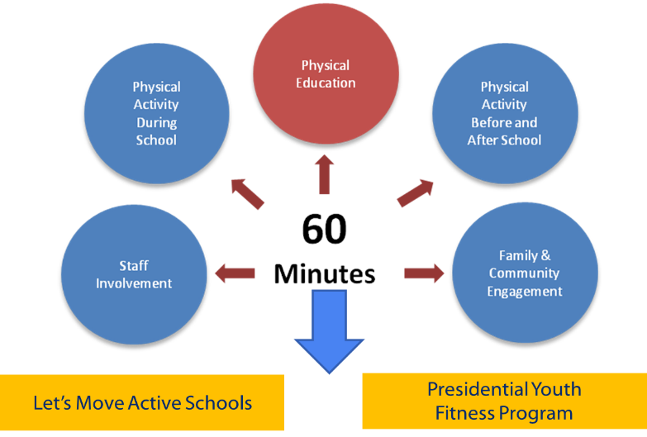
Comprehensive School Physical Activity Program (CSPAP)
Notes:
This visual shows that children need at least 60 minutes of physical activity a day. The Comprehensive School Physical Activity Program shows how staff involvement, physical activity during the school day/before school/after school, and family and community planning can help children meet this recommendation. Programs like Let’s Move! Active Schools and the Presidential Youth Fitness Program support these efforts.

Slide 27
How To Get Americans Moving More
Improve physical education and physcial activity in schools and early child care settings.
Increase opportunities and incentives for physical activity in worksites.
Make communities more walkable through transportation and community design planning.
Notes:
There are many strategies that can help promote physical activity among Americans. These include improving physical education (PE) and physical activity in schools and early childcare settings; increasing opportunities and incentives for physical activity in worksites; and making communities more walkable through transportation and community design planning.

Slide 28
OBESITY

Slide 29
Obesity is common, costly, and serious
More than one-third of adults (78.6 million) have obesity.
Since 1980, there has been a dramatic increase in obesity in the United States. Recent data suggest a slowing or leveling off of this trend.
The annual medical costs for obesity among adults in the U.S. are estimated to be $147 billion per year.
Obesity is associated with the leading causes of death in the U.S., including Type 2 diabetes, cardiovascular disease, and some cancers.
Notes:
In the United States, obesity is very common, although statistics show it may be leveling off somewhat. Obesity places a huge financial burden on our nation. The medical costs of adult obesity is estimated to cost $147 billion annually. Obesity is a serious public health issue as a leading cause of serious health conditions and deaths.

Slide 30
Overweight and Obesity—Adults
Body Mass Index (BMI) is a number calculated from a person’s weight and height. BMI is a fairly reliable indicator of body fatness for most people.
BMI | Weight Status
Below 18.5 | Underweight
18.5 – 24.9 | Normal
25.0 – 29.9 | Overweight
30.0 and above | Obese
For a BMI calculator, go to: WWW.CDC.GOV/HEALTHYWEIGHT
Notes:
Body Mass Index (BMI) is a number calculated from a person’s weight and height. BMI is a fairly reliable indicator of body fatness for most people.
It is important to note that BMI is not a direct measure of body fatness and that BMI is calculated from an individual's weight, which includes both muscle and fat. As a result, some individuals may have a high BMI but not have a high percentage of body fat. For example, highly trained athletes may have a high BMI because of increased muscularity rather than increased body fatness.
Although some people with a BMI in the overweight range (from 25.0 to 29.9) may not have excess body fatness, most people with a BMI in the obese range (equal to or greater than 30) will have increased levels of body fatness. It is also important to remember that weight is only one factor related to risk for disease.

Slide 31
Body Mass Index (BMI) For Children and Teens
Weight Status Category | Percentile Range
Underweight | Less than the 5th percentile
Healthy weight | 5th percentile to less than the 85th percentile
Overweight | 85th to less than the 95th percentile
Obese | Equal to or greater than the 95th percentile
http://www.cdc.gov/healthyweight/assessing/bmi/childrens_bmi/about_childrens_bmi.html
Notes:
Body Mass Index (BMI) is a number calculated from a child's weight and height. BMI is a reliable indicator of body fatness for most children and teens. BMI is used as a screening tool to identify possible weight problems in children. CDC and the American Academy of Pediatrics recommend the use of BMI to screen for overweight and obesity in children beginning at 2 years old. For children, BMI is used to screen for obesity, overweight, healthy weight, or underweight. However, BMI is not a diagnostic tool.
After BMI is calculated for children and teens, the BMI number is plotted on the CDC BMI-for-age growth charts (for either girls or boys) to obtain a percentile ranking. Percentiles are the most commonly used indicator to assess the size and growth patterns of individual children in the United States. The percentile indicates the relative position of the child's BMI number among children of the same sex and age. The growth charts show the weight status categories used with children and teens (underweight, healthy weight, overweight, and obese). BMI-for-age weight status categories and the corresponding percentiles are shown in the table.

Slide 32
Prevalence of Childhood Obesity in the U.S., 2011-2012
Childhood obesity prevalence remains high. Young people with obesity, aged 2 to 19, is 17%.
In 2011-2012, 8.4% of 2- to 5-year-olds had obesity compared with 17.7% of 6- to 11-year-olds and 20.5% of 12- to 19-year-olds.
Among children 2 to 5, the percentage with obesity declined from 13.9% in 2003 – 2004 to 8.4% in 2011-2012.
Source: Ogden, et al. Prevalence of Childhood and Adult Obesity in the United States, 2011-2012, JAMA. 2014.
Notes:
Childhood obesity is still a problem in the U.S., however, has declined in recent years for young children.

Slide 33
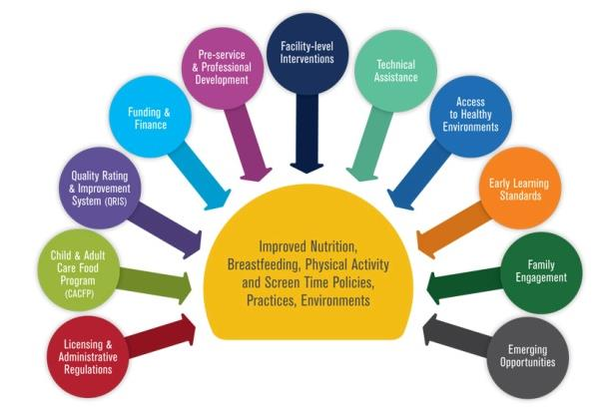
Spectrum of Opportunities for Obesity Prevention in Early Care and Education Settings
Notes:
This diagram shows many areas to work in to prevent obesity in early care and education settings. Integrating prevention strategies into these areas can lead to improved nutrition, breastfeeding, physical activity, and screen time policies, practices, and environments.

Slide 34
Let’s Move! Child Care is a nationwide call-to-action that empowers child care providers to make positive health changes in children, early on, that could last a lifetime.
CDC ‘s Division of Nutrition and Physical Activity is the government agency leading the Let’s Move! Child Care initiative.
For more information, go to: http://www.healthykidshealthyfuture.org/home/startearly.html
Notes:
As millions of children spend significant time in childcare and early education settings, Let’s Move! Child Care focuses on improving health in these settings. Let’s Move! Child Care is nationwide initiative to help child care providers make positive health changes in early child care settings. CDC is the lead agency for this initiative on behalf of the White House’s Let’s Move! program. For more information, tools, and resources on this initiative, go to: http://www.healthykidshealthyfuture.org/home/startearly.html

Slide 35
Let’s Move! 5 Child Care Goals
Physical Activity: Provide 1-2 hours of physical activity during the day.
Screen Time: None under age 2. For 2+, work to limit to 30 minutes/week during child care. Aim for no more than 1-2 hours/day of quality screen time at home.
Healthy Food: Try to serve fruits or vegetables at every meal. Eat meals family-style when possible. Avoid serving fried food.
Healthy Beverages: When you can, give water during meals and all day. Avoid sugary drinks. Two and up, serve low- or non-fat milk and 4-6 ounces max of 100% juice a day.
Infant Feeding: Provide breast milk to infants of mothers who wish to breastfeed. Welcome mothers to nurse mid-day and support parents' decisions with infant feeding.
Notes:
The Let’s Move! Child care program has 5 goals that address the following areas: Physical Activity; Screen Time; Healthy Foods; Healthy Beverages; and
Infant Feeding. For more detailed information, tools, and resources on implementing these goals, go to: http://www.healthykidshealthyfuture.org/home/startearly.html

Slide 36
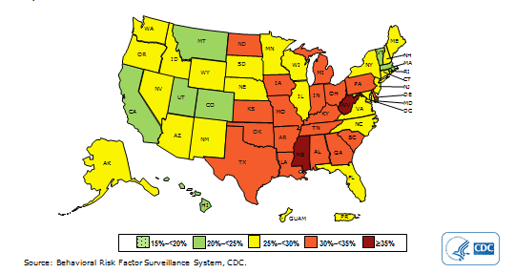
Prevalence* of Self-Reported Obesity Among U.S. Adults by State and Territory, BRFSS, 2013
*Prevalence estimates reflect BRFSS methodological changes started in 2011. These estimates should not be compared to prevalence estimates before 2011.
Notes:
This map shows the self-reported prevalence of obesity among U.S. adults by state.

Slide 37
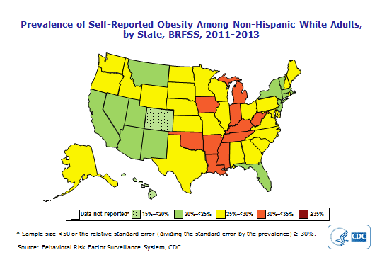
Prevalence of Self-Reported Obesity Among White Adults, by State (BRFSS, 2011-2013)
Notes:
This map shows the self-reported prevalence of obesity among White adults in the U.S. by state.

Slide 38
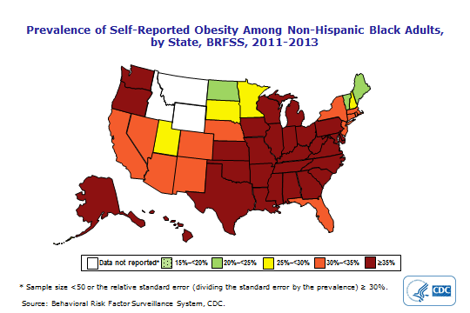
Prevalence of Self-Reported Obesity Among Non-Hispanic Black Adults by State (BRFSS, 2011-2013)
Notes:
This map shows the self-reported prevalence of obesity among non-Hispanic Black adults in the U.S., by state.

Slide 39
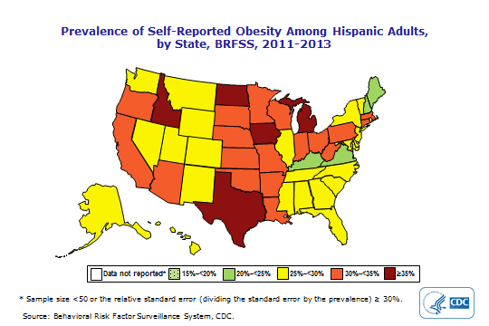
Prevalence of Self-Reported Obesity Among Hispanic Adults, by State (BRFSS, 2011-2013)
Notes:
This map shows the self-reported prevalence of obesity among Hispanic adults in the U.S., by state.

Slide 40
Medical Costs for Adults With Obesity Are Rising
 | 1998 (in 2008 dollars) | 2006 (in 2008 dollars)
Total Costs | $75 billion/yr | $147 billion/yr
% of U.S. Medical Costs | 6.5% | 9.1%
Increased prevalence, not increased per capita costs, was the main driver of the increase in costs.
Finkelstein et al. Health Affairs 2009; 28:w822.
Notes:
Medical costs for adults with obesity are increasing over time.

Slide 41
Solutions Surround Us
Clinical Settings
Schools
Food Retail Environments
Community Design
Notes:
There are many opportunities to impact the prevalence of obesity in our nation in clinical settings, schools, places where food is purchased, and in communities. The following slides will provide a few examples.

Slide 42
Clinical Settings
Adopt policies and practices in maternity hospitals that support breastfeeding.
Conduct regular BMI screenings; document and track in electronic health records.
Provide nutrition and physical activity counseling for high risk groups.
Notes:
There are many supports that can be put in place in clinical settings to help prevent and reduce obesity, such as:
Adopting policies and practices in maternity hospitals that support breastfeeding.
Conducting BMI screenings regularly on clinical visits; documenting and tracking obesity in electronic health record systems.
Providing nutrition and physical activity counseling for high risk groups

Slide 43
Schools
Meet or exceed nutrition and physical activity standards in schools and afterschool programs.
Establish Safe Routes to School programs.
Establish shared-use agreements to increase places for physical activity after school hours.
Notes:
As children spend much of their days in the school setting, schools play an important role in influencing the health of our nation’s children. Schools can meet or exceed national nutrition and physical activity standards. They can make walking and bicycling to school safer and more accessible for children, including those with disabilities, by establishing a Safe Routes to School program. Schools can collaborate with other government agencies to keep facilities open so children and community members have greater access to places for physical activity after regular school hours.

Slide 44
Childcare and Early Education
Provide nutritious meals and snacks.
Engage children in adequate, age-appropriate physical activities.
Limit screen time.
Fully support breastfeeding mothers and babies.
Notes:
There are many opportunities to integrate healthy actions into children's’ days in childcare and early education settings.

Slide 45
Food Retail Settings
Healthy grocery options
Healthy concessions, vending, and cafeteria standards
Healthy restaurant options and kids meals
Healthy corner stores
Notes:
Creating healthy food environments is part of a comprehensive approach to providing Americans with access to healthier foods and beverages in a variety of settings, including grocery stores, restaurants, concessions stands, vending machines, and cafeterias.

Slide 46
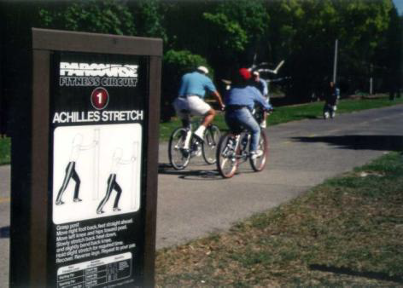
Community Design
Complete Streets
Trails & greenways; parks and recreational facilities
Planning and zoning ordinances for healthy design
Notes:
Communities have many opportunities to increase accessibility of spaces where people can more easily be physically active. A few examples are:
Complete Streets are designed and operated to enable safe access for all users, including pedestrians, bicyclists, motorists and transit riders of all ages and abilities.
Building trails and greenways, parks and recreational facilities offer opportunities for community members to be physically active.
Provisions for healthy design can be incorporated into city or county ordinances to ensure opportunities are available for communities to be physically active.

Slide 47
www.cdc.gov/winnablebattles
U.S. Department of Health and Human Services
Centers for Disease Control and Prevention

