Slide 1
Connecting the Dots: An Overview of the Links Among Multiple Forms of Violence

Slide 2
Background
“Connecting the Dots” Brief
  What it is: Brief document that translates research about the connections between different forms of violence (e.g. shared risk and protective factors)
  Audience: Public health and violence prevention practitioners and their partners
  Purpose: Help violence prevention practitioners and their partners 1) Better understand and make the case for the connections between multiple forms of violence, 2) Think strategically and creatively about ways to prevent all types of violence from occurring in the first place
The findings and conclusions in this presentation do not necessarily represent the official position of the Centers for Disease Control and Prevention
Notes:
Understanding the overlapping causes of violence and the things that can protect people and communities is important, and can help CDC, its partners, and other working in the field of violence prevention better address violence in all its forms. The purpose of “Connecting the Dots: An Overview of the Links Between Multiple Forms of Violence” is to translate the research about the connections between different forms of violence and describe how these connections affect communities. It is hoped that this information will help violence prevention practitioners think strategically and creatively about ways to prevent all types of violence from occurring in the first place, and opportunities to coordinate and integrate responses to violence in a way that recognizes these connections and considers the individual in the context of their home environment, neighborhood, and larger community.
The purpose of this presentation is to provide an overview of the content from the “Connecting the Dots” brief in a “user friendly” presentation format. It is hoped that this format will be useful for violence prevention practitioners and their partners as they make the case for a coordinated approach to preventing multiple forms of violence.

Slide 3

Gang Violence
“Gang violence is connected to bullying is connected to school violence is connected to intimate partner violence is connected to child abuse is connected to elder abuse. It’s all connected.”
-Dr. Deborah Prothrow-Stith, Adjunct Professor, Harvard School of Public Health
Source: Wilkins, N., Tsao, B., Hertz, M., Davis, R., Klevens, J. (2014). Connecting the Dots: An Overview of the Links Among Multiple Forms of Violence. Atlanta, GA: National Center for Injury Prevention and Control, Centers for Disease Control and Prevention Oakland, CA: Prevention Institute.
Notes:
Many of those who work on preventing violence in communities are aware that different forms of violence are connected and often co-occur in communities, families, and among individuals.

Slide 4
Different Forms of Violence
Peer Violence:
youth violence, bullying, gang-related violence, fights
Suicidal Behavior
Child Maltreatment:
physical, sexual, emotional, neglect
Intimate Partner Violence
Teen Dating Violence
Sexual Violence
Elder Abuse
CHILDHOOD
ADOLESCENCE
ADULTHOOD
Source: Centers for Disease Control and Prevention, Division of Violence Prevention
Notes:
Different forms of violence occur across the lifespan.
This graphic shows the time in a lifespan when these different forms of violence most commonly occur. Since there is an overlap among these different forms of violence, one person may experience mutiple forms of violence in their lifetime or even at the same time.
There are shared risk and protective factors that make people more or less likely to experience one or more of these types of violence during their lifetime. Also, involvement in one type of violence can, in of itself, be a risk factor for another form of violence.

Slide 5
Why Focus on Shared Risk and
Protective Factors?
Prevent multiple forms of violence simultaneously
Develop new partnerships
Leverage resources/funding streams
Consider a larger pool of strategies
Source: Wilkins, N., Tsao, B., Hertz, M., Davis, R., Klevens, J. (2014). Connecting the Dots: An Overview of the Links Among Multiple Forms of Violence. Atlanta, GA: National Center for Injury Prevention and Control, Centers for Disease Control and Prevention Oakland, CA: Prevention Institute.
Notes:
There are a number of reasons for focusing on shared risk and protective factors across different types of violence, such as the ones listed here. What’s more, working from a perspective of shared risk and protective factors can help make violence prevention work more efficient and relevant in communities, since it recognizes that people don’t live in “vacuums,” they live within families, schools, neighborhoods, and a broader community where they could be experiencing multiple risk or protective factors, and/or multiple forms of violence.

Slide 6
Defining Shared Risk and Protective Factors
Research on risk and protective factors for violence is continuously evolving
In the tables on the following slides:
  Risk and protective factors are collapsed into general categories, but may have been measured differently across different violence areas/different studies*
  “X’s” indicate the existence of at least one study published in a peer reviewed journal demonstrating an association between the risk or protective factor and that type of violence.
*For more information on how each factor was measured, please refer to the “Connecting the Dots: An Overview of the Links between Multiple Forms of Violence” brief where references for each study can be found.
Notes:
As noted in the tables on the following slides, some of the societal and community risk and protective factors were
measured through surveys of individuals (e.g. surveys asking people about their neighborhood’s support and cohesion) versus measures at the actual community level (e.g. city alcohol licensing lists to measure alcohol outlet density), so may be considered proxies for societal and community level risk and protective factors.
“X’s” in the tables on the following slides indicate the existence of at least one study published in a peer reviewed journal demonstrating an association between the risk or protective factor and that type of violence. Absence of an “X” in the table does not necessarily mean there is NO association between a particular risk/protective factor and a type of violence, but could mean there just have not been any studies published demonstrating the connection between that risk/protective factor and type of violence.

Slide 7
Societal Risk Factors
 | CM | TDV | IPV | SV | YV | Bullying | Suicide | Elder Abuse
Norms supporting aggression* | X | X | X | X | X |  |  | X
Media Violence |  |  |  | X | X | X | X
Societal income inequality | X |  | X |  | X | X
Weak health, educational, economic, and social policies/laws | X |  | X | X |  |  | X
Harmful gender norms* | X | X | X | X | X | X
NOTE: CM (Child Maltreatment), TDV (Teen Dating Violence), IPV (Intimate Partner Violence), SV (Sexual Violence), YV (Youth Violence)
*Norms are generally measured at the individual level
Source: Wilkins, N., Tsao, B., Hertz, M., Davis, R., Klevens, J. (2014). Connecting the Dots: An Overview of the Links Among Multiple Forms of Violence. Atlanta, GA: National Center for Injury Prevention and Control, Centers for Disease Control and Prevention Oakland, CA: Prevention Institute.
Notes:
The risk factors listed in this table are general categories
The way each risk factor was operationalized/measured may vary across the different forms of violence and from study to study.
For more information on how each factor was measured, please refer to the “Connecting the Dots: An Overview of the Links between Multiple Forms of Violence” publication where references for each study can be found.

Slide 8
Neighborhood Risk Factors
 | CM | TDV | IPV | SV | YV | Bullying | Suicide | Elder Abuse
Neighborhood poverty | X |  | X | X | X |  | X
High alcohol outlet density | X |  | X |  | X |  | X
Community Violence | X |  |  | X | X | X
Lack of economic opportunities | X |  | X | X | X |  | X
Low Neighborhood Support/ Cohesion* | X | X | X |  | X |  | X
NOTE: CM (Child Maltreatment), TDV (Teen Dating Violence), IPV (Intimate Partner Violence), SV (Sexual Violence), YV (Youth Violence)
*Neighborhood support/cohesion typically measured at the individual level
Source: Wilkins, N., Tsao, B., Hertz, M., Davis, R., Klevens, J. (2014). Connecting the Dots: An Overview of the Links Among Multiple Forms of Violence. Atlanta, GA: National Center for Injury Prevention and Control, Centers for Disease Control and Prevention Oakland, CA: Prevention Institute.
Notes:
The risk factors listed in this table are general categories
The way each risk factor was operationalized/measured may vary across the different forms of violence and from study to study.
For more information on how each factor was measured, please refer to the “Connecting the Dots: An Overview of the Links between Mulitple Forms of Violence” publication where references for each study can be found.

Slide 9
Neighborhood Protective Factors
 | CM | TDV | IPV | SV | YV | Bullying | Suicide | Elder Abuse
Coordination of services among community agencies | X |  | X |  |  |  | X | X
Access to mental health and substance abuse services | X |  |  |  |  |  | X
Community support and connectedness* | X |  | X | X | X |  | X | X
NOTE: CM (Child Maltreatment), TDV (Teen Dating Violence), IPV (Intimate Partner Violence), SV (Sexual Violence), YV (Youth Violence)
*Community support and connectedness typically measured at the individual level
Source: Wilkins, N., Tsao, B., Hertz, M., Davis, R., Klevens, J. (2014). Connecting the Dots: An Overview of the Links Among Multiple Forms of Violence. Atlanta, GA: National Center for Injury Prevention and Control, Centers for Disease Control and Prevention Oakland, CA: Prevention Institute.
Notes:
The protective factors listed in this table are general categories
The way each protective factor was operationalized/measured may vary across the different forms of violence and from study to study.
For more information on how each factor was measured, please refer to the “Connecting the Dots: An Overview of the Links between Mulitple Forms of Violence” publication where references for each study can be found.

Slide 10
Relationship Level Risk Factors
 | CM | TDV | IPV | SV | YV | Bullying | Suicide | Elder Abuse
Social isolation | X | X | X |  | X | X | X | X
Poor parent-child relationships | X | X | X | X | X | X | X
Family conflict | X | X | X | X | X | X
Economic stress | X |  | X |  | X |  | X | X
Association w/ delinquent peers |  | X | X | X | X | X
Gang involvement |  | X | X | X | X
NOTE: CM (Child Maltreatment), TDV (Teen Dating Violence), IPV (Intimate Partner Violence), SV (Sexual Violence), YV (Youth Violence)
Source: Wilkins, N., Tsao, B., Hertz, M., Davis, R., Klevens, J. (2014). Connecting the Dots: An Overview of the Links Among Multiple Forms of Violence. Atlanta, GA: National Center for Injury Prevention and Control, Centers for Disease Control and Prevention Oakland, CA: Prevention Institute.
Notes:
The risk factors listed in this table are general categories
The way each risk factor was operationalized/measured may vary across the different forms of violence and from study to study.
For more information on how each factor was measured, please refer to the “Connecting the Dots: An Overview of the Links between Mulitple Forms of Violence” publication where references for each study can be found.

Slide 11
Relationship/Individual Level Protective Factors
 | CM | TDV | IPV | SV | YV | Bullying | Suicide | Elder Abuse
Family support/ connectedness | X | X |  |  | X | X | X | X
Connection to a caring adult |  | X |  |  | X |  | X
Association w/ prosocial peers |  | X |  |  | X | X
Connection/ commitment to school |  | X |  | X | X | X | X
Skills solving problems non-violently | X | X |  |  | X |  | X
NOTE: CM (Child Maltreatment), TDV (Teen Dating Violence), IPV (Intimate Partner Violence), SV (Sexual Violence), YV (Youth Violence)
Source: Wilkins, N., Tsao, B., Hertz, M., Davis, R., Klevens, J. (2014). Connecting the Dots: An Overview of the Links Among Multiple Forms of Violence. Atlanta, GA: National Center for Injury Prevention and Control, Centers for Disease Control and Prevention Oakland, CA: Prevention Institute.
Notes:
The protective factors listed in this table are general categories
The way each protective factor was operationalized/measured may vary across the different forms of violence and from study to study.
For more information on how each factor was measured, please refer to the “Connecting the Dots: An Overview of the Links between Mulitple Forms of Violence” publication where references for each study can be found.

Slide 12
Individual Level Risk Factors
 | CM | TDV | IPV | SV | YV | Bullying | Suicide | Elder Abuse
Low education | X | X | X |  | X | X | X
Lack of non-violent problem solving skills | X | X | X | X | X | X | X | X
Poor behavior/ impulse control | X | X | X | X | X |  | X
Violent victimization | X | X | X | X | X | X | X | X
Witnessing violence | X | X | X | X | X | X | X
Mental Health Problems | X | X | X |  | X |  | X | X
Substance use | X | X | X | X | X | X | X | X
NOTE: CM (Child Maltreatment), TDV (Teen Dating Violence), IPV (Intimate Partner Violence), SV (Sexual Violence), YV (Youth Violence)
Source: Wilkins, N., Tsao, B., Hertz, M., Davis, R., Klevens, J. (2014). Connecting the Dots: An Overview of the Links Among Multiple Forms of Violence. Atlanta, GA: National Center for Injury Prevention and Control, Centers for Disease Control and Prevention Oakland, CA: Prevention Institute.
Notes:
The risk factors listed in this table are general categories
The way each risk factor was operationalized/measured may vary across the different forms of violence and from study to study.
For more information on how each factor was measured, please refer to the “Connecting the Dots: An Overview of the Links between Mulitple Forms of Violence” publication where references for each study can be found.

Slide 13
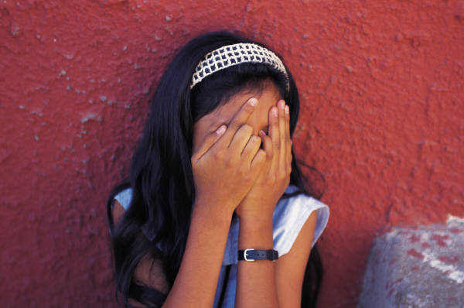
Survivors of one form of violence are more likely* to be victims of other forms of violence
  Girls who are sexually abused are more likely to:
    suffer physical violence and sexual re-victimization
    engage in self-harming behavior
    be a victim of intimate partner violence later in life
  Youth who have been physically abused by a dating partner are also more likely to have:
    suffered abuse as a child
    been a victim of sexual assault
    witnessed violence in their family
  Women and girls involved in gangs:
    often experience physical, emotional and sexual abuse by other gang members
    are more likely to have been physically or sexually abused as children
*Likelihood refers to the probability of re-victimization as compared to non-victims. It never means always.
Source: Wilkins, N., Tsao, B., Hertz, M., Davis, R., Klevens, J. (2014). Connecting the Dots: An Overview of the Links Among Multiple Forms of Violence. Atlanta, GA: National Center for Injury Prevention and Control, Centers for Disease Control and Prevention Oakland, CA: Prevention Institute.
Notes:
It is important to note that while being a survivor of one form of violence increases the likelihood that an individual will experience another form of violence, being a victim of multiple forms of violence is not inevitable.

Slide 14

…(Cont.) Survivors of one form of violence are more likely* to be victims of other forms of violence
Youth who report attempting suicide:
  are approximately five times more likely to have been in a physical fight in the last year
Children who have been bullied:
  are at greater odds for becoming involved in physical violence (e.g. weapon carrying, physical fighting)
*Likelihood refers to the probability of re-victimization as compared to non-victims. It never means always.
Source: Wilkins, N., Tsao, B., Hertz, M., Davis, R., Klevens, J. (2014). Connecting the Dots: An Overview of the Links Among Multiple Forms of Violence. Atlanta, GA: National Center for Injury Prevention and Control, Centers for Disease Control and Prevention Oakland, CA: Prevention Institute.
Notes:
It is important to note that while being a survivor of one form of violence increases the likelihood that an individual will experience another form of violence, being a victim of multiple forms of violence is not inevitable.

Slide 15


Survivors of Violence are at Risk for Other Negative Health Behaviors/Outcomes
  Adverse Childhood Experiences (ACEs)
As ACEs “score” goes up, so does risk for…
  Risky Behaviors
    Physical Inactivity, Smoking, Drug/Alcohol Abuse, Early Sexual Activity
  Chronic Disease
    Obesity, COPD, Asthma, Diabetes, Liver Disease, Heart Disease
  Other Health Outcomes
    Teen Pregnancy, STDs, Miscarriage, Depression, Suicide Attempts, Early Death, Job Problems/Lost Time from Work, Perpetration of IPV
Source: Centers for Disease Control and Prevention, Adverse Childhood Experiences Study. Available at:
http://www.cdc.gov/violenceprevention/acestudy/
Notes:
The Adverse Childhood Experiences (ACE) study is one of the largest investigations ever conducted to assess associations between childhood maltreatment and later-life health and well-being. The study is a collaboration between the Centers for Disease Control and Prevention and Kaiser Permanente's Health Appraisal Clinic in San Diego. More than 17,000 Health Maintenance Organization (HMO) members undergoing a comprehensive physical examination chose to provide detailed information about their childhood experience of abuse, neglect, and family dysfunction. The ACE Study findings suggest that certain experiences are major risk factors for the leading causes of illness and death as well as poor quality of life in the United States. It is critical to understand how some of the worst health and social problems in our nation can arise as a consequence of adverse childhood experiences. Realizing these connections is likely to improve efforts towards prevention and recovery.
ACEs measured included: 1) Household Dysfunction (parental substance abuse, parental separation/divorce, parental mental illness, witnessing intimate partner violence, parental criminal behavior); 2) Child Abuse (Psychological, Physical, Sexual abuse); 3) Child Neglect: (Emotional, Physical)
This slide presents some of the key findings from the ACEs study, showing the link between early childhood adversity and a wide range of negative health outcomes.
For more information on the ACEs Study please visit: http://www.cdc.gov/violenceprevention/acestudy/

Slide 16
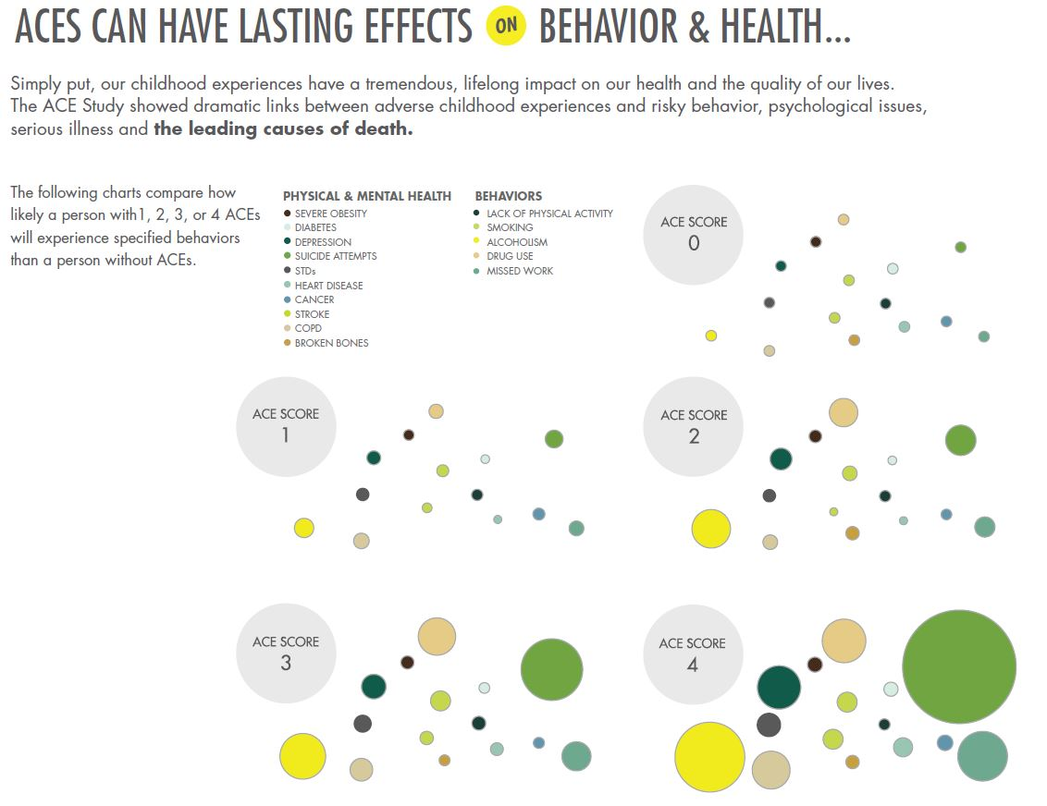
ACEs Can Have Lasting Effects on Behavior & Health (Infographic)
How Do ACEs Affect Our Lives?
Source: CDC, Adverse Childhood Experiences Study. Available at:
http://www.cdc.gov/violenceprevention/acestudy/
Notes:
Cumulative Risk: As the number of ACEs an individual experiences goes up, so does that individuals’ risk for experiencing negative behaviors/outcomes
Graphic taken from the ACEs infographic: http://vetoviolence.cdc.gov/childmaltreatment/phl/resource_center_infographic.html
For more information on the ACEs study, visit: http://www.cdc.gov/violenceprevention/acestudy/

Slide 17

Although most victims of violence do not behave violently, they are at higher risk for behaving violently
  Children who experience physical abuse or neglect early in their lives are at greater risk for committing:
    violence against peers (particularly for boys)
    bullying
    teen dating violence
    child abuse, elder abuse, intimate
    partner violence, and sexual
    violence later in life
  Youth who have witnessed parental violence are more likely to:
    bully others
Source: Wilkins, N., Tsao, B., Hertz, M., Davis, R., Klevens, J. (2014). Connecting the Dots: An Overview of the Links Among Multiple Forms of Violence. Atlanta, GA: National Center for Injury Prevention and Control, Centers for Disease Control and Prevention Oakland, CA: Prevention Institute.
Notes:
It is important to note that most people who are victims of violence do not act violently. However, people who experience or are exposed to one form of violence are at a higher risk for both being a victim of other forms of violence and for inflicting harm on others.

Slide 18

People who behave violently are more likely to commit other forms of violence
Adults who are violent toward their partners are at higher risk of also abusing their children.
Youth who bully are more likely to:
  carry weapons and be physically violent.
  sexually harass peers
  commit violence against partners as teens
  commit violence against partners as adults
Source: Wilkins, N., Tsao, B., Hertz, M., Davis, R., Klevens, J. (2014). Connecting the Dots: An Overview of the Links Among Multiple Forms of Violence. Atlanta, GA: National Center for Injury Prevention and Control, Centers for Disease Control and Prevention Oakland, CA: Prevention Institute.

Slide 19

Examples of Potential Strategies for Addressing Multiple Forms of Violence
Community/Societal level
  Norms change strategies
  Strategies/activities that enhance
  community support &
  connectedness
  Coordinated services
Relationship level
  Strategies that support families under stress
  Strategies that connect youth with supportive adults, pro-social peers, and their schools
Individual level
  Strategies that build youth and families’ skills in solving problems non-violently
  Substance abuse prevention strategies

Slide 20
For More Information
Connecting the Dots: An Overview of the Links Between Multiple Forms of Violence
http://www.cdc.gov/violenceprevention/pub/connecting_dots.html
CDC’s Division of Violence Prevention
http://www.cdc.gov/violenceprevention/

