Slide 1
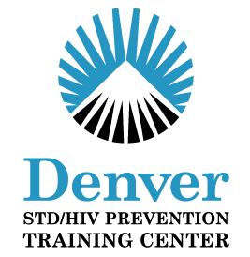
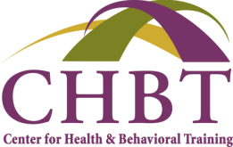
Behavioral Interventions for
STD/HIV Prevention
Prepared by Kees Rietmeijer, MD, MSPH, Medical Director,
Denver Clinical Prevention Training Center (PTC)
and
Maureen P. Scahill, NP, MS, Nurse Practitioner, Trainer, TA Provider
Center for Health & Behavioral Training, Rochester, New York
for STD101
March 12, 2012
National Center for HIV/AIDS, Viral Hepatitis, STD, and TB Prevention
Division of STD Prevention

Slide 2
Relevance of HIV Prevention Interventions for STD Prevention and Vice-Versa
HIV is an STD & other STDs may enhance the transmission of HIV – biological connection
Similar behavioral goals
  Sexual behavior change
    Reduce number of partners
    Condom use
  Getting tested & getting partner(s) tested
  Treatment & treatment adherence
Many interventions developed for HIV prevention impact STD outcomes, e.g.,
  Condom use
  Mutual monogamy with HIV & STD tested-negative partner
  Healthcare seeking, including HIV & STD routine testing

Slide 3
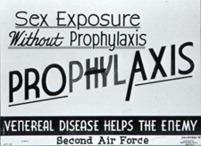
Behavioral Science-based Interventions for STD/HIV Prevention
Historical Perspective
Behavioral Intervention – Levels
  Individual-level approaches – one client at a time
  Group-level approaches – small groups of people with similar life experiences & circumstances
  Community-level approaches – neighborhoods, cities, schools – broadly reaching persons with similar life experiences & circumstances
www.cdc.gov
Structural Interventions – another type of community- wide approach – addresses components of behaviors that could affect public health
  Availability,
  Accessibility
  Acceptability
(continued)
Blankenship, KM et al. (2006). Journal of Urban Health: Bulletin of NY Academy of Medicine, 83 (1)
Charania, MR et al. (2010). AIDS Behavior, DOI 10.1007/s10461-010-9812-y.
McGough, LJ & Handsfield, HH, in Aral, SO & Douglas, JM (Eds). (2007). Behavioral Interventions for Prevention and Control of STDs
Notes:
References
Blankenship, KM, Friedman, SR, Dworkin, S, Mantell, JE. (2006). Structural interventions: concepts, challenges and opportunities for research. Journal of Urban Health: Bulletin of the New York Academy of Medicine, 83 (1), p 59-72.
McGough, LJ & Handsfield, HH, in Aral, SO & Douglas, JM (Eds). (2007). History of behavioral interventions in STD control, in Behavioral Interventions for Prevention and Control of Sexually Transmitted Diseases, Springer (NYC), p 3-22.
Charania, MR, Crepaz, N, Guenther-Gray, C, Henny, K, Liau, A, Willis, LA, Lyles, CM. (2010). Efficacy of structural-level condom distribution interventions: a meta-analysis of US and international studies, 1998-2007. AIDS Behavior, DOI 10.1007/s10461-010-9812-y.

Slide 4
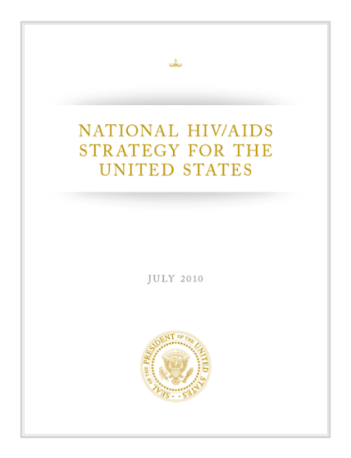
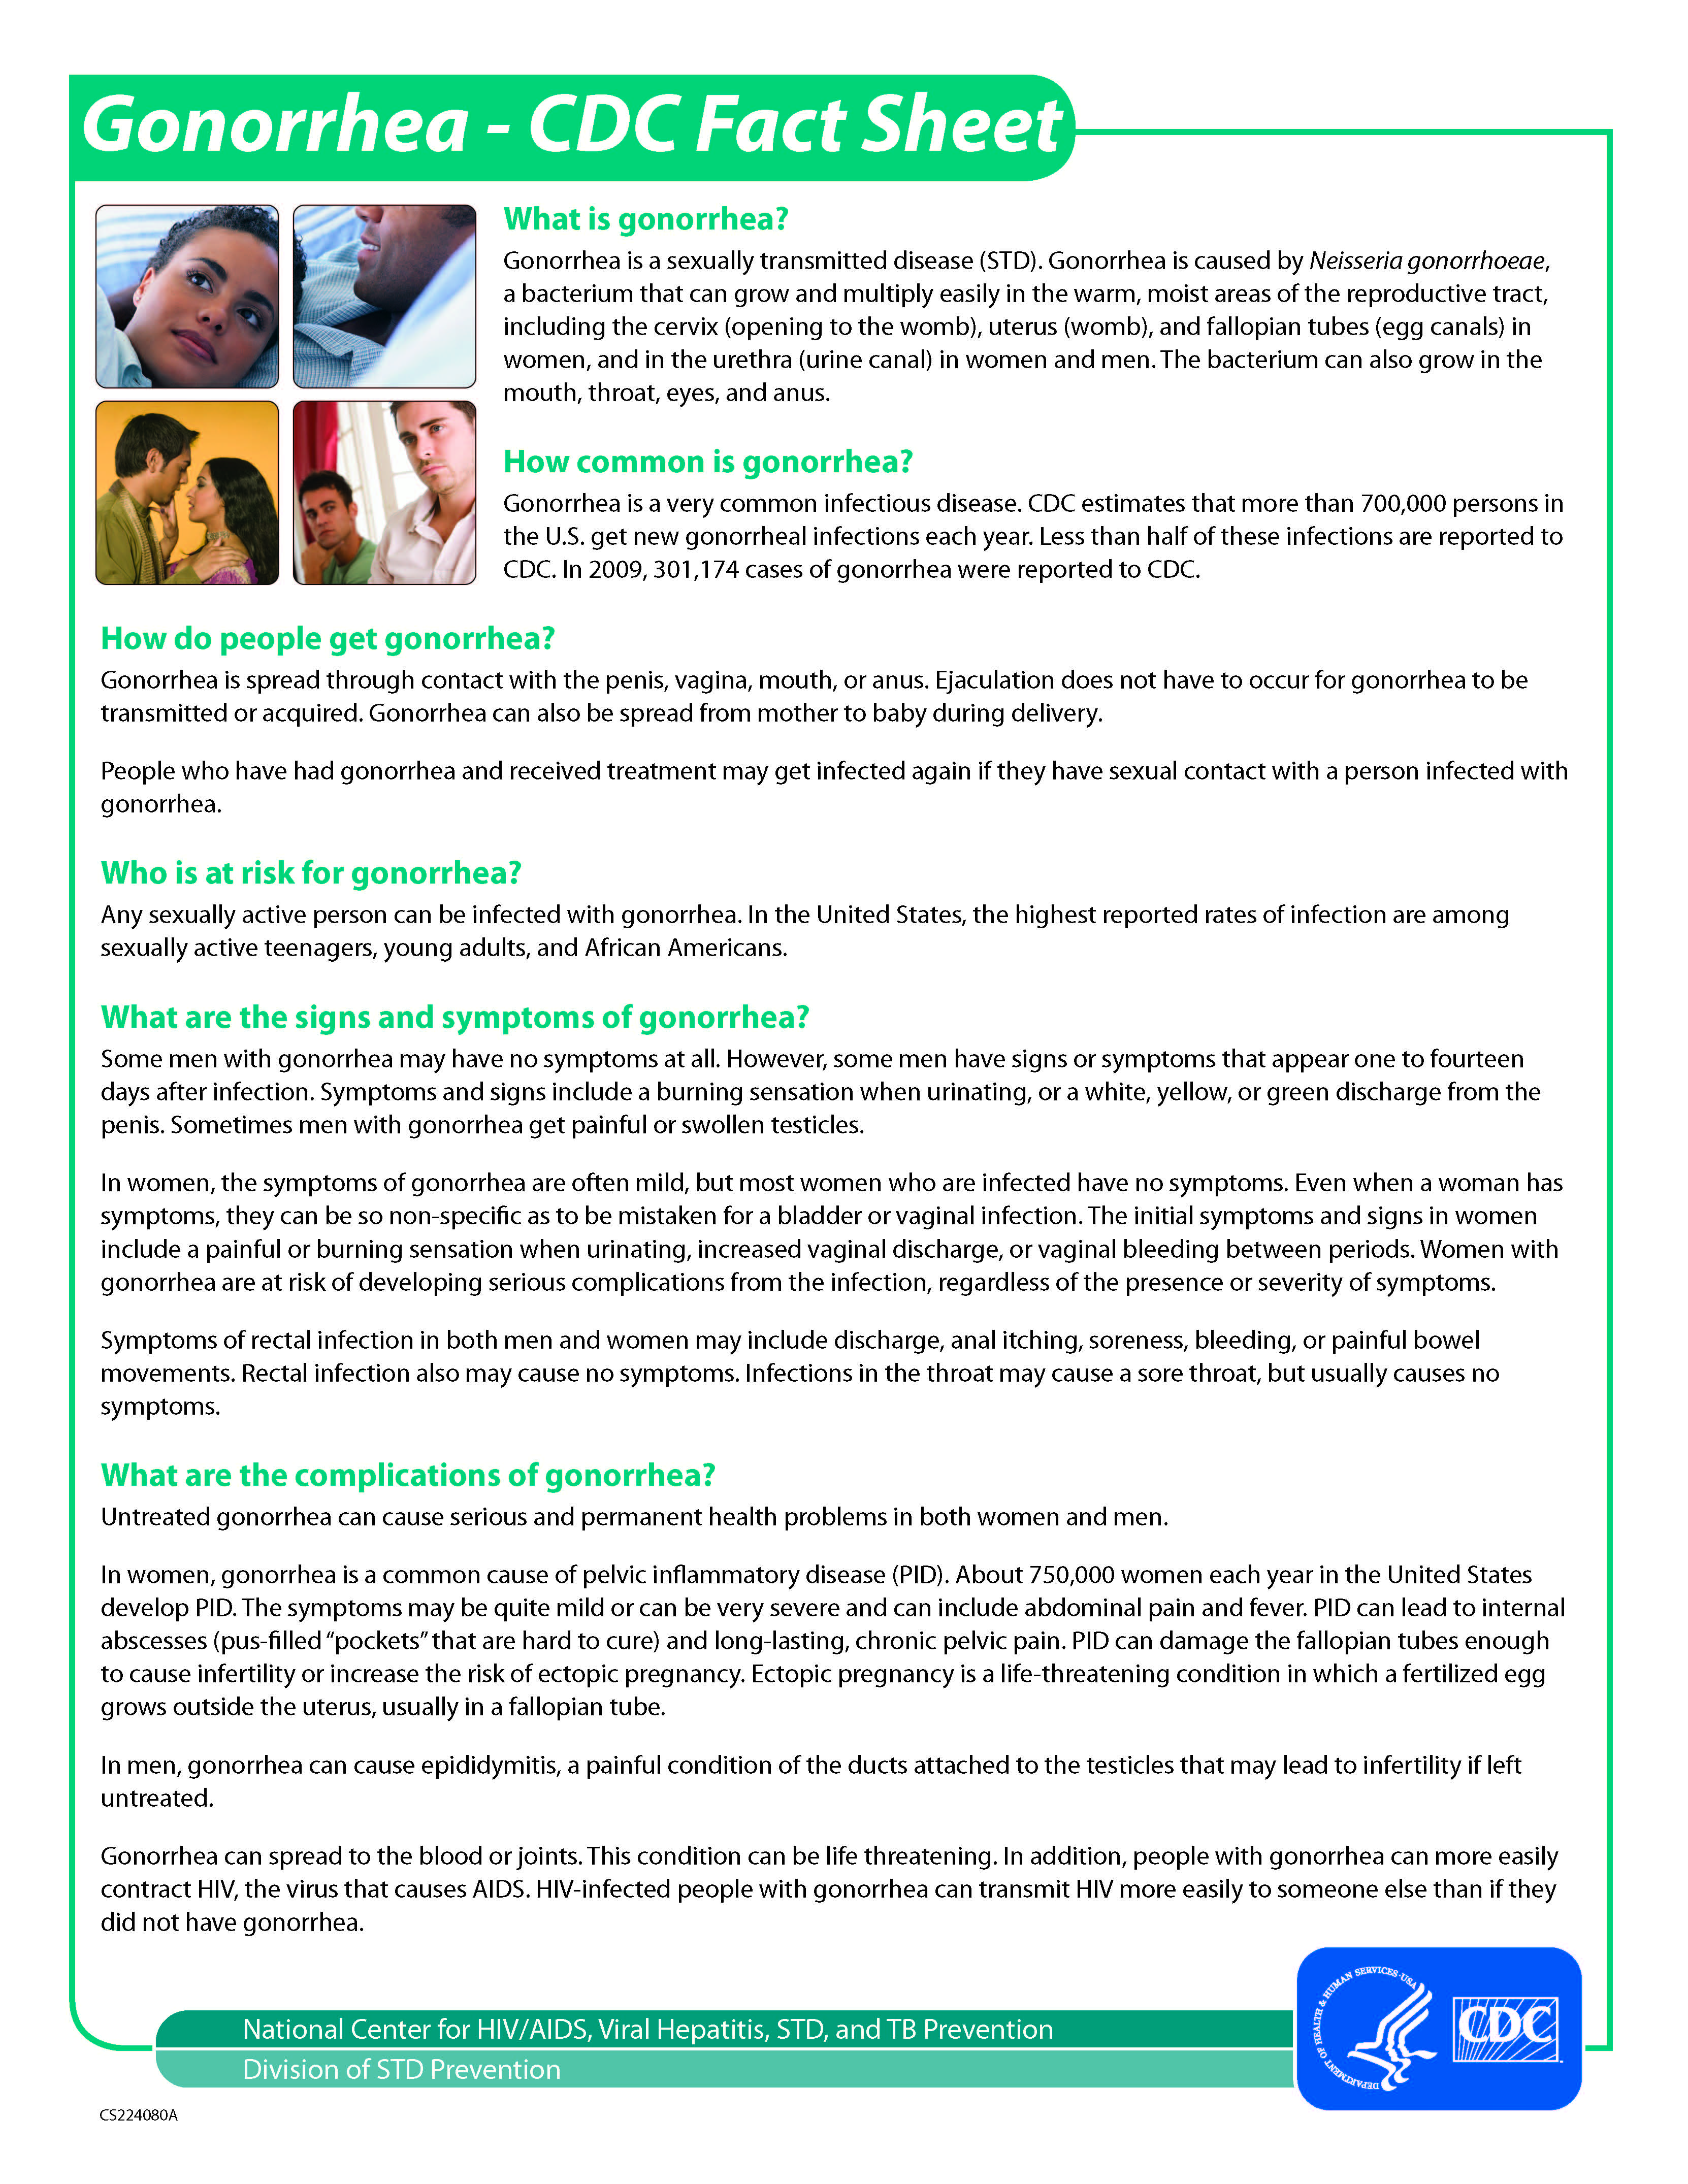

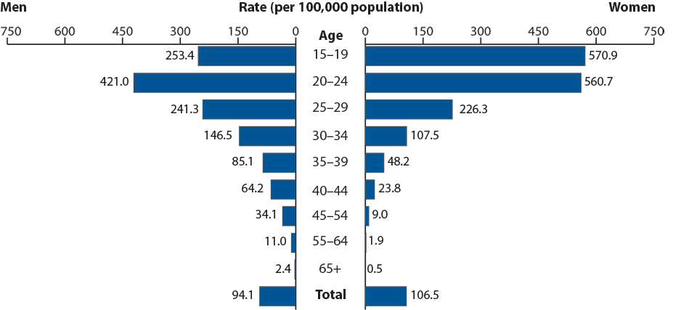

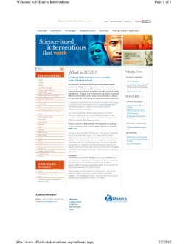
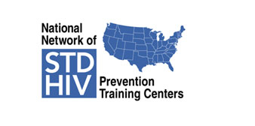

Behavioral Science-based Interventions for STD/HIV Prevention
National HIV/AIDS Strategy (NHAS)
  Includes biomedical, behavioral, & structural approaches
Resources – information about
  Training
  Technical Assistance
  Tools for working with clients & communities
  Behavioral Interventions
  Epidemiology
www.effectiveinterventions.org
www.cdc.gov
www.cdcnpin.org
Notes:
References
Websites: www.effectiveinterventions.org; www.cdc.gov; www.cdcnpin.org

Slide 5
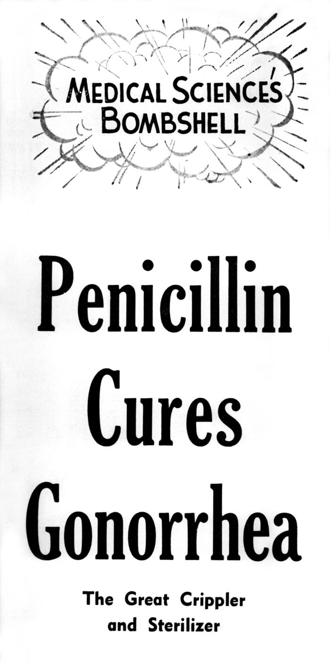
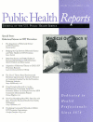
Historical Perspective
Before HIV
  Main focus was identification & treatment of bacterial STDs – secondary & tertiary prevention – which also helped reduce spread – primary prevention
  Prevention messages were given as an “add-on” in the form of education & even “orders”
  Partner services
After HIV – initially – education & later – other behavioral influences
  Increased emphasis on behavioral interventions to prevent acquisition of (incurable) infections – primary prevention
    Approaches were based in giving knowledge in hope of leading to safer & healthier behavior
    Later – it was recognized that social & behavioral science-based interventions addressed much more than knowledge alone ~ & ~ they were effective
GC Resistance
Bolan GA et al (2012) NEJM, 366 (6)
(1996 ) Public Health Reports, III (S1) Entire Issue
www.cdc.gov
(continued)
Notes:
References
Bolan, GA, Sparling, PF, Wasserheit, JN. (2012). The emerging threat of untreatable gonococcal infection. New England Journal of Medicine, 366 (6), p 485-87.
(1996). Public Health Reports, III (S1) – entire edition dedicated to integration of behavioral science & public health science to improve HIV prevention.
www.cdc.gov – Old Poster – historical image – to show how focus was on specific treatment (antibiotics) – but since the 1990s, GC has been pen-resistant – this slide is animated with the microscopic illustration of cephalosporin-resistant GC (from Bolan, GA, Sparling, PF, Wasserheit, JN. (2012). The emerging threat of untreatable gonococcal infection. New England Journal of Medicine, 366 (6), p 485-87.)

Slide 6
Historical Perspective
From Orders to Education-Alone to Behavioral
Traditional STD prevention messages were “orders” – just do not have sexual contact ~ or ~ use a condom
  Intuitively a good thing to do – “An ounce of prevention is better than a pound of cure”
HIV – during 1980s – there was urgency & fear –
  Most of the prevention response came from affected communities
  Delivered in the form of educational messages, e.g.,
    Reduce the number of partners
    Use condoms
HIV & other STDs – during 1990s & 2000s
  Scientific evidence supports behavior science-based interventions
  Community involvement continued & there was an embrace of the behavioral science-based approaches – researchers & communities joined forces, including study of “homegrown” interventions
* McGough, LJ & Handsfield, HH, in Aral, SO & Douglas, JM (Eds). (2007). Behavioral Interventions for Prevention and Control of STDs
Notes:
Reference
McGough, LJ & Handsfield, HH, in Aral, SO & Douglas, JM (Eds). (2007). History of behavioral interventions in STD control, in Behavioral Interventions for Prevention and Control of Sexually Transmitted Diseases, Springer (NYC), p 3-22.

Slide 7
Behavioral Interventions for STD/HIV Prevention
Behavioral science-based interventions with other health behaviors had shown effectiveness
Due to this experience & a recognition that STD/HIV prevention needed to improve – application of behavioral science to STD/HIV prevention & behavior change was recommended by the CDC, NIH, & others – for nearly 20 years *
Cost-benefit analyses have had variable results
  D Cohen et al (RAND)
  D Holtgrave et al has conducted many of these studies
(continued)
NIH-IOM (1997). The Hidden Epidemic: Confronting STDs.; NIH (1997). Consensus Statement Report
CDC (1993, 1998, 2002, 2006, 2010). MMWR – STD Treatment Guidelines – multiple editions
CDC (2001, 2006). MMWR – HIV CTR Guidelines
Cohen, D et al. (2005). Health Affairs, 24 (4)
Holtgrave, DR et al. (1994). Archives of Internal Medicine , 153 (10), p 1225-30
Notes:
Behavioral Science Recommendation References
CDC Reports/MMWRs:
CDC (1999, updated 2001). Compendium of HIV Prevention Interventions with Evidence of Effectiveness.
CDC. (2001, 2006). HIV Counseling, Testing and Referral Guidelines.
CDC. (1993, 1998, 2006, 2010). MMWR – STD Treatment Guidelines.
CDC. (1998). HIV Prevention Through Early Detection and Treatment of Other STDs – US Recommendations of the Advisory Committee for HIV and STD Prevention. MMWR.
NIH Reports/Recommendations:
National Institutes of Health – Institute of Medicine. (1997). The Hidden Epidemic: Confronting Sexually Transmitted Diseases.
NIH. (1997). Consensus Conference Report.
Cost-Benefit Analyses:
Cohen, DA et al. (2005). Cost-Effective allocation of government funds to prevent HIV infection. Health Affairs, 24 (4), p 915-926.
David R. Holtgrave, PhD; Ronald O. Valdiserri, MD, MPH; A. Russell Gerber, MD; Alan R. Hinman, MD, MPH. (1993). Human immunodeficiency virus counseling, testing, referral, and partner notification services. A cost-benefit analysis. Archives of Internal Medicine, 153 (10), p 1225-1230.

Slide 8
Behavioral Interventions for STD/HIV Prevention
STD/HIV Prevention researchers base their studies in several behavioral science theories, e.g.,
  Health Belief Model
  Social Cognitive Theory
  Stage of Change/Transtheoretical Model of Behavior Change Theory
  The HIV epidemic led to new models, e.g., Kelly’s AIDS Risk Reduction Model, or Fisher & Fisher’s Information, Motivation, Behavior Model
  Many interventions use elements from various & different theoretical approaches, or combinations of different theories
Several meta-analyses have been conducted to determine utility, e.g.,
  R DiClemente et al  CM Obermyer & M Osborne
  L Weinhardt et al  JS Lin et al
DiClemente, RJ et al. (2005). Seminars in Pediatric Infectious Diseases, 16 (3)
Weinhardt, LS et al. (1999). American Journal of Public Health, 89 (9)
Obermeyer, CM & Osborne, M. (2007). American Journal of Public Health, 97 (10)
Lin, JS et al. (2008). Annals of Internal Medicine, 149 (7)
Notes:
References – Collective Reviews & Meta-analyses
DiClemente, RJ et al. (2005). A programmatic and methodologic review and synthesis of clinic-based risk-reduction interventions for sexually transmitted infections: research and practice implications. Seminars in Pediatric Infectious Diseases, p 199-81.
Weinhardt LS, Carey MP, Johnson BT, Bickham NL. (1999). Effects of HIV counseling and testing on sexual risk behavior: a meta-analytic review of published research, 1985–1997. American Journal of Public Health, 89 (9), p 1397-05.
Obermeyer, CM & Osborne, M. (2007). The Utilization of testing and counseling for HIV: a review of the social and behavioral evidence. American Journal of Public Health, 97 (10), p 1-13
Lin, JS, Whitlock, E, O’Connor, E, Bauer, V. (2008). Behavioral counseling to prevent sexually transmitted infections: a systematic review for the US Preventive Services Task Force. Annals of Internal Medicine, 149 (7), p 497-08 & W 96-9.
Background re HIV-specific:
Kelly’s AIDS Risk Reduction Model, which identified stages of readiness: (1) Knowledge of disease transmission & recognition of personal susceptibility; (2) Perception of the costs & benefits of behavioral change; (3) Enjoyment of low-risk activities; (4) Self-efficacy & attainment of skills; as well as ways to approach each stage.
Fisher’s IMB Model, information & motivation, then skills can lead to behavior change.

Slide 9


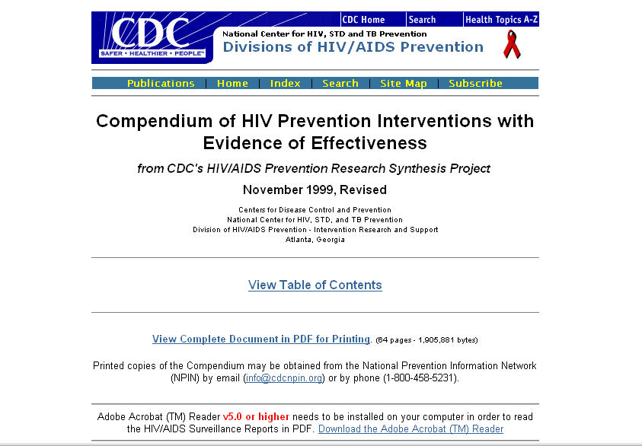
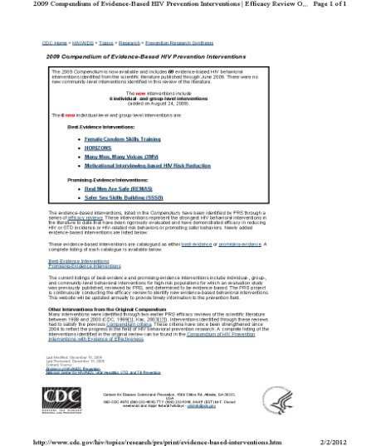
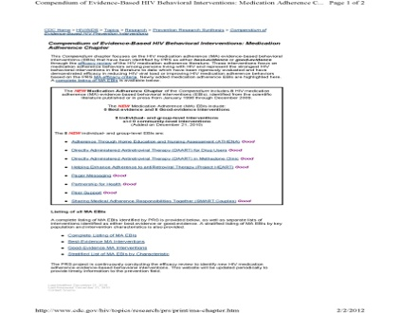
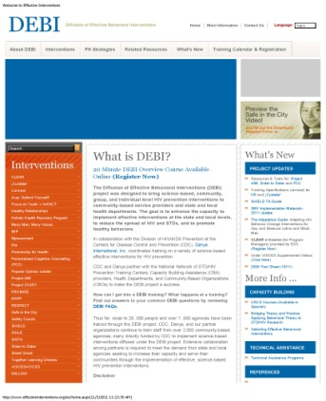
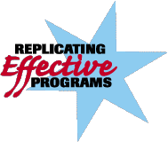
CDC Efforts and Projects
Prevention Research Synthesis Project
Compendium of HIV Prevention Interventions with Evidence of Effectiveness
  Original – 1999 (listed 24)
  Updated – 2009 (listed > 70)
  Newest Chapter – 2010 – Medication Adherence Interventions (currently lists 8)
Replicating Effective Behavioral Programs Project – many of these interventions were replicated in “real world” settings by partnerships of researchers & community settings
Diffusion of Effective Behavioral Interventions (training, materials, & technical assistance)
www.effectiveinterventions.org
www.cdc.gov/hiv/topics/research/prs/index.htm
www.effectiveinterventions.org
www.cdc.gov/hiv/topics/cba/index.htm
www.cdc.gov/hiv/topics/research/prs/compendium-evidence-based-interventions.htm
www.cdc.gov/hiv/topics/prev_prog/rep/resources/qa/
Notes:
References/Notes
This is to illustrate the evolution from PRS to the DEBI Project
www.cdc.gov/hiv/topics/research/prs/index.htm
www.effectiveinterventions.org
www.cdc.gov/hiv/topics/cba/index.htm
www.cdc.gov/hiv/topics/research/prs/compendium-evidence-based-interventions.htm
www.cdc.gov/hiv/topics/prev_prog/rep/resources/qa/

Slide 10

Behavioral Interventions – Individual Level
Client-centered, one-on-one intervention
Science-based interventions with
  Research findings that show efficacy
  Program evaluation that shows effectiveness in the “real world”
Individual Level Interventions (ILIs) should be evidence-based & if not, then science- or theory-based, e.g.,
  Stage of Change/Transtheoretical Model of Behavior Change Theory
  Health Belief Model
  Theory of Gender and Power
  Theory of Reasoned Action
  AIDS Risk Reduction Model
  Information-Motivation-Behavioral Skills Model (IMB)
(continued)
St Lawrence, JS & Fortenberry, JD in Aral, SO & Douglas, JM (Eds). (2007). Behavioral Interventions for Prevention and Control of STDs
wwww.cdc.gov/hiv/topics/research/prs/compendium-evidence-based-interventions.htm
ww.effectiveinterventions.org
Notes:
References
St Lawrence, JS & Fortenberry, JD in Aral, SO & Douglas, JM (Eds). (2007). Behavioral interventions for STDs: theoretical models and intervention methods, in Behavioral Interventions for Prevention and Control of STDs, Springer (NYC), p 23-59.
wwww.cdc.gov/hiv/topics/research/prs/compendium-evidence-based-interventions.htm
ww.effectiveinterventions.org

Slide 11
ILIs – Client-centered Counseling
These are client-centered, i.e., based on the client’s individual circumstances & experiences
  Thus can be tailored to each person
This client-centered approach was recommended by the CDC for HIV pre- & post-test counseling to be
  “Client-centered counseling refers to counseling conducted in an interactive manner responsive to individual client needs…” This requires an “understanding of the unique circumstances of the client …” through “the use of open-ended questions and active listening”. *
Since then, many ILIs have been developed, studied, & implemented
  Effectiveness has been shown with only have 1-2 sessions with the client, while others might include several sessions
(continued)
* CDC. (1997). Prevention Case Management Guidance, p 41
Notes:
Reference
US DHHS Public Health Service CDC. (1997). HIV Prevention Case Management Guidance, p 41

Slide 12
Elements of Client-Centered Counseling
Personalized risk assessment – thus useful for any/all target populations
Facilitates & supports client-initiated behavior change
Helps client recognize barriers to risk reduction
Negotiates an acceptable & achievable risk-reduction plan – to identify a possible “first step” by the end of the counseling session; these could be simple or more involved, e.g.,
  “I’ll start carrying condoms with me.”
  “I’ll call the Drug Treatment Center for an appointment.”
  “I plan to talk with my partner about getting
  HIV/STD-tested – tonight.”
Refer client to other specialized services, if needed
(continued)
CDC. (2012). Program Operations Guidelines for STD Prevention
CDC. (2009). Procedural Guidance for Community Based Organizations
Kamb ML et al. (1998). JAMA, 280 (13)
Notes:
References
CDC. (downloaded Feb 2012). Program Operations Guidelines for STD Prevention.
CDC. (2009). Procedural Guidance for CBOs.
Kamb, ML, Fishbein, M, Douglas, JM, Rhodes, F, Rogers, J, Bolan, G, Zenilman, J, Hoxworth, T, Malotte, K, Iatesta, M, Kent, C, Lentz, A, Graziano, S, Beyers, RH, Peterman, TA, for the Project RESPECT Study Group. (1998). Efficacy of risk-reduction counseling to prevent HIV and STDs: a randomized controlled trial. Journal of the American Medical Association, 280 (13), p 1161-67.

Slide 13
Client-Centered Counseling Challenges
Providing counseling that truly reaches the client
  History of risk behaviors as well as risk reduction successes
  Knowledge and attitudes & beliefs about STDs, HIV, Viral Hepatitis, & the client’s own sense of vulnerability to these infections
Identifying the best way to take that gathered information & using it to help the client work towards safer &/or healthier behavior by letting the client do most of the talking
  Which is guided by the counselor’s questions & comments – this often presents a challenge, since it is a shift from the traditional HIV/STD prevention educator approach
Assisting the client with identifying next steps that are reasonable & achievable
(continued)
CDC. (2012). Program Operations Guidelines for STD Prevention
CDC. (2009). Procedural Guidance for Community Based Organizations
Kamb ML et al. (1998). JAMA, 280 (13)
Notes:
References
CDC. (downloaded Feb 2012). Program Operations Guidelines for STD Prevention.
CDC. (2009). Procedural Guidance for CBOs.
Kamb, ML, Fishbein, M, Douglas, JM, Rhodes, F, Rogers, J, Bolan, G, Zenilman, J, Hoxworth, T, Malotte, K, Iatesta, M, Kent, C, Lentz, A, Graziano, S, Beyers, RH, Peterman, TA, for the Project RESPECT Study Group. (1998). Efficacy of risk-reduction counseling to prevent HIV and STDs: a randomized controlled trial. Journal of the American Medical Association, 280 (13), p 1161-67.

Slide 14

Client-centered Counseling – the Approach
Research has shown some common themes
Use a combination of open-ended & close-ended questions
  Open-ended examples
    Are STDs something you worry about for yourself?
    What’s been your experience with condoms?
    What’s the difference between the times you use condoms & the times you don’t?
    Who decided to introduce condoms the last time you used them?
    What do you think you can do to reduce your risk for STDs?
  Open-ended questions yield information about the client’s risk & safety history as well as attitudes & beliefs related to his/her risk
(continued)
Carey, MP et al (2009) AIDS and Behavior, DOI 10.1007/s10461-009-9587-1
CDC. (2012). Program Operations Guidelines for STD Prevention
CDC. (2009). Procedural Guidance for Community Based Organizations
Kamb ML et al. (1998). JAMA, 280 (13)
Notes:
References
CDC. (downloaded Feb 2012). Program Operations Guidelines for STD Prevention.
CDC. (2009). Procedural Guidance for CBOs.
Kamb, ML, Fishbein, M, Douglas, JM, Rhodes, F, Rogers, J, Bolan, G, Zenilman, J, Hoxworth, T, Malotte, K, Iatesta, M, Kent, C, Lentz, A, Graziano, S, Beyers, RH, Peterman, TA, for the Project RESPECT Study Group. (1998). Efficacy of risk-reduction counseling to prevent HIV and STDs: a randomized controlled trial. Journal of the American Medical Association, 280 (13), p 1161-67.

Slide 15
Client-centered Counseling – the Approach
Use a combination of open-ended & close-ended questions
  Close-ended questions provide clarifications & specifics – used to get “the facts” besides the big picture
  Close-ended examples
    Are your partners males, females, or both?
    How many partners would you say you’ve had over the past 3 months?
    When was the last time you had sex?
    When was the last time you had sex without a condom?
    Have you &/or your partner been STD-tested? HIV-tested?
Use the principle of “Ask – Don’t Tell!”
Carey, MP et al (2009) AIDS and Behavior, DOI 10.1007/s10461-009-9587-1
CDC. (2012). Program Operations Guidelines for STD Prevention
CDC. (2009). Procedural Guidance for Community Based Organizations
(continued)
Notes:
References
Carey, MP, Senn, TE, Vannable, PA, Coury-Doniger, P, Urban, MA. (2009). Brief and intensive behavioral interventions to promote sexual risk reduction among STD clinic patients: results from a randomized controlled trial. AIDS and Behavior, DOI 10.1007/s10461-009-9587-1
CDC. (downloaded Feb 2012). Program Operations Guidelines for STD Prevention
CDC. (2009). Procedural Guidance for CBOs

Slide 16
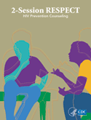


Examples of Evidence-based ILIs
Project RESPECT ₁
  Studied & implemented in STD Clinics
  In DEBI Project – for variable settings
Personalized Cognitive Counseling (PCC) ₂
  Studied MSM who with histories of repeat HIV testing – in publicly-funded Anonymous HIV CTR Programs
  Recent addition to DEBI Project
Choosing Life: Empowerment! Action! Results! ₃
  Studied persons living with HIV & those at high risk with HIV – to reduce risk behaviors
  In DEBI Project
Kamb ML et al. (1998). JAMA, 280 (13)
Dilley, JW et al. (2007). JAIDS, 30 (2); 44 (5) – 2 citations
Lightfoot, M et al. (2007). Behavior Modification, 31 (2)
Notes:
References
Kamb, ML, Fishbein, M, Douglas, JM, Rhodes, F, Rogers, J, Bolan, G, Zenilman, J, Hoxworth, T, Malotte, K, Iatesta, M, Kent, C, Lentz, A, Graziano, S, Beyers, RH, Peterman, TA, for the Project RESPECT Study Group. (1998). Efficacy of risk-reduction counseling to prevent HIV and STDs: a randomized controlled trial. Journal of the American Medical Association, 280 (13), p 1161-67.
(a) Dilley, JW, Woods, W., Sabatino, J. Lihatsh, T, Adler, B, Casey, S et al. (2002). Changing sexual behavior among gay male repeat testers for HIV: a randomized, controlled trial of a single-session intervention. Journal of Acquired Immune Deficiency Syndrome, 30 (2), p 177-86; (b) Dilley, JW, Woods, WJ, Loeb, L, Nelson, K, Sheon, N, Mullen, J et al. (2007). Brief cognitive counseling with HIV testing to reduce sexual risk among men who have sex with men: results from a randomized controlled trial using paraprofessional counselors. Journal of Acquired Immune Deficiency Syndrome, 44 (5), p 569-77.
Lightfoot, M., Rotheram-Borus, M. J., & Tevendale, H. (2007). An HIV-preventive intervention for youth living with HIV. Behavior Modification, 31 (3), p 345-63.

Slide 17

Behavioral Interventions – Group Level
Most evaluated type of intervention (GLI)
Because GLIs work with a group – typically 6-12 people/group – the group members need to have enough in common for the intervention to be relevant
Have been shown to be effective in many risk groups
  Youth – Out-of-school & In-school
  Men who have sex with men (MSM)
  Injection drug users (IDUs)
  STD clinic patients
  Persons living with HIV
  Heterosexual women & men (women more studied/implemented)
(continued)
St Lawrence, JS & Fortenberry, JD in Aral, SO & Douglas, JM (Eds). (2007). Behavioral Interventions for Prevention and Control of STDs
wwww.cdc.gov/hiv/topics/research/prs/compendium-evidence-based-interventions.htm
ww.effectiveinterventions.org
Notes:
References
St Lawrence, JS & Fortenberry, JD in Aral, SO & Douglas, JM (Eds). (2007). Behavioral interventions for STDs: theoretical models and intervention methods, in Behavioral Interventions for Prevention and Control of STDs, Springer (NYC), p 23-59.
wwww.cdc.gov/hiv/topics/research/prs/compendium-evidence-based-interventions.htm
www.effectiveinterventions.org

Slide 18


Behavioral Interventions – Group Level
  As with the Individual, GLIs
    Focus on behavioral influencers such as knowledge, perceived risk, intentions, outcome expectancies, self- efficacy, perceived norms
    Are behavioral science-based & theory-based, e.g.,
      Social Cognitive Theory
      SOC/TTM
      Theory of Reasoned Action
      Theory of Innovation
      AIDS Risk Reduction Model
      Information-Motivation-Behavioral Skills Model (IMB)
(continued)
Kelly, JA et al (1991). AJPH, 81 (2)
PHR , III (1999) Entire Issue
St Lawrence, JS & Fortenberry, JD in Aral, SO & Douglas, JM (Eds). (2007). Behavioral Interventions for Prevention and Control of STDs
Valente, TW & Davis, RL. (1999). Annals of the American Academy of Political & Social Science, 566 (1)(Si)
Notes:
References
Kelly, JA, St Lawrence, JS, Diaz, YE, Stevetnson, LY, Hauth, AC, Brasfield, TL, Kalichman, SC, Smith, JE, Andrew, ME. (1991). HIV risk behavior reduction following intervention with key opinion leaders of population: an experimental analysis. American Journal of Public Health, 81 (2), p 168-71.
(1996). Public Health Reports, III (S1) – entire edition dedicated to integration of behavioral science & public health science to improve HIV prevention.
St Lawrence, JS & Fortenberry, JD in Aral, SO & Douglas, JM (Eds). (2007). Behavioral interventions for STDs: theoretical models and intervention methods, in Behavioral Interventions for Prevention and Control of STDs, Springer (NYC), p 23-59.
Valente, TW & Davis, RL. (1999). Accelerating the diffusion of innovations using opinion leaders. The ANNALS of the American Academy of Political and Social Science, 566 (1), p 55-67.

Slide 19
Behavioral Interventions – Group Level
GLIs use the dynamics of a facilitated group to provide
  Modeling & practicing behavioral skills
  On-going reinforcement
  Instruction on social pressure
  Reinforce clear values/norms regarding unprotected sex
Usually, these interventions involve multiple sessions – generally delivered over a few weeks to a few months – in various intervals, e.g.,
  Daily or weekly sessions
  Follow-up sessions – weeks to months later
(continued)
St Lawrence, JS & Fortenberry, JD in Aral, SO & Douglas, JM (Eds). (2007). Behavioral Interventions for Prevention and Control of STDs
Notes:
Reference
St Lawrence, JS & Fortenberry, JD in Aral, SO & Douglas, JM (Eds). (2007). Behavioral interventions for STDs: theoretical models and intervention methods, in Behavioral Interventions for Prevention and Control of STDs, Springer (NYC), p 23-59.

Slide 20



Examples of Evidence-based GLIs
Focus on Youth with Impact ₁
  Studied in youth – to reduce HIV/STD risk behaviors; also has parent-focused part
  In DEBI Project
Many Men, Many Voices (3MV) ₂
  Studied Black MSM with STD/HIV risk behaviors
  In DEBI Project
¡Cuídate! ( “Take Care of Yourself“) ₃
  Studied 13-18 year-old Latino females – to reduce HIV/STD risk behaviors
  In DEBI Project
Stanton, B et al.1(996 & 2004). Archive of Pediatrics & Adolescent Medicine, 150 (4) & 158 (10) – 2 citations
Wilton, L et al. (2009). AIDS Behavior, 13 (3)
Villarruel, AM (2006). Archives of Pediatrics & Adolescent Medicine, 160 (8); Gallegos, EC et al. (2008). Salud Publica de Mexico, 50 (1)
Notes:
References
Stanton B, Cole M, Galbraith J, Li X, Pendleton S, Cottrel L, Marshall S, Wu Y, Kaljee L. (2004). A randomized trial of a parent intervention: Parents can make a difference in long-term adolescent risk behaviors, perceptions and knoledge. Archives of Pediatrics & Adolescent Medicine, 158 (10), p 947-955.; Stanton B, Li X, Ricardo I, Galbraith J, Feigelman S, Kaljee L. (1996). A randomized controlled effectiveness trial of an AIDS prevention program for low-income African-American youth. Archives of Pediatrics & Adolescent Medicine, 150 (4), p 363-372.
Wilton, L., Herbst, J.H., Coury-Doniger, P., Painter, T.M., English, G., Alvarez, M.E., Scahill, M., Roberson, M.A., Lucas, B., Johnson, W.D., Carey, J.W. (2009). Efficacy of an HIV/STI Prevention Intervention for Black Men Who Have Sex with Men: Findings from the Many Men, Many Voices (3MV) Project. AIDS Behavior, 13 (3), p 532-544.
Villarruel, A.M., Jemmott, J.B. III, and Jemmott, L.S. (2006). A randomized controlled trial testing an HIV prevention intervention for Latino youth. Archives of Pediatric & Adolescent Medicine, 160 (8), p 772–777; Gallegos, E.C., Villarruel, A.M., Loveland-Cherry, C., Ronis, D.L., and Zhou, Y. (2008). Intervención para reducir riesgo en conductas sexuales de adolescentes: Un ensayo aleatorizado y controlado [Intervention to reduce sexual risk behavior in adolescents: A randomized controlled trial]. Salud Pública de México, 50 (1), p 59-66.

Slide 21

Behavioral Interventions – Community Level
Community is the target of the intervention, rather than the individual or a group
  Obviously, the reach is very extensive
Like with Group, CLIs must be directed to a specific target population so that the prevention is relevant
Goals include changing community norms, reaching those that do not come into agencies/clinics for care, & empower community members, which are met through carefully designed strategies
(continued)
St Lawrence, JS & Fortenberry, JD in Aral, SO & Douglas, JM (Eds). (2007). Behavioral Interventions for Prevention and Control of STDs
wwww.cdc.gov/hiv/topics/research/prs/compendium-evidence-based-interventions.htm
ww.effectiveinterventions.org
Notes:
References
St Lawrence, JS & Fortenberry, JD in Aral, SO & Douglas, JM (Eds). (2007). Behavioral interventions for STDs: theoretical models and intervention methods, in Behavioral Interventions for Prevention and Control of STDs, Springer (NYC), p 23-59.
wwww.cdc.gov/hiv/topics/research/prs/compendium-evidence-based-interventions.htm
www.effectiveinterventions.org

Slide 22
Behavioral Interventions – Community Level
Reach & relevance is also accomplished by conducting these interventions through outreach using community members in venues/geographic areas where high-risk groups congregate
Like Individual & Group, CLIs use concepts from a number of behavior change theories, particularly
  Diffusion of Innovation
  Empowerment
  SOC/TTM
  Theory of Reasoned Action
It is essential to identify the Messenger & the Message
(continued)
Guenther-Grey, C et al. (1996). Public Health Reports, 111 (S1)
Kelly, JA (1991) AJPH, 81 (2)
St Lawrence, JS & Fortenberry, JD in Aral, SO & Douglas, JM (Eds). (2007). Behavioral Interventions for Prevention and Control of STDs
Valente, TW & Davis, RL (1999) ANNALS of the AAPSS, 566 (1)
wwww.cdc.gov/hiv/topics/research/prs/compendium-evidence-based-interventions.htm
ww.effectiveinterventions.org
Notes:
References
Kelly, JA, St Lawrence, JS, Diaz, YE, Stevetnson, LY, Hauth, AC, Brasfield, TL, Kalichman, SC, Smith, JE, Andrew, ME. (1991). HIV risk behavior reduction following intervention with key opinion leaders of population: an experimental analysis. American Journal of Public Health, 81 (2), p 168-71.
Guenther-Grey, C, Noroian, D, Fonseka, J, Higgins, D. (1996). Developing community networks to deliver HIV prevention interventions. Public Health Reports, 111 (S1), p 41-9.
St Lawrence, JS & Fortenberry, JD in Aral, SO & Douglas, JM (Eds). (2007). Behavioral interventions for STDs: theoretical models and intervention methods, in Behavioral Interventions for Prevention and Control of STDs, Springer (NYC), p 23-59.
Valente, TW & Davis, RL. (1999). Accelerating the diffusion of innovations using opinion leaders. The ANNALS of the American Academy of Political and Social Science, 566 (1), p 55-67.
wwww.cdc.gov/hiv/topics/research/prs/compendium-evidence-based-interventions.htm
www.effectiveinterventions.org

Slide 23
Behavioral Interventions – Community Level
Messengers – community members who
  Have full buy-in to the message & are fully prepared to pass on to others in community
  Model the behavior change
  Have access to community – particularly to the high-risk individuals who may be less likely to access prevention services
  Have good connecting skills inside ~ & ~ outside of their own networks & are persuasive
  Are recognized & respected as informal leaders who are “in the know” – they’re credible & believed – opinion leaders
Message – content & “packaging” developed with
  Community input through formative research
Guenther-Grey, C et al. (1996). Public Health Reports, 111 (S1)
St Lawrence, JS & Fortenberry, JD in Aral, SO & Douglas, JM (Eds). (2007). Behavioral Interventions for Prevention and Control of STDs
Valente, TW & Davis, RL. (1999). Annals of the American Academy of Political & Social Science, 566 (1)(Si)
wwww.cdc.gov/hiv/topics/research/prs/compendium-evidence-based-interventions.htm
ww.effectiveinterventions.org
Notes:
References
Guenther-Grey, C, Noroian, D, Fonseka, J, Higgins, D. (1996). Developing community networks to deliver HIV prevention interventions. Public Health Reports, 111 (S1), p 41-9.
St Lawrence, JS & Fortenberry, JD in Aral, SO & Douglas, JM (Eds). (2007). Behavioral interventions for STDs: theoretical models and intervention methods, in Behavioral Interventions for Prevention and Control of STDs, Springer (NYC), p 23-59.
Valente, TW & Davis, RL. (1999). Accelerating the diffusion of innovations using opinion leaders. The ANNALS of the American Academy of Political and Social Science, 566 (1), p 55-67.
wwww.cdc.gov/hiv/topics/research/prs/compendium-evidence-based-interventions.htm
www.effectiveinterventions.org

Slide 24

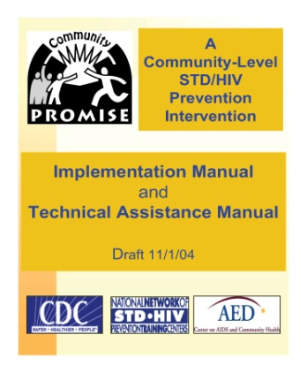


Examples of Evidence-based CLIs
Mpowerment Project ₁
  Studied in young MSM (gay & bisexual) – to reduce HIV sexual risk behaviors; has a newer version for persons living with HIV
  In DEBI Project
PROMISE ₂
  Studied in many communities with different target populations for STD/HIV risk behaviors
  In DEBI Project
Popular Opinion Leader (POL) ₃
  Initially studied MSM in gay bars; has since been adapted to many other target populations – Black MSM: d-up: DEFEND YOURSELF
  In DEBI Project
Kegeles, SM et al. (1996). AJPH, 86 (8)
CDC AIDS Community Demonstration Projects Research Group. (1999). AJPH, 89 (3)
Kelly, JA et al. (1991). AJPH, 81 (2) ~ & ~ Jones, KT et al. (2008). AJPH, 98 (6)
Notes:
References
Kegeles, SM, Hays, RB, Coates, TJ. (1996). The Mpowerment Project: a community-level HIV prevention intervention for young gay men. American Journal of Public Health, 86 (8), p 1129-36.
CDC AIDS Community Demonstration Projects Research Group (1999). Community-level HIV intervention in five cities: final outcome data from the AIDS community demonstration projects. American Journal of Public Health, 89 (3), p 336B-345.
Kelly, JA, St Lawrence, JS, Diaz, YE, Stevenson, LY et al. (1991). HIV risk behavior reduction following intervention with key opinion leaders of population: an experimental analysis. American Journal of Public Health, 81 (2), p 168-71.
Jones, KT, Gray, P, Whiteside, YO, Wang, T, Bost, D, Dunbar, E, Foust, E, Johnson, WD. (2008). Evaluation of an HIV prevention intervention adapted for Black men who have sex with men. American Journal of Public Health, 98 (6), 1043-50.

Slide 25
Structural Interventions
Health is promoted by working to change the social context in which STD/HIV risk activities occur, & this is accomplished by changing one or more of the following (often in combination)
  Changing laws , e.g., legalizing needle exchange
  Changing physical environment, e.g., improving sidewalks, street lighting, & safety – to facilitate taking walks as exercise; or improving healthy & affordable food choices in neighborhood stores
  Changing organizational structures, e.g., integration of HIV, STD, Viral Hepatitis, & TB services – to provide “one-stop shopping” that can facilitate & improve prevention & care of these overlapping infectious diseases & epidemics
  Changing usual operating procedures, , e.g., having walk-in services rather than by appointment only – making it easier for the clientele to access services
Blankenship, KM et al. (2006). Journal of Urban Health: Bulletin of NY Academy of Medicine, 83 (1)
Charania, MR et al. (2010). AIDS Behavior, DOI 10.1007/s10461-010-9812-y.
McGough, LJ & Handsfield, HH, in Aral, SO & Douglas, JM (Eds). (2007). Behavioral Interventions for Prevention and Control of STDs
Notes:
References
Blankenship, KM, Friedman, SR, Dworkin, S, Mantell, JE. (2006). Structural interventions: concepts, challenges and opportunities for research. Journal of Urban Health: Bulletin of the New York Academy of Medicine, 83 (1), p 59-72.
McGough, LJ & Handsfield, HH, in Aral, SO & Douglas, JM (Eds). (2007). History of behavioral interventions in STD control, in Behavioral Interventions for Prevention and Control of Sexually Transmitted Diseases, Springer (NYC), p 3-22.
Charania, MR, Crepaz, N, Guenther-Gray, C, Henny, K, Liau, A, Willis, LA, Lyles, CM. (2010). Efficacy of structural-level condom distribution interventions: a meta-analysis of US and international studies, 1998-2007. AIDS Behavior, DOI 10.1007/s10461-010-9812-y.
Nursery Rhyme Redux – Structural Intervention (MS analogy):
Jack & Jill had to climb a hill to fetch water – this led to a fall
If the well were not up on a hill – maybe no fall would have occurred
If the well were next to their house – maybe they could fetch the water even more easily
Better yet – if they had indoor plumbing – they would not have to leave the house with a bucket to fetch water

Slide 26
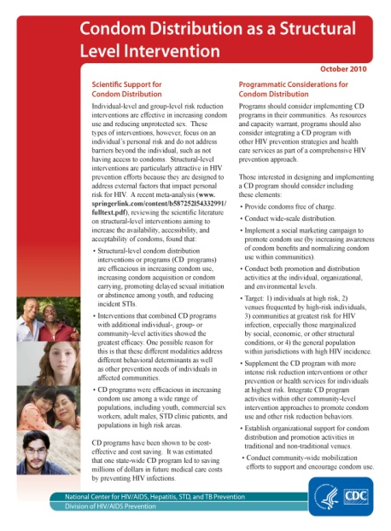
Example of Structural Intervention
Condom Distribution – Soon to Be Available
 | Individual | Organizational | Environmental
Availability | Condom bowls Providing low cost condoms Providing condom coupons | 100% condom-use policies Condoms in jails & prisons | Increasing public funds for making condoms available
Acceptability | Distributing promotional items (flyers to youth) | PSAs TV campaigns Community mobilization | Social Marking campaigns
Accessibility | Wide-spread distribution of free condoms | Development & production of female condoms Expanding publicly –funded distribution (e.g., vans) | Policy change
Adapted from: Charania, MR et al, p 2
Charania, MR et al. (2010). AIDS Behavior, DOI 10.1007/s10461-010-9812-y, p 2.
See www.cdc.gov & www.effectiveinterventions.org
See www.effectiveinterventions.org
Notes:
References
Charania, MR, Crepaz, N, Guenther-Gray, C, Henny, K, Liau, A, Willis, LA, Lyles, CM. (2010). Efficacy of structural-level condom distribution interventions: a meta-analysis of US and international studies, 1998-2007. AIDS Behavior, DOI 10.1007/s10461-010-9812-y.
www.cdc.gov
www.effectiveinterventions.org

Slide 27

Behavioral Science-based Interventions for STD/HIV Prevention
While there are these various approaches – combining them has been shown to be even more effective
  Individual-level – working on the behaviors of individuals
  Group-level – working with small numbers of individuals
  Community-level – working with larger sectors of a community
  Structural – working towards broad change
It is also clear that a variety of interventions can likewise have an even larger synergy
  Biomedical
  Behavioral
  Public Health Strategies
Charania, MR et al. (2010). AIDS Behavior, DOI 10.1007/s10461-010-9812-y, p 2.
St Lawrence, JS & Fortenberry, JD in Aral, SO & Douglas, JM (Eds). (2007). Behavioral Interventions for Prevention and Control of STDs
McGough, LJ & Handsfield, HH, in Aral, SO & Douglas, JM (Eds). (2007). Behavioral Interventions for Prevention and Control of STDs
Notes:
References
Charania, MR, Crepaz, N, Guenther-Gray, C, Henny, K, Liau, A, Willis, LA, Lyles, CM. (2010). Efficacy of structural-level condom distribution interventions: a meta-analysis of US and international studies, 1998-2007. AIDS Behavior, DOI 10.1007/s10461-010-9812-y.
McGough, LJ & Handsfield, HH, in Aral, SO & Douglas, JM (Eds). (2007). History of behavioral interventions in STD control, in Behavioral Interventions for Prevention and Control of Sexually Transmitted Diseases, Springer (NYC), p 3-22.
St Lawrence, JS & Fortenberry, JD in Aral, SO & Douglas, JM (Eds). (2007). Behavioral interventions for STDs: theoretical models and intervention methods, in Behavioral Interventions for Prevention and Control of STDs, Springer (NYC), p 23-59.

Slide 28
Newer Challenges – Viral STDs Including HIV
Bacterial STDs are curable – medicine can eradicate them
  However – some of the bacterial infections have become resistant to several antibiotics – particularly gonorrhea, as previously noted
Viral STDs are treatable – but not curable
  So, in addition to medical treatments – prevention of viral STDs involves behavior change, including
    Protected sex
    No sexual contact
  This is true for all the viral sexually-transmitted infections
    HIV
    Viral Hepatitis (A, B, C)
    Herpes Simplex Virus (HSV)
    Human Papilloma Virus (HPV)
Some viral STDs are vaccine-preventable – these vaccines are both highly effective & safe
  Hepatitis A & Hepatitis B (HAV & HBV)
  Human Papilloma Virus (HPV)
(continued)
Bolan, GA et al. (2012). NEJM, 366 (6) * CDC. (2010) STD Treatment Guidelines, MMWR, 59 (RR-12)
Curran, JW. (1996). & Satcher, D. (1996). Public Health Reports, III (S1) – 2 citations * www.cdc.gov/vaccines/vpd-vac/default.htm
St Lawrence, JS & Fortenberry, JD in Aral, SO & Douglas, JM (Eds). (2007). Behavioral Interventions for Prevention and Control of STDs
Notes:
References
Bolan, GA, Sparling, PF, Wasserheit, JN. (2012). The emerging threat of untreatable gonococcal infection. New England Journal of Medicine, 366 (6), p 485-87.
CDC. (2010). Sexually Transmitted Diseases Treatment Guidelines. MMWR, 59 (RR-12).
ww.cdc.gov/vaccines/vpd-vac/default.htm
Curran, JW. (1996). Bridging the Gap between behavioral science and public health practice in HIV prevention. Public Health Reports, III (S1), p 3-4.
Satcher, D. (1996). The importance of behavioral science in HIV prevention. Public Health Reports, III (S1), p 1-2.
St Lawrence, JS & Fortenberry, JD in Aral, SO & Douglas, JM (Eds). (2007). Behavioral interventions for STDs: theoretical models and intervention methods, in Behavioral Interventions for Prevention and Control of STDs, Springer (NYC), p 23-59.

Slide 29
Newer Challenges – Viral STDs
In the past 10 years, rising concern about increased risk behaviors among persons with HIV have arisen
  Incident STDs (syphilis, gonorrhea) have increased among populations that also have high rates of HIV – many of whom were aware of their status – showing that the sexual risks have risen, which has contributed to increases in new HIV infections
    This pattern has been seen in different populations, particularly MSM
  The causes for these increases in STD rates have been attributed to various reasons, including
    Compared to HIV, the perception of risk for STDs is generally much lower
    Many STDs are perceived to be “curable” which means treatment is as simple as a “shot” or a “pill”
    HIV Harm Reduction perspectives
CDC. (2003). MMWR, 52 (15) * CDC. (2007). MMWR, 60 (11)
Gilliam, PP & Straub, DM (2009) JANAC, 20 (2)
Janssen, RS et al. (2001). American Journal of Public Health, 91 (7)
West, GR et al (2007) AIDS Education and Prevention, 19 (4)
(continued)
Notes:
References
CDC. (2003). Advancing HIV prevention: new strategies for a changing epidemic – US, 2003. MMWR, 52 (15), p 329-56.
CDC. (2011). Clinical and behavioral characteristics of adults receiving medical care for HIV infection – Medical Monitoring Project, US, 2007. MMWR Surveillance Summaries, 60 (11).
Gilliam, PP & Straub, DM. (2009). Prevention with positives: a review of published research, 1998-2008. Journal of the Association of Nurses in AIDS Care, 20 (2), p 92-09.
Janssen, RS, Holtgrave, DR, Valdiserri, RO, Shepherd, M, Gayle, HD, DeCock, KM. (2001). The serostatus approach to fighting the HIV epidemic: prevention strategies for infected individuals. American Journal of Public Health, 91 (7), p 1019-24.
West, GR, Corneli, AL, Best, K, Kurkjian, KM, Cates, W. (2007). Focusing HIV prevention on those most likely to transmit the virus. AIDS Education and Prevention, 19 (4), p 275-88.

Slide 30
Newer Challenges – Viral STDs
Other causes for these increases in STD rates include
  The reduction in perception of risk or of the severity of HIV
  Improved treatment & survival as well as quality of life for those living with HIV, related to
    Antiretroviral medications (HAART) & less side effects,
    Greater knowledge & technology for assessing patients (viral load & resistance testing, better understanding of immune status)
      Undetectable Viral Load confusions
    Those with HIV feel better than in past – life can continue including school, work, family, sex, &/or substance use
  Prevention burn-out – often called “condom fatigue”
CDC. (2003). MMWR, 52 (15) * CDC. (2007). MMWR, 60 (11)
Gilliam, PP & Straub, DM (2009) JANAC, 20 (2)
Janssen, RS et al. (2001). American Journal of Public Health, 91 (7)
West, GR et al (2007) AIDS Education and Prevention, 19 (4)
Notes:
References
CDC. (2003). Advancing HIV prevention: new strategies for a changing epidemic – US, 2003. MMWR, 52 (15), p 329-56.
CDC. (2011). Clinical and behavioral characteristics of adults receiving medical care for HIV infection – Medical Monitoring Project, US, 2007. MMWR Surveillance Summaries, 60 (11).
Gilliam, PP & Straub, DM. (2009). Prevention with positives: a review of published research, 1998-2008. Journal of the Association of Nurses in AIDS Care, 20 (2), p 92-09.
Janssen, RS, Holtgrave, DR, Valdiserri, RO, Shepherd, M, Gayle, HD, DeCock, KM. (2001). The serostatus approach to fighting the HIV epidemic: prevention strategies for infected individuals. American Journal of Public Health, 91 (7), p 1019-24.
West, GR, Corneli, AL, Best, K, Kurkjian, KM, Cates, W. (2007). Focusing HIV prevention on those most likely to transmit the virus. AIDS Education and Prevention, 19 (4), p 275-88.

Slide 31
Newer Challenges – Viral STDs
Other causes for these increases in STD rates include
  Reluctance to disclose status – still associated with stigma, but is also associated with loss of relationships or sex
  Perception that if a partner wanted condoms to be used – s/he would ask or insist
  Younger at-risk individuals not being reached by old messages or the experiences of those in the early days of the HIV epidemic
There is an increased need for effective behavioral interventions for persons with HIV inside & outside the clinical care setting
CDC. (2003). MMWR, 52 (15) * CDC. (2007). MMWR, 60 (11)
Gilliam, PP & Straub, DM (2009) JANAC, 20 (2)
Janssen, RS et al. (2001). American Journal of Public Health, 91 (7)
West, GR et al (2007) AIDS Education and Prevention, 19 (4)
Notes:
References
CDC. (2003). Advancing HIV prevention: new strategies for a changing epidemic – US, 2003. MMWR, 52 (15), p 329-56.
CDC. (2011). Clinical and behavioral characteristics of adults receiving medical care for HIV infection – Medical Monitoring Project, US, 2007. MMWR Surveillance Summaries, 60 (11).
Gilliam, PP & Straub, DM. (2009). Prevention with positives: a review of published research, 1998-2008. Journal of the Association of Nurses in AIDS Care, 20 (2), p 92-09.
Janssen, RS, Holtgrave, DR, Valdiserri, RO, Shepherd, M, Gayle, HD, DeCock, KM. (2001). The serostatus approach to fighting the HIV epidemic: prevention strategies for infected individuals. American Journal of Public Health, 91 (7), p 1019-24.
West, GR, Corneli, AL, Best, K, Kurkjian, KM, Cates, W. (2007). Focusing HIV prevention on those most likely to transmit the virus. AIDS Education and Prevention, 19 (4), p 275-88.

Slide 32
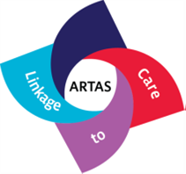
Newer Challenges – HIV
“Prevention with Positives”
Several interventions for persons living with HIV have been developed & implemented – particularly for sexual risk reduction
  These interventions address these changes in risk perceptions associated with advances in HIV care
  The focus on those with HIV is consistent with traditional public health infectious disease approach
DEBI menu now lists several for persons living with HIV
  Effective behavioral interventions – e.g., WiLLOW, CLEAR, Healthy Relationships, Partnership for Health
  Public Health Strategies – e.g., CRCS, ARTAS
  Several can be delivered to clients regardless of HIV status, e.g., Project START, SAFETY COUNTS
www.cdc.gov/hiv/topics/research/prs/compendium-evidence-based-interventions.htm
www.effectiveinterventions.org
Notes:
References/Notes
www.cdc.gov/hiv/topics/research/prs/compendium-evidence-based-interventions.htm (Compendium = 10 studies for Positives are listed; 8 for Medication Adherence – Total of 18)
www.effectiveinterventions.org
CRCS – Comprehensive Risk Counseling and Services
ARTAS – Anti-Retroviral Treatment and Access to Services

Slide 33

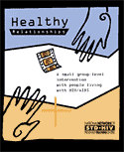

“Prevention with Positives” Examples
All in the DEBI Project
Women Involved in Life Learning from Other Women (WiLLOW) ₁
  Studied women living with HIV – to improve support, coping skills, & to reduce sexual risk behaviors – a GLI
Healthy Relationships ₂
  Studied men (MSM & heterosexual) & women living with HIV – to improve coping & decision-making skills – GLI
Partnership for Health ₃
  Studied men (MSM & heterosexual) & women in HIV Care clinics – to reduce sexual risk behaviors – an ILI – to be delivered by medical providers
Wingood, GM. (2004). Journal of Acquired Immune Deficiency Syndrome, 37 ( S2)
Kalichman, S (2001). American Journal of Preventive Medicine, 21 (2)
Richardson, JL et al. (2004). AIDS, 18 (8)
Notes:
References
Wingood, GM ., DiClemente, R ., Mikhail, I, Lang, D L, Hubbard-McCree, D, Davies, SL et al. (2004). A randomized controlled trial to reduce HIV transmission risk behaviors and STDs among women living with HIV: the WiLLOW program. Journal of Acquired Immune Deficiency Syndromes, 37 (S2), p S58-7.
Kalichman, S, Rompa, D, Cage, M, DiFonzo, K, Simpson, D, Austin, J, Luke, W, Buckles, J, Kyomugisha, F, Benotsch, E, Pinkerton, S, Graham, J. (2001). Effectiveness of an intervention to reduce HIV transmission risks in HIV-positive people. American Journal of Preventive Medicine, 21 (2), p 84-2.
Richardson, JL, Milam, J, McCutchan, A, Stoyanoff, S, Bolan, R, Weiss, J, Kemper, C, Larsen, RA, Hollander, H, Weismuller, P, Chou, CP, Marks, G. (2004). Effect of brief safer-sex counseling by medical providers to HIV-1 seropositive patients: a multi-clinic assessment. AIDS, 18 (8), p 1179-86.

Slide 34
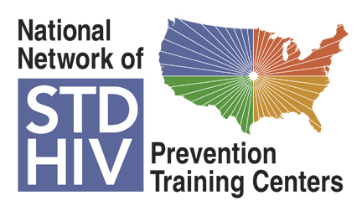
STD/HIV Prevention Behavioral Interventions
Proven effective behavioral interventions are available at Individual, Group, & Community Levels
  HIV & STD prevention
  Healthcare seeking behaviors
  Prevention for Persons Living with HIV
CDC continues the process of supporting the dissemination of selected interventions to clinical settings, community-based organizations, & other providers of prevention services, with increasing focus on working with those living with HIV
Training offered by the NNPTC is part of this process
www.stdhivpreventiontraining.org
Notes:
www.stdhivpreventiontraining.org

Slide 35
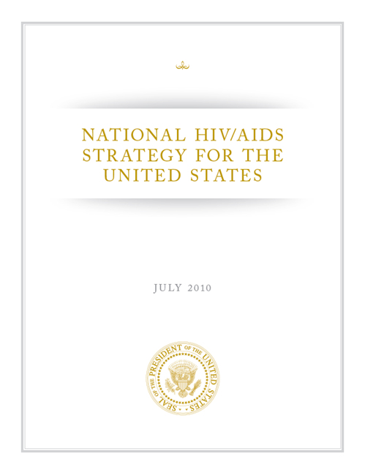
National HIV/AIDS Strategy for the United States
  “The United States will become a place where new HIV infections are rare and when they do occur, every person, regardless of age, gender, race/ethnicity, sexual orientation, gender identity or socio-economic circumstance, will have unfettered access to high quality, life-extending care, free from stigma and discrimination.” www.whitehouse.gov/onap
Notes:
Reference
The White House Office of National AIDS Policy (AIDSpolicy@who.eop.gov)
www.whitehouse.gov/onap

Slide 36
National HIV/AIDS Strategy
The National HIV/AIDS Strategy (NHAS) is an aggressive approach to changing the HIV epidemic – 4 goals
  Reducing New HIV Infections – by 25% by the year 2015
  Increasing Access to Care and Improving Health Outcomes for People Living with HIV
  Reducing HIV-Related Health Disparities
In order to achieve these goals – we need to work together in all service areas – NHAS objectives include
  Achieving a More Coordinated National Response to the HIV Epidemic in the United States
    Integration of STD/HIV Care & Prevention is clearly a way to help reach this important goal – using combined behavioral, biomedical, & public health approaches
www.whitehouse.gov/onap
Notes:
www.whitehouse.gov/onap

Slide 37
Resources
Websites that can help you obtain more information about interventions & training, materials, & technical assistance (TA)
  CDC – general www.cdc.gov
    National Network of Prevention Training Centers (NNPTCs) –www.STDHIVpreventiontraining.org
    “DEBI Interventions” – www.effectiveinterventions.org, which also has information on training & TA
    National Prevention Information Network (NPIN) – www.cdcnpin.org
  HRSA – general www.hrsa.gov
    HIV – http://hab.hrsa.gov/
    AIDS Education & Training Centers (AETCs) – www.aidsetc.org
  NIH – general www.nih.gov
    AIDS Info – www.aidsinfo.org
  White House – www.aids.gov
Notes:
References/Notes
Multiple internet reference addresses for training & policy & prevention materials

