Slide 1
Antimicrobial-Resistant Gonorrhea Webinar Preparation for Tabletop Exercise
CDC’s Division of STD Prevention │ Antibiotic-Resistant Gonorrhea Tabletop Exercise
Updated April 2021

Slide 2
Disclaimer
The findings and conclusions in this presentation are those of the author and do not necessarily represent the official position of the Centers for Disease Control and Prevention
Slide Author
Robert D. Kirkcaldy, MD, MPH, CAPT USPHS
Centers for Disease Control and Prevention
Division of STD Prevention

Slide 3
Roadmap
Objective of Tabletop Exercise (TTX)
Gonorrhea (GC)
Clinical manifestations, diagnosis, & treatment
Epidemiology
Prevention & Control
GC antibiotic resistance
Background
Laboratory Testing
Epidemiology
Clinical and programmatic responses
Summary
Notes:
These slides will cover the objective of the planned gonorrhea table-top exercise.
The slides will also provide basic information about gonorrhea so that all tabletop exercise participants can all start with some important knowledge about gonorrhea.
In the US, gonorrhea is often referred to with the shorthand of GC (for gonococcus, a label for the bacteria that causes gonorrhea).
The slides will cover
--clinical manifestations of gonorrhea and how clinician diagnose and treat gonorrhea
--epidemiology of gonorrhea in the United States and
--how gonorrhea is prevented and controlled in the United States
Especially for this tabletop exercise, it is important to be aware of the challenges posed by antibiotic resistance.
The slides will cover a bit of the background of this area, and briefly cover laboratory testing, epidemiology, and clinical and programmatic responses.
Hopefully at the end of these slides, all tabletop exercise participants will have some basic knowledge about gonorrhea that they can bring into the exercise.

Slide 4
Objectives of Antibiotic-Resistant Gonorrhea (ARGC) Tabletop Exercise (TTX)
Improve local/state capacity to effectively respond to outbreak of ARGC
Assess how the local/state response plan addresses outbreak
Identify future steps to improve response planning
Notes:
The objectives of the tabletop exercise will be to improve local and/or state capacity to effectively respond to an outbreak of antibiotic-resistant gonorrhea
Because participants will be using a pre-developed response plan during the tabletop exercise, another objective is to assess how the local or state response plan adequately addresses a simulated outbreak
And through the exercise, participants will identify gaps and future steps to improve response planning

Slide 5
Tabletop (TTX) Participation Expectations
Participants will include
[Fill in agencies and groups participating]
Prior to TTX, participants expected to
View this webinar
Carefully read the (local or state) resistant GC outbreak response plan
Carefully read the tabletop outbreak scenario
During TTX, participants will work through scenario & questions, using the local/state resistant GC outbreak response plan as guide
Module 1: Preparedness; Module 2: Response; Module 3: Recovery
After TTX:
Use lessons learned from TTX to further improve the response plan
Notes:
Participants in the tabletop exercise will include a broad range of (agencies/groups), such as [fill in (representatives from STD programs, emergency response, preparedness, STD clinic?, others)]
Prior to the tabletop exercise, participants should view this webinar, read the response plan, and the outbreak scenario.
During the exercise, participants will work through the scenario and address questions as a group. The local or state response plan that was developed at the local or state level will serve as your guide for how to address the unfolding scenario and answer the questions.
You will probably find that the scenario raises issues that aren’t addressed in the response plan. That’s perfectly ok and to be expected. That is why we do tabletop exercises. We want to identify gaps and sticking points that can be figured out before we have to respond in real life.
There are 3 modules in the exercise: one on preparedness, one the response, and one focused on recovery or the post-outbreak phase.
After the exercise, participants should gather together the lessons learned and identified gaps and designate someone or a group to use these to further improve the response plan.

Slide 6
Gonorrhea

Slide 7
Gonorrhea Overview
Caused by bacterium Neisseria gonorrhoeae (also referred to as GC or gonococcus)
Transmission
During vaginal, anal, or oral sex
During delivery if mother has cervical infection
Notes:
Gonorrhea is caused by the bacterium Neisseria gonorrhoeae. And is often referred to with the shorthand of GC for gonococcus)
Transmission is primarily sexual, during vaginal, anal, or oral sex.
But neonates can also be infected during delivery if a mother has an untreated cervical infection.

Slide 8
Gonorrhea Clinical Signs/Symptoms
Urethritis
Urethral discharge
Painful urination
Incubation period:
1-14 days (usually 2-5 days)
Often asymptomatic
Pharynx (throat)
Rectum
Notes:
The signs and symptoms of gonorrhea differ between cisgender men and women and between different anatomic sites.
In cisgender men and anyone with a natal penis, an infection of the urethra causes urethritis or inflammation of the urethra, which is the tube that bring urine out through the penis. This causes the symptoms of lots of greenish discharge and pus coming from the urethra and pain with urination.
After being infected, it often takes several days for the symptoms to occur. The time between the actual infection and when symptoms occur is called the incubation period.
If infections occur in the pharynx or rectum, such as from oral and anal sex, there are often no symptoms at all.

Slide 9
Gonorrhea Clinical Signs/Symptoms Cont.
Urethritis
To find these infections, clinicians need to take sexual history & screen at appropriate anatomic sites
(suboptimal outside of STD clinics)
Urethral discharge
Painful urination
Incubation period:
1-14 days (usually 2-5 days)
Often asymptomatic
Pharynx (throat)
Rectum
Notes:
To find these infections, clinicians need to ask the right questions but taking a sexual history, and then screen or test the patient at the appropriate anatomic sites.
This is routinely done in STD clinics. Unfortunately, sexual history-taking and testing of the pharyngeal and rectal anatomic sites is often NOT done in other healthcare settings.
Even though there are no symptoms, the infection can still be passed on to the patient’s sexual partners.

Slide 10
Clinical Signs/Symptoms Cont.
Infection at site of exposure: cervix, pharynx, rectum
Often there are no symptoms
When present, cervical symptoms can include
Vaginal discharge
Painful urination
Pain with intercourse
Lower abdominal pain
Vaginal spotting
To find these infections, clinicians need to take sexual history & screen at appropriate anatomic sites
Notes:
In cisgender women and anyone with female reproductive anatomy that they were born with,
Infections can occur at the site of sexual exposure.
Having vaginal sex with someone with gonorrhea can lead to infections at the cervix.
Oral sex can lead to pharyngeal or throat infections. And anal sex can lead to rectal infections.
Infections at these anatomic sites often have no symptoms at all and are silent.
When symptoms of cervical infections do occur, they can include
Vaginal discharge or vaginal spotting
Painful urination
Pain with intercourse
And lower abdominal pain

Slide 11
Extragenital (Pharyngeal or Rectal) Gonorrhea
Commonly have no symptoms
Can serve as reservoirs of infection
Can be more challenging to cure (especially pharyngeal gonorrhea)
Might promote antibiotic resistance?
Notes:
We sometimes group pharyngeal and rectal infections into what we call extra-genital infections. Meaning in addition to genital. Some people use ‘non-genital infections’.
As mentioned, these infections commonly don’t have any symptoms. So why should we care?
There are a few reasons:
Infections of these anatomic sites can serve as reservoirs of infection if they’re not treated. Someone’s sexual partners can be infected. And this can contribute to continued spread of gonorrhea in a community
They can be more challenging to treat. Pharyngeal gonorrhea can be harder to cure than infections at other anatomic sites because it can be harder to get right amount of antibiotics into the tissues of the throat.
Data suggest that infections in the throat and rectum might be more likely to acquire and promote antibiotic resistance than genital infections.
That’s a lot of information, but the important 3 things to know are that infections in the throat and rectum are important, can be silent, and, especially when in the throat, can be harder to cure.

Slide 12
Problems Caused by Untreated Gonorrhea
Pelvic Inflammatory Disease
Ectopic Pregnancy, Infertility
Prostatitis, Epididymitis
Neonatal conjunctivitis & blindness
Disseminated gonococcal infection
Increased HIV acquisition/transmission
Notes:
Why do we care about gonorrhea? Mainly because of the problems caused by untreated gonorrhea
In those with female reproductive anatomy, it can cause pelvic inflammatory disease or PID, a painful abdominal condition.
PID can progress to cause ectopic pregnancy and infertility, robbing young women of their fertility.
Gonorrhea can also cause inflammation of the prostate and epididymis, causing pain and fever
In newborns born to mothers with cervical gonorrhea, gonorrhea can cause eye inflammation (or conjunctivitis) and blindness
Neisseria gonorrhoeae can also slip into the bloodstream and cause disseminated gonococcal infection, which can affect the joints and heart valves
If a partner is living with HIV, gonorrhea can increase the risk of acquisition and transmission of HIV.

Slide 13
Testing
Nucleic Acid Amplification Tests (NAATs)
Gram Stain
Culture
Notes:
Next we turn to testing. How is gonorrhea detected and diagnosed?
There are three main ways – (1) a gram stain, (2) by growing the bacteria in culture, and (3) nucleic acid amplification tests or NAATs that test for bacteria’s DNA or RNA
You don’t have to become an expert in these.
We just want you to be aware that there a few approaches and that there are pro’s and con’s of each

Slide 14
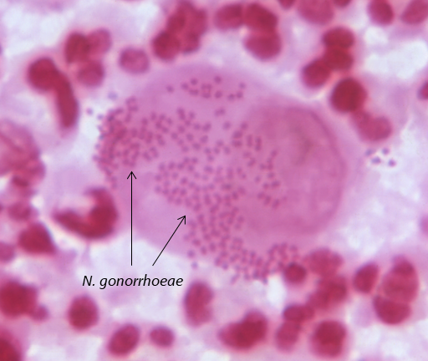
Gram Stain
Microscope slide is created to visualize bacteria
Recommended for urethral specimens from symptomatic men
Photo: CDC, Dr. Caldwell
Notes:
Gram stain is an old but reliable type of testing in which a specimen of urethral discharge is taken and put on a microscope slide and washed with chemicals.
Then you can look in the microscope to see the actual bacteria in the human cells.
You get a diagnosis fast. But fewer and fewer clinics still do Gram stain, and it’s only recommended for urethral infections.

Slide 15
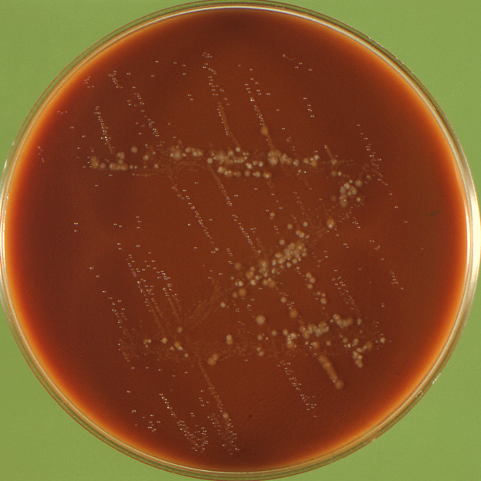
Gonorrhea Culture
Grow the actual bacteria on media plate
Historical standard
Highly sensitive for urethral, lower sensitivity for extragenital infections
Logistically challenging
Declining in use
Photo: CDC
Notes:
Culture is also an old technique, but still really important, especially for antibiotic resistance.
Culture is when you take a sample from an anatomic site and grow the actual bacteria on a media plate, meaning a petri dish filled with a gel that is full of nutrients to help the bacteria grow and antibiotics to kill other bacteria. We use media plates that provide an ideal environment to grow Neisseria gonorrhoeae.
Culture is really sensitive for urethral infections, but not that sensitive for infections of other anatomic sites.
There are 3 big things to know about culture.
It is logistically challenging because the bacteria is fussy and hard to grow.
Because of the logistical challenges and development of new testing approaches, culture is declining in use and often only done in some STD clinics.

Slide 16
Gonorrhea Culture Cont.
Grow the actual bacteria on media plate
Historical standard
Highly sensitive for urethral, lower sensitivity for extragenital infections
Logistically challenging
Declining in use
Photo: CDC
Currently, antibiotic susceptibility testing (AST) requires culture!!
Notes:
But importantly, 3. currently antibiotic susceptibility testing requires culture.
Susceptibility testing is how you detect resistance in the lab. A positive culture (also called an isolate) undergoes the additional susceptibility testing by exposing the culture to different concentrations of antibiotics in the lab.
While there are exciting developments that might change this in the future, but right now, susceptibility testing to detect resistance requires culture.
One real-world challenge that some jurisdictions face is how to get resistance test results for a possibly-resistant gonococcal infection if clinicians and laboratories in the area don’t use culture.

Slide 17
Gonorrhea Testing
Nucleic Acid Amplification Tests (NAATs)
Gram Stain
Culture
Notes:
And the third testing approach is by nucleic acid amplification tests or NAATs

Slide 18
Nucleic Acid Amplification Tests
Detects bacteria DNA or RNA
Highly sensitive and specific
Less stringent handling procedures
FDA approved for endocervical, vaginal, & urethral swabs, urine, and (as of 2019) pharyngeal and rectal swabs
Has largely replaced culture as diagnostic test of choice
BUT cannot be used (yet) for antibiotic susceptibility testing
https://www.cdc.gov/mmwr/pdf/rr/rr6302.pdf
Notes:
NAATs are relatively new and they have become the go-to test for diagnosis of gonorrhea.
They detect bacteria DNA or RNA
They are highly sensitive and specific
And unlike culture, they are really easy to handle. They can be left at room temperature on a counter top
They are FDA-approved for testing of endocervical, vaginal, and urethral swabs and urine. And as of last year, also testing of pharyngeal and rectal swabs
They have largely replaced culture as test of choice
But cannot yet be used for susceptibility testing. You need to get culture for that.
As a summary, culture is necessary for susceptibility testing to detect resistance, but few clinics do it because it is a bit logistically challenging.
NAATs are easy to use, widely available, and great for diagnosis of gonorrhea, but you can’t do susceptibility testing with them.
NOTE: Investigators are developing and have tested molecular assays for resistant mutations, especially for ciprofloxacin resistance. But none of the assays are yet FDA-approved (as of August 2020) and reliable assays for ceftriaxone resistance are not available (because the resistance mutations are complex and not fully understood)
https://www.fda.gov/news-events/press-announcements/fda-clears-first-diagnostic-tests-extragenital-testing-chlamydia-and-gonorrhea

Slide 19
Screening Recommendations
Women <25 (older if at risk)*
Pregnant women <25 (older if at risk)*
First prenatal care visit
Third trimester if still at elevated risk
* Those with a new sex partner, >1 sex partner, a sex partner with concurrent partners, or a sex partner who has an STD, inconsistent condom use among persons not in mutually monogamous relationships, previous or coexisting STD, and exchanging sex for money or drugs
Notes:
Earlier slides noted that cervical infections often don’t cause symptoms, but can lead to PID and infertility.
To identify the infections before the complications occur, screening for gonorrhea is recommended.
CDC and the US Preventive Services Task Force recommend at routine annual gonorrhea and chlamydia screening of sexually-active women aged <25 years of age. Older women who are at elevated risk may also be screened.
Pregnant women should also be screened at the first prenatal care visit. Women found to have gonorrhea should be treated and re-tested in 3 months. Pregnant women who remain at risk for gonorrhea should be retested during the third trimester.

Slide 20
Screening Recommendations Cont.
Sexually-active MSM
At least annually at sites of contact (regardless of condom use)
More frequently (every 3–6 months) if at increased risk*
People with HIV
At first HIV evaluation, then at least annually
More frequently (every 3–6 months) if at increased risk*
People on HIV PrEP
At initiation, then every 3–6 months
* multiple partners, have partners with multiple partners, those with HIV if risk behaviors persist, and those on HIV PrEP
Notes:
CDC also recommends that sexually-active men who have sex with men be screened at least annually at sites of sexual contact and more frequently if at increased risk.
And people living with HIV and people who are taking pre-exposure prophylaxis to prevent HIV should also be screened.
The important take-away is that some groups are epidemiologically at elevated risk and should be screened.

Slide 21
Treatment of Uncomplicated Gonorrhea 2020 CDC Guidelines Update
Ceftriaxone 500 mg as a single intramuscular (IM) dose *For persons weighing ≥150 kg: ceftriaxone 1 g IM
If chlamydia has not been excluded: co-treat with doxycycline 100 mg twice daily for 7 days
St Cyr et al. Update to CDC’s Treatment Guidelines for Gonococcal Infection, 2020. MMWR 2020;69(50):1911-1916
Notes:
According to CDC’s updated 2020 STD Treatment Guidelines, people with uncomplicated gonorrhea should be treated with the antibiotic ceftriaxone 500 mg.
For persons weighing 150 or more kg, treat with 1 g of ceftriaxone.
If chlamydia has not been excluded, co-treat with doxycycline.
As you’ll learn, CDC’s treatment guidelines for gonorrhea have been updated multiple times to keep pace with emerging antibiotic resistance in Neisseria gonorrhoeae.

Slide 22
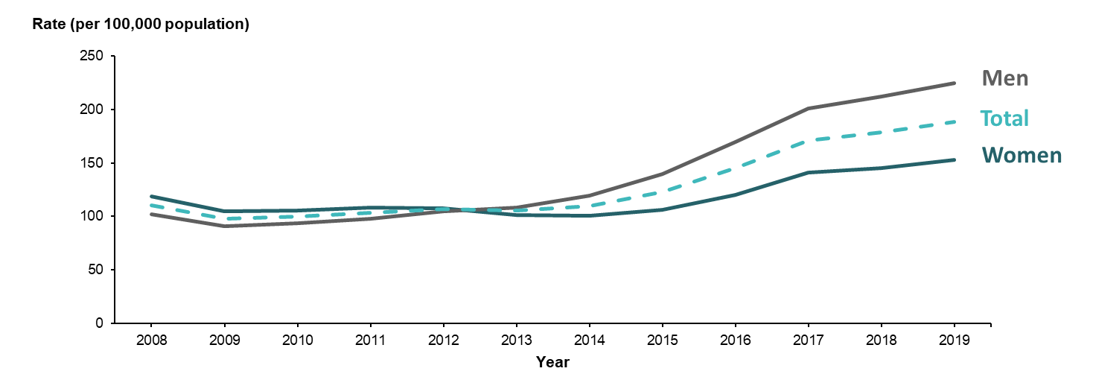
Gonorrhea Rates Increased Since 2009, Especially Among Men
Gonorrhea rates by gender and year, United States, 2008–2019
Notes:
Let’s turn to the epidemiology of gonorrhea in the United States. This will provide a sense of what has been happening with gonorrhea and which groups are most affected.
In 2009, we saw a historically low rate of gonorrhea. But since then, the rate of gonorrhea has increased steadily.
Increases were seen among both men and women, but rates increased more sharply among men and rates were higher among men during 2013–2016.
Surveillance case report data don’t include information on the gender of the sex partner of the infected people. To get those data, we use enhanced surveillance platforms.

Slide 23
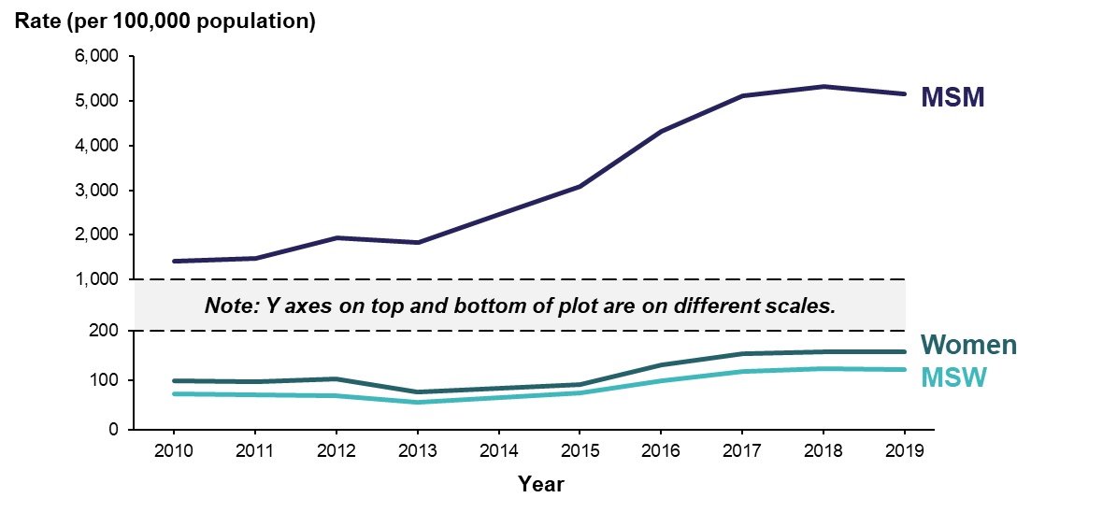
Estimated Gonorrhea Rates Increasing Among MSM at Sentinel Surveillance Sites
NOTE: Estimate based on weighted analysis of data obtained from interviews (n=28,979) conducted among a random sample of reported gonorrhea cases. Sites include Baltimore, Philadelphia, New York City, Washington State, San Francisco, and California (excluding San Francisco). ACRONYMS: MSM = Gay, bisexual, and other men who have sex with men; MSW = Men who have sex with women only
Notes:
In cities and states participating in STD sentinel surveillance, gonorrhea rates increased nearly 300% among gay, bisexual, and other men who have sex with men (or MSM) during 2010 to 2017.
Case rates among men who have sex only with women (or MSW) and women also increased by 54% and 88.%, respectively.

Slide 24
Extragenital Gonorrhea Is Common Among MSM
Among 2,077 MSM attending community venues in 5 cities who self-collected specimens for STD testing
1 in 20
had rectal gonorrhea
1 in 20
had pharyngeal gonorrhea
Source: National HIV Behavioral Surveillance (NHBS); Johnson Jones M et al. MMWR 2019;68(14):321-325
Notes:
Not only is gonorrhea increasing among MSM, but extragenital gonorrhea is common among MSM
In a sample of over 2000 men attending community venues (such as bars and clubs) in 5 cities in 2018, about 1 in 20 had rectal gonorrhea and 1 in 20 had pharyngeal gonorrhea.

Slide 25
Cornerstone of GC Prevention and Control Is Rapid Detection and Effective Treatment
Screen correct population at anatomic sites of sexual contact
Treat according to CDC guidelines
Work with patient and/or health department to ensure recent partners are tested and treated
Notes:
The cornerstone of gonorrhea prevention and control is rapid detection and effective treatment.
This includes screening the correct populations to rapidly detect infections
Treat according to CDC guidelines
And clinicians should work with the patient and/or health department to ensure that the patient’s recent partners are also tested and treated. Not might this prevent onward spread and prevent problems in the partners, but it may protect the patient from re-infection.

Slide 26
Cornerstone of GC Prevention and Control Is Rapid Detection and Effective Treatment Cont.
Work with patient and/or health department to ensure recent partners are tested and treated
Partner Services can be challenging because of
Limited engagement by patients and clinicians
Persons with multiple or anonymous partners
Difficult to reach populations
Growing case burden
Declining public health resources
Notes:
But getting partners tested and treated (what is often called Partner Services) can be challenging.
Some patients and clinicians may find this important or don’t want to work with the health department on this
When patients have many partners and especially when they were anonymous, that adds to the challenge of finding the partners
Some populations are difficult to reach, because they are distrustful of the government, engaged in illegal activities, or other reasons
A growing case burden with flat resources limits what health departments can do
And this is compounded if jurisdictions face declining public health resources.

Slide 27
Promotion of Behavioral Approaches
Mutual Monogamy
Condom Use
Abstinence
Notes:
What else can be done?
People in the community can be encouraged to prevent gonorrhea through abstinence, mutual monogamy with a partner who has tested negative, limiting the number of partners one has, and/or correct and consistent condom use.

Slide 28
Neisseria gonorrhoeae Antibiotic Resistance
Notes:
Turning now to Neisseria gonorrhoeae antibiotic resistance

Slide 29
Pre-1937 Gonorrhea Treatments Were Ineffective at Best and Sometimes Toxic
Emetics (copaiba) (severe vomiting)
Laxatives
Diuretics
Injections: permanganate, chloride, tannate, zinc, silver nitrate, lead acetate, iodide of iron with iron filings, earth and water, honey, chloroform (causes severe pain, bleeding)
Turpentine
Cubebs (pepper)
Sandalwood oil, Balsam oil
Leeching
Retention of urine by forceps
Sounds
Hot bath (dipping skin of penis into scalding hot water)
Notes:
Gonorrhea has been recognized for centuries and efforts to treat gonorrhea have been sought for centuries.
Before the availability of antibiotics in the 1930s, patent medicines were used for therapy. Some were cocaine mixed with alcohol. In the early 20th century, medical treatment emphasized irrigation of the genital tracts with caustic solutions such as potassium permanganate, mercurochrome and other antiseptics.
Clearly these treatments weren’t ideal and might have themselves caused severe problems such as strictures, which were then treated by inserting metal rods (or sounds) into the urethral to break up the stricture.

Slide 30
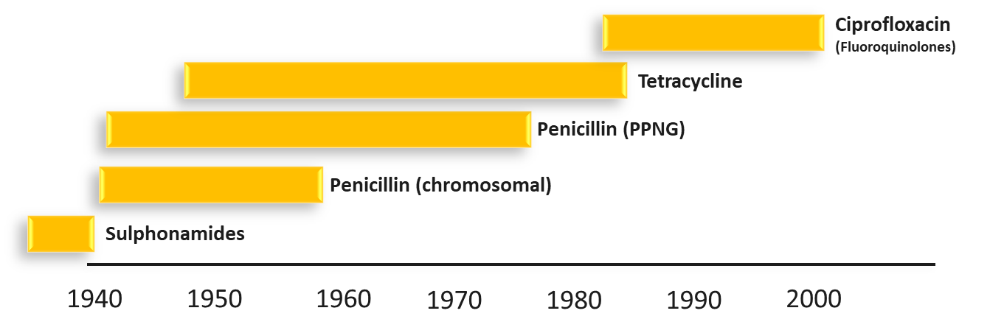
GC Has Successively Developed Resistance to Each Antibiotic Used for Treatment
PPNG = penicillinase-producing N. gonorrhoeae
Adapted from: Goire N et al. Molecular approaches to enhance surveillance of gonococcal antimicrobial resistance. Nature Reviews Microbiology 2012
Notes:
So the introduction of the sulfa drugs and penicillin in the 1930s and 1940s was a revolution in treatment. However, Neisseria gonorrhoeae has demonstrated a remarkable ability to mutate and develop antibiotic resistance to each antibiotic used for treatment. Soon after use of sulfa drugs, gonorrhea became resistant. By the 1970s and 1980s, penicillin resistance was so widespread that penicillin was no longer recommended.
Tetracycline resistance was soon common.
Ciprofloxacin became available in the 1980s. But resistance to ciprofloxacin became common by the mid-2000s and this drug was no longer recommended.

Slide 31
GC Has Successively Developed Resistance to Each Antibiotic Used for Treatment Cont.
Following emergence of ciprofloxacin resistance, CDC changed treatment recommendations to only recommend cephalosporins (cefixime and ceftriaxone)
PPNG = penicillinase-producing N. gonorrhoeae
Adapted from: Goire N et al. Molecular approaches to enhance surveillance of gonococcal antimicrobial resistance. Nature Reviews Microbiology 2012
Notes:
After ciprofloxacin resistance, the only remaining drug class left that was recommended by CDC was the cephalosporins. This included the oral antibiotic cefixime and the injectable antibiotic ceftriaxone.

Slide 32
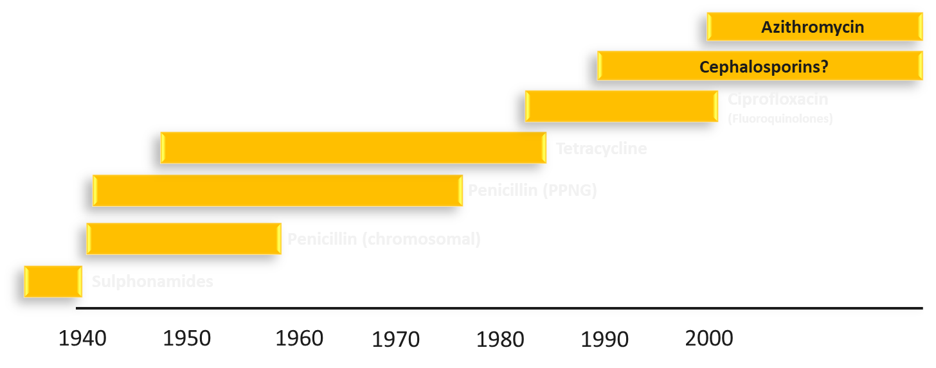
Emerging Resistance Threatens to Undermine Effectiveness of Only Remaining Recommended Treatment
PPNG = penicillinase-producing N. gonorrhoeae
Adapted from: Goire N et al. Molecular approaches to enhance surveillance of gonococcal antimicrobial resistance. Nature Reviews Microbiology 2012
Notes:
But there is growing concern about the emergence of resistance to the cephalosporins.
And there is also concern about emerging resistance to azithromycin.
Emerging resistance threatens to undermine the only remaining recommended treatment.
Experts are increasing concerned about the possibility of gonorrhea becoming untreatable because of antibiotic resistance.

Slide 33
A Brief Detour About Antibiotic Susceptibility Testing…
Notes:
But before we continue the story of the emergence of resistance, we’ll take a detour to discuss antibiotic susceptibility testing and how it works.
This may help to understand the resistance trends and to understand things you might hear during the tabletop exercise.

Slide 34
Antibiotic Susceptibility Testing (AST)
Laboratory tests to identify to which antibiotics an infection is susceptible or resistant
A positive culture specimen (“isolate”) is exposed to antibiotics to see if it continues to grow
No longer done in routine clinical practice for GC
GC AST largely only performed in some public health laboratories
Notes:
Antibiotic susceptibility testing is a type of laboratory testing in which
Laboratory tests are performed to identify to which antibiotics to which an infection is susceptible or resistance. Susceptibility testing is done for bacterial, fungal, and viral infections. For the purposes of the tabletop exercise, we’ll focus on bacterial (and especially N. gonorrhoeae) antibiotic susceptibility testing.
As discussed previously, antibiotic susceptibility testing currently relies on a culture specimen of live bacteria (called an isolate). The bacterial specimen (or isolate) is exposed to antibiotics at varying concentrations to see if it continues to grow at the different concentrations.
Because culture is rarely done in routine clinical practice, susceptibility testing is also no longer done in routine clinical practice for gonorrhea.
Rather, gonorrhea susceptibility testing is largely only performed in some public health laboratories and reference laboratories.

Slide 35
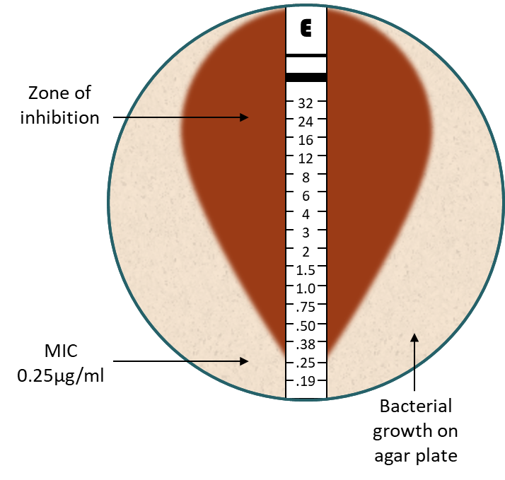
There Are Three Culture-based Approaches to GC AST
Disk diffusion (Kirby-Bauer): rapid, simple, accuracy?
Etest: rapid, relatively simple, accurate, provides results as minimum inhibitory concentrations (MICs)
Agar dilution: gold standard, takes longer, laborious (done in reference labs), accurate, provides MICs
Plates with multiple antibiotic concentrations are made
Bacteria placed on plates to assess which concentration inhibits growth in the laboratory
Notes:
There are 3 culture-based approaches to gonorrhea susceptibility testing.
It’s not important to know the details of these, but just to grasp the general concepts of how AST works and the results
Disk diffusion, which discs that are impregnated with a specific antibiotic are placed on a even layer of bacteria. A picture is shown in the top right. The white dots are the antibiotic discs. The antibiotic diffuses out of the disc into the bacteria. A clear zone around the disc indicates that the bacteria died and are thus susceptible to the antibiotic. When discs just appear to be sitting on the hazy bacterial layer, this indicates that the bacteria is still alive despite the antibiotic – and are RESISTANT to the antibiotic. ** Disk diffusion is rapid and simple to perform but may have less accuracy than other methods.
Etest works on a similar principle. Instead of using discs, Etest uses strips that are impregnated with antibiotics, but at a gradient of concentration. The strip is laid on a layer of bacteria. Microbiologists can read the concentrations at which the antibiotics kill the bacteria and at that what antibiotic concentrations the bacteria can survive. Etest provides results in minimum inhibitory concentrations or MICs, which will be explained in the next series of slides. Etest will be used in the tabletop exercise scenario
Agar dilution is the third approach and is considered the gold standard. But it takes longer and is laborious and is accurate. Like Etest, it provides results in MICs. With agar dilution, microbiologists make plates with multiple antibiotic concentrations. Bacteria are placed on the plates to assess which concentration inhibits bacteria growth.

Slide 36
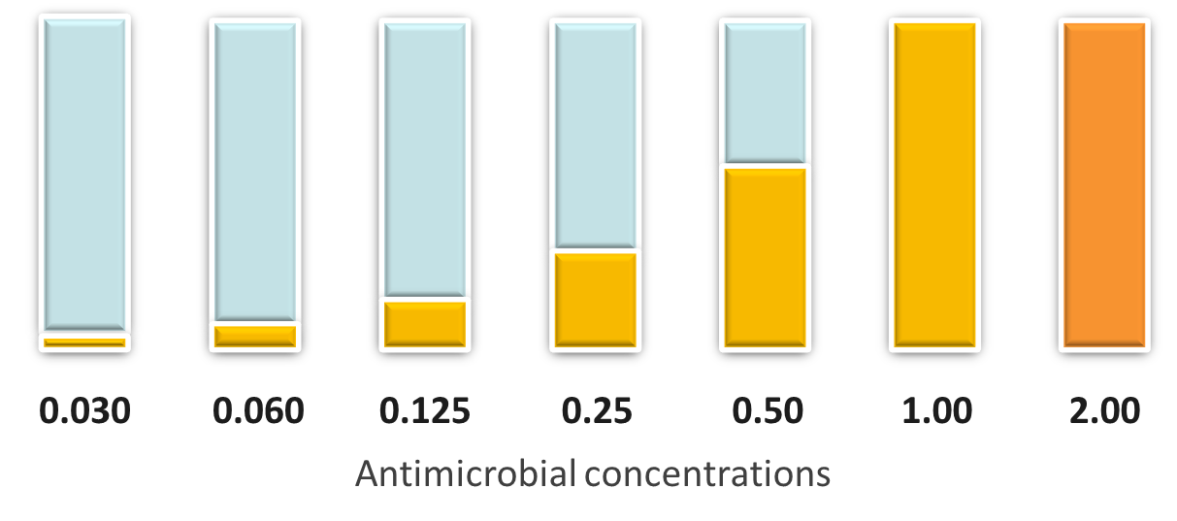
Minimum Inhibitory Concentrations (MICs)
MIC: lowest antibiotic concentration that inhibits visible growth in the laboratory
Notes:
What are MICs? It will be useful to have a general sense of the concept during the tabletop exercise, because AST results will be presented and will be presented as MICs.
Minimum inhibitory concentrations or MICs are the lowest antibiotic concentration that inhibits visible growth of the bacteria in the laboratory.
To illustrate the general concept, the next few slides show an over-simplified description.
Imagine that you are in the laboratory and you mix equal amounts of antibiotic powder and water. You consider that concentration to be 1.0. Then you take some of that solution and dilute it with water so that the antibiotic is at a half-strength. You put that aside and label it as 0.5. Then you again dilute with water so the antibiotic is a quarter of the strength of the original – you label that as 0.25. And you keep doing this to get lower and lower concentrations of antibiotic in your mixtures. These mixtures are shown to the left of the 1.0 mixture. And you can keep going lower and lower if you want to.
Then imagine that you take some of the 1.0 mixture and add more antibiotic powder to double the concentration – you label that 2.0. Then you add even more powder to make a quadruple strength, which you label 4.0. and you can keep going higher and more concentrated.

Slide 37
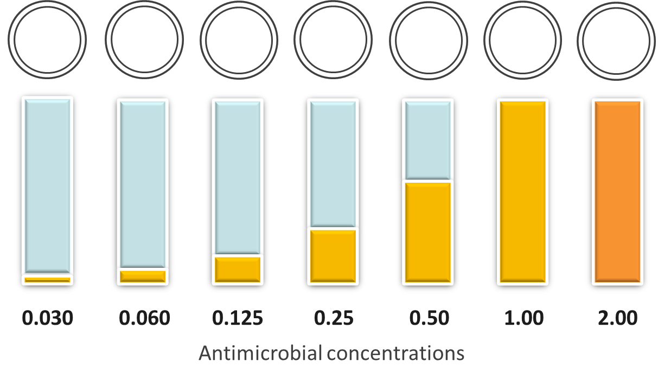
Fill Each Plate with the Antibiotic Solutions
Notes:
So they you fill a plate (or petri dish) with each of the antibiotic solutions.
So the one on the left has 0.03. The next one has 0.06 and so on.

Slide 38
Put Same Amount of Bacteria on Each Plate
Notes:
Then you add the same amount of the bacteria to each plate.

Slide 39
Time
Notes:
Then you wait

Slide 40
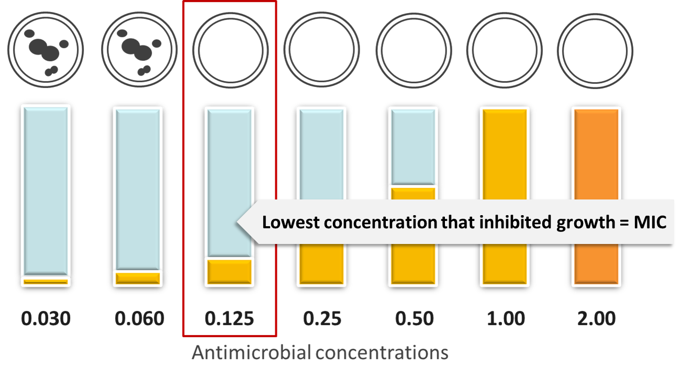
Bacteria Growing on Last 2 Plates
Notes:
When the results are ready to be read, you find this result.
You find that the bacteria were able to keep growing at the very lowest concentrations of antibiotic – in the plates with very little antibiotic. The bacteria are still growing on the 0.03 and 0.06 plates.
But the bacteria stopped growing and died on the 0.125 plate and all the plates with higher antibiotic concentrations.
You would report that 0.125 is the lowest concentration that inhibited growth – this is the MIC.

Slide 41
Warning of Emerging Resistance
Survival at higher concentrations can be warning of emerging resistance
Notes:
The ability of bacteria to grow despite higher and higher concentrations can be a warning of emerging resistance.

Slide 42
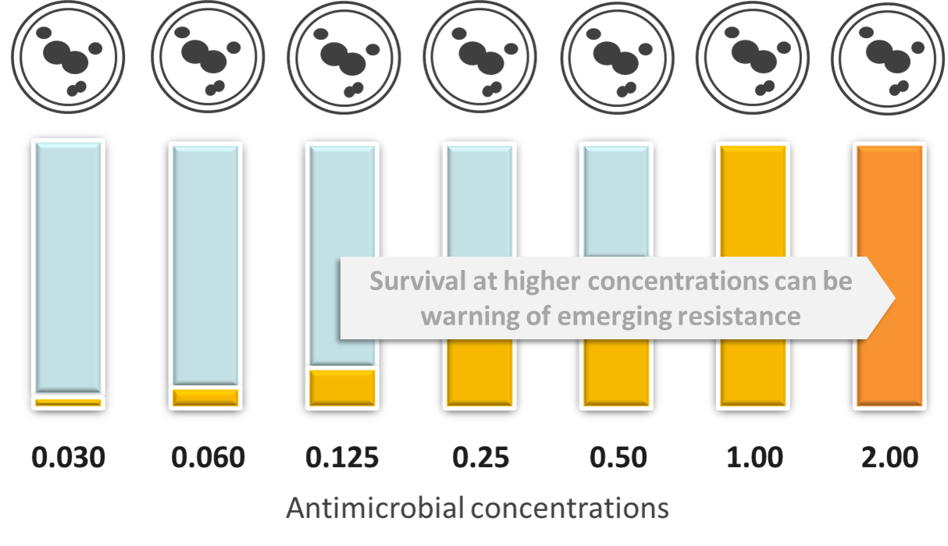
Warning of Emerging Resistance Cont.
So generally, increasing MICs = Badness
Notes:
So higher MICs are bad. They mean that the bacteria can survive despite being exposed to higher and higher amounts of antibiotics.
Low MICs are good and indicate the bacteria die when they are exposed to just a tiny amount of antibiotic.
That the big take-away from this section.
But it gets nuanced and a bit more complicated in practice.
Because the question arises – what MICs are considered high? What MICs are considered low?
It depends on the bacteria and the drug and fortunately there are experts who help to interpret the results. The next few slides will cover that.

Slide 43
Interpretations of MICs (and why you may hear “resistance”, “non-susceptible”, and maybe even “elevated MICs”)
For each bacteria and antibiotic, Clinical and Laboratory Standards Institute (CLSI) decides which MIC level (“breakpoint”) is associated with resistance
Notes:
The next few slides will cover how one can interpret Neisseria gonorrhoeae MICs.
And touch on why you might hear different wording around interpretation – such as resistance, but also terms such as non-susceptible and maybe elevated MICs.
For each bacteria and antibiotic (referred to as a bug-drug combinations), the Clinical and Laboratory Standards Institute decides which MIC level is associated with resistance. These are called “breakpoints”

Slide 44
Interpretations of MICs Cont. (and why you may hear “resistance”, “non-susceptible”, and maybe even “elevated MICs”)
For each bacteria and antibiotic, Clinical and Laboratory Standards Institute (CLSI) decides which MIC level (“breakpoint”) is associated with resistance
For example:
Penicillin MICs of ≥ 2 µg/ml classified as resistant
Ciprofloxacin MICs of ≥ 1 µg/ml classified as resistant
Notes:
And MIC breakpoints can vary widely by bug-drug combinations
In the case of Neisseria gonorrhoeae, penicillin MICs of 2 and greater are classified as resistant
Ciprofloxacin MICs of 1 and greater are classified as resistant

Slide 45
Interpretations of MICs Cont. (and why you may hear “resistance”, “non-susceptible”, and maybe even “elevated MICs”)
For each bacteria and antibiotic, Clinical and Laboratory Standards Institute (CLSI) decides which MIC level (“breakpoint”) is associated with resistance
BUT CLSI has not yet established a resistance breakpoint for ceftriaxone
Notes:
Complicating interpretation is that CLSI has not yet established for resistance breakpoints for resistance for the antibiotic recommended for treatment (ceftriaxone)

Slide 46
Interpretations of MICs Cont. (and why you may hear “resistance”, “non-susceptible”, and maybe even “elevated MICs”)
For each bacteria and antibiotic, Clinical and Laboratory Standards Institute (CLSI) decides which MIC level (“breakpoint”) is associated with resistance
BUT CLSI has not yet established a resistance breakpoint for ceftriaxone
Ceftriaxone MICs ≤ 0.25 µg/ml classified as “susceptible” but there aren’t any other interpretations provided
Notes:
CLSI has established that ceftriaxone MICs of 0.25 ug/ml are classified as susceptible. But other interpretations, such as what is considered resistance, are not yet provided.

Slide 47
Interpretations of MICs Cont. (and why you may hear “resistance”, “non-susceptible”, and maybe even “elevated MICs”)
For each bacteria and antibiotic, Clinical and Laboratory Standards Institute (CLSI) decides which MIC level (“breakpoint”) is associated with resistance
BUT CLSI has not yet established a resistance breakpoint for ceftriaxone
So we hesitate to officially call this “resistance” in official communications (and instead use other terms)
(We do use “resistance” to refer to the larger issue)
Notes:
But because CLSI has not established resistance breakpoints, we hesitate to officially use the term ceftriaxone resistance. Instead we use other terms

Slide 48
How We Interpret and Describe Ceftriaxone MICs
Antibiotic | Susceptible MICs (µg/mL) Per CLSI | Non-Susceptible | MICs associated with unsuccessful treatment
Ceftriaxone | ≤ 0.25 | ≥ 0.5 | 0.5, 1.0 (?)
Notes:
These slides show the interpretation of MICs for ceftriaxone and azithromycin.
Accordingly to CLSI, ceftriaxone MICs of <=0.25 micrograms per milliliter are considered susceptible. CLSI has not defined a resistance threshold, so many people use the term non-susceptible to describe MICs of 0.5 micrograms per milliliter and higher. Documented treatment failures have occurred with MICs of 0.5 and higher, but there is still a lot of uncertainty about which MIC levels are associated with unsuccessful treatment.

Slide 49
How We Interpret and Describe Ceftriaxone MICs Cont.
Antibiotic | Susceptible MICs (µg/mL) Per CLSI | Non-Susceptible | CDC criteria used for surveillance purposes (Elevated MICs)
Ceftriaxone | ≤ 0.25 | ≥ 0.5 | ≥ 0.125
For surveillance purposes, CDC has used lower/more conservative MIC thresholds to detect early warning signs of increasing MICs
Have referred to these as “elevated MICs”
Notes:
For surveillance purposes and to closely monitor for increasing MICs that may precede resistance, CDC uses lower MIC thresholds, such as ceftriaxone of >=0.125.

Slide 50
Laboratory Results Are Not Entirely Predictive of Clinical Outcome
Increasing MICs increase the probability that a person’s infection will not be cured
Some difficult-to-treat infections, such as pharyngeal GC, might not be cured if even MICs are just mildly elevated
Notes:
Laboratory AST results are not entirely predictive of clinical outcomes.
Increasing MICs in the lab increase the probability that a patient’s infection won’t be cured. But it can depend on other factors.
Some infections, such as gonorrhea in the throat (or pharyngeal gonorrhea) can be more difficult to treat normally. Patients might not be cured at this anatomic site even if MICs are just mildly elevated.

Slide 51
MIC Interpretation Take-away Points
MICs indicate the antibiotic concentration that kills bacteria in the laboratory
High and/or increasing MICs are warning signs for resistance
We don’t yet know which ceftriaxone MICs reliably predict clinical cure or unsuccessful treatment (and it may vary by patient, dose, and especially anatomic site)
Recently described cases suggest that ceftriaxone MICs ≥0.5 µg/ml are associated with unsuccessful treatment (treatment failure)
Notes:
That was a lot of information. But here are some key take-away points.
MICs indicate the antibiotic concentration that kills bacteria in the laboratory
High and increasing MICs are warning signs of resistance
We don’t yet know which ceftriaxone and azithromycin MICs reliably predict cure or unsuccessful treatment.
But recent cases suggest that ceftriaxone MICs of 0.5 and greater and azithromycin MICs of greater than 8 are associated with unsuccessful treatment.

Slide 52
Back to the Epidemiology of GC Resistance
Notes:
Ok, back to the epidemiology of gonorrhea resistance

Slide 53
Resistant N. gonorrhoeae Strains Have Emerged in East or Southeast Asia Before Spreading Globally
Notes:
Using a broad brush: Over the past 40 years, resistant strains have tended to emerge or at least be initially detected in East or Southeast Asia before spreading globally

Slide 54
Resistant N. gonorrhoeae Strains in the US Appear to Emerge in Hawaii then Spread Eastward
Notes:
Resistant strains in the United States have tended to be first detected in Hawaii (probably because of geographic proximity to Asia) and then to spread to the West Coast and then spread eastward across the continental US.

Slide 55
Resistant N. gonorrhoeae Strains in the US Appear to Emerge in Hawaii then Spread Eastward Cont.
Resistant strains often first detected among heterosexuals
Prevalence of resistance increases rapidly among MSM
Notes:
Often, the first resistant strains are first detected among heterosexuals. But then the prevalence of resistance among MSM with gonorrhea tends to increase rapidly and stay high
But these general patterns of geography and populations affected are not set in stone and new resistant strains don’t always fit this pattern.

Slide 56
GC Has Successively Developed Resistance to Each Antibiotic Used for Treatment
Following emergence of fluoroquinolone resistance in 2000s, CDC changed treatment recommendations to only recommend cephalosporins (cefixime and ceftriaxone)
PPNG = penicillinase-producing N. gonorrhoeae
Adapted from: Goire N et al. Molecular approaches to enhance surveillance of gonococcal antimicrobial resistance. Nature Reviews Microbiology 2012
Notes:
Following the emergence of fluoroquinolone resistance in the 2000s, CDC changed treatment recommendations to only recommend cephalosporins – the oral cefixime and the injectable ceftriaxone.

Slide 57
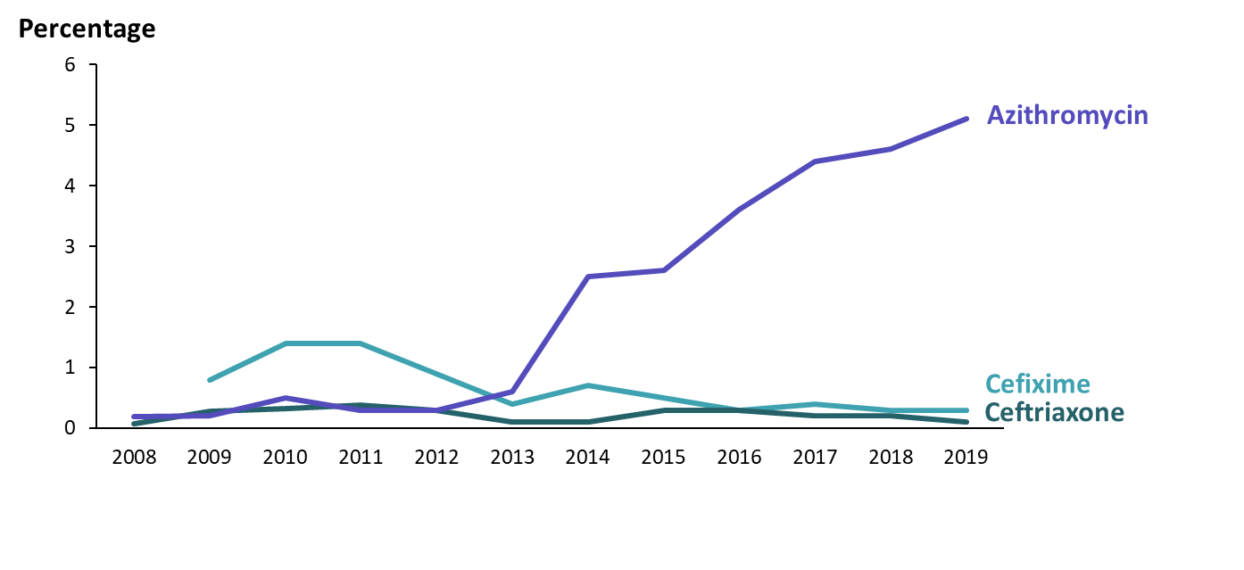
Percentage of Neisseria gonorrhoeae with Elevated Azithromycin, Cefixime, or Ceftriaxone MICs by Year, Gonococcal Isolate Surveillance Project, 2008–2019
NOTE: Isolates not tested for cefixime susceptibility in 2008. Elevated cefixime MICs ≥0.25 µg/ml; elevated ceftriaxone MICs ≥0.125 µg/ml;
Notes:
Then what happened? This next set of slides shows the proportion of Neisseria gonorrhoeae isolates with elevated azithromycin, cefixime, or ceftriaxone MICs.
These data are from the Gonococcal Isolate Surveillance Project, or GISP, which has monitored Neisseria gonorrhoeae antibiotic susceptibility since 1986
As a reminder, elevated MICs can be precursor for resistance, and increasing proportions of isolates with elevated MICs suggest emerging resistance.

Slide 58
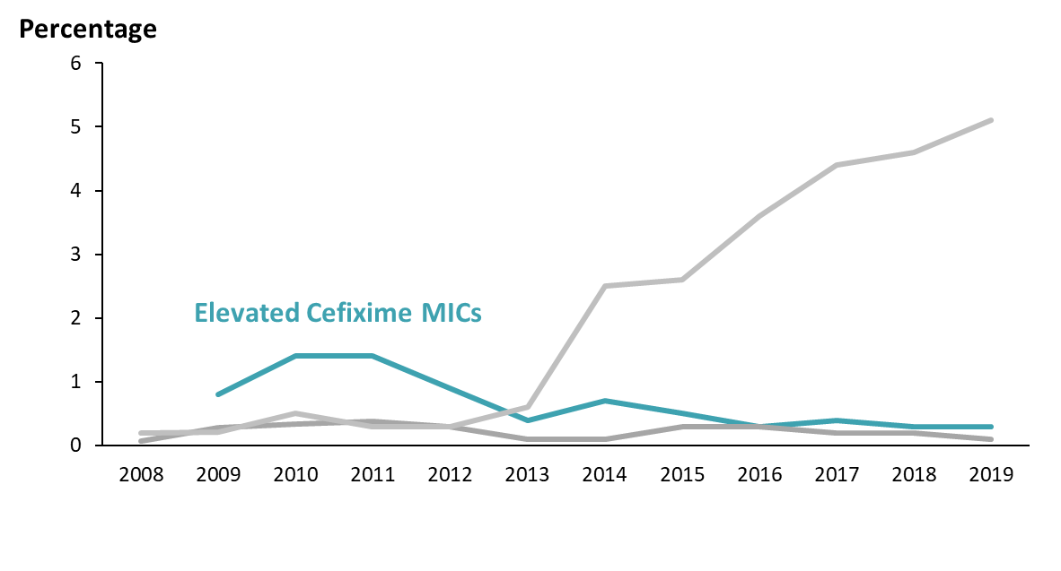
Percentage of Neisseria gonorrhoeae with Elevated Azithromycin, Cefixime, or Ceftriaxone MICs by Year, Gonococcal Isolate Surveillance Project, 2008–2019
NOTE: Isolates not tested for cefixime susceptibility in 2008. Elevated cefixime MICs ≥0.25 µg/ml; elevated ceftriaxone MICs ≥0.125 µg/ml;
Notes:
In the early 2000s, increasing cefixime MICs were reported from Asia.
In 2009 and 2010, the proportion with elevated cefixime MICs began increasing
In 2010, treatment guidelines were changed to recommend 2 drugs for gonorrhea treatment, a cephalosporin PLUS either azithromycin or doxycycline. And the ceftriaxone dose was increased.
In 2012, treatment guidelines were again changed to no longer recommend cefixime, and to only recommend ceftriaxone PLUS azithromycin for gonorrhea treatment

Slide 59
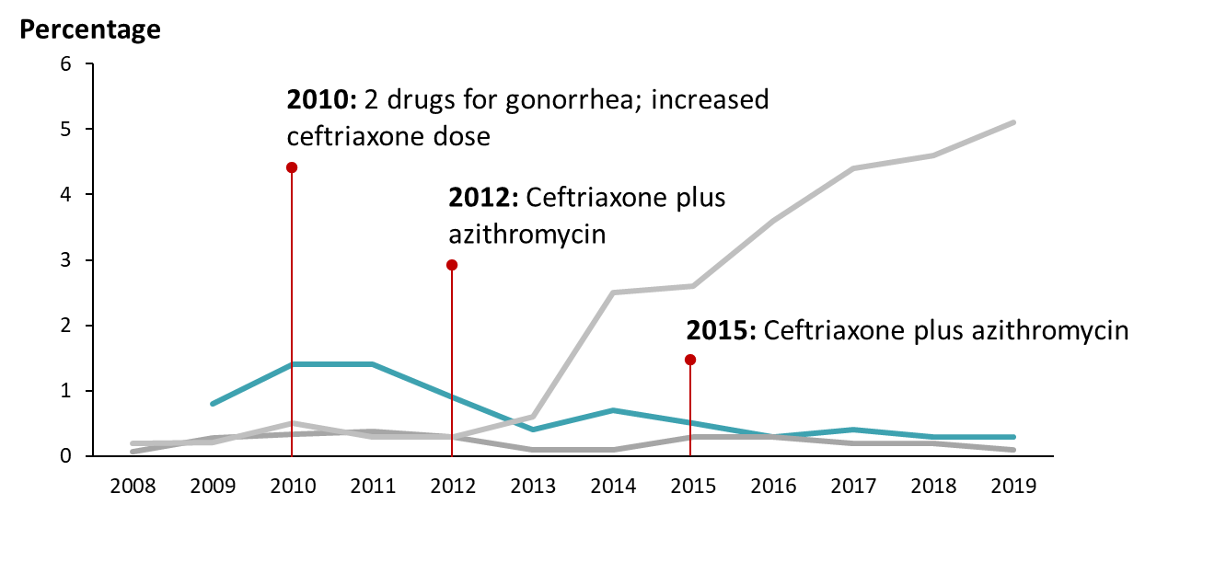
Percentage of Neisseria gonorrhoeae with Elevated Azithromycin, Cefixime, or Ceftriaxone MICs by year, Gonococcal Isolate Surveillance Project, 2008–2019
NOTE: Isolates not tested for cefixime susceptibility in 2008. Elevated cefixime MICs ≥0.25 µg/ml; elevated ceftriaxone MICs ≥0.125 µg/ml;
Notes:
In the early 2000s, increasing cefixime MICs were reported from Asia.
In 2009 and 2010, the proportion with elevated cefixime MICs began increasing
In 2010, treatment guidelines were changed to recommend 2 drugs for gonorrhea treatment, a cephalosporin PLUS either azithromycin or doxycycline. And the ceftriaxone dose was increased.
In 2012, treatment guidelines were again changed to no longer recommend cefixime, and to only recommend ceftriaxone PLUS azithromycin for gonorrhea treatment
The recommendation was reinforced in the 2015 guidelines
The proportion of isolates with elevated cefixime MICs declined and has remained low.

Slide 60
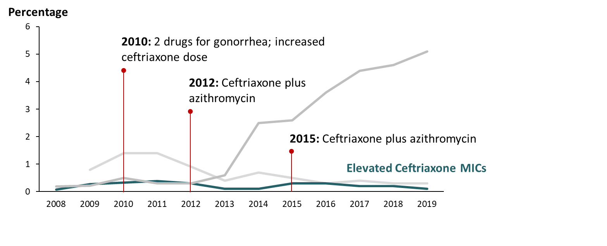
Percentage of Neisseria gonorrhoeae with Elevated Azithromycin, Cefixime, or Ceftriaxone MICs by Year, Gonococcal Isolate Surveillance Project, 2008–2019
NOTE: Isolates not tested for cefixime susceptibility in 2008. Elevated cefixime MICs ≥0.25 µg/ml; elevated ceftriaxone MICs ≥0.125 µg/ml;
Notes:
The proportion of GISP isolates with elevated ceftriaxone MICs, seen in deep teal, has also remained low.

Slide 61
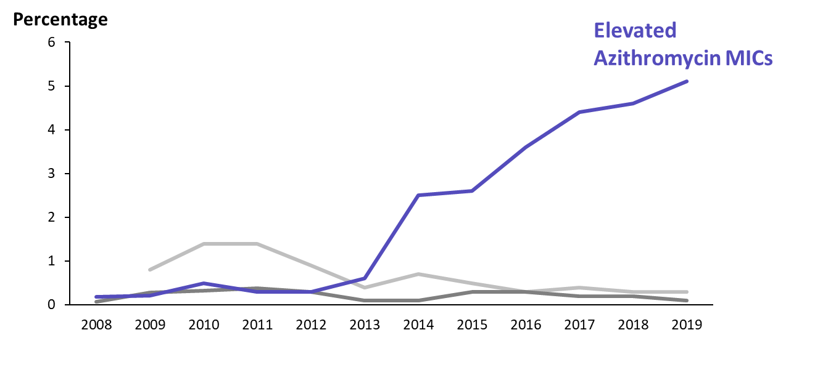
Percentage of Neisseria gonorrhoeae with Elevated Azithromycin, Cefixime, or Ceftriaxone MICs by Year, Gonococcal Isolate Surveillance Project, 2008–2019
NOTE: Isolates not tested for cefixime susceptibility in 2008. Elevated cefixime MICs ≥0.25 µg/ml; elevated ceftriaxone MICs ≥0.125 µg/ml;
Notes:
Around 2014, the percentage with elevated azithromycin MICs began increasing sharply.

Slide 62
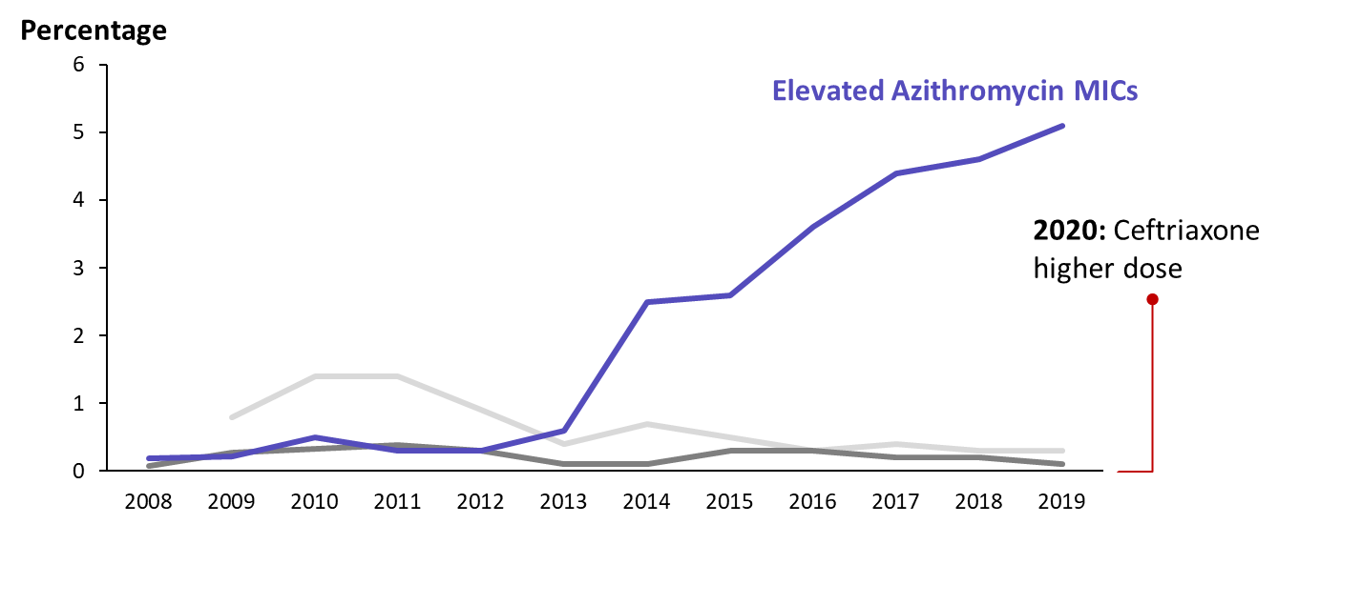
Percentage of Neisseria gonorrhoeae with Elevated Azithromycin, Cefixime, Or Ceftriaxone MICs by Year, Gonococcal Isolate Surveillance Project, 2008–2019
NOTE: Isolates not tested for cefixime susceptibility in 2008. Elevated cefixime MICs ≥0.25 µg/ml; elevated ceftriaxone MICs ≥0.125 µg/ml;
Notes:
Around 2014, the percentage with elevated azithromycin MICs began increasing sharply.
In the 2020 updated CDC Treatment guidelines, azithromycin co-treatment was no longer recommended and the dose of ceftriaxone was increased to 500 mg.
----------
Generally, the isolates with elevated azithromycin MICs have been fully susceptible to cephalosporins.

Slide 63
Cluster of Neisseria gonorrhoeae Isolates with High-level Azithromycin Resistance and Decreased Ceftriaxone Susceptibility, Hawaii, 2016
High-level Azithromycin Resistance (MIC ≥256) AND
Elevated Ceftriaxone MICs (MIC ≥0.125)
Notes:
But we saw a warning sign in 2016 that this might not always be the case.
In 2016, the Hawaii Department of Health identified a cluster of isolates with high level azithromycin AND elevated ceftriaxone MICs in 7 patients (6 males and 1 female). All 7 patients were symptomatic with dysuria, penile discharge, or vaginal discharge at the time of specimen collection.

Slide 64
Cluster of Neisseria gonorrhoeae Isolates with High-level Azithromycin Resistance and Decreased Ceftriaxone Susceptibility, Hawaii, 2016 Cont.
High-level Azithromycin Resistance (MIC ≥256) AND
Elevated Ceftriaxone MICs (MIC ≥0.125)
All cured with ceftriaxone 250 mg/azithromycin 1g
Notes:
Fortunately, all the affected patients were cured with the treatment regimen that was recommended at the time – ceftriaxone 250 mg and azithromycin 1 g
Four of the 7 named partners were found and treated.
The strain was not detected in Hawaii again

Slide 65
Gonorrhoea Treatment Failure Caused by a Neisseria gonorrhoeae Strain with Combined Ceftriaxone and High-level Azithromycin Resistance, England, February 2018 Rapid Communication
MSW with urethritis
Still infected at pharynx despite ceftriaxone 1g & doxycycline
High-level azithromycin resistance (MIC ≥256) AND ceftriaxone-RS (MIC 0.5)
Pharyngeal infection cured with IV ertapenem
Notes:
The next few slides will provide a snapshot of a few recent resistant cases.
In 2018, a man with urethritis presented for care in England. He was also found to have pharyngeal gonorrhea. Despite treatment with ceftriaxone 1 g and doxycycline, his pharyngeal infection was not cure. The isolate from his throat demonstrated high level azithromycin resistance and reduced ceftriaxone susceptibility.
The infection was eventually cured with intravenous ertapenem, which is an antibiotic that is used in hospitals for highly resistant infections.

Slide 66
Gonorrhoea Treatment Failure Caused by a Neisseria gonorrhoeae Strain with Combined Ceftriaxone and High-level Azithromycin Resistance, England, February 2018 Cont. Rapid Communication
MSW with urethritis
Still infected at pharynx despite ceftriaxone 1g & doxycycline
High-level azithromycin resistance (MIC ≥256) AND ceftriaxone-RS (MIC 0.5)
Pharyngeal infection cured with IV ertapenem
Had sex with female partner during recent travel to Southeast Asia
Notes:
He reported having had sex with a woman during his recent travel to Southeast Asia

Slide 67
Gonorrhoea Treatment Failure Caused by a Neisseria gonorrhoeae Strain with Combined Ceftriaxone and High-level Azithromycin Resistance, England, February 2018 Cont. Rapid Communication
MSW with urethritis
Still infected at pharynx despite ceftriaxone 1g & doxycycline
High-level azithromycin resistance (MIC ≥256) AND ceftriaxone-RS (MIC 0.5)
Pharyngeal infection cured with IV ertapenem
Had sex with female partner during recent travel to Southeast Asia
2 similar cases then identified in Australia
Notes:
2 similar cases were then identified in Australia

Slide 68
Resistant Cases in England
Notes:
In 2019, resistant cases were identified in England, with travel connections to Ibiza, Spain.

Slide 69
Resistant Cases in England Cont.
Women 1
Presented to SHC with urinary symptoms
4 male partners while in Ibiza, Spain
Ceftriaxone MIC 1.0, Azithromycin MIC 0.5
Pen-, Tet-, and Cipro-resistant
Cured with ceftriaxone 500 mg/azithro 1 g
Public Health England (PHE) unable to contact any partners
Eyre DW et al. Eurosurveillance 2019
MIC=minimum inhibitory concentration; SHC=Sexual Health Clinic
Notes:
A woman presented to a sexual health clinic with urinary symptoms. She reported having had 4 male partners while in Ibiza for vacation. The gonococcal isolate had a high ceftriaxone MIC of 1 and was resistant to penicillin, tetracycline, and ciprofloxacin, antibiotics that were formerly recommended or used for gonorrhea treatment.
She was cured with ceftriaxone 500 mg and azithromycin 1 g. Her partners couldn’t be contacted.

Slide 70
Resistant Cases in England Cont.
Women 1
Presented to SHC with urinary symptoms
4 male partners while in Ibiza, Spain
Ceftriaxone MIC 1.0, Azithromycin MIC 0.5
Pen-, Tet-, and Cipro-resistant
Cured with ceftriaxone 500 mg/azithro 1 g
Public Health England (PHE) unable to contact any partners
Women 2
Asymptomatic initially, then rectal symptoms
Recent male partner spent 6 months in Ibiza
Same MICs as Case 1
Not cured w/ ceftriaxone 1 g OR gentamicin 240 IM/azithromycin 2 g
Cured with IV ertapenem x 3 days
Eyre DW et al. Eurosurveillance 2019
MIC=minimum inhibitory concentration; SHC=Sexual Health Clinic
Notes:
Then a 2nd woman with the same strain was identified. She developed rectal symptoms. She hadn’t traveled, but her partner just returned from 6 months in Ibiza. Her isolate had the same MICs. However, she was not cured after getting ceftriaxone and then getting another drug called gentamicin. Like the patient earlier, she was cured after getting intravenous ertapenem for 3 days.
In the 1990s, gonorrhea could be treated with a single dose of an oral drug. These cases raise concern that, if resistance continues to emerge and new drugs aren’t introduced, gonorrhea might require intravenous treatment in the future.

Slide 71
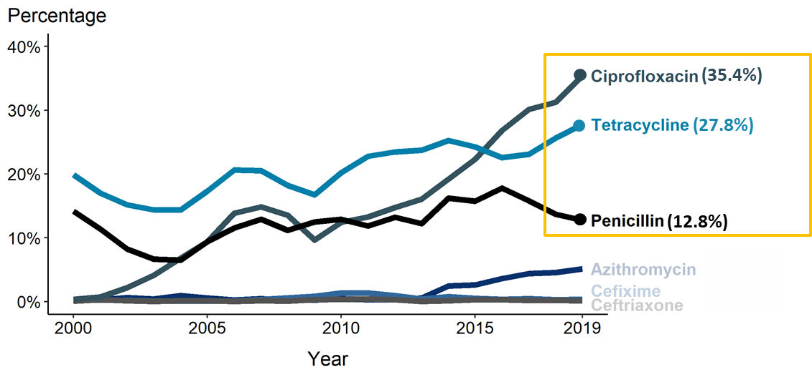
Prevalence of Tetracycline, Penicillin, or Fluoroquinolone Resistance* or Elevated Cefixime, Ceftriaxone, or Azithromycin Minimum Inhibitory Concentrations (MICs)† — Gonococcal Isolate Surveillance Project (GISP), 2000–2019
* Resistance = Fluoroquinolone (ciprofloxacin): MIC ≥ 1.0 µg/mL; Penicillin: MIC ≥ 2.0 µg/mL or Beta-lactamase positive; Tetracycline: MIC ≥ 2.0 µg/mL.
† Elevated MICs = Azithromycin: MIC ≥ 1.0 µg/mL (2000–2004), MIC ≥ 2.0 µg/mL (2005–2019); Ceftriaxone: MIC ≥ 0.125 µg/mL; Cefixime: MIC ≥ 0.25 µg/mL.
NOTE: Cefixime susceptibility was not tested in 2007 and 2008.
Notes:
Often people ask whether we can just solve the problem by using older drugs, such as penicillin, again for empiric treatment
These are also data from GISP and show that once Neisseria gonorrhoeae develops resistance to a drug, it has tended to hold onto that resistance. The proportion of isolates with resistance to ciprofloxacin, tetracycline, or penicillin remains high
----------------
Note from source: Line graph showing the prevalence of tetracycline, penicillin, or fluoroquinolone resistance or elevated cefixime, ceftriaxone, or azithromycin minimum inhibitory concentrations among Neisseria gonorrhoeae isolates by year from 2000 to 2018. In 2018, 31.2% of Neisseria gonorrhoeae isolates collected from GISP sites were resistant to ciprofloxacin, 25.6% to tetracycline, and 13.7% to penicillin.

Slide 72
As Resistance Emerges, the Antibiotic Pipeline Has Been Running Dry
Very few new antibiotics are being developed
Encouragingly, two new antibiotics fared well in Phase 2 trials for gonorrhea treatment
Gepotidacin, Zoliflodacin
Commercial availability not imminent
Notes:
So we’ve reviewed how the prevalence of resistance is high to previously recommended antibiotics and that resistance may be emerging to the currently recommended antibiotic
A huge challenge is that even as resistance is emerging, the antibiotic pipeline has been running dry.
Very few new antibiotics are being developed. In the past decade, government investment and incentives have spurred development.
And encouragingly, there are 2 new antibiotics under investigation that have fared well in Phase 2 clinical trials for gonorrhea treatment: Gepotidacin (JEP – oh – ti – DAY- sin) and Zoliflodacin (ZOE-lee-flow-DAY-sin)
But both are still in the clinical trial phase and commercial availability is not imminent.
So we are in the position of having a single recommended drug for gonorrhea treatment and the storm clouds of resistance are on the horizon.

Slide 73
Clinical and Programmatic Responses to GC Resistance
Notes:
There are many things that we can do now to slow the spread of ceftriaxone resistance when it does emerge and to mitigate the impact. The last section I will cover is about clinical and programmatic responses to gonorrhea resistance.

Slide 74
There Are Several Ways that a Resistant Infection May Be Identified
Clinical treatment failures
A patient whose symptoms do not resolve after receiving recommended treatment
A patient whose lab tests for gonorrhea remain positive after receiving treatment
Laboratory-identified
AST results from an infection demonstrate elevated MICs
Notes:
For this presentation and for the purposes of the tabletop exercise, we will focus on detection of a resistant infection. If a resistant infection can be rapidly identified, that will give you the best chance of containing it or at least to slowing its spread and mitigating the impact.
There are several ways that a resistant infection may be identified.
A patient with a resistant infection may experience treatment failure,
This could be a patient whose symptoms of gonorrhea do not resolve after receiving recommended treatment
OR
A patient whose lab tests for gonorrhea remain positive after receiving treatment
Or resistance may be detected through laboratory testing if susceptibility testing is performed
Antibiotic susceptibility testing (AST) results from an infection demonstrate elevated MICS – as we discussed earlier.

Slide 75
Suspected Cephalosporin Treatment Failure
Persistence of N. gonorrhoeae infection despite appropriate ceftriaxone-based treatment (and patient was not re-infected)
Consider when:
Symptoms do not resolve within 3-5 days after appropriate treatment and no sexual contact after treatment
OR
Positive test-of-cure (positive culture 72+ hours or positive NAAT 7+ days after treatment and no sexual contact after treatment
Notes:
When should a clinician suspect a treatment failure may have occurred?
When there is persistence of Neisseria gonorrhoeae infection despite appropriate ceftriaxone-based treatment and the patient was not reinfected.
Have vigilance and consider when
A patient’s symptoms do not resolve within 3-5 days after appropriate treatment and no sexual contact occurred after treatment (i.e., the patient did not have sex and did not get reinfected)
Or
There is a positive test of cure. In a test of cure, a patient is re-tested 7-14 days after treatment to ensure that the patient was cured. If there is a positive culture test 72 hours after treatment or a positive NAAT test 7+ days after treatment, and there was no sexual contact, then this would be considered a positive test of cure. The patient may still have gonorrhea despite treatment.

Slide 76
CDC STD Treatment Guidelines, 2015 Initial Management of Possible Treatment Failure
Clinician
Take a good sexual history (did the patient have sex after treatment?)
Collect specimens for gonorrhea culture/AST and NAATs from all exposed sites
Test for other STDs
Consult infectious disease specialist, Health Dept (HD) STD program, or STD/HIV Prevention & Training Center (PTC) (nnptc.org)
Notify the Health Dept STD program
Have patient return for test of cure (TOC)
Encourage the patient to cooperate with the HD on partner services (contact tracing)
Health Department (HD)
Prioritize notification and testing of partners
Report case to CDC
Notes:
If there is a possible treatment failure, what should be done?
Clinicians are encouraged to take a good sexual history from the patient. The history should focus on whether the patient had sex after treatment, but can also include the gender of sex partners and the type of sex that the patient has had (to know which anatomic sites should be tested).
Collect specimens for culture (and subsequent AST) and NAATs from all exposed anatomic sites
Because persistent symptoms might be caused by other STDs, it’s a good idea to test for other possible infections
Consult an infectious disease specialist, the health department STD program, or the STD/HIV Prevention Training Center in your region.
Notify the health department STD program
Have the patient return for a test of cure
And encourage the patient to cooperate with the HD STD program on contacting their partners
Health Department STD programs are encouraged to prioritize partner services for such patients, with notification and testing (ideally NAATs and cultures) of partners
And please promptly notify CDC ----
But at this stage, it’s important to remember that possible treatment failures might not be due to resistance. They could be due to re-infections, infections with other STDs, or false-positive tests of cure. Several of the steps outlined above are meant to figure this out.

Slide 77
CDC STD Treatment Guidelines, 2015 Management if High Suspicion of Resistance
Clinician
Collect specimens for culture and AST from all exposed sites
Test for other STDs that might cause the symptoms
Notify health department
Contact CDC for guidance with treatment (in collaboration with health department)
Consider gentamicin 240 mg IM/azithromycin 2g (not reliable for pharyngeal infections)
Have patient return for test of cure (TOC) with culture
Ensure recent sex partners are evaluated and treated, encourage patient’s cooperation with HD on partner services
Health Department (HD)
Ensure recent sex partners are evaluated and treated
Notify CDC
Think about communications
Notes:
But what if you have a high suspicion that the patient has a resistant infection?
Perhaps the patient’s description of their symptoms and sexual history or the AST results point strongly to resistance.
Collect specimens for gonorrhea testing, especially culture and susceptibility testing
Test for other STDs
Through the health department, contact CDC for guidance on treatment. There are no clear data to guide the treatment decision. If not a pharyngeal infection, an option includes gentamicin and azithromycin. CDC is available and would like to be involved in the decision if possible
Have the patient return for a test of cure
To prevent or slow the spread and reduce the risk of re-infection of the patient and complications from gonorrhea among the partners, ensure partners are evaluated and treated. Work with the health department on this and encourage the patient to cooperate with the health department by providing information about their recent partners
Health departments can ensure recent sex partners are evaluated and treated
Notify CDC
And think about whether to, when, and how to communicate to stakeholders

Slide 78
Programmatic and Laboratory Guidance
Local and state STD programs are encouraged to develop local response plans
Interview suspected ceftriaxone-resistant cases, ensure adequate treatment for patient and recent partners
Local & state public health lab directors are encouraged to maintain culture and AST capabilities, or if not, to identify other labs in their area with such capacity
Labs that conduct AST are asked to promptly notify ordering clinician and HD STD program about elevated ceftriaxone MICs
Isolates with high ceftriaxone MICs should be submitted to CDC for AST reference testing
Sources: https://www.ncbi.nlm.nih.gov/pmc/articles/PMC4604802/; https://www.cdc.gov/mmwr/preview/mmwrhTml/rr6302a1.htm
Notes:
In preparation for the detection of a resistant infection
Local and state STD programs are encouraged to develop local response plans
The foundation of the plans should be how to interview suspected cases and ensure adequate treatment for the patient and their recent partners
Local and state public health lab directors are encouraged to maintain culture and AST capabilities themselves or at least to identify other laboratories with this capacity with which they can develop MOUs and send specimens. SOPs and protocols can be developed ahead of time.
Labs that conduct AST are asked to promptly notify the ordering clinician and HD STD program about elevated ceftriaxone MICs detected in the laboratory
Isolates with high ceftriaxone MICs should be submitted to CDC for reference testing.

Slide 79
Considerations for Establishing Culture and AST Locally
It takes time (weeks to months) to establish procedures, train staff, ensure accuracy of results
Laboratory needs CO2 incubator, supplies
Notes:
It’s never too early to start establishing gonorrhea culture and AST locally
It can take weeks to months to establish procedures, train staff, and ensure accuracy of results.
To receive culture specimens, the laboratory will need a CO2 incubator and others supplies.

Slide 80
There Are Several Options for Getting Specimens to a Laboratory for Culture
Candle jar
InTray
BBL swabs
Jembec with CO₂ Capsules
ESwab Liquid Amies Media
Others
Notes:
The laboratory can also collaborate with the health department STD program to figure out routing of specimens from clinicians.
In terms of the culture specimen itself, there are several options for getting a viable specimen to the laboratory for culture.
One is the use of a candle jar – which provides a CO2 enriched environment.
The culture plate is placed into the jar with a lit candle and sealed.
Other options include InTray, which is a small self-contained culture plate with a CO2 capsule
BBL culture swabs
Jembec systems with CO2 capsules
ESwab liquid amies media
And others

Slide 81
Summary
Gonorrhea rates increasing, resistance emerging, and antibiotic pipeline has been running dry
Difficulty treating gonorrhea will result in increasing complications and thwarting prevention/control
CDC-recommended treatment still highly effective for circulating strains, but emerging resistance threatens effectiveness
Planning now may mitigate the public health impact of resistant infections and might slow spread
Notes:
In summary
Gonorrhea rates are increasing, resistance to our only remaining recommended antibiotic may be emerging, and the antibiotic pipeline is running dry
Difficulty treating gonorrhea will result in increasing complications and thwarting of prevention and control efforts
CDC recommended treatment is still highly effective, but emerging resistance threatens effectiveness
Planning now may mitigate the public health impact of resistance and slow the spread of resistant infections

Slide 82
Questions

