Slide 1
Teen Pregnancy Prevention:
Application of CDC’s Evidence-Based Contraception Guidance
Division of Reproductive Health
Centers for Disease Control and Prevention
November 1, 2013
National Center for Chronic Disease Prevention and Health Promotion
Division of Reproductive Health
Notes:
This presentation will provide an overview of the current trends in teen pregnancy as well as the efforts providers can make to increase use of effective contraception according to the CDC’s Evidence-Based Contraception Guidance

Slide 2
Learning Objectives
Participants will be able to:
Review the trends in teen pregnancy, sexual behavior and contraceptive use
Describe current contraceptive methods available to teens
Describe the current evidence-based recommendations about the safety and effectiveness of contraceptive methods for teens

Slide 3
SECTION I.
Trends in teen pregnancy , SEXUAL Behavior and contraceptive use

Slide 4
Current Trends
Pregnancy, birth and abortion rates are declining in the U.S. for teens aged 15-19 years old
Teen birth rates vary by age, race/ethnicity and state
The U.S. still has the highest teen birth rate of any industrialized country
Teens use less effective methods and use these methods inconsistently

Slide 5
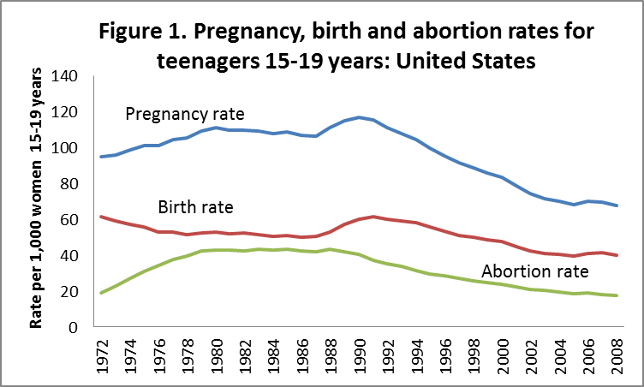
Pregnancy, birth and abortion rates for teens, 15-19 years old
Kost K and Henshaw S, U.S. Teenage Pregnancies, Births and Abortions, 2008: National Trends by Age, Race and Ethnicity, 2012.
Notes:
This graph compiled by the Guttmacher Institute shows pregnancy, birth and abortion rates for teens ages 15-19 years old in the United States from 1972 through 2008
Overall pregnancy, birth and abortion rates for 15-19 year olds are declining
Still in 2008 there were nearly 750,000 pregnancies to women <20 years old, a rate of 67.8 per 1000 women 15-19yo
Of these pregnancies, 59% ended in birth and 26% ended in abortion
<http://www.guttmacher.org/pubs/USTPtrends08.pdf>
www.TheNationalCampaign.org

Slide 6

Adolescent pregnancy in U.S.
3 in 10 adolescent girls
will become pregnant by age 20
The National Campaign to Prevent Teen and Unplanned Pregnancy, February 2011. http://www.thenationalcampaign.org/resources/pdf/FastFacts_3in10.pdf

Slide 7
Adolescent pregnancy in U.S.
5 in 10 black and Hispanic girls
will become pregnant by age 20
The National Campaign to Prevent Teen and Unplanned Pregnancy, February 2011. http://www.thenationalcampaign.org/resources/pdf/FastFacts_3in10.pdf

Slide 8
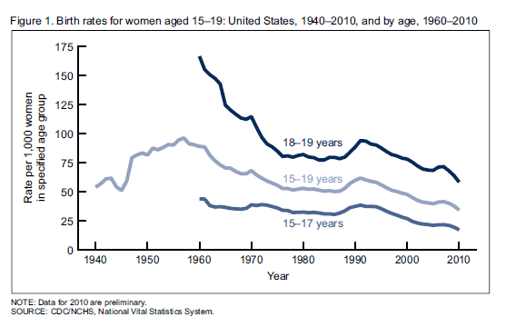
Teen Birth Rate by Age
Notes:
This graph shows birth rates for females 15-17, 15-19 and 18-19 years old from 1940 through 2010 according to 2011 Preliminary Birth Data from the National Center for Health Statistics.
The birth rate dropped 2% in 2008 (prelim), after increases seen in 2006 and 2007.
Overall, from 1991 to 1010 the teen birth rate has decreased 45% and is at a historic low.

Slide 9
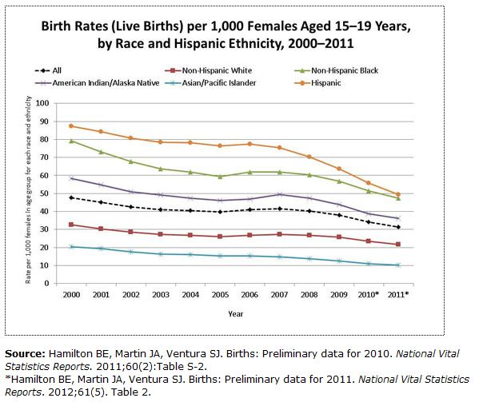
Teen Birth Rate by Race and Ethnicity
Notes:
This graph shows the teen birth rates according to race and hispanic ethnicity for females, 15-19 years old from 2000 through 2011.
The highest rates are for hispanic and non-hispanic blacks.
Rates for all races are also at historic lows.

Slide 10
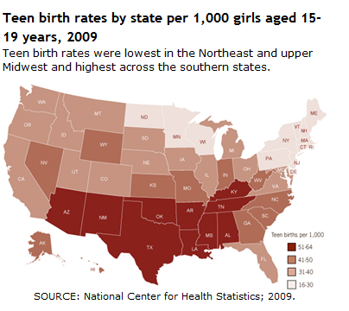
Notes:
This is a map of the United States representing teen birth rates, by state, 2009.
Teen Birth rates were lowest in the northeast and upper midwest and highest across the southern states.
The states in red have teen birth rates of 51-64 per 1000 women aged 15-19 years.
The states in light grey have rates of 16-30 teen births per 1000 women aged 15-19 years.

Slide 11
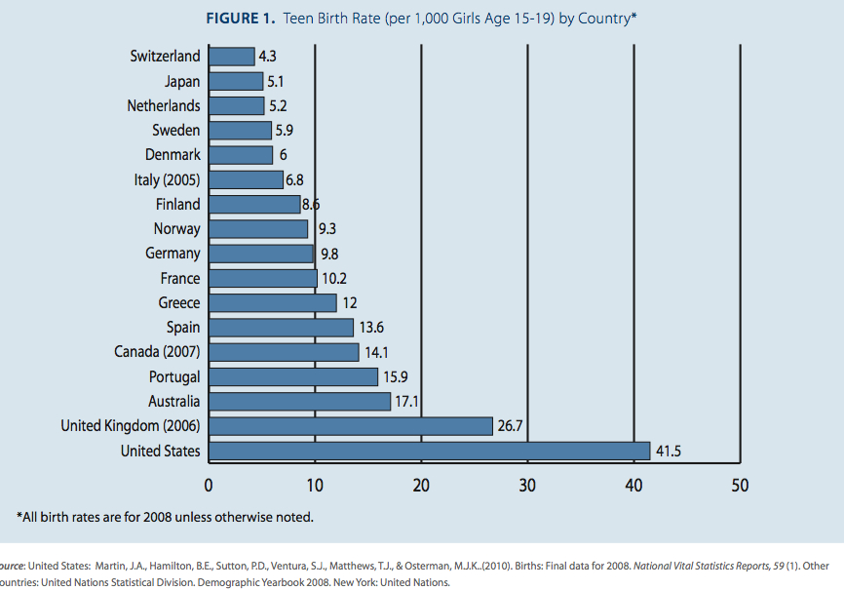
Teen Birth Rate (per 1,000 females, 15-19 years old) by Country
www.TheNationalCampaign.org
Notes:
This graph shows the teen birth rates per 1000 women aged 15-19 years by country.
All birth rates are for 2008 unless otherwise noted.
Though rates have been declining, the US still has the highest teen birth rate (ages 15-19), 6-9 times that of other developed countries.
In 2008, there were 41.5 births per 1000 female teenagers ages 15-19 in the U.S. and that rate has decreased to 34.3 per 1000 female teenagers in 2010.
This is much higher than the highest rate in Europe-- 26.7 births per 1000 female teenagers in the UK, and almost 10 times the lowest rate in Switzerland.

Slide 12
Percent of pregnancies that are unintended
U.S., 2006
Finer, Contraception, 2011;84:478.
Notes:
This graph shows the percent of pregnancies that were unintended in the US in 2006 categorized into age.
49% of all pregnancies in the US are unintended.
Percentages are highest among younger age groups with more than 4 out of five pregnancies being unintended among women age 19 and younger.
Specifically, among women less than 15 and 15-19, 98% and 82% respectively are unintended.

Slide 13
Consequences
Infant
  Prematurity
  Infant mortality
  Abuse
  Future teen pregnancy
Teen Mom
  Low educational attainment
  Unemployment
  Poverty
  Risk for repeat pregnancy
Society
  $9.1 billion in 2004
Santelli and Melnikas, 2010
http://www.guttmacher.org/pubs/FB-ATSRH.html
Klein, JD and the Committee on Adolescence, 2006
Notes:
Significant consequences result for the infant, teen mother and society as a whole.
The risks of poor neonatal outcomes such as a low birth weight infant, preterm delivery or neonatal death are more than double the risk for an adult woman.
Children of teen mothers are more likely to be subject to abuse and neglect.
As many as 60% of those who become pregnant in early or mid adolescence have a history of childhood sexual or physical abuse and that cycle also may repeat itself.
At least one-third of parenting adolescents of both sexes are themselves products of adolescent pregnancy.
Fewer than 2% of teens who give birth before age 18 will graduate from college by age 30.
Teen mothers are also more likely to come from poverty and have higher rates of school dropout.
Teen mothers are also at risk for repeat pregnancy and over 15% of teen births are repeat pregnancies.
Teen childbirth cost the US $9.1 billion in 2004 according to the National Campaign to Prevent Teen Pregnancy.

Slide 14
Goals of Teen Pregnancy Prevention
Decrease pregnancies among female teens
Delay initiation of teen sexual activity
Increase use of effective contraceptive methods
http://www.cdc.gov/winnablebattles/Goals.html
Notes:
Teen Pregnancy Prevention Goals are to:
Decrease pregnancies among female teens
Delay initiation of teen sexual activity
Increase use of contraception, particularly long-acting, reversible methods, among sexually active teens

Slide 15

Percentage of High School Students Who Ever Had Sexual Intercourse, by Sex* and Race/Ethnicity,† 2011
* M > F
† B > H > W
National Youth Risk Behavior Survey, 2011
Notes:
This graph shows the percentage of high school students in 2011 who have ever had sexual intercourse by sex and race/ethnicity.
47.4% of all high school students surveyed had ever had sexual intercourse.
The prevalence of having ever had sexual intercourse was 45.6% among female students and 49.2% among male students.
The prevalence of having ever had sexual intercourse was higher among black (60.0%) than Hispanic (48.6%) students and higher among Hispanic than white (44.3%) students.
50% of adolescent pregnancies occur within the first 6 months of coitarche. (Haffner ed. Facing Facts 1995)

Slide 16

Percentage of High School Students Who Were Currently Sexually Active,* by Sex and Race/Ethnicity,† 2011
* Had sexual intercourse with at least one person during the 3 months before the survey.
† B > W, H
National Youth Risk Behavior Survey, 2011
Notes:
This graph shows the percentage of high school students who were currently sexually active or had had sexual intercourse with at least one person during the 3 months before the survey by sex and race/ethnicity.
This data is from the National Youth Risk Behavior Survey, 2011.
33.7% of all high school students surveyed reported current sexually activity.
The prevalence of being currently sexually active was 34.2% among female students and 33.3% among male students.
The prevalence of being currently sexually active was higher among black (41.3%) than white (32.4%) and Hispanic (33.5%) students.

Slide 17
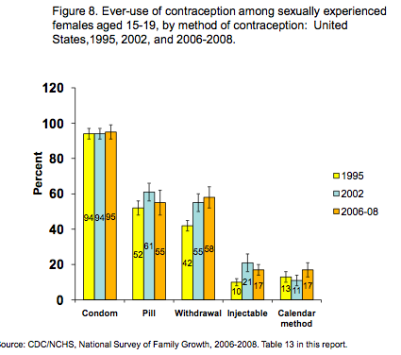
Use of contraception among sexually experienced females, 15-19 years old
Notes:
This graph shows ever-use of contraception among sexually experienced females, 15-19 years old by contraceptive method.
This data is from the National Survey of Family Growth 2006-2008.
Most sexually experienced female teens have ever used contraception with condoms being the most reported (95%), followed by the pill (55%).
Over half (58%) of teens have used withdrawal for contraception.
Less than 20% have used the more effective injectable method.

Slide 18
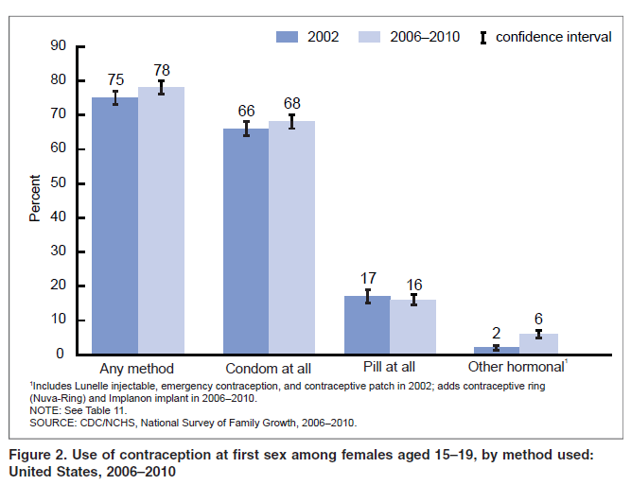
Use of contraception at first sex among females, 15-19 years old
Notes:
This graph shows use of contraception at first sex among females, 15-19 years old.
Use of contraception at first sex among this population has generally increased.
Still, only 2/3s have used a condom at first sex and less than a fifth have used the pill.
Note: Statistics for condom ‘‘at all,’’ pill ‘‘at all,’’ and other hormonal reflect use of that method regardless of whether it was used alone or in combination with another method.

Slide 19
Use of Contraceptive at Last Sex among Teens
Females, 15-19 years old: 86%
Males, 15-19 years old: 93%
Martinez et al., NSFG/NCHS, 2011.
Notes:
The percentage of females and males 15-19 years old that used contraception at last sex has also increased.

Slide 20

Percentage of High School Students Who Used a Condom During Last Sexual Intercourse,* by Sex† and Race/Ethnicity,§ 2011
* Among the 33.7% of students nationwide who were currently sexually active.
† M > F
§ B > H
National Youth Risk Behavior Survey, 2011
Notes:
This graph also depicts data from the National Youth Risk Behavior Survey, 2011 showing the percentage of high school students who used a condom during last intercourse, by sex and race/ethnicity.
Among the 33.7% of high school students surveyed nationwide who were currently sexually active, 60.2% reported that either they or their partner had used a condom during last sexual intercourse.
The prevalence of having used a condom during last sexual intercourse was higher among male (67.0%) compared to female (53.6%) students.
The prevalence of having used a condom during last sexual intercourse was higher among black (65.3%) compared to Hispanic (58.4%) students, and 59.5% among white students.

Slide 21

Impact of inconsistent and non-use of contraception on teen pregnancies
46% due to non-use of contraception
54% due to contraceptive failure
  Effectiveness of method
  Consistent and correct use
Santelli et al., 2006
Notes:
While the majority of teens have used contraception in the past, most are using condoms or pills.
Approximately half of teens who are having sex are not using contraception.
Of the teens who are having sex and using contraception, more than half experience contraceptive failure due to incorrect or inconsistent use or using less effective methods, such as condoms alone or pills.

Slide 22
Declines in Adolescent pregnancy and Unmet Need for contraception
Majority of decline attributable to increased contraceptive use among adolescents
Among adolescents who become pregnant, about half due to contraceptive failure
  Failure of method
  Failure to use correctly and consistently
Santelli, Am J Public Health 2007;97:150.
Santelli, Persp Sex Reprod Health, 2006;38:106.
Notes:
The majority of the decline in adolescent pregnancy is attributable to increased use of contraception among adolescents.
However, it is important to note that among adolescents who become pregnant, about half are due to non-use of contraception and half are due to contraceptive failure. So even if the adolescent is using contraception, she may experience failure of the method itself, or more likely, she may not be using the method correctly and consistently, for example forgetting to take her pill or not using a condom.

Slide 23
Why teen moms did not use contraception
Reason | Percent
Thought could not get pregnant | 31.4
Partner did not want to use contraception | 23.6
Did not mind if got pregnant | 22.1
Trouble getting birth control | 13.1
Side effects from contraception | 9.4
Thought she or partner was sterile | 8.0
CDC, MMWR 2012;61:25.
Notes:
This table shows reasons that women age 15-19 who recently delivered a live birth from an unintended pregnancy did not use contraception.
This data comes from PRAMS (Pregnancy Risk Assessment Monitoring System) from 2004-2008.
The most common reason was that they thought they could not get pregnant.
Almost 25% stated that their partner did not want to use contraception, which likely was a condom.
Pregnancy ambivalence was also a common reason.

Slide 24



Abstinence is the only 100% effective way to prevent HIV, other sexually transmitted infections (STIs), and pregnancy
Notes:
Abstinence is most effective way to prevent HIV other STIs (sexually transmitted infections) and pregnancy.
It should be included in counseling not just for teens who have not yet engaged in sexual intercourse but also as an option for teens who are sexually active but may not have a reliable method available at a given time.

Slide 25
SECTION II.
CONTRACEPTIVE METHODS
Notes:
Objectives for this section are:
Review data on current use of contraceptive methods in the US
Describe the Tier System of Contraceptive Effectiveness
Review the currently available contraceptive methods in the US, including dual protection
Highlight the need for more consistent and effective method use

Slide 26
Use of Specific Methods by females,15-19 years old
Mosher, National Center for Health Statistics. Vital Health Stat 2010;23:29.
Notes:
Of females 15-19 years old who are sexually active, this graph shows the percentage of current method use among those using contraception.
Despite increasing recommendations that adolescents should consider using long-acting reversible contraception or LARC, this graph shows that most adolescents are using the pill or condoms.
Note that less than 4% are using IUDs.
Note: if woman reported using more than 1 method, she was classified by most effective method used, e.g.if she reported using pill and condom, she was classified as pill user.

Slide 27
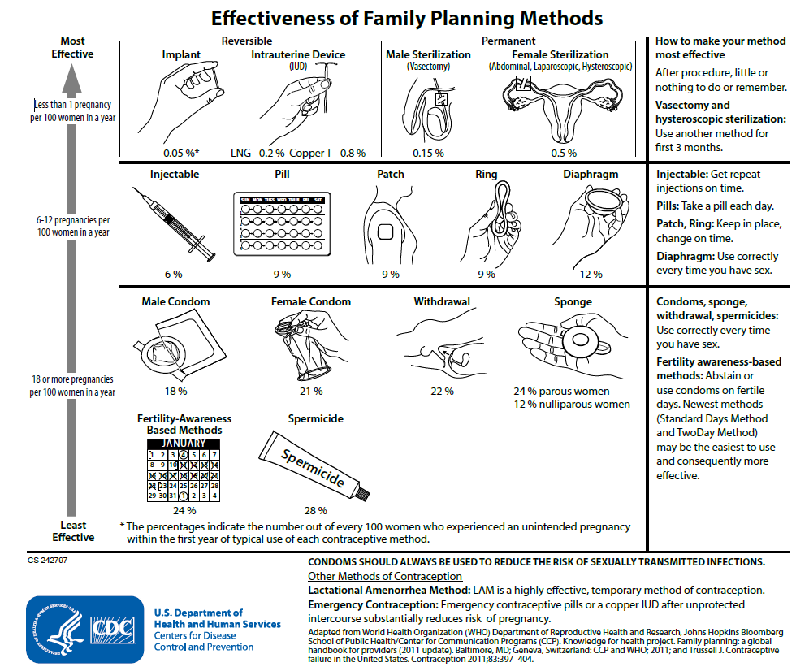
Effectiveness of family planning methods
Tier 1
Tier 2
Tier 3
http://www.cdc.gov/reproductivehealth/UnintendedPregnancy/Contraception.htm
Notes:
This figure shows currently available contraceptive methods, ranked by typical effectiveness, meaning how effective is the method at preventing pregnancy with real-world use.
Incorrect or inconsistent use can impact the effectiveness of the contraceptive method.
In tier 1 are the most effective methods, with less than 1 pregnancy occurring per 100 women per year. The most effective reversible methods include implants and IUDs or intrauterine devices.
Tier 2 methods include injectables, pills, patch, vaginal ring, and diaphragm; failure rates range from 6-12%.
Tier 3 methods include condoms, withdrawal, sponge, spermicide, and fertility awareness based methods; failure rates range from 18-28%.
The more commonly used method among teens, the pill and the condom, are listed in the second and third tier, respectively.

Slide 28
Typical Use and Perfect Use
Typical Use
  Failure rate
  Average person
  Not always consistent or correct
  During first year
Perfect Use
  Failure rate
  Use is consistent and correct
  At every sex act
  During the first year
Trussell, 2011
Notes:
It is important to highlight typical use failure rates when counseling teens on contraception options.
Failure rates during typical use describe the number of pregnancies for the average person who does not always use the method correctly or consistently. This reflects the effectiveness of a method.
Failure rates during perfect use are estimated based on consistent, correct use at every act of intercourse. For pills (combined or progestin-only), the perfect use failure rate is 0.3% compared to the typical use failure rate of 9%. The levonorgestrel intrauterine devise (IUD) is not user-dependent like the pill and therefore, has the same perfect use and typical use failure rate of 0.2%.
Among 100 couples who use no contraception it is estimated that 85 will experience a pregnancy in the first year.
Typical use estimates for most methods are based on the National Survey of Family Growth (spermicides, withdrawal, fertility awareness-based methods, diaphragm, male condom, OCPs and DMPA).
Other estimates were based on previous studies or were extrapolated from similar methods.

Slide 29
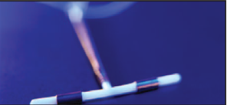
Reversible Tier 1 Methods:
“Most Effective”
Long Acting Reversible Contraception (LARC)
Levonorgestrel-releasing intrauterine system
Copper IUD
Implant
Notes:
While Tier One includes both permanent methods or sterilization and reversible methods, this talk will focus on reversible methods only.
Long-acting reversible contraception (LARC) are highly effective tier one methods that do not impact future fertility and provide easy long-term contraception with typical use failure rates <1%.
In the US, LARCs include two levonorgestrel IUDs and the copper IUD as well as the etonorgestrel implant.

Slide 30
TIER 1 for Adolescents:
Long Acting Reversible Contraception (LARC)
“Forgettable contraception”
Not dependent on compliance/adherence
“Expanding access to LARC for young women has been declared a national priority” (IOM)
“Should be considered as first-line choices for both nulliparous and parous adolescents” (ACOG 2007)
  Finer, et al. Changes in use of long-acting contraceptive methods in the United States, 2007-2009. Fertil Steril 2012.
Notes:
LARCs have been growing in popularity among all contraceptive users, including 15-19 year olds.
While there has been general concern in providing LARCs to young women or nulliparous women, both the Institute of Medicine and ACOG (the American Congress of Obstetricians and Gynecologists) highly recommend LARCs for these at risk populations.
These are easy highly effective methods since they are not user-dependent, also called “forgettable contraception”.

Slide 31
Levonorgestrel IUD
Effective for at least 3 or 5 years
Side effects: irregular bleeding
Reduces dysmenorrhea and menstrual blood loss
Does not protect against STIs
Contraceptive Technology, 20th edition
http://www.accessdata.fda.gov/scripts/cder/drugsatfda
Notes:
There are now two levonorgestrel IUDs FDA-approved in the US.
Mirena was approved in 2000. It initially releases 20ug of levonorgestrel daily and is effective for at least 5 years.
Skyla was recently approved in 2013. It initially releases 14ug of levonorgestrel and is effective for 3 years.
Since the local effects of progesterone cause an atrophic endometrium, side effects include irregular bleeding for the first 3-6 months followed by lighter bleeding or amenorrhea and reduced dysmenorrhea.
Studies with the 5-year IUD show that it may alleviate heavy bleeding from many causes including bleeding diatheses, anticoagulation, fibroids and adenomyosis.
Neither protects against sexually transmitted infections (STIs) and dual protection with condoms should be strongly encouraged.

Slide 32
Copper intrauterine device (IUD)
Approved for 10 years
Effective for at least 12 years
Side effects: irregular bleeding, heavy bleeding
Most effective emergency contraception
Does not protect against STIs
Contraceptive Technology, 20th edition
http://www.accessdata.fda.gov/scripts/cder/drugsatfda
Notes:
The Copper T380A has been FDA-approved since the 1980s and is effective for at least 10 years.
The most common reason for Copper IUD discontinuation is heavier, more painful periods which may decrease over time.
Anticipatory counseling regarding menstrual changes after both IUDs are placed is extremely important and may help with continuation.
The Copper IUD can also be offered for emergency contraception up to 5 days after unprotected intercourse and is more than 99% effective.
The Copper IUD does not protect against STIs and dual protection with condoms should be strongly encouraged.

Slide 33
Contraceptive implant
Effective for at least 3 years
Side effects: irregular bleeding
Does not protect against STIs
Contraceptive Technology, 20th edition
Notes:
There is currently only one contraceptive implant initially called Implanon which was approved in the US in 2006.
The implant has recently been updated to Nexplanon which is an identical etonorgestrel rod that is now radioopaque and has a new inserter.
Etonorgestrel levels remain stable over three years and leads primarily to anovulation. Similarly to the levonorgestrel IUD, it also acts on the uterus to cause an atrophic endometrium and thickens cervical mucus to block sperm penetration.
The effects on the uterine cavity may disrupt menstrual cycles leading to amenorrhea, irregular bleeding or infrequent bleeding and, less often, prolonged or frequent bleeding.
The contraceptive implant does not protect against STIs and dual protection with condoms should be strongly encouraged.

Slide 34
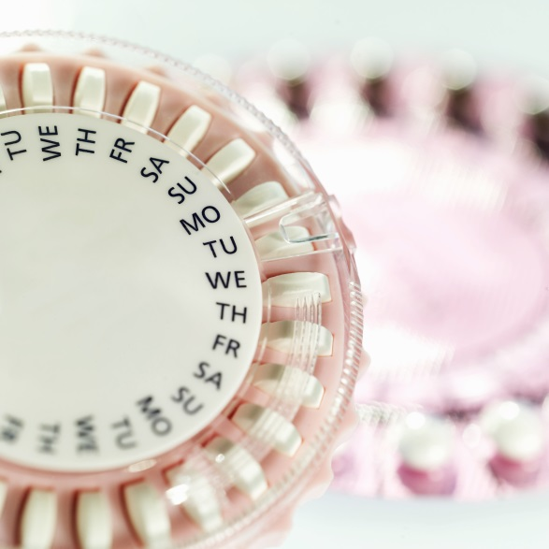
Tier 2 Methods:
“Moderately Effective”
Injectable (DMPA)
Pill
Patch
Ring
Contraceptive Technology, 20th edition
Notes:
The tier 2 methods include the injectable (DMPA), the pill (both combined and progestin-only), the combined hormonal patch and the combined vaginal ring.
These methods have higher typical use failure rates because they require more effort by the user.

Slide 35
Correct and consistent use
Methods that require more effort by the user have higher typical failure rates
Correct and consistent use of pills and condoms may be difficult for all ages
Women ages 18-24, in last 3 months
  45% missed > 1 pill
  62% did not use condoms every time
Frost and Darroch, 2008
Notes:
The most effective method of contraception is the method a woman or couple is most likely to use consistently and correctly.
Correct and consistent use helps close the gap between typical use and perfect use.
Methods that require more effort by the user have higher typical failure rates because there is more room to not use the method correctly and consistently.
Both the pill and condom (which were shown earlier as the most common methods used by teens) are difficult to use correctly and consistently by most users.
In one study that surveyed 2000 women nationwide, found that 45% of young women age 18-45 using pills missed one or more pills in the last 3 months and 62% of those using condoms were not using them every time they had sex.

Slide 36
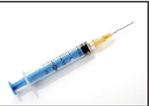
Depot medroxyprogesterone acetate (DMPA)
One injection every 3 months
Reliable contraception for 3 months, but effects may last up to 9 months
Side effects: irregular bleeding and amenorrhea
Does not protect against STIs
Contraceptive Technology, 20th edition
Notes:
Depot medroxyprogesterone acetate, DMPA, Depo, or the shot are all names used for an injectable projestin that is given either intramuscularly or less commonly subcutaneously every 3 months.
Due to the larger dose of systemic hormone, effects on ovulation may last up to 9 months.
Amenorrhea and irregular bleeding again may be a side effect; in one study of teenagers, almost 2/3 reported amenorrhea at 6 months.
DMPA does not protect against STIs and dual protection with condoms should be strongly encouraged.

Slide 37
Contraceptive pills
Combined pills contain estrogen and progestin (COCs)
Progestin-only pills (POPs)
Extended use
Side effects: irregular bleeding
Do not protect against STIs
Contraceptive Technology, 20th edition
Notes:
Contraceptive pills include both combined oral contraceptives (COCs) and progestin-only pills (POPs).
Combined pills are generally dosed over a 28-day cycle with 21 active pills and 7 days of placebo.
POPs are dosed over a 28-day cycle with 28 active pills and no placebo and can be useful for women who are breastfeeding or have other conditions that may not make them candidates for safe estrogen use.
Extended use of combined pills may aid in compliance and can decrease symptoms associated with menses including heavy menstrual bleeding and dysmenorrhea.
OCPs do not protect against STIs and dual protection with condoms should be strongly encouraged.

Slide 38
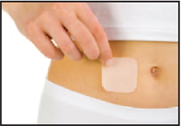
Contraceptive patch
Releases estrogen and progestin
One patch per week for 3 weeks, then 1 patch-free week
Side effects: irregular bleeding
Does not protect against STIs
Contraceptive Technology, 20th edition
Notes:
The contraceptive patch is another combined hormonal contraceptive containing both estrogen and progestin which are delivered transdermally.
The user applies one new patch and removes the old patch each week for three weeks. The last week of the cycle the user does not use a patch and this is generally the time of bleeding.
The patch does not protect against STIs and dual protection with condoms should be strongly encouraged.

Slide 39
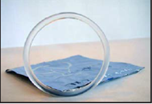
Contraceptive vaginal ring
Releases estrogen and progestin
One ring for 3 weeks, then 1 ring-free week
Side effects: irregular bleeding
Does not protect against STIs
Contraceptive Technology, 20th edition
Notes:
The contraceptive vaginal ring is another combined hormonal contraceptive that delivers estrogen and progestin vaginally.
The user places the plastic ring in the vagina and leaves it in place for 3 weeks. It can be removed in the fourth week at which point bleeding occurs.
The ring does not protect against STIs and dual protection with condoms should be strongly encouraged.

Slide 40
Quick Start
Initiation of contraception on any day of the cycle
More reliable and faster protection from unplanned pregnancies
Advise 7 days of backup or abstinence
Improves short-term continuation
No increase in unscheduled bleeding
Contraceptive Technology, 20th edition
Notes:
Quick start refers to the initiation of contraception on any day of the cycle to allow for more reliable and faster protection from unplanned pregnancies as long as reasonably certain that the woman is not pregnant.
Encourage 7 days of back-up contraception such as condom or abstinence until method takes effect which may vary.
Quick start initiation may improve short-term continuation of combined oral contraceptives and has not been shown to increase unscheduled bleeding.

Slide 41
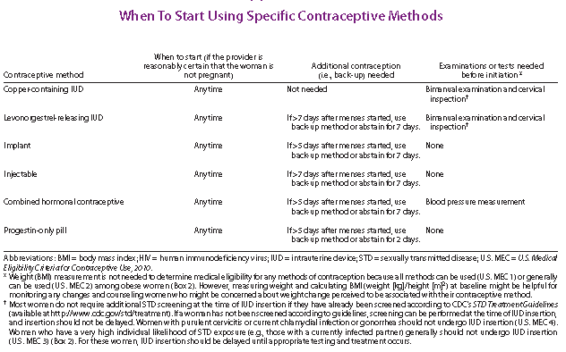
US SPR
Notes:
Thus the recommendation for initiation of CHCs is to use backup or abstain from intercourse for 7 days if the method is initiated greater than 5 days from the start of last menstrual period.
The US SPR also provides guidance both within the document and summarized in a user-friendly chart to guide providers on how to counsel patients on backup needs for all methods.
As you can see from this chart, all methods of contraception can be started at any time, if the provider is reasonably certain the woman is not pregnant.

Slide 42
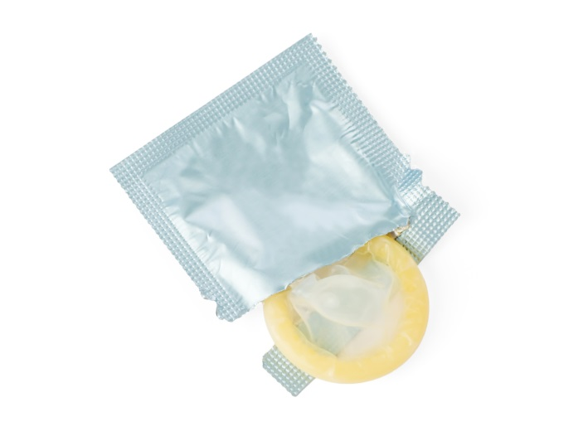
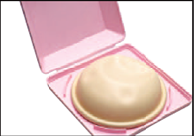
Tier 3:
“Least Effective”
Condoms (male and female)
Diaphragms, cervical cap, sponge
Fertility awareness-based methods
Withdrawal
Spermicides
Contraceptive Technology, 20th edition
Notes:
These are examples of Tier 3 methods, or less effective methods.
These methods require even more effort by the user and have higher typical failure rates.
Correct and consistent use of condoms may be difficult for all ages.
Fertility-based methods refer to a range of techniques used to avoid the fertile window, including rhythm method, cycle beads, basal body temperature, etc.
Given the high incidence of anovulatory cycles in teens, fertility awareness based methods should be used with caution in this population as ovulation can be predicted.
Withdrawal-- or removal of the penis from the vagina prior to ejaculation– and spermicides have typical use failure rates >20%; withdrawal at 22% and spermicides at 28%.
It is important to note that over half of sexually active teens have used withdrawal for contraception in the past and likely underestimate the failure rate of this method.

Slide 43

Emergency Contraception
Up to 120 hours after unprotected sex
Two methods of delivery
  Copper IUD
  Emergency Contraceptive Pills (ECPs)
Contraceptive Technology, 20th edition
Notes:
Emergency contraception was mentioned earlier while introducing the Copper T380A.
Emergency contraception, otherwise known as EC, are the methods used to prevent pregnancy AFTER unprotected intercourse which may include assault, condom breakage or slippage, missed or late hormonal methods or no method used.
EC includes the Copper IUD and emergency contraceptive pills, or ECPs.

Slide 44
Emergency contraceptive pills
Ulipristal acetate
  Anti-progesterone, single pill
  More effective than LNG between 3-5 days
  May be more effective than LNG among obese Prescription only
Levonorgestrel
  Available as one or two pills
  Progestin-only
Yuzpe Method
  Combined estrogen/progestin pills, multiple pills
  less effective, more side effects
Contraceptive Technology, 20th edition
US Selected Practice Recommendations, 2013
Notes:
There are 3 variations of ECPs that can be used and all work primarily by delaying or inhibiting ovulation; ECPs do not cause abortion or harm an already established pregnancy.
Since ovulation may only be delayed for the cycle, a woman may become pregnant if she has unprotected intercourse in the coming weeks before her next menses.
It is recommended by the American Academy of Pediatrics and the US Selected Practice Recommendations for Contraceptive Use, 2013 (US SPR) that appropriate patients be offered advance prescription of ECPs and that ongoing contraception be addressed if ECPs are used (Committee on Adolescence Policy Statement: Emergency Contraception, Pediatrics: 130;1174-1182: 2012).
The newest formulation available is ulipristal acetate, an anti-progesterone, which was approved in 2010 for up to 120 hours.
It is available by prescription only and has been shown in a few studies to be more effective than levonorgestrel at and beyond 72 hours.
Levonorgestrel has been available as one or two pills since first approved in 1998. It is now available as one pill without prescription regardless of age.
It is recommended to take the single or two pills as soon as possible after unprotected sex as effectiveness declines over time.
The Yuzpe method, an off-label use of combined oral contraceptives requires taking multiple OCPs at once in two doses which is not as effective as the other methods and often causes nausea and vomiting.

Slide 45
Non-contraceptive benefits
Dysmenorrhea: COCs, implant, LNG-IUD
Cycle Control: LNG-IUD, DMPA, OCPs
Cancer protection: COCs protect against ovarian and endometrial cancer
Ectopic Pregnancy: COCs
Acne: COCs and possibly patch and ring
Menstrual suppression: Continuous CHCs, DMPA, implants, LNG-IUD
Pain from Endometriosis: COCs, DMPA, implant, LNG-IUD
Premenstrual or menstrual-related symptoms: extended or continuous use of CHCs, or any menstrual suppression
Contraceptive Technology, 20th edition
ACOG Practice Bulletin No 110, 2012
Notes:
Hormonal contraceptives have several non-contraceptive benefits that may relieve symptoms of patients not in need of contraception or may provide added benefit while also providing contraception.
Dysmenorrhea affects up to 90% of young women and can be improved or alleviated with combined oral contraceptives, the etonorgestrel implant or the levonorgestrel IUD.
Irregular cycles or heavy cycles which are common with anovulation in young women may be improved with LNG-IUD, DMPA, or oral contraceptive pills (OCPs) as either cyclic, extended or continuous use of combined oral contraceptives or as progestin-only pills.
COCs have been also shown to protect against both ovarian and endometrial cancer as well as ectopic pregnancy. Combined hormonal contraceptives (CHCs) especially pills may improve acne.
Menstrual suppression may be desirable for life events, disabled patients or for menstrual-related symptoms and can be achieved with continuous use of CHCs, DMPA, implants or the LNG-IUD.
Endometriosis-related pain may be alleviated with COCs, DMPA, implant or LNG-IUD.
Extended or continuous use of CHCs may also improve premenstrual symptoms otherwise experienced without hormonal contraception or on cyclic regimens that have a 7 day hormone-free interval.

Slide 46
DUAL Protection
Notes:
While abstinence is the most effective way to prevent both pregnancy and sexually transmitted infections, we need to educate teens how to prevent these outcomes if they are sexually active or are planning to be sexually active.
Now that we understand the contraceptive methods that are available and their failure rates, let’s discuss dual protection.
Dual protection for those sexually active is the protection against both pregnancy and STIs using either a hormonal method, an IUD or a condom AND consistently and correctly using condoms

Slide 47
Typical effectiveness of family planning methods
Tier 1
Tier 2
Tier 3
Adapted from WHO’s Family Planning: A Global Handbook for Providers (2001) and Trussell et al (2011).
Notes:
Again looking at typical use contraceptive failure rates, male and female condoms are in Tier 3 with failure rates of 18 and 21%, respectively

Slide 48
Condoms
Male and female condoms
Male latex condoms reduce risk of STIs, including HIV, when used correctly and consistently
Female condoms give women shared responsibility of the condom in addition to reducing the risk of STIs and HIV.
Notes:
While not highly effective contraceptive methods, male and female condoms have an extremely important role in healthy sexual behaviors.
Consistent and correct use of the male latex condom reduces the risk for HIV infection and other STIs, including chylamydial infection, gonorrhea and trichomoniasis.
When male latex condoms cannot be used properly, a female condom should be considered.

Slide 49
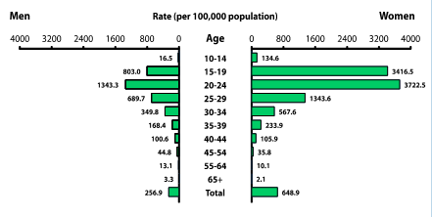
Chlamydia—Rates by Age and Sex, United States, 2011
2011-Fig 5. SR
CDC, 2011
Notes:
This graph shows age- and sex-specific rates of chlamydia infection per 100,000.
Men are on the left and women on the right, stratified by age group.
Rates of chlamydia in young women ages 15 to 19 are particularly high compared to young boys or compared to women of older age groups.
For example, compared to young men ages 15-19, young women ages 15-19 have almost 5 times higher rate of chlamydia infection.

Slide 50
Effectiveness of Contraceptive Methods at
Preventing STIs and Pregnancy
STI Protection
Dual
Protection Strategies
Hormonal/IUD+ condoms
(dual method)
Consistent condom use
Good
Male Condoms
Moderate
Female Condoms
Spermicides
Periodic Abstinence
IUD
Injectables
Implants
OCs
None
Moderate
Good
Pregnancy Protection (Typical Use)
*Adapted from Cates W Jr. and Steiner MJ Sex Transm Dis 2002;29(3):168-74.
Notes:
9
This graph shows how STI protection and pregnancy protection overlap. Since no method is good at both, it is important for those at risk for pregnancy and infection to use dual protection.
Male condoms and LARCs provide the most effective combination.

Slide 51
Dual Protection Guidance
“{COCs, POC, IUDs} do not protect against STI/HIV. If risk exists for STI/HIV, the correct and consistent use of condoms is recommended either alone or with another contraceptive method. “ ---U.S. Medical Eligibility Criteria for Contraceptive Use
“Condoms…should be used by all sexually active adolescents regardless of whether an additional method of contraception is used….. When initiating any hormonal contraceptive method, the need for consistent protection against STIs (either male or female condoms) should be reinforced. “ --- American Academy of Pediatrics, Committee on Adolescence
U.S. MEC: MMWR Recomm Rep 2010;59:1-86
AAP: Contraception and Adolescents . Pediatrics 2007;120;1135-48
Notes:
What guidance do we have regarding dual protection?
We know that other contraceptive methods do not protect against STIs and HIV.
The US Medical Eligibility Criteria as well as the American Academy of Pediatrics (AAP) recommends correct and consistent condom use if the risk for STIs and HIV are present either alone or with another method for contraception. The AAP states condoms should be used by all sexually active adolescents, regardless if another additional method is used for contraception.

Slide 52
Dual Protection in Healthy People 2020
FP-10 Increase the proportion of sexually active persons aged 15 to 19 years who use condoms to both effectively prevent pregnancy and provide barrier protection against disease
FP-11 Increase the proportion of sexually active persons aged 15 to 19 years who use condoms and hormonal or intrauterine contraception to both effectively prevent pregnancy and provide barrier protection against disease
http://www.healthypeople.gov/2020/topicsobjectives2020/objectiveslist.aspx?topicid=13
Notes:
Healthy People 2020 addresses dual protection with a goal to increase the proportion of sexually active persons aged 15-19 years who use condoms alone for both contraception and STI prevention as well as the proportion of this population who use condoms along with hormonal or intrauterine contraception.

Slide 53
Prevalence of Dual Protection among
Female Teens in the U.S.
Source | Population | Dual Method (at last sex) (hormonal and condom) | Consistent Condom Use (last 4 weeks)
NSFG, 2006-2008 | Ages 15-19, sexually active unmarried females | 20.8% | 51.6%
Teenagers in the United States: Sexual Activity, Contraceptive Use, and Childbearing, National Survey of Family Growth 2006–2008 http://www.cdc.gov/nchs/data/series/sr_23/sr23_030.pdf
Notes:
If our goal is to increase proportion of teens using dual protection, we should understand where we are starting from.
According to NSFG 2006-2008, only 20.8% of unmarried female teens used dual protection at last sex.
51.6% consistently used condoms in the previous four weeks.

Slide 54
SECTION III.
US FAMILY PLANNING GUIDANCE
Notes:
In this next section, the objectives are:
1. Become familiar with the US MEC categories
Focus on recommendations for use of LARC in teen population to be comfortable supplying teens with highly effective methods
Introduce the US Selected Practice Recommendations and understand how it can help with contraception provision

Slide 55
US MEDICal eligibility criteria, 2010

Slide 56
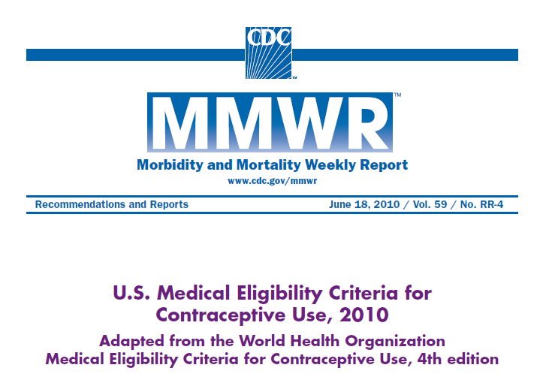
U.S. Medical Eligibility Criteria for Contraceptive Use, 2010
Notes:
As we’ve already seen, contraceptive use is key for adolescents who are attempting to avoid unintended pregnancy. CDC’s Division of Reproductive Health has been working to develop guidelines for the safe and effective use of contraception.
In 2010, the Division of Reproductive Health published the first edition of the U.S. Medical Eligibility Criteria for Contraceptive Use, or US MEC.
The US MEC provides evidence-based guidelines for healthcare providers on who can safely use contraceptive methods among women with certain medical conditions or characteristics. For example, is it safe for women with HTN to use pills or is it safe for postpartum women to use IUDs. It includes guidance for 17 contraceptive methods and over 120 medical conditions with the intention of decreasing barriers to contraceptive use among women with medical conditions.
Health care providers should always consider individual clinical circumstances when counseling patients.
56

Slide 57
MEC Categories
1. A condition for which there is no restriction for the use of the contraceptive method.
2. A condition where the advantages of using the method generally outweigh the theoretical or proven risks.
3. A condition where the theoretical or proven risks usually outweigh the advantages of using the method.
4. A condition which represents an unacceptable health risk if the contraceptive method is used.
Notes:
The US MEC uses a numeric scheme to provide the recommendations for specific contraceptive method and medical condition combinations.
A “1” means that there is no restriction for the use of the contraceptive method for a woman with that given medical condition, for example copper IUD use among women with hypertension.
A “2” means that the advantages of using the method generally outweigh the theoretical or proven risks.
A “3” flips the risk-benefit ratios and says that the theoretical or proven risks of the method usually outweigh the advantages – or that there are no other methods that are available or acceptable to the women with that medical condition.
Finally, a “4” means that there is an unacceptable health risk if the contraceptive method is used by a woman with that medical condition.

Slide 58
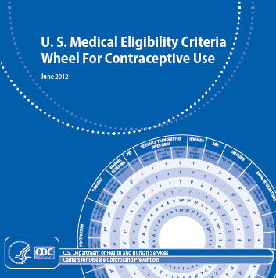
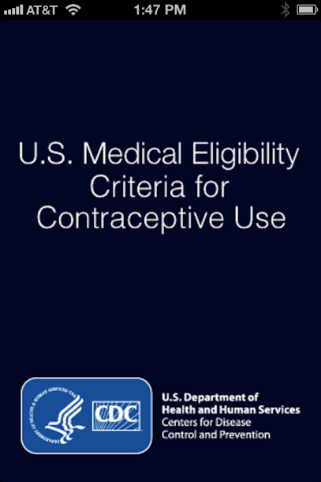
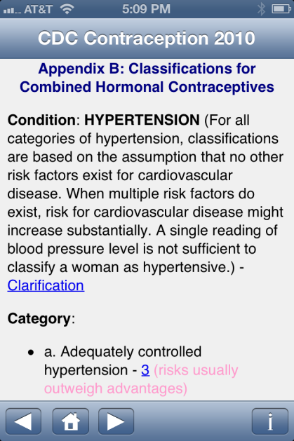
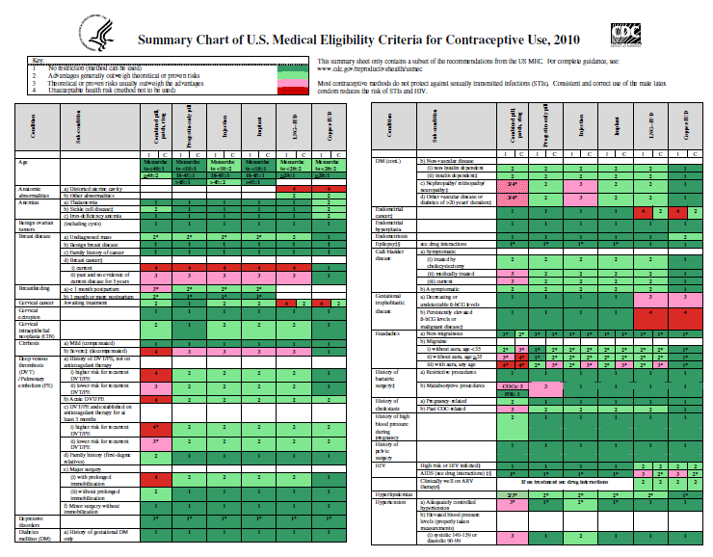
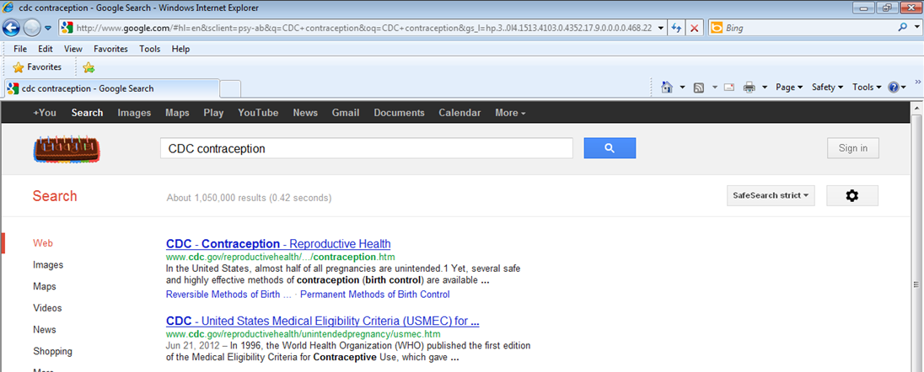
How you can use the US MEC
Notes:
The US MEC can be found and used in several ways.
The original document was published as an MMWR can be found online by searching CDC contraception or by using one of the US MEC tools: the summary chart, the wheel or the new app available for the iPhone and iPad.
There is also a US MEC website which is listed at the end of this presentation.
58

Slide 59
Summary of MEC by age
Method | COC, Patch, Ring | POP | Implant | Barrier | Injection | IUD
Age | < 40 | All ages | All ages | All ages | <18 | < 20
MEC | 1 | 1 | 1 | 1 | 2 | 2
1 | No restriction
2 | Generally can use
3 | Generally do not use
4 | Do not use
Notes:
Here is an example of the numeric scheme in the MEC for age.
Age as a characteristic for the MEC, and subgroups for age are different for different methods.
For progestin-only pills, the implant and barrier methods, recommendations are the same for all ages.
Since risks and benefits vary for different methods, the subgroup divisions for combined hormonal contraception, the injection and the IUD are set at different ages.

Slide 60
Contraception: Myths and Misconceptions
Myth: IUDs cause pelvic inflammatory disease and infertility
  Fact: Chlamydia and gonorrhea cause PID and can lead to infertility
Myth: DMPA causes fractures
  Fact: Small amount of bone mineral density lost during use, regained after discontinuation
Myth: Contraceptive pills cause cancer
  Fact: Protects against ovarian and endometrial cancer
Notes:
There are many myths and misconceptions that commonly prevent women from accessing effective contraceptive methods.
Three such myths are noted here.
Evidence-based recommendations help dispel these myths.

Slide 61
Barriers to LARC provision
Patient preference
Concern about safety
  Risk of PID
  Nulliparous, adolescent, not monogamous
Not trained in IUD insertion
IUDs not available
Tyler, Obstet Gynecol 2012;119:762
Madden, Contraception 2010;81:112..
Notes:
Two recent publications surveyed providers to determine why LARCs are not being provided.
Concerns for safety including risk of PID was included in the previous slide as one of the contraception myths.
Other common factors included patient preference, concern about safety for other reasons, not being trained in insertion and not having IUDs available.

Slide 62
Teen use of LARCs
Barriers
  Cost
  Knowledge and attitudes
    80% of adolescents never heard of IUD
Opportunity
  CHOICE project, St. Louis
  Women educated about LARC
  All methods provided without cost
  62% of adolescents chose LARC
  69% of ages 14-17
  61% of ages 18-20
Whitaker, Contraception 2008;78:211.
Mestad, Contraception 2011;84:493.
Notes:
Medical barriers due to these myths held by providers as well as patients are just some of the reasons that teens are not accessing effective contraception, especially LARCs.
Cost, knowledge and attitudes are other barriers to LARC use.
The CHOICE project in St. Louis provided no-cost contraception of a woman’s choice after listening to a comprehensive educational script.
Over 60% of teens chose a LARC method when knowledge and cost barriers were removed.

Slide 63

Clinical Scenario 1
16 year old female, healthy, nulliparous, currently using condoms, but wants more reliable method. Which of the following options are available to her?
  A. IUD (copper or levonorgestrel)
  B. Implants
  C. DMPA
  D. Combined hormonal methods (pill, patch, ring)

Slide 64
Safety of IUDs for Teens
IUDs and age <20: US MEC 2
IUDs and Expulsion
  Evidence shows slightly increased risk of expulsion in younger women
IUDs and infertility
  No evidence that IUDs cause later infertility
  Infertility associated with gonorrhea and Chlamydia
IUDs and STIs
  No evidence that IUDs increase risk of STI acquisition
  Women with current cervicitis, chlamydial infection, gonorrhea should not start an IUD (US MEC 4)
  Women with a very high individual likelihood of exposure to chlamydial infection or gonorrhea generally should not start an IUD (US MEC 3)
Notes:
Like previously mentioned, there are various myths and misperceptions regarding IUD use in adolescents.
These concerns are real and should be addressed with reassurance that evidence-based recommendations tell us that the IUD is generally safe for use in adolescents.
There is concern regarding an increased risk for expulsion which has been shown in some studies and thus the recommendation for IUD in women less than 20 is a category 2.
Risk of infertility has been shown to be associated with gonorrheal and chlamydial infection, not due to age.
Risk of STIs is another common concern for this population and IUD use and those who are currently infected or at high risk for infection should not use or generally should not use the IUD.

Slide 65
Safety of DMPA for Teens
DMPA and age <18: US MEC 2
DMPA and Bone mineral density
  Small amounts of BMD lost using DMPA
  BMD regained after discontinuation
  Unclear how BMD relates to fracture risk in adolescents
  No evidence that DMPA increases fracture in adolescents
DMPA and Obesity
  Obese adolescents who use DMPA may be more likely to gain weight than non-obese DMPA users and obese users of other methods
Notes:
There has also been a lot of concern regarding use of DMPA in adolescents, specifically regarding loss of bone mineral density and weight gain.
There is no evidence that DMPA use increases fracture risk in adolescents and it is unclear how bone mineral density measures are associated with future fractures in adolescents.
We do know that bone mineral density is lost in small amounts during DMPA use in women, including adolescents.
And we also know that the bone mineral density is regained after discontinuation.
As for obesity, obese adolescents using DMPA may be more likely to gain weight compared to non-obese users and obese users of other methods.
Thus, DMPA is a category 2 opposed to a category 1 for women <18 years old.

Slide 66
Clinical Scenario 1
16 year old female, healthy, nulliparous, currently using condoms, but wants more reliable method. What options are available to her?
  A. IUD (copper or levonorgestrel) (US MEC 2)
  B. Implants (US MEC 1)
  C. DMPA (US MEC 2)
  D. Combined hormonal methods (pill, patch, ring) (US MEC 1)
  ALL OF THE ABOVE! Plus…
Encourage continued condom use for dual protection

Slide 67

Clinical Scenario 2
18 year old G1P0, pregnant, and being counseled for postpartum family planning. She is not planning on breastfeeding. What options are available to her immediately postpartum?
  A. IUD (copper or levonorgestrel)
  B. Progestin-only methods (pill, injectable, implant)
  C. Combined hormonal methods (pill, patch, ring)

Slide 68

Postpartum: Hormonal Contraception
Condition | Combined methods | Progestin-only methods
Postpartum (non-breastfeeding women)
a) < 21 days | 4 | 1
b) 21 days to 42 days
i) With other risk factors for VTE | 3 | 1
ii) Without other risk factors for VTE | 2 | 1
c) > 42 days | 2 | 1
Notes:
Hormonal contraception recommendations for the postpartum period have been updated since the 2010 US MEC publication and those updates are shown here.
Major changes include:
First 21 days, CHCs are category “4”, meaning should not be used, given high risk of venous thromboembolism (VTE).
For 21-42 days after delivery, the recommendation acknowledges that there may still be some safety concerns, but this depends on presence of other risk factors. With risk factors, CHCs are category “3”, meaning that risks generally outweigh benefits. Without risk factors, “2”, meaning that benefits generally outweigh risks.
Beyond 42 days, CHCs are category “1”, meaning there are no safety concerns based on postpartum status.

Slide 69

Postpartum IUD Insertion
Condition | Sub-Condition | LNG-IUD | Cu-IUD
Postpartum (In breastfeeding and non-breastfeeding women, including post-caesarian women) | a) <10 minutes after delivery of placenta | 2 | 1
 | b) 10 minutes after delivery of placenta to <4 weeks | 2 | 2
 | c) ≥ 4 weeks | 1 | 1
 | d) Puerperal sepsis | 4 | 4
Notes:
There are separate subgroups for postpartum IUD insertion.
Rather than recommendation based on days after delivery, recommendations are based on whether the IUD is placed within 10 minutes after placental delivery or from 10 minutes up until 4 weeks after placental delivery or at 4weeks or more from delivery. All of these time frames are a category 1 or 2 so are safe or generally safe to use among women of any age.
Puerperal sepsis is a category 4 meaning do not use.

Slide 70
Clinical Scenario 2
18 year old G1P0, pregnant, and being counseled for postpartum family planning. She is not planning on breastfeeding. What options are available to her immediately postpartum?
  A. IUD (copper or levonorgestrel) (US MEC 2)
  B. Progestin-only methods (pill, injectable, implant) (US MEC 1)
  C. Combined hormonal methods (pill, patch, ring) (US MEC 4)
    (Wait until 21-42 days postpartum, depending on VTE risk factors)
  Encourage Dual protection with condom use
Notes:
Given the US MEC recommendations, she can safely use either IUD or a progestin-only method immediately postpartum.
Depending on other VTE risk factors, she may also use combined hormonal methods at 21 days or 42 days postpartum.

Slide 71

Clinical Scenario 3
16yo nulliparous female with heavy cycles and dysmenorrhea presents with her mother since she is missing school at the start of most periods. She is sexually active with her boyfriend using condoms. What options are available to her?
  A. IUD (copper or levonorgestrel)
  B. Implants
  C. DMPA
  D. Combined hormonal methods (pill, patch, ring)

Slide 72
Clinical Scenario 3
16yo nulliparous female with heavy cycles and dysmenorrhea presents with her mother since she is missing school at the start of most periods. She is sexually active with her boyfriend using condoms. What options are available to her?
  A. IUD (copper or levonorgestrel) (US MEC 2)
  B. Implants (US MEC 1)
  C. DMPA (US MEC 2)
  D. Combined hormonal methods (pill, patch, ring) (US MEC 1)
  All of the above
Encourage continued condom use for dual protection
Notes:
According to the US MEC, she can safely start any of the methods above for contraceptive use
However, all methods other than the Copper IUD have been shown to be beneficial to women who have heavy cycles and dysmenorrhea
NAOMI EDIT: I see the value of this scenario but I am a little unsure about including it because it gets more into therapeutic use rather than safety

Slide 73
US SELECTED PRACTICE RECOMMENDATIONS
Notes:
In this next section, the objectives are:
1. Become familiar with the US SPR categories
Focus on recommendations for use of LARC in teen population to be comfortable supplying teens with highly effective methods
Introduce the US Selected Practice Recommendations and understand how it can help with contraception provision

Slide 74
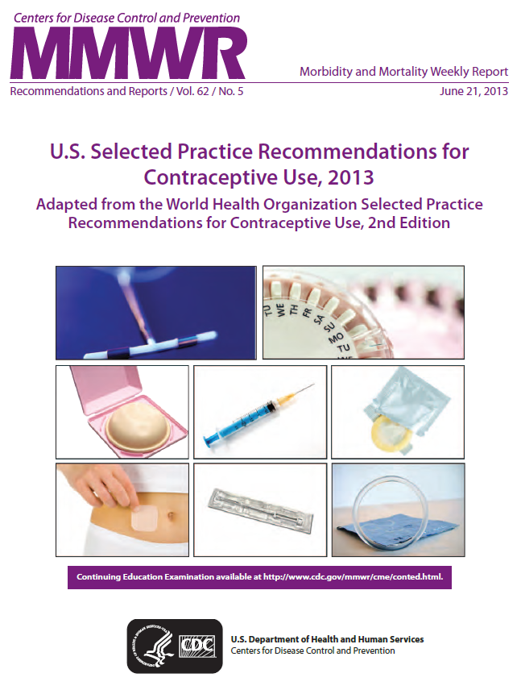
U.S. Selected Practice Recommendations for Contraceptive Use
Notes:
In June 2013, The US Selected Practice Recommendations, 2013 was published in a Morbidity and Mortality Weekly Report by CDC.
74

Slide 75
US Selected Practice Recommendations for Contraceptive Use, 2013
Follow-up to US Medical Eligibility Criteria for Contraceptive Use, 2010
Adapted from World Health Organization
Intent: Evidence-based guidance for common, yet controversial contraceptive management questions
  When to start
  Missed pills
  Bleeding problems
  Exams and test
  Follow-up
  How to be reasonably certain that a woman is not pregnant
Notes:
The US SPR is a companion document to the US MEC and like the US MEC was adapted from the World Health Organization.
The intention of the US SPR is to provide evidence-based recommendations for common, yet controversial contraceptive management questions, such as issues listed here.

Slide 76
US Selected Practice Recommendations for Contraceptive Use, 2013
Target audience: health-care providers
Guidance intended to assist health care providers when they counsel patients about contraceptive use
Applies to women of all ages, including adolescents
What is NOT included in the US SPR
  NOT the Medical Eligibility Criteria
  NOT comprehensive textbook
  NOT rigid guidelines
  NOT well-woman care
Notes:
The US SPR is intended for use by health-care providers in counseling patients about method use as well as management of certain problems with use.
The US SPR is not a comprehensive textbook, does not answer who can safely use methods like the US MEC, does not provide rigid guidelines to follow and does not address guidance for well-woman care.
The recommendations in the US SPR apply to women of all ages, including adolescents. Adolescents in particular may face certain barriers to initiating and using contraception effectively, including challenges in accessing supplies and difficulties with adherence. The goal of the US SPR is to reduce these barriers by providing guidance for how all women, including adolescents, can initiate methods easily and continue use effectively.

Slide 77
Format of US SPR
Arranged by contraceptive method
For each recommendation:
  Recommendation itself
  Comments and evidence summary
Simplified text of actual recommendations
Bullets, tables, flowcharts, algorithms

Slide 78
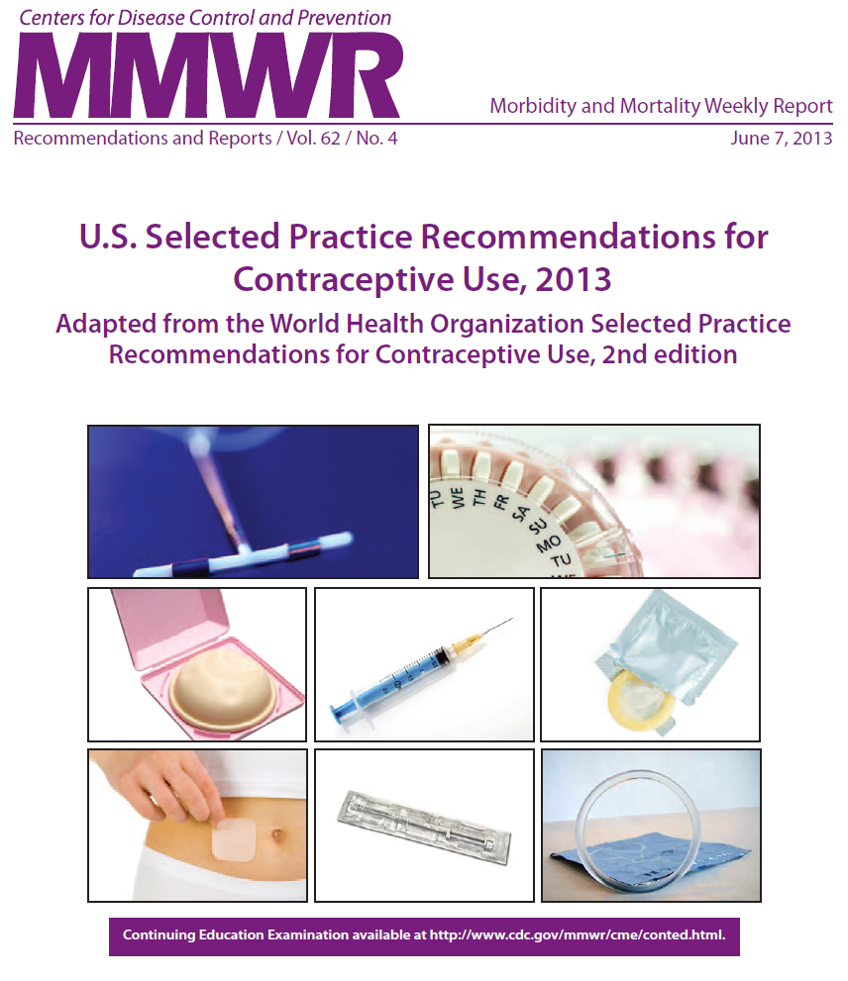
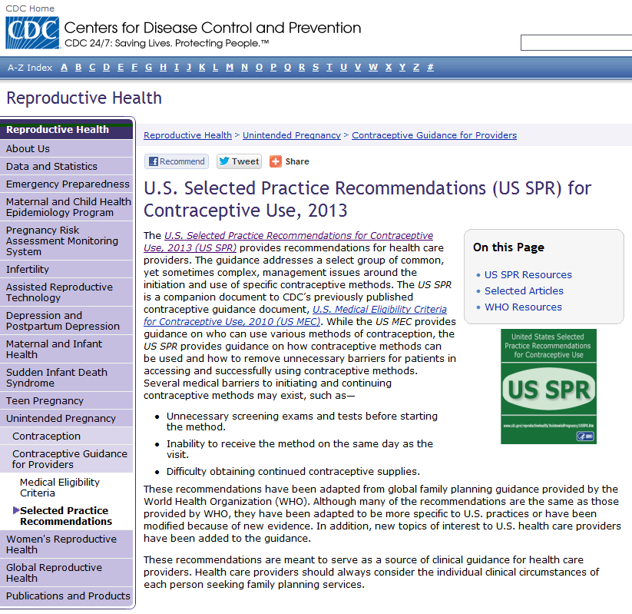

How you can use the US SPR
Notes:
The US SPR can be found and used in several ways.
The original MMWR document can be found online by searching CDC contraception
There is also a US SPR website which is listed at the end of this presentation
78

Slide 79
CLINICAL SCENARIOS

Slide 80

Clinical Scenario 1:
When to start a contraceptive method?
16 y.o. female comes to office desiring contraception and decides she wants the implant.
  Q: When can she start?

Slide 81
When can a woman start a contraceptive method
Barriers to starting any method
  Starting during menses
  Coming back for a second (or more) visit
  Filling a prescription
Starting when woman requests contraception (“Quick start”)
  May reduce time woman is at risk for pregnancy
  May reduce barriers to starting
Notes:
There are several barriers to initiating contraception which increases the time a woman is at risk for unintended pregnancy.
Some examples of these barriers are waiting for next menses to start the method or coming back for another visit or the need to fill a prescription.
Quick start is the start of a contraceptive method when a woman requests it.
This may reduce the time a woman is at risk for pregnancy and may reduce barriers to starting a method.

Slide 82
US SPR
Notes:
The US SPR provides guidance both within the document and summarized in a user-friendly chart to guide providers on when to start a method and how to counsel patients on backup needs for all methods.
Any of the methods can be started at any time if a provider is reasonably certain that a woman is not pregnant.
For the implant, if it has been more than 5 days since last cycle, she will need to use a back-up method or abstain from sexual intercourse for 7 days.

Slide 83
When to start a contraceptive method:
Other situations
Amenorrheic
Postpartum
  Breastfeeding
  Not breastfeeding
Postabortion
Switching from another contraceptive method
Notes:
For women in other situations that may not have a last menstrual cycle to refer to, guidance on how to initiate methods is also provided.
These situations include for women who are amenorrheic, postpartum, postabortion or are switching from another method.
These recommendations can be found under each contraceptive method in the When to Start section.

Slide 84
Clinical Scenario 1:
When to start a contraceptive method?
16 y.o. female comes to office desiring contraception and decides she wants the implant.
  Q: When can she start?
  A: Anytime, if reasonably certain she is not pregnant.
    If it has been more than 5 days since menstrual bleeding started, she will need to abstain from sex or use additional contraceptive protection for the next 7 days
Notes:
To answer this question, the recommendation for pills and for all methods is a woman can start a method anytime, if a provider can be reasonably certain she is not pregnant
If it has been more than 5 days since menstrual bleeding started, she will need to abstain from sex or use additional contraception for the next 7 days after starting her combined pills

Slide 85

Clinical Scenario 2:
How to be reasonably certain that a woman is not pregnant
16 y.o. female comes to office desiring contraception and decides she wants the implant.
  Q: How can you be reasonably certain
  she is not pregnant?

Slide 86
Evidence: Pregnancy test limitations
Pregnancy detection rates can vary based on sensitivity of test and timing with respect to missed menses
Pregnancy test not able to detect pregnancy resulting from recent intercourse
Pregnancy test may remain positive several weeks after pregnancy ends
Cervinski, Clin Chem Lab Med. 2010;48:935-42.
Cole LA, Expert Rev Mol Diagn. 2009;9:721-47.
Wilcox, JAMA. 2001;286:1759-61.
Korhonen, Clin Chem. 1997;43:2155-63.
Reyes, Am J Obstet Gynecol. 1985;153:486-9.
Steier, Obstet Gynecol. 1984;64:391-4.
Notes:
Some providers may question whether or not they should do a pregnancy test to rule out pregnancy and may also question if a pregnancy test is enough.
The evidence shows that pregnancy testing does have limitations.
Pregnancy detection rates vary depending on the sensitivity of the test and the timing of testing with respect to missed menses, last intercourse or last pregnancy.
False negatives may occur with recent intercourse while false positives may occur after recent pregnancy.

Slide 87
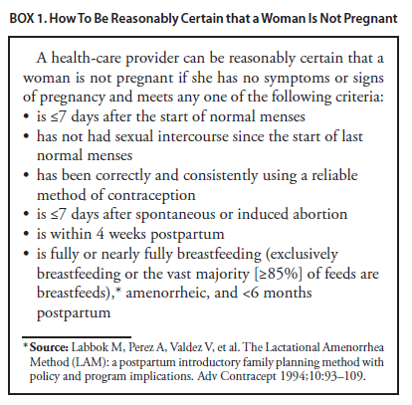
US SPR
Notes:
The US SPR provides highly accurate criteria that a provider can review with a patient
If a woman has no signs or symptoms of pregnancy and meets any one of the criteria, a provider can be reasonably certain that she is not pregnant
Criteria include… (READ LIST)
NAOMI EDIT: Don’t need notes section

Slide 88
Evidence on Pregnancy Checklist (PC)
Study, year, country | # Women | Positive preg test | Sensitivity of PC | Specificity of PC | PPV of PC | NPV of PC
Stanback, 1999, Kenya | 1852 | 1% | 64% | 89% | 6% | 99%
Stanback, 2006, Kenya | 1852 (without signs/sx) | 1% | 55% | 90% | 6% | 99%
Stanback, 2008, Nicaragua | 263 | 1% | 100% | 60% | 3% | 100%
Torpey, 2010, Africa | 535 HIV+ | 4% | 90.9% | 38.7% | 6% | 99%
Stanback, Lancet, 1999;354:566.
Stanback, J Fam Plann Reprod Health Care, 2006;32:27.
Stanback, Rev Panam Salud Publica, 2008;23:116.
Torpey, BMC Public Health, 2010;10:249.
Notes:
Several studies have been conducted comparing the negative predictive value of this criteria with a pregnancy test.
These studies all showed a negative predictive value of 99% or 100%.
This means of the 100 who had a negative result according to the pregnancy checklist, 99 to 100 of them were not pregnant according to a pregnancy test.
This indicates that this pregnancy checklist criteria can be used to accurately rule out pregnancy and safely start contraception.
Currently there are no published studies in the US but there is no reason to think it would be any different than the situations in these studies.

Slide 89
Clinical scenario 2:
How to be reasonably certain that a woman is not pregnant
16 y.o. female comes to office desiring contraception and decides she wants the implant.
  Q: How can you be reasonably certain she is not pregnant?
  A: If she has no signs or symptoms of pregnancy and fulfills one of criteria, a provider can be reasonably certain that the women is not pregnant.

Slide 90

Clinical Scenario 3:
Exams and tests
16 y.o. female comes to office desiring contraception and decides she wants the implant.
  Q: Do you need to do any exams or test before she starts?
Notes:
Are there other tests to consider or exams that need to be done before providing her with pills?

Slide 91
US SPR
Exams and tests prior to initiation
Unnecessary tests may be barrier to starting
  Women (adolescents) may not be comfortable with pelvic exam
  Coming back for a second (or more) visit to receive test results
Recommendations address exams and test needed prior to initiation
  Class A = essential and mandatory
  Class B = contributes substantially to safe and effective use, but implementation may be considered within the public health and/or service context
  Class C = does not contribute substantially to safe and effective use of the contraceptive method
Notes:
This question addresses other barriers to initiating contraception.
A pelvic exam itself may be a barrier to women especially adolescents from getting contraception if they are not willing to participate in the exam.
Waiting for test results may be another barrier that delays contraceptive use.
The US SPR provides recommendations that address exams and tests needed prior to starting a woman on a method.
These recommendations are categorized into 3 classes:
Class A are essential and mandatory for a given method.
Class B exams and tests contribute substantially to safe and effective use, but implementation may be considered within the public health and/or service context.
Finally, Class C does not contribute substantially to safe and effective use of the method.

Slide 92
US SPR
Exams and tests prior to initiation
Examination or test | Contraceptive method and class
Examination | LNG and Cu-IUD | Implant | Injectable | CHC | POP | Condom | Diaphragm or cervical cap | Spermicide
Blood pressure | C | C | C | A* | C | C | C | C
Weight (BMI) | — † | —† | —† | —† | —† | C | C | C
Clinical breast examination | C | C | C | C | C | C | C | C
Bimanual examination and cervical inspection | A | C | C | C | C | C | A | C
Laboratory test
Glucose | C | C | C | C | C | C | C | C
Lipids | C | C | C | C | C | C | C | C
Liver enzymes | C | C | C | C | C | C | C | C
Hemoglobin | C | C | C | C | C | C | C | C
Thrombogenic mutations | C | C | C | C | C | C | C | C
Cervical cytology (Papanicolaou smear) | C | C | C | C | C | C | C | C
STD screening with laboratory tests | —§ | C | C | C | C | C | C | C
HIV screening with laboratory tests | C | C | C | C | C | C | C | C
Notes:
This slide replicates the summary chart in the US SPR for all contraceptive methods and commonly performed screening exams and tests

Slide 93

US SPR
Exams and tests prior to initiation
Examination or test | Contraceptive method and class
Examination | LNG and Cu-IUD | Implant | Injectable | CHC | POP | Condom | Diaphragm or cervical cap | Spermicide
Blood pressure | C | C | C | A* | C | C | C | C
Weight (BMI) | — † | —† | —† | —† | —† | C | C | C
Clinical breast examination | C | C | C | C | C | C | C | C
Bimanual examination and cervical inspection | A | C | C | C | C | C | A | C
Laboratory test
Glucose | C | C | C | C | C | C | C | C
Lipids | C | C | C | C | C | C | C | C
Liver enzymes | C | C | C | C | C | C | C | C
Hemoglobin | C | C | C | C | C | C | C | C
Thrombogenic mutations | C | C | C | C | C | C | C | C
Cervical cytology (Papanicolaou smear) | C | C | C | C | C | C | C | C
STD screening with laboratory tests | —§ | C | C | C | C | C | C | C
HIV screening with laboratory tests | C | C | C | C | C | C | C | C
Notes:
Here you can see that there are very few class A exams and tests, none of which are listed under Implant.
The blood pressure recommendation before initiating combined hormonal contraceptives is class A accompanied by this statement:
† In cases in which access to health care might be limited, the blood pressure measurement can be obtained by the woman in a non–health-care setting (e.g., pharmacy or fire station) and self-reported to the provider
A pelvic exam is essential before placement of an IUD or to fit a diaphragm or cervical cap but is not necessary for any other method.

Slide 94
Pelvic Exam before Initiating Contraception
Is not necessary before starting implant
No US MEC 3 or 4 conditions will be detected by pelvic
Evidence:
  Two case-control studies
  Delayed versus immediate pelvic exam before contraception
Tepper Contraception 2013
Notes:
Pelvic examination is not necessary before initiation of the implant because it does not facilitate detection of conditions for which hormonal contraceptives would be unsafe.
A systematic review examined two case-control studies comparing delayed and immediate pelvic examination before initiation of oral contraceptives or DMPA.
No differences in risk factors for cervical neoplasia, incidence of STDs, incidence of abnormal Papanicolaou smears, or incidence of abnormal wet mounts were found.

Slide 95

US SPR
Exams and tests prior to initiation
Examination or test | Contraceptive method and class
Examination | LNG and Cu-IUD | Implant | Injectable | CHC | POP | Condom | Diaphragm or cervical cap | Spermicide
Blood pressure | C | C | C | A* | C | C | C | C
Weight (BMI) | — † | —† | —† | —† | —† | C | C | C
Clinical breast examination | C | C | C | C | C | C | C | C
Bimanual examination and cervical inspection | A | C | C | C | C | C | A | C
Laboratory test
Glucose | C | C | C | C | C | C | C | C
Lipids | C | C | C | C | C | C | C | C
Liver enzymes | C | C | C | C | C | C | C | C
Hemoglobin | C | C | C | C | C | C | C | C
Thrombogenic mutations | C | C | C | C | C | C | C | C
Cervical cytology (Papanicolaou smear) | C | C | C | C | C | C | C | C
STD screening with laboratory tests | —§ | C | C | C | C | C | C | C
HIV screening with laboratory tests | C | C | C | C | C | C | C | C
Notes:
There is also the category highlighted here which addresses weight for hormonal methods as well as STD screening prior to IUD placement.
For Implant initiation, the recommendation for checking weight is “Weight (BMI) measurement is not needed to determine medical eligibility for any methods of contraception because all methods can be used (USMEC 1) or generally can be used (USMEC 2) among obese women (5). However, measuring weight and calculating BMI at baseline might be helpful to monitor any changes and counsel women who might be concerned about weight change perceived to be associated with their contraceptive method.”

Slide 96
Clinical Scenario 3:
Exams and tests
16 y.o. female comes to office desiring contraception and decides she wants the implant.
  Q: Do you need to do any exams or test before she starts?
  A: No
Notes:
There are no exams or tests that are necessary before initiating the implant.
Measuring weight and calculating BMI at baseline might be helpful to monitor any changes and counsel women who might be concerned about weight change perceived to be associated with their contraceptive method.

Slide 97
Clinical Scenario 3:
Exams and tests
16 y.o. female comes to office desiring contraception and now decides she wants the levonorgestrel IUD.
  Do any of the previous steps change?
  Q1: When can she start?
  Q2: How can you be reasonably certain she is not pregnant?
  Q3: Do you need to do any exams or test before she starts?
Notes:
What if she decided to get a levonorgestrel IUD instead of an implant? Do any of the previous steps change?
The first question was “When can she start?” She can start anytime as long as a provider can be reasonably certain that she is not pregnant
The criteria to answer that question have also been reviewed
Finally, do you need to do any exams or tests before starting and let’s review that chart again

Slide 98
US SPR
Exams and tests prior to initiation
Examination or test | Contraceptive method and class
Examination | LNG and Cu-IUD | Implant | Injectable | CHC | POP | Condom | Diaphragm or cervical cap | Spermicide
Blood pressure | C | C | C | A* | C | C | C | C
Weight (BMI) | — † | —† | —† | —† | —† | C | C | C
Clinical breast examination | C | C | C | C | C | C | C | C
Bimanual examination and cervical inspection | A | C | C | C | C | C | A | C
Laboratory test
Glucose | C | C | C | C | C | C | C | C
Lipids | C | C | C | C | C | C | C | C
Liver enzymes | C | C | C | C | C | C | C | C
Hemoglobin | C | C | C | C | C | C | C | C
Thrombogenic mutations | C | C | C | C | C | C | C | C
Cervical cytology (Papanicolaou smear) | C | C | C | C | C | C | C | C
STD screening with laboratory tests | —§ | C | C | C | C | C | C | C
HIV screening with laboratory tests | C | C | C | C | C | C | C | C
Notes:
Again, there are few exams and tests that are necessary.
A pelvic exam is essential before placement of an IUD, therefore it is the only class A exam or test listed for an IUD.
Measuring weight and calculating BMI at baseline might be helpful to monitor any changes and counsel women who might be concerned about weight change perceived to be associated with their contraceptive method.”
For IUD use, the US SPR recommendation states that most women do not require additional STD screening at the time of IUD insertion if they have already been screened according to CDC’s STD Treatment Guidelines.
Those recommendations can be found on the CDC website http://www.cdc.gov/std/treatment/2010/
Those who have not be screened can be screened at time of IUD placement and insertion should not be delayed for test results unless at a very high individual likelihood of STD exposure.

Slide 99
Clinical scenario 3:
Exams and tests
16 y.o. female comes to office desiring contraception and now decides she wants the levonorgestrel IUD.
  Q3: Do you need to do any exams or test before she starts?
  A: Pelvic exam and STI screening as appropriate.
Centers for Disease Control and Prevention. Sexually Transmitted Diseases Treatment Guidelines, 2010. MMWR 2010;59. No RR-12
Notes:
For IUD placement, a bimanual exam is necessary before placement.
STI screening should also be performed according to CDC STD Treatment Guidelines.
That means annual screening of all sexually active females aged ≤25 years for C. trachomatis and N. gonorrhoeae. Women aged <25 years are at highest risk for gonorrhea infection. Other risk factors that place women at increased risk include a previous gonorrhea infection, the presence of other STDs, new or multiple sex partners, inconsistent condom use, commercial sex work, and drug use.
Patients seeking treatment or screening for a particular STD should be evaluated for all common STDs.
Those who have not be screened according to guidelines can be screened at time of IUD placement and insertion should not be delayed for test results unless at a very high individual likelihood of STD exposure.

Slide 100

Clinical Scenario 4 :
Emergency Contraception
17 y.o. female had unprotected intercourse 4 days ago and is worried about pregnancy.
  Q: What are her emergency
  contraception options?

Slide 101
Four options available in the US
Intrauterine device
  copper intrauterine device (Cu-IUD)
Emergency contraceptive pills (ECPs)
  ulipristal acetate (UPA) available in a single dose (30 mg)
  levonorgestrel (LNG) in a single dose combined
  estrogen/progestin in 2 doses
Notes:
Currently there are four options for emergency contraception or EC.
The copper Intrauterine device and three types of emergency contraceptive pills or ECPs.
The three types of pills include ulipristal acetate or UPA, levonorgestrel or LNG as well as combined estrogen and progestin oral contraceptive pills.
All options may be utilized within 5 days of unprotected sexual intercourse.
The Copper IUD should be placed within 5 days of the first act of unprotected sexual intercourse.

Slide 102
SPR Recommendation on Effectiveness
Large systematic review of 42 studies showed that the pregnancy rate among emergency IUD users is 0.09%
UPA and LNG ECPs have similar effectiveness when taken within 3 days after unprotected intercourse
  UPA has been shown to be more effective than the LNG formulation between 3 and 5 days after unprotected intercourse .
UPA may be more effective than LNG for women who are obese.
The combined estrogen/progestin regimen is less effective than UPA or LNG and is associated with more frequent side effects
Notes:
Since these options are not all the same, how can you help her choose the best option for her?
The evidence shows that Copper IUDs are highly effective as emergency contraception and can be continued as regular contraception if that is what she desires and she is willing to come in for a visit.
UPA and LNG have similar effectiveness when taken within 3 days after unprotected intercourse while UPA may be more effective between days 3 and 5 after unprotected sex.
UPA may also be more effective than LNG for women who are obese according to one study.
The combined regimen also known as Yuzpe method is less effective than the other two ECPs and is associated with more frequent side effects particularly nausea and vomiting.

Slide 103
Clinical Scenario 4 :
Emergency Contraception
17 y.o. female had unprotected intercourse 4 days ago and is worried about pregnancy.
  Q: What are her emergency contraception options?
  A:
    Copper IUD
    Ulipristal acetate
    Levonorgestrel ECPs
    Combination estrogen/progestin pills
Notes:
This patient therefore has four options assuming she has no conditions or characteristics (such as being a smoker) that would effect her eligibility for combined hormonal methods.

Slide 104
Clinical Scenario 4 :
Initiation of regular contraception after emergency contraception pills
17 y.o. female had unprotected intercourse 4 days ago and is worried about pregnancy. She has chosen to take UPA
  Q: When can she start regular
  contraception after ECPs?
Notes:
If she decides to take ulipristal acetate, when can she start regular contraception after taking the pills?

Slide 105
Evidence
Data limited to expert opinion and product labeling.
Theoretical concerns for decreased effectiveness of systemic hormonal contraception after UPA use.
The resumption or initiation of regular hormonal contraception following ECP use involves consideration of the risk of pregnancy if ECPs fail.
Notes:
A systematic review conducted for the US SPR searched for articles concerning the resumption or initiation of contraception within the same cycle as ECP use.
No articles met inclusion criteria, thus data for presentation at the US SPR expert meeting was limited to product labeling and the recommendation also is limited to expert opinion.
The theoretical concern for decreased effectiveness of systemic hormonal contraception when initiated after UPA use was raised.
The risk of pregnancy if ECPs fail was also considered.

Slide 106
US SPR Recommendation:
When to initiate regular contraception after emergency contraception pills
Any regular contraceptive method can be started immediately after the use of ECPs.
Advise the woman to have a pregnancy test, if she does not have a withdrawal bleed within 3 weeks.
UPA
  The woman will need to abstain from sex or use barrier contraception for 14 days or her next menses, whichever comes first.
LNG and combined estrogen/progestin formulations
  The woman will need to abstain from sex or use barrier contraception for 7 days.
Notes:
Thus the recommendation states that any regular contraceptive method can be started immediately after ECP use.
If a woman does not have a withdrawal bleed within 3 weeks of ECP use, she should take a pregnancy test.
If she uses UPA, given the anti-progestogen action, she needs to abstain or use barrier contraception for 14 days or until her next menses.
If she uses LNG or combined pills, she needs to abstain or use barrier contraception for 7 days.

Slide 107
Clinical Scenario 4 :
Initiation of regular contraception after emergency contraception pills
17y.o. female had unprotected intercourse 4 days ago and is worried about pregnancy.
  Q: When can she start regular contraception after ECPs?
  A: She can start contraception immediately but she will need to abstain from sex or use barrier contraception for 7 days if she uses LNG or 14 days if she uses UPA or until her next menses, whichever comes first.

Slide 108
Take Home Messages
Rates of adolescent pregnancy in the US are decreasing, but remain high
Adolescents who are at risk of unintended pregnancy need access to highly effective contraceptive methods
Adolescents are eligible to use all methods of contraception
  there is no contraceptive method that an adolescent cannot use based on age alone
Long-acting, reversible contraception (LARCs) may be particularly suitable for many adolescents
  IUDs
  Implants
Dual protection should be encouraged for adolescents
Notes:
Rates of adolescent pregnancy in the US are decreasing, but remain high.
Adolescents who are at risk of unintended pregnancy need access to highly effective contraceptive methods.
Adolescents are eligible to use all methods of contraception.
There is no contraceptive method that an adolescent cannot use based on age alone.
Long-acting, reversible contraception (LARCs) including IUDs and implants may be particularly suitable for many adolescents.
Dual protection should be encouraged for adolescents.

Slide 109
Take Home Messages
Most women of any age can start methods anytime
Few, if any, exams or tests are needed
Anticipatory counseling for potential bleeding problems and proper management provided
Routine follow-up generally not required
Discuss emergency contraception often
Regular contraception should be started after EC
Notes:
Most women, including teens, can start methods of contraception anytime (including on the day of the visit), as long as the provider is reasonably certain that the woman is not pregnant.
Few, if any, examinations or tests are needed before starting a contraceptive method.
Bleeding problems are a major reason for contraceptive discontinuation; recommendations on anticipatory counseling before starting a method and management of bleeding problems are provided.
Adolescents should be advised to return at any time to discuss side effects or other problems, if she wants to change the method being used, and when it is time to remove or replace the contraceptive method. Otherwise, routine follow-up is generally not required.
Many options for emergency contraception are available, including the copper-IUD and different formulations of pills. Regular contraception should be started after emergency contraceptive use.

Slide 110
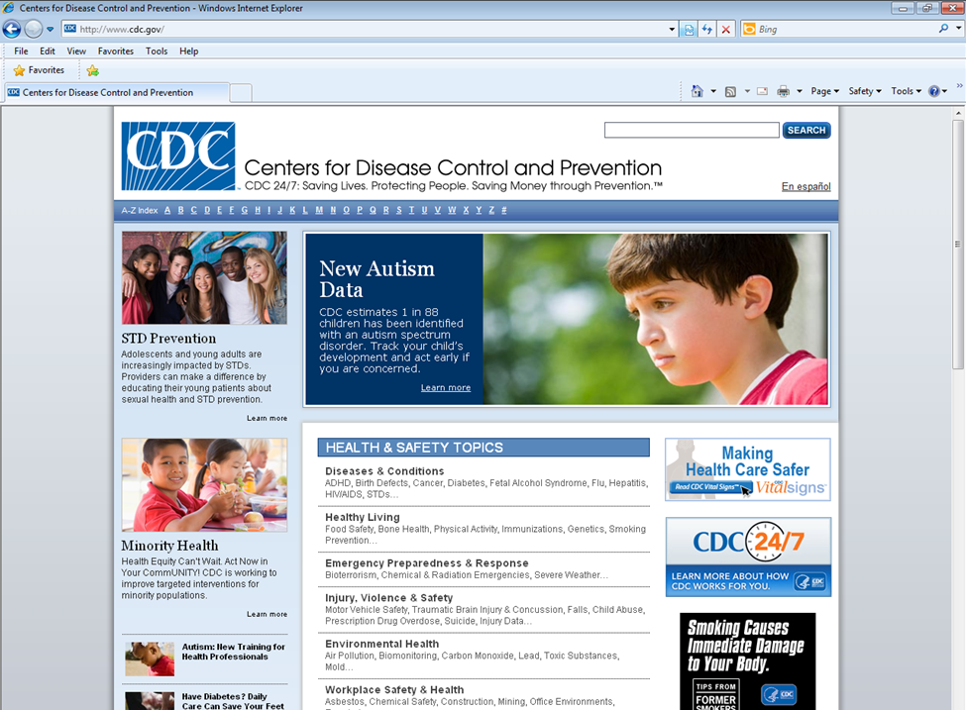
How to find Teen Pregnancy information?
www.cdc.gov
Notes:
More Teen Pregnancy information can be found at cdc.gov then clicking on “T” from the A-Z Index
Teen Pregnancy is then listed on the left hand side of the following page

Slide 111
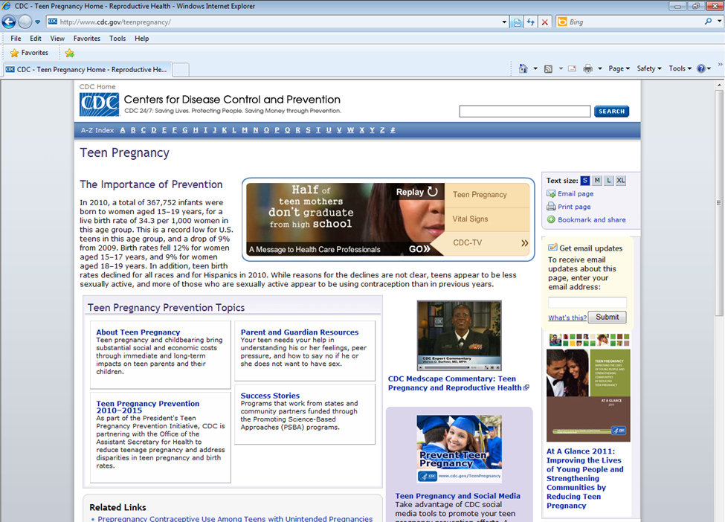
www.cdc.gov/teenpregnancy/
http://www.cdc.gov/vitalsigns/teenpregnancy/

Slide 112
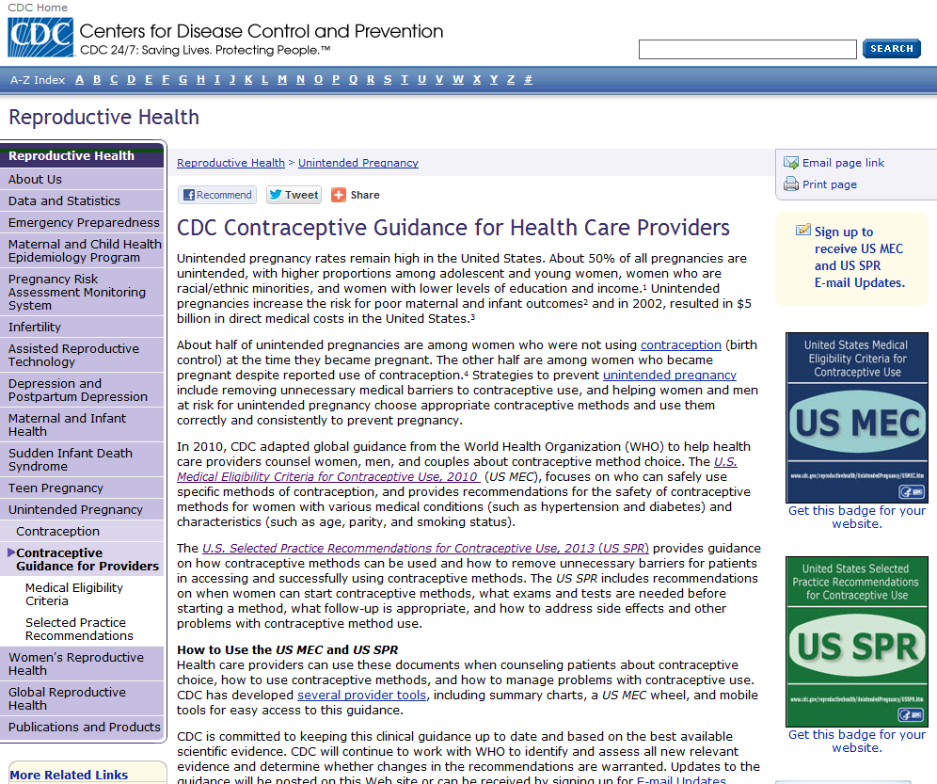
CDC Contraceptive Guidance
www.cdc.gov/reproductivehealth/UnintendedPregnancy/Contraception_Guidance.htm

Slide 113
Resources
US MEC published in CDC’s Morbidity and Mortality Weekly Report (MMWR):
http://www.cdc.gov/mmwr/preview/mmwrhtml/rr5904a1.htm?s_cid=rr5904a1_w
US SPR published in CDC’s Morbidity and Mortality Weekly Report (MMWR):
http://www.cdc.gov/mmwr/preview/mmwrhtml/rr6205a1.htm?s_cid=rr6205a1_w
CDC evidence-based family planning guidance documents:
http://www.cdc.gov/reproductivehealth/UnintendedPregnancy/USMEC.htm
CDC Vital Signs:
http://www.cdc.gov/vitalsigns/teenpregnancy

Slide 114
Use of trade names and commercial sources is for identification only and does not imply endorsement by the US Department of Health and Human Services.
The findings and conclusions in this presentation have not been formally disseminated by the Centers for Disease Control and Prevention and should not be construed to represent any agency determination or policy.

