Slide 1
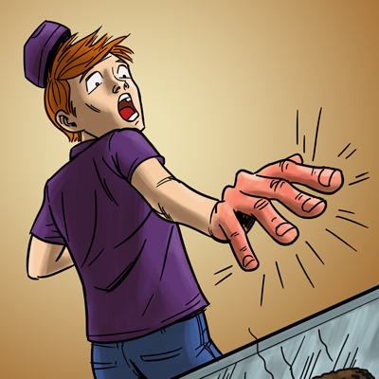
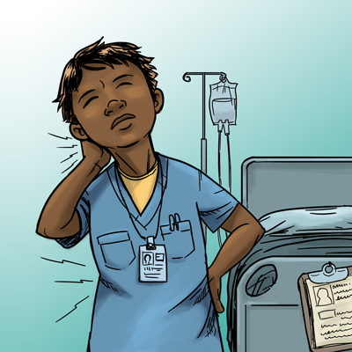
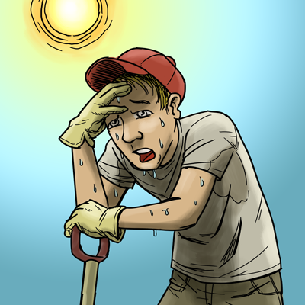
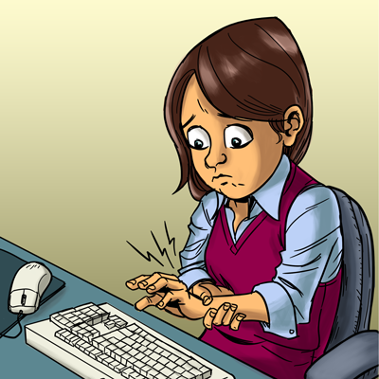
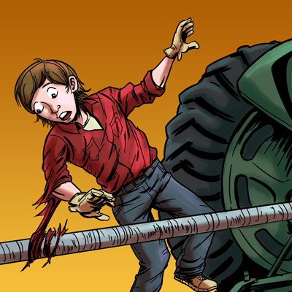


A Safety & Health Curriculum
For Young Workers
New York Edition
DEPARTMENT OF HEALTH AND HUMAN SERVICES
Centers for Disease Control and Prevention
National Institute for Occupational Safety and Health

Slide 2
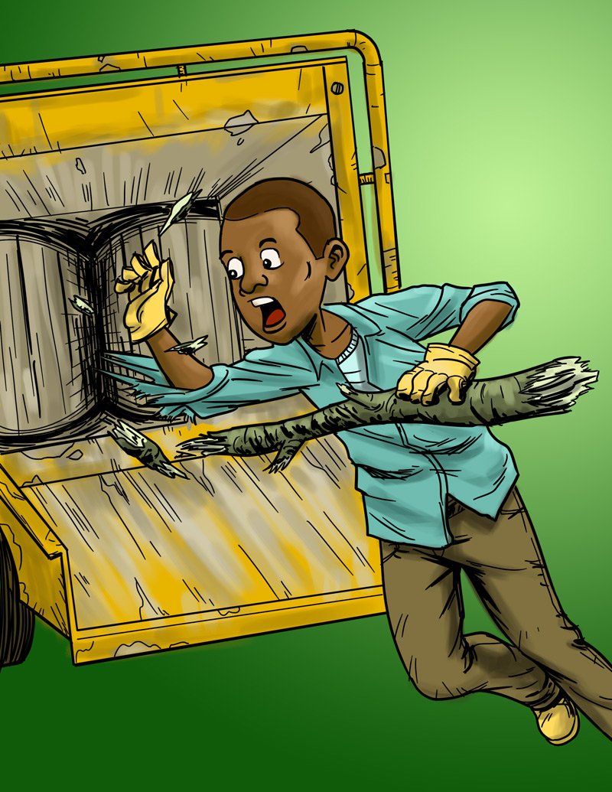
Introduction to Young Worker Injuries
Lesson 1

Slide 3

You Will Learn About
Ways young workers can be hurt on the job.
Ways to predict and prevent workplace injuries.
Common health and safety hazards on the job.
Ways to reduce or control workplace hazards.
Emergencies in the workplace and how to respond.
What to do if you see something at work that could hurt you or make you sick.
What legal rights and responsibilities young people have at work.

Slide 4
What is Your Experience With Work?
How many of you have had a job?
Where did you work?
What did you do?
Have you ever been hurt at work? Do you know someone who was hurt at work?
Has any task at work made you uncomfortable?
  Have you had any health and safety training
  at work?

Slide 5
Job Safety Quiz
The law says your employer must give you a
safe and healthy place to work.
True False
The law limits how late you can work on a school night
if you are under 16.
True False
If you are 16 years old, you can drive a car on public streets as part of your job.
True False

Slide 6
Job Safety Quiz (continued)
If you are injured on the job, your employer must pay for your medical care.
True False
How often do teens get injured on the job in the United States?
One every day One every hour
One every 9 minutes

Slide 7
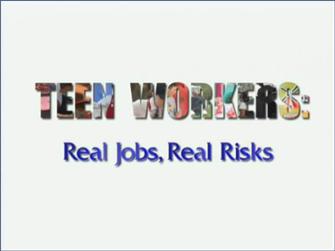
Why Are Young Workers
More Likely to be Hurt on the Job?
Video and Discussion
Notes:
7

Slide 8
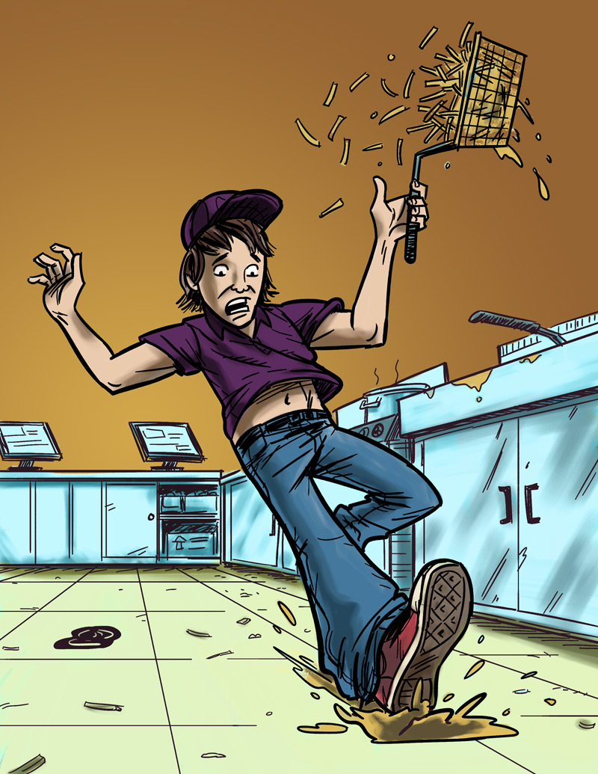
Examples of Teen Work Injuries
Jack’s Story
Job: Fast food worker
Hazard: Greasy, slippery floors
Injury: Injured tailbone
The Impact of Work Injuries
Why did this happen?
What could have kept Jack from being hurt?
How could this injury change Jack’s life?

Slide 9
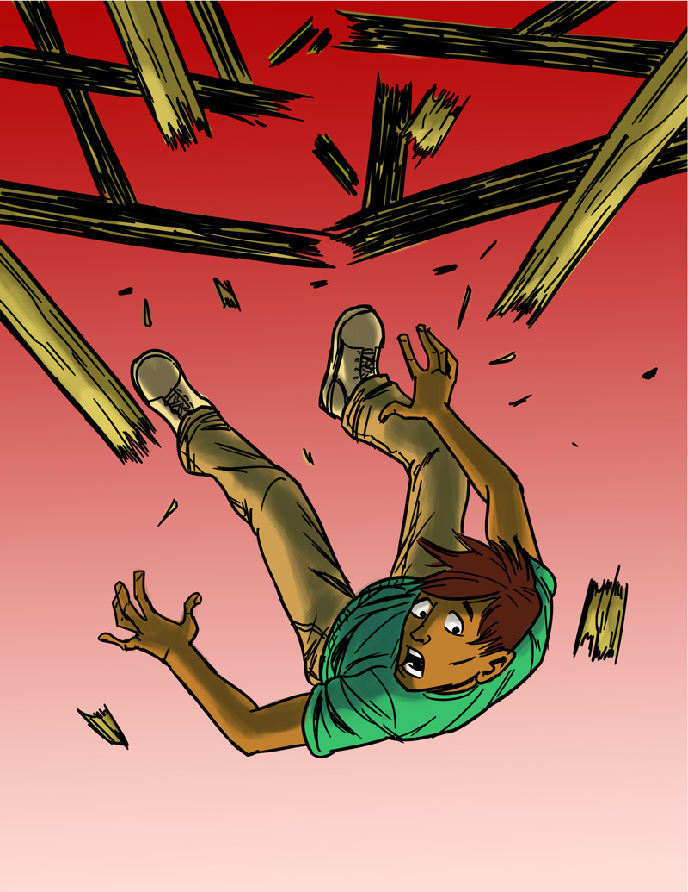
Teen Work Injuries
Antonio’s Story
Job: Construction helper
Hazard: Unguarded chimney hole
(on an unfinished roof)
Injury: Broken back
The Impact of Work Injuries
Why did this happen?
What could have kept Antonio
from being hurt?
How could this injury change Antonio’s life?

Slide 10
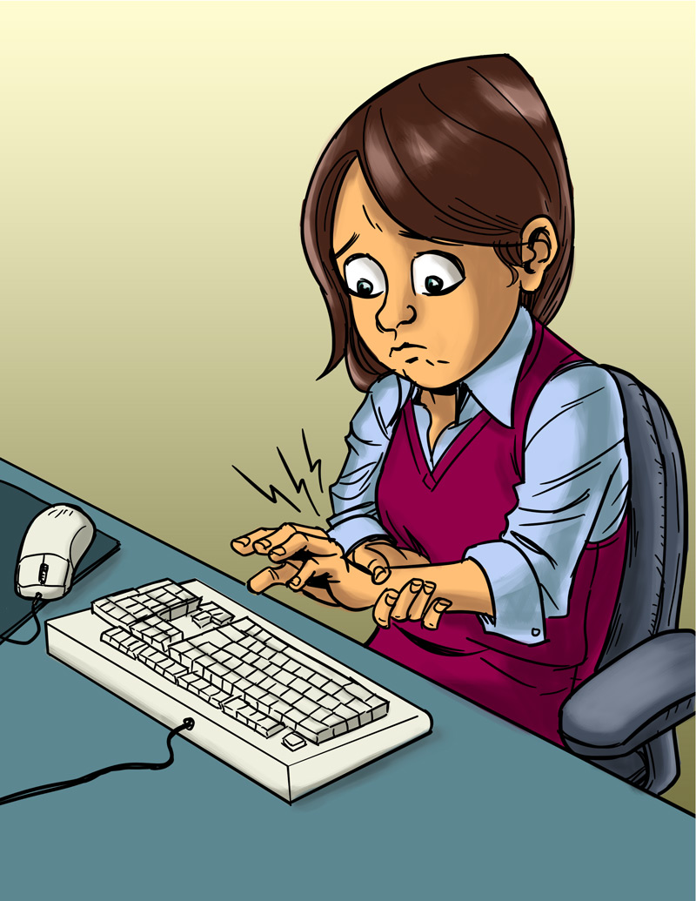
Teen Work Injuries
Angela’s Story
Job: Office worker
Hazard: Too much typing
in an awkward position
Injury: Repetitive stress injury
The Impact of Work Injuries
Why did this happen?
What could have kept Angela
from being hurt?
How could this injury change
Angela’s life?

Slide 11
Teen Work Injuries
Terrell’s Story
Job: Landscape worker
Hazard: Wood chipper
Injury: Death
The Impact of Work Injuries
Why did this happen?
What could have kept Terrell
from being killed?

Slide 12
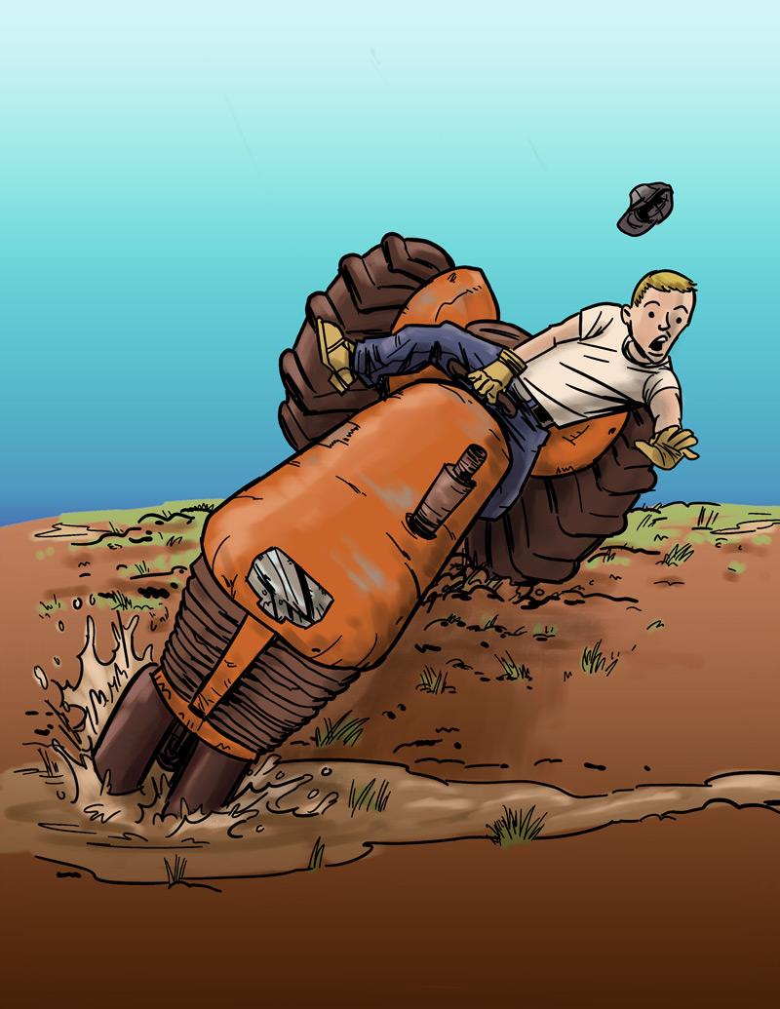
Teen Work Injuries
Cody’s Story
Job: Farm worker
Hazard: Tractor without roll bar
Injury: Legs crushed under tractor
The Impact of Work Injuries
Why did this happen?
What could have kept Cody
from being hurt?
How could this injury change
Cody’s life?

Slide 13
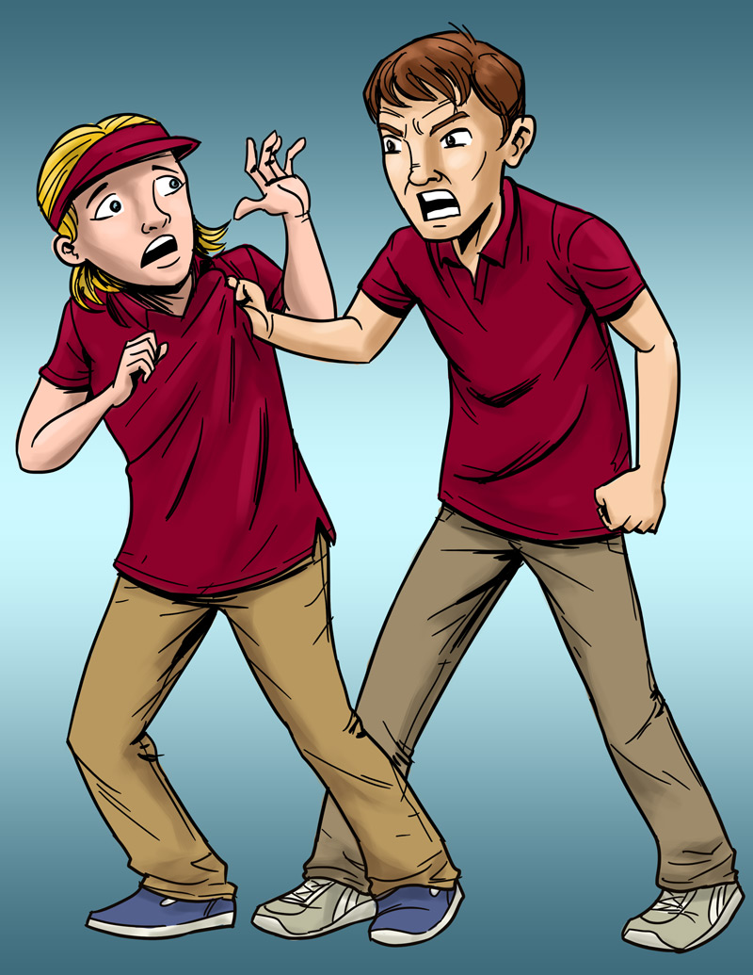
Teen Work Injuries
Lindsey’s Story
Job: Pizza shop cashier
Hazard: Violence (by a co-worker)
Injury: Bumps and bruises caused
by abusive co-worker
The Impact of Work Injuries
What could Lindsey’s employer have done to stop her abuser?
What would you do if this happened?
How could this change Lindsey’s life?

Slide 14
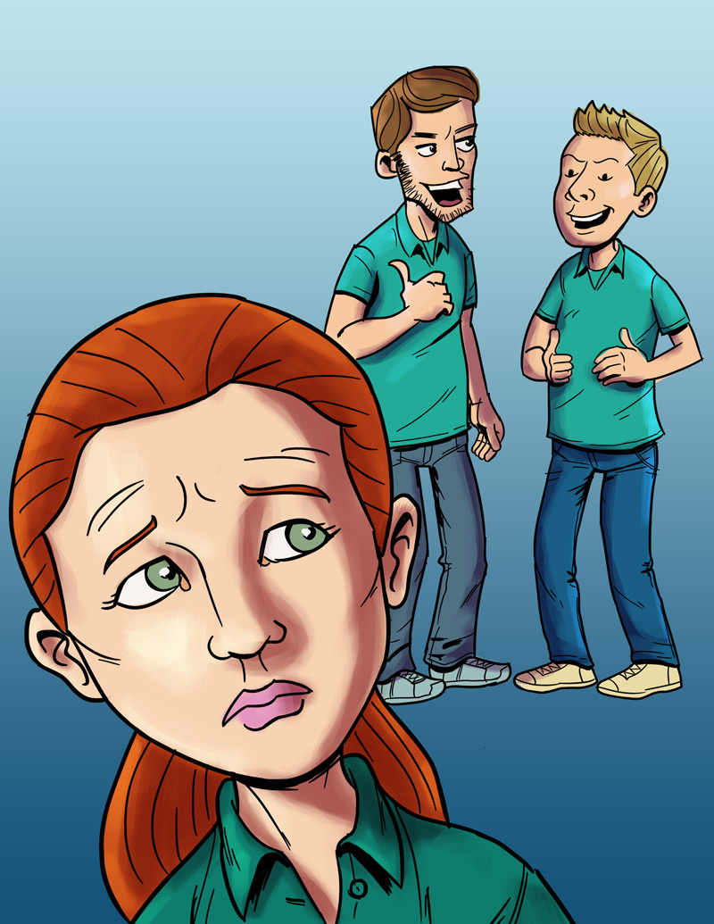
Teen Work Injuries
Anna’s Story
Job: Smoothie shop worker
Hazard: Sexual harassment
Injury: Emotional trauma
The Impact of Work Injuries
What could Anna's employer have done to stop her harasser?
What would you do if this happened
to you?
How could this change Anna’s life?

Slide 15
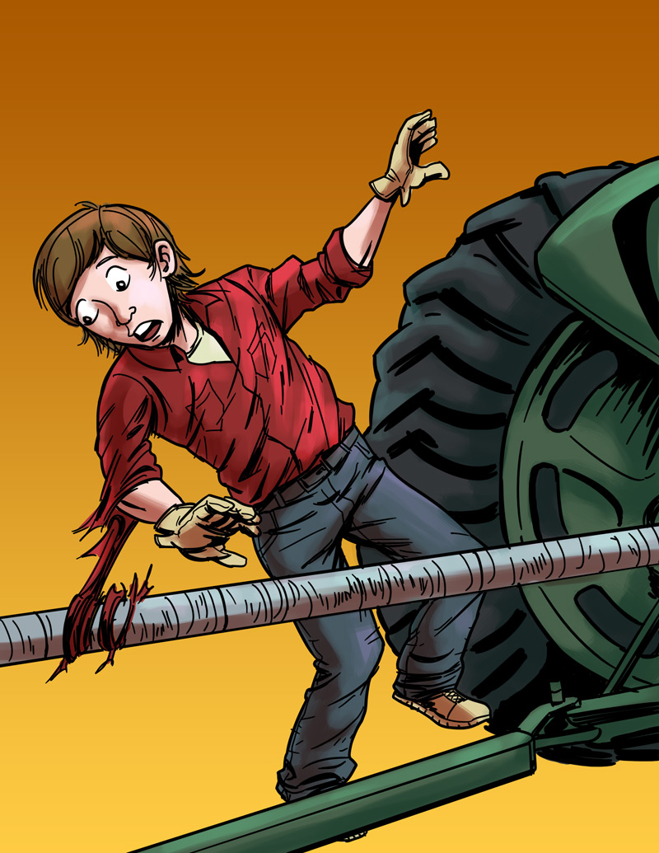
Teen Work Injuries
Logan’s Story
Job: Farm worker
Hazard: Unguarded, rotating bar on a tractor
Injury: Severed arm, broken neck
The Impact of Work Injuries
Why did this happen?
What could have kept Logan
from being hurt?
How could this injury change
Logan’s life?

Slide 16
Teen Worker Injury Statistics
About 1.6 million U.S. teens (ages 15–17) work. About half of 10th graders work, and three out of four of 12th graders have jobs.
Many youths are hurt on the job.
On average, each year
    Nearly 60,000 workers younger than 18 go to the ER after being hurt on the job. The number of teens hurt on the job is much higher than that.
    37 workers younger than 18 die on the job.
  Young workers have twice the chance of being hurt than adult workers.
NIOSH 2010 www.cdc.gov/niosh/topics/youth/chartpackage.html
www.cdc.gov/mmwr/preview/mmwrhtml/mm5915a2.htm

Slide 17
Teen Worker Statistics
Where Teens Work:
% of total workers, aged 15–17, per industry
*Includes restaurants
Based on national data, and may vary by state. Working teens under age 14 not represented.
Source: NIOSH / CDC 2009 (www.cdc.gov/niosh/topics/youth/chartpackage.html)

Slide 18
Teen Worker Injury Statistics
Where Teens
Are Hurt on the Job:
% of total workers, aged 15–17, per industry
*Includes restaurants.
These data are for injuries that require at least one day away from work. They do not include youth who work on small farms, work for government agencies, or are self-employed.
Source: NIOSH / CDC 2009 (www.cdc.gov/niosh/topics/youth/chartpackage.html)

Slide 19
Key Points
By the end of the course, you will be able to:
Recognize job hazards and reduce them.
Know the laws that protect teens from working too late or too long.
Know the laws that protect teens from doing dangerous work.
Know the laws that protect working teens from discrimination
and harassment.
Decide how to solve health and safety problems at work.
Name some of the agencies that enforce health and safety laws and child labor laws.
Decide what to do in an emergency.

Slide 20
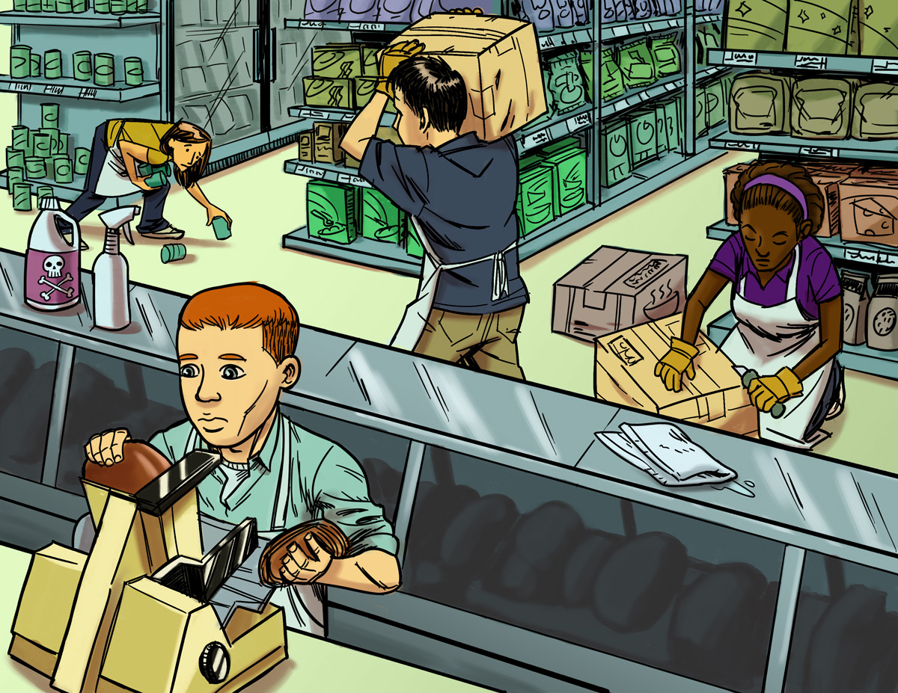
Finding Hazards
Lesson 2 (and 2B)

Slide 21
Job Hazards
A job hazard is anything at work that can hurt you either physically or mentally.
Safety hazards can hurt you.
  Knives, hot grease.
Chemical hazards are gases, vapors, liquids, or dusts that can harm your body.
  Cleaning products, pesticides.

Slide 22
Job Hazards (continued)
Biological hazards are living things that can cause sickness or disease, such as HIV/AIDS, hepatitis, tuberculosis.
  Bacteria, viruses.
Other health hazards are other harmful things that can injure you or make you sick. Some are not easy to see because they may not make you sick right away.
  Noise, radiation, repetitive movements, heat, cold, stress, violence.

Slide 23
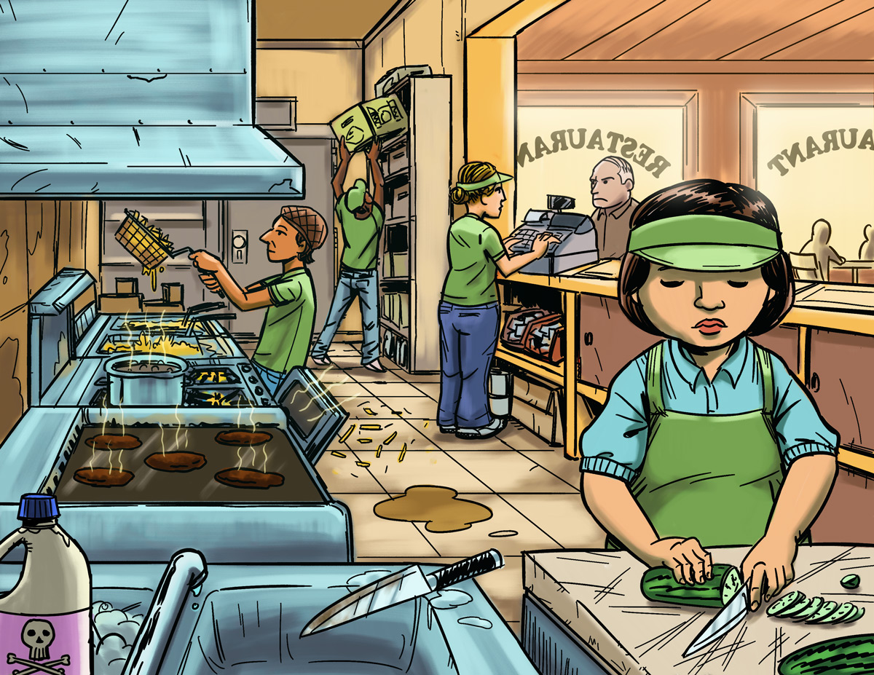
Find the Hazards: Fast Food Restaurant
a
Illustrated Workplaces

Slide 24
Find the Hazards: Grocery Store
a
Illustrated Workplaces

Slide 25
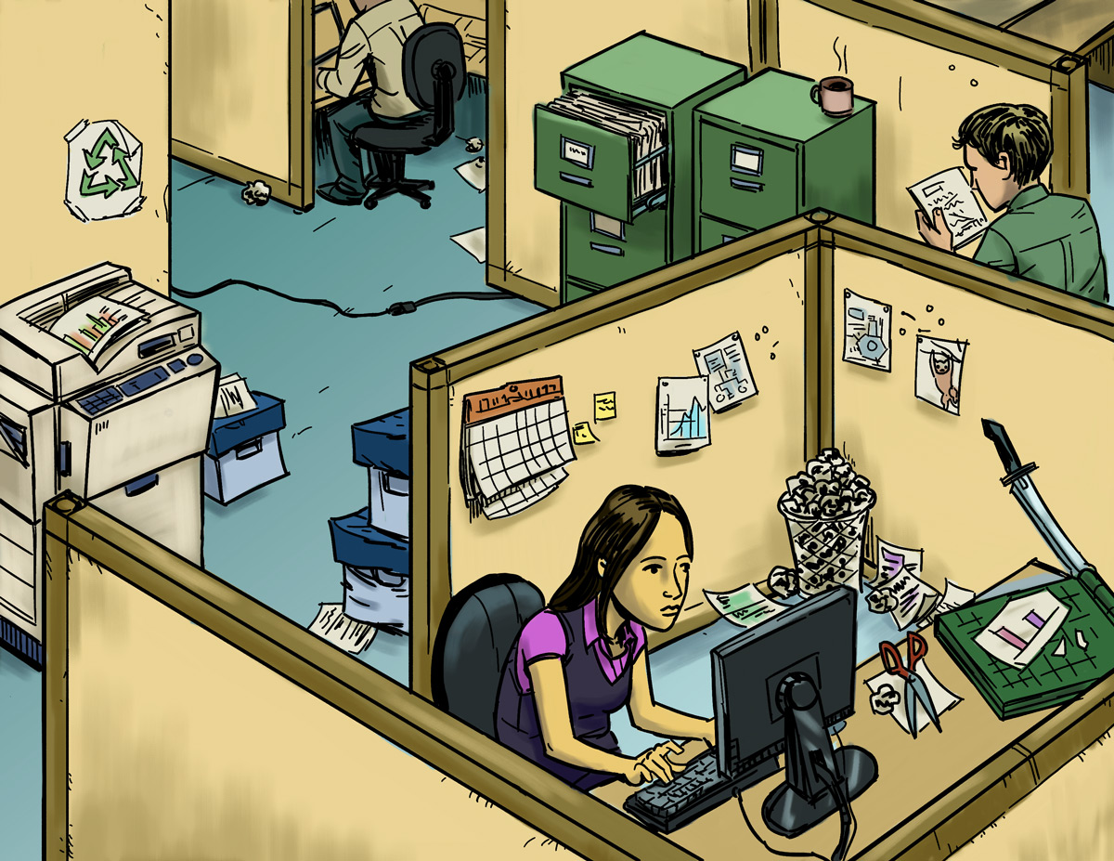
Find the Hazards: Office
a
Illustrated Workplaces

Slide 26
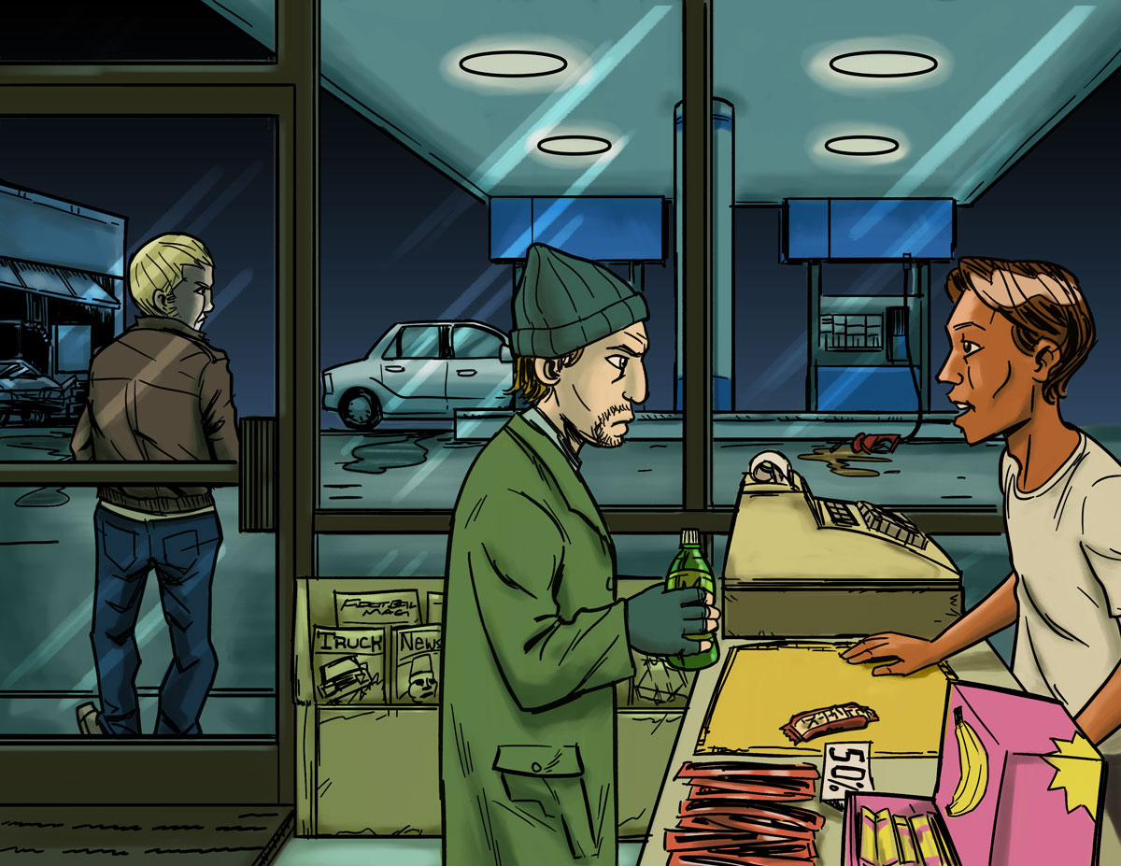
Find the Hazards: Gas Station
a
Illustrated Workplaces

Slide 27
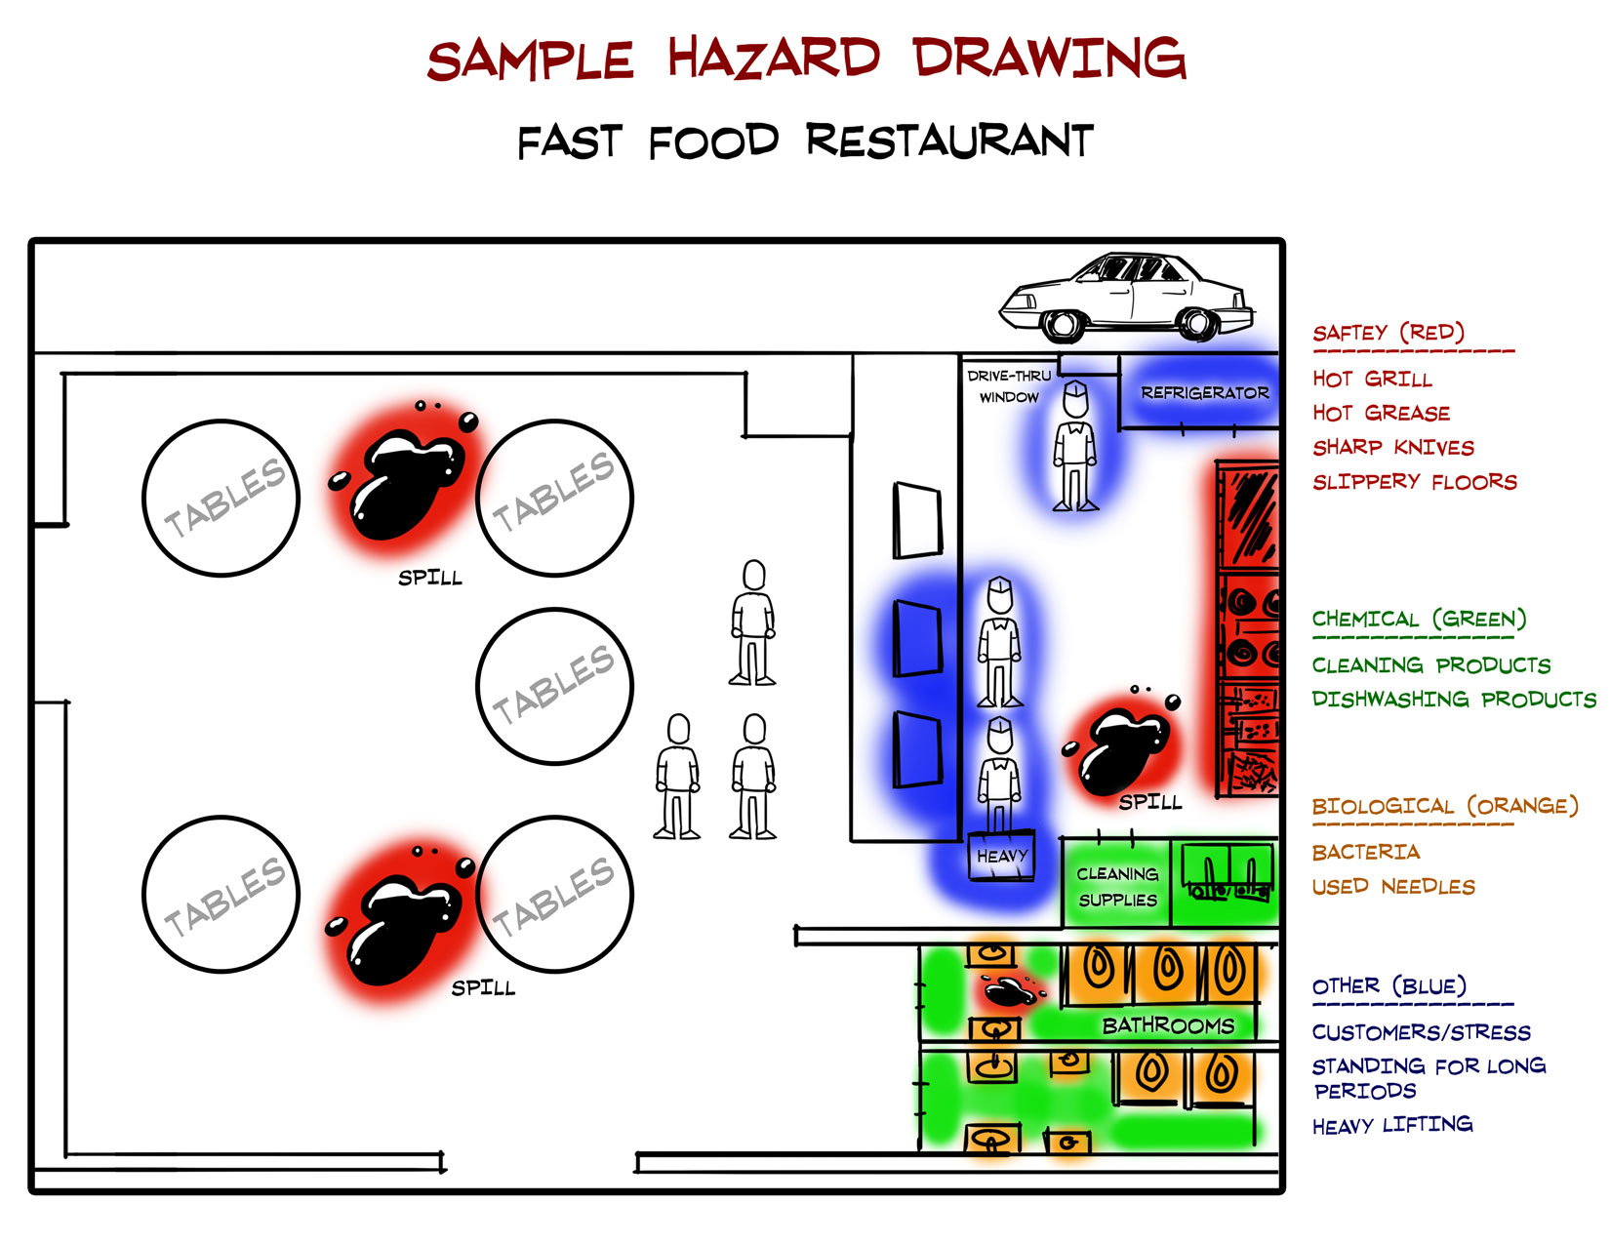
Hazard Mapping Activity
aa

Slide 28
Finding Hazards: Key Points
Every job has health and safety hazards.
You should always be aware of these hazards.
Find out about chemicals at work by checking labels, reading SDSs (Safety Data Sheets),
getting training, and asking questions.

Slide 29
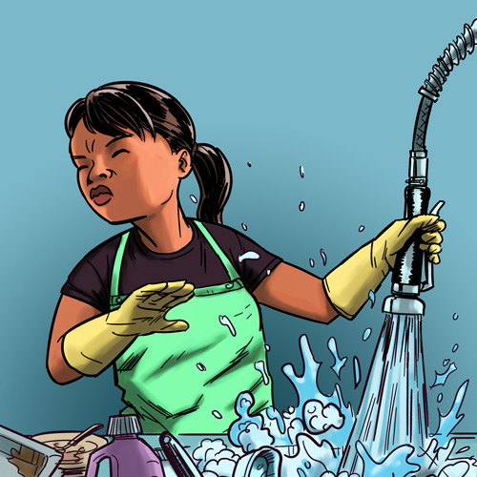
Making the Job Safer
Lesson 3 (and 3B)

Slide 30
Controlling Hazards
a
Remove
the Hazard
$2000
(for example, use safer
chemicals, use a machine guard)
Improve Work
Policies and Procedures
$1000
(for example, conduct training,
assign enough people to do the job)
Wear Personal Protective Equipment (PPE)
$500
(for example, wear gloves, use a respirator)

Slide 31
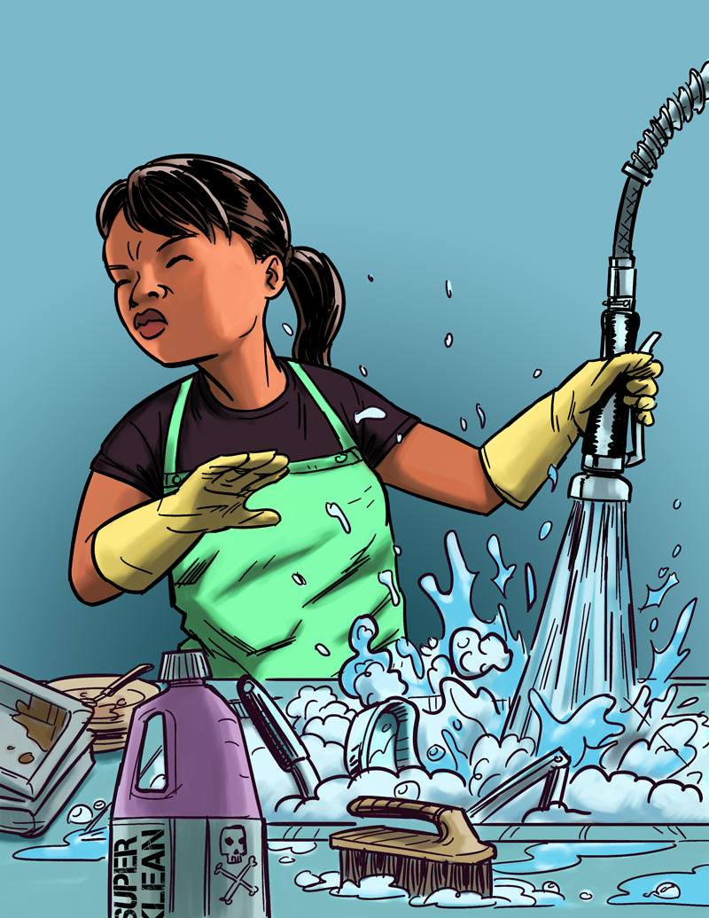
Eliminating or Reducing Hazards
Jasmine’s Story
Job: Hospital dishwasher
Hazard: Chemical dishwashing solution
Injury: Chemical burn to the eye
$25,000 Safety Pyramid Game

Slide 32
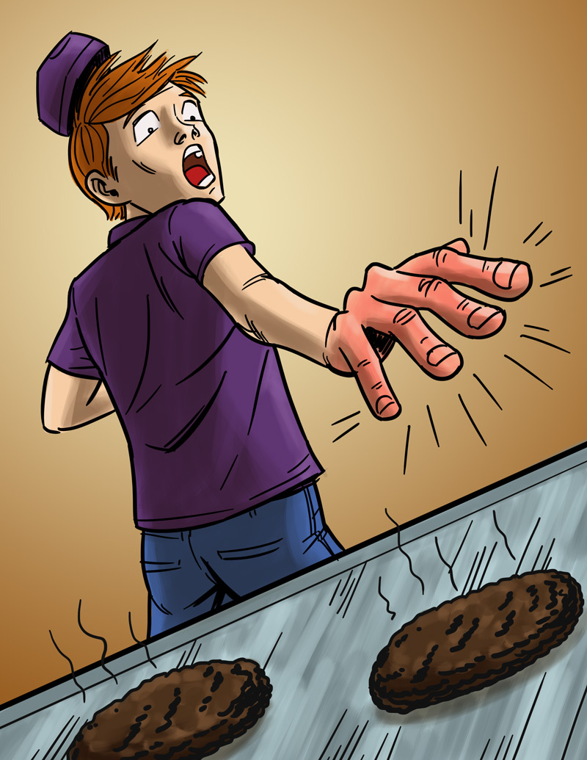
Eliminating or Reducing Hazards
Will’s Story
Job: Fast food worker
Hazard: Hot grill
Injury: Burned hand
$25,000 Safety Pyramid Game

Slide 33
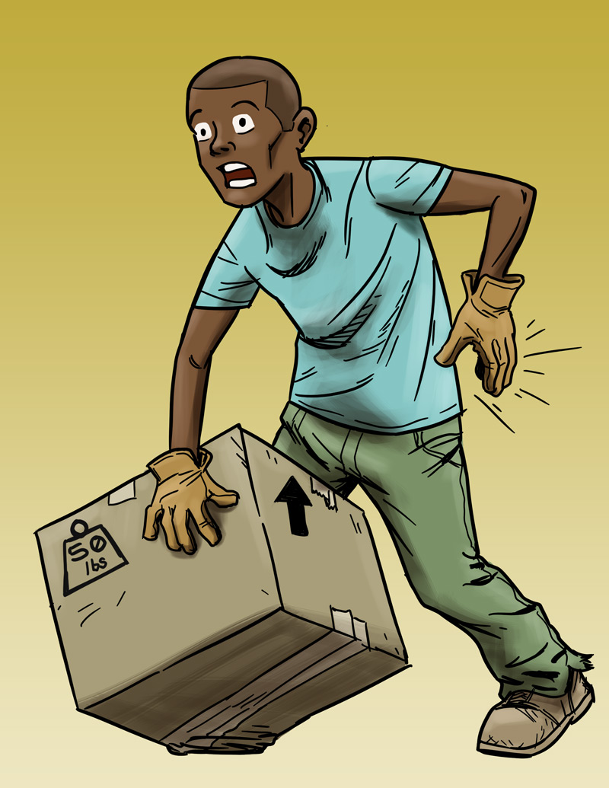
Eliminating or Reducing Hazards
Andre’s Story
Job: Grocery store clerk
Hazard: Lifting heavy boxes
Injury: Back strain
$25,000 Safety Pyramid Game

Slide 34
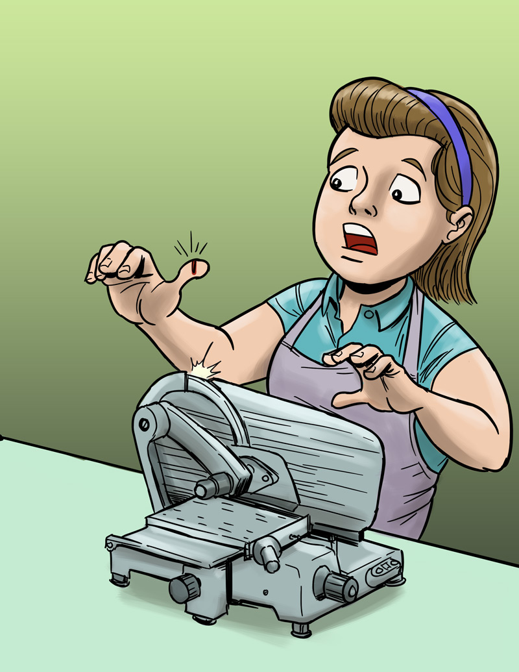
Eliminating or Reducing Hazards
Molly’s Story
Job: Grocery store deli clerk
Hazard: Meat slicer
Injury: Cut finger
$25,000 Safety Pyramid Game

Slide 35
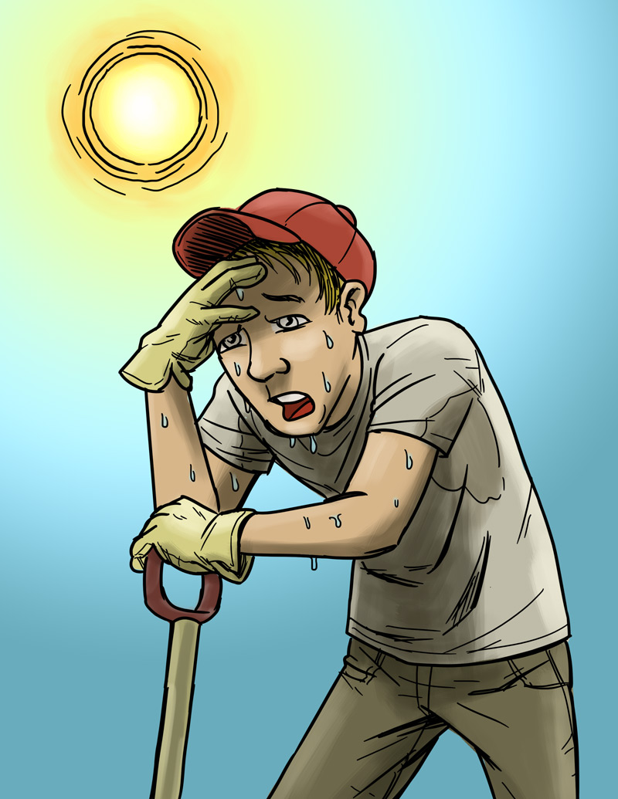
Eliminating or Reducing Hazards
Chris’s Story
Job: City public works employee
Hazard: Working when it’s too hot
Injury: Heat stroke
$25,000 Safety Pyramid Game

Slide 36
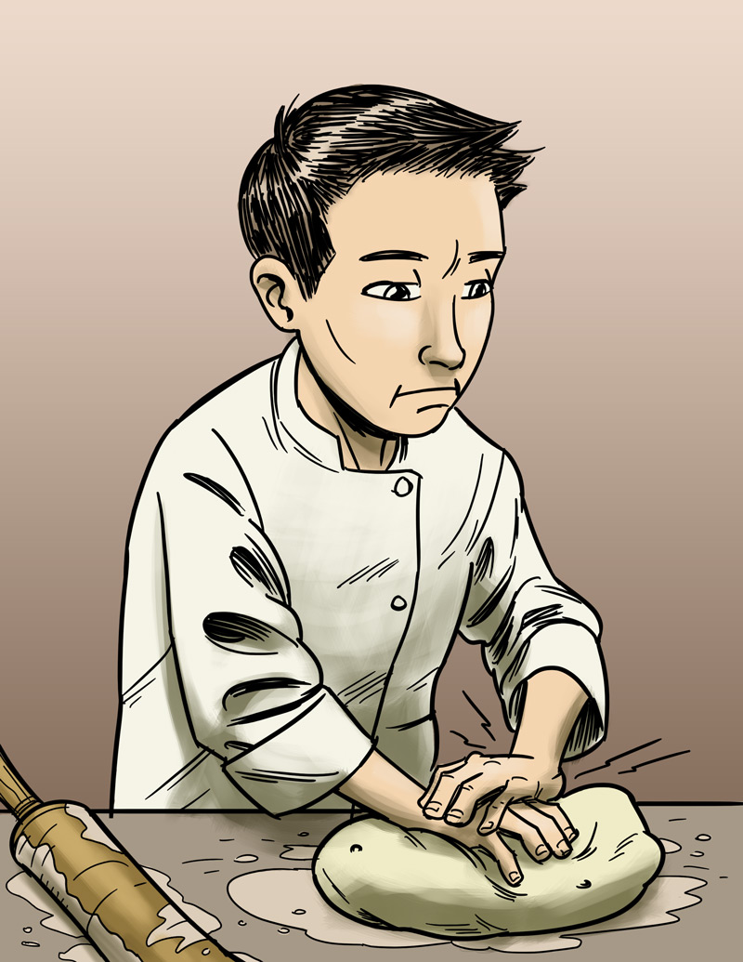
Eliminating or Reducing Hazards
James’s Story
Job: Pizza shop employee
Hazard: Doing the same thing over and over
Injury: Hand, back injury
$25,000 Safety Pyramid Game

Slide 37
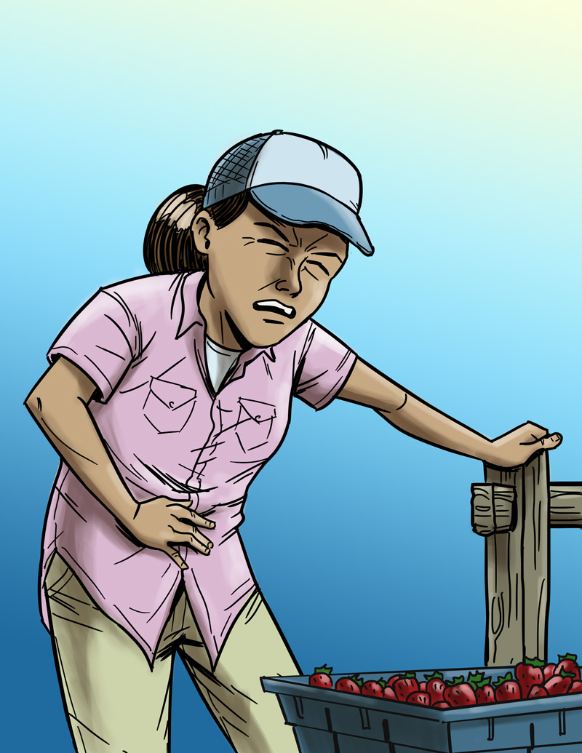
Eliminating or Reducing Hazards
Maria’s Story
Job: Farm worker
Hazard: Pesticides/chemicals
Injury: Illness due to poisoning
$25,000 Safety Pyramid Game

Slide 38
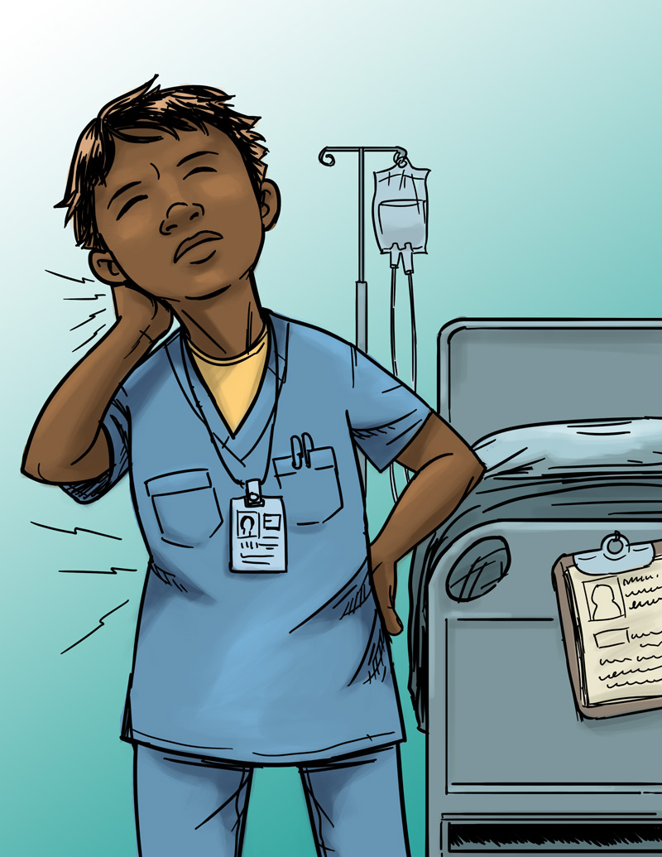
Eliminating or Reducing Hazards
Jada’s Story
Job: Nursing aide
Hazard: Heavy lifting
Injury: Back, neck, and shoulder pain
$25,000 Safety Pyramid Game

Slide 39
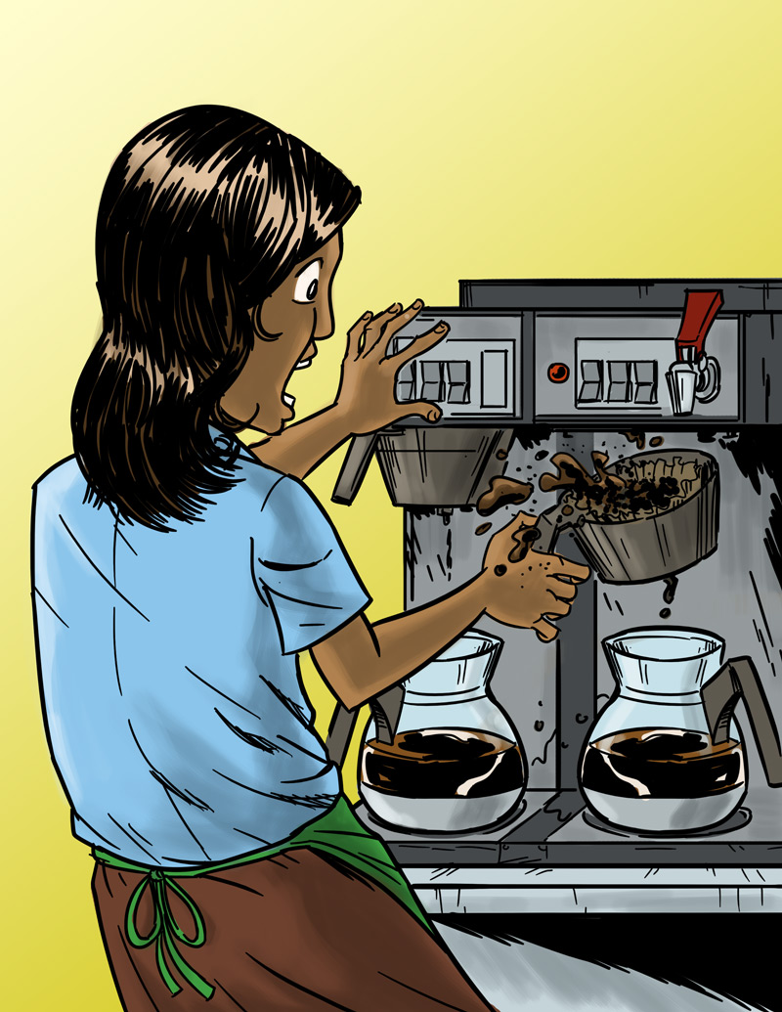
Eliminating or Reducing Hazards
Anita’s Story
Job: Barista
Hazard: Hot liquids
Injury: Burn
$25,000 Safety Pyramid Game

Slide 40
Making the Job Safer: Key Points
OSHA says that employers must give workers a safe workplace.
It’s best to get rid of a hazard, if possible.
If your employer can’t get rid of the hazard, there are usually many ways to protect you from it.

Slide 41
Emergencies at Work
Lesson 4 (and 4B)

Slide 42
Emergencies at Work
What is an emergency at work?
An emergency is any unplanned event that poses a threat.
An emergency can threaten employees, customers, or the public.
It might shut down work at a business.
It might cause damage, or it could harm
the environment.

Slide 43
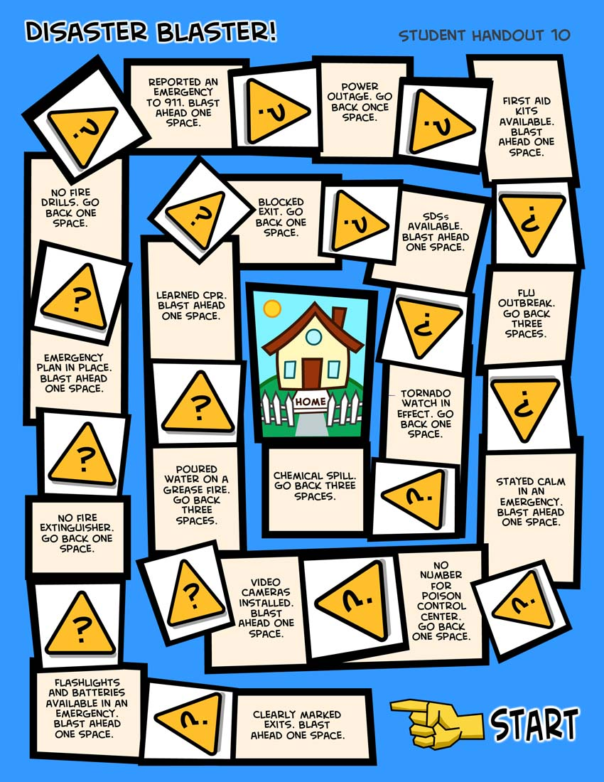

Emergencies at Work
Disaster Blaster! Game

Slide 44
Emergencies at Work: Key Points
Many workplaces need an emergency action plan. Workers should be trained on the plan.
The plan should include information about:
  The kinds of emergencies and how to respond.
  Places to meet during an emergency.
  The best ways to get out of a building or move away from danger.
  Emergency equipment and alert systems.
  Key people who will be in charge.
  What to do if someone is hurt.
  What each worker should do.
  Practice drills.

Slide 45
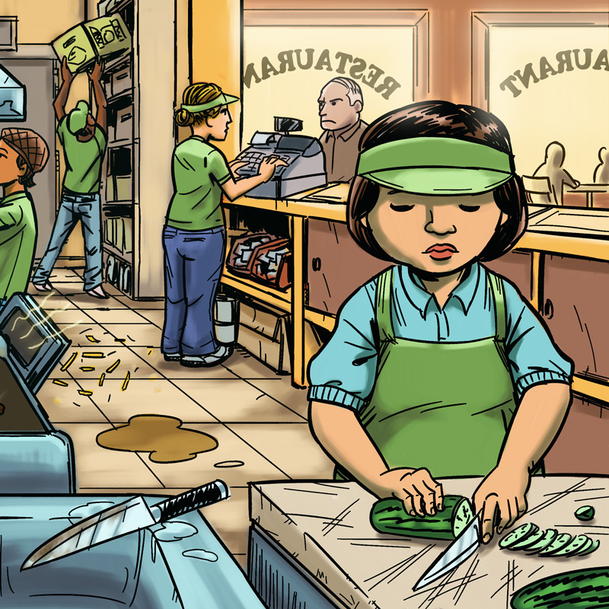
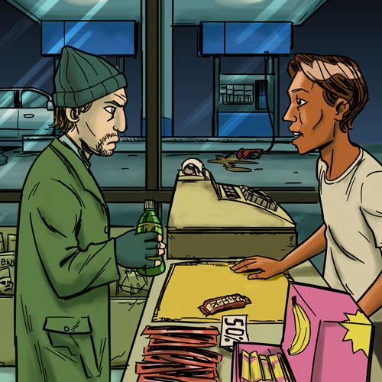
Know Your Rights and Responsibilities
Lesson 5 (and 5B)

Slide 46
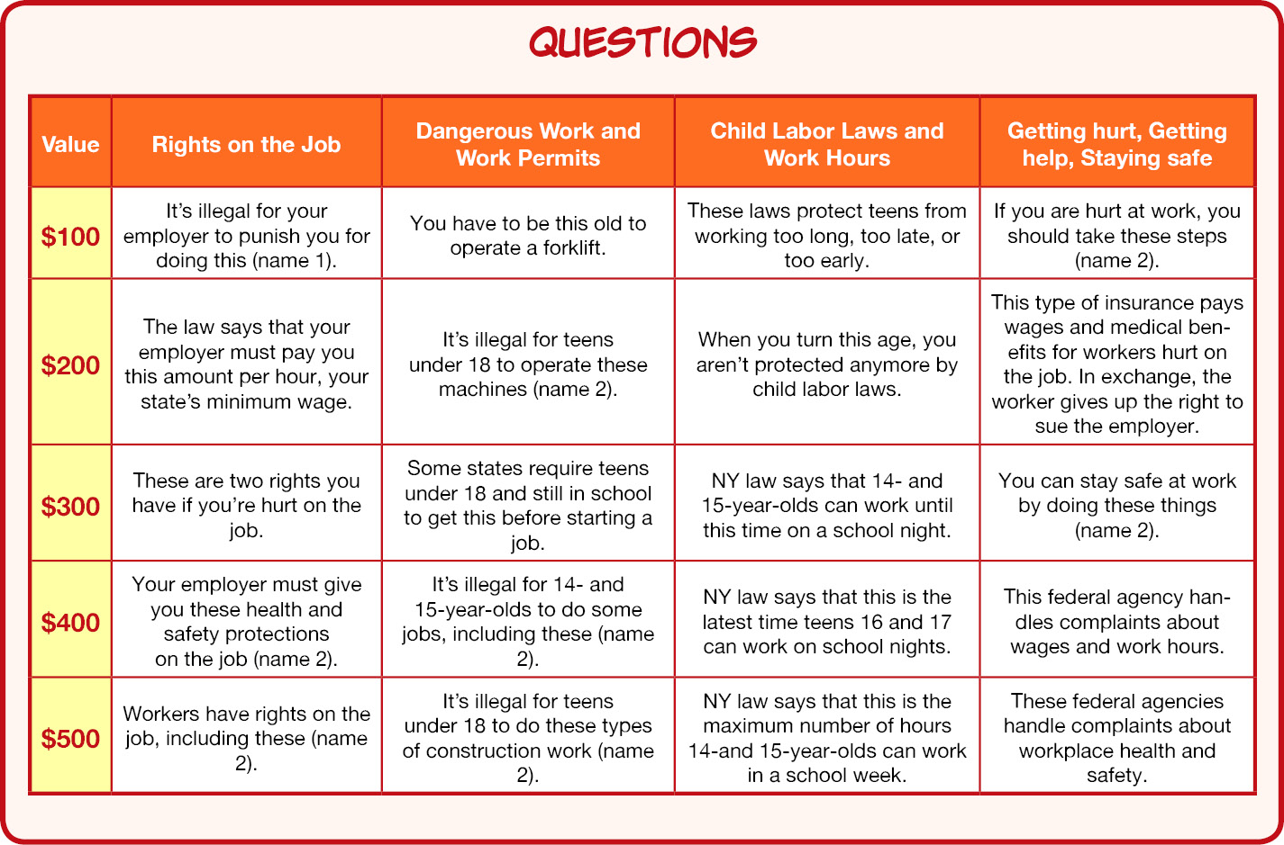
Know Your Rights: Quiz Game

Slide 47
Know Your Rights: Key Points
Federal and state labor laws protect teens from:
Hazardous jobs.
Working too long, too late, or too early.
OSHA says every employer must give workers:
A safe workplace.
Safety training on certain hazards (when required).
Safety equipment (when required).
By law, your employer is not allowed to punish or fire you for reporting a safety problem at work!

Slide 48
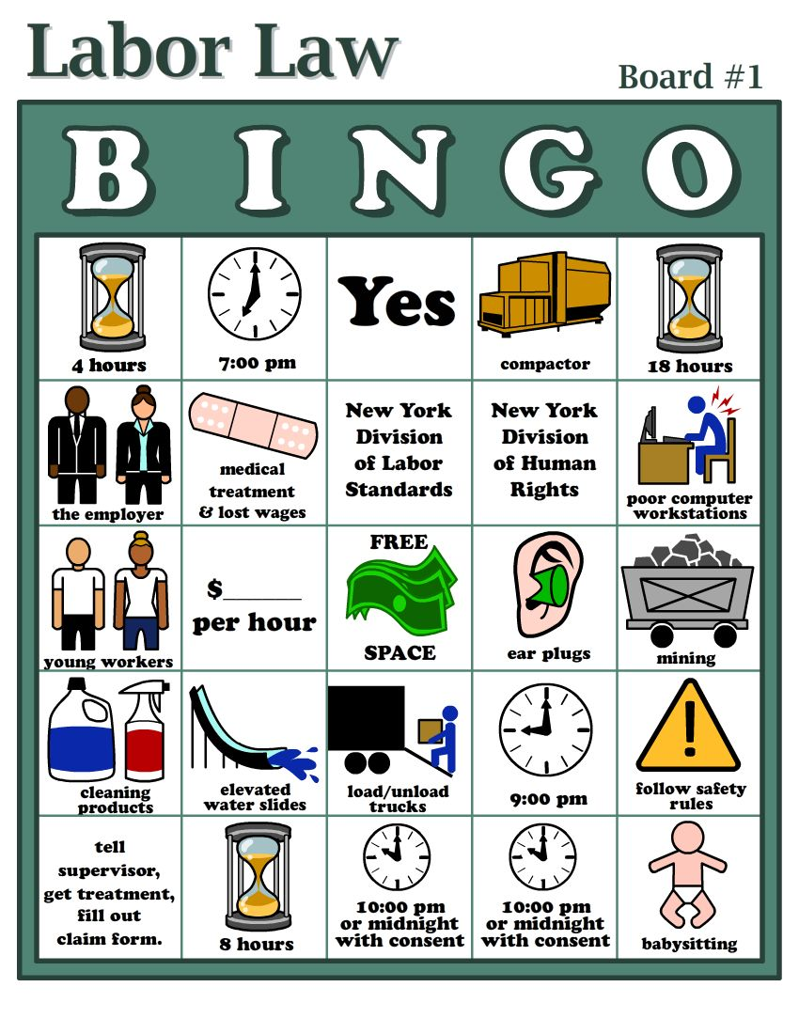
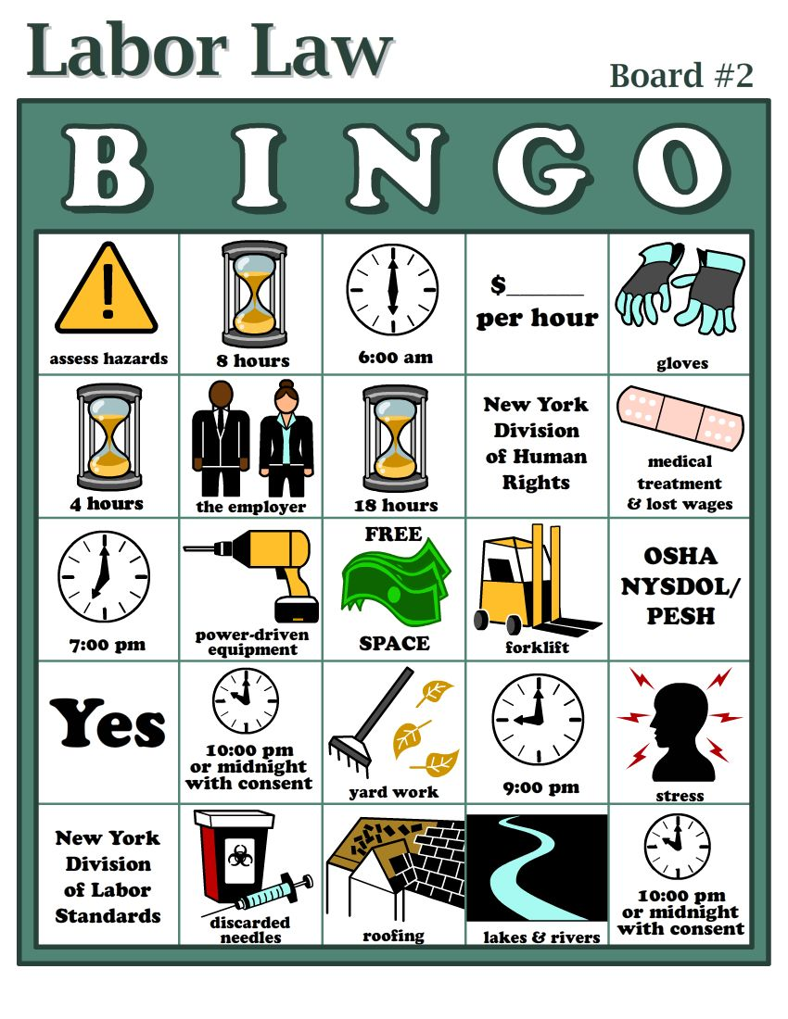
Know Your Rights
State Labor Law Bingo Game

Slide 49
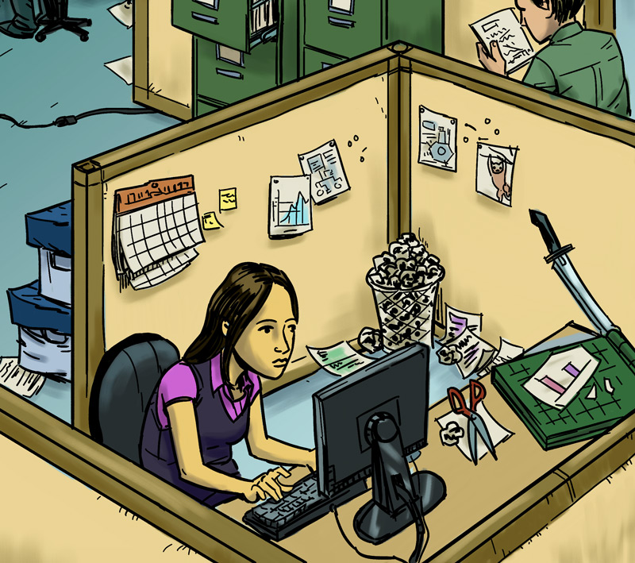
Taking Action
Lesson 6 (and 6B)

Slide 50
Taking Action: Key Points
Steps in Problem Solving:
Define the problem.
Get advice.
Choose your goals.
Know your rights.
Decide the best way to talk to the supervisor.
Contact a state or federal Wage & Hour Division or OSHA for help, if necessary.
Talk to a teacher, parent, co-worker, or other trusted adult.

Slide 51
Summing Up
Know:
Your rights at work.
Your responsibilities at work.
Your employer’s responsibilities at work.
How to respond to problems at work.

