Slide 1
Caring for Yourself While Caring for Others Module 7: Tips for Safely Handling Threatening Behavior When Providing Homecare
Presenter’s Name
Host Organization

Slide 2
Session Goals
Participants will be able to do the following:
Describe the types of threatening behavior homecare workers may experience when working in homes.
Identify factors that can heighten the risk that threatening behaviors may occur.
Explain how to manage your own emotions and reactions when threatened.
Outline effective strategies to reduce risks and handle threatening situations safely.

Slide 3
Threatening Behavior Homecare Workers May Experience
The spectrum includes…
Verbal threats and abuse.
Threatening body language.
Unwanted sexual advances.
Exposure to illegal activity.
Display of weapons.
Physical attack.
Photo by ®Thinkstock

Slide 4
Who Might Threaten Homecare Workers and Others in the Home?
Clients.
Family members.
Others living in the home.
Visitors in the home.
Photo by ®Thinkstock

Slide 5
What Do You Hear and See Happening in this Role Play?
What are the potential health and safety risks for Belinda, the homecare worker in this story?
What threatening behavior do you see or hear?
Photo by ®Thinkstock
What risk factors and signs suggest there might be future threatening behavior?
Why might the threatening behavior continue, become worse, decrease, or stop in the future?

Slide 6
Early Signs and Risk Factors
Verbal expressions of anger or frustration—such as tone, yelling, cursing.
Body language—such as pacing, clenched fists, coming too close, agitated movements.
Clients or others who have a history of mental illness, alcoholism, drug abuse, or violence.
Photo by ®Thinkstock

Slide 7
More Early Signs and Risk Factors
History of troubled relationships with others in the home, or a history of troubling behaviors.
Signs of alcohol or drug abuse.
Other high-risk illegal behavior.
Recent life crises—such as illness, job loss, death—that cause new stress and tension.
Photo by ®Thinkstock

Slide 8
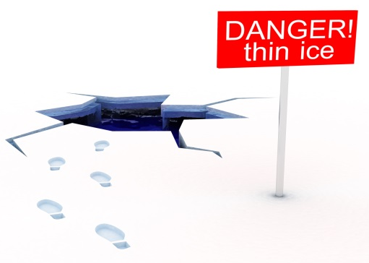
Safe and Effective Strategies to Avoid Threatening Behavior
During visits, use basic safety precautions:
Be alert and conscious of risks.
Evaluate each situation for possible threat.
Watch for signals of impending threats:
Verbally expressed anger and frustration.
Threatening body language and gestures.
Signs of drug or alcohol abuse.
The presence of weapons.
Ask clients to have threatening visitors leave.
Photo by ®Thinkstock

Slide 9
Safe and Effective Responses to Threatening Behavior
Maintain behavior that helps to defuse anger:
Present a calm, caring, confident attitude.
Keep your voice low and calm.
Do not give orders or argue.
Do not match threats or mirror body language.
Acknowledge the other person’s feelings.
Try to keep 6 feet from a threatening person.
Photo by ®Thinkstock

Slide 10
Safe and Effective Responses to Threatening Behavior
Avoid behaviors that may be interpreted as aggressive, for example:
Moving rapidly or getting too close.
Touching unnecessarily.
Speaking loudly.
Have a cell phone with you.
Be sure your employer or others know where you are and your schedule.
Try to keep an open pathway for exiting.
Photo by ®Thinkstock

Slide 11
Safe and Effective Responses to Threatening Behavior
If you are being verbally abused or threatened, calmly ask the person to stop. If he or she does not, leave and notify your employer.
If you feel frightened or unsafe, listen to your feelings, trust your judgment, remain calm— but leave as quickly as possible.
If you can’t gain control of the situation, shorten the visit and remove yourself from it.
If you feel seriously threatened, leave immediately.
Photo by ®Thinkstock

Slide 12
Safe and Effective Responses to Threatening Behavior
If you need help, call your employer or 911, depending on the severity of the situation—or if you can’t leave.
Report all incidents of threatening behavior to your employer as soon as possible.
Notify your employer if you see an unsecured weapon or illegal activity in a client’s home.
If you see a crime, call the police.
Photo by ®Thinkstock

Slide 13
Addressing Threatening Situations
Bring up
health and safety issues as soon
as possible.
What would you feel if you were in this situation?
What strategies would you use to manage your feelings?
What would be your goals in this situation? What’s your bottom line?
What strategies would you use to reduce the risks and stay safe in this situation?
What would you say, and to whom should you address this situation?

Slide 14
Thanks for Your Great Participation!
Additional Resources:
Homecare workers’ handbook: Caring for Yourself While Caring for Others. http://www.cdc.gov/niosh/docs/2015-103/pdf/2015-103.pdf
NIOSH Hazard Review: “Occupational Hazards and Home Health Care.” http://www.cdc.gov/niosh/docs/2010-125/pdfs/2010-125.pdf
Home and Community Health Worker Handbook, British Columbia, Canada, OHSAH. http://www.phsa.ca/NR/rdonlyres/6C69D638-8587-4096-A8AA-7D2B0141C3B2/59614/HandbookHomeandCommunityHealthcareWorkersHandbook.pdf
Safety Manual for Homecare Workers, Oregon Homecare Commission. http://apps.state.or.us/Forms/Served/de9062.pdf

Slide 15
Credits
[Insert trainer and/or training organization’s name(s), and contact information here.]

